Slide 1

Advanced R
Tools for Advanced Data Analytics in R
A Course Designed by Data Smart Science
&
Presented by
Dr. Eric Asare & Seth Appiah

Slide 2
Recap of last’s week lesson
Base R apply family of functions
Apply()
Lapply()
Sapply()
Vapply()
Tapply()
Language of data wrangling with the Dplyr package

Slide 3
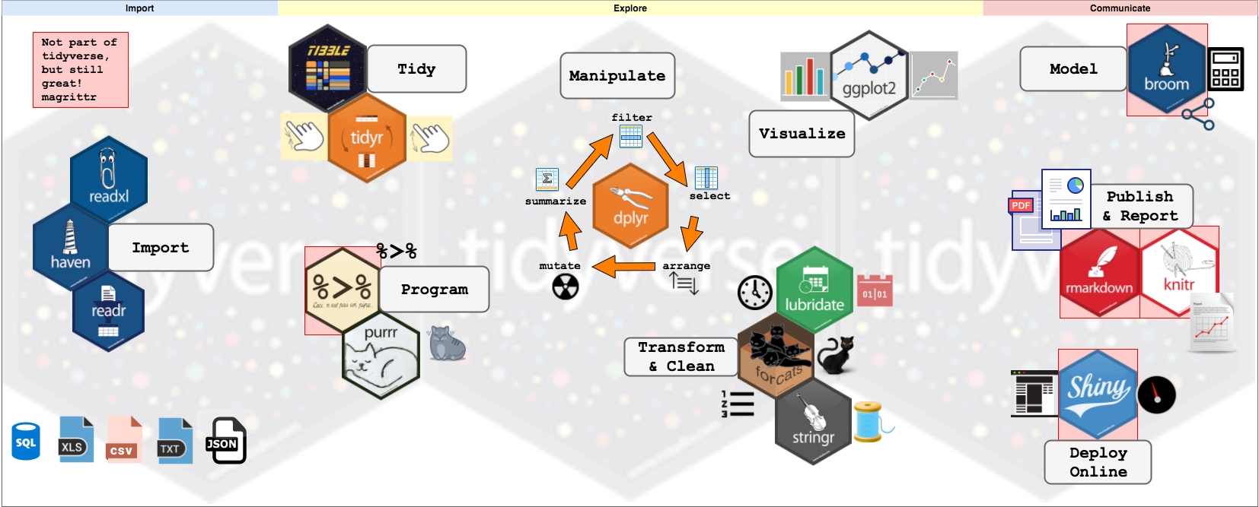
Today

Slide 4
Today’s Outline
Applying functions to a single list’
Applying functions to 2 lists
Applying functions to more than 2 lists

Slide 5
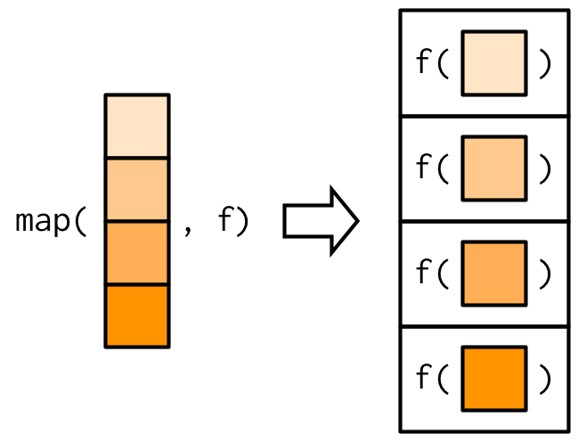
Map(): Applying functions to single list
The output of map() is always a list
What if we want to return a vector output of
a specific datatype?
Map_int(): returns an integer vector
Map_dbl(): returns a double vector
Map_chr(): character vector
Map_lgl(): logical vector

Slide 6
Today’s Outline
Square_root <- function(x) {
x^1/2
}
Traditional way of writing functions:
Anonymous functions:
Function(x) x^1/2

Slide 7
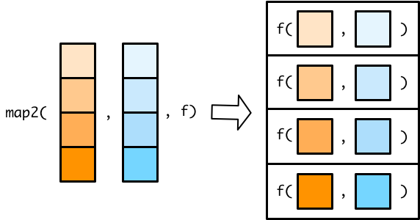
Map2(): Applying functions to 2 lists
Output of map2() is a list.
What if we want to return a vector output of
a specific datatype?
Map2_int(): returns an integer vector
Map2_dbl(): returns a double vector
Map2_chr(): character vector
Map2_lgl(): logical vector

Slide 8
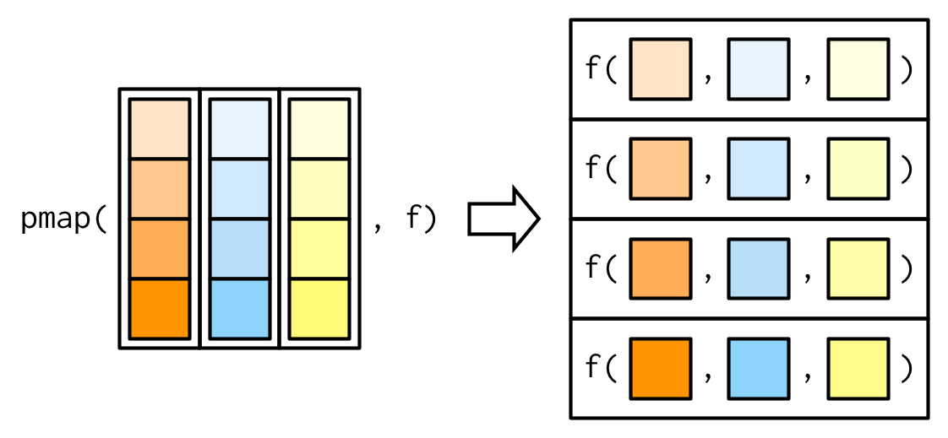
Today’s Outline
Output of pmap() is a list.
What if we want to return a vector output of
a specific datatype?
pmap_int(): returns an integer vector
pmap_dbl(): returns a double vector
pmap_chr(): character vector
pmap_lgl(): logical vector

