Slide 1

Advanced R
Tools for Advanced Data Analytics in R
A Course Designed by Data Smart Science
&
Presented by
Dr. Eric Asare & Seth Appiah

Slide 2
Recap of last’s week lesson
We defined a variable
Fundamental information we can use to create variables
Illustrated how to code functions in R
Illustrated how to control the flow of function codes with if-else statements

Slide 3
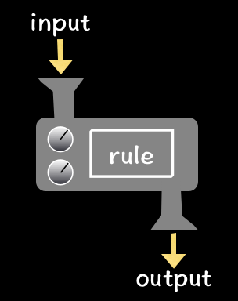
Creating Functions in R
What is a function?
What is a function?
Function
Function with if-else
Function name <- function(inputs){
rule
return (output of rule)
}
Function name <- function(inputs){
if(condition){
rule
return (output of rule)
}
else{
rule
return (output of rule)
}
}
Calculated<- Function name (inputs)

Slide 4
Loops
An instruction that repeats until a specific condition is reached
When the specific instruction is reached loop stops or exits.
Two main types are: For and while loops

Slide 5
Creating For Loops in R
For each item in
the sequence
Loop
For(time in 1:10) {
print(2 * i)
}
Yes
Last item reached?
Let’s manual solve the loop problem
when time is 1: it is 2 *1
time is 2: 2*2
…
…
…
time is 10: 2*10
Exit loop
No
Body of loop

Slide 6
Wrapping For Loops in Functions
Loop wrapped in function
Calling Loop function
Loop_function <- function(T){
For(time in 1:10) {
print(2 * i)
}
}
Loop_function (T=10)

Slide 7
Creating Loops in R
Enter while loop
Loop
i <- 1
while(i < 11) {
print(2 * i)
i = i +1
}
No
Is expression valid?
Wrapping while loop in function
Exit loop
while_function <- function(){
i <- 1
while(i < 11) {
print(2 * i)
i = i +1
}
)
Yes
Body of while loop

Slide 8
R and Python Comparisons
R function Python Function
Function_name <- function(inputs){
rule
return (output of rule)
}
Or
Function_name <- function(inputs){
rule
return (output of rule)
}
def function_name(inputs):
rule
return (output of rule)
*instead of {} python functions uses positions and spacing
to define the structure of the function.
Calculated<- Function_name (inputs)
Calculated<- Function_name (inputs)

Slide 9
R & Python Comparisons

