Slide 1

Advanced R
Tools for Advanced Data Analytics in R
A Course Designed by Data Smart Science
&
Presented by
Dr. Eric Asare & Seth Appiah

Slide 2
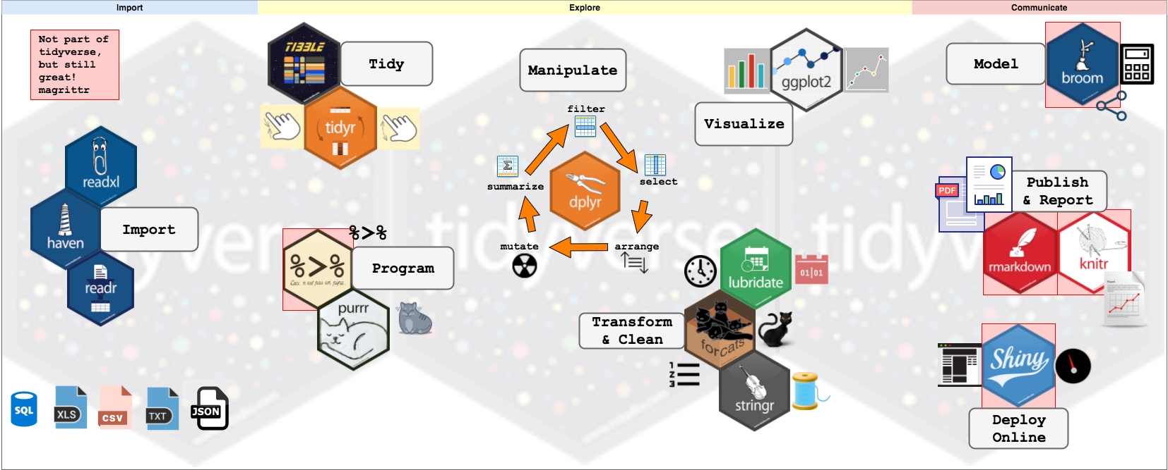
Tidyverse

Slide 3
Character manipulations
What is a character?
What functions in Stringr that can help us work with characters”
STR_LENGTH() : counts the number of characters in a string.
name <- “eric” --- number of characters are 4 which are: 1:e 2:r 3:I 4:c
str_length(name) will be 4.
2. STR_SUB(string, start, end): access individual characters in a string from the specified position.
Ex. Access character “r” in eric. It is in the 2rd position.
str_sub(name, start =2, end =2) : “r”
3. Replace characters in a string
Ex. Replace the “c” in eric with “K”
str_sub(name, 4) <- “k”

Slide 4
Whitespace manipulations
What is a whitespace?
What functions in Stringr that can help us work with whitespaces”
str_trim(arguments) : removes leading and trailing whitespaces.
name <- c(“eric”, “is “, “good” )
str_trim(name) : “eric” “is “ “good”

Slide 5
Pattern matching & manipulations
What is a pattern?
General structure: str_”pattern function” (string to process, pattern to search)

Slide 6
Pattern matching: Detect
Detect: If the pattern is present in the string or text, returns true.
Similar to str_subset() which returns the actual element(s) of the character vector.
Ex. Lets define a character vector: names
names <- c(“eric”, “jacob”, “seth”, Sammy”)
pattern <- “eric”
a) Is “eric” present in names? Str_detect(names, pattern): True False False False
Or str_subset(names, pattern): “eric”
b) Count number of matches: str_count(names, pattern): 1

Slide 7
Pattern matching: Extract, replace, split
Extract: extract the first match in the string.
str_extract(string, pattern)
2) Replace the match pattern: str_replace()
Pattern <- “eric”
str_replace(names, pattern, “erik”)
3) Split text based on a pattern
let say you have a date: today_date <- “2022 - March - 28”
separator <- “-”
str_split(today_date, separator)

Slide 8
Regular Expressions (Regex)
Regex are sequence of characters that specify a search pattern in text.
The foundation for forming these regex patterns are:
Literal Characters
Meta-characters
Posit Character classes

Slide 9
Literal Characters
All letters in the English alphabet.
Usually used to form words, sentences, paragraphs …
Ex. 1: “ Sammy and Seth are best friends” : This sentence is also called a string
“Sammy”, “and”, “Seth”, “are”, “best”, “friends” are substrings
All digits in the number system. :0, 1, 2,.., 9
Ex.2 : “2020-04-03”

Slide 10
Meta-characters
All characters that are not literal characters.
They are:
. \ |
( ) [
] { }
$ - ^
* + ?
To turn MC into literal characters, use back slatch “\” but in R it is “\\”

Slide 11
Meta-characters --- Wild Character
Dot or “ . ”
The “ . ” is used to match any character except new line
word <- c(“goat”, “good”, “main”)
pattern <- “G o . t”
str_detect(word, pattern) :
Ex.2. The “.” in “G o . t” : could be “goat”, “good”
Ex.3. “5.00” : could be 5000, 5.00, 5-00
* To escape “.” in R: “5 \\.00” : 5.00

Slide 12
Meta-characters --- Character sets
They are described by : [ ]
Any character in [ ] can be a match
Ex3. “go[ao]d” : could be “good” or “goad”
To describe a range of characters use: “-”
“[0123456789]3067134413”
Ex4. “[0-9]3067134413”

Slide 13
Meta-characters --- Negative Character Sets
Match characters that are not defined in [ ]: this is how it is specified [^…]
Match Canada country code: “[^023456789]3067134413”

Slide 14
Character Classes
Already defined classes that can be used as short-cuts to match patterns
Class Meaning Character Sets
\\d any digit [0-9]
\\D any non-digit [^0-9]
\\w any character which is part of a word [a-zA-Z0-9]
\\W not part of a word [^a-zA-Z0-9]
\\s any white space [\f\n\r\t\v]
\\S any non-white character [^\f\n\r\t\v]

Slide 15
POSIX Character Classes
Class Meaning Character Sets
[:alnum:] any letter or digit [a-zA-Z0-9]
[:alpha:] any letter [a-zA-Z]
[:digit:] any digit [0-9]
[:lower:] any lower case letter [a-z]
[:upper:] any upper case letter [A-Z]
[:space:] any whitespace [\f\n\r\t\v ]
[:punct:] any punctuation symbol
[:print:] any printable character
[:graph:] any printable character excluding space
[:xdigit:] any hexadecimal digit [a-fA-F0-9]
[:cntrl:] ASCII control characters

Slide 16
POSIX Character Classes
Class Meaning Character Sets
[:alnum:] any letter or digit [a-zA-Z0-9]
[:alpha:] any letter [a-zA-Z]
[:digit:] any digit [0-9]
[:lower:] any lower case letter [a-z]
[:upper:] any upper case letter [A-Z]
[:space:] any whitespace [\f\n\r\t\v ]
[:punct:] any punctuation symbol
[:print:] any printable character
[:graph:] any printable character excluding space
[:xdigit:] any hexadecimal digit [a-fA-F0-9]
[:cntrl:] ASCII control characters

Slide 17
Positional Meta-characters
Character Meaning Ex
^.. Matches a line starting with the substring. ^You
..$ Matches a line ending with the substring. You$
^ .. $ Matches a line that starts and ends with substring, i.e., exact match. ^God is great$

Slide 18
Quantifiers characters
Say character : q
Character Meaning Examples
..* 0 or more instances .. [eu]* : no e or no u; e or u, eeeeeeeee or uuuuuuuu…
..+ 1 or more instances of .. [eu]+ : e or u, ee or uu … eeeeeeeee or uuuuuuuu…
..? 0 or 1 instance of .. [eu]? : no e or no u; e or u
..{m} Exactly m instances of .. [eu]{2} : ee or uu; [eu]{1} same as [eu]
..{m,} At least m instances of .. [eu]{3,}
..{m,n} Between m and n instances of .. [eu]{3, 5}: eee, eeee, eeeee
uuu,uuuu,uuuuu

