Slide 1
sustaiNU
Erica Yee
Information Science & Journalism, 5th year
yee.er@husky.neu.edu

Slide 2

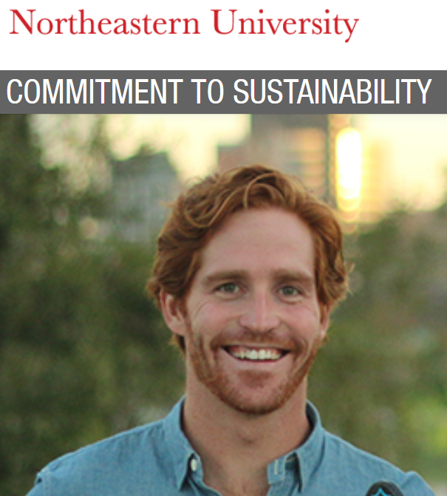


The problem
Notes:
Northeastern touts its commitment to environmental sustainability. However, in my daily life, I don’t really know how to take meaningful actions. Our campus is filled with opportunities, but it doesn’t mean people use them regularly.

Slide 3
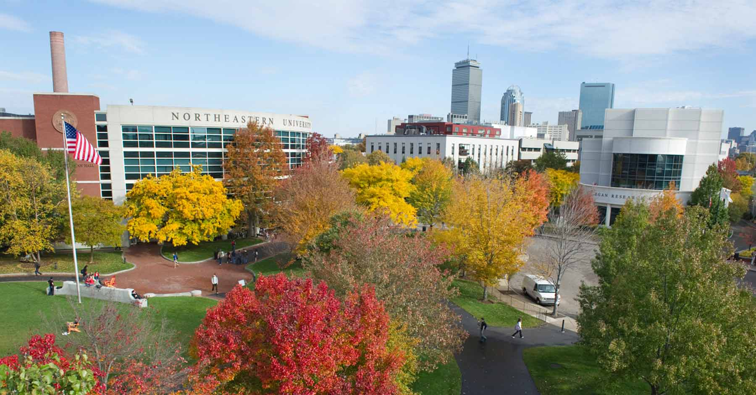
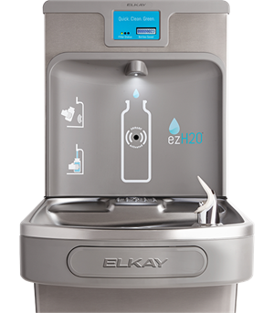



The opportunity
Notes:
To address this problem, I propose an app that shows eco-friendly sustainability initiatives specific to our campus and student life. The app could encourage students to take these actions through a gamified habit tracker system.

Slide 4
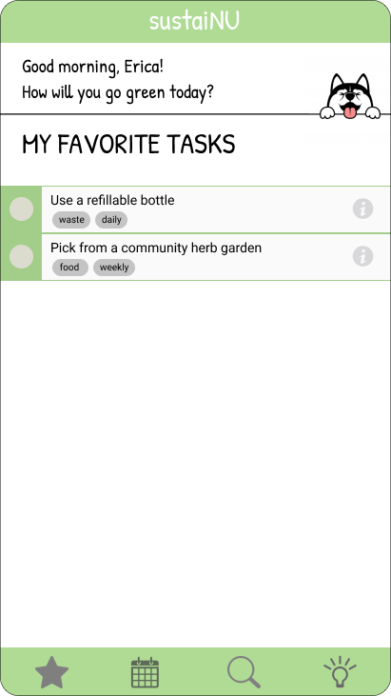
The solution
Directions
Context
Customization
Engagement
Notes:
There are plenty of habit tracking apps already, but I envision one specifically catered to Northeastern students. It would give clear directions and context on why these actions matter. Users would be able to customize the habits they want to cultivate and stay engaged through a gamified experience.

Slide 5
...and the next idea is...

