Slide 1
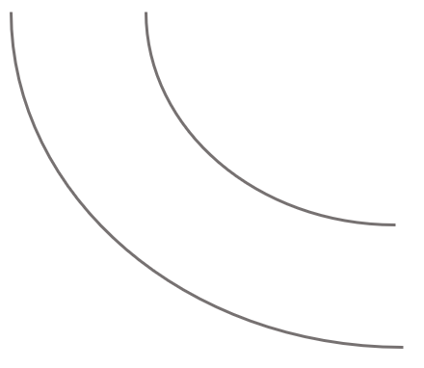
Impact
4!
12?
1?
13?
4?
3!
2?
14?
8?
5?
11?
15?
No Brainer
9?
6?
1!
7?
2!
10?
Do Later
Don’t Do Now
3?
Feasibility

Slide 2
Impact
4!
12?
1?
13?
4?
3!
2?
14?
8?
5?
11?
15?
9?
6?
1!
7?
2!
10?
3?
Feasibility

