Slide 1
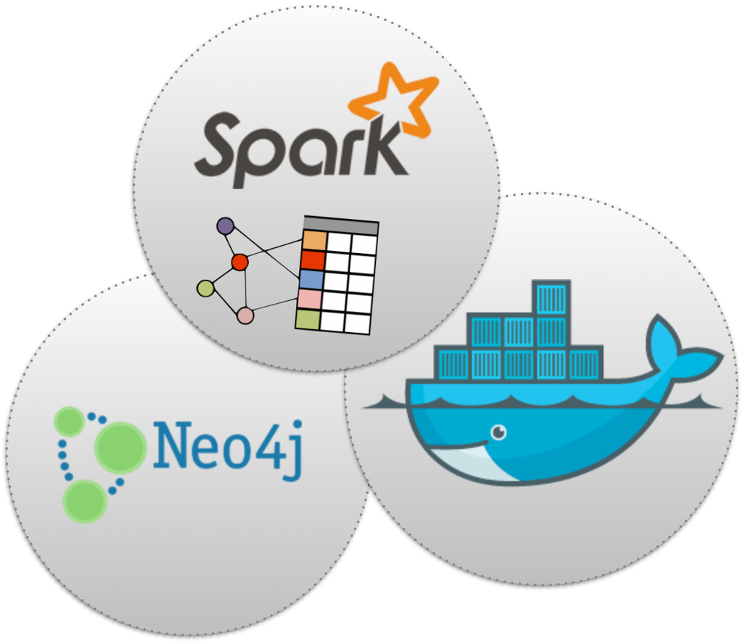
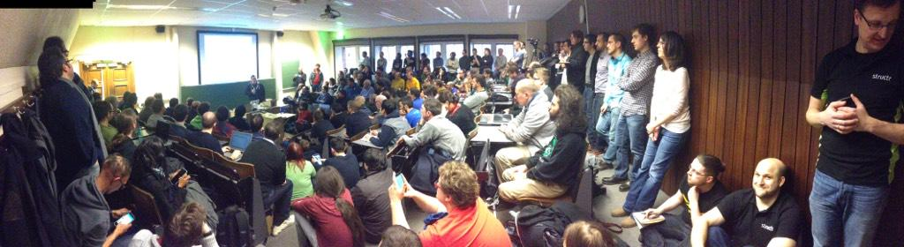
Big Graph Analytics on Neo4j with Apache Spark
Kenny Bastani
FOSDEM '15, Graph Processing Devroom

Slide 2
My background
Second year speaking in the graph devroom
Extremely thankful for all the organizers of this
devroom have done for this technology
Thank you organizers!

Slide 3
I apologize in advance for these incredibly low-budget slides

Slide 4
Engineer + Evangelism
I evangelize about Neo4j and graph database technology
I am an engineer at Digital Insight, a Silicon Valley based SaaS banking platform provider.

Slide 5
Engineering
NCR/Digital Insight
$18 Trillion per year in ATM withdrawals

Slide 6
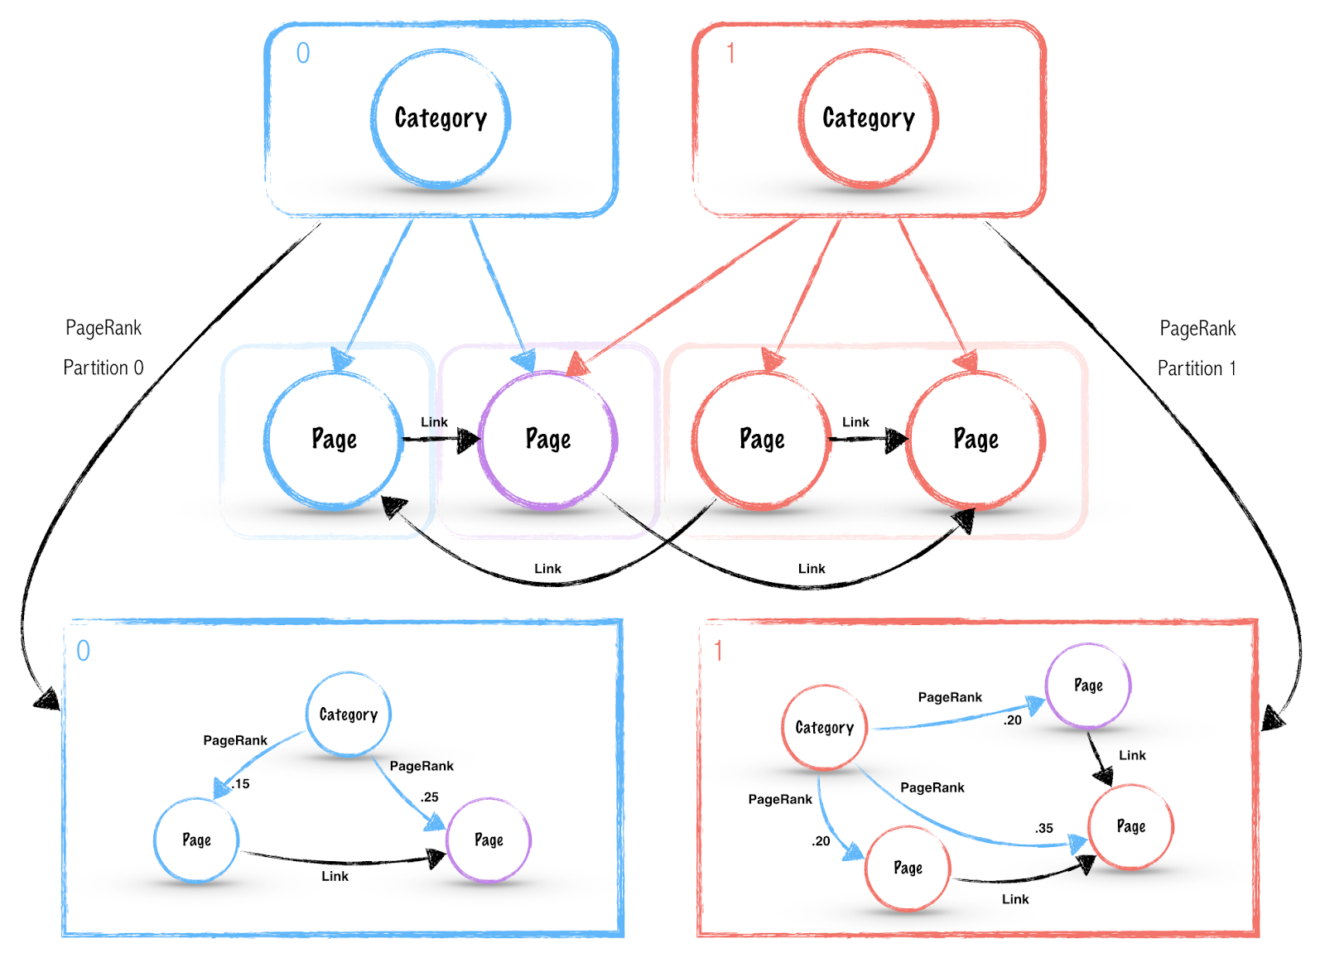
As a Graph Database Evangelist
I make cool things with graphs and blog about it

Slide 7
Just so we're clear…
I'm not selling you anything today

Slide 8
Agenda
Let's try and have some fun.
We're going to run PageRank on all human knowledge.
After a lot of low-budget slides.

Slide 9
The Problem
It's hard to analyze graphs at scale

Slide 10
The importance of graph algorithms
PageRank gave us Google
Friend of a friend gave us Facebook

Slide 11
Every hacker and tinkerer should be able to turn world changing ideas into a reality

Slide 12
Every research scientist who needs graph analytics to save millions of lives should have that power

Slide 13
The simple fact is that you are brilliant but your brilliant ideas require complex big data analytics

Slide 14
So then you need to learn a lot of things or steal a lot of money to change the world

Slide 15
Why is it so hard to do this stuff?

Slide 16
Enemy #1:
Relational Databases
Relational databases store data in ways that make it difficult to extract graphs for analysis

Slide 17
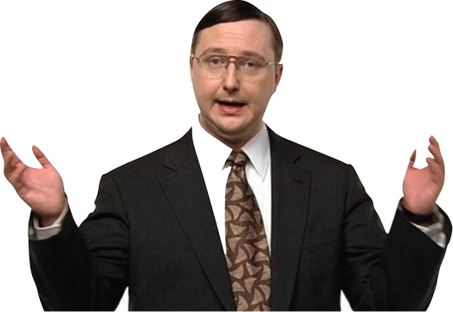
"I need to combine 32 different tables in 5 different system of records and put it in a CSV every hour."
– This guy represents every business person that controls your future as an engineer

Slide 18
You're probably thinking…

Slide 19
Sorry business, no PageRank for you!

Slide 20
But you courageously move forward regardless
This is what is likely to happen next.

Slide 21
Enemy #2:
Big Data
If you still think Big Data is a buzz word
You haven't had to feel the pain of failing at it.

Slide 22
When you hit a wall because your data is too big
You start to see what this big data thing is all about.

Slide 23

What seems to be the problem? Where's my PageRank
All those records you merged from those 32 different tables turns out to be petabytes of data.

Slide 24
Frantic and scared
You turn to your most dependable friend

Slide 25
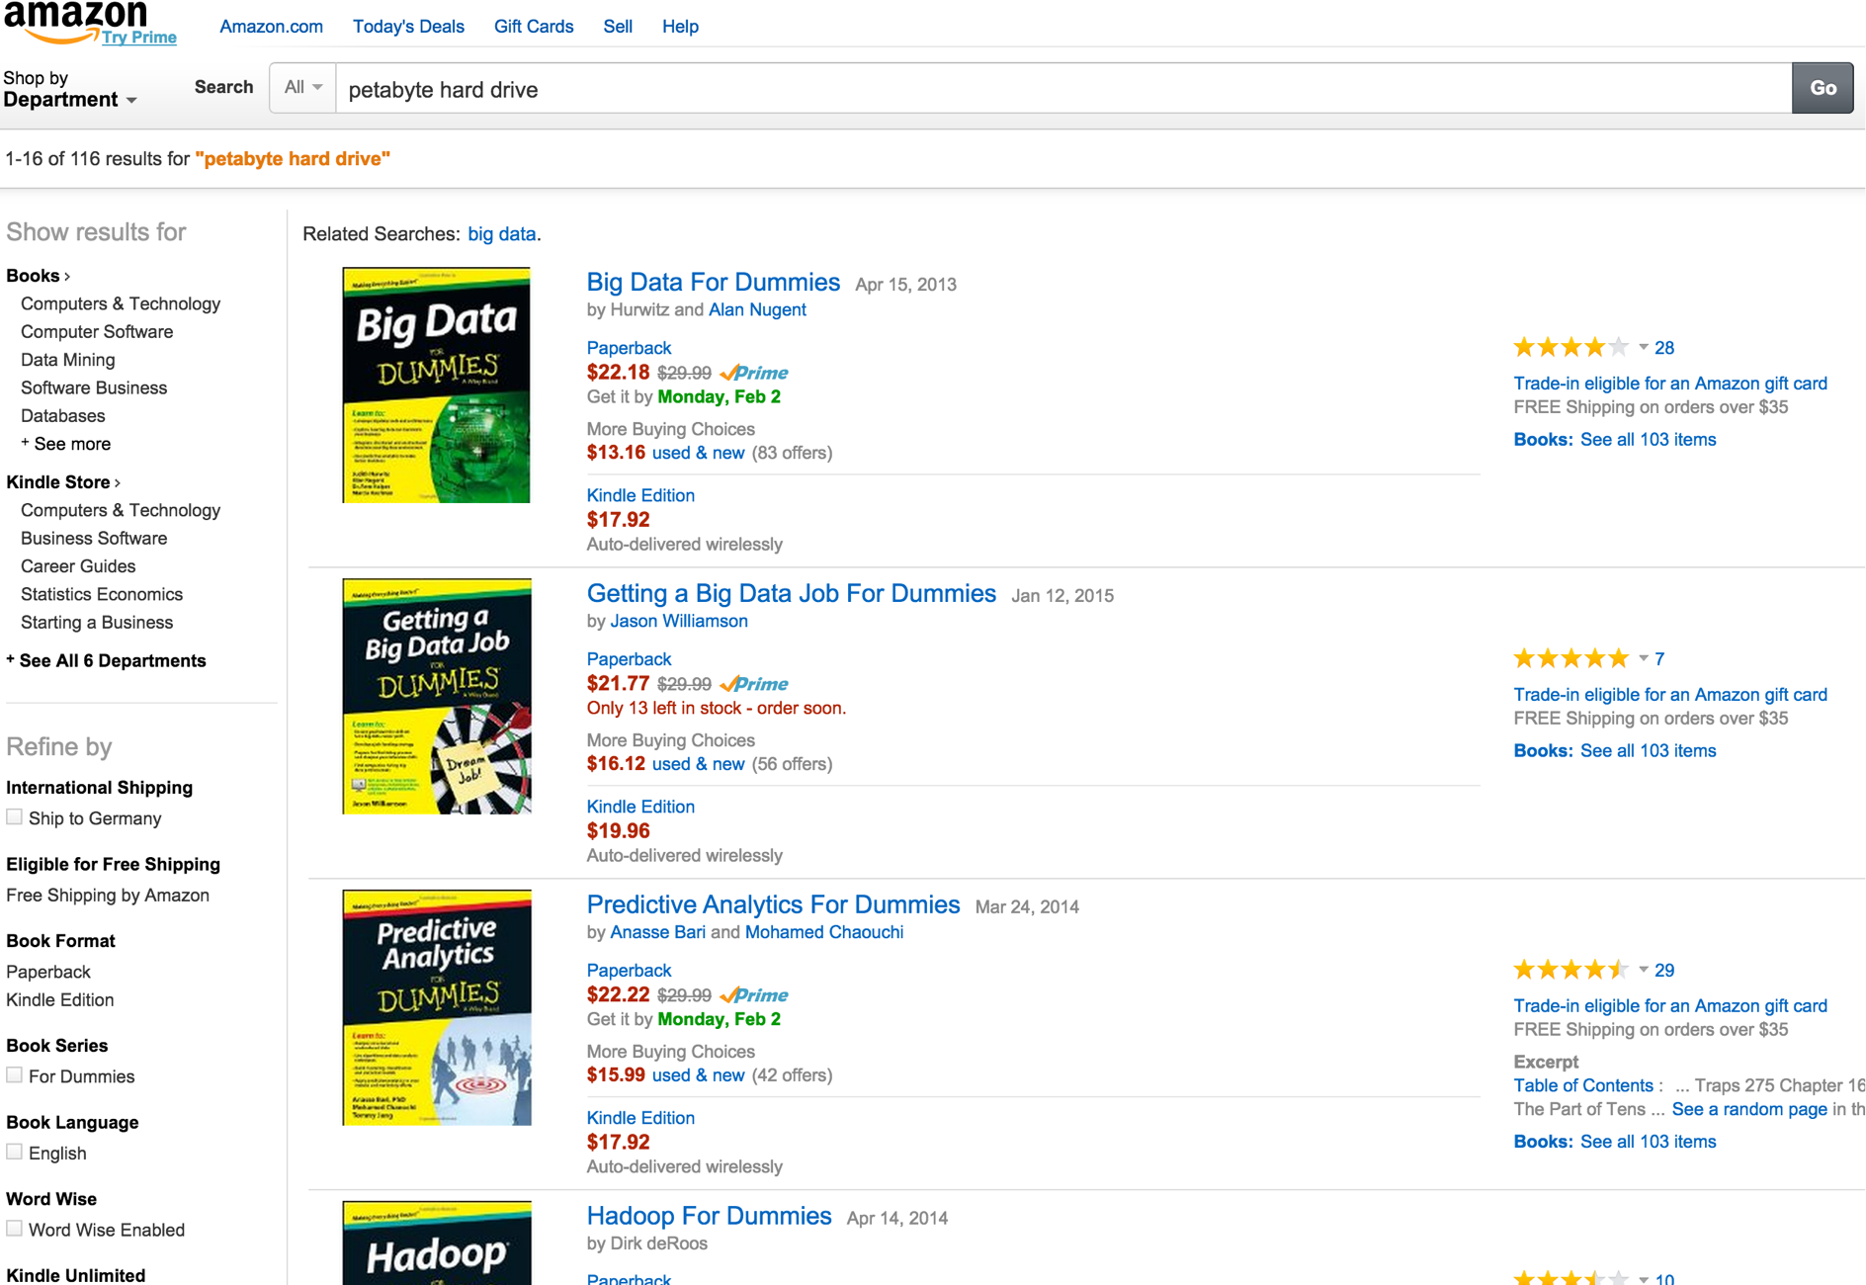
You might search for a

Slide 26
Now that you know that Big Data is the real deal
You read "Big Data for Dummies" and continue to tackle the PageRank problem

Slide 27
Distributed File Systems
Distributed file systems are a foundational component of big data analytics
Chops things into manageable sized blocks, usually 64mb
Spreads those blocks out across a cluster of VM resources

Slide 28
Hadoop MapReduce
Worth mentioning, Hadoop started this whole MapReduce craze
You could translate the raw data from a CSV and turn it into a map of keys to values
Keys are distributed per node and used to reduce the values into a partitioned analysis

Slide 29
Ok so now you know about Big Data, Hadoop, HDFS
You fire up your Amazon EC2 Hadoop cluster...

Slide 30
This guy is still waiting…

Slide 31
You hold your breath..
And submit the PageRank job…
You wait…

Slide 32

3 hours later…
Out of memory: heap space exceeded!

Slide 33
It must be the configs
You check the configs
Increase the heap space
Do some Stackoverflow trolling
And you submit the PageRank job again…

Slide 34
Graph algorithms can be evil at scale
It depends on the complexity of your graph
How many strongly connected components you have
But since some graph algorithms like PageRank are iterative
You have to iterate from one stage and use the results of the previous stage

Slide 35
It doesn't matter how many nodes you have in your cluster
For iterative graph algorithms the complexity of the graph will make you or break you
Graphs with high complexity need a lot of memory to be processed iteratively

Slide 36
This guy is going to have to settle for collaborative filtering

Slide 37
Neo4j Mazerunner Project

Slide 38
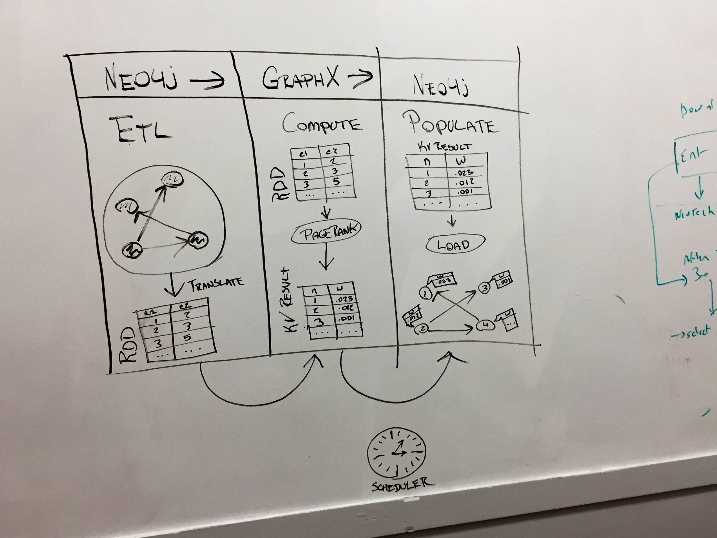
What is Neo4j Mazerunner?

Slide 39
The basic idea is…
Graph databases need ETL so you can analyze your data and look it up later.
Graph databases are great and all, but…
No platform in the open source world should be the one platform that does everything.
Especially a database.

Slide 40
Docker
If you're not up on Docker, let me give you a quick intro.

Slide 41
Docker
Docker is a VM framework that lets you easily create a recipe for an image and deploy applications with ease.
The idea is that infrastructure and operational complexity makes it hard for agile development of new products.

Slide 42
Why?
If I am an engineer on a product team, I want to choose my own software libraries and languages to solve problems.

Slide 43
Microservices for the win
So here is the future of software development:
  Cloud OS like Apache Mesos manages datacenter resources
  If you build a new service, use whatever application framework you want. As long as you communicate over REST.

Slide 44
Microservices cont.
Docker gives you the freedom to use Neo4j, or OrientDB, or MongoDB or whatever application dependency you want inside your container.
Because of something called graceful degradation, if OrientDB or Neo4j fail at being everything, they'll fault only within their container and not bring your entire SaaS platform to its knees.

Slide 45
Beware of the monolith…
Monolithic apps are those software platforms that just try and do every possible damn thing. They're like Swiss army knives of the software world.
If you rely on one service to do everything, your entire platform is going to come down when it fails.
And it will fail…

Slide 46
Docker cont.
Summarizing:
  Docker containerizes your bad engineering decisions without bringing down your platform.
  So I'm pretty much a fan of that.

Slide 47
So is this guy…

Slide 48
Mazerunner runs on Docker
You can pull it down and deploy it safely and roll the dice on some awesome analytics capabilities that lend well to graph data models.

Slide 49
HDFS and Apache Spark
Apache Spark is a really interesting open source project.
It is a scalable big data and machine learning platform. It also lets you do in-memory analytics on a graph dataset.

Slide 50
So I wrote the world's first analysis service for a graph database that does 2-way ETL

Slide 51
That scared a lot of people in the "graph databases are infallible" club

Slide 52
Analysis is not a lookup

Slide 53
Analytics on graphs takes massive amounts of system resources and might bring down your OLTP capabilities as it competes to share system resources

Slide 54
Now let's fire up Neo4j Mazerunner
Demo Goals:
  I will hopefully be successful at showing you how to install Mazerunner on Docker
  I will demo you an analysis job scheduler that extracts subgraphs, analyzes them, and pops the results back to Neo4j

Slide 55
Where do we go now?
Become a committer to the project and let's make it better
Find the link on my blog — www.kennybastani.com

Slide 56
Thanks!
Follow me on Twitter:
http://www.twitter.com/kennybastani

