Slide 1
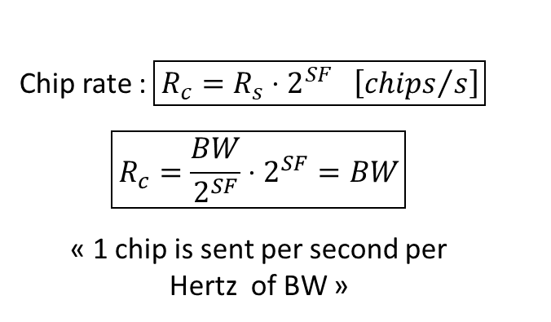


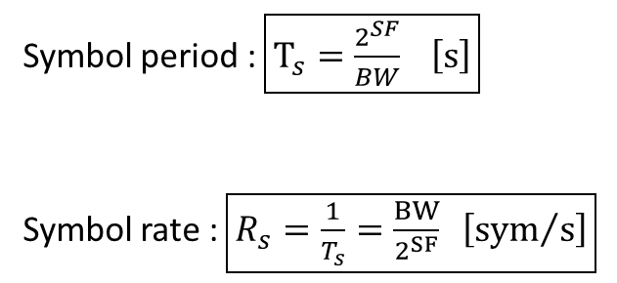


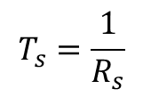

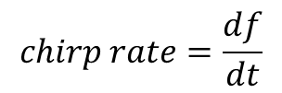


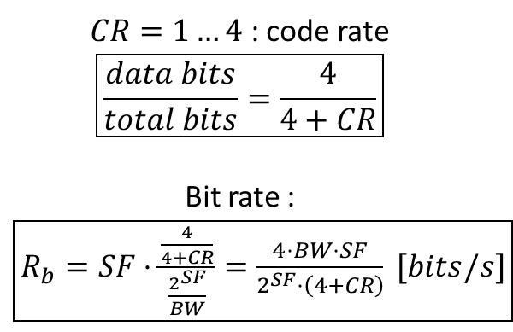
$$frequency$$
$$f_{high}$$
$$BW$$
$$df$$
$$dt$$
$$chirp rate=\frac{df}{dt}$$
$$f_{low}$$
1 symbol
$$time$$
$$T_{s}=\frac{1}{R_{s}}$$
$CR=1…4$ : code rate
$$\boxed{\frac{data bits}{total bits}=\frac{4}{4+CR}}$$
Bit rate : $\boxed{R_{b}=SF⋅\frac{\frac{4}{4+CR}}{\frac{2^{SF}}{BW}}=\frac{4⋅BW⋅SF}{2^{SF}⋅\left(4+CR\right)} [bits/s]}$
Symbol period : $\boxed{T_{s}=\frac{2^{SF}}{BW} \left[s\right]}$
Symbol rate : $\boxed{R_{s}=\frac{1}{T_{s}}=\frac{BW}{2^{SF}} \left[{sym}/s\right]}$
Chip rate : $\boxed{R_{c}=R_{s}⋅2^{SF} \left[{chips}/s\right]}$
$$\boxed{R_{c}=\frac{BW}{2^{SF}}⋅2^{SF}=BW}$$
« 1 chip is sent per second per Hertz of BW »

