Slide 1
Exploration of Stable Cycles in Dynamical Systems
Eric Binnendyk

Slide 2
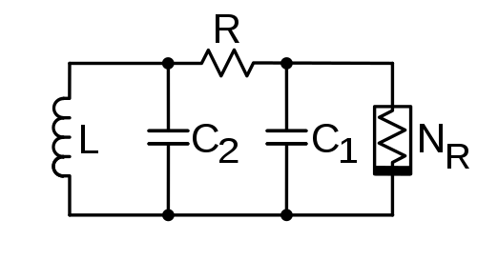
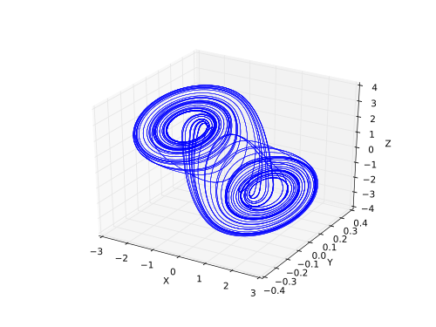
Many physical systems can be modeled as a point flowing through a phase of states.
These situations can be modeled by abstract mathematical models called dynamical systems.
Dynamical systems have many applications in varied fields, including chaos theory, mathematical physics, and circuitry.
Chua’s circuit and its phase space trajectory over a period of 100 seconds. Credit: Chua's_circuit_with_Chua_diode.svg by Chetvorno licensed under CC0 ChuaAttractor.svg by Shiyu Ji licensed under CC-BY-SA 4.0

Slide 3
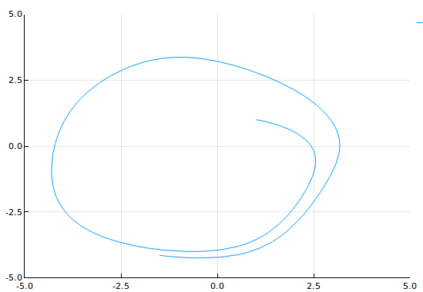
Continuous dynamical systems:
Consist of a space of points and field of velocity vectors
For any starting point, its trajectory can be mapped as a function of time
Given initial coordinates, the trajectory can be found by solving a system of multiple differential equations
Figure 1 shows a sample trajectory.
x₁, x₂: position coordinates
x₁’, x₂’: velocity components - derivatives of position over time
Formula:
x₁’ = sin(x₁) + x₂
x₂’ = cos(x₂) - x₁
Fig. 1: Trajectory of (x₁’, x₂’) = (sin(x₁)+x₂, cos(x₂)-x₁) for t = 0 … 10

Slide 4
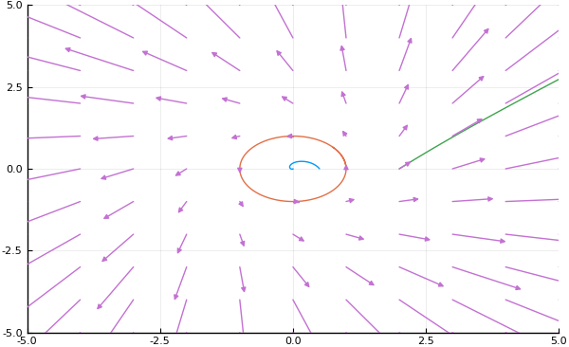
IN general, a point can:
converge to a fixed point
diverge
enter an orbit
Looking for points that perfectly retrace their orbit without perturbation
Fig. 2: Example of converging, stable, and diverging trajectories in the system (x₁’, x₂’) = (x₁√(x₁² + x₂²) - x₁ - x₂, x₂√(x₁² + x₂²) + x₁ - x₂)

Slide 5
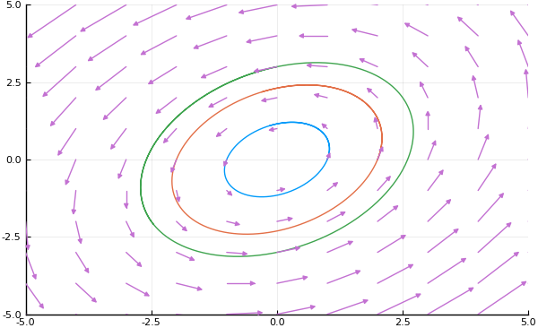
Linear systems
Any orbits that occur will always be ellipses with uniform period
x = (x₁, x₂)
x’ = (x₁’, x₂’)
x’ = Ax, where A is some 2 by 2 matrix
Fig. 3: Three elliptical orbits in the system (x₁’, x₂’) = (0.5x₁ - 1.5x₂, 2x₁ - 0.5x₂)

Slide 6
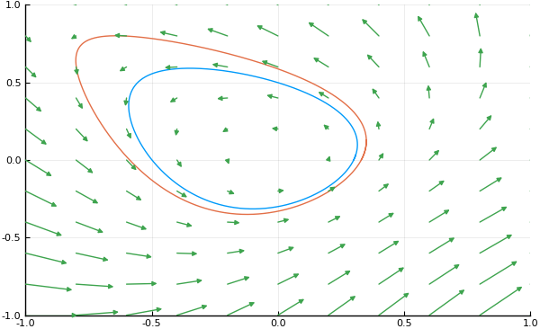
Non-linear systems
Trajectories may go into orbits of irregular shape.
Orbits can also be of varying period, as in the case (x₁’, x₂’) = (x₁² - x₂, x₁ + x₂²).
The figure shows two orbits with periods 6.886 and 7.626 respectively.
Fig. 4: Stable orbits in the system (x₁’, x₂’) = (x₁² - x₂, x₁ + x₂²) with starting points (0, 0.3) and (0, 0.35).

Slide 7
Research methods
Focus: systems of form
x₁’ = -x₂ + f(x₁)
x₂’ = x₁ + g(x₂)
where f and g are even functions and f(0) = g(0) = 0.
Method: numerical methods using a modified version of Euler’s method.
Each value x_{n}(t + Δt) was calculated from the previous value x_{n}(t) using the second order Taylor approximation.

Slide 8
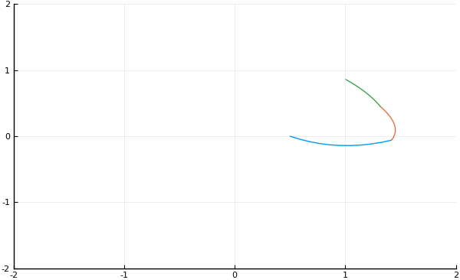
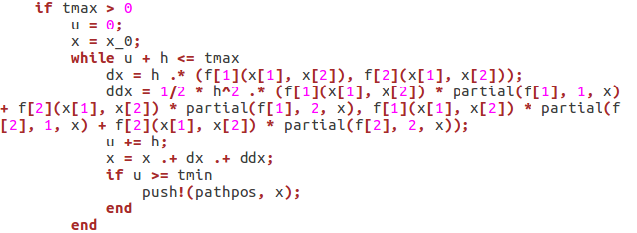
Example: x₁’ = -x₂ + cos(x₁), x₂’ = x₁ - cos(x₂)
x₁’’ = -x₂’ - x₁’ sin(x₁) = -x₁ + cos(x₂) - (-x₂ + cos(x₁))sin(x₁)
x₁(t + Δt) ≈ x₁(t) + x₁’(t)Δt + ½ x₁’’(t)Δt² = x₁(t) + (-x₂(t) + cos(x₁(t)))Δt + … etc
x₂(t + Δt) ≈ ...
Example: Δt = 1
First 3 quadratic approximations
are shown
3
2
t = 0 1

Slide 9
Results
For some of the systems I studied, all points sufficiently close to the origin appeared to go into orbits.
For example, f = g and f = -g seem to always work.
For other systems, such as f(x₁) = x₁² + 0.1*x₁⁴, g(x₂) = 3*(x₂² + 0.1*x₂⁴), the trajectories returned to a place which, despite being very close to the initial point, did not become closer upon refining the precision.
While this does not actually prove anything, it opens up the opportunity to make a conjecture about the appearance of stable orbits that is likely to be true.

Slide 10
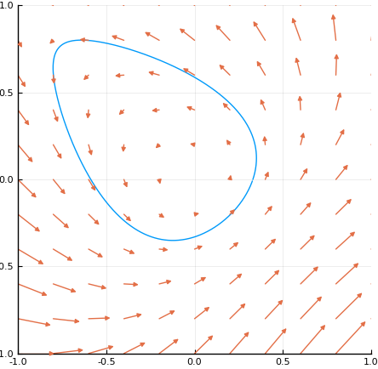
This cycle can be proved stable; every vector to the left of the line of symmetry is the reflection (and negation) of a vector on the right.

Slide 11
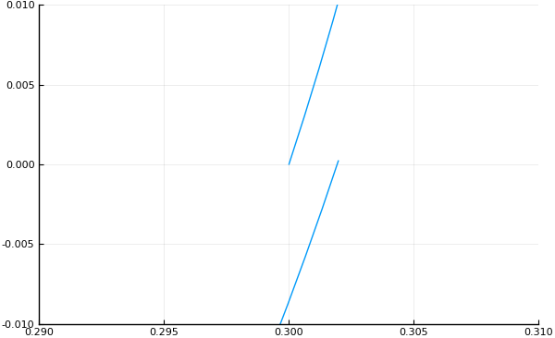

x₁’ = 0.7x₁² - x₂; x₂’ = x₂² + x₁; x(0) = (0.3, 0)
Not a stable cycle
With Δt = 0.01, the graph of the system passes close to the initial point x(0) at t = 0.662
With Δt = 0.001, the returning trajectory does not get noticeably closer to x(0)

Slide 12
Before my research, I conjectured that if one modified a linear system with stable cycles by adding a vector field with the same values at antipodal points, the result would still have stable cycles in a neighborhood of the origin. My research suggests that this conjecture is not true.

Slide 13
Acknowledgements
I would like to thank the mathematics and computer science departments at New Mexico Tech, and Professor Ramyaa for being my advisor for this project.
Are there any questions?

