Slide 1


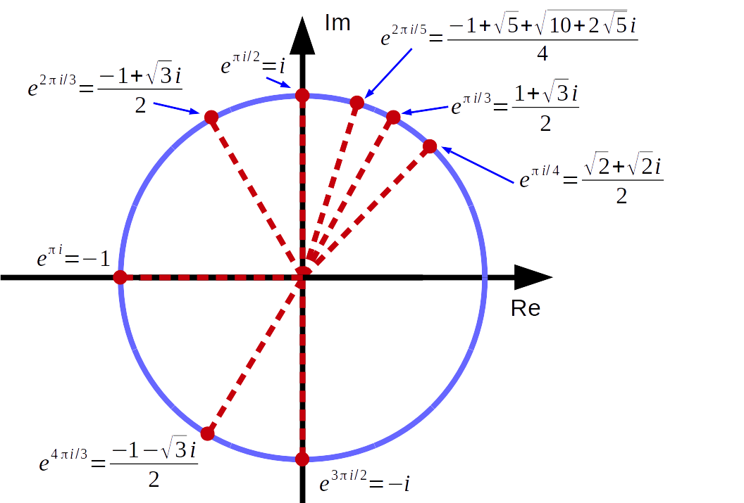
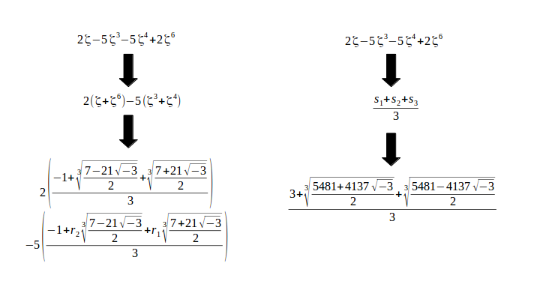
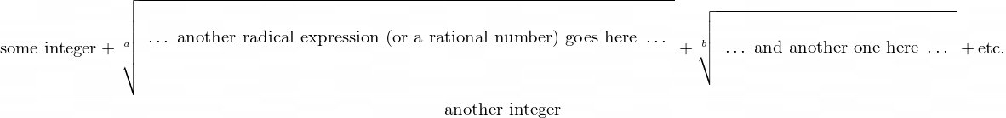
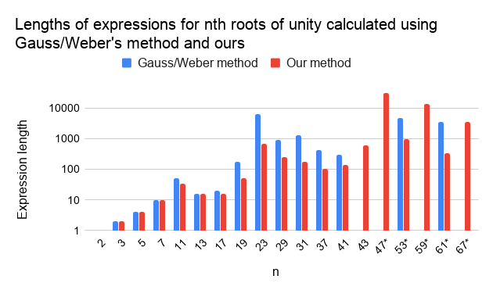
New Algorithm for Radical Expressions for Roots of Unity
Eric Binnendyk¹, Mingji Zhang²
SRS 2020-106
Departments of ^{1, 2}Mathematics, New Mexico Institute of Mining & Technology, Socorro, NM 87801
ABSTRACT
We introduce a new method to find radical expressions for roots of unity; that is, complex numbers that yield 1 when taken to some integer power. This method yields more compact expressions than previous methods suggested by Carl Gauss and Andreas Weber by finding compact radical expressions for arbitrary sums of roots of unity as well as single values. We also develop a formula for the “size” of the expression for a root of unity.
Roots of unity have many applications. For example, they are used in the Fast Fourier Transform, an efficient method of computing a Fourier transform which is widely used in physics and electrical engineering. Radical expressions for roots of unity lead to radical expressions for cos(n*pi) and sin(n*pi) for all rational numbers n, which can be applied to geometric constructions of regular polygons. They can also be a pedagogical tool for explaining why certain trigonometric functions result in simple values (e.g. cos(pi/3) = 1/2 and cos(pi/5) = (1 + sqrt(5))/4).
Here, ζ is a 7th root of unity
DISCUSSION
Even though we have measured the expressions generated by our algorithm to be shorter, there are a few potential issues with the length metric we used. For instance, the size metric requires that the radical expressions do not contain unexpanded products of sums (e.g. (1 + √2)(√2 + √3)). In our implementation of Gauss/Weber’s method, all such products were expanded into sums, affecting the expression’s size. Furthermore, our method can produce radical expressions with quite large integers (a 23rd root of unity contains integers that are 98 digits long) but our size metric does not take integer size into account.
It is interesting to note that the expression is “customizable” depending on the order in which the prime factors of p – 1 are chosen. In particular, if p is prime we can always choose an expression which is a sum of real and imaginary parts.
Figure 1:Some common roots of unity on the complex plane, and their radical expressions.
Figure 2: Computation of a sum of 7th roots of unity using my algorithm (right) and Gauss’s algorithm (left). The values s₁, s₂, s₃ are the Fourier transform of the original expression and its conjugates while r₁ and r₂ are cube roots of unity.
METHODS
Theoretical overview
Any value from the nth cyclotomic field (that is, any sum of nth roots of unity) can be expressed via radicals in terms of other “simpler” sums: one using only nth roots of unity and the others using (n*c)th roots where c is some prime factor of n – 1. This can be done by rearranging the coefficients in the sum repeatedly to form other sums and taking the discrete Fourier transform of all of them. This step is repeatedly applied to every sum of roots of unity in the expression until the sums become rational numbers, resulting in a complete radical expression.
Computational aspects
Each radical expression that the algorithm generates has a particular structure: a sum of roots of simpler radical expressions, divided by an integer (figure 3). Knowing the structure of the result made it easier to write code for the process.
Top-down recursion: The method can be described in terms of itself--evaluate a sum by expressing it in terms of simpler sums, then evaluate those sums. Our code for computing the values uses a recursive function call to take advantage of this self-reference.
Evaluation metric: We also developed a formula to compute the “length” of a radical expression and compare it with previous people’s radical expressions.
Figure 3: Structure of the expressions (above), exemplified by the real part of an 11th root of unity (below). Created using latex2png.com.
RESULTS
On a preliminary test run of our code, we were able to generate radical expressions for pth roots of unity for all primes p up to 43, as well as for some larger primes like 73, 97, 193, and 257. Using our assessment of the size of a radical expression, the resulting expressions are smaller than the corresponding expressions generated by Gauss/Weber’s method (see figure 4). We also developed a formula to accurately predict the sizes of our expressions without running the code.
We have not analyzed our code runtime in detail but based on observations we expect our code for our method to run faster than our code for Gauss/Weber’s method once we implement the same optimizations in each code.
BACKGROUND
Historically, the most common method of expressing nth roots of unity in radicals was developed by Carl Gauss in the 1700s^{[1][2]}. There have been several improvements and variations on this method, mostly involving the runtime, most recently by Andreas Weber in 1995^{[3]}. However, for large n, most methods produce long expressions that cannot practically be written out in full.
Our new method, based on Galois theory (the theory of roots of polynomials), avoids these problems by producing shorter radical forms for roots of unity. We generalizes the problem to finding a radical form for any sum of nth roots of unity which may occur as an intermediate step, rather than first breaking it into standard sums called periods (figure 2).
To analyze this method, we wrote code to implement it and analyze the size of the resulting expressions compared to the forms produced by previous algorithms.
*length extrapolated from formula
Figure 4: Lengths of radical expressions for nth roots of unity for some values of n.
Future Work
When we take the nth root of a complex value, our code uses floating-point computation to identify the correct choice of complex root by comparing each approximate value to the desired result. This computation is the main limiting factor keeping our method from working for larger primes. Future work could include redesigning this part of the algorithm so that it does not use floating-point computations.
REFERENCES
[1] Gauss, Carl F. Disquisitiones Arithmeticae. Yale University Press. pp. 359-360, 1965. ISBN 0-300-09473-6.
[2] Lynn, Ben. “Number Theory - Roots of Unity.” Stanford Applied Cryptography Group, https://crypto.stanford.edu/pbc/notes/numbertheory/rootsunity.html
[3] Weber, Andreas. “Computing radical expressions for roots of unity.” ACM SIGSAM Bulletin, 30, 1996, pp. 11-20. 10.1145/240065.240070.
Contact Information
Eric Binnendyk, undergraduate mathematics/computer science double major at New Mexico Tech, eric.binnendyk@student.nmt.edu
Research advisor: Mingji Zhang, Assistant Professor at the New Mexico Tech Department of Mathematics, mingji.zhang@nmt.edu

