Slide 1
Client Sentiment Radar
An always-on agent that reads the client's own words and tells the account lead where the temperature is, where it is heading, and which deadlines it is tied to.
What we did in the hour
Team Token Hoarders
Picked Track 1 (always-on) and one sharp scope rule: score only what the client says; our replies are context, never signal.
Froze a data contract in ten minutes, then split into four lanes: data, backend, UI, routine and demo.
Built a FastAPI scorer on Claude with structured outputs, a single-page radar UI, and a Claude Routine that scans on a schedule and reaches out when a contact turns escalating.
Stretch: an MCP plugin so the same radar answers questions from Claude Code and Cowork.
Eric Blue, Andela
Mike, Alex and Aditya, Deloitte
Anthropic Partner Base Camp
Agent Hackathon, Track 1
Shack15, San Francisco
September 10, 2026
Scored on the client's words only
Notes:
Open with the problem: account leads find out late. The signal was there in the client's own emails and meeting turns. We built the thing that reads them so nobody has to.

Slide 2
The agent approach: two halves, one scored store
Reactive alone is a query tool. The trigger nobody presses is what makes it an always-on agent.
1
Always-on: a Claude Routine
2
On demand: UI and plugin
Runs on a schedule (daily 07:00; hourly for the demo) with nobody asking.
Pulls new client emails and transcript turns from the data repo.
Calls POST /ingest so scoring lives in one place; diffs GET /radar against the last run.
Reaches out: an alert with the driving quote when a contact turns escalating or the weekly average drops more than 0.3. Otherwise, the cited Monday brief.
Posts to Slack or an alerts.json banner. No click required.
Radar UI: six-week trend with deadline markers, contact temperature, client message feed with tone chips and quotes, Brief me, ingest box.
Plugin (Claude Code and Cowork): radar_status, radar_contact, radar_search, radar_brief, radar_ingest, radar_diff over the same backend.
Ask: "How is the Northwind account feeling this week?" or "Did anything change since Monday's brief?"
Every answer cites the message ids behind it and carries the time of the last scan.
Scope rule: only the client's words are scored. Our own replies are context for the brief, never signal for the score.
Notes:
The dashboard is what you look at on Monday. The plugin is what you ask on Wednesday. The routine is what makes both true without anyone remembering to run it.

Slide 3
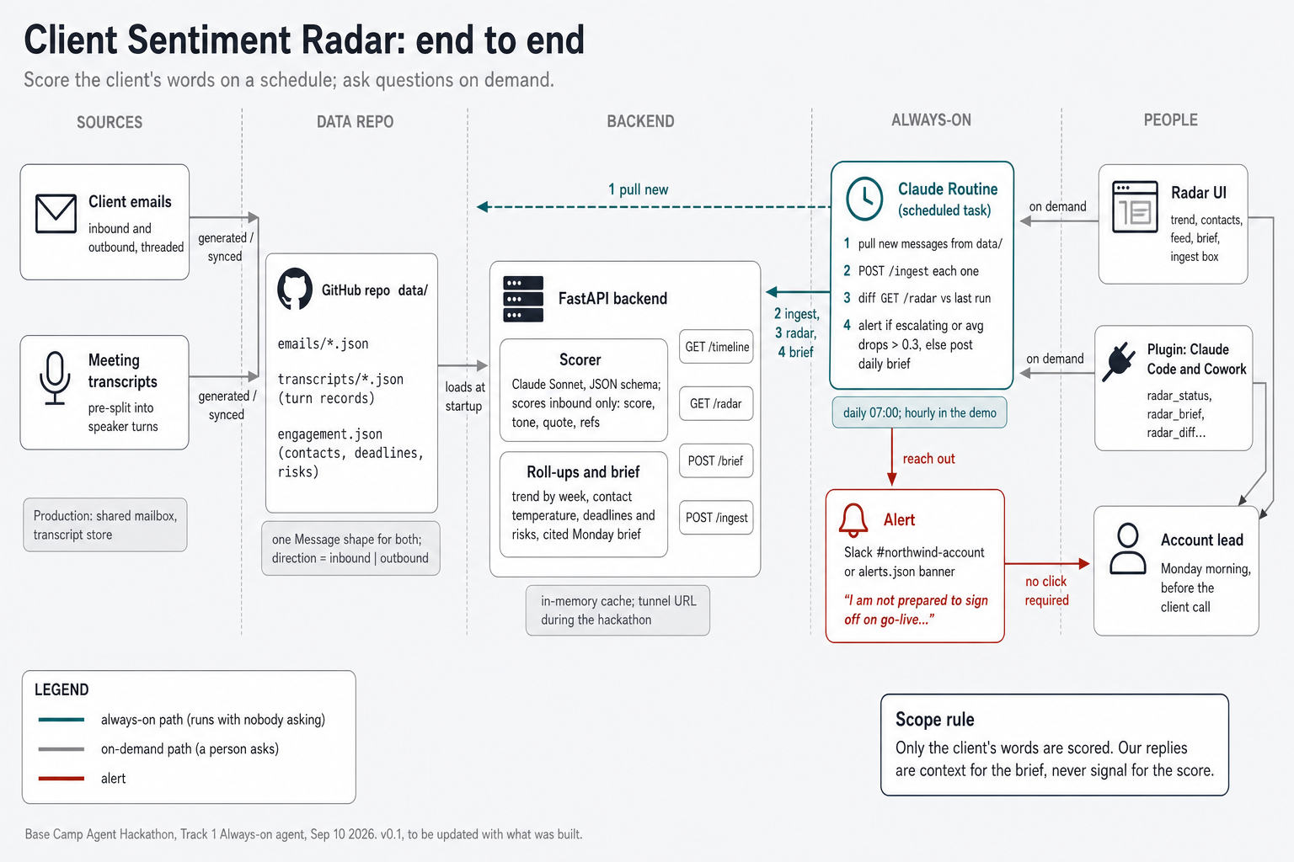
How it works end to end
Data repo, FastAPI scorer, the routine on the always-on path, UI and plugin on demand
Scorer
Claude Sonnet, JSON schema, effort low. One call per client message, cached. Returns score, tone, driving quote, and linked deadline or risk ids.
Contract
One Message shape for emails and transcript turns; direction = inbound or outbound. Frozen at minute 10 so four lanes could build in parallel.
Routine
Claude scheduled task reaching the backend through a tunnel. Alert on escalation or a 0.3 drop; daily brief otherwise.
Notes:
Walk the teal path first: routine pulls, ingests, diffs, alerts. Then the grey path: UI and plugin ask the same backend. Point at the scope rule callout.

Slide 4
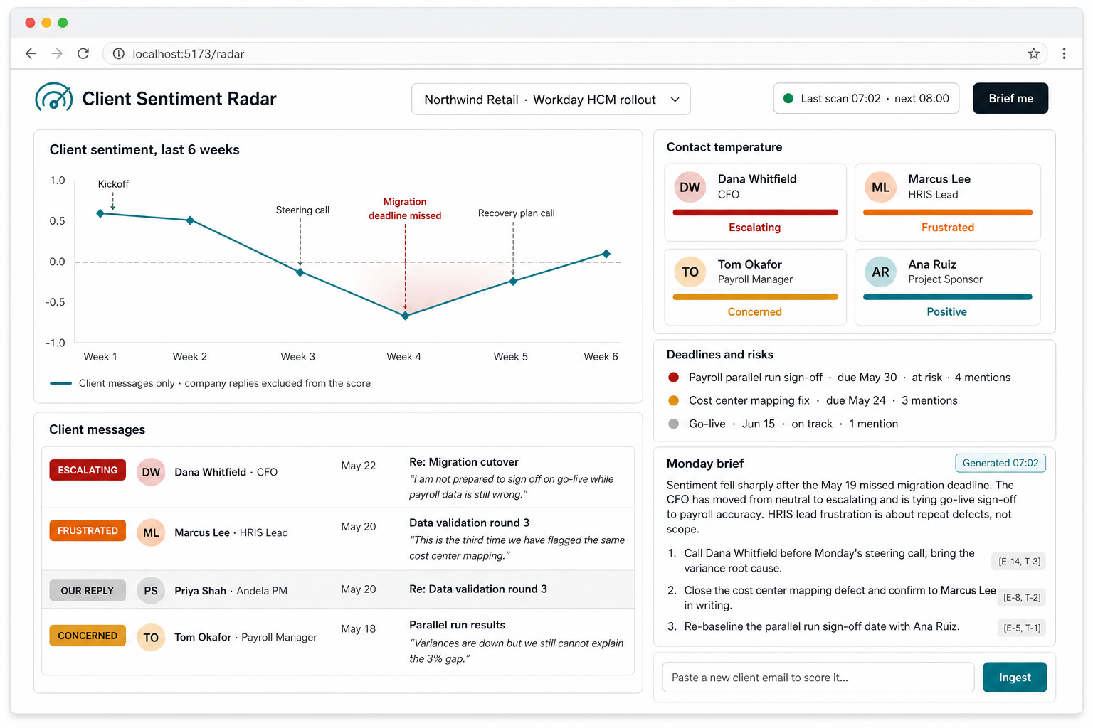
The radar, and the two-minute demo
Northwind Retail, Workday HCM rollout: warm at kickoff, a dip after the missed migration deadline, the CFO in red
Demo
1
Open the radar: click the week 4 dip, read the CFO's quote.
2
Brief me: three actions, each citing message ids.
3
Paste a new escalating email; the line drops, the brief changes.
4
From a second laptop, commit an email to data/ and fire the routine.
5
The alert lands in Slack with nobody touching the dashboard.
6
Ask from Claude Code: "How is Northwind feeling this week?"
Status: hackathon scaffold, synthetic data, in-memory state. Production shape: same routine against the shared mailbox, posting every morning.
Notes:
Steps 4 and 5 are the always-on moment; nobody touches the UI. Then open the dashboard and show the line already moved.

Slide 5
Ask it from Claude Code
The plugin exposes the same scored store as tools; every answer cites the client messages behind it
claude ~/basecamp-hackathon-client-sentiment
More you can ask
> How is the Northwind account feeling this week?
radar_status(engagement="northwind")
Cooling. Weekly average -0.4, down from +0.5 at kickoff.
The drop follows the missed May 19 migration deadline.
Dana Whitfield, CFO: escalating. "I am not prepared to sign
off on go-live while payroll data is still wrong." [E-14]
Marcus Lee, HRIS Lead: frustrated about repeat defects,
not scope. [E-11, T-3]
Ana Ruiz, Sponsor: still positive; your ally for
re-baselining. [T-3]
At-risk deadline: payroll parallel run sign-off, May 30
(4 client mentions). Last scan 07:02.
> Did anything change since Monday's brief?
radar_diff(since="monday") -> 2 new client emails scored
Tom Okafor, Payroll Manager: concerned -> neutral (+0.1).
"Variances are now within tolerance on the second sample."
Dana Whitfield: still escalating (-0.7); copied the steering
committee and asked for a written go-live gate.
Net: delivery signal improving, executive signal not.
Recommend a direct call with Dana before Thursday. █
"I have the steering call with Dana at 2. What do I need to know?"
Her trajectory, last three quotes, the deadline she tied her position to, one opening line.
"Marcus keeps saying we repeat defects. Is that fair?"
Every defect mention in order, distinct versus repeated, which workstream they cluster on.
"Which deadlines is the client worried about?"
Ranked by client mentions and tone, not by the project plan.
"Here is the email Dana just sent. How bad is it?"
Score, tone, the driving sentence, what changed since her last message.
"Post the brief to #northwind-account."
Done, with the next scheduled scan time.
Notes:
Same tools work in Cowork. The point: nobody opens a dashboard on a Wednesday; they ask the tool they already have open, and the answer cites the client's own words.

