Slide 1
THasINKync:
Multi-Threaded Programming in .Net

Slide 2
Eric Burcham
Likes
Dogs
Most people
Telling bad jokes
The words “bro” and “totally.” I’m not kidding.
Dislikes
Dog hair
A few people
Telling jokes that don’t work (Happens a LOT)
Making lists of stuff

Slide 3
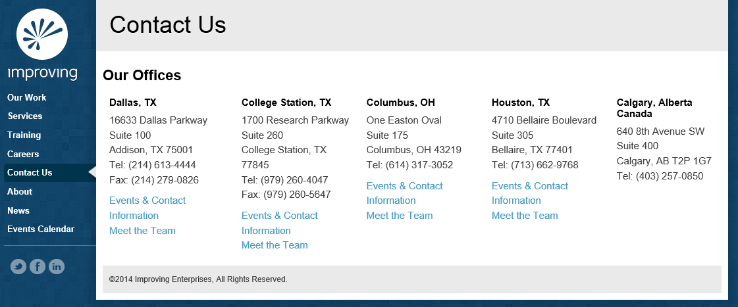
I’m an Improver
Principal Consultant with Improving Enterprises
We’re hiring (Attitude and Aptitude)
You should totally call me, bro: 214-578-9217
Or email: eric.Burcham@improvingenterprises.com
We have a website: www.improvingenterprises.com
Go Now!!!

Slide 4



Save the Date
Tuesday, August 11, 2015
8am-5pm
Studio Movie Grill City Center
Register now AgileDotNext.com
Get 10% off by entering IEfriends

Slide 5

Houston Techfest
All-day Internet and Technology Conference
September 12, 2015
It has a logo. Here it is!!!
It’s pretty much free. As in free beer. There’s gas and your time and stuff, but whatever…
It actually has pretty decent speakers.
WAY better than me.
I’ll be there too, though, probably.

Slide 6
Broism: Bilbro Baggins
Bilbro Baggins: Your bro who is obsessed with Lord of the Rings. Example: Joe has seen the twin towers like 5 times. He’s such a Bilbro Baggins.

Slide 7
Overiew
Lots of bad jokes (I can’t help it)

