Slide 1
Software Anti-Patterns
The right way NOT to do it!
https://github.com/ericburcham/anti-patterns

Slide 2
Eric Burcham
Enterprise Products
eburcham@eprod.com
(214) 578–9217

Slide 3
About This Talk
What is an anti-pattern?
What is a design pattern?
None of these anti-pattern names are original.
Why I chose the anti-patterns I chose.
Who this talk is for.
How this talk is organized.
Zero code.

Slide 4
About This Talk
What is an anti-patterns
None of this is original.
Why I chose the anti-patterns I chose.
How this talk is organized.

Slide 5

Organizational Anti-Patterns
The wrong way to organize, manage, resource projects, and lead.

Slide 6

Analysis Paralysis
Definition: Overthinking a design to the degree that a decision is never made, or action is never taken.
Symptoms: A decision is treated as over-complicated, with too many detailed options, and making a choice takes a long time.
Solution: Stop striving for perfection and try something sensible. Adapt as problems arise.

Slide 7
Bike Shedding
Definition: When members of a team give disproportionate weight to trivial issues.
Symptoms: Parkinson’s law of triviality is in effect. Humans tend towards the trivial. You are arguing about unimportant detail when you should be solving the big problems.
Solution: Assign the simple stuff to a competent person, give them the authority to do it, and get out of their way.
Caveat: No second-guessing the person in charge after the fact.

Slide 8

Design by Committee
Definition: A project that has many designers involved but no unifying plan or vision.
Symptoms: Too many viewpoints. Lots of back-and-forth. Poor or divided leadership. People with poor technical knowledge involved in tech design. People with little business knowledge involved in business design. Needless complexity. Persistent lack of consensus. Banality.
Solution: Business is a meritocracy, not a democracy. Designate a leader for each design project. The leader should solicit any necessary input according to their leadership style, then make a decision.

Slide 9
Escalation of Commitment
Definition: Failure to Revoke a Decision When it Proves Wrong.
Symptoms: The “Sunk Cost Fallacy” is in effect. You are facing increasingly negative outcomes from some decision, action, or investment. Nevertheless, you continue down the same path, furthering your investment and, therefore, your cost of correction.
Solution: DETACH. Discard emotional investment and make a deliberate, sound decision. If immediate change is not possible, raise your concerns to project leadership. Consider a parallel implementation instead of a replacement.

Slide 10

Seagull Management
Definition: A manager who only interacts when there is a problem, flies in, makes a lot of noise, squawks at everyone, then flies out.
Symptoms: Your manager makes hasty decisions about things they have little understanding of. This results in messy situations you must clean up.
Solution: Manage upwards. Ensure they have the necessary information, even if doing so is uncomfortable. Exercise patience. Remember, nobody can make decisions with information they don’t have. Be proactive; anticipate problems and deal with them before your boss notices. When you need a decision, take your boss the information they need before they come screaming into the conference room.

Slide 11
Typecasting, or “The Expert’s Curse.”
Definition: Locking successful employees into narrowly-defined roles based on their past successes instead of their potential.
Symptoms: A person becomes so strongly identified with their job or role that it becomes difficult to transition to other roles, including those which may better benefit the organization.
Solution: Make sure that you make your career or project goals known to others. If you know you are good at something, participate in that activity. Block time on your calendar if necessary. This is particularly effective for those wanting to transition into a design or architectural role.

Slide 12

The Death March
Definition: An effort whose staff, while expecting to fail, are compelled to continue, often with much overwork, enforced by management which is in denial.
Symptoms: There is consensus among the teams members. Everyone knows in their heart they are destined to fail. Yet management refuses to accept the obvious, and continues to crack the whip.
Discussion Point: Operating on the edge – how do you draw the line between maximum team performance and a death march?
Discussion Point: What are some of the risks of continuing this behavior?
Solution: Learn from your mistakes. It doesn’t have to be this way, but you have to be proactive. Do not abandon a team that has made this mistake in the past. If you have the guts, stick around and lead. Change the world you are in.

Slide 13
Scope Creep
Definition: Uncontrolled changes or continual growth in a project’s scope. Also adding features after the original requirements have been accepted.
Symptoms: Poorly understood features exist in the backlog. These features will always grow in scope and complexity. They will never diminish. New concerns arise in a demonstration after the original requirements are fulfilled.
Solution: The causes of this are known entities. Recognize and call them out. Be super aggressive about making sure that business design is done thoroughly. Do anything and everything you can before you go to code. Whiteboard. Ask questions. Call out fear, uncertainty, and doubt (FUD). Do design work. If the situation becomes unavoidable, make sure leadership knows about the additional work so that compensation can be made.

Slide 14
Brooks’ Law From: The Mythical Man-Month by Fred Brooks
Definition: In an attempt to increase velocity, resources are added to a project¹ when the project is already crippled by management overhead.
Symptoms: Existing members are still not productive, fully integrated with the culture, or “in the know,” but are being asked to refer, interview, train and integrate new team members.
Solution: Resource projects early in the process. Determine if the project is really late, or if the original schedule was too optimistic. The quality and role of people added must be taken into account over their quantity. Add team members slowly and deliberately, allowing each small group time to “gel” before adding members again.

Slide 15

Tester-Driven Development
Definition: A situation in which new requirements are specified in bug reports.
Symptoms: Your feature meets the original requirements, but is found lacking through no fault of your own. For whatever reason (politics, carelessness, callousness, laziness) these shortcomings in requirements are reported as bugs instead of new requirements.
Discussion Point: New requirements are not bugs, and teams that run this way are in for all kinds of problems, especially with morale.
Solution: Stand up for yourself. Insist that work be filed correctly.

Slide 16
Resume-Driven Development
Definition: Tooling and architecture chosen for the leader's next role rather than the current problem.
Symptoms: Strategic decisions are unaccompanied by a stated business reason. The technology stack on the team's charter would look great on LinkedIn. “We need to be on Kubernetes” arrives without a workload that justifies it.
Solution: Force every adoption decision through a written justification: the business problem, the alternatives considered, and the cost of reversal. Separate “interesting” from “necessary.” Build a culture where saying “not yet” to new tech is rewarded, not punished.

Slide 17
Spotify Model Cargo Cult
Definition: Adopting squads, tribes, chapters, and guilds wholesale from a 2012 whitepaper that Spotify itself has since moved past.
Symptoms: Org structure is copied from a famous company without studying why it worked there. Ceremony increases. Outcomes do not. Engineers cannot explain what a chapter does, only that they belong to one.
Solution: Steal the principles, not the labels. Decide what you are actually trying to optimize for — autonomy, alignment, throughput — and design the org around that. If a structure does not survive the question “what changes if we remove it?” remove it.

Slide 18
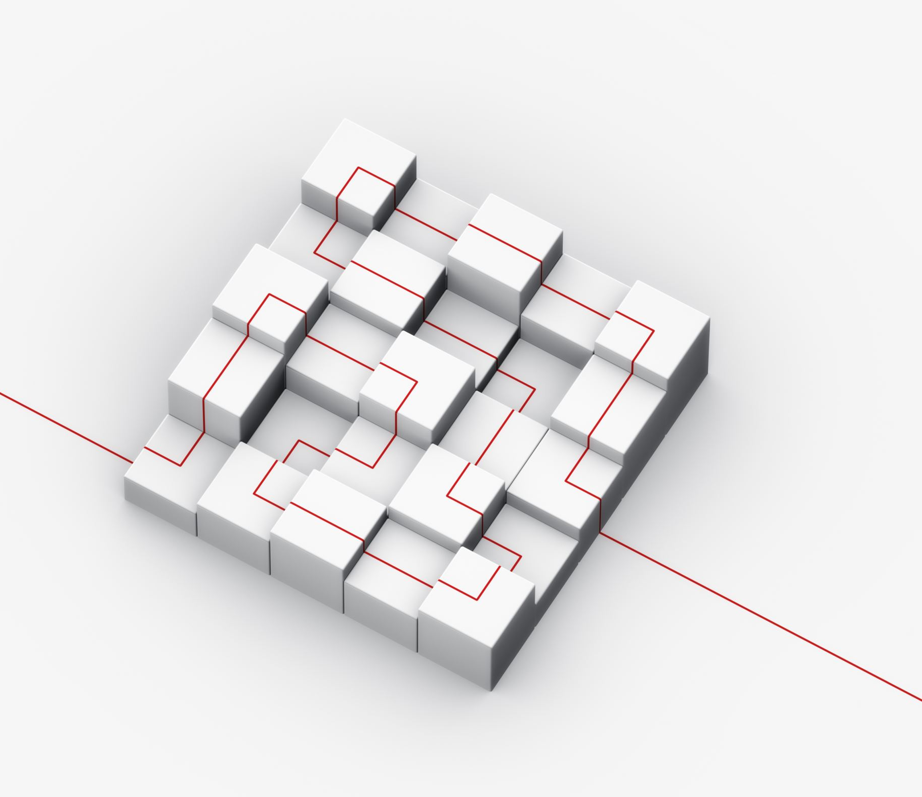
Reorg-Driven Development
Definition: When leadership cannot solve the technical problem, they redraw the boxes on the org chart. Repeatedly.
Symptoms: Solutions to engineering problems arrive in PowerPoint and never in code. Reporting lines change faster than the systems they manage. Team identity resets before any team gets good at anything.
Solution: Demand a written hypothesis before any reorg: what is broken, why this structure fixes it, and how success will be measured. Pair org changes with technical changes, not as a substitute for them. Pairs well with Seagull Management.

Slide 19

Software Design Anti-Patterns
The wrong way to think about software before you code.

Slide 20
Group Think
Definition: A collective state where members begin to (often unknowingly) think alike and reject differing viewpoints.
Symptoms: The desire for harmony and conformity outweighs the impetus to make rational decisions. Consensus is reached very easily, even when the necessity of critical evaluation is necessary.
Solution: Assign a critical evaluator whose job it is to freely air objections and doubts. Leaders should avoid expressing an opinion when critical evaluation is highly desirable.

Slide 21

That’s Not What I Would Do
Definition: A cognitive bias that involves preferring your own solution to a given problem over any other solution.
Symptoms: You are in a design or coding session and are thinking up arguments against someone else’s solution, rather than asking questions to make sure you understand it.
Solution: Keep an open mind, and respect others enough to understand their solutions before proposing your own. Keep “good enough” in mind. A less than ideal solution today often trumps a clever or perfect one tomorrow.

Slide 22

Abstraction Inversion
Definition: When users of a construct need functions implemented within, but not exposed by its interface.
Symptoms: You find yourself re-implementing the required functions. Many users attempting to solve the same problem.
Solutions: Follow the open-closed principle. Choose carefully which constructs to seal, make virtual, make public, protected, or internal. Use access modifiers semantically, rather than protectively.

Slide 23
Big Ball of Mud (BBOM or “Bomb”)
Definition: A software system that lacks a clear architecture.
Eric’s Comments: This is undesirable from a software engineering point of view, but common in practice due to business pressures, developer turnover, and code entropy.
Symptoms: Haphazard structure. Sprawling domains or assembly. Tight coupling. Sloppiness. Spaghetti-code. You find yourself making repeated, expedient repair.
Solutions: Fight Entropy! Fix “broken windows.” Give individual files just a minute or two of love. Refactor obvious things to patterns. Study and understand the code before making changes to avoid making it worse.

Slide 24
Gold Plating (BBOM’s Evil Twin)
Definition: Continuing to work on a task or project past the point where the work is adding value.
Symptoms: You are working on something long after meeting the requirements. This is endless polish, not common things like refactoring to patterns or cleaning your code for readability.
Discussion Point: Perfect is the enemy of done.
Solution: DETACH. When you meet the requirements for your feature, take a step back and observe your work. Is it “good enough?” Take a few minutes, clean it up for readability, and move on.

Slide 25

Distributed Monolith
Definition: A set of services that must be deployed together, share a database, and fail in unison. All the operational cost of microservices, none of the independence.
Symptoms: A change in one service requires coordinated releases across several. Services share schemas, tables, or libraries with breaking changes. An outage in one component takes down the rest. CI times grow without the benefit of independent deploys.
Solution: Identify the seams that already exist in the business domain before splitting the code. Give each service its own data. If two services cannot be deployed independently, they are one service wearing two hats — merge them back until the boundary is real.

Slide 26

AI-Washing the Architecture
Definition: Bolting a language model onto an existing workflow because the deck needs the slide, not because the workflow needs language understanding.
Symptoms: An LLM is introduced into a flow that has deterministic inputs and outputs. Latency and cost go up. Accuracy goes down. Nobody can explain what the model is doing that a rules engine or query could not.
Solution: Start from the problem, not the tool. Use LLMs where ambiguity, language, or unstructured input is the actual difficulty. For everything else, prefer the boring, testable solution. The Golden Hammer has a new head; the rule is the same.

Slide 27
Strangler Fig That Never Strangles
Definition: A migration begun in earnest, paused for a reorg, and quietly abandoned mid-strangle. The old system survives indefinitely alongside the new one.
Symptoms: You maintain two systems and the integration seam between them. Each team blames the other for bugs that cross the boundary. “Finishing the migration” has been on the roadmap for three planning cycles.
Solution: Set and defend a deprecation date for the old system before the new one ships its first feature. Track the percentage of traffic, data, or use cases moved — not the features built. Be willing to revert rather than live in the seam forever.

Slide 28

Programming Anti-Patterns
The wrong way to think about software while you code.

Slide 29
Repository Abuse
Definition: Failing to use a repository efficiently, instead relying on nested loops, client-filtering, and lazy-loading.
Symptoms: You get strange database exceptions. You execute queries in a loop. You have .Where(lambda) after a repository.Find(query). You don’t have sufficient include statements in your query to prevent lazy-loading of properties.
Solutions: Write queries that bring exactly the data you need for your usage. Do not re-use semi-correct queries. Alter them or make new ones. Include the properties you need for your usage. Bring back collections and loop over them, rather than querying in a loop.

Slide 30
Circular Dependency
Definition: A relationship between two or more modules which either directly or indirectly depend on each other to function properly.
Symptoms: You have assemblies that reference one another. You have using statements in your API code file that reference domain namespaces. You are struggling to write callbacks across domains.
Solutions: Use design patterns like Observer, Pub-Sub, or Command, rather than lamely implementing callbacks.

Slide 31

God Object
Definition: Any object that knows too much (omniscient) or does too much (omnipotent).
Symptoms: Your service providers are large and/or complex. You use giant objects for coordinating complex operations instead of following common design patterns. Your domain boundaries are not clearly defined, and your entities know details about other lines of business.
Solutions: Study and follow strategic design patterns. DDD, for example, is designed specifically to solve these problems. Invest in yourself and learn common tactical design patterns.

Slide 32
Sequential Coupling
Definition: A class that requires its methods to be called in a particular sequence.
Symptoms: Non-private methods named Init, Begin, or Start. Property Injection.
Solution: Inject dependencies via constructors, where possible. In aspect-oriented programming, use the Service Locator (anti) pattern to resolve dependencies.

Slide 33
Cargo Cult Programming
Definition: Using patterns and methods without understanding why.
Symptoms: You are relying on “what has gone before.” You are programming with copy/paste. You are not carefully thinking through problems and solutions.
Solution: Know design patterns. Know S.O.L.I.D. principles. Know anti-patterns. Know general and project-specific best practices and standards.

Slide 34
Coding by Exception
Definition: Adding new code to handle each special case as it arises.
Symptoms: You are coding protectively. You are swallowing exceptions. You are using exceptions for control flow.
Solution: Solve underlying problems. Let unexpected exceptions fail all the way to process boundaries.

Slide 35
Boat Anchor
Definition: Retaining a part of a system that no longer has any use, typically “in case it is needed later.”
Symptoms: You are having a hard time differentiating between obsolete code that doesn’t do anything and working code which does.
Solution: Occasionally scour the code for that which is no longer referenced. Either move it to a separate location where it can be referenced if necessary or delete it.

Slide 36

Lava Flow
Definition: Retaining undesirable (redundant or low-quality) code because removing it is too expensive or has unpredictable consequences.
Symptoms: You find yourself adding to, maintaining, or adding dependencies to an original incomplete or poor design.
Discussion Point: The longer this continues, the worse the problem will become.
Solution: There is NO easy solution. Do the work to clean up broken pieces. Budget time for this in your project. Attempt to get management buy-in for the long-term investment. Otherwise, at minimum, call out the costs.

Slide 37
Vibe Coding
Definition: Prompting an AI assistant until the output “feels right,” committing without reading it, and meeting the bugs in production.
Symptoms: Diffs are large, unfamiliar, and difficult to explain in review. The author cannot answer questions about why a particular approach was chosen. Tests pass but exercise the wrong invariants. Cargo Cult Programming’s direct descendant, accelerated.
Solution: Treat AI output as a junior engineer’s first draft, not as a finished product. Read every line you commit. Ask the model to justify its choices and verify the justification. If you cannot defend the code in review, you cannot ship it.

Slide 38
Mock Maximalism
Definition: A test suite that mocks every dependency, achieves high coverage, and verifies nothing about real behavior.
Symptoms: Tests pass while the system is broken. Refactoring requires rewriting the tests in lockstep with the code. Bugs reproduce in production but not in the suite. You are testing that your mocks behave like your mocks.
Solution: Mock at the system boundary, not inside the domain. Prefer integration tests over unit tests that mock collaborators. Use real implementations — in-memory databases, fake clocks, test containers — whenever the cost is reasonable.

Slide 39
“any” Drift
Definition: A typed codebase that started strict, accumulated escape hatches under deadline pressure, and is now untyped code in a costume.
Symptoms: “any,” “object,” or unchecked casts proliferate. Refactors that should be safe break at runtime. Autocomplete stops being useful. The compiler is satisfied; the runtime is not.
Solution: Treat type escape hatches as technical debt with a name attached. Enable lint rules that surface them. Pay them down in small, deliberate passes — not in heroic week-long sprints that never get scheduled.

Slide 40
Methodological Anti-Patterns
The wrong way to actually code.

Slide 41
Copy-and-Paste Programming
Copy-and-Paste Programming
Definition: Copying and modifying existing code rather than creating generic solutions.
Symptoms: Seems obvious.
Discussion Point: The often occurs with inexperienced programmers who find writing their own solutions difficult or irritating. This also occurs when people “Google” a solution to a problem, and then don’t actually take the time to understand the code they have found.
Solution: Have courage when programming. Write solutions. Learn from the experience. Caveat: This is probably OK for boilerplate ONLY. I still prefer snippets, though.

Slide 42

The Golden Hammer, or “Law of Instrument”
Definition: A cognitive bias that involves over-reliance on a familiar tool. “If all you have is a hammer, everything looks like a nail.”
Symptoms: You are trying to use your favorite language or library to solve a problem and having more trouble than expected. You spent a lot of money on a tool and now need to justify the cost.
Solution: When approaching problems of a nature that is new to you, do the research to see if there are existing tool that efficiently address that problem. Don’t worry about appearing ignorant and ask questions. You will look more ignorant if you try to drive a screw with a hammer than if you ask how to drive a screw.

Slide 43

Not Invented Here
Definition: The tendency towards reinventing the wheel.
Symptoms: There is an adequate, existing solution to your problem and you either chose not to look for it, or not to use it when doing so would have been reasonable.
Solution: If you are working on something that seems like it might be a common problem, check for an existing solution.
Example: PDF Tools for .Net.

Slide 44

Reinventing the Square Wheel
Definition: Failure to adopt an existing solution, but also creating a much worse solution.
Symptoms: You are really struggling on something that seems like it might be a common problem.
Solution: When you are out of your depth, admit it. Enlist help. Find a good solution and use it, but also study it to improve yourself.

Slide 45
Premature Optimization
Definition: Coding early on for perceived efficiency, sacrificing good design, maintainability, and (often) even real-world efficiency.
Symptoms: You are adding code that is only intended to increase performance. In self-review, you discover that your code is difficult to read or comprehend, and will be difficult for others to approach.
Discussion Point: Jackson’s Rules of Optimization
Solution: There is no need to neglect performance in your design, but do the design work. Prefer maintainability where it is reasonable to do so. Only spend time in deep optimization in actual performance-critical code.

Slide 46

LGTM Culture
Definition: Pull requests approved without being read, because the queue is long and the author is senior.
Symptoms: Reviews come back in minutes, regardless of diff size. Comments are rare and almost always cosmetic. Defects that a careful reader would catch reach production. Code review has become ceremony rather than control.
Solution: Make review quality visible: track defects caught, questions asked, and changes requested. Cap PR size so reading is realistic. Rotate reviewers so no one is permanently downstream of the same author. Make “I do not understand this yet” an acceptable review comment.

Slide 47

Feature Flag Sprawl
Definition: Flags accumulated faster than they are retired. Production behavior becomes a Boolean algebra problem no one on the team can solve on a whiteboard.
Symptoms: Flags outlive the features they gated. Multiple flags interact in undocumented ways. Debugging requires asking which flags are on for which users. Removing a flag is treated as a project, not a cleanup.
Solution: Give every flag an owner and an expiration date at creation. Track flag age the way you track open bugs. Retire flags as a recurring item on the team’s plate, not a heroic effort once a year. Default to off; opt in to permanence.

Slide 48
Prompt-and-Pray
Definition: Asking an AI assistant for a solution, accepting the first answer, and shipping it. Copy-and-Paste Programming’s nephew, except the source confabulated and cannot be subpoenaed.
Symptoms: API calls are made to functions that do not exist. Library versions are wrong. Security advice is plausible and incorrect. The author cannot explain the code beyond pointing at the prompt.
Solution: Verify before you trust. Run the code. Read the docs the model claimed to cite. Ask the model to produce tests, then read those too. Treat hallucination as the default mode of the tool, not the exception.

