Slide 1
Cloud Patterns and Practices
Containers, Clusters, and Chaos - Oh My!

Slide 2
Introduction
Wherein I tell you what I’m going to tell you…

Slide 3
Your Affable Presenter
Eric Burcham
Enterprise Architect
Report to VP, IT Applications
Available Resource to the Entire Department
Ping me on teams Extension 4103
Mobile: (214) 578-9217 (call anytime)
https://github.com/ericburcham/cloud-patterns-and-practices

Slide 4
What This Presentation Is
A conversation
Assume-nothing
Introductory
Food for thought
Deliberately broad
Deliberately high-level
Actionable today, but…
My goal is to provoke thought

Slide 5
What This Presentation Is Not
Detail-oriented
Example code
Applicable everywhere
Dictatorial in nature
Highly-opinionated
Closed to interpretation
A detailed migration guide for existing workloads

Slide 6
Departmental Roll-Call: Who All is Here?
Big Data Services
Anybody Else?

Slide 7
What are Patterns and Practices
Wherein I explain what a “known good solution” is…

Slide 8
Patterns: Blueprints for Building
Reusable solutions to common problems
Typically abstract and language-agnostic
Focused on structural or behavioral aspects of a solution
Generally target code or architecture, but not both

Slide 9
Practices: Construction Techniques and Team Habits
Recommended ways of working
Processes
Methodologies
Cultural habits
Help teams build, deploy, and maintain systems effectively
More about how you work than what you build
Examples:
DevOps/DevSecOps/MLOps
Agile practices (pre-monetization)
Operational practices
Security practices
Team practices
Notes:
Agile practices: rapid iteration, TDD
Operational practices: blue/green deployments and canary releases
Security practices: shift-left security, zero trust, secrets management
Team practices: cross-functional teams, shared ownership, blameless postmortems, “you build it, you run it”

Slide 10
Patterns and Practices Combined
Comprise the lingua franca of software systems solution and design
Teams, tools, and technologies vary widely
Patterns and practices provide:
A shared vocabulary.
A shared mental model.
Transcendence over languages, frameworks, or platforms.

Slide 11
Discarding a Misconception
Insert [your title here], but in general…
A programmer’s job is not to write programs. Code is just the output
A programmer’s job is to design solutions
TDD Mantra: Red, Green, Refactor
TDD Mantra corrected: THINK!, Red, Green, Refactor

Slide 12
Benefits of a Lingua Franca
Cross-team collaboration
Scalability of knowledge
Tool and platform agnosticism
Design consistency
Notes:
Cross-team collaboration: Architects, developers, DevOps, and QA can align using shared concepts like "circuit breaker" or "immutable infrastructure."
Scalability of knowledge: New team members or partners can ramp up faster when familiar patterns and practices are in place.
Tool and platform agnosticism: Whether you're using AWS, Azure, or Kubernetes, the same principles often apply.
Design consistency: Promotes reusable, proven solutions and avoids reinventing the wheel.

Slide 13
Enterprise Grade Solutions
Wherein I propose something to look forward to…

Slide 14
Exercise: Rank the following “-abilities”
Applicability (1)
Testability
Reliability
Availability
Usability
Maintainability
Scalability
Portability
Notes:
Discussion points
This list was given to be by a mentor in the late 90’s. It represented his take on what “Enterprise Grade Software” meant. Was it hard to crash? Did it fail elegantly? Did failures cascade to other systems? What the code legible… even (dare I say) beautiful? These are the first things in my career I was taught to hold dear.
These are all important. Any ranking of them is relative to that statement. Neglect any three of these, and you’re going to be hurting. Neglect any more than that, and you’re in for a world of hurt.
If you must trade some of these for others, you had better think it through and know why you are choosing one over another. Context is critically important.
Take portability for example. Depending on the organization you work for and the target runtimes available, this could be very high on the list. It could also be near the bottom or thrown out entirely.
Testability is often ignored or neglected. This can be a terrible mistake. Consider the process of certifying your solution. Do you want to be able to automate most of that, or do you want to manually test the software for quality, performance, reliability, and scalability by hand every time you hoist to production? But testability also comes at a cost, and sometimes this cost can be quite substantial. For very simple solutions, small API footprints, integration points (does my SQL connection work…), or systems that are almost entirely read-only, the cost may not be worth it. But for business-critical transactional systems, absolutely. Then, in your world of AI and machine learning, the entire process of automated testing and certification are different from anything I have done and comes with an entire suite of concerns that are specific to your problem and solution spaces.

Slide 15
What Does Enterprise Grade Mean Today?
Fit for purpose
Security by design (When in doubt, start here)
Organized design
Isolation of complexity
Platform-managed concerns
Cost-optimized
Operational excellence
Multi-layer resilience
Policy-driven governance
Unified observability
Infrastructure as code
Composable architecture
Event-driven
Notes:
This slide does not represent a list of things to leave and do today at the expense of all else. Rather it represents one of many possible desired end states.
We need to participate in a maturation of thinking that aligns with the times and the new solution spaces available to us. The evolution is from “Enterprise Grade Software” to “Enterprise Grade Solutions.” This reflects a fundamental shift in how we organize and isolate complexity in providing solutions to complex problems. It also represents a fundamental shift in how we deal with crosscutting concerns. Concerns can now be separated not just across code, but across infrastructure, operations, and governance layers. The goal is to create systems where complexity is contained, solutions are logically organized, and each crosscutting concerns is handled at the ideal layer in the solution stack.
Fit for purpose: Above all, you must solve the problem in front of you. If your system doesn’t do what you need it to do, you might as well pack up and go home.
Security by design: Security cannot be an afterthought. This means zero-trust network architecture, encryption everywhere, automated compliance scanning, and embedding security policies within infrastructure as code throughout the development lifecycle.
Talk about Cherryl
Talk about security and compliance in general
Talk about David Pool’s new role
Organized design: Solutions should be organized strategically around business domains and logical boundaries rather than technical layers or implementation details. Pay special attention aligning data flows with domain events. Organizational principles should extend from code structure to cloud resource naming to team topologies, ensuring that system design mirrors the business it serves so it is easy to understand, navigate, and evolve.
Isolation of complexity: Complexity should be isolated at multiple levels – from microservice boundaries to network segmentation to data access patterns and more. This means pushing cross-cutting concerns like SSL termination, authentication, and rate limiting to the platform layer through service meshes and API gateways. It also means keeping business logic focused and pristine.
Platform-managed concerns: Following 12-factor principles and beyond, modern solutions delegate infrastructure concerns to the platform. Load balancing, service discovery, secret management, certificate rotation, and the like become declarative configurations rather than application code, allowing developers and AI/ML engineers to focus on business value.
Cost-optimized: With cloud spend often representing significant operational expense, solutions should try to implement intelligent resource allocation, spot instance usage, serverless where appropriate, and continuous cost monitoring with automated optimization. All of this is, of course, both free and effortless.
Operational excellence: Beyond traditional operations, this encompasses GitOps and DevSecOps workflows, automated disaster recovery, self-healing systems, and chaos engineering. And who doesn’t want to play with something called “Chaos Monkey?” The system itself becomes responsible for maintaining its operational health, with human operators setting policies rather than executing procedures.
Multi-layer resilience: Resilience should be considered at every layer – from redundant infrastructure to circuit breakers in code to automated failover strategies. Each layer isolates failures from propagating, creating defense in depth that goes beyond simple high-availability.
Policy-driven governance: Security, compliance, and cost controls can be expressed as policies that the system enforces automatically. To name a few examples, this includes network security groups, data classification and access rules, budget alerts, license compliance and vulnerability scanning for dependencies, runtime process protection, and on the list goes. The point here is to organize governance concerns into manageable, auditable components so we can isolate solution developers from having to spend time on them.
Unified observability: The system should provide comprehensive visibility across all layers such as infrastructure and cost metrics, application traces, saga status of business transactions, and business KPIs. Provide a single pane of glass for understanding system behavior. This organization of monitoring data enables teams to quickly isolate issues in complex distributed systems.
Infrastructure (and other things) as code: All system components – networks, storage, security policies, compliance rules, and orchestration of executing workloads, are defined as versioned, testable code. This transforms infrastructure from a collection of manual configurations into an organized, repeatable solution that can be systematically validated and evolve.
Composable architecture: Systems are organized as loosely coupled, independently deployable components that communicate through well-defined contracts. This includes not just microservices, but data pipelines, ML models, and infrastructure modules that can keep clear boundaries as they are composed into larger solutions.
Event-driven: Modern architectures leverage event streaming, message queues, and reactive patterns to handle massive scale and provide near-realtime capabilities. This enable loose coupling between services and supports both synchronous and asynchronous processing patterns.

Slide 16
The Twelve-Factor App
Wherein I teach you how to write code that doesn’t bite you in the cloud…

Slide 17
The 12 Factors
Codebase – One codebase tracked in revision control, many deploys
Dependencies – Explicitly declare and isolate dependencies
Config – Store config in the environment (and NEVER the repo)
Backing services – Treat backing services as attached resources
Build, release, run – Strictly separate build and run stages
Processes – Execute the app as one or more stateless processes

Slide 18
The 12 Factors
Port binding – Export services via port binding
Concurrency – Scale out via the process model
Disposability – Maximize robustness with fast startup and graceful shutdown
Dev/prod parity – Keep development, staging, and production as similar as possible.
Logs – Treat logs as event streams
Admin processes – Run admin/management tasks as one-off processes

Slide 19
I. Codebase
One codebase tracked in revision control, many deploys

Slide 20
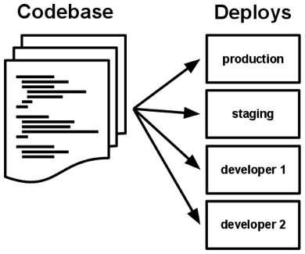
One codebase, many deploys
Notes:
One codebase tracked in revision control, many deploys.
Your repository defines the basic unit of organization for an application. It should be a single code base that can be deployed to multiple environments. This should mean hosting the app in a single repository, though this is not enough on its own. An app needs to be a cohesive unit of code rather than several different applications hosted in the same repository.
This might seem basic, but it helps to define the scale and scope of an application. It encourages smaller, more manageable units that have clearer responsibilities and are easier to automate.
There are a lot of ways to decide what goes in a given repository, but my primary advice is that it be a single, cohesive unit. Whatever is in your repository should be part of the same overall system. You want to avoid dumping everything your team does over the years in one repo. For example: multiple related micro services are fine. Multiple unrelated projects are not fine. For very large distributed systems with dozens of services, try using a strategy like domain-driven design, and putting one domain with its associated services in each repository.

Slide 21
II. Dependencies
Explicitly declare and isolate dependencies

Slide 22
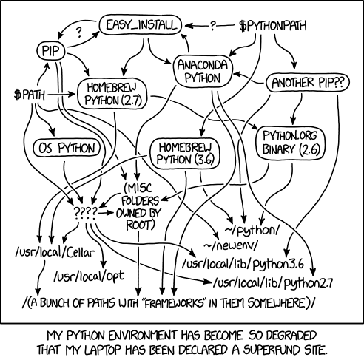
Explicitly declare and isolate dependencies
Notes:
Explicitly declare and isolate dependencies
You should be able to define all the dependencies that an application uses in a manifest that lives within the application. There is no room for system-wide frameworks or external tools. This makes it easier to set up new environments, particularly for developers as any dependencies can be automatically acquired through a packaging system such as Nuget.
This used to be all but impossible with .Net as we relied on the existence of a system-wide framework. This created a prerequisite for an environment to be configured with a specific set of framework dependencies. Applications written in .Net Core, on the other hand, can have all their dependencies packaged, including any underlying frameworks. In the .Net world we use nuget package manager, but virtually every tech stack, including operating systems, has a package manager of some kind for managing dependencies. The key idea here is that you treat the runtime environment like a substrate, not like part of the application. If you’re writing a website, just bind to port 443. Don’t expect to have someone making complex configuration in IIS by hand. If you are building a Node application, use NPM to install your dependencies during the build step. If you are building a micro-service in Java, use Maven or Gradle.
The underlying theme here is that you don’t expect help from the environment. If you need to depend on work other than your own, bring it along for the ride during build time.

Slide 23
III. Config
Store config in the environment

Slide 24
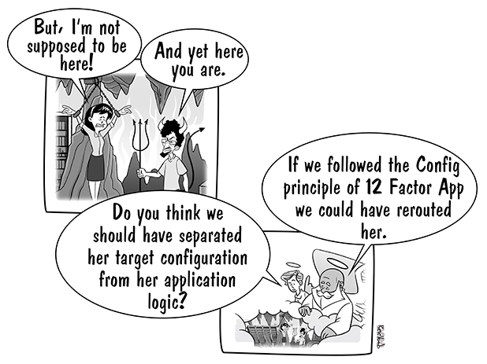
Store config in the environment

Slide 25
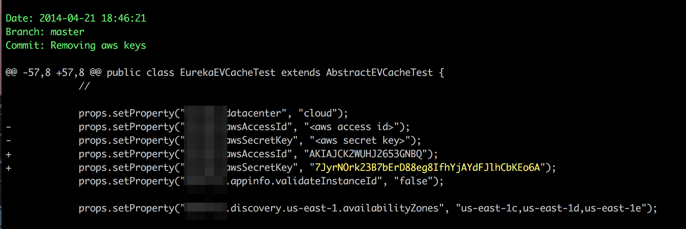
Store config in the environment
NOPE!!!
Notes:
Store configuration in the environment
When is the last time you saw this?
We have a major problem here! There in an encryption key stored in a configuration file in our git repository. This is a huge problem for many reasons. For one, it is readily available to any developer. For another, it can be use to decrypt other more important secrets. At deploy time it may need to be expunged or overridden. This could be a connection string, SAN address, mail server credentials… anything we should want to keep secret from the public.
A good litmus test for handling configuration is to ask yourself this question: “Could we, at any time, open-source this software without exposing any secrets about our network, encryption keys, certificates, or any kind of credentials?” If the answer to this question is “no,” you have a problem.
In this context, configuration is defined as anything that is likely to vary between deployments and environments. There should be explicit separation between any configuration settings and code. A good litmus test for this is whether you can open source the code base at any moment without compromising any credentials or network addresses.
Ideally, configuration should be factored into environment variables where they are easier for operations teams to manage. Above all you need to avoid relying on JSON, web.config, app.config, or other configuration files that ship with code or storing multiple configurations for different environments.
This approach is supported by the configuration APIs in .Net Core, which provide a hierarchy of configuration sources. This allows you to define a baseline configuration in appsettings.json and override any settings with environment variables and an external secrets store.

Slide 26
IV. Backing services
Treat backing services as attached resources

Slide 27
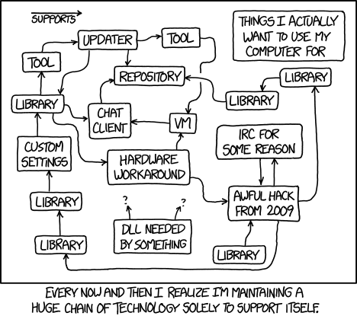
Treat backing services as attached resources

Slide 28
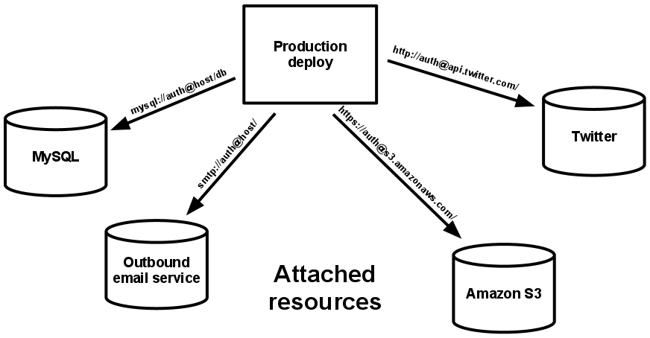
Treat backing services as attached resources
Notes:
Treat backing services as attached resources
A backing service is anything that is consumed over a network, such as databases or external APIs. There is no distinction between services you manage locally and those that belong to third parties. They should all be treated as resources that can be attached and detached without requiring code changes.
This concept is tied very strongly to configuration. As developers, we know we’re going to be using a SQL server. We might even know where it is, or have a way to connect to it and troubleshoot problems. But the code itself should never store that information. Which SQL server, what data center it is in, whether it is installed locally or running in a Docker container… all these concerns are runtime concerns. When it is time to run the program, the environment provides this configuration information through environment variables, through a secrets manager, or through a custom configuration provider that provides such information through a secure means.
In this way, we “attach” to our necessary outside services at runtime. If our SQL server moves, our runtime environment is stopped, an automated process updates the environment’s connection string, and the application is re-started. In the world of containers, we just destroy any running containers and re-create them with the new configuration. At no time is the configuration itself part of the source code or the build artifacts. Only the runtime environment itself knows where our resources reside, and provides the configuration to attach to them.
If you have to change source code by hand or recompile your application to connect to a different outside resource, you are doing it wrong!

Slide 29
V. Build, release, run
Strictly separate build and run stages

Slide 30
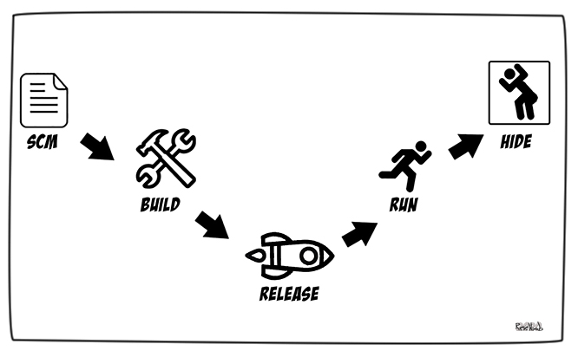
Strictly separate build and run stages

Slide 31
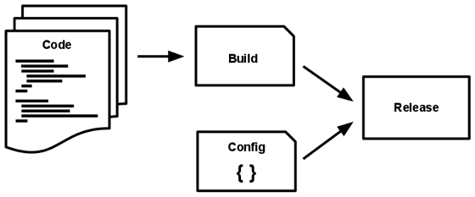
Strictly separate build and run stages
Notes:
Strictly separate build and run stages
This requires an explicit separation between the processes that build, release, and run software.
Let’s define some terms.
Build – a build process should create an executable bundle and execute any tests you have along the way.
Release – a release in an immutable combination of the built artifacts and configuration.
Run – the process of deploying and executing the application. This should always be handled by some kind of process orchestrator, and should have as few moving parts as possible.
Suffice it to say, each of these stages should be automated rather than relying on human intervention. In the .Net world, we can use Azure DevOps server for these steps. Open-source projects might rely on Travis CI or Circle CI. Team City is an option that supports virtually any technology stack.
The important effect of using this approach is that once the build artifacts are created, they remain exactly the same, regardless of the deployment environment. If you need to debug a problem from production, you can use exactly the same bits that are running there to debug locally. You don’t have to worry about subtle compilation differences. If you are a business person or development manager watching a demo in a staging environment, you know the same bytes will be deployed to production.
Every release should always have a unique release ID such as a timestamp or incrementing number. At Enterprise, we should use semantic versioning. Releases are an append-only ledger. A release cannot be altered in any way once it is created. Any change must create a new release.

Slide 32
VI. Processes
Execute the application as one or more stateless processes

Slide 33
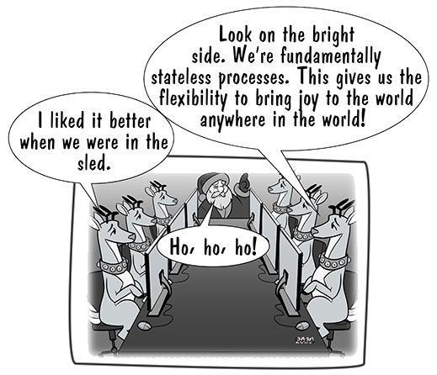
Execute the application as one or more stateless processes
Notes:
Execute the application as one or more stateless processes
A “process,” for our purposes, is defined as the single execution of an application. An application should run in a separate process that does not share information with other running applications. This means not using techniques such as sticky sessions or caches to share state between processes.
Twelve-factor applications share-nothing. Any data that needs to persist must reside in a client-side cookie or a stateful backing service, such as a database.
The memory or local storage subsystem of the runtime environment can be used as a simple, brief, single-transaction storage medium. But this should be used for during-request intermediate results only. Nothing should be kept in-process or in the execution environment between requests or units of work. Even the complete loss of this single-use cache should have no effect on the overall system state.
Sticky sessions, where user session data is cached in memory and future requests are expected to come to the same service instance, are a critical violation of twelve-factor design principles and should never be used or relied upon. When performance at scale is critical, this kind of information is a good candidate for data stores like Memcached or Redis that offer time-expiration.

Slide 34
VII. Port binding
Export services via port binding

Slide 35
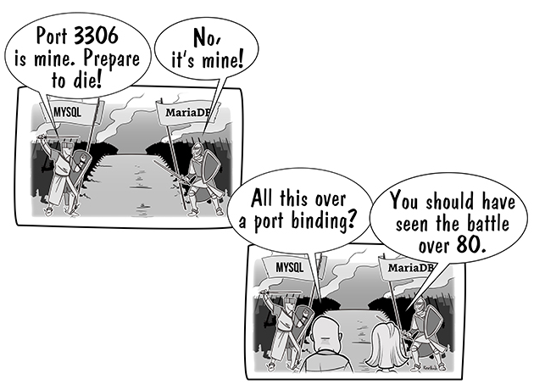
Export services via port binding
Notes:
Export services via port binding
A twelve-factor app should be completely self-contained and not rely on the run-time injection of an external host or server. If you want to expose an API over HTTP then an app should export the service and bind it to a specific port rather than having it implemented via a web server.
When building for .Net, you no longer rely on IIS. When using PHP, Python, or Perl, you don’t use Apache. When building in Java, you don’t plan to depend on Tomcat. You simply start up the service and bind it to an external port.
This is typically accomplished by using dependency declarations to use something like Kestrel for .Net, Tornado for Python, Thin for Ruby, or Jetty for Java and other JVM-based languages.
It becomes the responsibility of the environment to route requests to the port that the application is bound to. This is a very different approach to using a web server such as IIS to create an HTTP-based service. This can be controlled with hostname resolution and a load-balancer, or can be handled in a completely opaque way in a runtime environment designed for scale, such as Kubernetes.
HTTP is not the only service that can be exported, of course. Virtually anything can bind to a port and wait for incoming requests. Incoming requests can also be pulled actively, without port-binding, by maintaining an active connection to one or more backing services, such as a file system or message transport.

Slide 36
VIII. Concurrency
Scale out via the process model

Slide 37
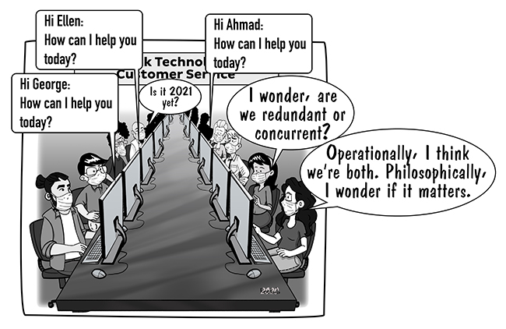
Scale out via the process model

Slide 38
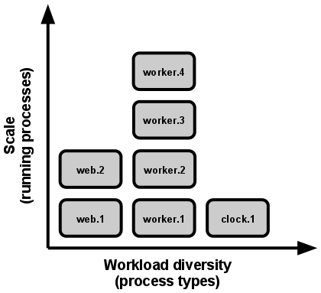
Scale out via the process model
Notes:
Scale out via the process model
The Unix process model is a simple and powerful abstraction for running server-side applications. Processes are configured to exist in a certain state and are managed automatically when the operating system or runtime environment starts up. They are also restarted automatically if they crash or die for any reason.
There are many process managers: Launched for OS X. Upstart for Ubuntu. Windows services are another flavor. The Docker runtime. Kubernetes is designed for extreme scale and self-healing. What all of these have in common is that beyond their configuration, they are hands off. DevOps personnel configure the desired state of the application, and the process manager tries to “make it so.” In more modern platforms this is done using infrastructure as code.
By using good configuration practices, using stateless processes, treating dependencies as attached resources, and using basic port binding, it is very easy to increase the number of running processes needed to meet the scale of incoming requests. Another advantage is that many of the intricacies of in-process scaling via multi-threading are avoided. By treating each request as an independent unit of work which can be handled by any instance of a given process, we avoid the need to manage thread locking, avoid the resource limitations involved in scaling up within a single server, and make it much easier to debug our applications.
There is some nuance involved here, though. Ultimately your scaling will by bound by other parts of your distributed system, particularly any data storage infrastructure, which is difficult to scale out. That said, the running process should provide a basic unit of scale that enables more elastic scaling to occur.

Slide 39
IX. Disposability
Maximize robustness with fast startup and graceful shutdown

Slide 40
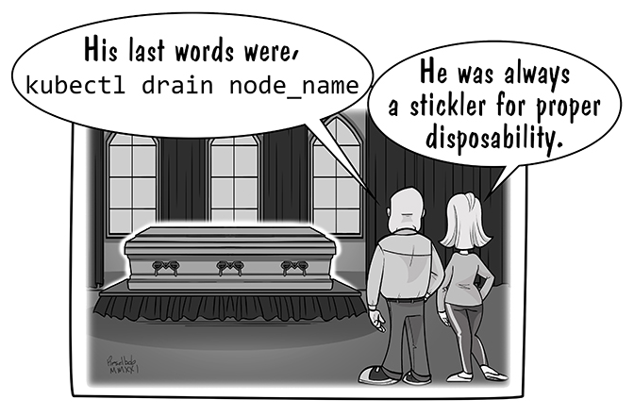
Maximize robustness with fast startup and graceful shutdown
Notes:
Maximize robustness with fast startup and graceful shutdown
Genuinely responsive elastic scaling requires that you can spin up instances quickly and kill them off without much ceremony.
You will need to take the time to ensure that applications shut down gracefully. Once they receive a command to close… e.g. a SIGTERM signal from a process manager, they should stop accepting new requests and return any unprocessed items back to wherever they came from. In other words, 12 factor applications do not “drain stop.” They punt.
In .Net Core you can use a HostApplicationLifetime instance to implement a graceful shutdown by hooking into events such as ApplicationStopping and ApplicationStopped. Note that these will not necessarily fire in a debug environment, but they will fire when being managed by an orchestrator. You can also use CancellationToken in your processing to check that a shutdown has not been signaled before doing any work.
Consideration should also be given to “sudden death” scenarios where there’s no opportunity for graceful shutdown. This is more to do with the way workloads are organized, such as using transactional messaging that will return messages to a queue if they are not explicitly terminated.

Slide 41
X. Dev / prod parity
Keep development, staging, and production as similar as is reasonable

Slide 42
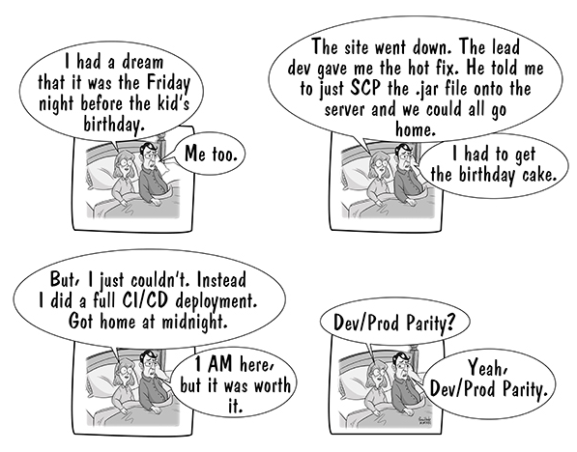
Keep development, staging, and production as similar as possible
Notes:
Keep development, staging, and production as similar as possible
There are several different ways in which environments diverge. Code can get stuck in “testing hell” so the version in test environments starts to diverge from production. It can be difficult to keep tools and frameworks in sync. There’s also sometimes a difference in personnel between each environment which can give rise to subtle differences in configuration.
Twelve factor applications help to reduce this divergence by producing stateless, self-contained applications that depend less on external frameworks. Containerization can help further by creating more certainty over run-time environments. Ultimately, you need to ensure that environments have a similar topology and only really vary in size.

Slide 43
XI. Logs
Treat logs as event streams

Slide 44
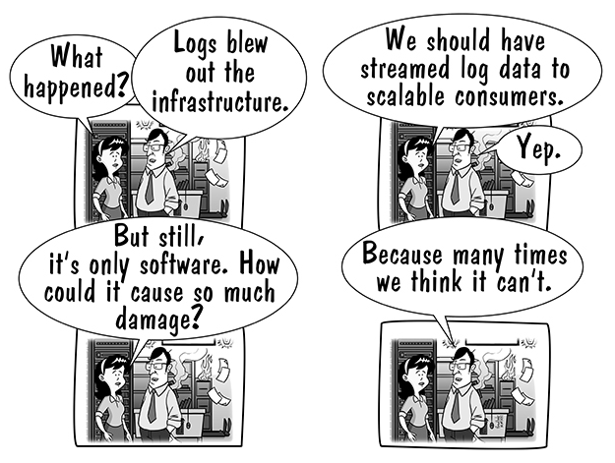
Treat logs as event streams
Notes:
Treat logs as event streams
A twelve-factor application should treat logs as a time-ordered sequence of events and shouldn’t worry about how they are routed or stored. Log entries should be written directly to stdout or stderror. The aggregation, storage, and processing of these entries is a separate concern that should be taken care of by the environment. This approach tends to be associated with tools such as the ELK stack or Splunk that capture and process log streams.
This can be difficult for application developers who are used to being able to configure the shape and destination of log files, including rotation and rollover practices. This decoupling gives you more freedom to change the way logs are processed without having to make corresponding changes in application implementations. It also helps with elastic scalability, as manual log aggregation can quickly become a real pain when you scale up to dozens of instances.
Many implementations of .Net Core logging abstraction involve more explicit routing to a log store. For example, libraries such as Serilog have implementations that explicitly route output to Azure’s AppInsights. This is not in keeping with a twelve-factor application as it couples services more explicitly to an external service.
The .Net Core logging extensions support this abstraction by providing a standard interface for writing log statements and a hierarchy of providers that can route these statements to the console output stream.

Slide 45
XII. Admin processes
Run admin / management tasks as one-off processes

Slide 46
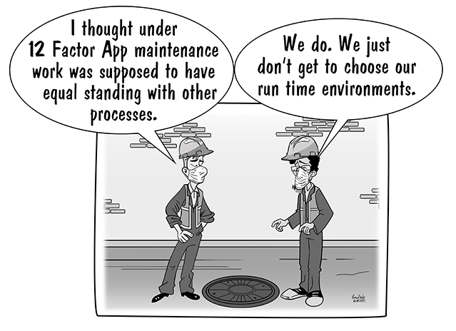
Run admin / management tasks as one-off processes
Notes:
Run admin / management tasks as one-off processes
This refers to upgrades or one-off configuration tasks and it implies they should be bundled with a release. A good example is using schema migrations to make changes to a target database. One thing that is missing from .Net Core in this respect is a REPL shell that allows you to run arbitrary code, such as the rails console command or irb in Ruby. We must work around this with shell scripts or applications that run as one-time executable processes rather than long-lived applications. Another option is to have applications run their own necessary changes on startup, though for security reasons I don’t recommend this. Applications generally should not be allowed to alter database schema, for example. Only data.

Slide 47
Basics of Microservices
Wherein I tell you the least know need to know about a very complex topic…

Slide 48
Microservices as a Strategic Design Pattern
Problem Set
Delivery contention
Technology lock-in
Scaling challenges
Organizational misalignment
Notes:
Delivery Contention - When multiple teams need to coordinate changes to deploy functionality, causing bottlenecks and delays
Technology Lock-in - Being forced to use a single technology stack across an entire system, limiting optimization opportunities
Scaling Challenges - Difficulty in scaling specific parts of a system independently based on actual load patterns
Organizational Misalignment - System architecture that doesn't match team boundaries, creating communication overhead

Slide 49
Microservices as a Strategic Design Pattern
Definition
Microservices are independently releasable services that are modeled around a business domain. A service encapsulates functionality and makes it accessible to other services via networks.

Slide 50
Microservices as a Strategic Design Pattern
Solution Set
Cross-functional teams
Independent deployability
Loose coupling
Stable interfaces
Independent evolution
Notes:
By embracing independent deployability as the core principle, microservices enable teams to make changes, deploy, and release functionality without requiring coordination with other services. This architectural approach naturally leads to loosely coupled services with stable interfaces, allowing organizations to scale teams, technology choices, and system components independently.

Slide 51
Key Characteristics of Microservices
Independently deployable
Modeled around a business domain
Own their own state
Clear, stable boundaries
Technology agnostic
Embrace information hiding
Notes:
The Essential Characteristics
Independently Deployable
Can be changed, deployed, and released without requiring other microservices to change
The fundamental characteristic from which other benefits flow
Modeled Around a Business Domain
Services represent real-world business capabilities
Prioritizes high cohesion of business functionality over technical functionality
Own Their Own State
Each microservice encapsulates its own database where required
Avoids shared databases to maintain clear boundaries
Clear, Stable Boundaries
Explicit, well-defined contracts between services
Internal implementation hidden from external consumers
Technology Agnostic
Services communicate via network protocols
Implementation details (language, data storage) are entirely hidden
Embrace Information Hiding
Hide as much information as possible inside a component
Expose as little as possible via external interfaces

Slide 52
Microservices Misnomered
Right-sizing services: Beyond the name
The reality
Key principles
One or more executable processes
Notes:
Right-Sizing Services: Beyond the Name
The term "microservice" can be misleading. The prefix "micro" suggests services should be as small as possible, but this interpretation misses the point entirely.
The Reality:
A microservice should be as small as possible, but still as large as necessary
Size is determined by business capability boundaries, not lines of code
Services must be large enough to:
Represent a complete business capability
Maintain data consistency within their boundaries
Provide a stable, meaningful interface to consumers
Key Principle: The focus should be on independent deployability and business alignment, not arbitrary size constraints. Some microservices might be relatively large if they encapsulate a complex business domain, while others might be quite small if they handle a focused capability. The "micro" refers more to the scope of business responsibility than to physical size metrics.
A microservice can be composed of more than one runnable process. Remember, the public interface is through clear and stable APIs over networks. The internals are hidden from and irrelevant to the outside world.

Slide 53
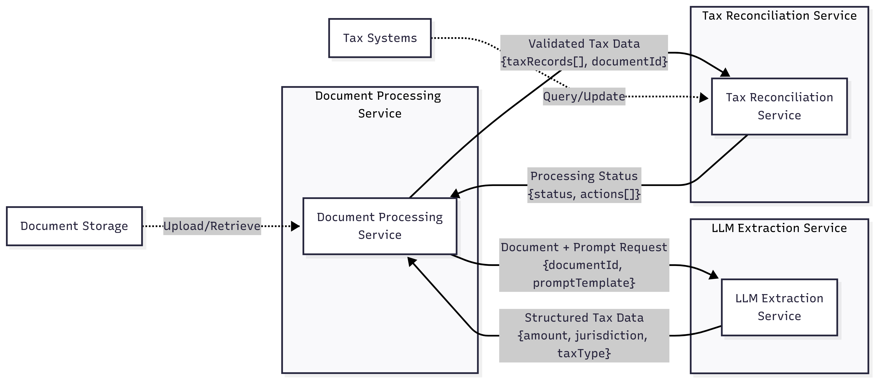
Microservices Example: Tax Bills
Notes:
This diagram illustrates how a tax information extraction system can be decomposed into focused microservices, each with clear boundaries and responsibilities:
Document Processing Service
Orchestrates the overall tax extraction workflow
Gathers documents from storage systems
Constructs and iterates on prompts based on extraction results
Manages document state and processing status
Has no knowledge of LLM internals or tax system specifics
LLM Extraction Service
Purely focused on the interaction with the language model
Accepts a prompt and document as input
Returns structured or semi-structured data as output
Completely agnostic to the tax domain - could be reused for any extraction task
Encapsulates model selection, prompt optimization, and response parsing
Tax Reconciliation Service
Domain-specific service that understands tax rules and systems
Validates extracted data against business rules
Interfaces with existing tax systems
Marks results for human review or automated processing
Contains all tax-specific business logic
Each service maintains clear contracts through well-defined APIs, allowing them to evolve independently. The LLM service, being domain-agnostic, could be reused across multiple extraction use cases, while the tax-specific logic remains isolated in the reconciliation service. This separation enables teams to work independently, scale services based on load, and update components without affecting the entire system.

Slide 54
Cloud Patterns and Practices Summary Table
Wherein I encourage you to click here… (If I were a joker that link would go to the Acrobat Reader installation page)

Slide 55
Patterns and Practices for Immediate Adoption
Wherein I pontificate on what you should do right now…

Slide 56
Immediate Adoption: Monitoring
Practices
Patterns
Observability and monitoring
Golden Signal Monitoring
Distributed Tracing Correlation
Centralized Logging
Notes:
Golden Signal Monitoring Pattern
Description: Focuses on four key metrics: latency, traffic, errors, and saturation rather than monitoring everything.
Why Immediate Adoption: Critical for establishing baseline visibility before production deployment. Reduces false alerts by 80% while ensuring critical issues are detected. Essential foundation for all cloud workloads.
Distributed Tracing Correlation Pattern
Description: Tracks requests across service boundaries with trace headers and service maps.
Why Immediate Adoption: With 600+ workloads, understanding service dependencies and troubleshooting distributed systems is critical from day one. Enables 90% faster problem resolution.
Centralized Logging Pattern
Description: Aggregates logs from all services into centralized location for analysis.
Why Immediate Adoption: CloudWatch Logs with minimal configuration. Essential for troubleshooting and can be implemented incrementally.

Slide 57
Immediate Adoption: Security
Practices
Patterns
Secrets Management
Zero Trust Architecture
Secrets Rotation
Zero Trust Security
Vault Key
Continuous Security Scanning
Notes:
Secrets Management Description: Centralized management of secrets using HashiCorp Vault or cloud-native solutions with automated rotation. Why Immediate Adoption: Hardcoded secrets are the #1 security vulnerability. Implementing proper secrets management prevents 95% of credential-related breaches.
Zero Trust Architecture Implementation Description: Comprehensive zero trust implementation including identity verification, microsegmentation, and continuous monitoring. Why Immediate Adoption: Cloud environments have no traditional perimeter. Zero trust is mandatory for protecting distributed workloads.
Secrets Rotation Pattern Description: Automatically rotates, manages, and distributes secrets throughout their lifecycle. Why Immediate Adoption: Static credentials pose immediate security risks. Must be implemented before production to avoid compliance issues and security breaches.
Pattern: Zero Trust Security Pattern Description: Requires verification of every access request regardless of location, implementing continuous authentication and least-privilege access. Why Immediate Adoption: Traditional perimeter security fails in cloud environments. Essential foundation for secure cloud operations from the start.
Pattern: Vault Key Pattern Description: Centralized secure storage and management of cryptographic keys and secrets. Why Immediate Adoption: Prevents embedding credentials in code/configs from the beginning, avoiding costly remediation later.
Pattern: Continuous Security Scanning Pattern Description: Automated vulnerability assessment using Amazon Inspector. Why Immediate Adoption: Enable Inspector on existing EC2 instances with minimal configuration. Immediate security visibility.

Slide 58
Immediate Adoption: DevSecOps
Practices
Patterns
Blue/Green Deployment Operations
CI/CD Pipeline Implementation
Blue/Green Deployment
Automated Rollback
Pipeline as Code
Notes:
Practice: Blue/Green Deployment Operations Description: Operational procedures and automation for managing blue/green deployments at scale. Why Immediate Adoption: Without proper deployment practices, migration failures can cause extended outages affecting business operations.
Practice: CI/CD Pipeline Implementation Description: Fully automated build, test, and deployment pipelines with integrated security scanning and approval workflows. Why Immediate Adoption: Manual deployments don't scale. CI/CD is foundational for managing 600+ workloads efficiently.
Pattern: Blue/Green Deployment Pattern Description: Two identical environments with traffic switching for zero-downtime deployments. Why Immediate Adoption: Enables safe production deployments with instant rollback capabilities. Critical for maintaining service availability during initial cloud migrations.
Pattern: Automated Rollback Pattern Description: Monitors deployment health metrics and automatically reverts to previous versions when failures are detected. Why Immediate Adoption: Minimizes downtime and manual intervention during critical migration phase. Essential safety net for early cloud deployments.
Pattern: Pipeline as Code Pattern Description: Version-controlled pipeline configurations stored alongside application code. Why Immediate Adoption: Establishes consistent, reproducible deployment processes from the start. Prevents configuration drift and enables peer review of deployment logic.

Slide 59
Immediate Adoption: Data Management
Practices
Patterns
Data Governance
Transaction
Eventual Consistency
Event Sourcing
Notes:
Practice: Data Governance in Cloud Description: Comprehensive data governance framework including classification, access controls, and compliance monitoring. Why Immediate Adoption: Regulatory compliance and data security requirements must be met from day one. Retrofitting governance is extremely difficult.
Pattern: Transaction Pattern Description: Ensures ACID properties for critical data operations in distributed systems. Why Immediate Adoption: Data integrity is non-negotiable. Must be implemented correctly from the start to avoid data corruption or loss.
Pattern: Event Sourcing Pattern Description: Stores all changes as immutable events, enabling audit trails and state recreation. Why Immediate Adoption: Provides complete audit trail and disaster recovery capabilities. Much harder to retrofit after systems are in production.

Slide 60
Patterns and Practices for Early Adoption
Wherein I pontificate on what you should do sooner rather than later…

Slide 61
Early Adoption: Cost Optimization
Practices
Patterns
FinOps Principles
Tagging Strategy
None
Notes:
Practice: FinOps Principles Implementation Description: Cross-functional approach to cloud financial management with visibility, optimization, and accountability. Why Early Adoption: Organizations waste 28% of cloud spend on average. Early FinOps adoption prevents runaway costs during migration.
Practice: Tagging Strategy Description: Comprehensive tagging taxonomy with automated enforcement for cost allocation and management. Why Early Adoption: Without tags, 60-80% of costs are unallocated. Essential for chargeback and optimization.

Slide 62
Early Adoption: Networking
Practices
Patterns
Service Mesh Implementation
Hub-and-Spoke Network
Service Mesh Pattern
Multi-Tier VPC Segmentation
Notes:
Practice: Service Mesh Implementation Description: Operational procedures for deploying and managing service mesh infrastructure (Istio, Linkerd). Why Early Adoption: Service mesh simplifies microservices networking, security, and observability. Earlier adoption means less retrofit work.
Pattern: Hub-and-Spoke Network Pattern Description: Centralizes connectivity through Transit Gateway, reducing costs by 50% compared to mesh architectures. Why Early Adoption: Network architecture is foundational. Early implementation avoids costly network redesigns later.
Pattern: Service Mesh Pattern Description: Provides interservice communication infrastructure with built-in reliability, security, and observability. Why Early Adoption: Complex to implement but provides critical capabilities. Best adopted early for new microservices architectures.
Pattern: Multi-Tier VPC Segmentation Pattern Description: Organizes resources into functional subnet tiers for defense in depth. Why Early Adoption: Fundamental security architecture that's difficult to change later. Required for compliance and security best practices.

Slide 63
Early Adoption: Storage
Practices
Patterns
Data Quality Management
Data Lake
Intelligent Data Tiering
Notes:
Practice: Data Quality Management Description: Automated data quality monitoring, validation, and remediation processes. Why Early Adoption: Poor data quality undermines all analytics initiatives. Early implementation prevents compounding quality issues.
Pattern: Data Lake Pattern Description: Centralized repository for structured and unstructured data at any scale. Why Early Adoption: Establishes foundation for analytics and breaks down data silos. Architecture decisions impact all future data workloads.
Pattern: Intelligent Data Tiering Pattern Description: Automatic data movement between storage tiers based on access patterns. Why Early Adoption: Immediate cost savings for existing data. S3 Intelligent-Tiering can reduce storage costs automatically without application changes.

Slide 64
Early Adoption: Disaster Recovery
Practices
Patterns
Disaster Recovery Operations
Pilot Light
Cross-Region Data Replication
Notes:
Practice: Disaster Recovery Operations Description: Documented procedures, regular drills, and automated failover processes. Why Early Adoption: DR capabilities must be proven before production workloads depend on them. Testing takes time to perfect.
Pattern: Pilot Light Pattern Description: Maintains minimal critical infrastructure in DR region for rapid activation. Why Early Adoption: Cost-effective DR (60-80% savings) that should be established before production. Provides peace of mind during migration.
Pattern: Cross-Region Data Replication Pattern Description: Automatic data replication across AWS regions for DR and compliance. Why Early Adoption: Critical for business continuity. Must be designed into architecture early rather than bolted on later.

Slide 65
Patterns and Practices: Low-Hanging Fruit
Wherein I pontificate on what might be relatively easy…

Slide 66
LHF: Teams
Practices
Patterns
Cross-Functional Teams
Agile Development (pre-monetization)
None (But avoid anti-patterns)
Notes:
Practice: Cross-Functional Teams Description: Breaking down silos between development, operations, and business teams. Why Low-Hanging Fruit: Organizational change that doesn't require technology investment. Immediate collaboration improvements.
Practice: Agile Development Description: Iterative development with regular feedback cycles. Why Low-Hanging Fruit: Process improvement that can start immediately. Faster value delivery without infrastructure changes.

Slide 67
LHF: DevSecOps
Practices
Patterns
Canary Release Operations
Test-Driven Development
Canary Deployment
Feature Flag
Static Content Hosting
Notes:
Practice: Canary Release Operations Description: Procedures for monitoring canary deployments and making promotion/rollback decisions. Why Low-Hanging Fruit: Builds on existing deployment infrastructure. Quick wins in deployment safety.
Practice: Test-Driven Development Description: Writing tests before code to ensure quality and maintainability. Why Low-Hanging Fruit: Can be adopted team by team without infrastructure changes. Immediate quality improvements.
Pattern: Canary Deployment Pattern Description: Gradual rollout starting with small traffic percentage to minimize risk. Why Low-Hanging Fruit: Easy to implement with ALB weighted routing or CodeDeploy. Immediate risk reduction with minimal effort.
Pattern: Feature Flag Pattern Description: Runtime toggles to enable/disable features without deployment. Why Low-Hanging Fruit: Simple to implement with AWS AppConfig. Enables safer deployments and A/B testing immediately.
Pattern: Static Content Hosting Pattern Description: Serves static assets from S3/CloudFront instead of application servers. Why Low-Hanging Fruit: Simple to implement, immediate performance improvement and cost reduction. Can be applied to existing workloads easily.

Slide 68
LHF: Performance Optimization
Practices
Patterns
Performance Testing
Scalability Testing
Reliability Testing (groups logically)
Caching Pattern
CDN Integration
Notes:
Practice: Performance Testing Description: Comprehensive performance testing integrated into CI/CD pipelines. Why Low-Hanging Fruit: Can use existing tools and infrastructure. Prevents performance surprises in production.
Pattern: Caching Pattern Description: Stores frequently accessed data in memory for faster retrieval. Why Low-Hanging Fruit: Easy to implement with ElastiCache or CloudFront. Immediate performance improvements with minimal application changes.
Pattern: CDN Integration Pattern (Origin Failover) Description: CloudFront with automatic failover between primary and secondary origins. Why Low-Hanging Fruit: Simple configuration change that provides high availability. No application modifications required.

Slide 69
Patterns and Practices: Maturity Phase 1: Optimization
Wherein I describe things I think you should already be thinking about…

Slide 70
Maturity 1: Teams
Practices
Patterns
Blameless Postmortems
On-Call Rotations
None
Notes:
Practice: Blameless Postmortems Description: Learning from incidents without blame to improve systems and processes. Why Maturity Phase 1: Requires cultural maturity and psychological safety. Builds on established incident response processes.
Practice: On-Call Rotations Description: Sustainable 24/7 coverage with "you build it, you run it" principles. Why Maturity Phase 1: Requires mature operational practices and adequate team size. Implement after stabilizing workloads.

Slide 71
Maturity 1: Advanced Networking
Practices
Patterns
None
AWS Cloud WAN *
PrivateLink Secure Access *
Notes:
Pattern: AWS Cloud WAN Pattern Description: Policy-driven software-defined global networking. Why Maturity Phase 1: Requires mature network architecture and understanding of traffic patterns. Best implemented after initial migration.
Pattern: PrivateLink Service Access Pattern Description: Private connectivity to services without internet exposure. Why Maturity Phase 1: Enhances security but requires service architecture maturity. Implement after core services are stable.

Slide 72
Maturity 1: Advanced Storage
Practices
Patterns
Data Lineage Tracking
Multi-Tier Backup and Recovery
Automated Lifecycle Management
Notes:
Practice: Data Lineage Tracking Description: Automated tracking of data transformations and dependencies. Why Maturity Phase 1: Complex to implement but critical for data governance. Best done after data architecture stabilizes.
Pattern: Multi-Tier Backup and Recovery Pattern Description: Tiered backup strategies based on RTO/RPO requirements. Why Maturity Phase 1: Requires understanding of data criticality and recovery requirements. Optimize after workloads are stable.
Pattern: Automated Lifecycle Management Pattern Description: Policy-driven data transitions between storage classes. Why Maturity Phase 1: Requires understanding of data access patterns. Implement after data usage patterns are established.

Slide 73
Maturity 1: Containers
Practices
Patterns
Container Security *
Kubernetes Operator
Service Mesh Sidecar
Notes:
Practice: Container Security Description: Comprehensive container security including scanning, runtime protection, and policy enforcement. Why Maturity Phase 1: Builds on basic container adoption. Advanced security practices require mature container operations.
Pattern: Operator Pattern Description: Encodes operational knowledge into Kubernetes extensions. Why Maturity Phase 1: Requires Kubernetes expertise and stable container platform. Reduces operational overhead by 70% for stateful apps.
Pattern: Service Mesh Sidecar Pattern Description: Proxy containers for advanced traffic management and security. Why Maturity Phase 1: Complex pattern requiring mature microservices architecture. Implement after basic containerization is stable.

Slide 74
Patterns and Practices: Maturity Phase 2: Advanced Optimization
Wherein I encourage you to consider the juice before you squeeze…

Slide 75
Maturity 2: Cost Optimization
Practices
Patterns
None
Spot Instance
Reserved Instance Ladder
Notes:
Pattern: Spot Instance Pattern Description: Leverages spare compute capacity at up to 90% discount for fault-tolerant workloads. Why Early Adoption: Significant cost savings (70-90%) but requires identifying suitable workloads. Best implemented early to maximize savings during migration.
Pattern: Reserved Instance Ladder Pattern Description: Phased approach to purchasing commitments, starting with 30-50% coverage for stable workloads. Why Early Adoption: Requires understanding of workload patterns. Early adoption enables cost optimization as workloads stabilize.

Slide 76
Maturity 2: Multi-Tenancy
Practices
Patterns
Multi-Tenant Operations
Tenant-Aware Auto Scaling
Database-per-Service Multi-Tenancy
Notes:
Practice: Multi-Tenant Operations Description: Operational procedures for managing multi-tenant environments including isolation, monitoring, and incident response. Why Maturity Phase 2: Complex operational model requiring mature processes and tooling.
Pattern: Tenant-Aware Auto Scaling Pattern Description: Custom scaling based on tenant-specific metrics and SLAs. Why Maturity Phase 2: Requires sophisticated monitoring and deep understanding of tenant patterns. For mature SaaS applications.
Pattern: Database-per-Service Multi-Tenancy Pattern Description: Hybrid approach with dedicated databases per service per tenant. Why Maturity Phase 2: Complex architecture requiring careful design. Implement when scaling multi-tenant systems.

Slide 77
Maturity 2: DevSecOps
Practices
Patterns
Infrastructure as Code Maturity
GitOps
Multi-Environment Promotion
Notes:
Practice: Infrastructure as Code Maturity Description: Advanced IaC practices including testing, modularization, and policy as code. Why Maturity Phase 2: Builds on basic IaC adoption. Advanced practices require tooling and process maturity.
Pattern: GitOps Pattern Description: Git as single source of truth with automated reconciliation. Why Maturity Phase 2: Requires mature CI/CD processes and Git workflows. Powerful but needs organizational readiness.
Pattern: Multi-Environment Promotion Pattern Description: Automated promotion through multiple environments with approval gates. Why Maturity Phase 2: Requires mature DevOps processes and multiple account setup. Implement after basic CI/CD is working.

Slide 78
Maturity 2: Edge Computing
Practices
Patterns
Edge Operations
Edge Discovery
Hybrid Edge-Cloud
Notes:
Practice: Edge Operations Description: Managing distributed edge infrastructure including deployment, monitoring, and updates. Why Maturity Phase 2: Requires mature operational capabilities and geographic distribution.
Pattern: Edge Discovery Pattern Description: Dynamic routing to optimal edge locations for ultra-low latency. Why Maturity Phase 2: Relevant for specific use cases requiring <10ms latency. Implement when expanding to edge locations.
Pattern: Hybrid Edge-Cloud Pattern Description: Process latency-sensitive operations at edge while leveraging cloud for compute-intensive tasks. Why Maturity Phase 2: Complex architecture spanning edge and cloud. For advanced use cases with strict latency requirements.

Slide 79
Maturity 2: Architecture
Practices
Patterns
Domain-Driven Design
Event-Driven Architecture
None
Notes:
Practice: Domain-Driven Design Description: Aligning software design with business domains using bounded contexts and ubiquitous language. Why Maturity Phase 2: Requires deep business understanding and architectural maturity. Best for complex domain modeling.
Practice: Event-Driven Architecture Description: Loosely coupled systems communicating through events for scalability and resilience. Why Maturity Phase 2: Complex architectural pattern requiring mature messaging infrastructure and eventual consistency handling.

Slide 80
Patterns and Practices: Maturity Phase 3: Innovation
Wherein I talk about breaking trail…

Slide 81
Maturity 3: Advanced Disaster Recovery
Practices
Patterns
Chaos Engineering
Multi-Site Active/Active
Warm Standby
Notes:
Practice: Chaos Engineering Description: Proactively testing system resilience through controlled experiments. Why Maturity Phase 3: Requires mature systems and strong operational practices. Advanced technique for improving reliability.
Pattern: Multi-Site Active/Active Pattern Description: Full production workloads across multiple regions simultaneously. Why Maturity Phase 3: Most complex and expensive DR pattern. Requires sophisticated data consistency strategies.
Pattern: Warm Standby Pattern Description: Scaled-down but fully functional environments in secondary regions. Why Maturity Phase 3: More expensive than Pilot Light. Implement for critical workloads after cost optimization.

Slide 82
Maturity 3: Advanced Security
Practices
Patterns
Compliance-as-Code Operations
Security Scanning in CI/CD
Compliance-as-Code
Attribute-Based Access Control
Notes:
Practice: Compliance as Code Operations Description: Continuous compliance monitoring and automated remediation workflows. Why Maturity Phase 3: Builds on established security practices. Requires sophisticated automation and
Practice: Security Scanning in CI/CD Description: Comprehensive security scanning including SAST, DAST, SCA, and container scanning. Why Maturity Phase 3: Requires mature CI/CD pipelines and security tooling integration.
Pattern: Compliance-as-Code Pattern Description: Automated compliance validation with AWS Config Rules and remediation. Why Maturity Phase 3: Requires mature security posture and understanding of compliance requirements.
governance.
Pattern: Attribute-Based Access Control Pattern Description: Dynamic authorization using user attributes and resource tags. Why Maturity Phase 3: Complex to implement but reduces IAM role proliferation by 90%. For mature organizations.

Slide 83
Maturity 3: Infrastructure as Code
Practices
Patterns
None
Module Composition
Dependency Inversion
Notes:
Pattern: Module Composition Pattern Description: Complex infrastructure from reusable components. Why Maturity Phase 3: Requires mature IaC practices and module library. Enables 70% faster deployments.
Pattern: Dependency Inversion Pattern Description: Infrastructure modules accept dependencies as inputs for flexibility. Why Maturity Phase 3: Advanced pattern requiring sophisticated IaC design. Enables 5x more module reuse.

Slide 84
Maturity 3: Stream Processing
Practices
Patterns
Realtime Analytics
Machine Learner
Notes:
Practice: Real-time Analytics Description: Streaming analytics infrastructure for immediate insights and actions. Why Maturity Phase 3: Complex infrastructure requiring mature data engineering capabilities.
Pattern: Machine Learner Pattern Description: Real-time ML model training and inference on streaming data. Why Maturity Phase 3: Requires mature data pipeline and ML capabilities. For advanced analytics use cases.
Pattern: Watermark Pattern Description: Synchronizes events across multiple out-of-sync streams. Why Maturity Phase 3: Complex pattern for sophisticated stream processing. Implement after basic streaming is working.

Slide 85
Maturity 3: Advanced Documentation
Practices
Patterns
Architecture Decision Records
Knowledge Management System
None
Notes:
Practice: Architecture Decision Records Description: Documenting architectural decisions with context, alternatives, and rationale. Why Maturity Phase 3: Requires architectural maturity and disciplined documentation culture.
Practice: Knowledge Management Systems Description: Comprehensive knowledge capture, organization, and sharing platforms. Why Maturity Phase 3: Requires cultural adoption and significant content investment.

Slide 86
Anti-Patterns to Avoid
Wherein I tell you what not to do…

Slide 87
Anti-Patterns
Lift and Shift *
Chatty Interface
Lowest Common Denominator
Notes:
Pattern: Lift and Shift Anti-pattern Description: Migrating applications without architectural changes. Why Avoid: Fails to realize cloud benefits. Proper refactoring reduces costs by 40-60%.
Pattern: Chatty Interface Anti-pattern Description: Excessive API calls causing performance and cost issues. Why Avoid: Batch operations and caching reduce API costs by 70%.
Pattern: Lowest Common Denominator Anti-pattern Description: Over-engineering for portability, sacrificing platform advantages. Why Avoid: Strategic use of managed services provides 3x better ROI.

Slide 88
References
Wherein I list my cheat codes…

Slide 89
The Twelve-Factor App
Contributed by the builders of the Heroku SaaS platform.
https://12factor.net/

Slide 90
Sam Newman: Building Microservices
O’Reilly Publishing

Slide 91
Kasun Indrasiri et al: Design Patterns for Cloud Native Applications
O’Reilly Publishing

