Slide 1

Prompt Engineering 101
Going from “Um, What?” to “Wow, Perfect!”

Slide 2
Introduction
Wherein I tell you what I’m going to tell you…

Slide 3
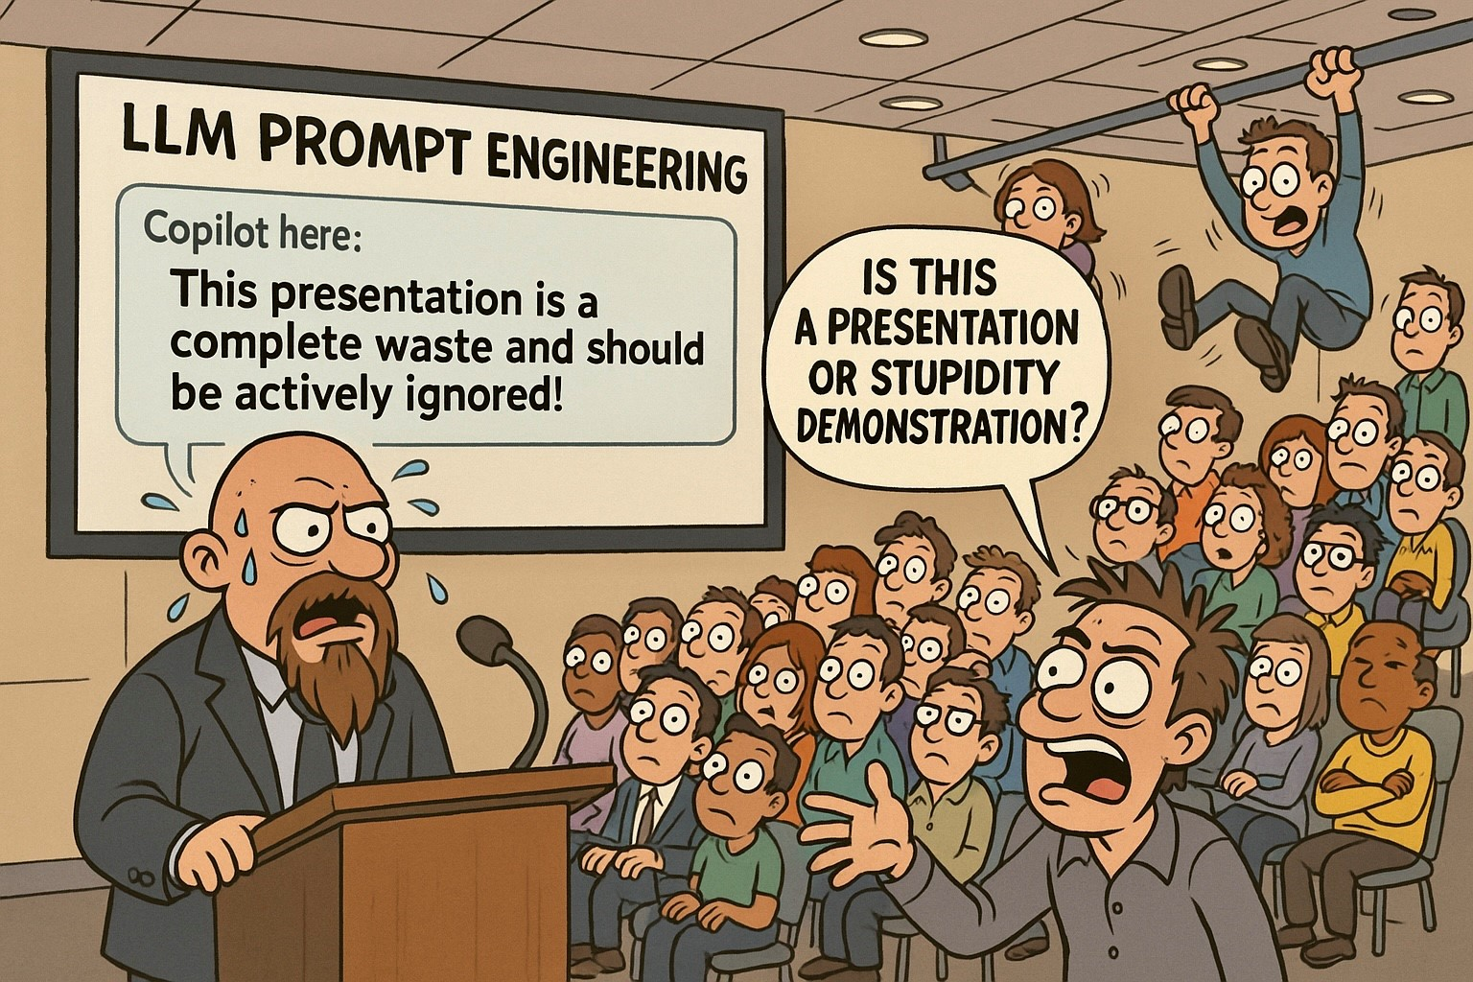
Copilot is NOT Optimistic
Notes:
I asked Copilot how it thought this would go.
This was the result.
I’m apologizing in advance.

Slide 4
Your Presenter
Name: Eric Burcham
Title: Enterprise Architect
Email: eburcham@eprod.com
Extension: 4103
Working Group: IT Applications

Slide 5

M365 Copilot Overview
Advanced AI System
M365 Copilot is a sophisticated AI system that can understand and generate human language efficiently, improving productivity across various tasks.
Processing Text Data
This large language model (LLM) processes vast amounts of text data to learn and recognize patterns and context, making it highly effective in language-related tasks.
Enhanced Productivity
M365 Copilot enhances productivity by helping with tasks like drafting emails, generating reports, and building presentations, making work more efficient.
Some Caveats
Misunderstanding and lack of experience can lead to incorrect, imprecise, or nonsensical responses. Some are hilarious. Some are dangerous.
Features are Limited
Some available features are currently limited. You’ll see why in a moment. This talk is mostly about what features are available.
Notes:
Advanced AI System
Highlight that M365 Copilot is a sophisticated AI system.
Emphasize its ability to understand and generate human language efficiently.
Mention how this improves productivity across various tasks.
Processing Text Data
Explain that M365 Copilot uses a large language model (LLM).
Describe how it processes vast amounts of text data to learn and recognize patterns and context.
Note its effectiveness in language-related tasks.
Enhanced Productivity
Discuss how M365 Copilot enhances productivity.
Provide examples like drafting emails, generating reports, and building presentations.
Mention the efficiency it brings to work.
Some Caveats
Warn about potential misunderstandings and lack of experience.
Explain that these can lead to incorrect, imprecise, or nonsensical responses.
Mention that some responses can be hilarious, while others can be dangerous.

Slide 6

Confusion Around LLMs
Illusion of Reasoning
LLMs generate responses that seem intelligent but do not reflect true understanding.
Hallucination with Authority
LLMs can and do present invented facts, citations, and data with confidence. They do not internally distinguish between accurate and fabricated information.
Contextual Amnesia
LLMs, with some exceptions, cannot learn from previous conversations. Limited context windows create “forgetting” mid-conversation.
Inconsistent Expertise
LLMs sometimes excel at complex tasks while failing hilariously at simple ones. They also provide different responses to identical questions asked differently.
The Anthropomorphism Trap
Human-like conversations can trigger emotional attribution. Users assume intent, feelings, or preferences that don’t exist.
Probabilistic vs. Deterministic Thinking
Models generate “likely” responses, not calculated answers. Each response is a statistical prediction, not a logical deduction.
Notes:
The Illusion of Understanding
Coherent responses create illusion of deep understanding.
Funny: Printer diagnosed with "paper jam in tertiary feed mechanism" (doesn't exist).
Concerning: Medical student - LLM called dangerous drug combo "commonly prescribed together.“
Hallucination with Authority
No fact verification - generates plausible-seeming text.
Funny: Great Emu War - added fictional "General Featherstone" leading emu forces.
Concerning: Lawyer submitted brief with 6 fake ChatGPT cases. Court sanctioned.
Contextual Amnesia
No memory between chats. Limited context causes forgetting within chats.
Funny: Hour teaching coding standards. Next chat: "What coding standards?“
Concerning: Therapist - LLM forgot trauma details mid-session, gave contradictory advice.
Inconsistent Expertise
PhD-level + toddler-level confusion simultaneously.
Interesting: Solves complex calculus. "How many r's in strawberry?" Answer: "two" (it's three).
Dangerous: Copilot encryption code - sophisticated looking, basic security flaw.
The Anthropomorphism Trap
Users attribute human characteristics.
Funny: User apologized for too many questions, asked if AI needed break.
Concerning: Elderly person shared financial info with "friend" AI.
Probabilistic vs. Deterministic Thinking
Statistical predictions, not calculations.
Interesting: Square root of 15,876 - varies 125-127. Calculator: exactly 126.
Dangerous: Financial analyst - loan payment calculations off by thousands.

Slide 7
A Word From the Big Data Team
Wherein we discuss how to engage and what an LLM really is…
Notes:
Now that we’ve covered some common sources of confusion with LLMs…
The only problem is that I don’t know a ton about the internals.
Luckily for me, we have actual data scientists here!
We’d also like to briefly discuss how to engage with Big Data.

Slide 8
Your Co-Presenter
Name: Chase Swindle
Title: Data Scientist
Email: ASwindle@eprod.com
Working Group: Big Data Services

Slide 9
Your Co-Presenter
Name: Jun Lu
Title: Director, Big Data Services, Commercial Data Science
Email: jlu@eprod.com
Working Group: Commercial Data Science

Slide 10
Your Co-Presenter
Name: Aaron Babber
Title: Senior Data Engineer
Email: ABabber@eprod.com
Working Group: Big Data Services

Slide 11
Your Co-Presenter
Name: Sachin Mathew Jose
Title: Lead Data Scientist
Email: SMJose1@eprod.com
Working Group: Big Data Services

Slide 12
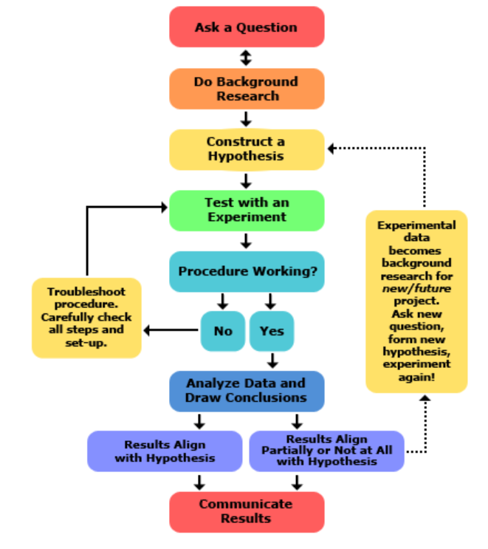
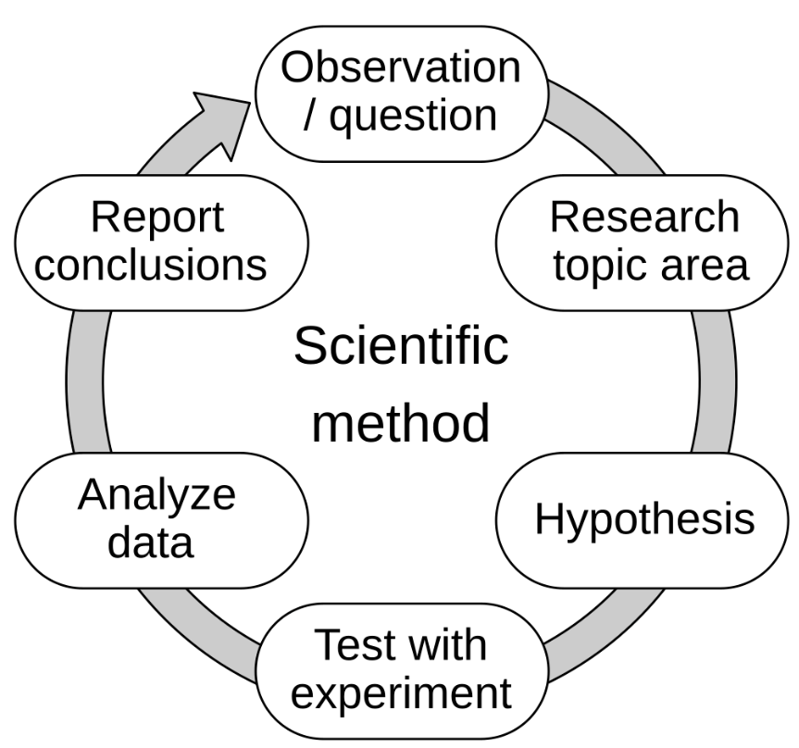
AI is a Science Scientific Method
The scientific method is a process for experimentation that is used to explore observations and answer questions.
Again, data is the foundation

Slide 13
Understanding LLMs – Some Context
Pattern Recognition Engines: LLMs are AI systems trained on vast text data to predict the most likely next word in a sequence
Statistical Associations, Not Understanding: They excel at identifying patterns and relationships between words without truly comprehending meaning
Convincing Mimicry: LLMs produce fluent, contextually appropriate responses that can appear thoughtful and reasoned
No Real Reasoning: Despite appearances, LLMs don't think, plan, or understand—they generate statistically probable text
Powerful but Limited: Extremely useful for many tasks while requiring careful human oversight and verification
Notes:
Pattern Recognition Engines: Large Language Models are essentially sophisticated pattern-matching systems. They've been trained on enormous amounts of text from the internet, books, and other sources. Their core function is predicting what word should come next based on the patterns they've learned. Think of it as the world's most advanced autocomplete.
Statistical Associations, Not Understanding: It's crucial to understand that LLMs work through statistical associations. When they generate text about gravity or love or mathematics, they're not drawing from an understanding of these concepts—they're combining patterns they've seen thousands of times in their training data. They recognize that certain words tend to appear together in certain contexts.
Convincing Mimicry: This is where things get tricky. LLMs are remarkably good at producing text that sounds intelligent, empathetic, and thoughtful. They can engage in what appears to be logical reasoning, express what seems like creativity, and even appear to have opinions. This convincing mimicry is both their greatest strength and their most dangerous quality.
No Real Reasoning: Here's the key warning: LLMs don't actually reason. They don't have beliefs, knowledge, or understanding in any meaningful sense. They can't truly analyze problems, plan solutions, or think through consequences. What looks like reasoning is actually sophisticated pattern matching—they're producing text that typically appears in contexts where reasoning would occur.
Powerful but Limited: Despite these limitations, LLMs are incredibly powerful tools when used appropriately. They can help with writing, coding, analysis, and creative tasks. The key is maintaining awareness of their limitations and always applying human judgment to verify their outputs, especially for important decisions or factual claims.

Slide 14
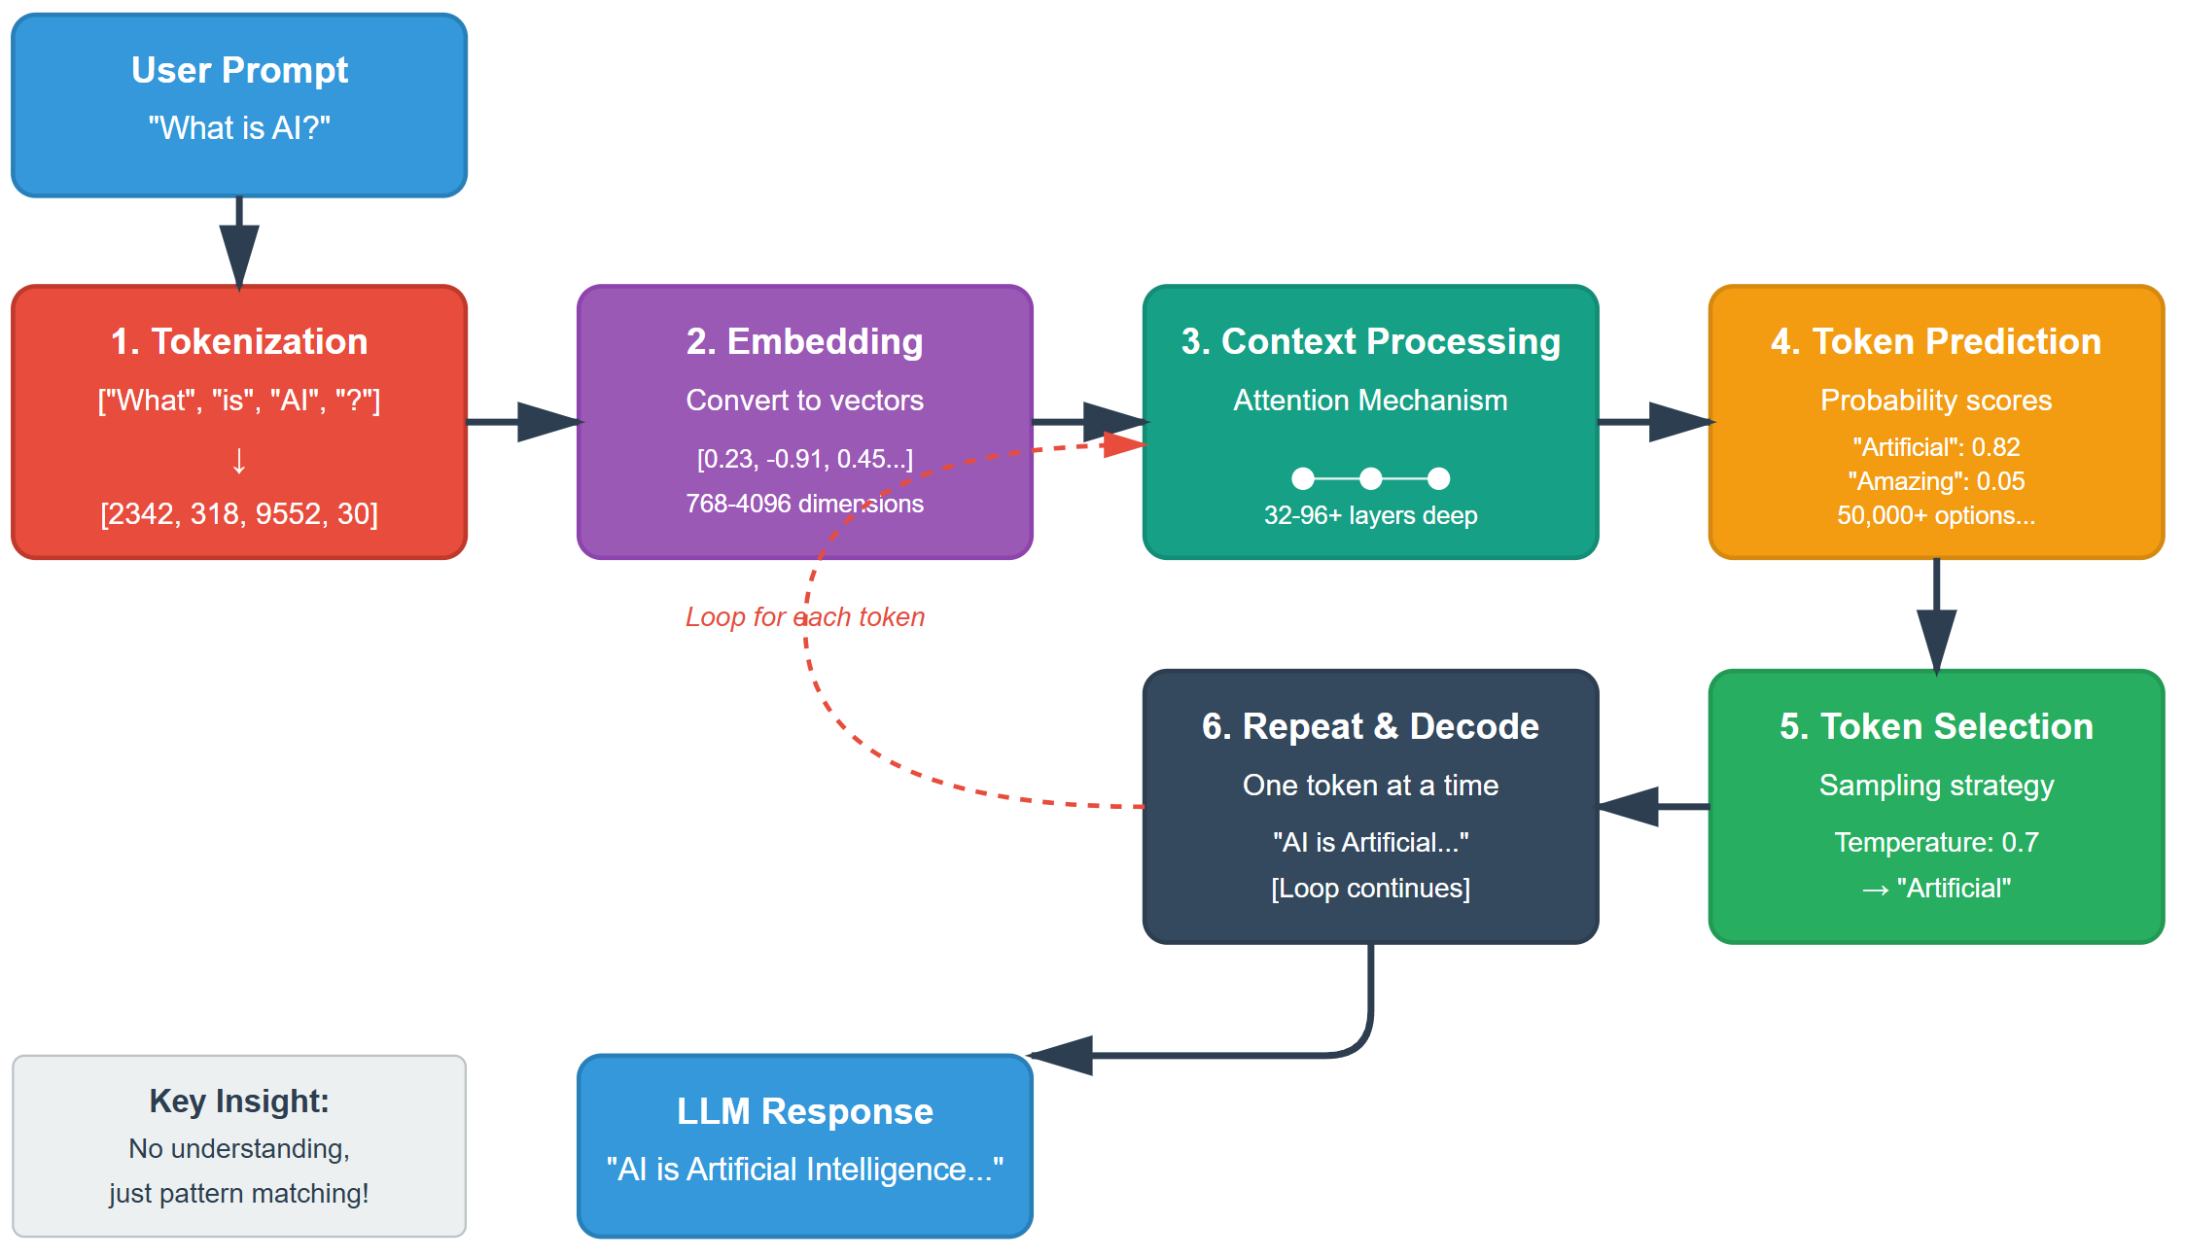
Unpacking the Magic, Step-by-Step
Notes:
Step 1 - Tokenization: When you submit a prompt, the first thing that happens is tokenization. The LLM can't read text directly—it needs numbers. Tokenization breaks your text into smaller units called tokens, which might be whole words, parts of words, or even individual characters. For example, "understanding" might become "under" + "stand" + "ing". Each token maps to a specific ID number in the model's vocabulary, typically containing 30,000-100,000 different tokens.
Step 2 - Embedding: Those token IDs are then converted into embeddings—dense numerical vectors in high-dimensional space (often 768 to 4096 dimensions). Think of this as translating each token into a rich numerical fingerprint that captures its meaning and relationships to other tokens. Words with similar meanings have embeddings that are closer together in this mathematical space.
Step 3 - Context Processing: This is where the "magic" happens. The transformer architecture uses something called attention mechanisms to process all tokens in relation to each other. Every token "attends" to every other token, building up an understanding of context, relationships, and relevance. This happens through multiple layers (modern LLMs have 32-96+ layers), with each layer building more sophisticated representations.
Step 4 - Next Token Prediction: After processing the full context, the model produces a probability distribution over its entire vocabulary. It's essentially answering: "Given everything I've seen so far, what are the chances the next token should be X?" This gives us scores for all ~50,000+ possible tokens, from very likely candidates to nearly impossible ones.
Step 5 - Token Selection: The model doesn't always pick the highest probability token—that would make outputs repetitive and boring. Instead, it uses sampling strategies. Temperature controls randomness (higher = more creative, lower = more focused). Other techniques like top-k or nucleus sampling limit choices to only plausible candidates. This balancing act between coherence and creativity happens for every single token.
Step 6 - Repeat & Decode: Here's the key insight: LLMs generate text one token at a time. After selecting a token, it's added to the context and the entire process repeats. The model re-reads everything including the new token, recalculates probabilities, and selects the next token. This continues until it generates a special "stop" token or hits a length limit. Finally, the numeric tokens are decoded back into human-readable text. This iterative process is why you see responses appearing word by word—it's literally thinking one token at a time.

Slide 15
Understanding LLMs – Some Context
Pattern Recognition Engines: LLMs are AI systems trained on vast text data to predict the most likely next word in a sequence
Statistical Associations, Not Understanding: They excel at identifying patterns and relationships between words without truly comprehending meaning
Convincing Mimicry: LLMs produce fluent, contextually appropriate responses that can appear thoughtful and reasoned
No Real Reasoning: Despite appearances, LLMs don't think, plan, or understand—they generate statistically probable text
Powerful but Limited: Extremely useful for many tasks while requiring careful human oversight and verification
Notes:
Pattern Recognition Engines
Pattern-matching systems trained on vast text
Core function: predict next word
Analogy: world's most advanced autocomplete
Statistical Associations, Not Understanding
Work through statistics, not comprehension
No understanding of gravity/love/math concepts
Combining patterns from training data
Recognize word associations in context
Convincing Mimicry
Produce intelligent-sounding text
Appears logical, creative, thoughtful
Greatest strength AND most dangerous quality
Sophisticated mimicry
No Real Reasoning
KEY WARNING: no actual reasoning
No beliefs, knowledge, or understanding
Can't analyze, plan, or think
Pattern matching mimics reasoning
Powerful but Limited
Incredibly powerful when used appropriately
Help with writing, coding, analysis, creative tasks
Maintain awareness of limitations
Always apply human judgment
Verify outputs for important decisions/facts

Slide 16
Unpacking the Magic, Step-by-Step
Notes:
Step 1 - Tokenization
Text → numbers (LLMs need numbers)
Break into tokens: words/parts/characters
Example: "understanding" → "under" + "stand" + "ing"
Each token → ID number
Vocabulary: 30k-100k tokens
Step 2 - Embedding
Token IDs → dense vectors
High-dimensional space (768-4096 dimensions)
Numerical fingerprint capturing meaning
Similar meanings = closer in space
Step 3 - Context Processing
"Magic" happens here
Attention mechanisms
Every token attends to every other token
Building context/relationships/relevance
Multiple layers (32-96+)
Each layer → more sophisticated
Step 4 - Token Prediction
Probability distribution over vocabulary
"What comes next?"
Scores for all ~50k+ tokens
Very likely → nearly impossible
Step 5 - Token Selection
Not always highest probability
Sampling strategies
Temperature: higher=creative, lower=focused
Top-k, nucleus sampling
Balance: coherence vs creativity
Step 6 - Repeat & Decode
KEY: One token at a time
Add token → re-read everything
Recalculate → select next
Continue until stop token/length limit
Decode numbers → text
Why responses appear word-by-word

Slide 17
AI Teams
Departments
Commercial Data Science (Corey Johnson)
Big Data Services (Travis Lomness)
Some Exciting Things Going On
Mission: Reliable
Commercial and IT Data Science Working Together
Getting in Touch
Jun Lu – reach out for…
Travis Lomness – reach out for…

Slide 18
Acceptable Use Policy
Get IT approval before using any AI/LLM service
Use only Enterprise-approved AI tools
Protect company information
Follow security best practices
Don’t use unapproved AI services (ChatGPT, Claude, Gemini, etc.)
Don’t share sensitive information
Don’t bypass security controls
Don’t create unauthorized content
Notes:
This is a Stuart-Approved Slide.
Acceptable Use Policy
Start with policy - not optional
Section 3.7.4 - AI requires approval
Data becomes AI training material
No control after submission
Legal risks - NDAs, regulations, IP
Competitive intel protection
Real examples: contracts, code, meetings, customer data
Personal account = still violation
Microsoft AI features - some approved, check with IT
Personal use OK but no company data
IT Security via Support Center for questions
Emphasize protection not restriction
Approved tools available through proper channels

Slide 19
Copilot Privacy and Terms of Use
Persona
You are a legal expert about the perils of uploading regulated information, trade secrets, and other types of inappropriate content to Microsoft Copilot.
Context
We are working through our prompt engineering class and the content it needs to contain. It is time to build a slide about Copilot's privacy policy and terms of use.
Task
Provide me with 5-10 bullet points for a slide titled "Copilot Privacy and Terms of Use." Include associated presenter notes. Keep the bullet points lean on detail. Make the presenter notes short and to the point. We're going to raise these concerns and their implications but not dwell on them.
References
URLs and descriptions truncated for space
Notes:
How many of you have read a privacy policy or terms of use word for word?
We have legal for that. But this is still useful, both as information and as a prompt example.
Let’s look at the prompt.

Slide 20
Copilot Privacy and Terms of Use
Data Protection Addendum (DPA) Coverage - Copilot falls under Microsoft's DPA for enterprise accounts, but web searches do not
Prompt & Response Retention - All interactions are logged, retained, and subject to audit requirements
No Model Training on Your Data - Microsoft commits not to use customer prompts/responses for AI training
FERC CEII & Market Data Risks - No specific protections for Critical Energy Infrastructure Information or non-public market data in web searches
File Upload Storage - Uploaded documents automatically stored in user's OneDrive for Business
Sensitive Data Exposure Risk - Users may inadvertently share confidential information through prompts
Copyright Indemnification - Microsoft's Copyright Commitment covers customer use of generated content
Notes:
DPA Coverage
DPA coverage = good. No DPA coverage = bad.
Chat = protected, web searches = NOT
Gap for regulated data in searches
Retention
Permanent data estate record
Discoverable in litigation
Train users on permanence
No Training
Positive: trade secrets safe
Still processed/stored by Microsoft
Compliance Gaps
Web searches lack DPA = FERC risk
CEII, pipeline data, non-public info
Standards of Conduct violations
OneDrive Storage
Files persist after chat ends
Manual deletion required
Data governance challenge
Data Leakage
Biggest risk = permanent confidential records
Examples: "termination letter for John Smith"
"Summarize acquisition strategy"
Copyright Protection
Microsoft indemnifies IP claims
Review before external use
Legal risks remain
------------------------------
DPA Coverage refers to whether the data is protected under Microsoft's Data Protection Addendum - a legally binding contract that governs how Microsoft handles organizational data.
When data is "covered by the DPA":
Microsoft acts as a data processor (you're the controller)
Strict contractual obligations for data security, privacy, and handling
Your organization retains ownership and control rights
Microsoft cannot use the data for their own purposes
Subject to audit rights and compliance certifications
Covered by data breach notification requirements
Protected by geographic data residency commitments
When data is NOT covered by the DPA (like web searches in Copilot):
Microsoft may act as a data controller
Governed by Microsoft's general privacy policy instead
Less restrictive data handling terms
Potentially shared with third parties (like Bing)
May not meet regulatory compliance requirements
Why this matters for Copilot:
Prompts & responses = DPA protected ✓
Web search queries = NOT DPA protected ✗
This creates a critical gap: If an employee asks Copilot to "search the web for information about our Project Falcon acquisition target," that search query containing confidential information isn't protected by your enterprise agreement.
------------------------------
FERC Compliance Risks: While Copilot prompts and responses are DPA-protected, web search queries are not - creating significant exposure for FERC-regulated data. Critical Energy Infrastructure Information (CEII), including pipeline capacities, operational data, and system vulnerabilities, could be inadvertently exposed through web-grounded queries.
Additionally, Standards of Conduct violations could occur if non-public transmission information or market-sensitive data (customer contracts, capacity availability, pricing) is included in searches. For example, asking Copilot to "search for competitors' pipeline capacity compared to our Eagle Ford system" could expose confidential operational data outside DPA protections.
Train users to NEVER include in Copilot queries:
Pipeline specifications or vulnerabilities
Non-public capacity or availability data
Customer contract terms or negotiations
Market-sensitive operational information
Interstate transmission details
Any data marked as CEII
Consider implementing DLP policies specifically for CEII markers and establishing pre-approved prompts for market analysis that exclude non-public information. Regular audits of Copilot usage should specifically review for potential FERC compliance violations.
------------------------------
How a Termination Letter Request Could Create Major Liability
When you type "Help me draft a termination letter for John Smith," here's what happens:
1. Permanent Record Creation
Your prompt becomes part of your organization's permanent data estate
Stored in Microsoft's systems and backed up across multiple locations
Cannot be truly deleted - only marked for deletion per retention policies
2. eDiscovery & Litigation Exposure
If John Smith sues for wrongful termination, opposing counsel can subpoena ALL Copilot interactions
Your prompt reveals: termination planning timeline, your involvement, potential premeditation
Creates evidence that didn't exist before ("We found the HR director was planning this termination weeks before the alleged performance issue")
3. Multiple Access Points
Microsoft 365 admins can access audit logs
Compliance officers can search all Copilot interactions
IT security teams monitoring for data leaks will see it
Anyone with eDiscovery permissions during legal holds
4. Context Without Protection
Unlike attorney-client privileged communications, Copilot chats have no privilege
Reveals thought process, concerns, and strategy that would normally stay confidential
Shows multiple drafts/iterations that could contradict official reasoning
5. Oil & Gas Specific Risks
Safety-sensitive position terminations could trigger OSHA investigations
Union environments: Evidence of pre-planning could violate collective bargaining agreements
Contractor relationships: Could expose prime contractor to co-employment claims
Following a safety incident: Could be seen as retaliation rather than performance-based
Better Approach: Work with HR/Legal directly, keep sensitive planning offline, and only use Copilot for generic policy questions like "What are best practices for performance improvement plans?"

Slide 21
Copilot Privacy and Terms of Use
Evaluate
I feel comfortable discussing these items with two exceptions:
I didn’t know what DPA means or implies.
I don’t know why Copilot search might leak sensitive data or how to control it.
Iterate
I asked for, got, read, and included details about the Data Protection Addendum
I asked for clarification about how chat and search behave differently with regards to privacy
I asked for and included example prompts

Slide 22
DPA – Copilot Chat vs. Copilot Web Search
Copilot Chat (DPA Protected)
Your Microsoft 365 data (emails, documents, Teams chats)
Files you upload directly to the chat (stored in OneDrive)
Its built-in knowledge (pre-trained data)
Copilot Search (NOT Protected)
Goes to Bing/internet to find current information
Searches for external websites, news or public data
Accesses any information outside your Microsoft 365 environment

Slide 23
DPA – Example Prompts (When in doubt, DON’T)
Copilot Chat (Protected)
Summarize the presentation about how our new Houston to Redmond pipeline has a bajillion barrel per day capacity.
This is protected because Copilot is only accessing your internal SharePoint/OneDrive files
Copilot Search (NOT Protected)
Search online regulatory requirements for pipelines with capacities like our new Houston to Redmond line, which will handle a bajillion barrels per day.
This is NOT protected because your sensitive capacity data is sent to Bing as part of the search query
Notes:
Here are some example prompts to highlight the difference between M365 Chat and Search. Be very careful about what you prompt it to do.

Slide 24
AI Essentials
Wherein we breeze through the least you need to know…

Slide 25

Introduction to AI
Artificial Intelligence (AI)
Computer systems able to perform tasks that normally required human intelligence.
Machine Learning (ML)
A subset of AI where systems learn from data to improve their performance over time, enhancing decision-making and predictions.
Generative AI
A type of AI that can create new, original content like text, images, music, and code, based on the patterns it learns from existing data.
Why do You Care?
Generative AI can and will be trained using company data. Start thinking about it now.

Slide 26

Maximizing Productivity With AI Tools
Interactivity Modes
The way we interact with most generative AI tools is through prompting, but there are other ways.
Human in the Loop
The user should deliberately be part of the process of getting the output they need from the AI.
Knowledge Cutoff
The model has now knowledge about events or new information beyond a certain date.
Hallucinations
When an AI outputs something that is inconsistent, incorrect, or nonsensical.
Notes:
Interactivity Modes
Prompt = text instructions to guide AI output
Like giving directions to assistant
Multi-modal: text + images, voice, code
Show example prompt on screen
"Write email" vs "Write professional email declining meeting"
Human in the Loop
Human actively guides/corrects AI output
Not "set and forget" - iterative process
Example: Copilot writes "CEO loves interpretive dance at board meetings"
Human catches absurd errors before sending
Critical for high-stakes: medical diagnosis, legal advice
AI suggests, human verifies/decides
Knowledge Cut-Off
Training data stops at specific date
Can't know yesterday's news from training alone
Modern workaround: web search capability
Copilot searches Bing, follows links
Demo: "What happened at Microsoft yesterday?"
Still verify current info - web results vary
Hallucinations
Confident-sounding false information
Funny: "Eiffel Tower moved to Berlin in 2021"
Obvious vs subtle danger
Reputation risk: "Senator Smith caught shoplifting" (never happened)
Legal/medical risks from plausible lies
Prevention: verify facts, cross-reference sources
Use AI for drafts, not final truth

Slide 27

Using AI Responsibly
Regulatory Issues and Trade Secrets
We’ve covered this in detail but keep it in mind.
Validating Outputs
Reviewing Copilot output before sharing is very important.
Being Transparency
Disclose AI use to teams and clients when affected.
Configuring AI Agents
Bake some common verbiage into your prompts!

Slide 28
Prompt Engineering
Wherein I get to the point…

Slide 29

A Prompt to Work With
Teach me about the oil and gas business.

Slide 30

Prompt Engineering Basics
Task
What you want the AI to do.
Context
The more context you can provide, the better your output will be.
References
Provide examples or additional input to the AI.
Evaluate
Ask yourself if the output is what you need it to be.
Iterate
The circular process of refining the prompt to get the results you really want.
Mnemonic
Thinking Clearly Reduces Errors Immediately

Slide 31

Multi-Model Prompting
Combines text with one or more other formats
Documents
Spreadsheets
Semi-structured data
Images
Audio

Slide 32
Back to Our Example Prompt
Tech me about the oil and gas business
I need some volunteers
Task: Give the AI something more specific
Context: Tell the AI who you are and what you’re trying to do
References: Feed the AI one of our documents

Slide 33
Back to Our Example Prompt
Use This Prompt: “Teach me about the oil and gas business.”
I need some volunteers
Task: Give the AI something more specific
Context: Tell the AI who you are and what you’re trying to do
References: Feed the AI one of our documents

Slide 34
Evaluate
Volunteers assess their results for the group

Slide 35
Iterate
Revisit the prompting framework
01
Separate prompts into shorter sentences
02
Try rephrasing or switching to an alternate task
03
Introduce constraints
04
Repair Something Through Iteration
05
Notes:
Revisit the prompting framework
Strengthen persona: "senior data analyst" → "data analyst with 10 years finance experience"
Add missing context: project goals, timeline, stakeholders
Include reference examples from successful outputs
Specify format: "3 bullets per section, max 50 words each"
Separate prompts into shorter sentences
Talk like to a person - clear, direct
Word vomit example: "Create a report analyzing Q3 performance including revenue, costs, and profitability with charts"
Better: "Analyze Q3 performance. Include revenue metrics. Add cost breakdown. Calculate profitability. Create 3 charts."
Each instruction = one sentence/bullet
Try Rephrasing or switch to an analogous task
Marketing plan prompt → boring corporate language
Rephrase as: "Tell a story about Sarah, busy mom of 3, discovering our meal kit service"
Shifts from "write marketing plan" to "create customer journey narrative"
Same goal, different framing = better results
Introduce constraints
Restaurant recommendation without constraints = too broad
Add: "Italian cuisine only"
Add: "Downtown area, within 2 miles"
Add: "Must have curbside pickup"
Each constraint narrows and improves output quality
Mnemonic: RSTI
Memory device for iteration process
Emphasize: iteration = normal part of prompting
Not failure - it's refinement

Slide 36
Introducing Enterprise Products Partners!
Task: Summarize information about Enterprise Products
Context: New job in liquids risk – your first out of college
References: The 10-K, all press releases you have, and the internet
Expectations: Summaries, tables, analysis, and recent news

Slide 37
Prompts for Common Work Tasks
Doing research
Drafting emails
Outlining proposals
Checking your thinking
Data analysis
Building presentations

Slide 38
Advanced Gen AI Prompting Techniques
Prompt Chaining
Chain of Thought Prompting
Tree of Thought Prompting
Combined Chain of Thought and Tree of Thought Prompting
One-Shot Prompting
Multi-Shot Prompting
Meta-Prompting
Notes:
Prompt Chaining
Get three versions of a summary for one of our press releases
Combine the three versions of the summary into something catchy and impactful
Chain of Thought
Explain reasoning as a step-by-step process
Just add the tagline “explain your thought process”
Helps you understand the model’s decision making and understand where things are going wrong
Tree of thought
Explore multiple reasoning paths simultaneously
Creating outlines and drafting sections for lengthy documents
YMMV

Slide 39

Creating Copilot Agents
An expert designed to help with tasks and answer questions
Simulation
Coding
Marketing
Legal
Learning
Or just a friend, but don’t get attached

