Slide 1


Mission: Reliable
Lunch & Learn Topic– 7/2/25
Copilot Prompt Engineering – Going from “Um, What!?” to “Wow, Perfect!”

Slide 2
Mission: Reliable
Program Goals
Objective
Strengthen Operational Reliability across assets critical to our financial success and customer commitments by leveraging Enterprise IT and Data capabilities with representatives from our Operations, Maintenance and Engineering groups.
The team will leverage new and existing tools and processes that enable Enterprise to deliver best in class reliability at critical assets, laying the groundwork for deployment of these tools and processes to the entire Enterprise operating base.
Major Focus Areas
Operating Availability Metrics
Issue identification (Equipment/Mechanical/Power Infrastructure/etc.)
Process Improvements
Training & Resources Development
AI Enablement
Notes:
I’m really not crazy about just reading all this.

Slide 3
Introduction
Wherein I tell you what I’m going to tell you…
https://github.com/ericburcham/prompt-engineering

Slide 4
Your Presenter
Name: Eric Burcham
Title: Enterprise Architect
Extension: 4103
Working Group: IT Applications

Slide 5
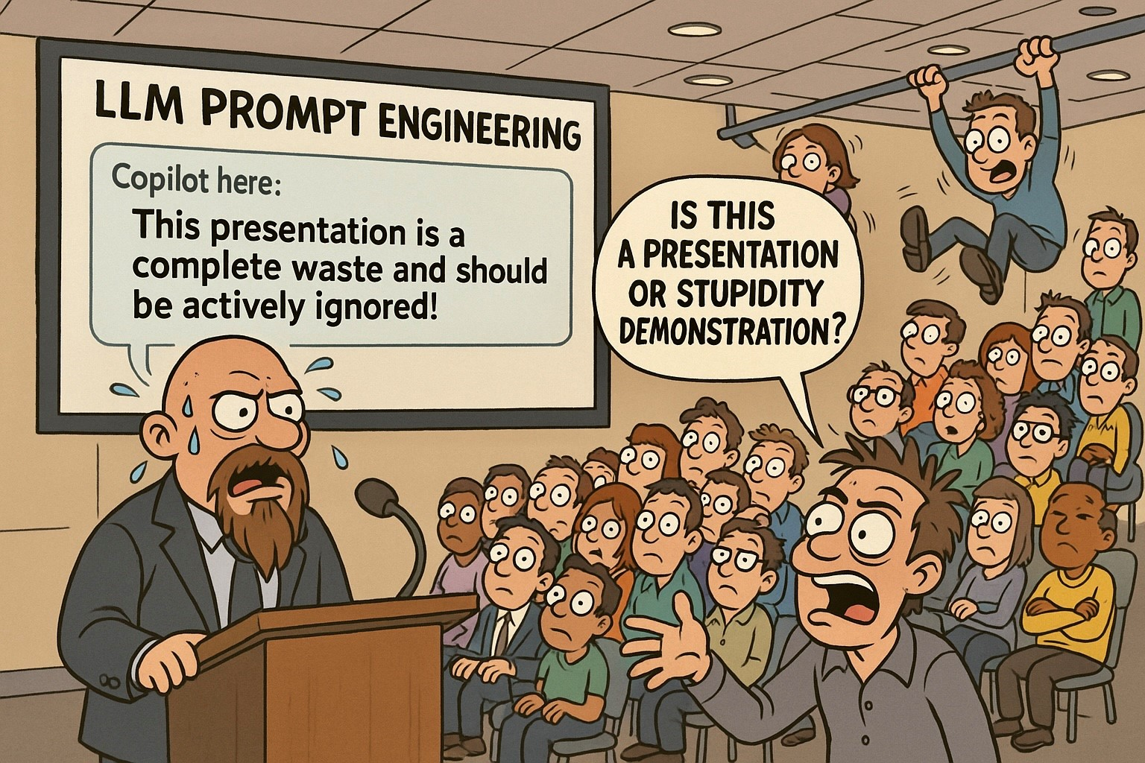
Copilot is NOT Optimistic
Notes:
I asked Copilot how it thought this would go.
This was the result.
I’m apologizing in advance.

Slide 6
Acceptable Use Policy (General)
Get IT approval before using any AI/LLM service
Use only Enterprise-approved AI tools
Protect company information
Follow security best practices
Don’t use unapproved AI services (ChatGPT, Claude, Gemini, etc.)
Don’t share sensitive information
Don’t bypass security controls
Don’t create unauthorized content
If you need an exception…
Notes:
This is a Stuart-Approved Slide.
Acceptable Use Policy
Start with policy - not optional
Section 3.7.4 - AI requires approval
Data becomes AI training material
No control after submission
Legal risks - NDAs, regulations, IP
Competitive intel protection
Real examples: contracts, code, meetings, customer data
Personal account = still violation
Microsoft AI features - some approved, check with IT
Personal use OK but no company data
IT Security via Support Center for questions
Emphasize protection not restriction
Approved tools available through proper channels
If you need an exception…
I think any an all ideas are useful. We have resources outside of Copilot that are more private, and Copilot may be the answer too in some cases. Talk to Lavina and she will get your idea moving the right direction.

Slide 7
Mission: Reliable Guidelines
Acceptable Use Policy
Copilot for web
Copilot for Office
Confidential company information
If you have an additional use case
Use of other cloud-based AI tools
Notes:
The Acceptable Use Policy applies to use of Copilot and other GenAI
Copilot for web has been authorized for company use
Copilot for Office is currently being evaluated and use of proofs-of-concept, including for specific Mission: Reliable use cases.
Confidential company information normally should not be uploaded to Copilot. However, for Mission: Reliable, an exception has been granted to the Mission: Reliable team if the information is not highly sensitive (PII, commercial contracts, credentials, etc.).
If you have an additional use case for Copilot that extends outside of the exception that has been granted or have a need for Copilot for Office (e.g., to use it against a larger set of documents) contact Lavina Fernandes.
Use of other cloud-based AI tools that have not been specifically authorized by IT are not allowed. You may request use through IT Compliance with a business case that cannot effectively be met with currently authorized cloud tools or other tools in our data center.

Slide 8
Copilot Privacy and Terms of Use
Prompt & Response Retention - All interactions are logged, retained, and subject to audit requirements
No Model Training on Your Data - Microsoft commits not to use customer prompts/responses for AI training
FERC CEII & Market Data Risks - No specific protections for Critical Energy Infrastructure Information or non-public market data in web searches
File Upload Storage - Uploaded documents automatically stored in user's OneDrive for Business
Sensitive Data Exposure Risk - Users may inadvertently share confidential information through prompts
Copyright Indemnification - Microsoft's Copyright Commitment covers customer use of generated content
Data Protection Addendum (DPA) Coverage - Copilot falls under Microsoft's DPA for enterprise accounts, but web searches do not
Notes:
Retention
Permanent data estate record
Discoverable in litigation
Train users on permanence
No Training
Positive: trade secrets safe
Still processed/stored by Microsoft
Compliance Gaps
Web searches lack DPA = FERC risk
CEII, pipeline data, non-public info
Standards of Conduct violations
OneDrive Storage
Files persist after chat ends
Manual deletion required
Data governance challenge
Data Leakage
Biggest risk = permanent confidential records
Examples: "termination letter for John Smith"
"Summarize acquisition strategy"
Copyright Protection
Microsoft indemnifies IP claims
Review before external use
Legal risks remain
DPA Coverage
DPA coverage = good. No DPA coverage = bad.
Chat = protected, web searches = NOT
Gap for regulated data in searches
------------------------------
DPA Coverage refers to whether the data is protected under Microsoft's Data Protection Addendum - a legally binding contract that governs how Microsoft handles organizational data.
When data is "covered by the DPA":
Microsoft acts as a data processor (you're the controller)
Strict contractual obligations for data security, privacy, and handling
Your organization retains ownership and control rights
Microsoft cannot use the data for their own purposes
Subject to audit rights and compliance certifications
Covered by data breach notification requirements
Protected by geographic data residency commitments
When data is NOT covered by the DPA (like web searches in Copilot):
Microsoft may act as a data controller
Governed by Microsoft's general privacy policy instead
Less restrictive data handling terms
Potentially shared with third parties (like Bing)
May not meet regulatory compliance requirements
Why this matters for Copilot:
Prompts & responses = DPA protected ✓
Web search queries = NOT DPA protected ✗
This creates a critical gap: If an employee asks Copilot to "search the web for information about our Project Falcon acquisition target," that search query containing confidential information isn't protected by your enterprise agreement.
------------------------------
FERC Compliance Risks: While Copilot prompts and responses are DPA-protected, web search queries are not - creating significant exposure for FERC-regulated data. Critical Energy Infrastructure Information (CEII), including pipeline capacities, operational data, and system vulnerabilities, could be inadvertently exposed through web-grounded queries.
Additionally, Standards of Conduct violations could occur if non-public transmission information or market-sensitive data (customer contracts, capacity availability, pricing) is included in searches. For example, asking Copilot to "search for competitors' pipeline capacity compared to our Eagle Ford system" could expose confidential operational data outside DPA protections.
Train users to NEVER include in Copilot queries:
Pipeline specifications or vulnerabilities
Non-public capacity or availability data
Customer contract terms or negotiations
Market-sensitive operational information
Interstate transmission details
Any data marked as CEII
Consider implementing DLP policies specifically for CEII markers and establishing pre-approved prompts for market analysis that exclude non-public information. Regular audits of Copilot usage should specifically review for potential FERC compliance violations.
------------------------------
How a Termination Letter Request Could Create Major Liability
When you type "Help me draft a termination letter for John Smith," here's what happens:
1. Permanent Record Creation
Your prompt becomes part of your organization's permanent data estate
Stored in Microsoft's systems and backed up across multiple locations
Cannot be truly deleted - only marked for deletion per retention policies
2. eDiscovery & Litigation Exposure
If John Smith sues for wrongful termination, opposing counsel can subpoena ALL Copilot interactions
Your prompt reveals: termination planning timeline, your involvement, potential premeditation
Creates evidence that didn't exist before ("We found the HR director was planning this termination weeks before the alleged performance issue")
3. Multiple Access Points
Microsoft 365 admins can access audit logs
Compliance officers can search all Copilot interactions
IT security teams monitoring for data leaks will see it
Anyone with eDiscovery permissions during legal holds
4. Context Without Protection
Unlike attorney-client privileged communications, Copilot chats have no privilege
Reveals thought process, concerns, and strategy that would normally stay confidential
Shows multiple drafts/iterations that could contradict official reasoning
5. Oil & Gas Specific Risks
Safety-sensitive position terminations could trigger OSHA investigations
Union environments: Evidence of pre-planning could violate collective bargaining agreements
Contractor relationships: Could expose prime contractor to co-employment claims
Following a safety incident: Could be seen as retaliation rather than performance-based
Better Approach: Work with HR/Legal directly, keep sensitive planning offline, and only use Copilot for generic policy questions like "What are best practices for performance improvement plans?"

Slide 9
DPA – Example Prompts (When in doubt, DON’T)
Copilot Chat (Protected)
Summarize the presentation about how our new Houston to Redmond pipeline has a bajillion barrel per day capacity.
This is protected because Copilot is only accessing your internal SharePoint/OneDrive files
Copilot Search (NOT Protected)
Search online regulatory requirements for pipelines with capacities like our new Houston to Redmond line, which will handle a bajillion barrels per day.
This is NOT protected because your sensitive capacity data is sent to Bing as part of the search query
Notes:
Here are some example prompts to highlight the difference between M365 Chat and Search. Be very careful about what you prompt it to do.

Slide 10
AI Essentials
Wherein we breeze through the least you need to know…

Slide 11

Introduction to AI
Artificial Intelligence (AI)
Computer systems able to perform tasks that historically required human intelligence.
Machine Learning (ML)
A subset of AI where systems learn from data to improve their performance over time, enhancing decision-making and predictions.
Generative AI
A type of AI that can create new, original content like text, images, music, and code, based on the patterns it learns from existing data.
Why do You Care?
Generative AI can and will be trained using company data. Start thinking about it now.

Slide 12

Using AI Responsibly
Being Transparent
Disclose AI use to others when affected.
Configuring AI Agents
Bake some common verbiage into your prompts!

Slide 13
Prompt Engineering
Wherein I get to the point…

Slide 14

Confusion Around LLMs
Illusion of Reasoning
LLMs generate responses that seem intelligent but do not reflect true understanding.
Hallucination with Authority
LLMs can and do present invented facts, citations, and data with confidence. They do not internally distinguish between accurate and fabricated information.
Contextual Amnesia
LLMs, with some exceptions, cannot learn from previous conversations. Limited context windows create “forgetting” mid-conversation.
Inconsistent Expertise
LLMs sometimes excel at complex tasks while failing hilariously at simple ones. They also provide different responses to identical questions asked differently.
The Anthropomorphism Trap
Human-like conversations can trigger emotional attribution. Users assume intent, feelings, or preferences that don’t exist.
Probabilistic vs. Deterministic Thinking
Models generate “likely” responses, not calculated answers. Each response is a statistical prediction, not a logical deduction.
Notes:
The Illusion of Understanding
Coherent responses create illusion of deep understanding.
Funny: Printer diagnosed with "paper jam in tertiary feed mechanism" (doesn't exist).
Concerning: Medical student - LLM called dangerous drug combo "commonly prescribed together.“
Hallucination with Authority
No fact verification - generates plausible-seeming text.
Funny: Great Emu War - added fictional "General Featherstone" leading emu forces.
Concerning: Lawyer submitted brief with 6 fake ChatGPT cases. Court sanctioned.
Contextual Amnesia
No memory between chats. Limited context causes forgetting within chats.
Funny: Hour teaching coding standards. Next chat: "What coding standards?“
Concerning: Therapist - LLM forgot trauma details mid-session, gave contradictory advice.
Inconsistent Expertise
PhD-level + toddler-level confusion simultaneously.
Interesting: Solves complex calculus. "How many r's in strawberry?" Answer: "two" (it's three).
Dangerous: Copilot encryption code - sophisticated looking, basic security flaw.
The Anthropomorphism Trap
Users attribute human characteristics.
Funny: User apologized for too many questions, asked if AI needed break.
Concerning: Elderly person shared financial info with "friend" AI.
Probabilistic vs. Deterministic Thinking
Statistical predictions, not calculations.
Interesting: Square root of 15,876 - varies 125-127. Calculator: exactly 126.
Dangerous: Financial analyst - loan payment calculations off by thousands.

Slide 15
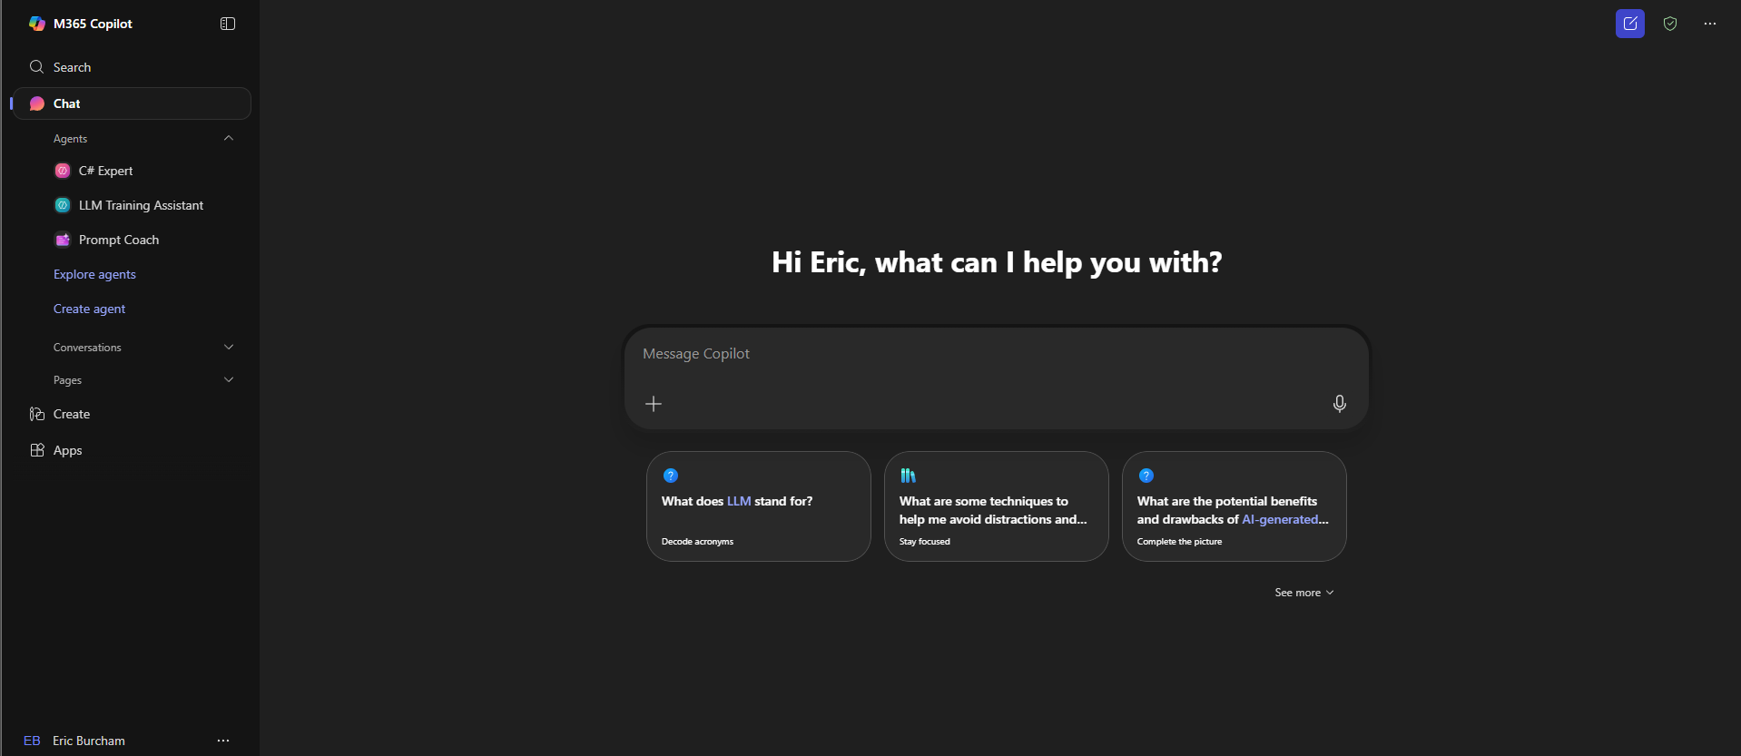
Copilot Interface Tour

Slide 16

A Prompt to Work With
Teach me about the oil and gas business.
Notes:
On this slide we will start with a very basic prompt and work towards something more useful.

Slide 17

Prompt Engineering Basics
Task
What you want the AI to do.
Context
The more context you can provide, the better your output will be.
References
Provide examples or additional input to the AI.
Evaluate
Ask yourself if the output is what you need it to be.
Iterate
The circular process of refining the prompt to get the results you really want.
Mnemonic
Thinking Clearly Reduces Errors Immediately
Notes:
Task: What do you want the AI to do?
Start with a clear action verb such as analyze, summarize, create, or identify.
Be specific about the desired output. Try tables, bulleted lists, email bodies, etc.
Example: Summarize the attached process document. Remove all the details to make a simple step-by-step checklist.
Context: What background information can you provide?
Provide relevant details about your goal or situation
Include constraints and requirements
Example: I’m a process engineer at a gas processing plant and I need to quickly make sure no basic steps have been overlooked in this very large document.
References: What examples or formats should the AI follow?
Include output instructions or sample formats, templates, or examples
Specify any standards or conventions to follow
Example: Format the step-by-step instructions as a bulleted list of tasks with no descriptions or other fluff
Evaluate: How will you judge if the response is good?
Do not, under any circumstance, truest LLM output without verifying
Try to stick to topics you are already comfortable with, or are comfortable researching
Get a subject matter expert to example the results if necessary
Iterate: How can you refine based on the response
Review the output and identify improvements
Adjust your prompt based on what did or didn’t work
Example: Add more detail about root causes

Slide 18
Evaluate and Iterate
Revisit the prompting framework
01
Separate prompts into shorter sentences
02
Try rephrasing or switching to an alternate task
03
Introduce constraints
04
Repair Something Through Iteration
05
Notes:
Evaluate
Look for errors in the response
When working with critical projects, have SMEs on hand
Don’t be afraid to edit the response before sharing
Ultimately, the user is responsible for correctness and coherence
Revisit the prompting framework
Strengthen persona: "senior data analyst" → "data analyst with 10 years finance experience"
Add missing context: project goals, timeline, stakeholders
Include reference examples from successful outputs
Specify format: "3 bullets per section, max 50 words each"
Separate prompts into shorter sentences
Talk like to a person - clear, direct
Word vomit example: "Create a report analyzing Q3 performance including revenue, costs, and profitability with charts"
Better: "Analyze Q3 performance. Include revenue metrics. Add cost breakdown. Calculate profitability. Create 3 charts."
Each instruction = one sentence/bullet
Try Rephrasing or switch to an analogous task
Marketing plan prompt → boring corporate language
Rephrase as: "Tell a story about Sarah, busy mom of 3, discovering our meal kit service"
Shifts from "write marketing plan" to "create customer journey narrative"
Same goal, different framing = better results
Introduce constraints
Restaurant recommendation without constraints = too broad
Add: "Italian cuisine only"
Add: "Downtown area, within 2 miles"
Add: "Must have curbside pickup"
Each constraint narrows and improves output quality
Mnemonic: RSTI
Memory device for iteration process
Emphasize: iteration = normal part of prompting
Not failure - it's refinement

Slide 19
Introducing Enterprise Products Partners!
Task: Summarize information about Enterprise Products
Context: New job in liquids risk – your first out of college
References: The 10-K, all press releases you have, and the internet
Expectations: Summaries, tables, analysis, and recent news
Notes:
On this slide we will highlight the effectiveness of a carefully engineered prompt to extract information from the SEC 10-K filing and a couple of press releases.

Slide 20
Prompts for Common Work Tasks
Doing research
Drafting emails
Outlining proposals
Checking your thinking
Data analysis
Building presentations

Slide 21
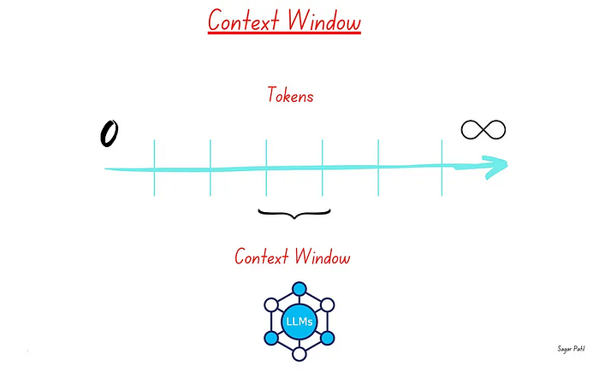

Slide 22
Advanced Gen AI Prompting Techniques
Presentations and Visualizations
Prompt Chaining
Chain of Thought Prompting
Tree of Thought Prompting
Combined Chain of Thought and Tree of Thought Prompting
One-Shot Prompting
Multi-Shot Prompting
Meta-Prompting
Notes:
On this slide we will evaluate some advanced techniques for working with more difficult problems.
Prompt Chaining
Get three versions of a summary for one of our press releases
Combine the three versions of the summary into something catchy and impactful
Chain of Thought
Explain reasoning as a step-by-step process
Just add the tagline “explain your thought process”
Helps you understand the model’s decision making and understand where things are going wrong
Tree of thought
Explore multiple reasoning paths simultaneously
Creating outlines and drafting sections for lengthy documents
YMMV

Slide 23

Creating Copilot Agents
An expert designed to help with tasks and answer questions
Simulation
Coding
Marketing
Legal
Learning
Or just a friend, but don’t get attached
Notes:
On this slide I will teach people how to build a Copilot agent and show some example agents I have already built.

Slide 24
Copilot Update – Business Solutions
From Cloud-Aware to Cloud-Smart
~200 applications in the cloud
Cloud Data approval:
Pending cloud data approval(cloud strategy), any solution needing to be operationalized for data in the cloud, needs approval from Security/Compliance and EVP’s
(This includes AWS, SAAS, Copilot, any AI solutions).

Slide 25
Resources
Google AI Essentials
https://www.coursera.org/specializations/ai-essentials-google
Google Prompting Essentials
https://www.coursera.org/specializations/prompting-essentials-google
Prompt Engineering by Lee Boonstra
https://www.innopreneur.io/wp-content/uploads/2025/04/22365_3_Prompt-Engineering_v7-1.pdf

Slide 26
Thank you

