Slide 1
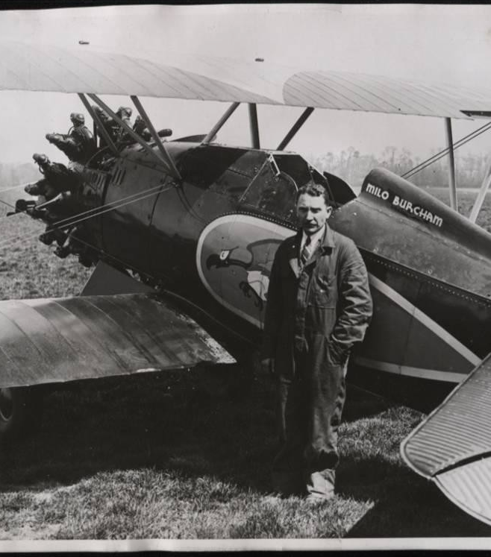
Sabotage, Secrets and Spylanes
An Abbreviated, Slightly Twisted, Opinionated, Not Necessarily 100% Accurate History of Agile.

Slide 2
Introduction
Where I tell you what I’m going to tell you.

Slide 3
Presentation Overview
Sabotage – Lessons from the CIA: How not to run your project.
Secrets – Lessons from DARPA: How to innovate consistently over time.
Spyplanes – Lessons from Skunkworks Lockheed Martin: Early examples of agile principles in practice.

Slide 4
Sabotage
How to literally ruin your project.

Slide 5
A Visual History of the CIA

Slide 6
CIA Accomplishments

Slide 7
Secrets
How innovate forever.

Slide 8
A Visual History of DARPA

Slide 9
DARPA Innovations

Slide 10
Spyplanes
Principles for being on time and under budget.

Slide 11
A Visual History of Lockheed Martin

Slide 12
Lockheed Martin Dead Sexy Airplanes

