Slide 1
Crime Analysis With Rhythm Maps
The San Diego Regional Data Library
Eric Busboom, eric@sandiegodata.org
http://sandiegodata.org

Slide 2
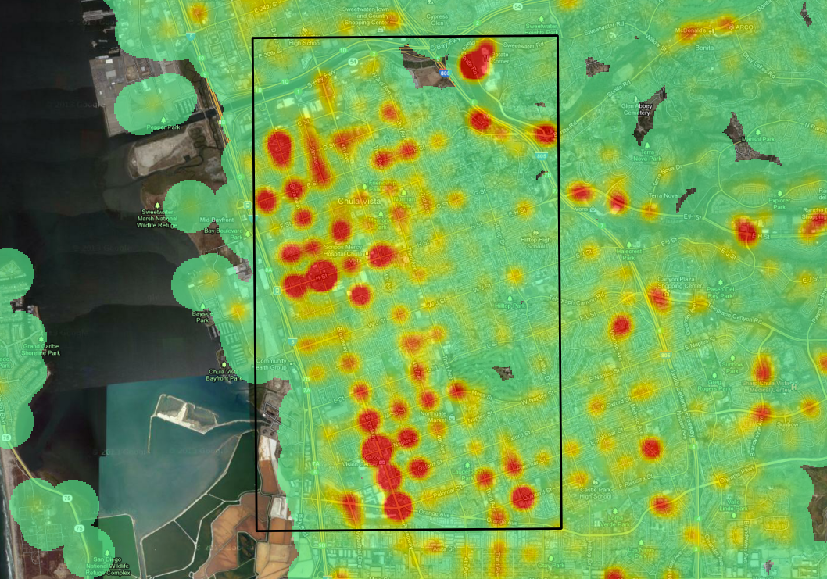

Slide 3
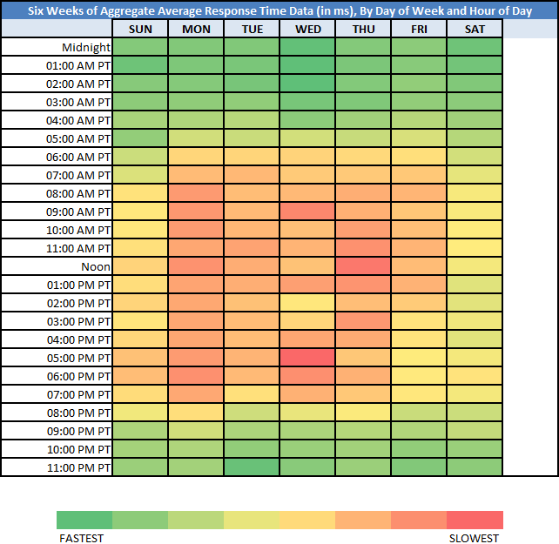

Slide 4
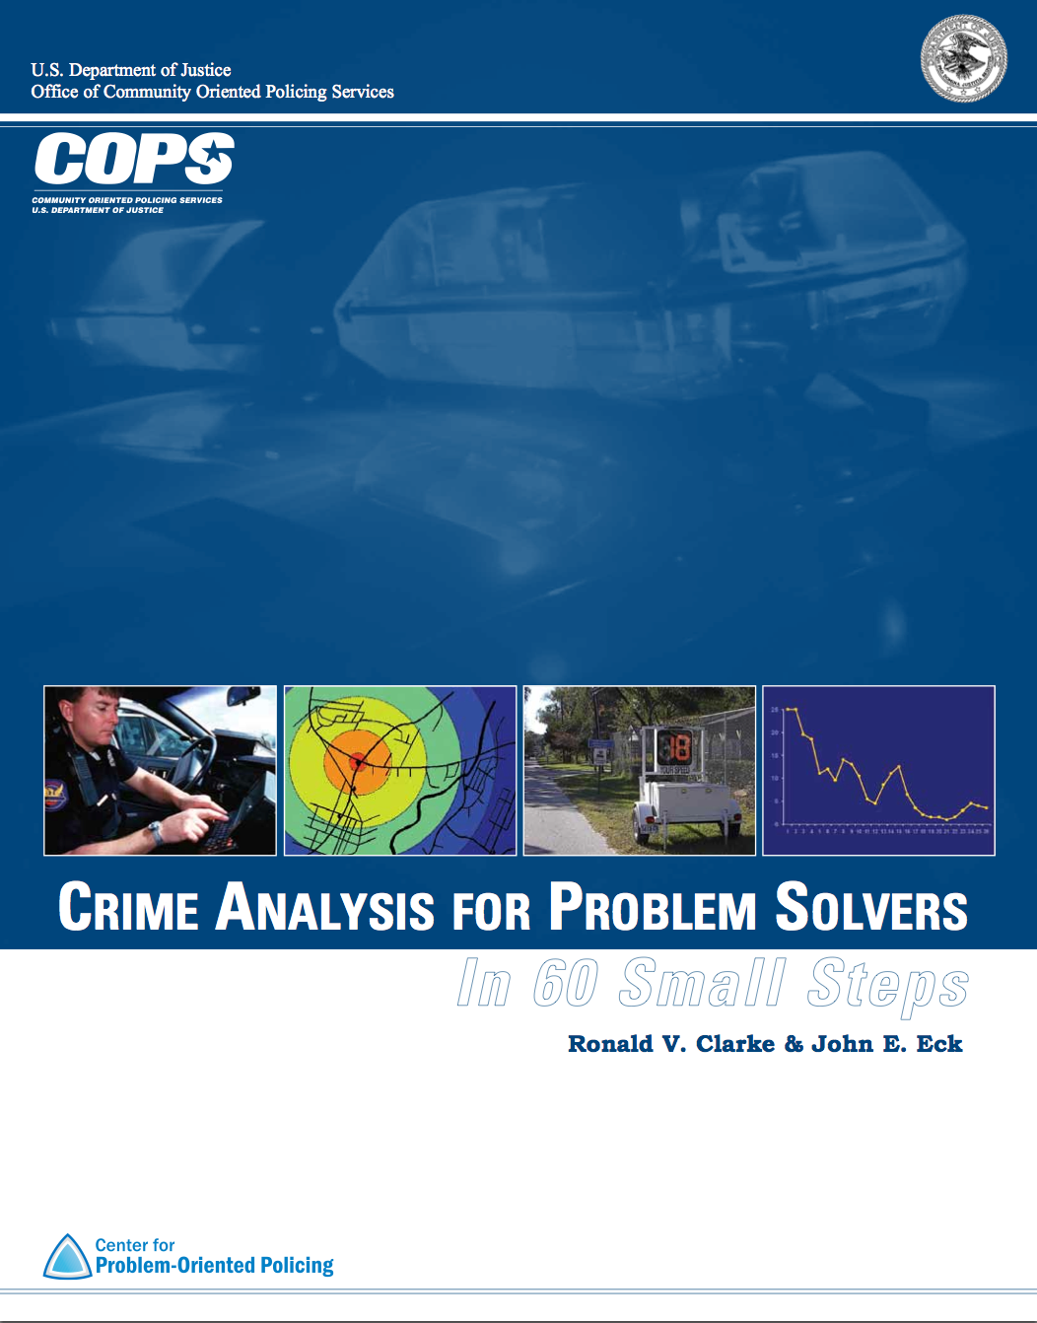

Slide 5
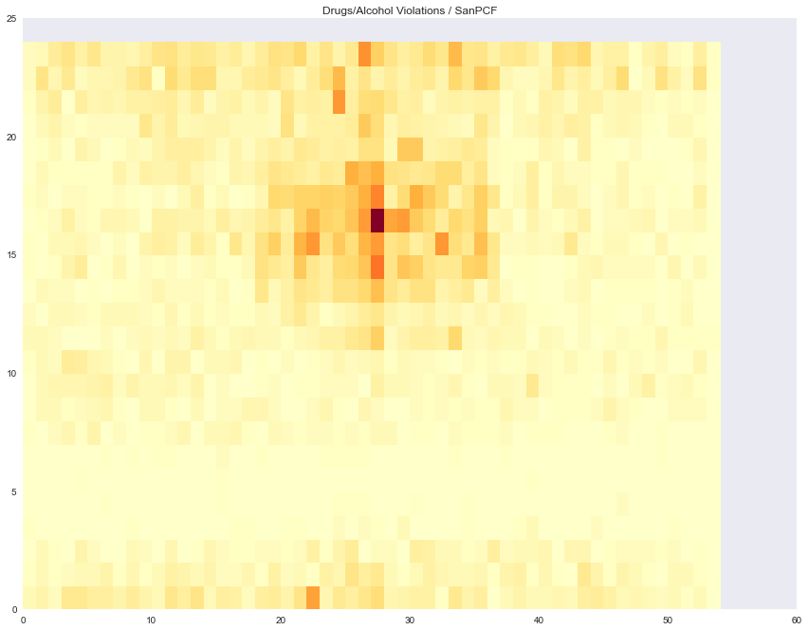

Slide 6
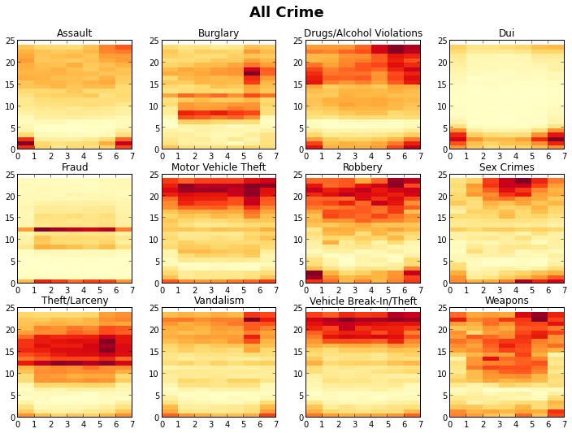

Slide 7
Burglary

Slide 8
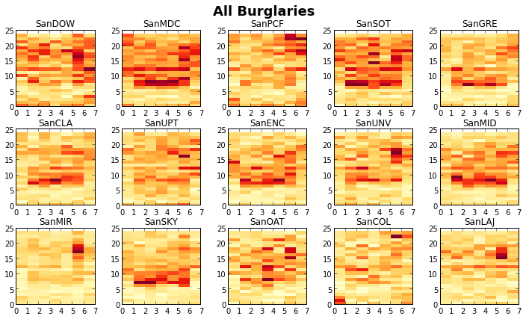

Slide 9
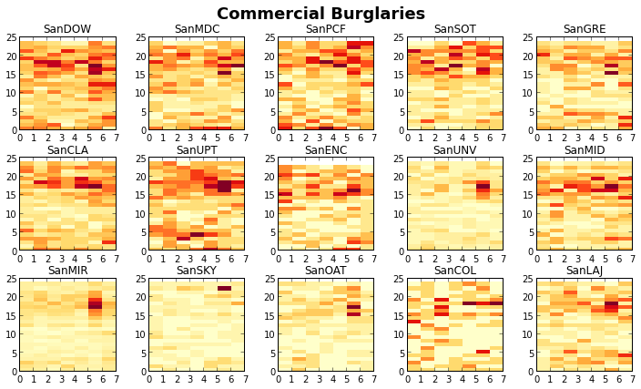

Slide 10
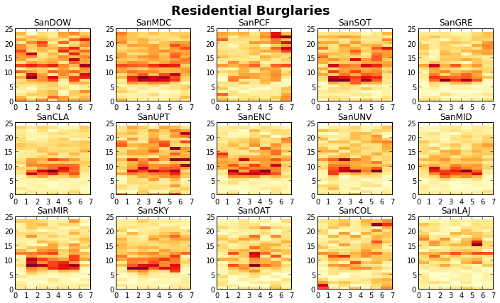

Slide 11
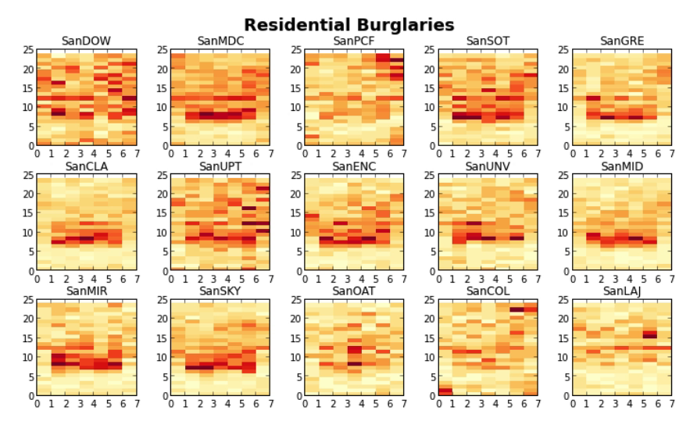

Slide 12
Prostitution

Slide 13
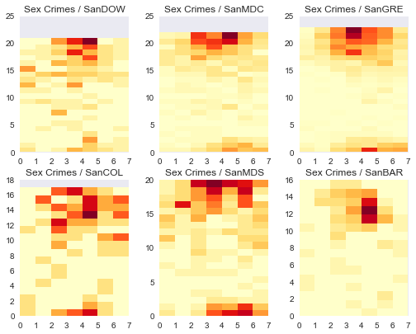

Slide 14
Long Term Rhythm

Slide 15
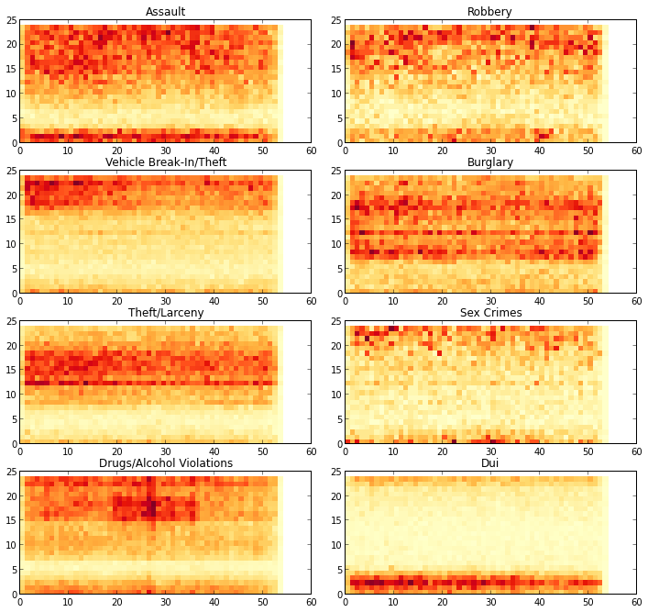
Hour / Week

Slide 16
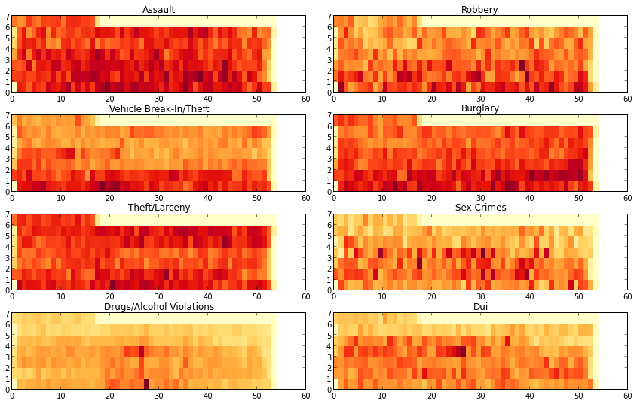
Year / Week

Slide 17
Kernel Density Estimation

Slide 18
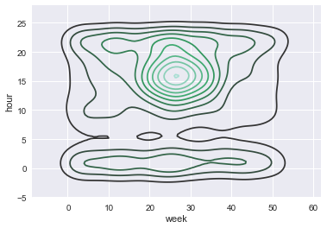

Slide 19
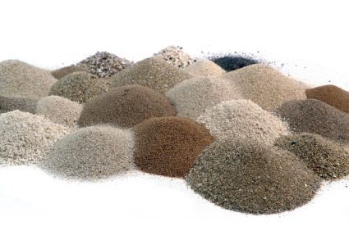

Slide 20
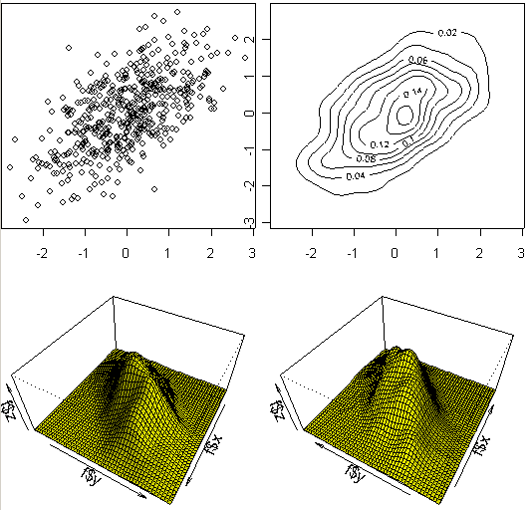

Slide 22
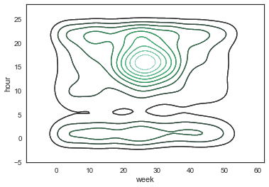

Slide 23
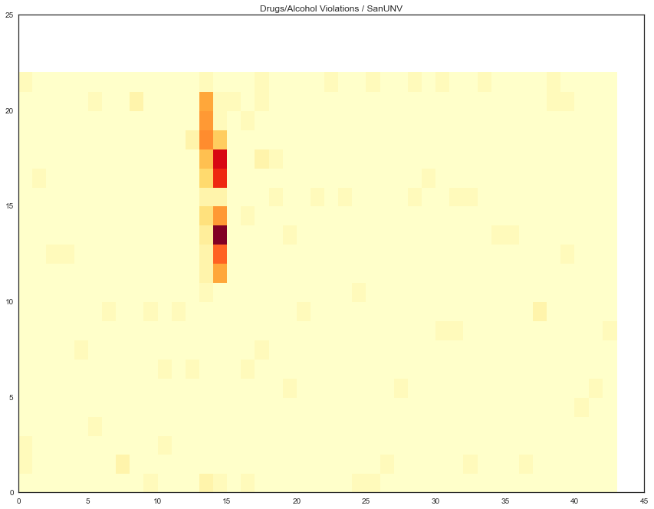
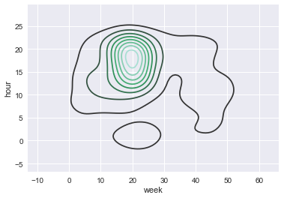

Slide 24
Heat Maps
Not just for maps
Explore different time dimensions
KDEs can smooth out the data to reveal new patterns ….
… but can also destroy patterns.

Slide 25
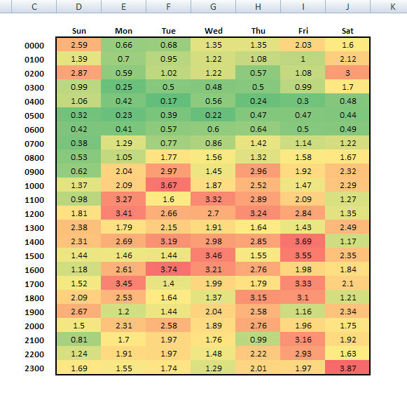
Making Heat Maps

Slide 26
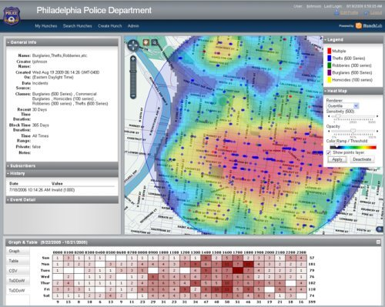
Making Heat Maps
Azavea Hunch Lab
http://www.azavea.com/products/hunchlab/

Slide 27
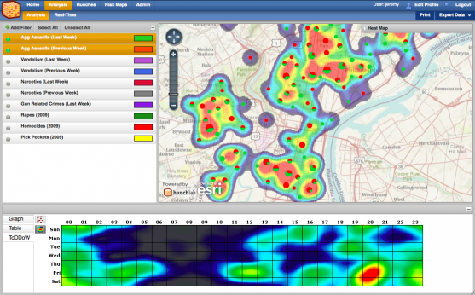

Slide 28
Crime Analysis With Rhythm Maps
The San Diego Regional Data Library
Eric Busboom, eric@sandiegodata.org
http://sandiegodata.org

