Slide 1

Data Warehouse Program Studi Sistem Informasi Fakultas Ilmu Komputer dan Rekayasa
Dr. Mardiani, S.Si., M.T.I

Slide 2
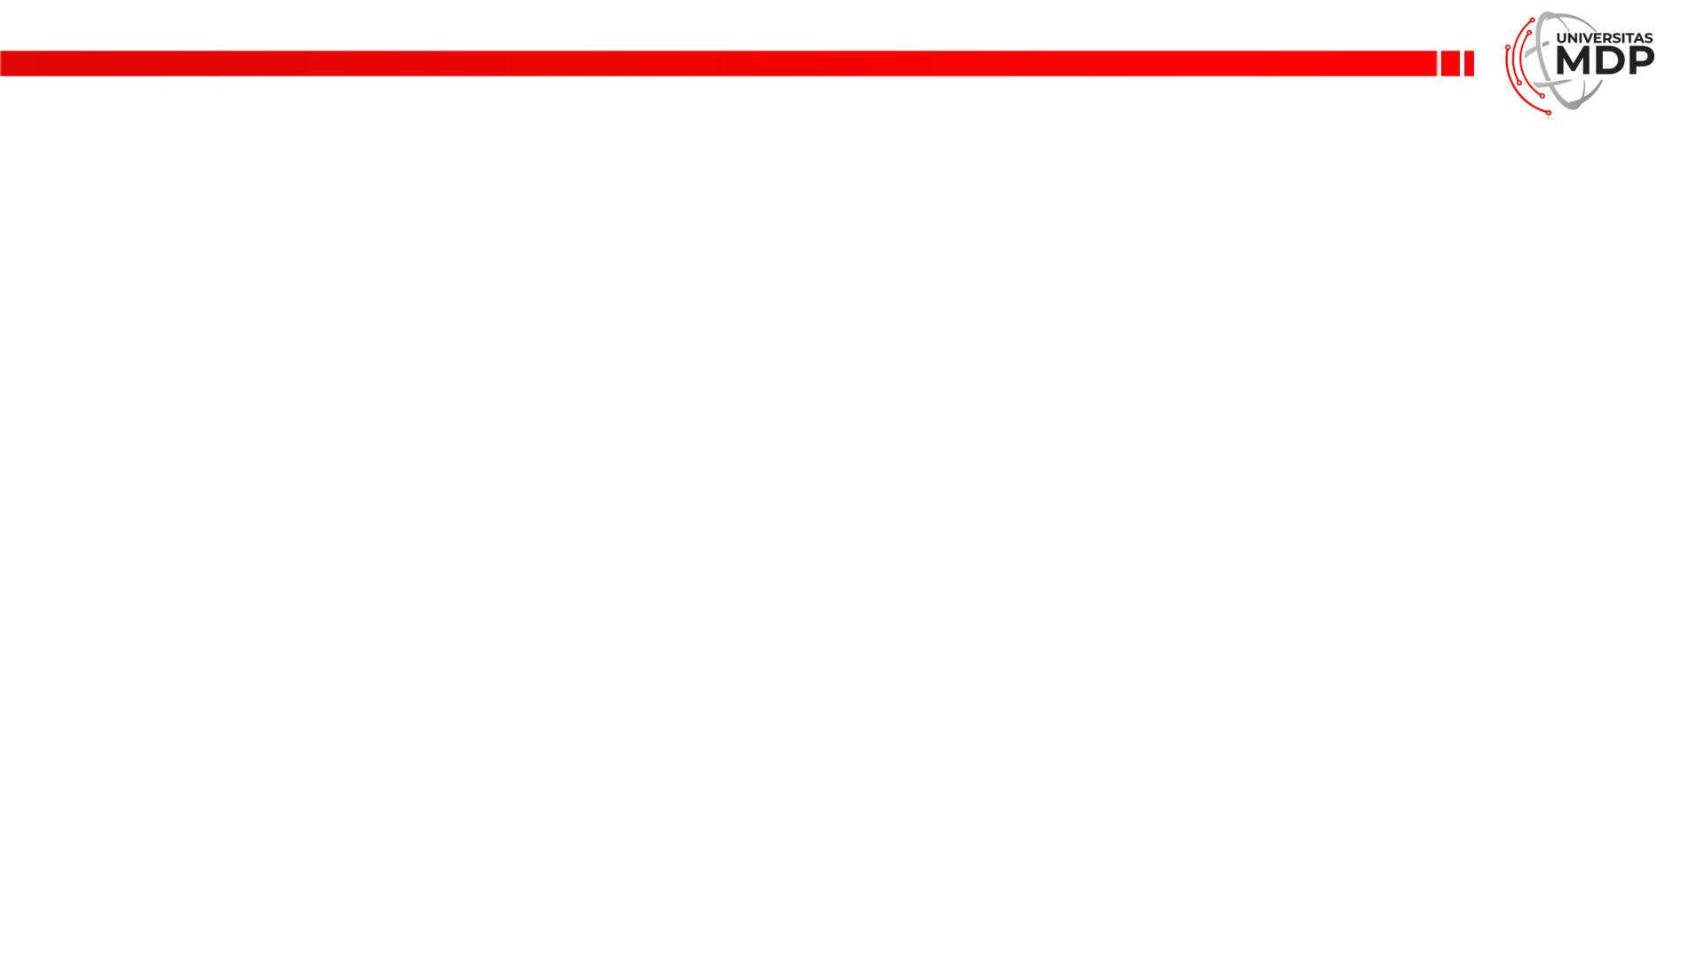
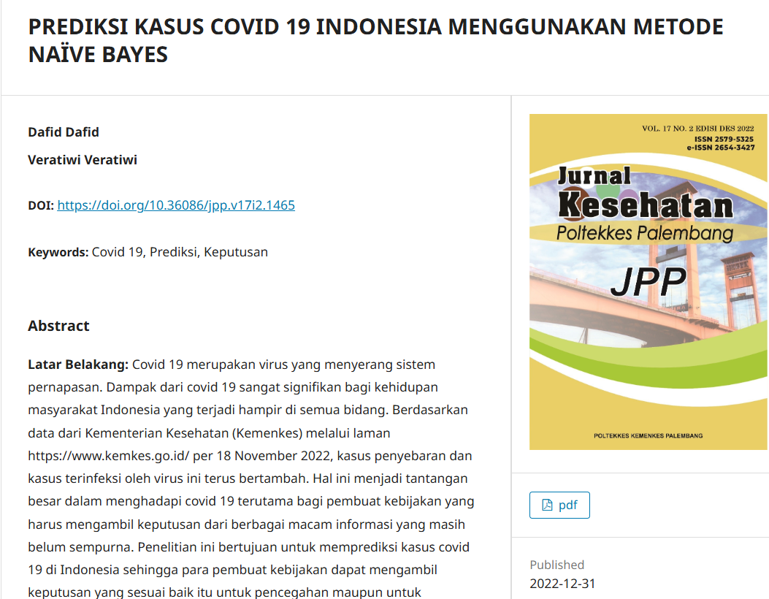
Publikasi-publikasi Data Mining

Slide 3
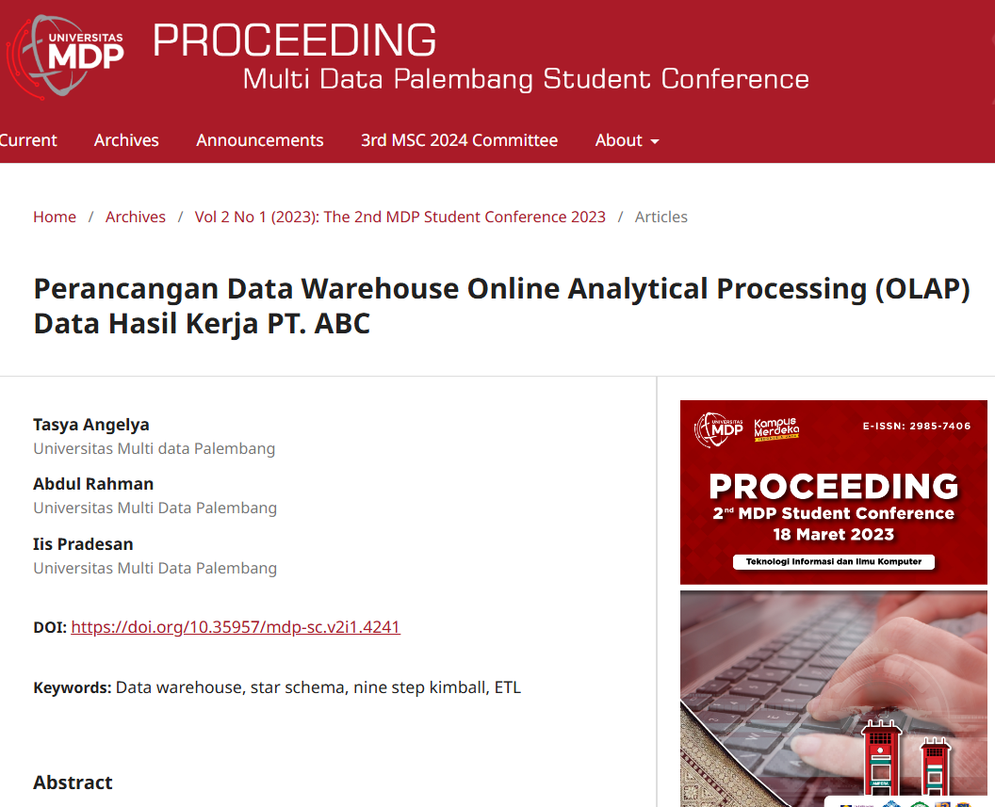
Publikasi-publikasi Data Mining

Slide 4
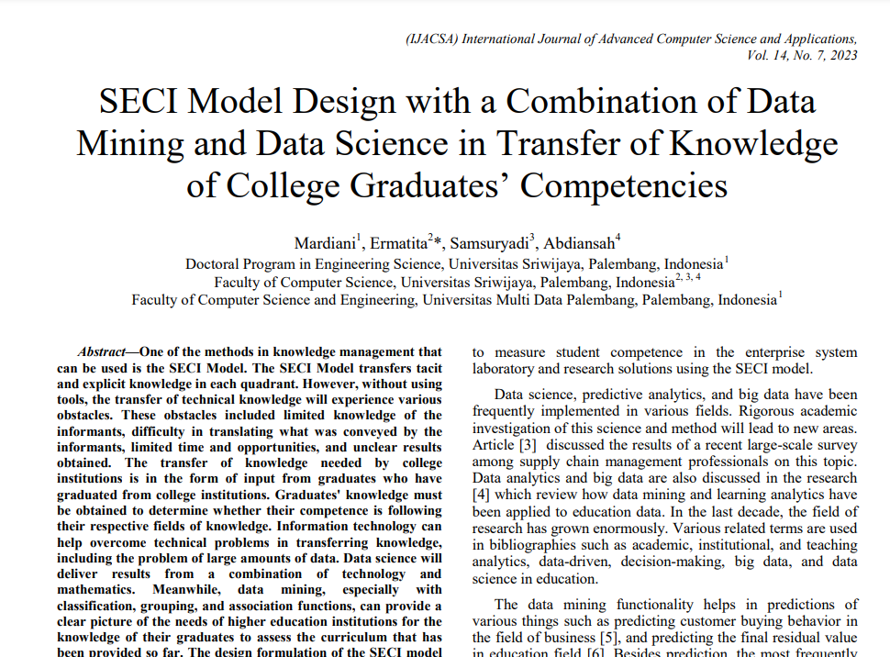
Publikasi-publikasi Data Mining

Slide 5
Algoritma-algoritma Data Mining

Slide 6
Classification

Slide 7
Dalam klasifikasi, terdapat target variabel kategori, misal penggolongan pendapatan dapat dipisahkan dalam beberapa kategori.
Beberapa algoritma klasifikasi diantaranya adalah Mean Vector, K-Nearest Neighbour, C.45, dan Bayessian.

Slide 8
Data Historis
Data historis disebut juga data latihan atau data pengalaman (trainning data), karena dari data tersebut akan didapat latihan untuk mendapatkan pengetahuan (data testing). Data historis juga disebut data lampau yang merupakan data pengalaman bagi user.
Algoritma klasifikasi akan menggunakan data latihan untuk pengetahuan yang hendak dihasilkan dalam klasifikasi data mining. Data terdiri atas dua jenis, yaitu predictor variable/pemrediksi dan target variable/tujuan.

Slide 9
Example Data
Class Attribute
Outlook | Temperature | Humidity | Windy | Play
sunny | hot | high | false | no
sunny | hot | high | true | no
overcast | hot | high | false | yes
rainy | mild | high | false | yes
rainy | cool | normal | false | yes
rainy | cool | normal | true | no
overcast | cool | normal | true | yes
sunny | mild | high | false | no
sunny | cool | normal | false | yes
rainy | mild | normal | false | yes
sunny | mild | normal | true | yes
overcast | mild | high | true | yes
overcast | hot | normal | false | yes
rainy | mild | high | true | no

Slide 10
Example Decision Tree 1
Humidity
high
normal
Outlook
Outlook
sunny
sunny
rainy
overcast
overcast
rainy
no
yes
Windy
yes
yes
Windy
true
false
true
false
no
yes
no
yes

Slide 11
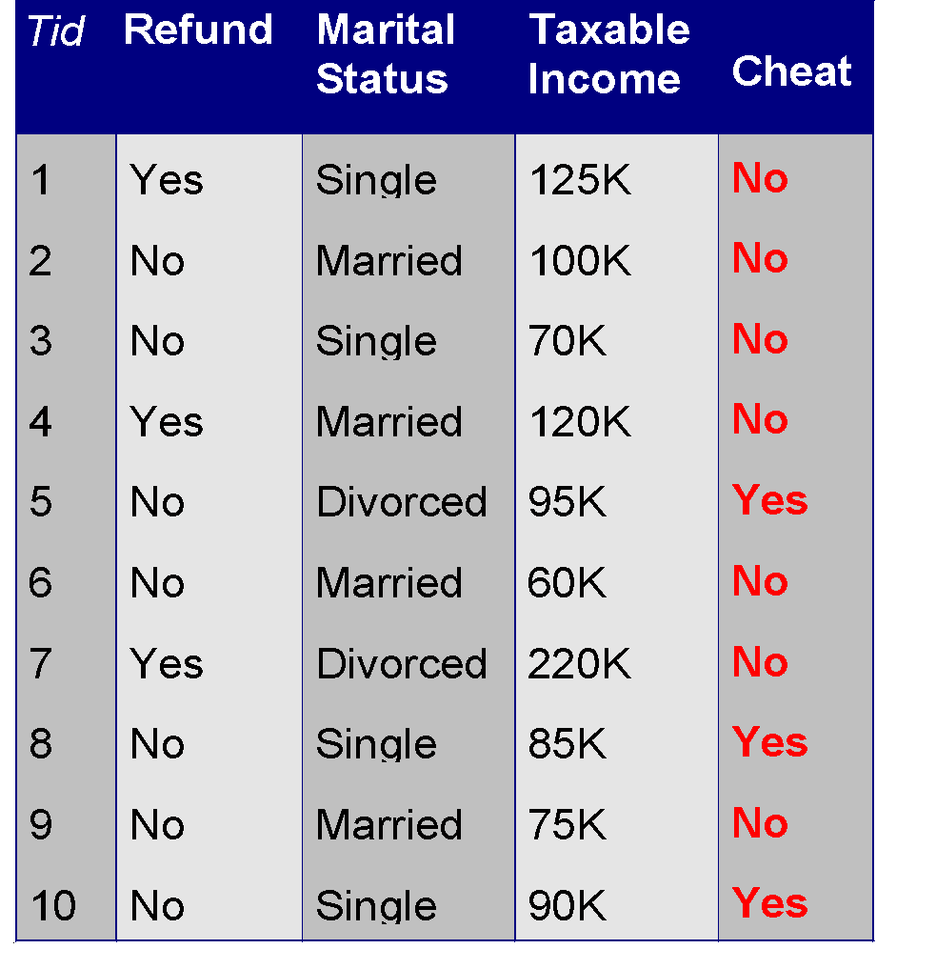
Example of a Decision Tree
categorical
categorical
continuous
class
Splitting Attributes
Refund
Yes
No
NO
MarSt
Single, Divorced
Married
TaxInc
NO
< 80K
> 80K
NO
YES
Training Data
Model: Decision Tree

Slide 12
Clustering

Slide 13
Definition
Clustering is “the process of organizing objects into groups whose members are similar in some way”.
A cluster is therefore a collection of objects which are “similar” between them and are “dissimilar” to the objects belonging to other clusters.

Slide 14
Pengklusteran merupakan pengelompokan record, pengamatan, atau memperhatikan dan membentuk kelas objek-objek yang memiliki kemiripan.
Beberapa algoritma pengelompokkan diantaranya adalah EM dan Fuzzy C-Means

Slide 15
Clustering Main Features
Clustering – a data mining technique
Usage:
Statistical Data Analysis
Machine Learning
Data Mining
Pattern Recognition
Image Analysis
Bioinformatics

Slide 16
Notion of a Cluster can be Ambiguous
How many clusters?
Six Clusters
Two Clusters
Four Clusters

Slide 17
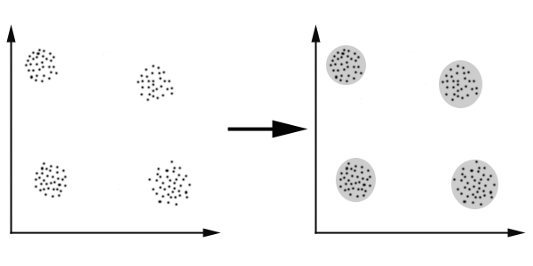
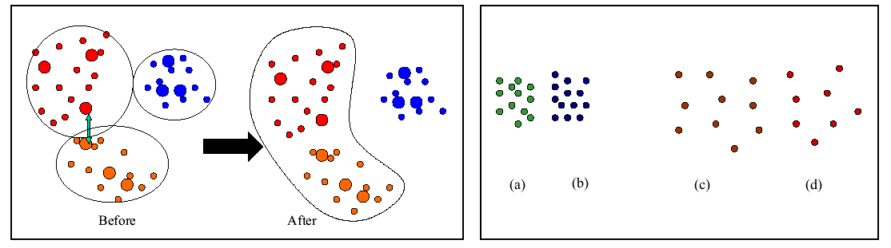
Distance based method
In this case we easily identify the 4 clusters into which the data can be divided; the similarity criterion is distance: two or more objects belong to the same cluster if they are “close” according to a given distance. This is called distance-based clustering.

Slide 18
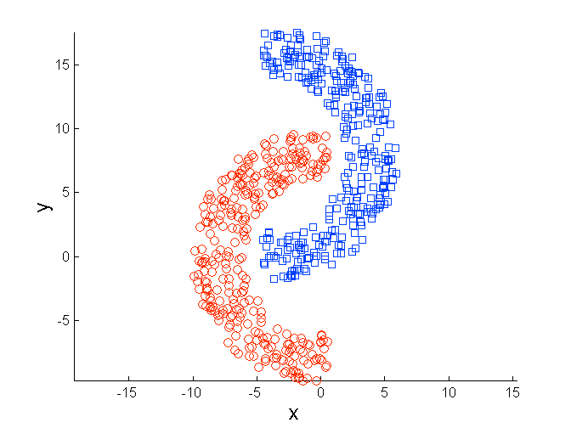
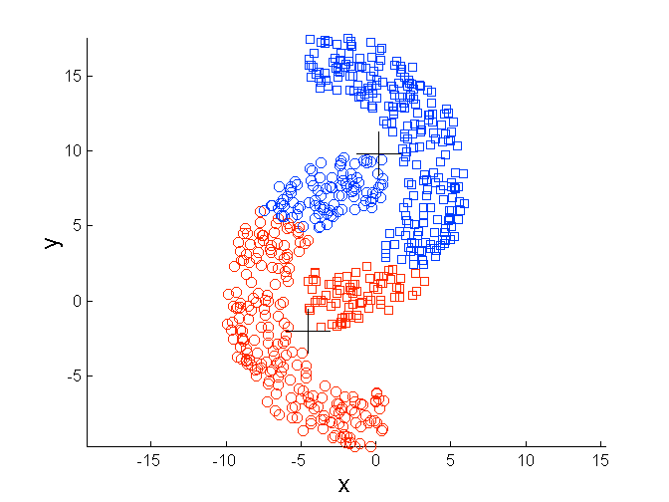
Limitations of K-means: Non-globular Shapes
Original Points
K-means (2 Clusters)

Slide 19
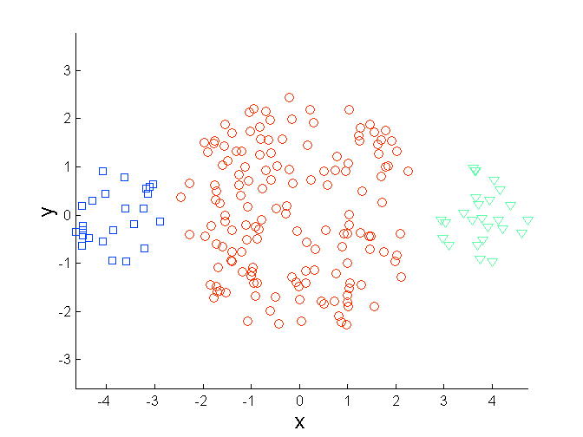
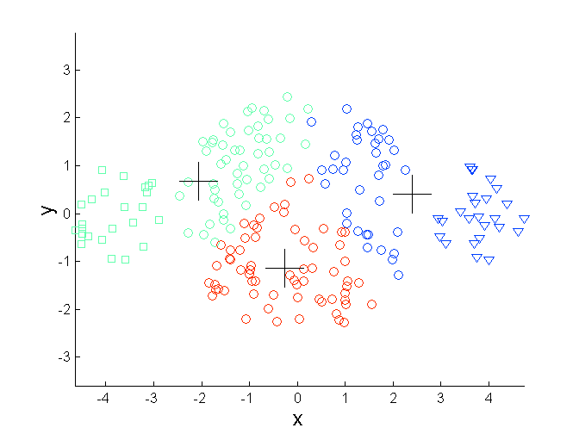
Limitations of K-means: Differing Sizes
Original Points
K-means (3 Clusters)

Slide 20
Types of Clustering
Hierarchical
Finding new clusters using previously found ones
Partitional
Finding all clusters at once

Slide 21
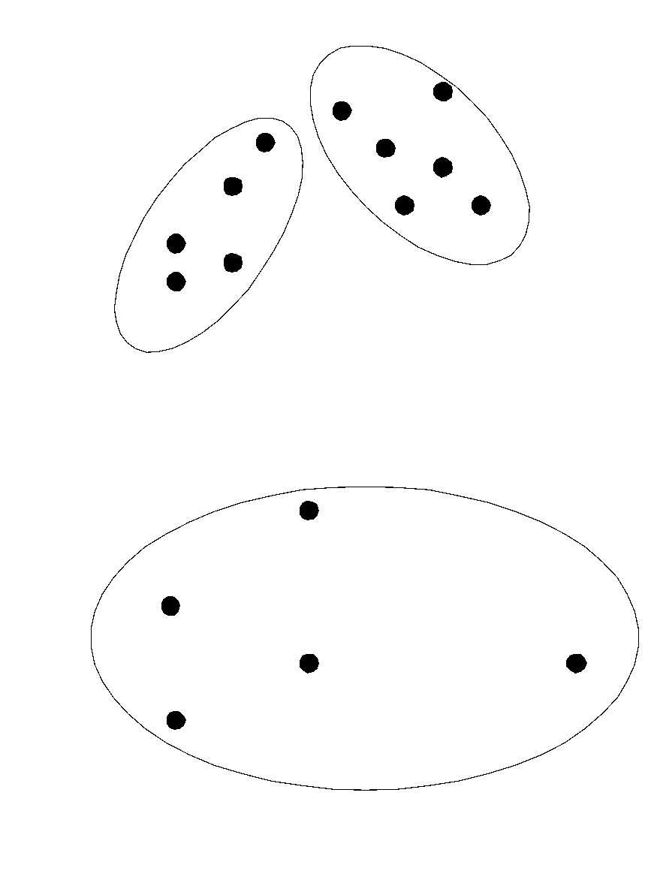
Partitional Clustering
Original Points
A Partitional Clustering

Slide 22
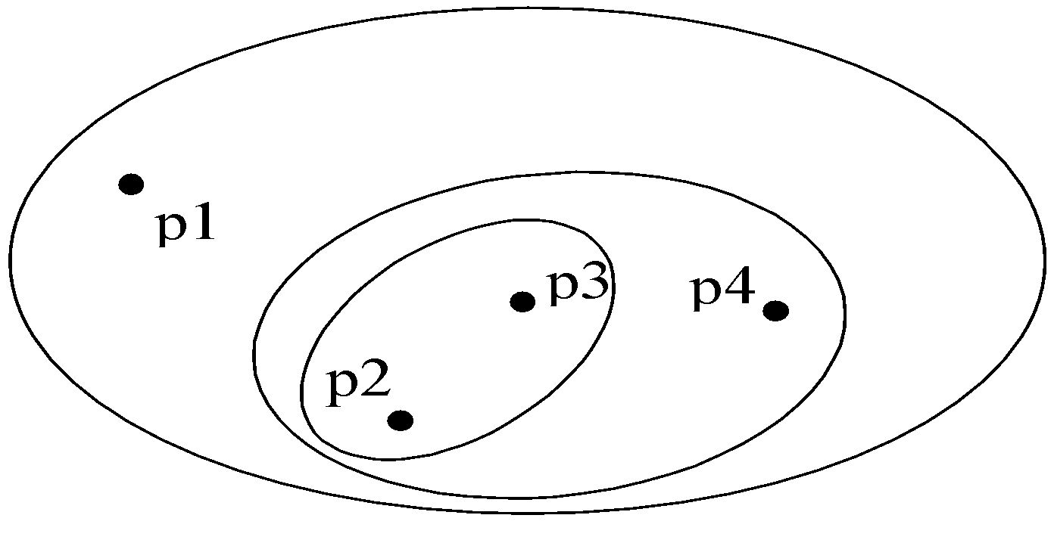
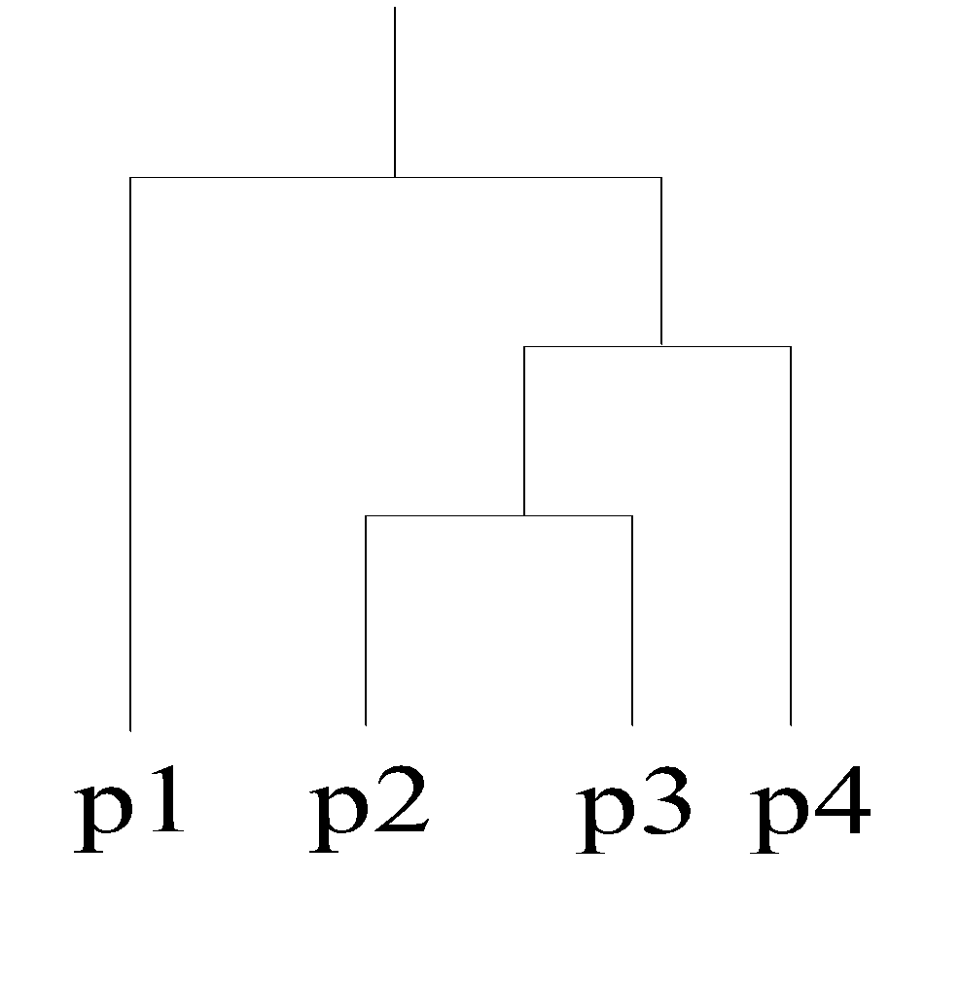
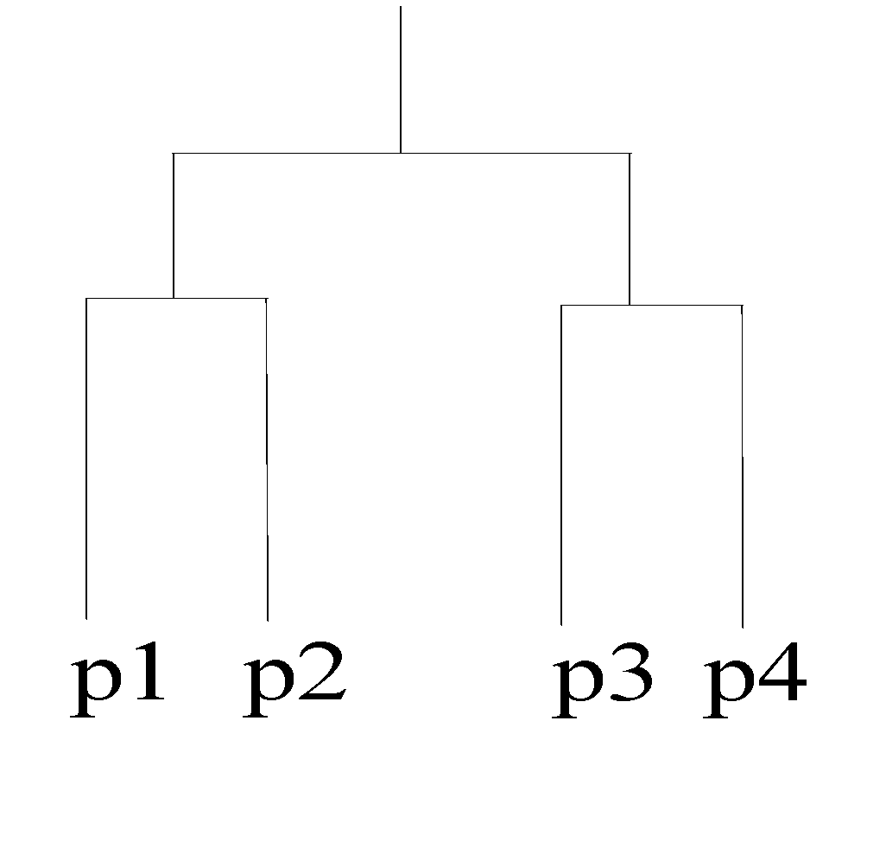
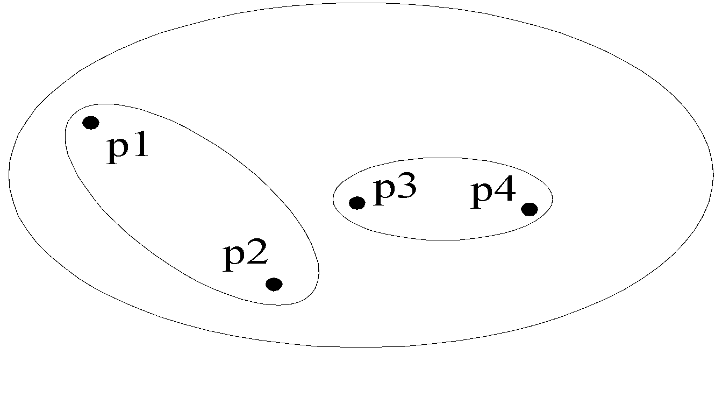
Hierarchical Clustering
Traditional Hierarchical Clustering
Traditional Dendrogram
Non-traditional Hierarchical Clustering
Non-traditional Dendrogram

Slide 23
Association

Slide 24
What Is Association Mining?
Association rule mining:
Finding frequent patterns, associations, correlations, or causal structures among sets of items or objects in transaction databases, relational databases, and other information repositories.
Applications:
Basket data analysis, cross-marketing, catalog design, loss-leader analysis, clustering, classification, etc.
Examples.
Rule form: “Body → Ηead [support, confidence]”.
buys(x, “diapers”) → buys(x, “beers”) [0.5%, 60%]

Slide 25
Tugas asosiasi data mining adalah menemukan atribut yang muncul dalam satu waktu.

Slide 26
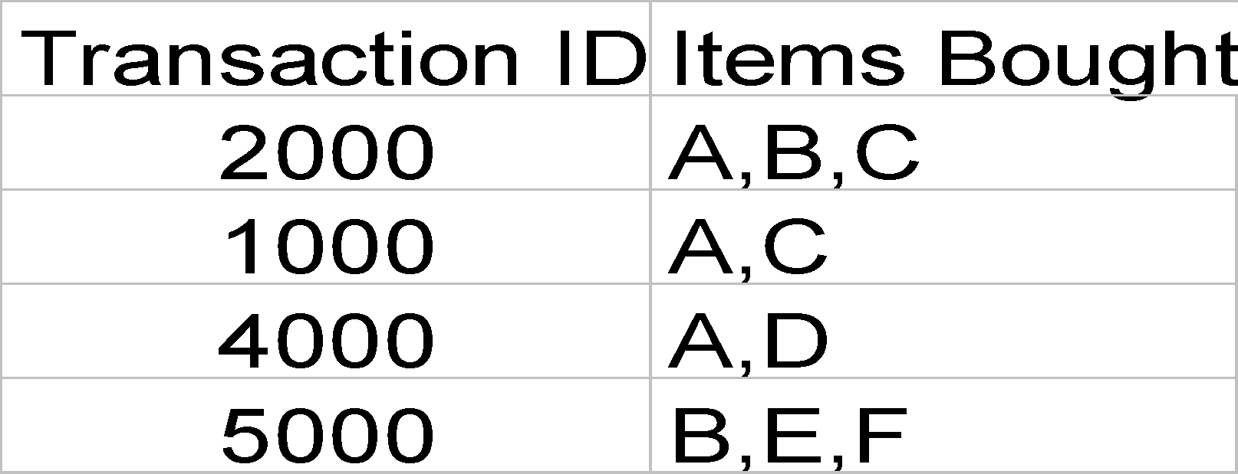
Rule Measures: Support and Confidence
Customer
buys both
Customer
buys diaper
Find all the rules X & Y ⇒ Z with minimum confidence and support
support, s, probability that a transaction contains {X  Y  Z}
confidence, c, conditional probability that a transaction having {X  Y} also contains Z
Customer
buys beer
Let minimum support 50%, and minimum confidence 50%, we have
A ⇒ C (50%, 66.6%)
C ⇒ A (50%, 100%)

Slide 27
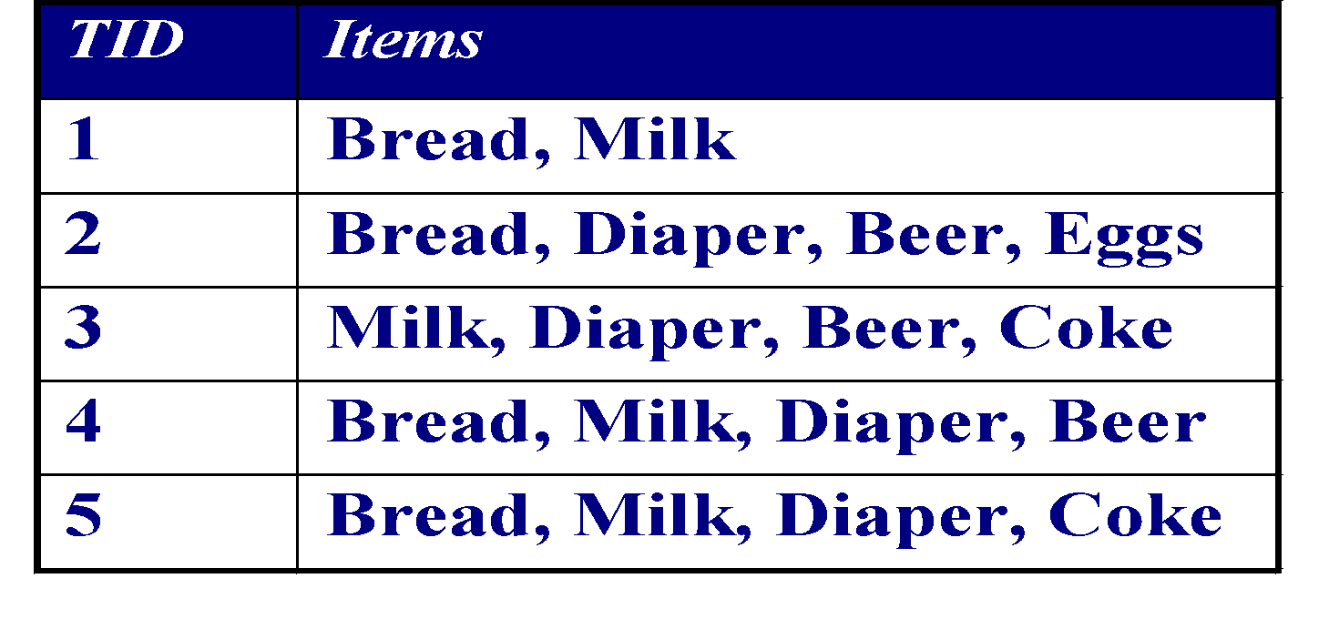
Association Rule Mining
Given a set of transactions, find rules that will predict the occurrence of an item based on the occurrences of other items in the transaction
Market-Basket transactions
Example of Association Rules
{Diaper} → {Beer}, {Milk, Bread} → {Eggs,Coke}, {Beer, Bread} → {Milk},

Slide 28
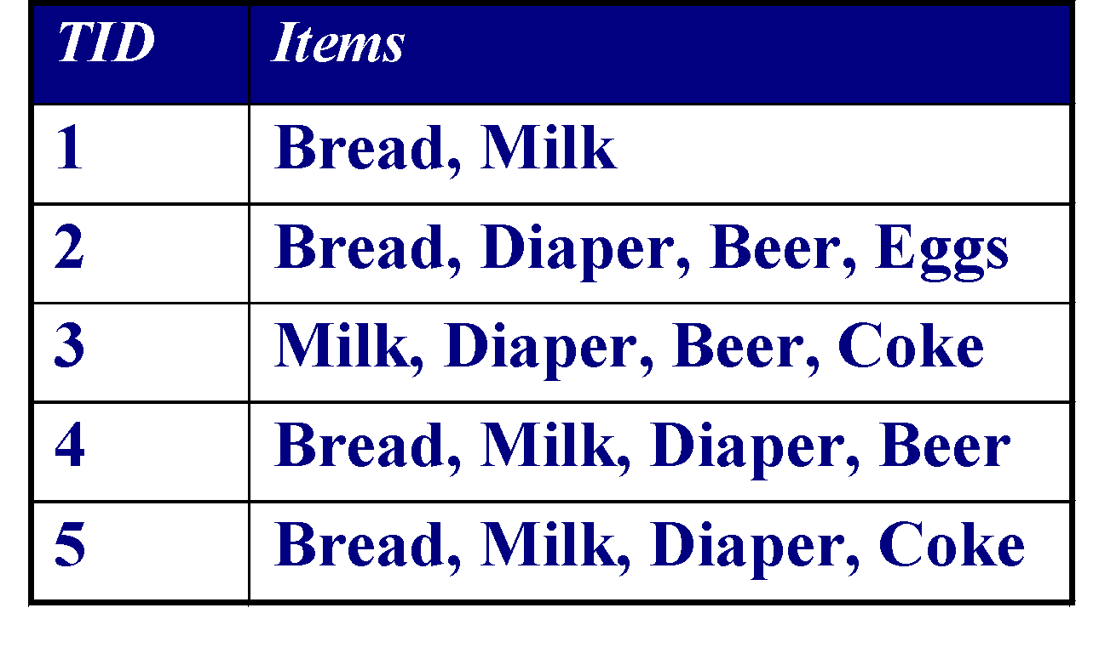
Definition: Frequent Itemset
Itemset
A collection of one or more items
Example: {Milk, Bread, Diaper}
k-itemset
An itemset that contains k items
Support count (σ)
Frequency of occurrence of an itemset
E.g. σ({Milk, Bread,Diaper}) = 2
Support
Fraction of transactions that contain an itemset
E.g. s({Milk, Bread, Diaper}) = 2/5
Frequent Itemset
An itemset whose support is greater than or equal to a minsup threshold

Slide 29

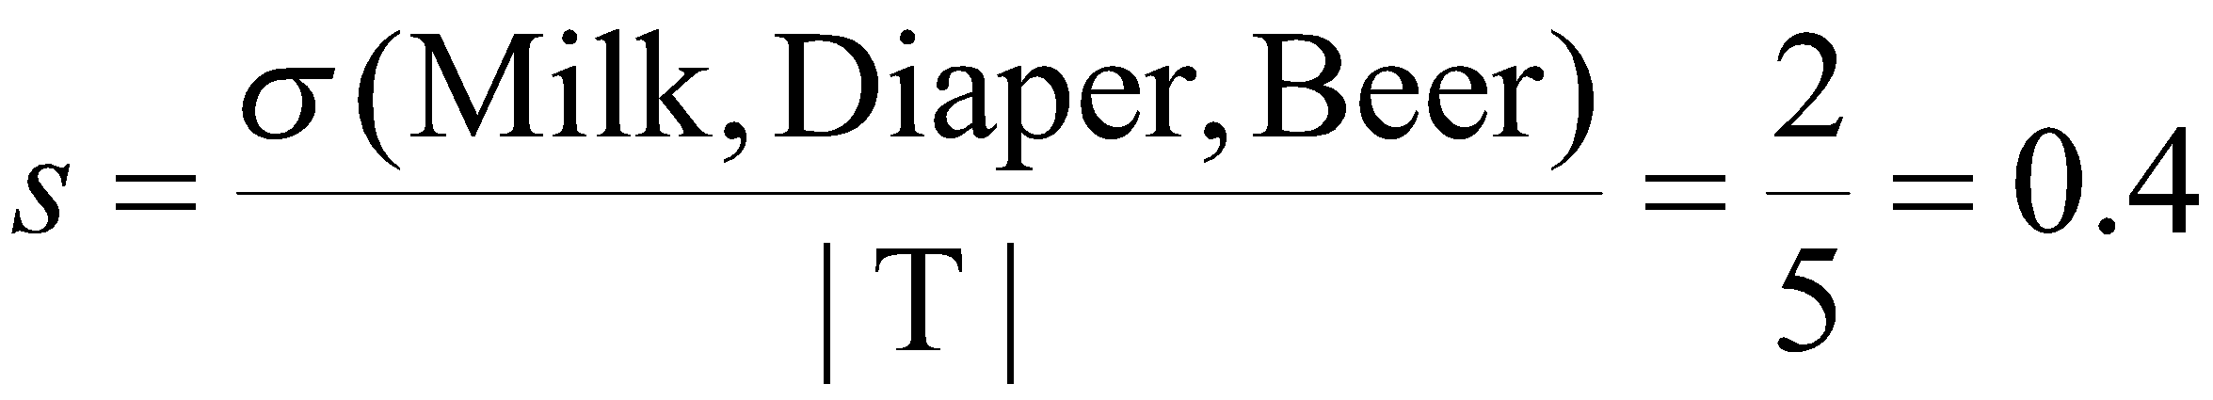
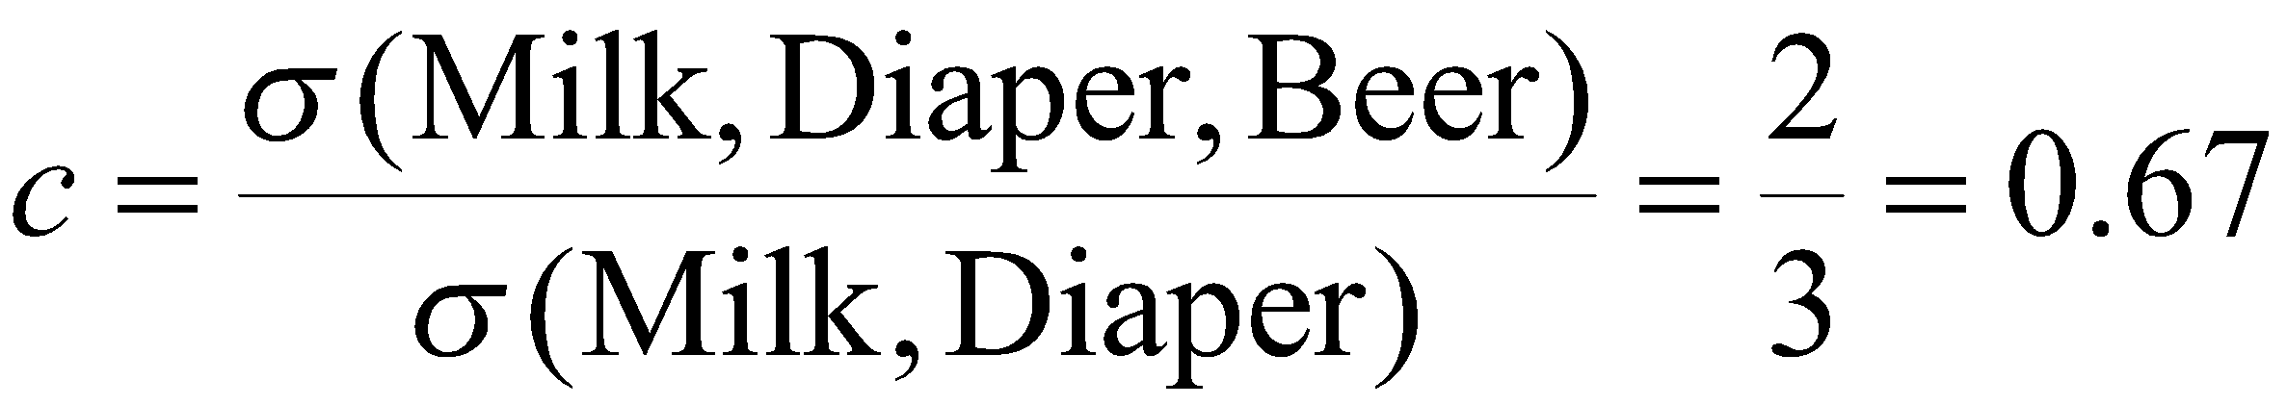
Definition: Association Rule
Example:
Example of Rules:
{Milk,Beer} → {Diaper}
{Diaper,Beer} → {Milk}
{Beer} → {Milk,Diaper}
{Diaper} → {Milk,Beer}
{Milk} → {Diaper,Beer}

Slide 30
Definition: Association Rule
Example:
Example of Rules:
{Milk,Beer} → {Diaper}
{Diaper,Beer} → {Milk}
{Beer} → {Milk,Diaper}
{Diaper} → {Milk,Beer}
{Milk} → {Diaper,Beer}
(s=0.4, c=1.0)
(s=0.4, c=0.67)
(s=0.4, c=0.67) (s=0.4, c=0.5)
(s=0.4, c=0.5)

Slide 31
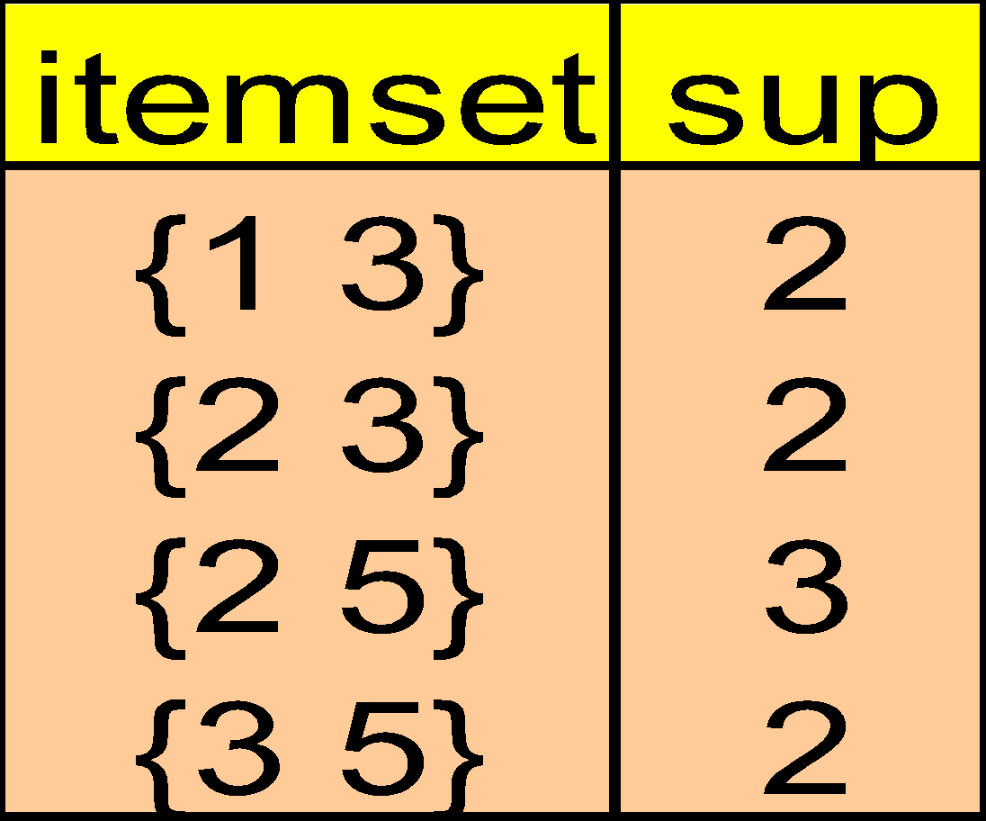
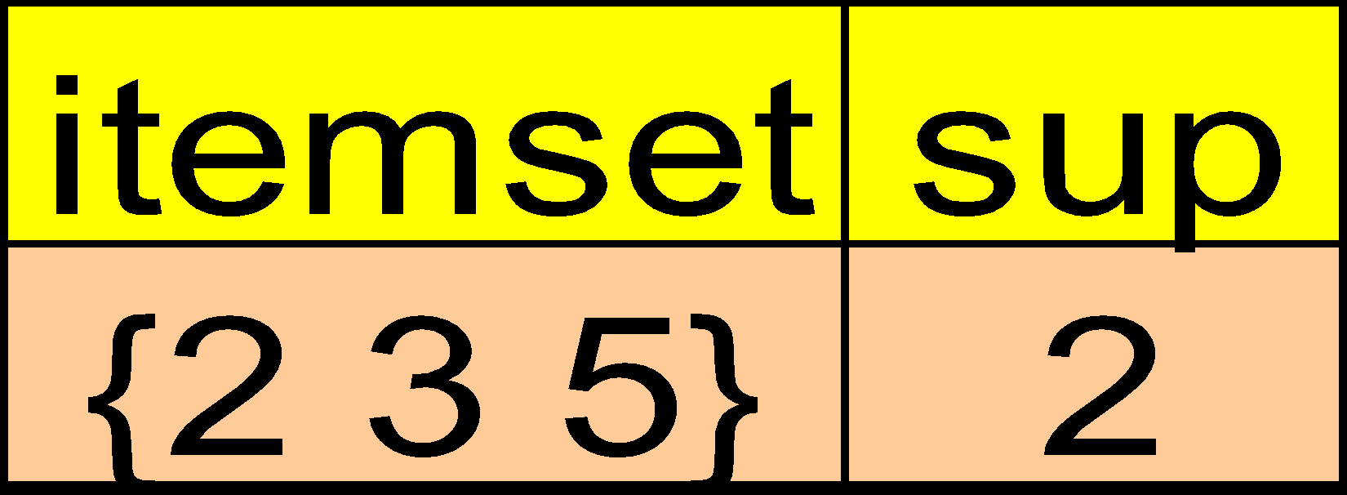
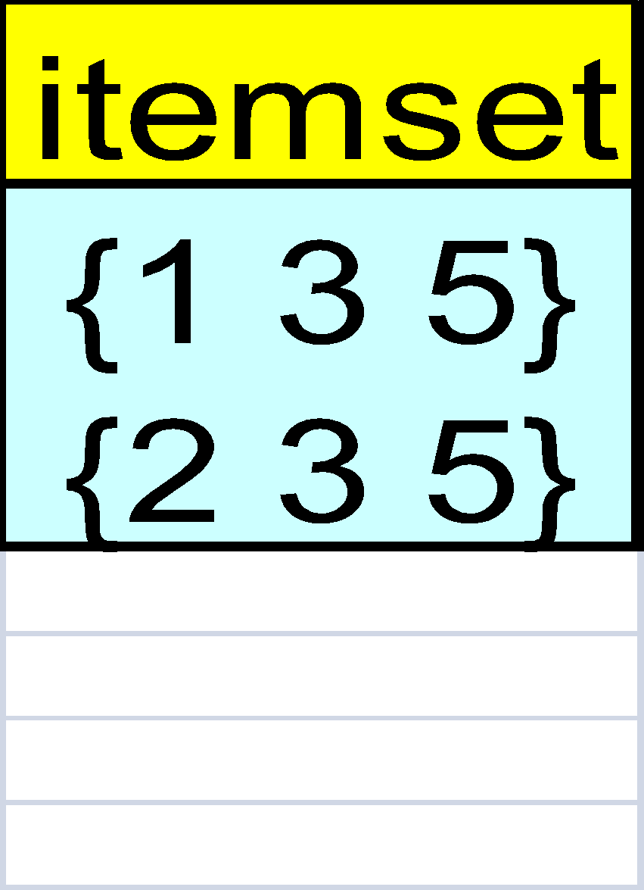
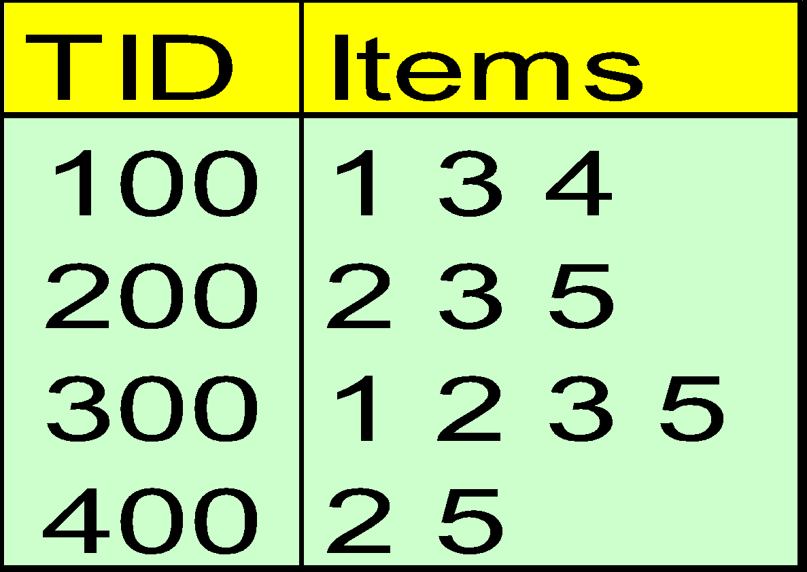
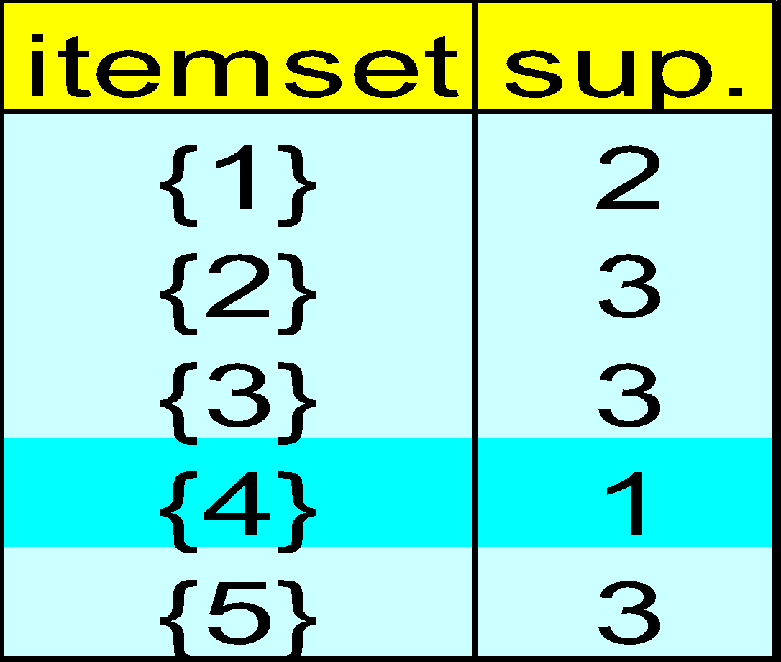
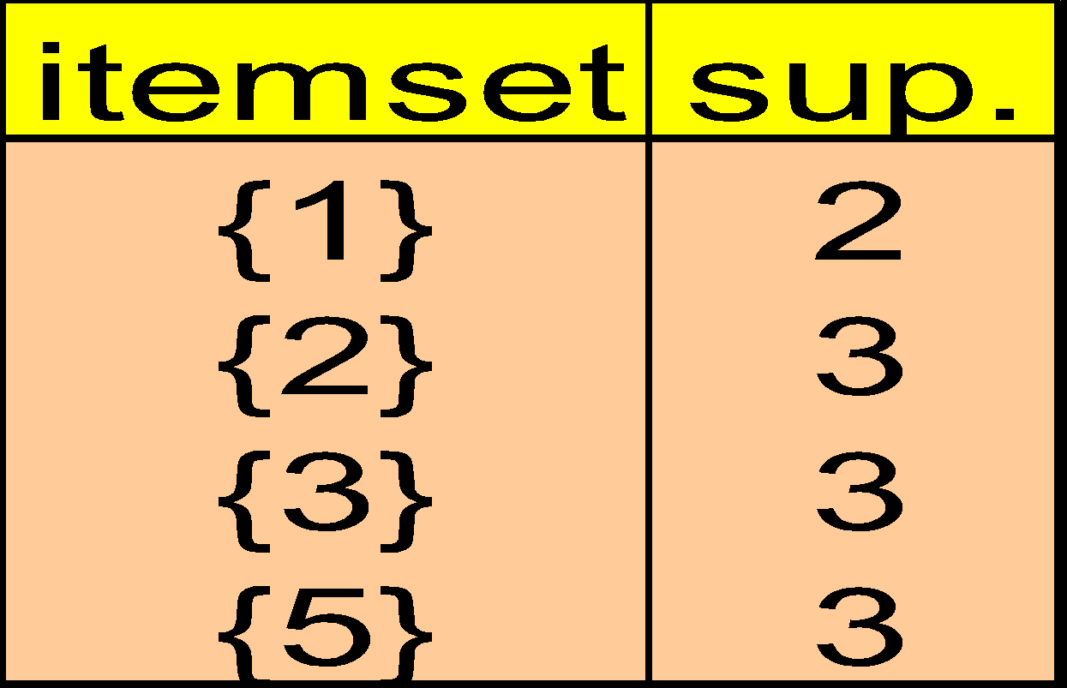
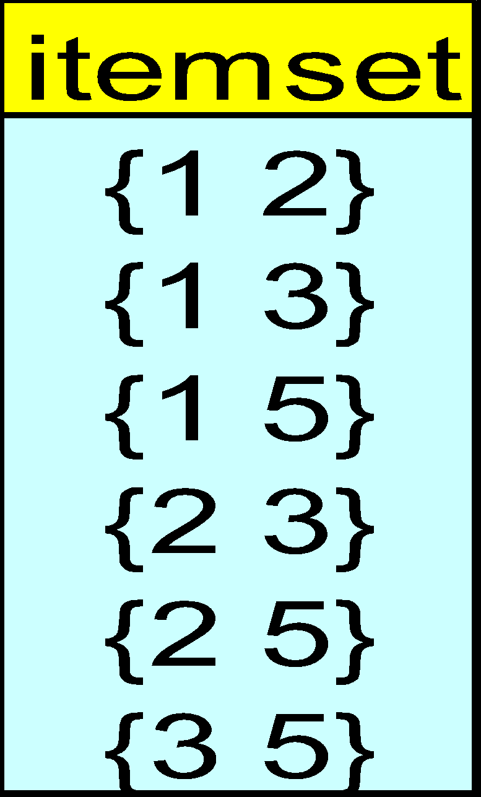
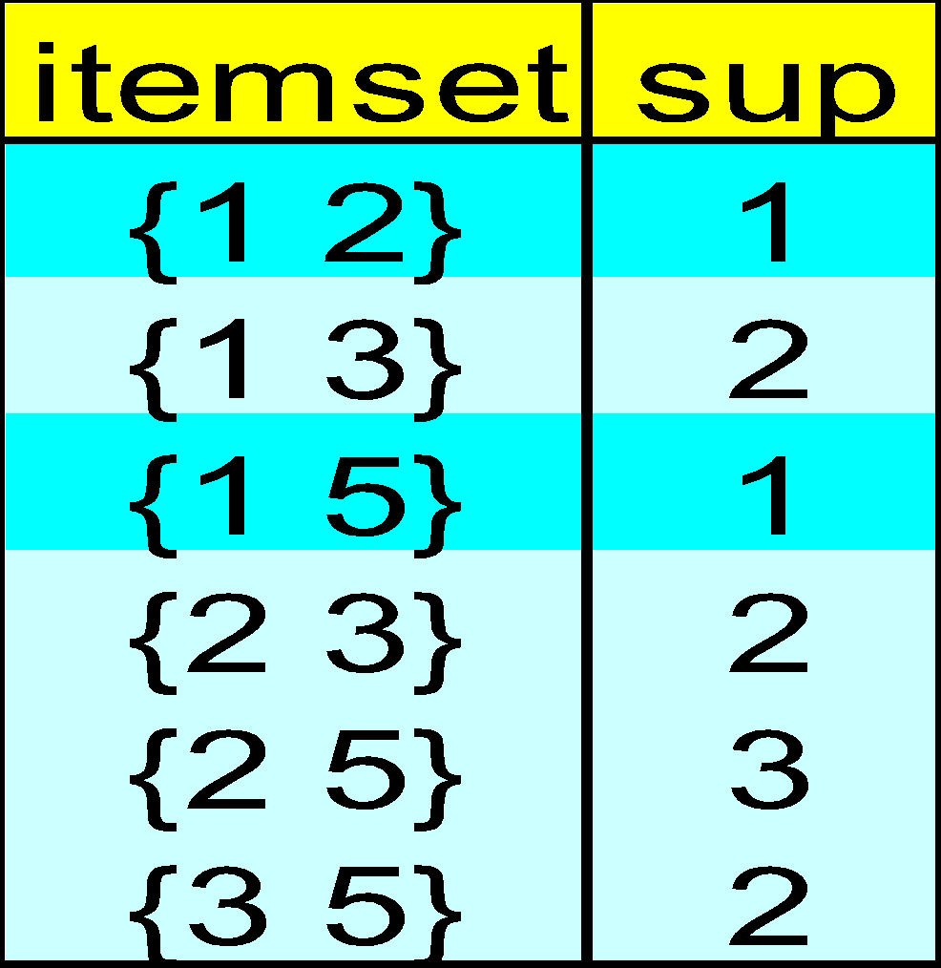
The Apriori Algorithm — Example
Database D
L₁
C₁
Scan D
C₂
C₂
L₂
Scan D
C₃
Scan D
L₃

Slide 32
Asosiasi dengan Business Intelligence
pada SQL Server

Slide 33
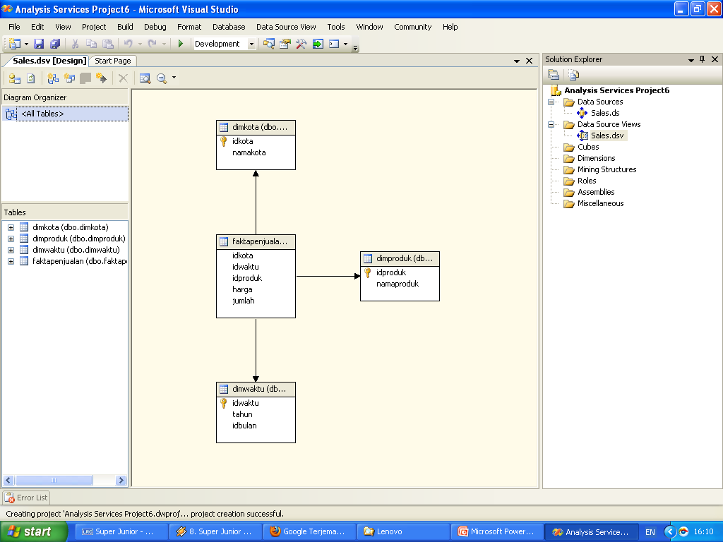

Slide 34
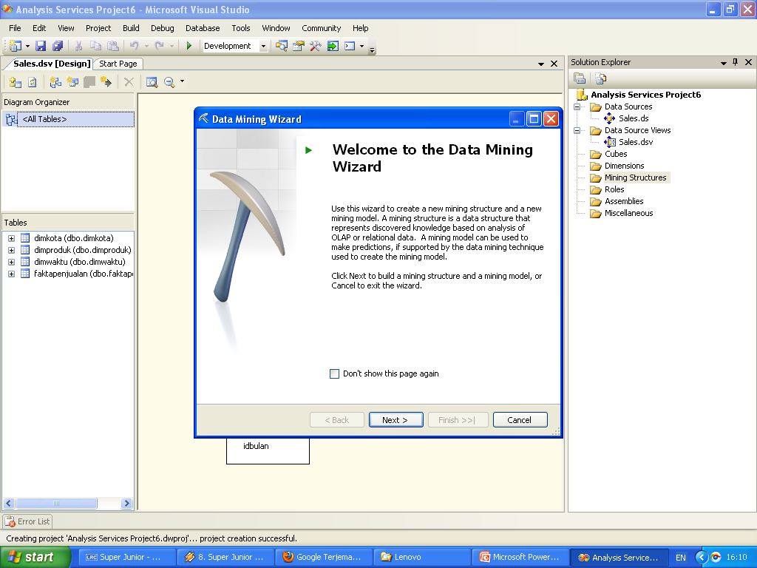

Slide 35
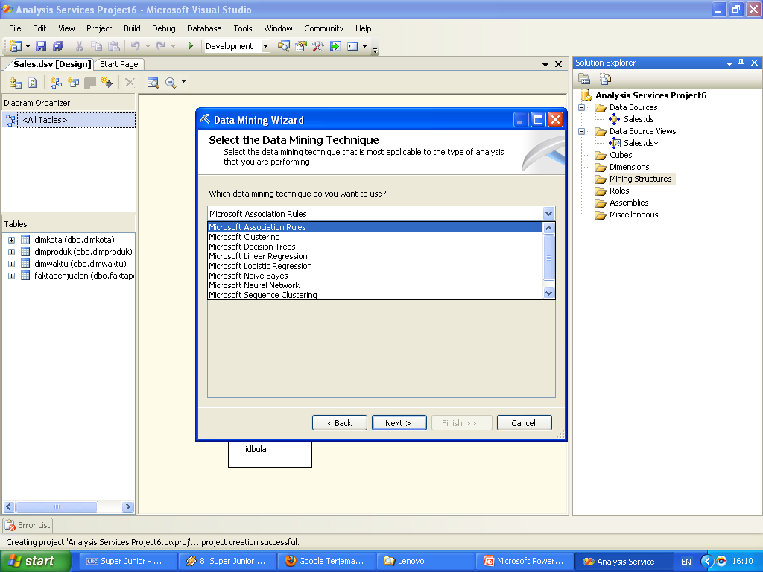

Slide 36
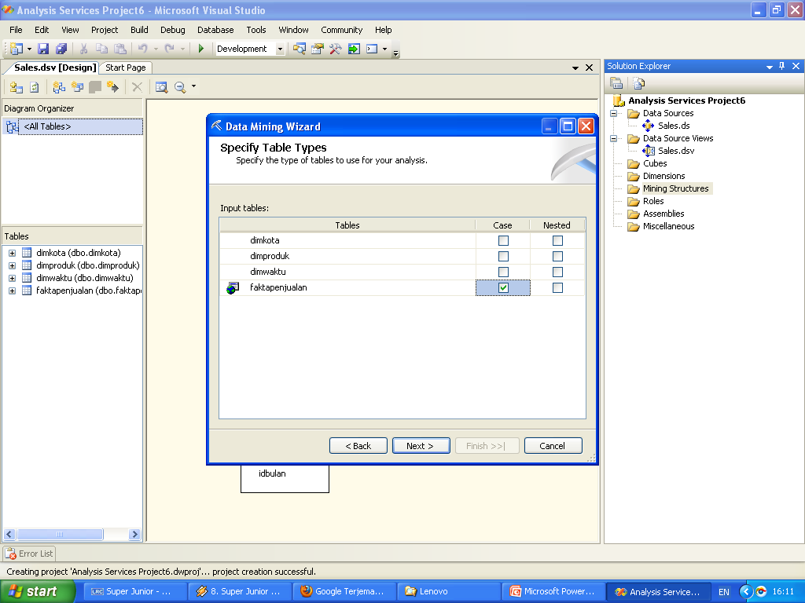

Slide 37
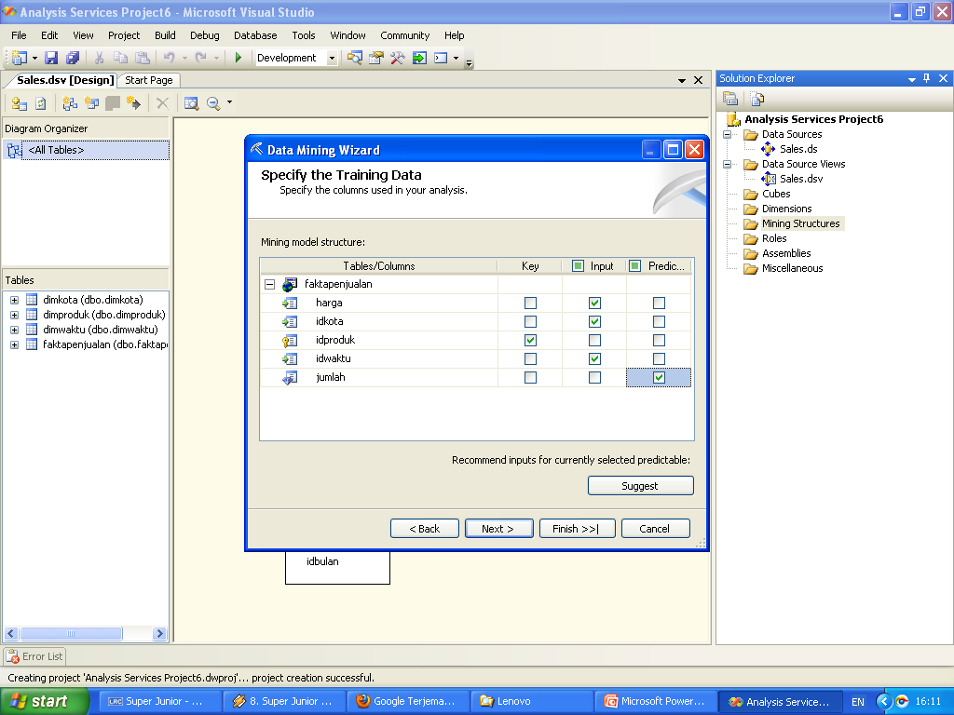

Slide 38
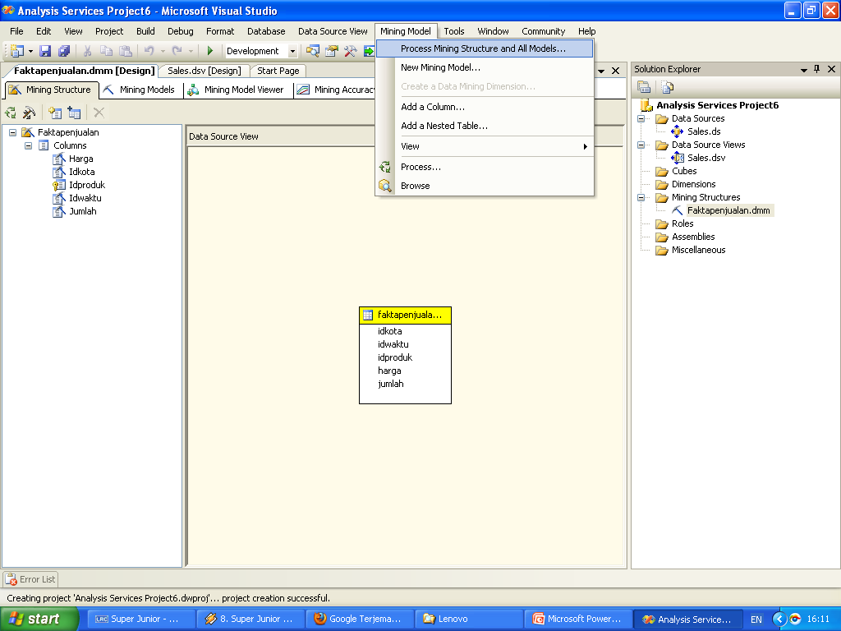

Slide 39
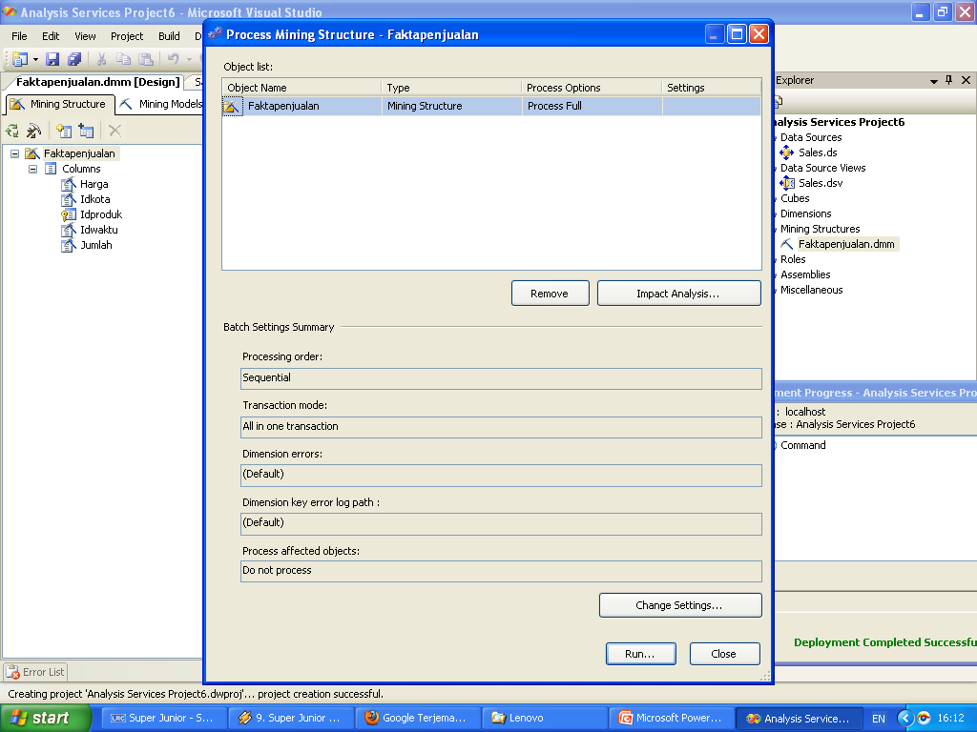

Slide 40
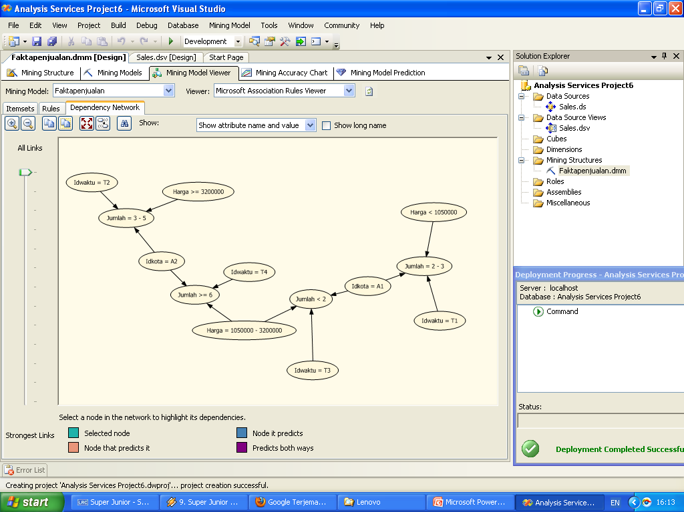

Slide 41
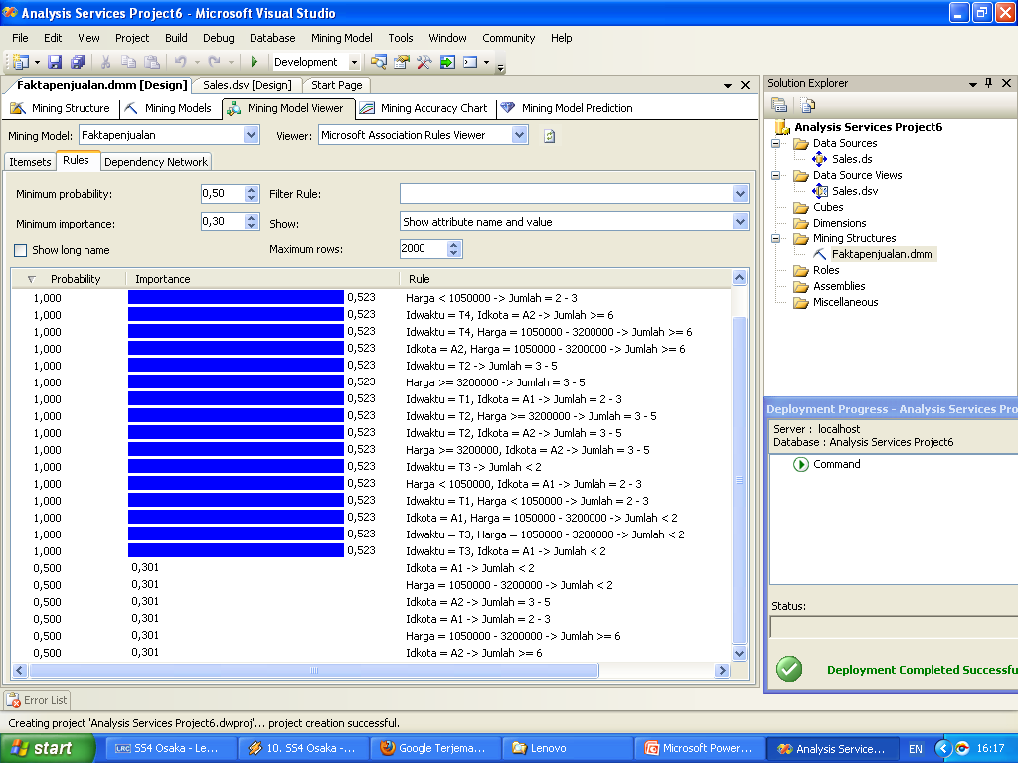

Slide 42
TERIMA KASIH
Dr. Mardiani, S.Si., M.T.I

