Slide 1
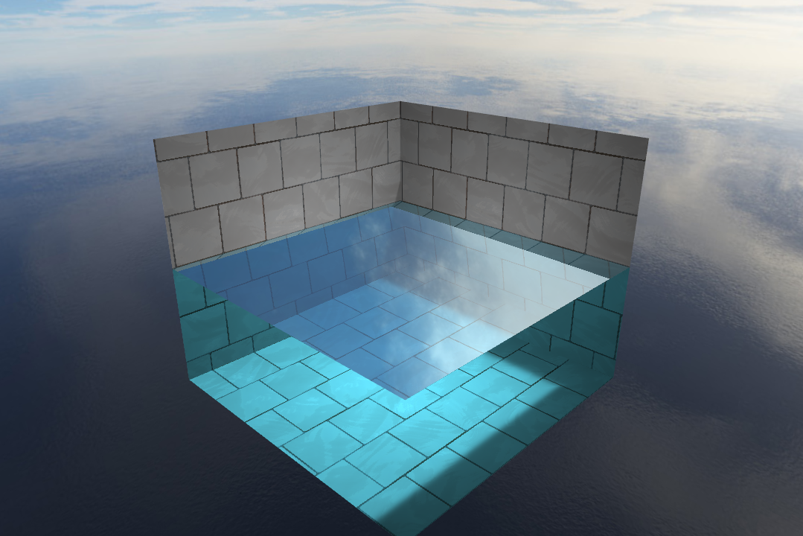
WebGL Interactive Water
Alpha
Binglu Du, Xinjie Ma

Slide 2
Introduction
WebGL
Extreme mobility & Cross-platform compatibility
Inspiration
http://madebyevan.com/webgl-water/ by Evan Wallace
Tasks
Water Shader
Interaction: Water Simulation
Fast, Real-time, Interactive

Slide 3
Demo
What we have now
Framework from scratch
Environment - Pool, Sky
Still Water Shader
Soft Shadow
Reflection/Refraction
Mouse Click Raytrace
Live Demo
http://dblsai.github.io/WebGL-Fluid

Slide 4
Future Work
Height Field
Water Simulation
Sphere, Cube, Obj Interaction
Caustics

