Slide 1
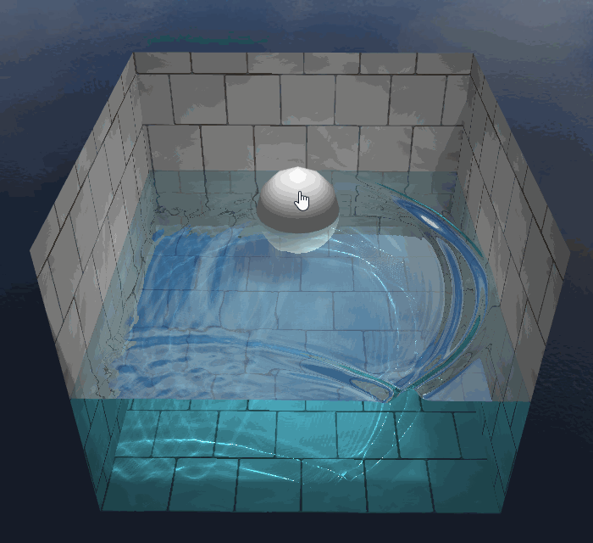
WebGL Interactive Water
Beta
Binglu Du, Xinjie Ma

Slide 2
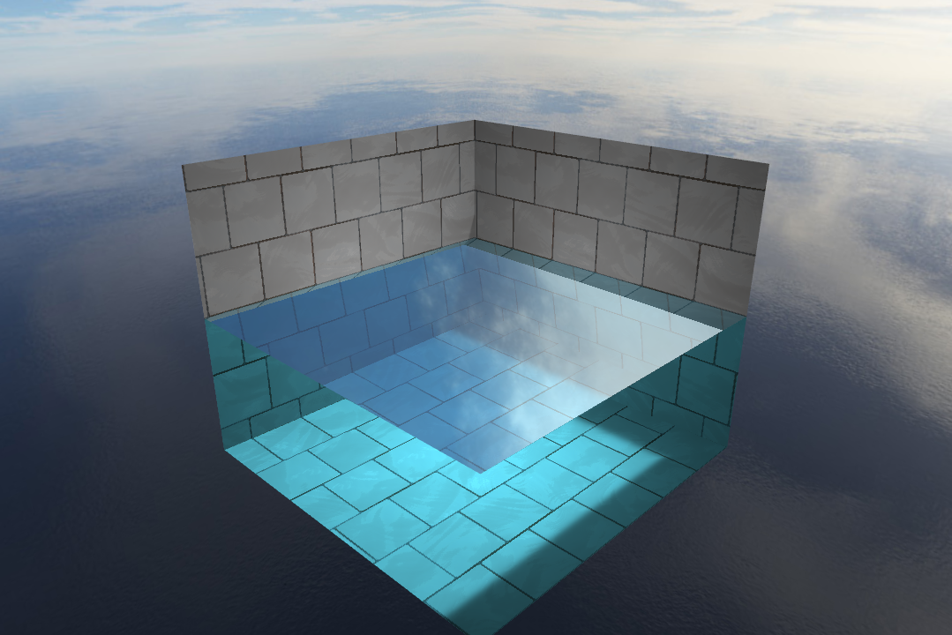
Alpha Features
Framework from scratch
Environment - Pool, Sky
Still Water Shader
Soft Shadow
Reflection/Refraction
Mouse Click Raytrace

Slide 3
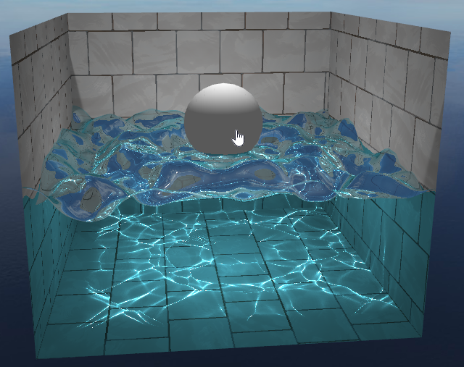
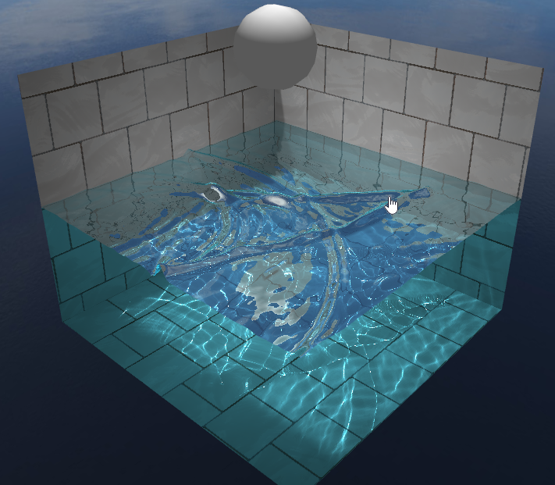
More in Beta
Water Simulation
Height Field
Sphere, Mouse Interaction
Caustics

Slide 4
Water Simulation
Simulation Data
gl.RGBA gl.FLOAT texture [height.y, normal.x, normal.z, speed.y]
Simulation Shaders
Height Map shader: height.y is updated by mouse click/sphere movement.
Normal Map shader: normal.x and normal.z is updated with new height information. normal.y can be recovered when used.
Step simulation: speed.y is calculated. the speed is also attenuated to eventually stop the wave pattern.
Water Mesh Shader
[height.y, normal.x, normal.z, speed.y] is passed into water mesh shaders as useful information to render out the water simualtion.
Notes:
height += drag (based on dist to click center)
normal = cross (dH/dx, dH/dy)
speed += (averageHeight - Height), averageHeight = (sum of 4 neighbouring Heights)/4
height += volume in water (oldCenter), height -= volume in water(newCenter)

Slide 5
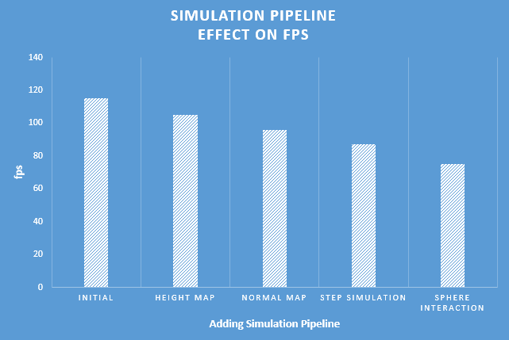

Slide 6
Caustics
Caustics result from light rays reflecting or refracting from a curved surface and hence focusing only in certain areas of the receiving surface
Two assumption:
Sun is directly above
floor is lit by rays emanating vertically above the point of interest
Calculate two refract rays, one is using vertical normal and the other is using the real normal
Write caustic value to caustic map
Notes:
Computing underwater caustics accurately is a complex process: millions of individual photons are involved
Here we simplify the computation process by making some assumptions:
Sun is directly above
floor is lit by rays emanating vertically above the point of interest: caustics will be maximal for vertical rays and will not be as visible for rays entering water sideways.
for each point we calculate two refract rays, one is using vertical normal and the other is using the real normal. And we get the caustic value by compare the two refract rays,
Then write the caustic value to the caustic map.

Slide 7
Demo
http://dblsai.github.io/WebGL-Fluid

Slide 8
Future Work
More obj interaction
User input(change force, light position etc.)
Other water shader effects
Wind and rain drop effects

