Slide 1
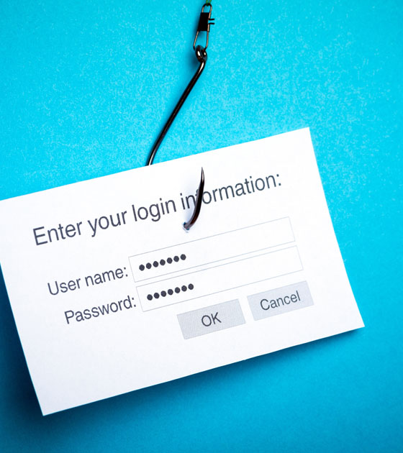
PHISHING AWARENESS TRAINING
Eric Thimi Alappatt
CodeAlpha Cybersecurity Internship Task-2

Slide 2

WHAT IS PHISHING?
Phishing is an online scam where criminals send fraudulent email messages, appearing legitimate. The emails contain links or attachments that trick recipients into entering confidential information (e.g. account numbers, passwords) into fake websites, or they infect computers with malware.
Phishing attempts involve deceiving individuals through messages, e-mail to reveal sensitive data.
Attackers often masquerade as a legitimate entities and mimic popular online services.

Slide 3
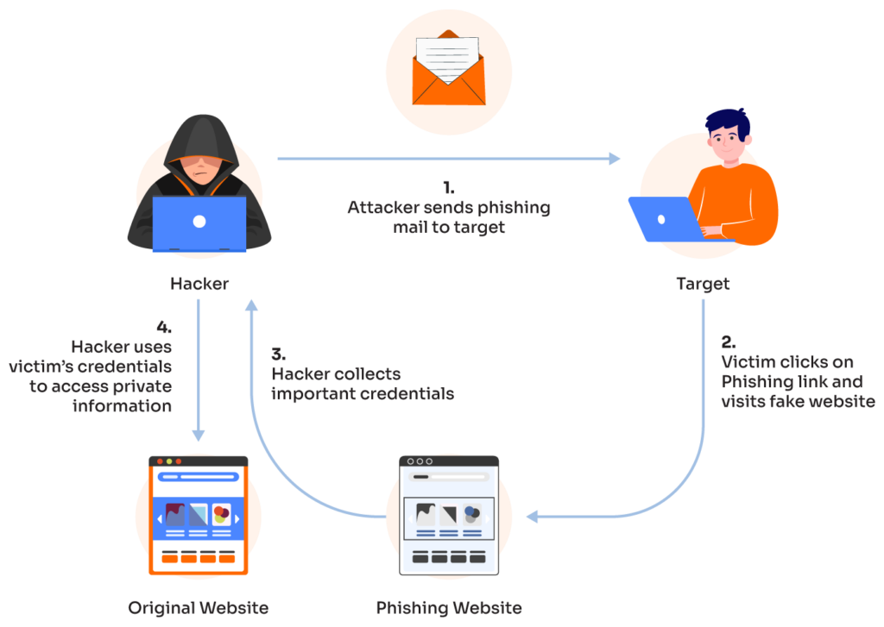
HOW PHISHING WORKS?
Email Delivery:- Attackers send email disguised as legitimate sources, often using similar logos and mimicking as real time software.
Clicking the Bait:- The email contains a link or attachment that, when clicked, triggers the next step.
Fake Website:- This link leads to a fraud website, duplicating the look and feel of a legitimate website.
Information Sharing:- Unaware of deception, the victim enters their login, personal details on fake site.
Data Theft:- The Attacker successfully captures the entered information for malicious purposes.

Slide 4





C
B
E
1
D
TYPES
MAKE PEOPLE ACCEPT ONE IDEA
SHARE IDEA
SLIDES ARE JUST A TOOL
BE SPECIFIC
PRESENT SINGLE IDEAS
It is much easier for an audience to understand and follow.
Share idea in the best way possible. By Telling a story or by explaining a real life example.
Phishing
People need time to absorb your ideas before going to another idea.
People need to know what to expect in order to get involved and interested in what you have to say.
You can use the medium of a presentation to help transfer your message, but it cannot do the job for you.

Slide 5





1
2
3
4
5
TEN
SPEAR PHISHING
SMISHING
CLONE PHISHING
VISHING
WHALING
Targeted attempt to steal sensitive information, typically focusing on a specific individual. These types of attack use personalized facts in order to appear legitimate.
Phone scam, and has the most human interaction of all the phishing attacks. Calls are often made through a spoofed ID, so it looks like a trustworthy source.
Steal sensitive information from senior-level. Whaling emails contain highly personalized information about the target organization, so they are more difficult to detect.
Use of text (SMS) messages, as opposed to emails, to target victims. Fraudsters send a text message to an individual, usually calling for the individual to act.
Used to create an identical email with malicious content. The cloned email will appear to come from the original sender and will contain malicious attachments.
steps

Slide 6
SUCCESSFUL ATTACKS
RESULTS IN
Loss of Sensitive Information
Financial Loss
Identity Theft
Loss of Intellectual Property

Slide 7
Exposed Personal Details
Backdoor
Unauthorized Transactions
Malware Installation

Slide 8
C
B
E
1
D
TIPS
MAKE PEOPLE ACCEPT ONE IDEA
SHARE IDEA
SLIDES ARE JUST A TOOL
BE SPECIFIC
PRESENT SINGLE IDEAS
It is much easier for an audience to understand and follow.
Share idea in the best way possible. By Telling a story or by explaining a real life example.
To Identify Phishing
People need time to absorb your ideas before going to another idea.
People need to know what to expect in order to get involved and interested in what you have to say.
You can use the medium of a presentation to help transfer your message, but it cannot do the job for you.

Slide 9
1
2
3
4
5
POOR GRAMMAR/
MISPELLINGS
REQUEST FOR SENDER INFORMATION
MISMATCHED URLS
SUSPICIOUS LINKS
SENSE OF URGENCY

Slide 10

RESPONDING TO PHISHING ATTACKS
Act Fast.
Don’t Panic.
Change Passwords.
Shut of Internet.
Notify Authorities.
Seek Professional Help.
Educate Yourself.

Slide 11
If It looks Phishy, It probably is

