Slide 1

Aotearoa AI Hackathon Festival 2026
Nurse Notes
Turning dense clinical text into clear, actionable health summaries that patients actually understand.
William Hernandez | Abigail Wong | Eric Ayers | Alex Noble | Himendra Harry Fernando
Notes:
William
harry
Eric
Alex
Abigail
- and we created nurse notes, which simplifies complex medical files and instructions into everyday language for patients.
The reason why we are all passionate about this project is because we love understanding things, especially when it comes to our health.
And I assume all of you are too.
What is this prescription? What do these numbers mean? Why do I need to take it?
Nurse notes helps simplify all the jargon so you know the answer to these questions

Slide 2
The Problem
Notes:
Whenever my grandma comes to visit from Sri Lanka, she can never go to the GP by herself because she can’t understand the doctors note because of low english proficiency.
She doesn’t have the same level of independence she would have had if she were to go to the doctors in sri lanka. And she is not the only exception.

Slide 3
The Statistics
56%
~90%
16.1%
of NZ adults — over 1.6 million people — can't obtain and understand basic health information well enough to make informed decisions.
of Pacific people aged 15 and over have low health literacy. Māori and Pacific rates sit below non-Māori.
of acute medical admissions in over-65s are readmitted within 30 days — higher for Māori, Pacific, and deprived areas.
https://www.hqsc.govt.nz/assets/Consumer-hub/Partners-in-Care/Publications-resources/health-literacy-background-info-Sep-2013.pdf
https://ojs.aut.ac.nz/pacific-health/article/view/4
https://nzmj.org.nz/media/pages/journal/vol-125-no-1367/medical-readmissions-amongst-older-new-zealanders-a-descriptive-analysis/e9c7f0e9e6-1696471425/medical-readmissions-amongst-older-new-zealanders-a-descriptive-analysis.pdf
Notes:
56% of New Zealand adults (immigrants and native-born) are unable to obtain or even understand basic health information to make informed decisions about their health.

Slide 4
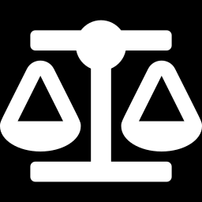
This isn't a nice-to-have. It's a legal right.
What it means to have this right disrespected
Right 5 — Code of Health & Disability Services Consumers' Rights
1
Medication Mismanagement
Confusing instructions cause incorrect dosage administration, treatment failures, or severe adverse events.
“Every consumer has the right to effective communication in a form, language, and manner that enables the consumer to understand the information provided.”
2
Compromised Informed Consent
Patients cannot make genuine choices when health risks and procedures are obscured by dense jargon.
3
Avoidable Readmissions
Discharge summaries that are poorly understood directly drive higher emergency readmission rates.
https://www.hdc.org.nz/your-rights/about-the-code/code-of-health-and-disability-services-consumers-rights/
Notes:
All patients have a right to be able to understand their medical records before they sign off of any forms.
And Nurse Notes allows them to exercise that right.

Slide 5
UN Sustainable Global Development Goals
“
“
3
Good Health and Well-being
10
Reduced Inequalities
Ensure healthy lives and promote well-being for all at all ages.
3.8 ACHIEVE UNIVERSAL HEALTH COVERAGE
Achieve universal health coverage, including financial risk protection, access to quality essential health-care services and access to safe, effective, quality and affordable essential medicines and vaccines for all
Reduce inequalities within and among countries
10.2 PROMOTE UNIVERSAL SOCIAL, ECONOMIC AND POLITICAL INCLUSION
By 2030, empower and promote the social, economic and political inclusion of all, irrespective of age, sex, disability, race, ethnicity, origin, religion or economic or other status.
”
”
https://globalgoals.org/goals/3-good-health-and-well-being/
https://globalgoals.org/goals/10-reduced-inequalities/
Notes:
Our problem links to the UN SDGs specifically good health and wellbeing and reduced inequalities because it concerns the quality of healthcare for all regardless of social and economic background.

Slide 6
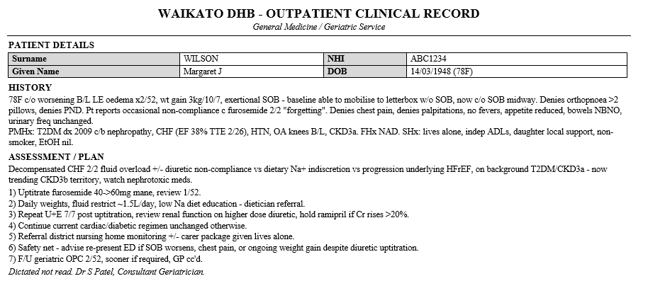
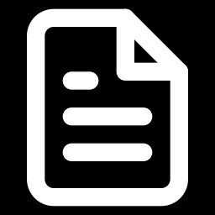
Nurse Notes Live Demo
What medications does the patient need to take?
What Should this patient be concerned about?
LITERACY PROFICIENCY
Medical Files: Level 3 and higher
Average patient ability: Level 2
Non-native english speakers: Level 1 & below
Notes:
1:30 – 3:30 · BIG IDEA + LIVE DEMO — C drives, B narrates
Slide 5, then switch to the app
Here we present an example clinical record. This is the medically dense, jargon heavy view of things. Take a second and read it. Would anyone here be able to play nurse and figure out what's actually required of this patient?
[C loads the document into the app]
[B] So our solution is Nurse Notes. It takes in a clinical document like this and presents it in a way that's readable and easy to understand.
[C clicks "Generate", plain-language text streams in]
[B] Using a prompt as pre-context for our LLM, we can get it to parse this kind of document with reasonable accuracy and present it in a clean, consistent format, highlighting what's actually important for the patient to know.
As context can be limited, it may be important for a nurse to add relevant details, such as level of activity permitted, or intensity, that the source document doesn't cover.
[C adds a note on activity level]
[B] For confirmation and legitimacy, a nurse is still the last point of approval. They may check for accuracy before the simplified report is released to the patient.
[C clicks "Approve for release"]
[B] Now it's been sent out. The patient has access to the plain-language version and the original medical notes, side by side, on their phone.
[C switches to phone view]
[B] As an additional feature for accessibility and inclusion, it uses the device's own text-to-speech to read the report out, no extra setup required.
[C taps read-aloud]
[B] Lastly, for convenience and for anyone who wants a physical copy, the simplified document can be downloaded and exported as a PDF.
[C clicks "Download PDF"]
[B] This isn't just useful for discharge summaries. Any time a clinical document gets handed to a patient and they're expected to just understand it, this is where it fits.

Slide 7
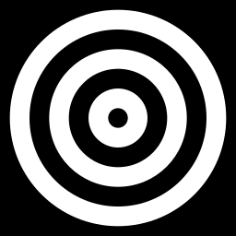
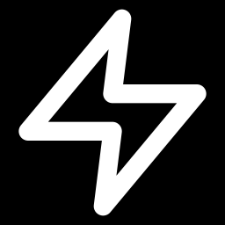
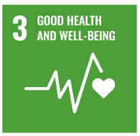
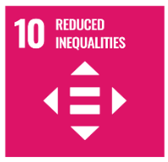
What changes if this ships
IMPACT
Currently Patients only remember 20% of what their doctors tell them and half of what they remember is recalled incorrectly
The Outcomes
The future
A decrease dosage mistakes by patients - SDG 3
Translating medical documents for non-native speakers
20% → 97%
Improving trust in New Zealand medical system - SDG 10
Update the solution to read handwritten medical reports
Improved understanding of medical documents
Nurses spend less time talking with patients, freeing up time for higher-priority tasks. -SDG 3
Integration with ManageMyHealth
Nurse Notes effectively eliminates forgetting, providing patients with clear and simple information and instructions
Kessels, R. P. C. (2003). Patients' memory for medical information. Journal of the Royal Society of Medicine, 96(5), 219–222.
Notes:
Right now, patients only remember 20% of what their doctor tells them the moment they leave hospital, and half of that is recalled incorrectly.
That's not a minor gap. Nurse Notes takes that 20% and pushes it to 97, effectively reducing forgetfulness by giving patients clear, simple, information and instructions they can actually keep and refer back to.
This translates into three real outcomes:
First, a decrease in dosage mistakes by patients, which ties directly to Good Health and Wellbeing.
Second, improved trust in the New Zealand medical system, reducing inequality, because patients who understand their care are patients who will trust in it.
Third, nurses spend less time re-explaining information and spend more time on higher-priority tasks, again supporting Good Health and Wellbeing.
William
Looking into the future, we've scoped three next steps.
Firstly, translating medical documents for non-native speakers, so language isn't a barrier on top of literacy.
Secondly, updating the solution to read handwritten medical reports, not just printed documents or verbal explanations.
And integrating with ManageMyHealth, so this plugs directly into infrastructure New Zealanders already use.
So in summary: Nurse Notes is a platform which makes healthcare easier to understand for all. Fewer medication errors, more trust, and more efficient nurses.

Slide 8
Notes:
Q1. "How is this different from ChatGPT, or from Epic's Emmie?"
Three ways. Epic's Emmie answers patient questions inside MyChart — it has no shipped feature that
rewrites a full inpatient discharge summary, and New Zealand's public hospitals don't run on Epic, so
none of it reaches a patient at Waikato. Second, we're not a chat box — the output is a fixed structure
with a mandatory human approval step, and nothing reaches a patient unsigned. Third, paste a patient
record into ChatGPT and you've just sent it offshore. Ours never leaves the machine.
Q2. "The model will get things wrong. How is this safe?"
It will, and we assume it. That's why nothing is auto-sent — a nurse signs every release. But we didn't
stop at the human. Where we could make an error impossible, we did: all date arithmetic is done in
JavaScript, not by the model, because that's where a small model reliably fails. And the prompt is built
so that a gap in the source produces a flag rather than a guess — the failure mode is "I don't know,"
not a confident invention. The human catches what's left. Roughly: deterministic code for what must be
exact, the model for language, a nurse for judgement.
Q3. "Would a nurse actually use this? Isn't reviewing it more work?"
Reviewing a one-page plain-language summary is faster than writing one from scratch, which is what a
good nurse does verbally today, unpaid and unrecorded. And it produces an artifact the patient takes
home. We're not claiming zero cost — we're claiming the cost lands in the right place, and it's why our
ask is a pilot ward with measured comprehension rather than a rollout. If a nurse won't use it, we'd
want to know that in week one.
Bonus — if a sponsor asks why you integrated no sponsor API
Deliberately. Our privacy and Māori data-sovereignty claim is that patient text never leaves the device
— a cloud API call would break the core promise of the product to win a side prize. We'd rather be
honest about the trade.

Slide 9
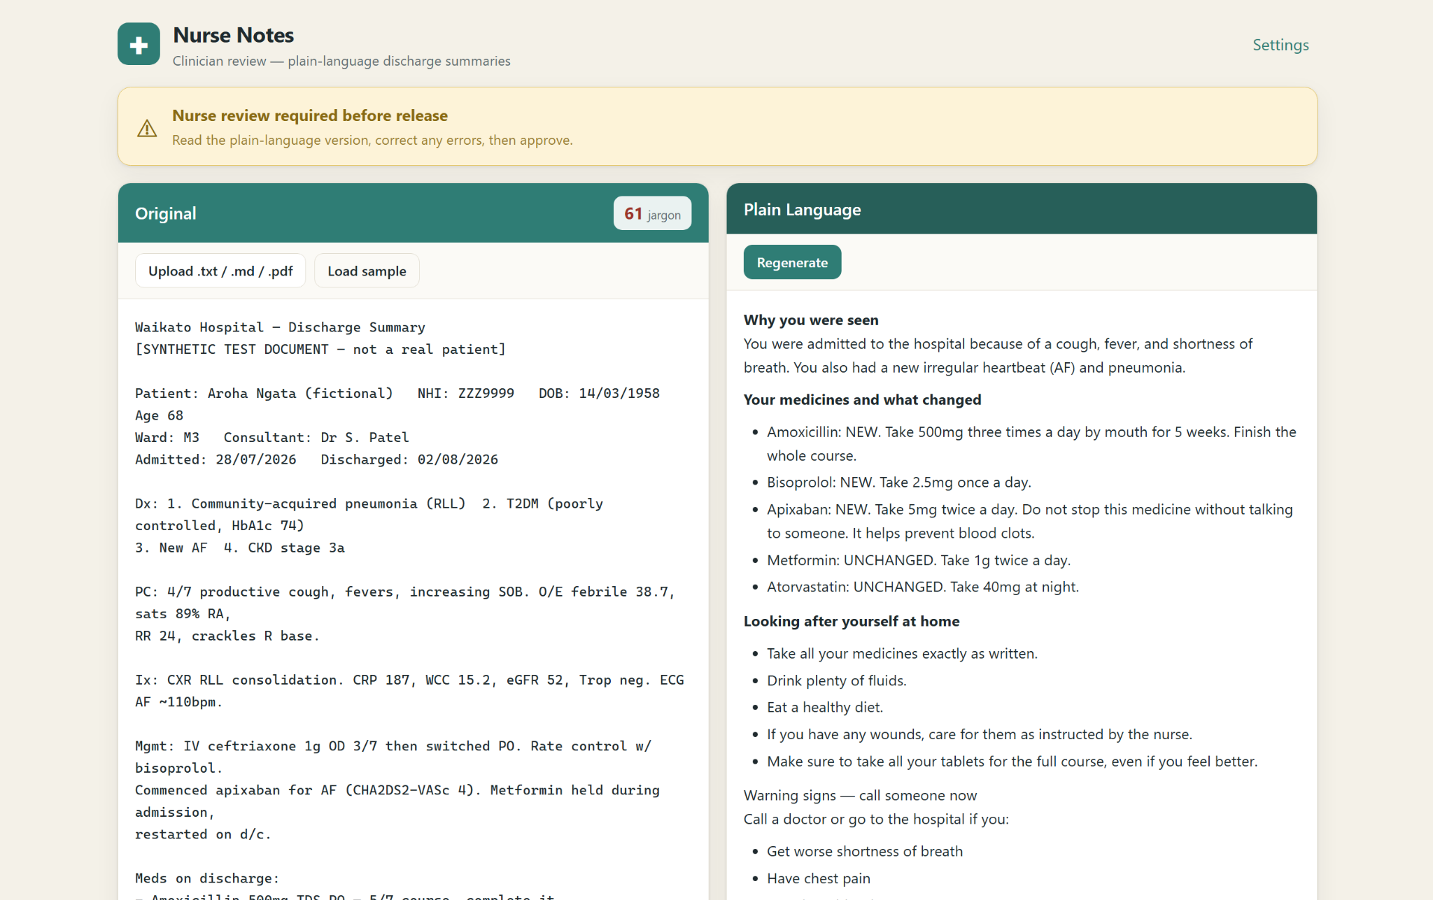
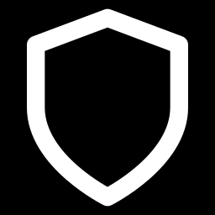
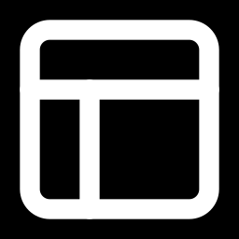
Same record. Two readings. One safety gate.
Before → after
A highly technical clinical text becomes an easy to understand yet medically accurate summary, side by side.
Clinician gate
Requires medical professional review and approval before it is handed over to a patient
Simplicity over complexity
Formatted for easy reading and navigation.

Slide 10
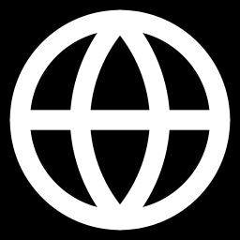
Four steps. No training, no hospital integration.
1
2
3
4
Ingest & structure
Rewrite + clinician gate
Visual breakdown
Language & format
Pull the parts a patient acts on from a PDF: meds & changes, warning signs, follow-ups, who to call.
Generate a plain-language version at a target reading level. A nurse approves or edits before release.
Medication timeline, a red-flag 'call now' card, and a follow-up calendar. Structure does the work.
Te reo Māori, Pacific languages, large print, audio — with human verification. Where Right 5 is met.
Why 48 hours works: PDF extraction + one structured-extraction call + one rewrite call + a review screen. The review UI is ordinary CRUD. Nothing to train, nothing to integrate.
Notes:
Still inside the 2-minute Big Idea. This is your Technology score. Emphasise the clinician gate (step 2, amber) is the safety design, and that the whole thing is genuinely buildable in the time given.

Slide 11
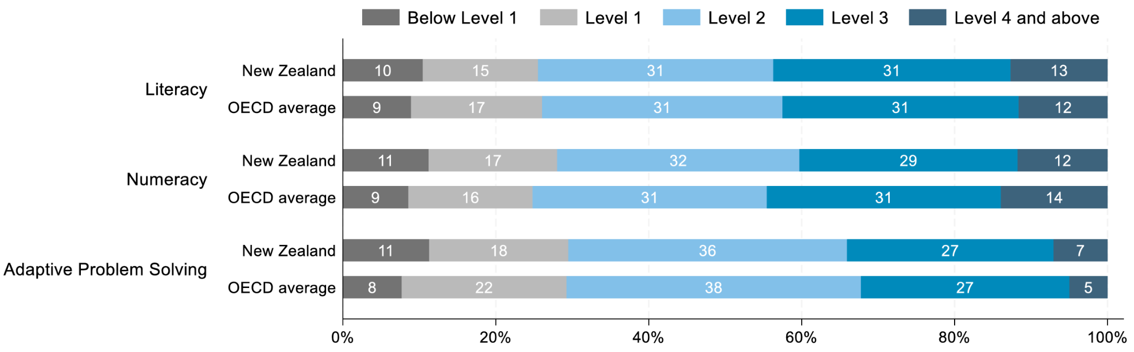
Bridging the Gap
LITERACY PROFICIENCY AMONGST ADULTS (2023)
Medical Files: Level 3 and higher
Average patient ability: Level 2
Non-native english speakers: Level 1 and below
https://www.oecd.org/en/publications/survey-of-adults-skills-2023-country-notes_ab4f6b8c-en/new-zealand_d67971ff-en.html

Slide 12
WHY THIS WINS ON THE SCORECARD
Every criterion, covered
Inspiration
Technology
Design & Innovation
Presentation
A defined problem with a legal spine and a human face.
Real AI, buildable in a day, with a clinician safety gate.
Structure-over-prose UI; te reo & Pacific output no rival ships.
One sentence any judge grasps: forms patients can actually understand.
SDG mapping: Indicator 3.8.1 (coverage of essential health services) + SDG 10.2 (inclusion — low literacy tracks with ethnicity & deprivation).
The ask: help us put a plain-language, clinician-approved consent form in front of the next patient who signs one.
Notes:
Closing slide. Explicitly map to the four equally-weighted criteria and the two SDG indicators so the judges can tick their sheet. End on the one-line ask.

