Slide 1
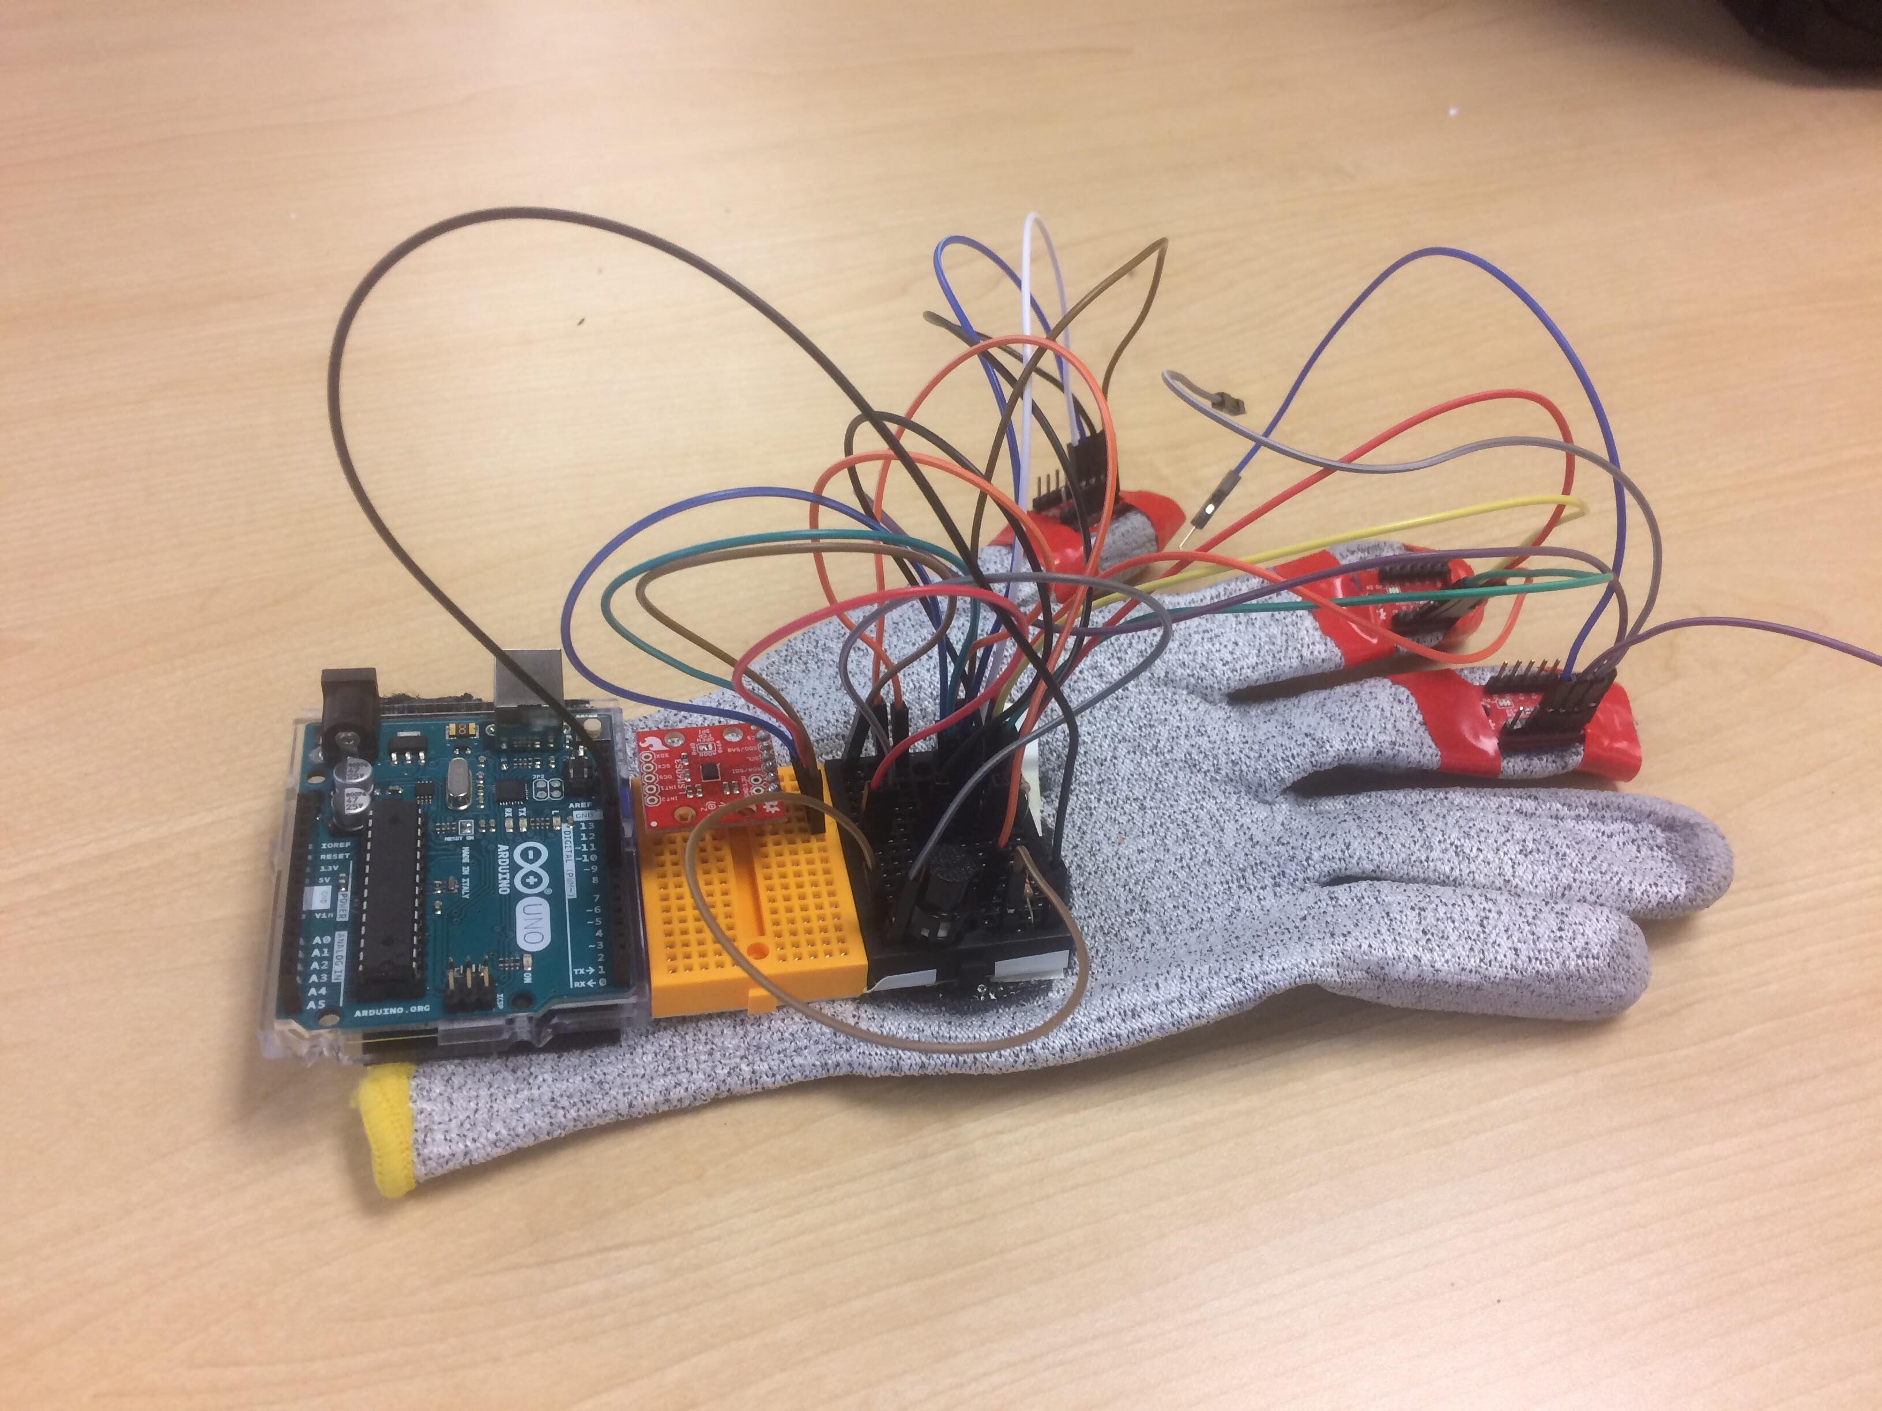
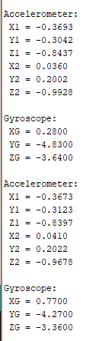
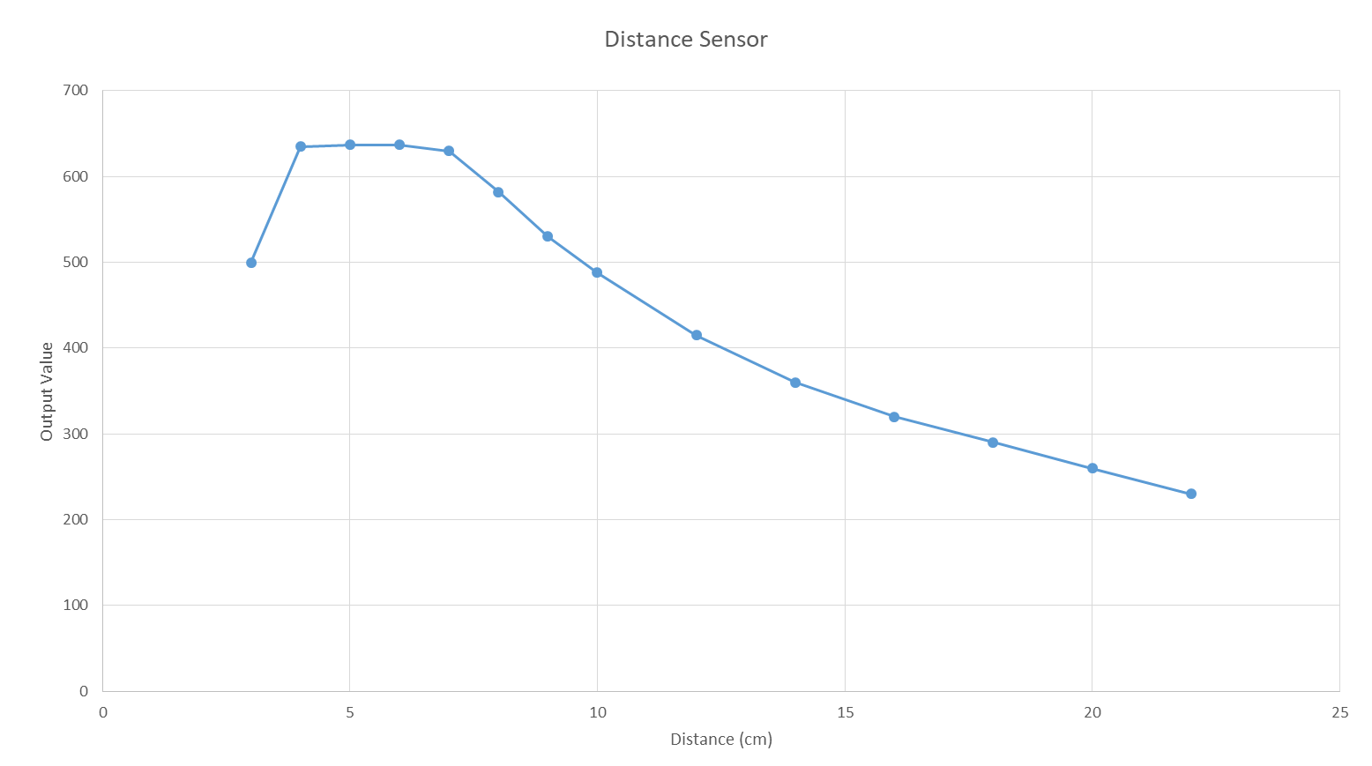
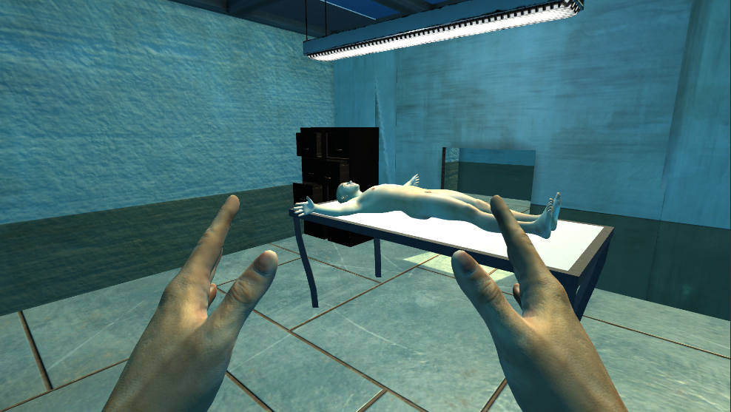
Virtual Reality Surgery Simulator
Group #33 : Adel Abdel-Hamid, Eric Chau, Monica Rao
TABLES AND FIGURES
Figure 1: Glove sensor
Figure 2: Distance sensor data
Figure 3: Simulation Output
Figure 4: Glove sensor Arduino Output

Slide 2
Our Project:
The VRSS is a simulation intended to add upon a surgeon’s training. The main purpose for it is to help surgeons in training in following procedures by giving them a visual and mechanical representation of the surgery in question, without wasting resources.
The VRSS consists of:
–A surgical glove that measures the fingers positions and the hand tilt and rotation
–A distance sensor that measures the position of the hands.
–A VR Headset that incorporate these measurements into the simulation
Components:
–The main Hardware components are:
i. The Gloves:
• Accelerometer provides the fingers coordinates
• Gyroscope provides the hand tilt
• Push button allows for a soft reset in case of confusion
ii. The Distance sensor:
• 4xIR distance sensors placed in a 2x2 matrix provide distance and movement estimation
• 2xServo Motors to increase the range of the distance sensor.
–Unity is used for the simulation of the VR environment, along with acting as the physics engine
- surgical tools provided within the VR environment depending on surgery being performed (ability to modify in the future)
- completion of simulation once the designated organ is removed or operation fails
Issues:
–The use of I2C connectivity caused a few complications:
i) Had to counter bus capacitance by adding resistors, wasting precious pins.
ii) Address clashes between similar sensors needed to be circumvented
–Connectivity between the Arduino outputs and the Unity code hasn’t been finalized at the time of this posters making.
–The distance sensors have a limited functioning range.
Work in progress:
– Making the gloves completely wireless by introducing Bluetooth and a portable battery pack.
– Enhance connectivity between the glove and the Unity program which controls the simulation
- Continue to build up the VR environment for a more realistic simulation
Conclusion and Recommendations:
With a larger team and a bigger budget, a more comfortable, affordable and precise version of the VRSS could be constructed and introduced into a training curriculum. The VRSS can also be adapted into various other areas of training such as in mechanics or other careers that require a good visual and deep understanding of a certain machine or object.
Introducing haptic feedback can also make the simulation more realistic but a limited budget and man power prevented such additions.
REFERENCES
Erin,A. (2015), Surgical Simulation Training: Is Virtual Reality The Future Of Surgical Training? ELearning Industry.
Kneebone, R. (2003), Simulation in surgical training: educational issues and practical implications, Imperial College London.

