Slide 1
Intro to Open and Reproducible Research
Eric Crandall

Slide 2
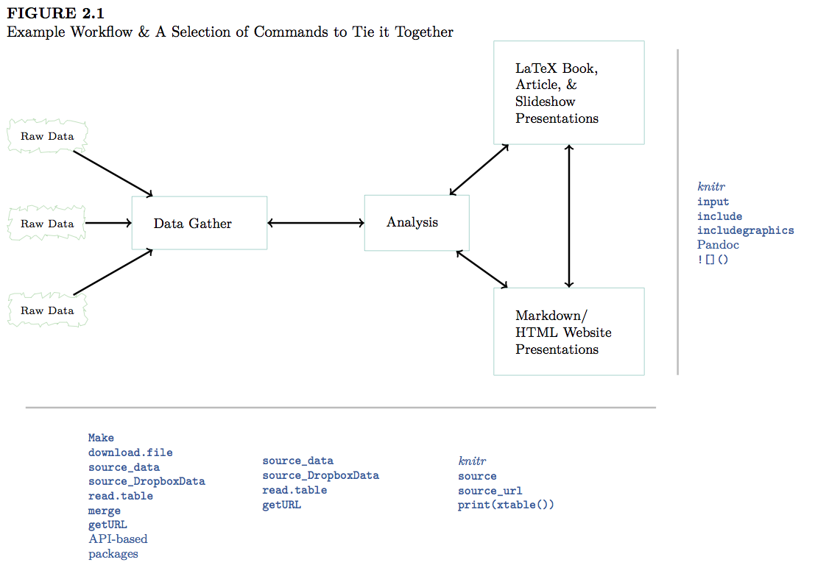
What is Reproducibility?
Gandrud 2014 gives this definition (especially for data analysis and computer science):
“The data and code used to make a finding are available and they are presented in such a way that it is (relatively) straightforward for an independent researcher to recreate the finding.”
GandrudFigure2.1

Slide 3
This actually seldom happens.
Consider two interesting articles by Tim Vines: * The Availability of Research Data Declines Rapidly with Article Age + Contacted Authors of 516 datasets with morphological data for discriminant analysis published between 1991 and 2011 + Received only 101 datasets!
“of 516 articles published between 2 and 22 years ago…the odds of a data set being extant fell by 17% per year.”

Slide 4
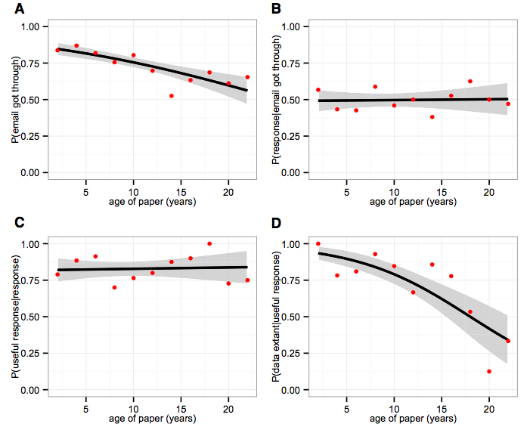
Vines et al. 2014: Figure1. The Effect of Article Age on Four Obstacles to Receiving Data from the Authors

Slide 5
Data not only need to be easily available, but methods also need to be reproducible
Gilbert et al. 2012 - Recommendations for utilizing and reporting population genetic analyses: the reproducibility of genetic clustering using the program structure
“we reanalysed data sets gathered from papers using the software package ‘structure’… 30% of analyses were unable to reproduce the same number of population clusters.”
Scientific articles have fairly detailed methods sections, but those are typically insufficient to actually reproduce an analysis.
Scientists owe it to themselves and their community to have an explicit record of all the steps in an analysis done at a computer.

Slide 6

Why are Open Data and Reproducibility Important?
For Science?
Standard to judge scientific claims
Data and methods need to be openly available in order to be reproducible
Avoiding effort duplication
Encouraging cumulative knowledge development
Sea of Doubts

Slide 7
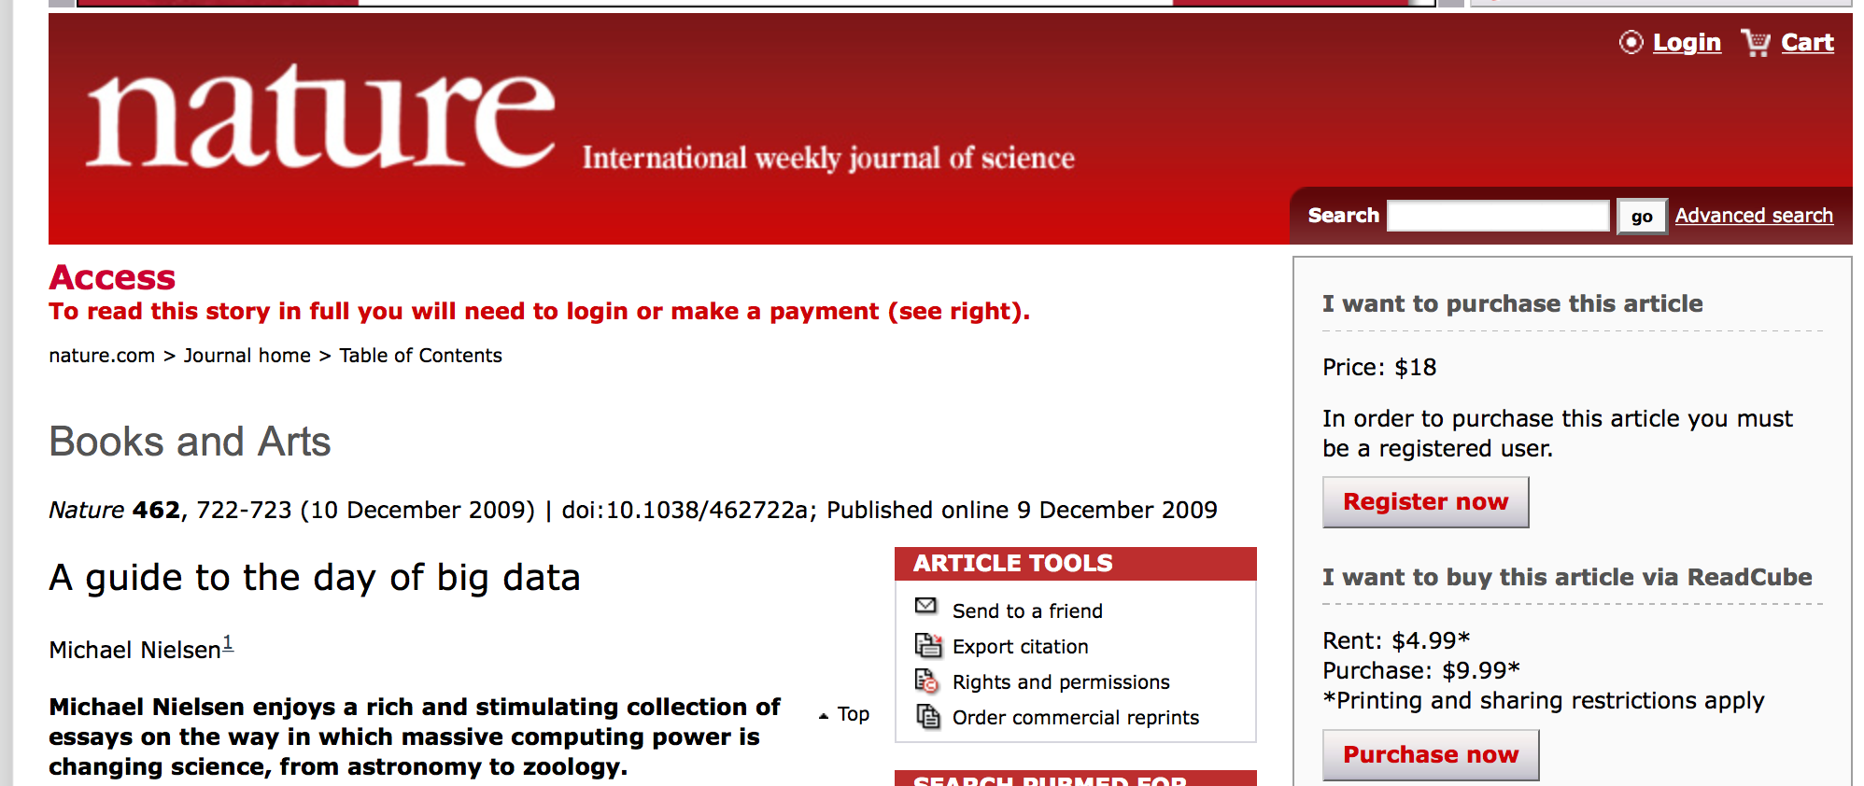
Gandrud 2014
Open Science
Open Science Links
Open Data
Reproducible Methods
Open Access Publications
Big Data

Slide 8
Why are Open Data and Reproducibility Important for You?
Better work habits
better, clearer documentation
Better teamwork
Re-analysis is easier
Higher research impact
Gandrud 2014

Slide 9
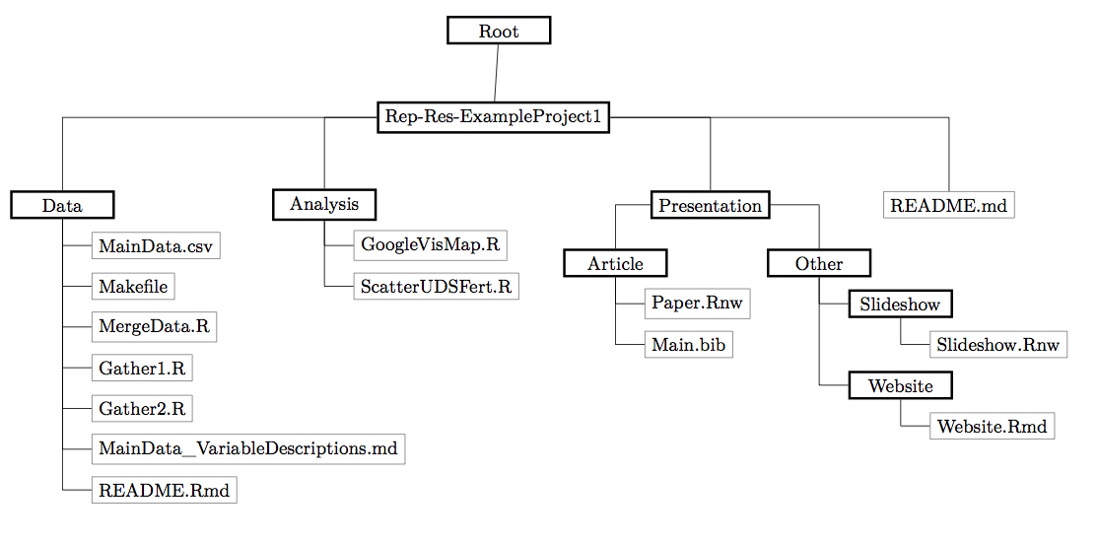
Tools for Research Reproducibility
Open Source Everything
R language
Rstudio and knitR
Markdown and LaTeX
Unix operating system
GitHub and git - version control (not covered in this class)
Creative Commons Licensing
Online Repositories (Dryad, Genbank,GBIF, GEOME, new ones all the time)
Reproducible Research Habits
Good habits to get into as a student!
10 Things Every Graduate Student Should Do By Carly Strasser
Stop Using Excel!
OK, maybe not entirely - its good for quick visualizing, data entry, etc.
It tends to be a crutch.
Stops you from thinking carefully about your data structure
Stops you from learning better ways to handle data
Proprietary software
Easy to mess up your data, no provenance
Dates!
At least keep your raw data in text format
Learn to Code
Any language.
R is a great starting place.
Here is code to paste cells from excel into an R data frame!
data <- read.table(pipe("pbpaste"),header=T)
Make a plan for managing data in each project
Keep all data (and ideally analyses) in a text file
Think about your file structure
Gandrud Figure 1

Slide 10
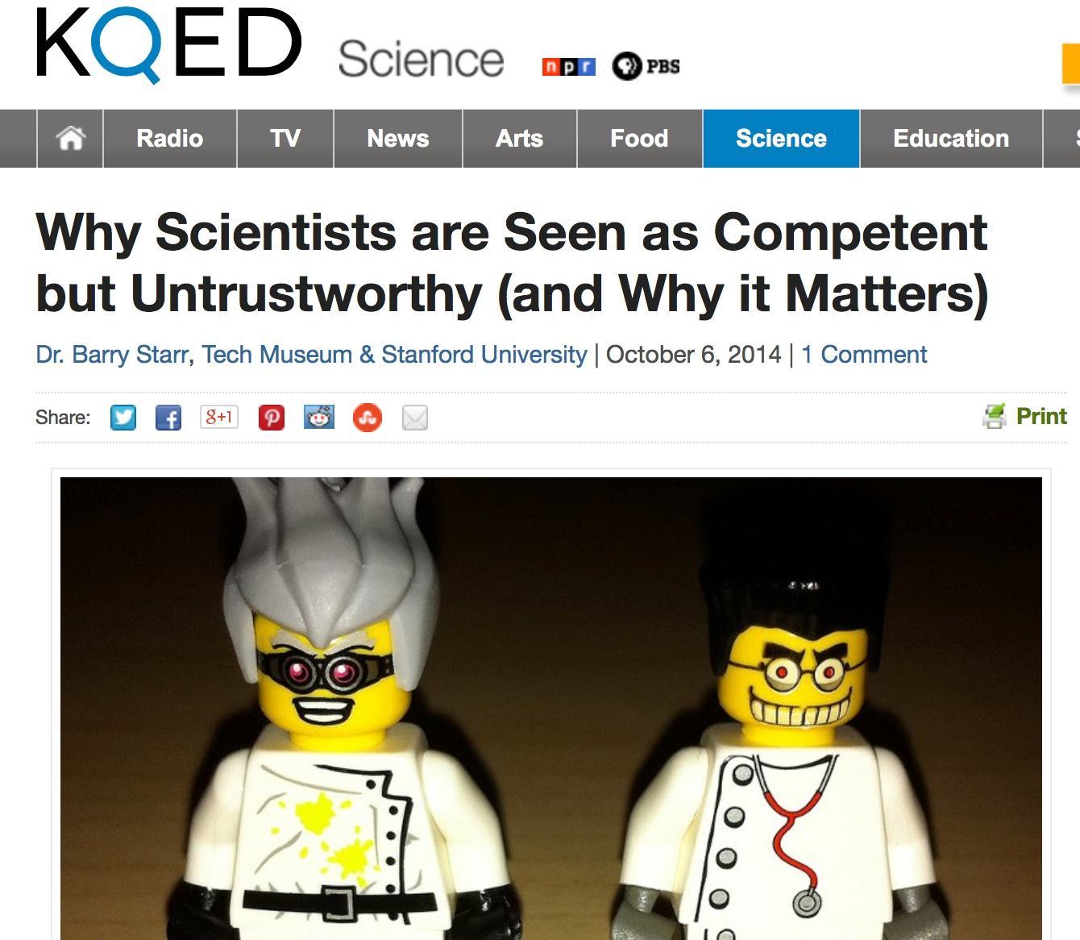
## Make a plan for managing data in each project - 2
Document everything
Explicitly tie your files together
Data management plans are now explicitly required by the NSF and other funding agencies!!! Gandrud Figure 2
Keep an electronic (online) notebook
Document everything!!
repeat your own analysis!!
show others what you did
Dokuwiki is great (keeps things in plain text)
I now use GitHub and Rmarkdown notebooks
Go open if you’re brave
Communicate Your Science
Start doing outreach now!
NSF vs. House Committee on Science
Science Mistrust

Slide 11
Publish Open-Access Articles
Biology Failed the Internet
Physics moved to pre-print servers a long time ago!
Open access journals (e.g. PLoS) were supposed to be a stop-gap measure!
Many schools now have open-access funds
The dark side of open-access
Most journals only own the “typesetting” (because that is all they did!).
Therefore you may legally post a pre-print
BiorXiv
PeerJ
Most universities now have pre-print platforms
ResearchGate, Academia.edu etc. are social networks whereby you are sharing articles with your “friends”
Rstudio
R studio is an Integrated Developer Environment for R * Is an IDE (integrated development environment) that sits on top of R and makes it easier to interact with R. * Organizes your work in R in neatly-contained packages of work (typically data and code) called “projects” * Nothing mysterious about these—just collections of files stored together in a single directory on your computer.

Slide 12
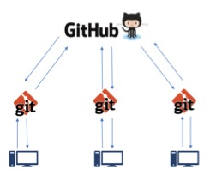
Git and GitHub
Thanks to Eric Anderson for portions of the git/github part of this lecture Eric Anderson
Git
A version control system, or VCS, tracks the history of changes as people and teams collaborate on projects together. As the project evolves, teams can run tests, fix bugs, and contribute new code with the confidence that any version can be recovered at any time. Developers can review project history to find out:
Which changes were made?
Who made the changes?
When were the changes made?
Why were changes needed?
All of this is stored as “commits” inside an invisible directory called .git
/reproducible_research/--% ls .git COMMIT_EDITMSG config hooks info objects refs HEAD description index logs packed-refs
A typical VCS for a non-computer programmer
Start writing my_manuscript.doc.
At some point worry that MS Word is going to eat your file, so,
Make a “backup” called my_manuscript_A.doc
Then, before overhauling the discussion, save the current file as my_manuscript_B.doc.
Email it to your coauthors and then have a series of files with other extensions such as the initials of their names when they edit them and send them back.
Etc.
Disadvantages:
Hard to find a good record of what is in each version. (Wait! I liked the introduction I wrote three weeks ago…where is that now?)
A terrible system if you have multiple files that are dependent on one another
If you decide that you want to merge the changes you made to the discussion in version _C with the edits on the introduction in version _K, it is hard.
GitHub (and others) is a distributed version control system (DVCS)
Git stores “snapshots” of your collection of files in a repository, which can be stored on GitHub
For our work, the “collection of files” will be “the stuff in your RStudio project”
Another reason it is nice to keep everything you need for a project together in a “project directory”
When you clone or repository, you get the whole version history
When someone else clones that repository, they also get the whole version history.
Git has well-developed features for merging changes made in different repositories
Unlike once popular centralized version control systems (rcs, cvs, subversion), DVCSs like GitHub don’t need a constant connection to a central repository. Developers can work anywhere and collaborate asynchronously from any time zone.
Github DVCS

Slide 13
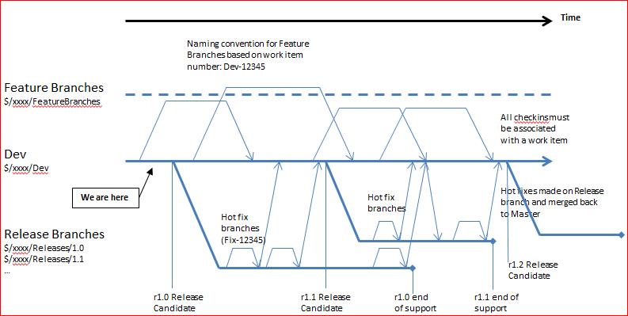
GitHub (and others) is a distributed version control system (DVCS)
Git and a DVCS system allow multiple people to work on multiple versions (“branches”) of a piece of software at the same time, without breaking the main branch. This approach can be used to add features or fix bugs.
To eliminate unnecessary work, Git and other VCSs give each contributor a unified and consistent view of a project, surfacing work that’s already in progress. Seeing a transparent history of changes, who made them, and how they contribute to the development of a project helps team members stay aligned while working independently.
Without version control, team members are subject to redundant tasks, slower timelines, and multiple copies of a single project.
GitHub Example for Software
The Github Flow

Slide 14
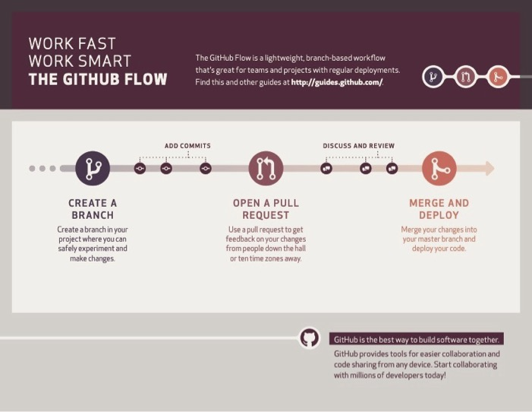
What’s a repository?
A repository, or Git project, encompasses the entire collection of files and folders associated with a project (i.e. a directory), along with each file’s revision history.
The file history appears as snapshots in time called commits, and can be organized into multiple lines of development called branches.
Because Github is a DVCS, repositories are self-contained units and anyone who owns a copy of the repository can access the entire codebase and its history.
Using the command line or other ease-of-use interfaces, a git repository also allows for: interaction with the history, cloning, creating branches, committing, merging, comparing changes across versions of code, and more.
What’s a repository?
Working in repositories keeps development projects organized and protected. Developers are encouraged to fix bugs, or create fresh features, without fear of derailing mainline development efforts.
Through platforms like GitHub, Git also provides more opportunities for project transparency and collaboration. Public repositories help teams work together to build the best possible final product.
The Github Flow
Video
The Github Flow

Slide 15
The GitHub Flow
The GitHub flow has six steps, each with distinct benefits when implemented:
Create a branch:Topic branches created from the canonical deployment branch (usually master) allow teams to contribute to many parallel efforts. Short-lived topic branches, in particular, keep teams focused and results in quick ships.
Add commits:Snapshots of development efforts within a branch create safe, revertible points in the project’s history.
Open a pull request:Pull requests publicize a project’s ongoing efforts and set the tone for a transparent development process.
The GitHub Flow
Discuss and review code:Teams participate in code reviews by commenting, testing, and reviewing open pull requests. Code review is at the core of an open and participatory culture.
Merge:Upon clicking merge, GitHub automatically performs the equivalent of a local ‘git merge’ operation. GitHub also keeps the entire branch development history on the merged pull request.
Deploy:Teams can choose the best release cycles or incorporate continuous integration tools and operate with the assurance that code on the deployment branch has gone through a robust workflow.
Alternatives to Github exist!
Bitbucket
Gitlab
Gitbucket
All work on a “freemium” model in which they provide free service to low-end users (like us), but charge for services needed by power users (like private repositories, more file storage space)

Slide 16
GitHub Tutorial
Do this in GitHub
Go to https://github.com/ericcrandall/reproducible_research
Click “Fork” in the upper right-hand corner and follow dialogue prompts to create fork in your account
Do This in RStudio
Select File -> New Project
Create project from: Choose “Version Control”
Choose “Git”
Input the url of this repository 1.https://github.com/yourusername/reproducible_research
and put it somewhere
I suggest a repository coming off your home directory called github.
(browse to where you want to put it in the “create project as subdirectory of:”)
So it should be in yourhome/github/reproducible_research
Hit Create Project
The status/staging panel
RStudio keeps git constantly scanning the project directory to find any files that have changed or which are new.
By clicking a file’s little “check-box” you can stage it.
Some symbols:
Blue-M: a file that is already under version control that has been modified.
Yellow-?: a file that is not under version control (yet…)
Green-A: a file that was not under version control, but which has been staged to be committed.
Red-D: a file under version control has been deleted. To make it really disappear, you have to stage its disappearance and commit.
Purple-R a file that was renamed. (Note that git in Rstudio seems to be figuring this out on its own.)
Staging Files
You can click the check box next to various files to stage them to be part of a commit.
I generally stage all changes for every commit
But one could conceive of being more strategic…
at the command line, staging or adding all files to a commit is achieved by:
git add .
The Commit window
Click “commit” to reach the commit window
Shows a “diff” of your changes.
In other words, what has changed between the last committed version of a file and its current state.
Green = additions, red = deletions
Holy smokes this is convenient
(Note: all this output is available from the command line, but the Rstudio interface is very nice, IMHO)
Making a Commit
Super easy:
After staging the files you want to commit…
Write a brief message (first line short, then as much after that as you want) and hit the commit button.
Tradition is to use present tense when describing your changes.
as in “Add new data file, update file slurping code”
This can be really handy when trying to find where you made an error!
Spending a little time to write informative commit messages can pay off.
At the command line, a commit is achieved thusly:
git commit -m "my commit message"
The History window
Easy inspection of past commits.
See what changes were made at each commit.
At the command line you can see this with
git log
How does git store and keep track of things
Everything is stored in the .git folder inside the RStudio project.
The “working copy” gets checkout out of there
Committed changes are recorded to the directory
What is inside of the .git directory?
We can use R to list the files.
# check out this file-system command in R dir(path = ".git", all.files = TRUE, recursive = TRUE)
## [1] "COMMIT_EDITMSG" ## [2] "config" ## [3] "description" ## [4] "HEAD" ## [5] "hooks/applypatch-msg.sample" ## [6] "hooks/commit-msg.sample" ## [7] "hooks/fsmonitor-watchman.sample" ## [8] "hooks/post-update.sample" ## [9] "hooks/pre-applypatch.sample" ## [10] "hooks/pre-commit.sample" ## [11] "hooks/pre-merge-commit.sample" ## [12] "hooks/pre-push.sample" ## [13] "hooks/pre-rebase.sample" ## [14] "hooks/pre-receive.sample" ## [15] "hooks/prepare-commit-msg.sample" ## [16] "hooks/push-to-checkout.sample" ## [17] "hooks/update.sample" ## [18] "index" ## [19] "info/exclude" ## [20] "logs/HEAD" ## [21] "logs/refs/heads/main" ## [22] "logs/refs/remotes/origin/HEAD" ## [23] "logs/refs/remotes/origin/main" ## [24] "objects/00/f53ce8066a38abfe40f99ffb0a445aa32b8011" ## [25] "objects/02/70d3cbc9f83e4c2eb1e11d0a147c31e5a644c0" ## [26] "objects/10/c739a3d513015f61e52b5d978604f9d0d8f291" ## [27] "objects/11/bcf458a321651e68c7627ef6890bafccef0b18" ## [28] "objects/13/23e55fd16b1e4f7965bacc0223492a178de5dd" ## [29] "objects/16/a9cdea4ad9456d9f9c661f24a9a3eb57e689c6" ## [30] "objects/19/85083191e8b2f5505f36625f7edcb1a0d6412f" ## [31] "objects/1f/3ede9a9f986201addf75b29e70fa8c2a8477f9" ## [32] "objects/21/f7e34c7ff8b756b03724b544f5e2ce2b9b082f" ## [33] "objects/23/f63b97abe22805008c32a9658bfc895538b6aa" ## [34] "objects/24/f75cad5b119c80678c244d47312d0ad02fc670" ## [35] "objects/26/2b2cfc8ba24c825f6b64acbe3ca395b7ff2f31" ## [36] "objects/28/f0057bd3f9d33a7ace7e366f7ffa4dc210f944" ## [37] "objects/2a/c44c9b964f841a8a24cc396a7fb2876b8e8aa5" ## [38] "objects/2c/ad0aa1a595ebf0779e1388933dac6b412a7114" ## [39] "objects/36/548b376ebcc447a10b93353cd9b1dc0b259b06" ## [40] "objects/37/2f57b5b80902a0eb6202670cb509eb321be2be" ## [41] "objects/3d/3116d6bc440e1415d17474676199ffb85f545f" ## [42] "objects/50/45808a94d041c6f6b785bf9c7fcc6ca550d3eb" ## [43] "objects/51/6fb82804f5d310f7e3e16b9138291527f0fd2a" ## [44] "objects/66/c1d3e45021859c6a7d5bf4b6a5f4c8fd0ce340" ## [45] "objects/70/1f64ed543adeb4a93909fb7db24076c7ff0590" ## [46] "objects/70/e9f8bc14094dfe37e0994c17dbbb536a3a3d48" ## [47] "objects/7b/3778658c5a9060a506261167781e5d18c33841" ## [48] "objects/80/70e6a38cc8a0742e7c13872f8ef41b644528c7" ## [49] "objects/81/17a4006e63621d735764ad2d51daa41a8ed605" ## [50] "objects/83/002948bce0dcb03b633293a58dc2a776bf88ef" ## [51] "objects/86/5d5629ef55987fe68127c149a3c5050ab237d0" ## [52] "objects/8e/3c2ebc99e2e337f7d69948b93529a437590b27" ## [53] "objects/96/f3bba4fe892703a8e364e79e08cc07721eccd5" ## [54] "objects/99/1898f18b7e0fc860e99e701e8ffceeb8ad2ed9" ## [55] "objects/bc/746a8952dc080a92ad1157f4280792168b1b87" ## [56] "objects/c8/959054c5e1331ea7170c3d94c487563782269a" ## [57] "objects/cb/b99a7196a266cb4e958f2bfc031bf478422080" ## [58] "objects/cd/dcc43841aa35f5553ab949d7c98f640074c576" ## [59] "objects/d0/603c55847f6fb92b975f6c989f4f24a7ffe131" ## [60] "objects/d0/63e8bc7af719bae7c8eb42a8bc12891480f305" ## [61] "objects/d2/11a25fb11a40ea713785f8e91c066682ca8e87" ## [62] "objects/d2/23b29197c549e12c83368d039f791fd74c3f93" ## [63] "objects/d4/c50d6843671ed282ae1d42d314c2edf01a8d76" ## [64] "objects/e7/cdfc9e85df4a28de8208cb8fff47fa8880ec97" ## [65] "objects/e8/a26260ce3b15f4349b41e19fc96f4ac05db927" ## [66] "objects/ea/0cbadfc24142a0ab84ef1ca35c5badf5f9318e" ## [67] "objects/ed/de644a9bc63ad2e7adafb59ab3f161c237673e" ## [68] "objects/f6/2cd7ba4a791cccad8b3ba40b15e023803be5a3" ## [69] "objects/f9/bac9fa4535cde8e9166a09ed4cc091aa4255b0" ## [70] "objects/fd/94b1c9d48ef9cbf72354a4eb9c57e923619b70" ## [71] "objects/fe/34adfb051b10b4fe9552744c72059ede597991" ## [72] "objects/pack/pack-73ddbaccd0bd543cfe129a05ce137348072fa9db.idx" ## [73] "objects/pack/pack-73ddbaccd0bd543cfe129a05ce137348072fa9db.pack" ## [74] "packed-refs" ## [75] "refs/heads/main" ## [76] "refs/remotes/origin/HEAD" ## [77] "refs/remotes/origin/main"
Yikes!
How does git know a file has changed?
Does it just look at the modification date?
NO! It “fingerprints” every file, so it knows when it has changed from the most recent committed version.
Demonstration. Change a file. Save, then undo the change and save again…Git knows the file has been changed back to its “former self”
SHA-1 hashes.
You will see things like ed00c10ae6cf7bcc35d335d2edad7e71bc0f6770 all over in Git-land.
You can treat them as very specific names for different commits.
How can I make git ignore certain files?
The .gitignore file!
File names (and patterns) in the .gitignore file are ignored recursively (down into subdirectories), by default.
Files won’t be ignored if they are already in the repository.
Example: *.html ## Go for it everyone! Git to playing
Make some changes and commit them yourselves.
Add some new files to the project, and commit those.
Get familiar with the diff window.
Check the history after a few commits.
Intro to Rmarkdown
Designed as a text markup language that would be
Simple
Expressive
Intuitive
Capable of conveying intent even without being compiled into HTML or PDF
There are many Markdown interpreters. The Rstudio folks have been using pandoc to crunch Markdown into other formats. It provides many useful extensions.
Customizations of style are mostly separate from the content.
This presentation was made in Rmarkdown!
To Do
Add Merge Conflicts Add Revert Add Rebase Add “github pages” * Open the shell (Tools->Shell…) and issue these two commands, replacing the name “John Doe” with yours, and his email with yours. + Use the email address that you gave to GitHub.
git config --global user.name "John Doe" git config --global user.email johndoe@example.com

