Slide 1
Client Full Name Investment Recommendation [- REFRESH] [- INDICATIVE BID]
DD MONTH YEAR

Slide 2
Overview of opportunity
Transaction Overview
Client introduction (from pricing memo) Client short name would like to purchase buy-in/buy-out annuity for XXX pension plan. If applicable, special wording might need – wind-up/split by tranches/indexation. The total deal size is approximately $XX. [Consultant is conducting the RFQ and indicative bids are being requested on indicative bid date. Binding quotes are subsequently being requested on binding bid date.][Consultant is conducting the RFQ and bids are being requested on bid date after indicative bids were requested on indicative bid date.][Consultant is conducting the RFQ and bids are being requested on bid date.]
Transaction Details
Product Type | Annuity buy-in/buy-out | Annuity buy-out
Source Pension Plan(s) | Pension plan full names | Régime complémentaire de retraite des employés syndiqués de Le Nouvelliste, La Tribune, La Voix de l’Est et Le Droit Régime complémentaire de retraite des employés non syndiqués des quotidiens régionaux de 3834310 Canada inc. Régime complémentaire de retraite des employés syndiqués de Le Soleil
Industry | Industry intro | Media
Cohort Membership | Headcount: Member type: | XX (XX retirees and beneficiaries and XX deferred vested) Salaried/Hourly/Union/Blue collar/white collar
Liability Characteristics | Liabilities Duration Initial Total Monthly Payments | $xx xx.xx $xx,xx
Transaction Timeline
Binding quote use below
Bid Invitation | Binding Quote | Bid Acceptance | Premium Payment Date | First Payment
Month Day, Year | Month Day, Year | Month Day, Year | Month Day, Year | Month Day, Year
Indicative quote use below
Bid Invitation | Indicative Quote | Binding Quote & Bid Acceptance | Premium Payment Date | First Payment
Month Day, Year | Month Day, Year | Month Day, Year | Month Day, Year | Month Day, Year

Slide 3
Overview of Return
At inception and based on a LICAT ratio of 130%, the Business Case returns are summarized below:
Target price | Total Capital | 1st year profit/(loss) | BAM Capital | BAC Premium | Asset Leverage | IRR (Base Case) | IRR (Business Case) | MOC | Cost of Funds | Initial Reserves
Preliminary Bid | $y.yM | $x.xM | $x.xM | $x.xM | #x | xx.x% | xx.x% | x.xx | x.xx% | $y.yM
Expected Clearing Price | $y.yM | $x.xM | $x.xM | $x.xM | #x | xx.x% | xx.x% | x.xx | x.xx% | $y.yM
BAC Minimum Bid | $y.yM | $x.xM | $x.xM | $x.xM | #x | xx.x% | xx.x% | x.xx | x.xx% | $y.yM
Spread Analysis
Target price | Cost of Funds | Net Yield (Base Case) | Earned Spread (Base Case) | Net Yield (Business Case) | Earned Spread (Business Case)
Expected Clearing Price | xx.x% | xx.x% | xx bps | xx.x% | xx bps
BAC Minimum Bid | xx.x% | xx.x% | xx bps | xx.x% | xx bps
Additional Commentary
BAC currently has approximately $xxM in excess capital available. If BAC were to be awarded this liability at its minimum bid, [no additional capital would be necessary.][an injection of additional capital would be required]
[Pricing is expected to be more competitive than BAC’s minimum bid.]
Notes:
Results are based as of market conditions on dd Month Year
Net yields and spreads earned are calculated at full ramp-up under Business Case

Slide 4
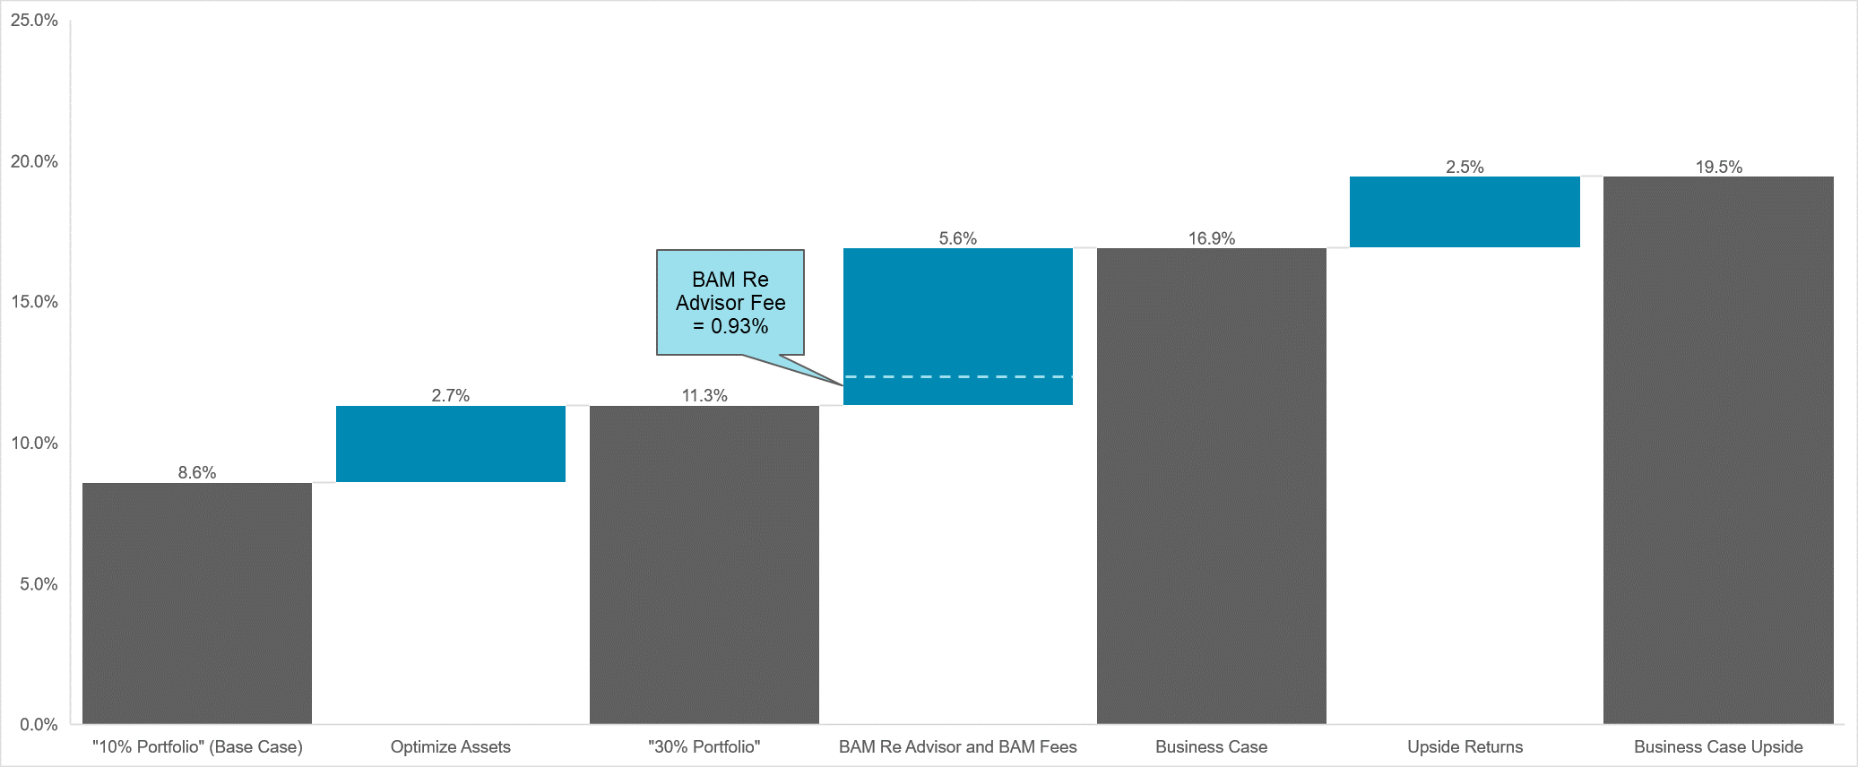
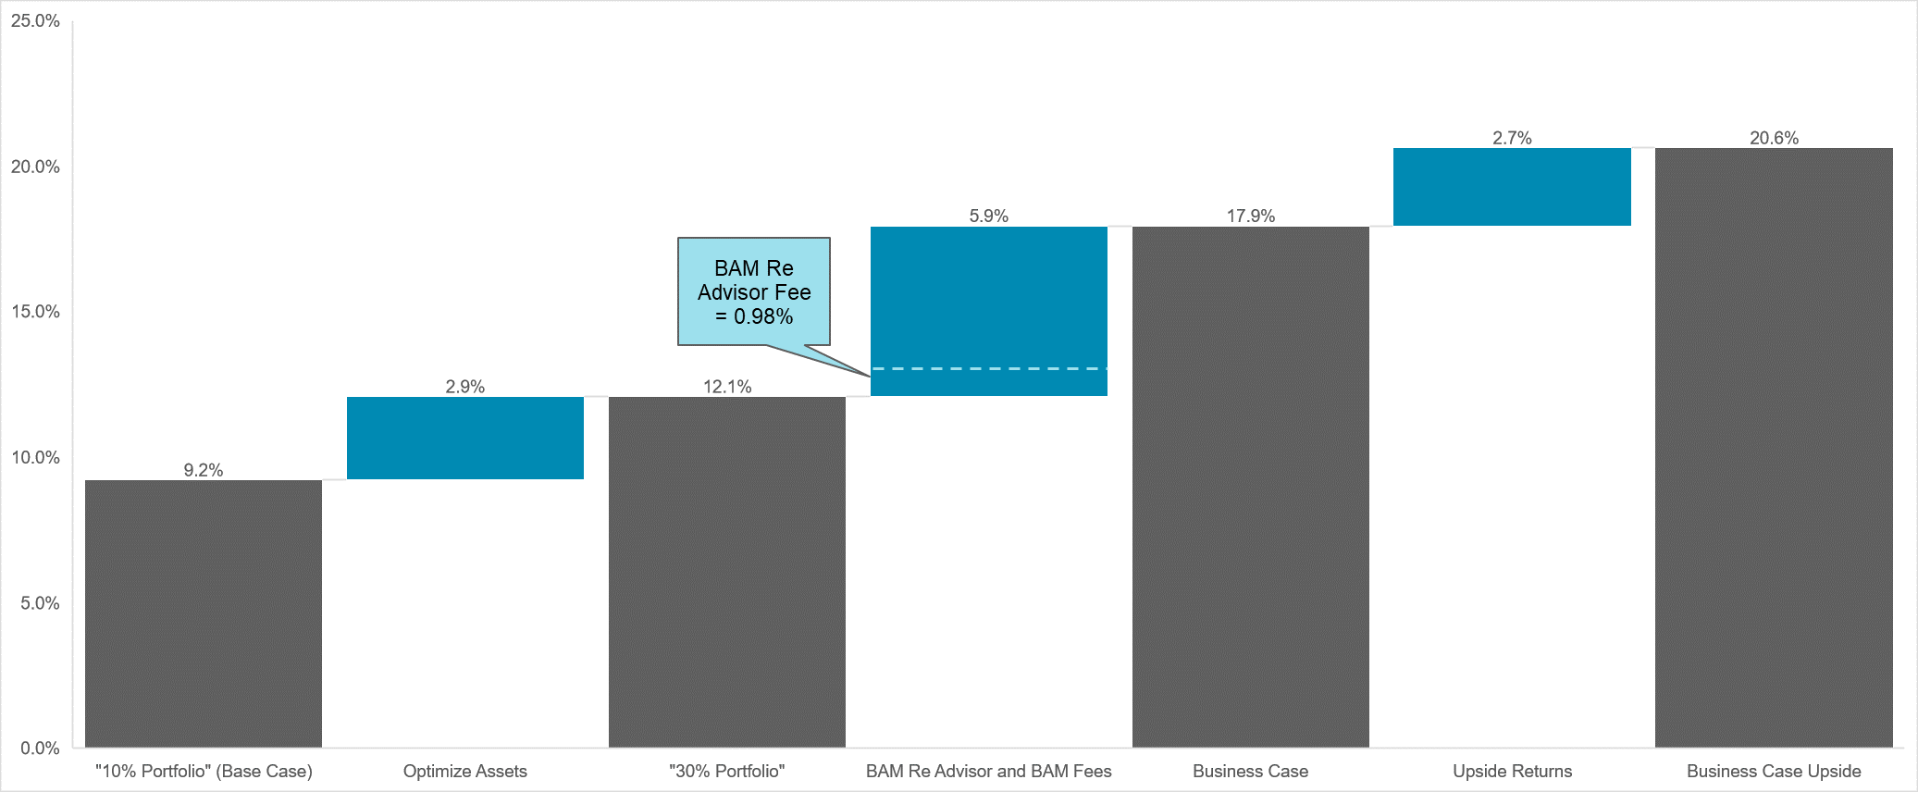
Return bridge
Expected Clearing Price
[Assets constrained y BAC’s commercial lending limit expected to remain at 10% indefinitely.][Allocation to assets constrained by BAC’s commercial lending limit expected to grow from 10% to 30% by 2026.]
Target asset portfolio of [30%][10%] alternatives and net yield reflecting mid point of fund target ranges.
BAM Re Advisor optimization based on BAM Re Advisor expected returns, expenses and defaults.
Investment management fees of 12 bps paid to BAM Re Advisor and 69 bps paid to BAM funds (excludes overhead costs borne by the manager).
Assumes fund returns at upper end of target range.
Note: The return bridges provided do not contemplate the impact of the creation of the US LLC which optimizes BAC’s tax position (4%-5% increase in IRR under both the Base Case and Business Case for this transaction).
3
2
1
BAC Minimum Bid
3
2
1
Notes: “10% Portfolio” and “30% Portfolio” refer to the allocation asset classes that are constrained by BAC’s commercial lending limit
“30% Portfolio” contemplates the ramp from 10% allocation to 30% allocation of these asset classes

Slide 5
Asset Portfolio
Base Case
Business Case

Slide 7
Income Statement – Expected Clearing Price
Brookfield Annuity Company |  | 2022 | 2023 | 2024 | 2025 | 2026 | 2027 | 2028 | 2029 | 2030 | 2031
Revenue
 | Net Premiums | 42,483,188 | 0 | 0 | 0 | 0 | 0 | 0 | 0 | 0 | 0
 | Investment Inc on CF & Rsv | 408,295 | 2,252,642 | 2,146,565 | 2,042,057 | 1,939,444 | 1,837,887 | 1,737,430 | 1,638,841 | 1,541,681 | 1,446,147
 | Additional Income from transition to Ulitmate mix | 40,703 | 105,873 | 100,749 | 95,674 | 90,714 | 85,737 | 80,870 | 76,101 | 71,387 | 66,765
 | Net Investment Income - Assets backing Liab's | 448,998 | 2,358,515 | 2,247,315 | 2,137,731 | 2,030,158 | 1,923,624 | 1,818,300 | 1,714,941 | 1,613,067 | 1,512,912
 | Net Investment Income - Surplus (Pre-Tax) | 37,031 | 211,340 | 206,008 | 197,524 | 188,936 | 180,501 | 172,111 | 163,816 | 155,586 | 147,391
 | Total Revenue | 42,969,218 | 2,569,854 | 2,453,323 | 2,335,255 | 2,219,093 | 2,104,125 | 1,990,411 | 1,878,757 | 1,768,653 | 1,660,304
Benefits & Expenses
 | Net claims and benefits paid | 324,127 | 3,784,273 | 3,651,006 | 3,534,814 | 3,409,515 | 3,313,054 | 3,197,439 | 3,077,947 | 2,969,200 | 2,855,826
 | Increase in Net Actuarial Reserves | 41,609,596 | -1,936,276 | -1,894,872 | -1,869,432 | -1,832,564 | -1,824,112 | -1,794,796 | -1,761,688 | -1,736,542 | -1,705,888
 | Operating Expenses* | 10,648 | 92,667 | 90,179 | 87,954 | 85,131 | 82,787 | 79,754 | 78,412 | 75,750 | 73,709
 | Total Benefits & Expenses | 41,944,371 | 1,940,664 | 1,846,312 | 1,753,335 | 1,662,082 | 1,571,729 | 1,482,398 | 1,394,671 | 1,308,408 | 1,223,648
 | Total net income (loss) before tax | 1,024,847 | 629,190 | 607,010 | 581,920 | 557,011 | 532,396 | 508,013 | 484,086 | 460,246 | 436,656
Income Tax
 | Taxes (at 26.5% corporate tax rate) | 271,584 | 166,735 | 160,858 | 154,209 | 147,608 | 141,085 | 134,624 | 128,283 | 121,965 | 115,714
 | Total net income (loss) after tax | 753,262 | 462,455 | 446,153 | 427,711 | 409,403 | 391,311 | 373,390 | 355,803 | 338,281 | 320,942
Notes:
[Model projection begins on liability assumption date (i.e., Month Day, Year). Premium is collected in Month Year, and reserve is established at that time.]
* Operating expenses are capped at approximately $3M in present value.

Slide 8
Balance Sheet – Expected Clearing Price
Brookfield Annuity Company |  | 2022 | 2023 | 2024 | 2025 | 2026 | 2027 | 2028 | 2029 | 2030 | 2031
Balance Sheet - Actuarial Liabilities & Backing Assets
 | Assets
 | Assets Backing Liabilities Plus Required Surplus | 45,307,197 | 43,277,640 | 41,234,329 | 39,214,636 | 37,234,506 | 35,263,599 | 33,323,664 | 31,417,993 | 29,538,072 | 27,689,306
 | Liabilities
 | Net Actuarial Reserves | 41,609,596 | 39,673,320 | 37,778,448 | 35,909,016 | 34,076,452 | 32,252,340 | 30,457,544 | 28,695,856 | 26,959,314 | 25,253,426
Surplus Balance
 | Surplus Asset Earned Rate Assumption | 5.72% | 5.72% | 5.72% | 5.72% | 5.72% | 5.72% | 5.72% | 5.72% | 5.72% | 5.72%
 | Available Capital - BOY | - | 3,697,601 | 3,604,320 | 3,455,881 | 3,305,620 | 3,158,054 | 3,011,259 | 2,866,120 | 2,722,137 | 2,578,758
 | Add: Capital Injection | 3,697,601 | - | - | - | - | - | - | - | - | -
 | Add: Profits from Operations (excl surplus inc) | 726,044 | 307,120 | 294,737 | 282,531 | 270,536 | 258,643 | 246,888 | 235,399 | 223,925 | 212,610
 | Add: Investment Income on Surplus | 27,218 | 155,335 | 151,416 | 145,180 | 138,868 | 132,668 | 126,502 | 120,404 | 114,356 | 108,333
 | Less: Dividends Paid | 2,944,339 | (555,736) | (594,591) | (577,972) | (556,970) | (538,106) | (518,529) | (499,786) | (481,660) | (463,821)
1 | Available Capital - EOY | 3,697,601 | 3,604,320 | 3,455,881 | 3,305,620 | 3,158,054 | 3,011,259 | 2,866,120 | 2,722,137 | 2,578,758 | 2,435,880
 | Total Equities and Liabilities | 45,307,197 | 43,277,640 | 41,234,329 | 39,214,636 | 37,234,506 | 35,263,599 | 33,323,664 | 31,417,993 | 29,538,072 | 27,689,306
 | Required Capital (RC) | 3,824,199 | 3,895,987 | 3,734,436 | 3,571,742 | 3,411,381 | 3,251,816 | 3,093,750 | 2,936,716 | 2,780,408 | 2,624,764
2 | Base Solvency Buffer (RCx1.05 in 2022, 1 after) | 4,015,409 | 3,895,987 | 3,734,436 | 3,571,742 | 3,411,381 | 3,251,816 | 3,093,750 | 2,936,716 | 2,780,408 | 2,624,764
3 | Surplus Allowance | 1,522,430 | 1,460,463 | 1,398,885 | 1,337,645 | 1,276,742 | 1,216,101 | 1,155,755 | 1,095,593 | 1,035,772 | 976,313
 | Total Ratio [ (1 + 3) /2 ] | 130.0% | 130.0% | 130.0% | 130.0% | 130.0% | 130.0% | 130.0% | 130.0% | 130.0% | 130.0%
Notes:
[Model projection begins on liability assumption date (i.e., Month Day, Year). Premium is collected in Month Year, and reserve is established at that time.]
No injection of cash necessary to cover required capital.

Slide 9
Income Statement – BAC Minimum Bid
Brookfield Annuity Company |  | 2022 | 2023 | 2024 | 2025 | 2026 | 2027 | 2028 | 2029 | 2030 | 2031
Revenue
 | Net Premiums | 42,852,674 | 0 | 0 | 0 | 0 | 0 | 0 | 0 | 0 | 0
 | Investment Inc on CF & Rsv | 408,295 | 2,252,642 | 2,146,565 | 2,042,057 | 1,939,444 | 1,837,887 | 1,737,430 | 1,638,841 | 1,541,681 | 1,446,147
 | Additional Income from transition to Ulitmate mix | 40,703 | 105,873 | 100,749 | 95,674 | 90,714 | 85,737 | 80,870 | 76,101 | 71,387 | 66,765
 | Net Investment Income - Assets backing Liab's | 448,998 | 2,358,515 | 2,247,315 | 2,137,731 | 2,030,158 | 1,923,624 | 1,818,300 | 1,714,941 | 1,613,067 | 1,512,912
 | Net Investment Income - Surplus (Pre-Tax) | 37,031 | 211,340 | 206,008 | 197,524 | 188,936 | 180,501 | 172,111 | 163,816 | 155,586 | 147,391
 | Total Revenue | 43,338,704 | 2,569,854 | 2,453,323 | 2,335,255 | 2,219,093 | 2,104,125 | 1,990,411 | 1,878,757 | 1,768,653 | 1,660,304
Benefits & Expenses
 | Net claims and benefits paid | 324,127 | 3,784,273 | 3,651,006 | 3,534,814 | 3,409,515 | 3,313,054 | 3,197,439 | 3,077,947 | 2,969,200 | 2,855,826
 | Increase in Net Actuarial Reserves | 41,609,596 | -1,936,276 | -1,894,872 | -1,869,432 | -1,832,564 | -1,824,112 | -1,794,796 | -1,761,688 | -1,736,542 | -1,705,888
 | Operating Expenses* | 10,648 | 92,667 | 90,179 | 87,954 | 85,131 | 82,787 | 79,754 | 78,412 | 75,750 | 73,709
 | Total Benefits & Expenses | 41,944,371 | 1,940,664 | 1,846,312 | 1,753,335 | 1,662,082 | 1,571,729 | 1,482,398 | 1,394,671 | 1,308,408 | 1,223,648
 | Total net income (loss) before tax | 1,394,332 | 629,190 | 607,010 | 581,920 | 557,011 | 532,396 | 508,013 | 484,086 | 460,246 | 436,656
Income Tax
 | Taxes (at 26.5% corporate tax rate) | 369,498 | 166,735 | 160,858 | 154,209 | 147,608 | 141,085 | 134,624 | 128,283 | 121,965 | 115,714
 | Total net income (loss) after tax | 1,024,834 | 462,455 | 446,153 | 427,711 | 409,403 | 391,311 | 373,390 | 355,803 | 338,281 | 320,942
Notes:
[Model projection begins on liability assumption date (i.e., Month Day, Year). Premium is collected in Month Year, and reserve is established at that time.]
* Operating expenses are capped at approximately $3M in present value.

Slide 10
Balance Sheet – BAC Minimum Bid
Brookfield Annuity Company |  | 2022 | 2023 | 2024 | 2025 | 2026 | 2027 | 2028 | 2029 | 2030 | 2031
Balance Sheet - Actuarial Liabilities & Backing Assets
 | Assets
 | Assets Backing Liabilities Plus Required Surplus | 45,307,197 | 43,277,640 | 41,234,329 | 39,214,636 | 37,234,506 | 35,263,599 | 33,323,664 | 31,417,993 | 29,538,072 | 27,689,306
 | Liabilities
 | Net Actuarial Reserves | 41,609,596 | 39,673,320 | 37,778,448 | 35,909,016 | 34,076,452 | 32,252,340 | 30,457,544 | 28,695,856 | 26,959,314 | 25,253,426
Surplus Balance
 | Surplus Asset Earned Rate Assumption | 5.72% | 5.72% | 5.72% | 5.72% | 5.72% | 5.72% | 5.72% | 5.72% | 5.72% | 5.72%
 | Available Capital - BOY | - | 3,697,601 | 3,604,320 | 3,455,881 | 3,305,620 | 3,158,054 | 3,011,259 | 2,866,120 | 2,722,137 | 2,578,758
 | Add: Capital Injection | 3,697,601 | - | - | - | - | - | - | - | - | -
 | Add: Profits from Operations (excl surplus inc) | 997,616 | 307,120 | 294,737 | 282,531 | 270,536 | 258,643 | 246,888 | 235,399 | 223,925 | 212,610
 | Add: Investment Income on Surplus | 27,218 | 155,335 | 151,416 | 145,180 | 138,868 | 132,668 | 126,502 | 120,404 | 114,356 | 108,333
 | Less: Dividends Paid | 2,672,767 | (555,736) | (594,591) | (577,972) | (556,970) | (538,106) | (518,529) | (499,786) | (481,660) | (463,821)
1 | Available Capital - EOY | 3,697,601 | 3,604,320 | 3,455,881 | 3,305,620 | 3,158,054 | 3,011,259 | 2,866,120 | 2,722,137 | 2,578,758 | 2,435,880
 | Total Equities and Liabilities | 45,307,197 | 43,277,640 | 41,234,329 | 39,214,636 | 37,234,506 | 35,263,599 | 33,323,664 | 31,417,993 | 29,538,072 | 27,689,306
 | Required Capital (RC) | 3,824,199 | 3,895,987 | 3,734,436 | 3,571,742 | 3,411,381 | 3,251,816 | 3,093,750 | 2,936,716 | 2,780,408 | 2,624,764
2 | Base Solvency Buffer (RCx1.05 in 2022, 1 after) | 4,015,409 | 3,895,987 | 3,734,436 | 3,571,742 | 3,411,381 | 3,251,816 | 3,093,750 | 2,936,716 | 2,780,408 | 2,624,764
3 | Surplus Allowance | 1,522,430 | 1,460,463 | 1,398,885 | 1,337,645 | 1,276,742 | 1,216,101 | 1,155,755 | 1,095,593 | 1,035,772 | 976,313
 | Total Ratio [ (1 + 3) /2 ] | 130.0% | 130.0% | 130.0% | 130.0% | 130.0% | 130.0% | 130.0% | 130.0% | 130.0% | 130.0%
Notes:
[Model projection begins on liability assumption date (i.e., Month Day, Year). Premium is collected in Month Year, and reserve is established at that time.]
No injection of cash necessary to cover required capital.

Slide 11
Indicative Pricing Feedback
Indicative bids were requested on Day Month Year using market conditions as of Day Month Year.
[BAC provided illustrative pricing on each individual parcel as well as the entire liability. Note that a small bulk discount was provided on the total relative to the sum of the individual parcels.]
Feedback is provided below:
Feedback on number of bidders
Feedback on pricing
Tranche | Bid | Relative to Expected Clearing Price | Relative ranking | Relative to lowest bid
Parcel A | $59.8M | +4.7% | 3rd | +1.8%
Parcel B | $55.5M | +4.7% | 4th | +2.8%
Parcel C | $47.1M | +5.0% | 4th | +2.4%
Parcel D | $45.8M | +5.0% | 5th | +2.4%
Parcel E | $13.2M | +5.6% | 3rd | +4.7%
Total | $220.5M | +4.5% | 3rd | +1.8%
Rank | Bid | Relative to Expected Clearing Price
1 | $32.4M | +2.5%
2 | $32.7M | +3.4%
3 | $32.8M | +3.8%
4 | $33.0M | +4.4%
BAC indicative bid

