Slide 1
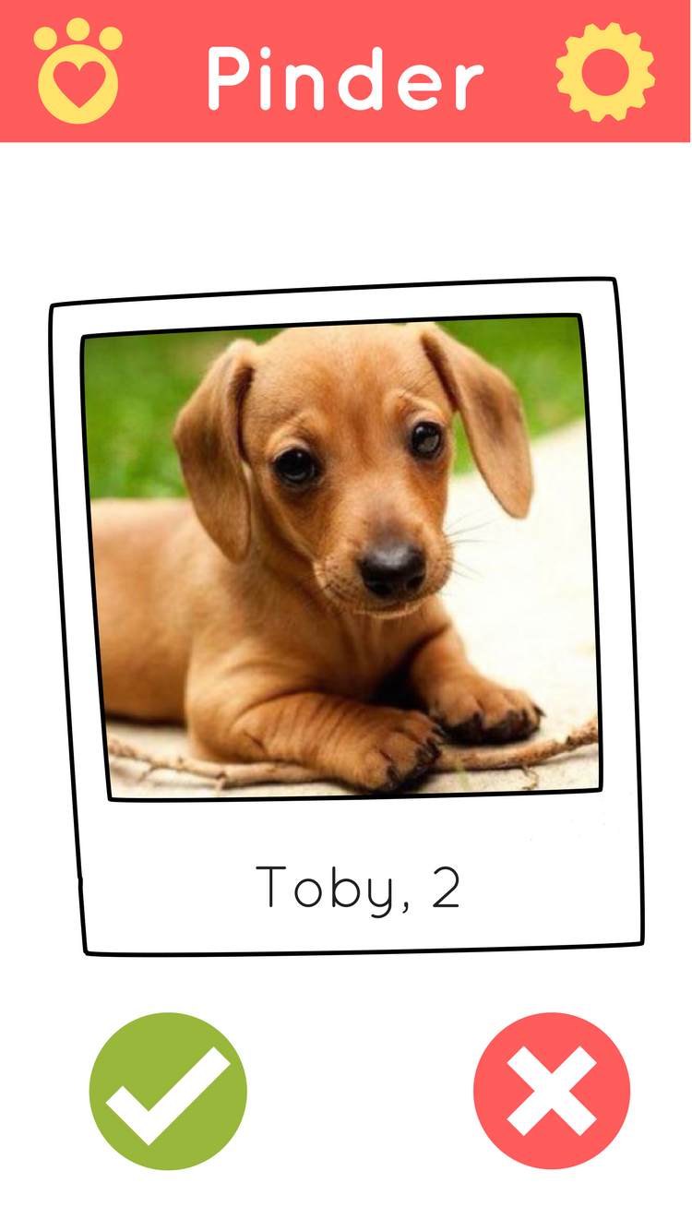
Main Page
Matches
Settings
Notes:
Main screen

Slide 2
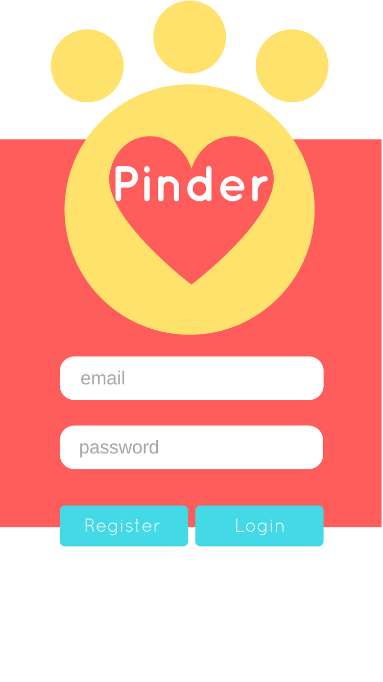
Login Page
Main Page
Profile Page
Notes:
Main screen

Slide 3
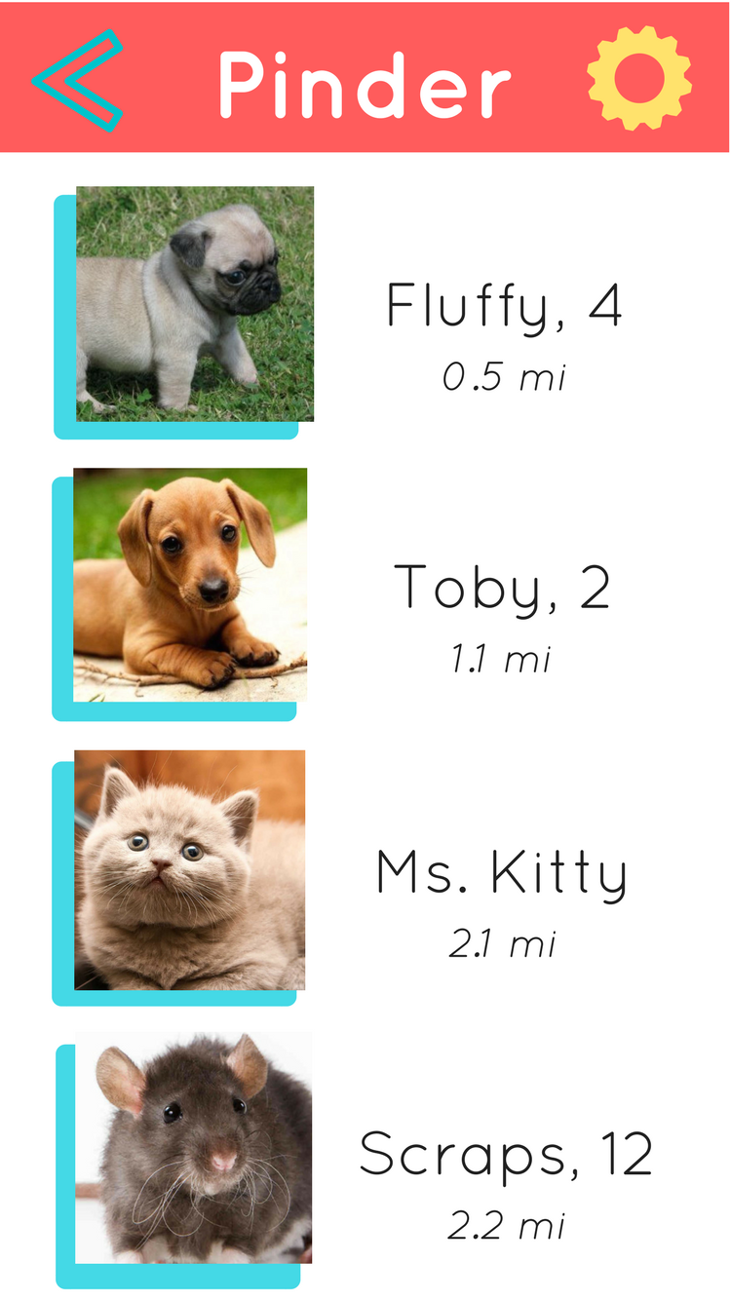
Matches Page
Main Page
Profile Page
Settings
Notes:
Main screen

Slide 4
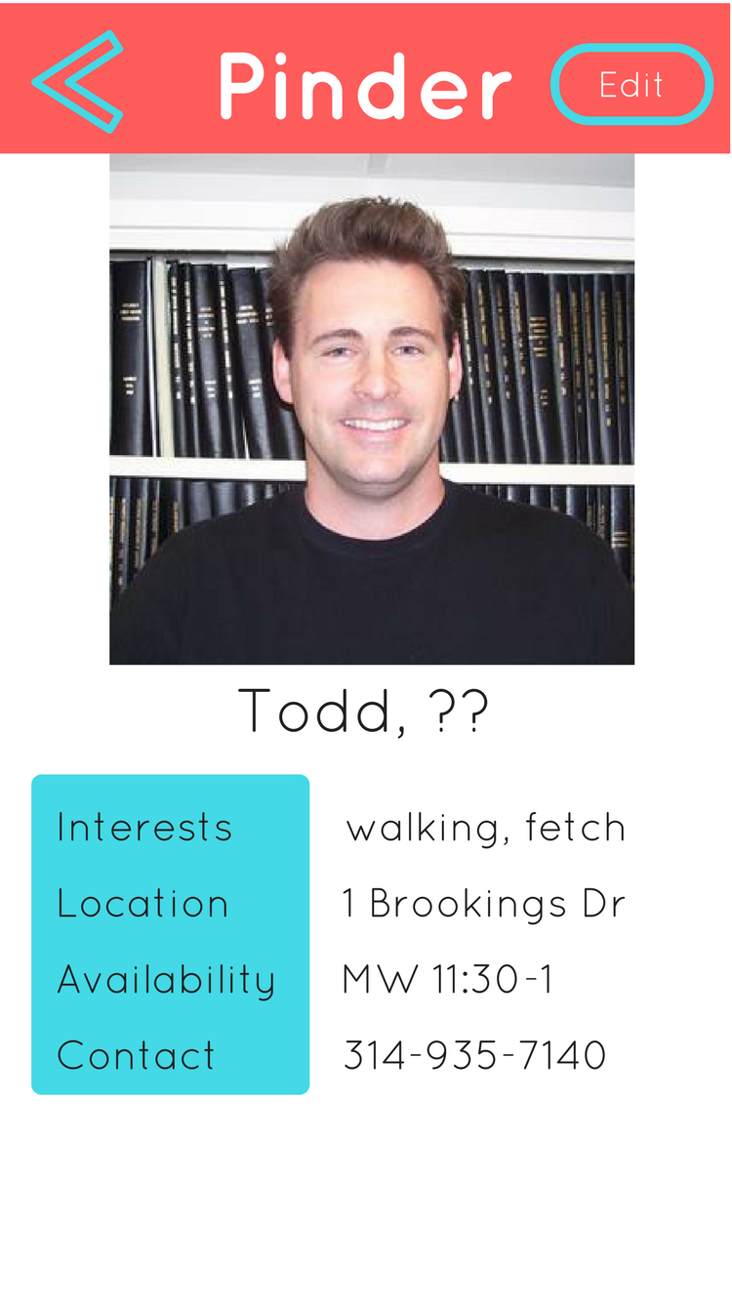
Personal Profile
Main Page
Allows Editing
Notes:
Main screen

Slide 5
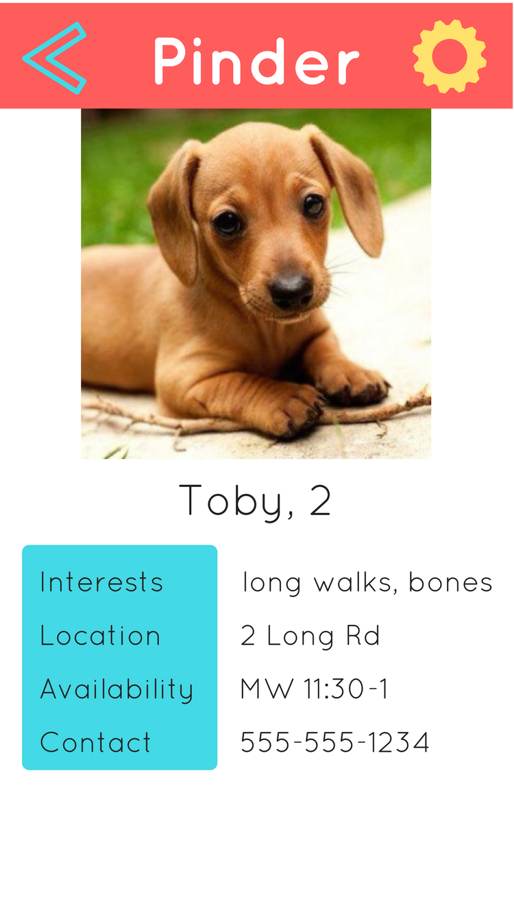
Pet Profile
Main Page
Settings
Integrate
with maps
Integrate
with phone
Notes:
Main screen

Slide 6
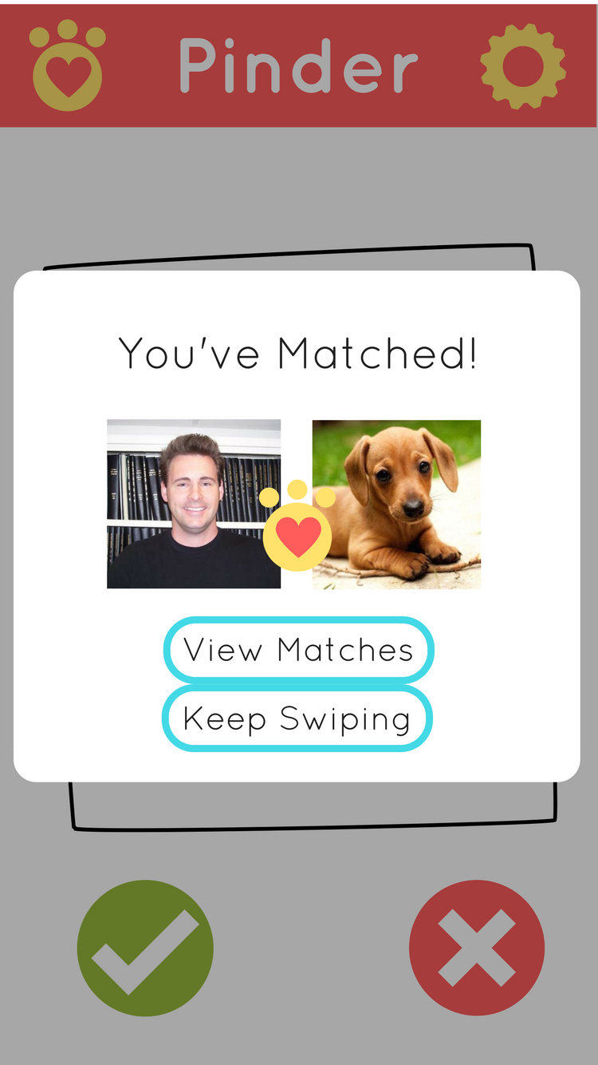
Match
Alert
Matches
Main Page
Notes:
Main screen

Slide 7
Demo
Notes:
Main screen

