Slide 1
Software-Defined Networking
Section 2

Slide 2

Per-router control plane
Individual routing algorithm components in each and every router interact in the control plane
Routing
Algorithm
control
plane
data
plane
values in arriving
packet header
0111
1
3
2

Slide 3
Logically centralized control plane
A distinct (typically remote) controller interacts with local control agents (CAs)
Remote Controller
control
plane
data
plane
CA
CA
CA
CA
CA
values in arriving
packet header
0111
1
3
2

Slide 4
Controller Availability
“control a large force like a small force: divide and conquer”
--Sun Tzu, Art of war
How many controllers?
How do you assign switches to controllers?
More importantly: which assignment reduces processing time
How to ensure consistency between controllers
Applications
Applications
Applications
Controller (N. O.S.)
Applications
Applications
Applications
Applications
Applications
Applications
Controller (N. O.S.)
Controller (N. O.S.)

Slide 5


SDN Reliability/Fault Tolerance
Controller: Single point of control
Bug in controller takes the whole network down
Existing network survives failures or bugs in code for any one devices
Applications
Applications
Applications
Controller (N. O.S.)

Slide 6
SDN Reliability/Fault Tolerance
Controller: Single point of control
Bug in controller takes the whole network down
Single point of failure
Existing network survives failures or bugs in code for any one devices
Applications
Applications
Applications
Controller (N. O.S.)

Slide 7

SDN Security
Controller: Single point of control
Compromise controller
If one device in the current networks are compromised the network may still be safe
Applications
Applications
Applications
Controller (N. O.S.)

Slide 8

SDN Security
Controller: Single point of control
Compromise controller
Denial of Service attack the control channel
Applications
Applications
Applications
Controller (N. O.S.)

Slide 9
Data-Plane Limitations
Limited Number of TCAM entries
Currently only 1K
Networks have more than 1K flows
How to fit network in limited entries?
Limited control channel capacity
All switches use same controller interface
Need to rate limit control messages
Prioritize certain messages
Limited switch CPU
Less power than a smartphone ☹
Limit control messages and actions that use CPU
Applications
Applications
Applications
Controller (N. O.S.)
O.S
Switch H.W

Slide 10
Debugging SDNs
Buggy
App
Problems can occur anywhere in the SDN stack
How do you diagnose each type of problem?
Applications
Applications
Applications
Network O.S.
Buggy
NOS
Buggy
Switch
Buggy
Switch
H/W
Switch Operating System
Switch Operating System
Switch Hardware
Switch Hardware

Slide 11
Types of Networks
ISP Networks
Entity only owns the switches
Throughput: 100GB-10TB
Heterogeneous devices: laptop/desktop
Medium latency: 20-80 milliseconds
Enterprise Networks
One entity owns many of the servers + switches
Throughput: 10G-40GB
Heterogeneous devices: laptop/desktop
Medium latency: 5-10 milliseconds
Clouds/Data Centers
One entity owns servers + switches
Extra low latency between 2 devices (20 microseconds)
Homogenous devices

Slide 12
Network Review
Core
Connects other switches
Lots of traffic (TB)
VERY Expensive
See a lot of flows
Implications
Can’t do per flow processing!
Can’t store per flow state
Edge Device
Connects hosts
Sees little traffic (GB)
Sees a small number of flows
Implications:
Can do per flow processing.
Can store per for state

Slide 13
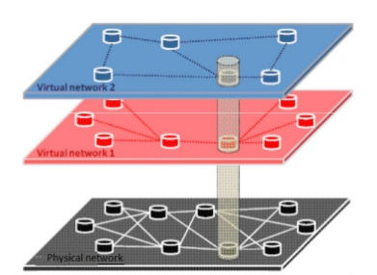
OpenFlow Network Slicing

Slide 14
Router Review
Slow Path/control plane
Has general purpose CPU
Runs routing algorithms
Only works on a few packets
Very very slow
Very very slow
Can’t process all packets
Fast path/data path
Specialized H/W
Very Expensive
Takes 3-5 years to change
Performs processing on every packet
Very very fast

Slide 15
Time Scales
 | Data | Control | Management
Time scales | Packets | Events | Humans
Task | Forwarding/buffering/filtering/scheduling | Routing, circuit set-up | Analysis, configuration
Location | Hardware Specialized hardware Processes at line rate. Every packet Very fast | Router software Uses CPU Can only process a small number of packets Very slow | Human or perl scripts

Slide 16
Ideally…
Managing network in a simple way
Directly and explicitly apply policies to network
Internet
Split load between S5 and S6
Shut down S6 for maintenance on May 1
S1
accurate network view
S5
S6
forwarding state
S2
S3
S4
Notes:
To motivate our work, let’s think about how we really want to manage a network and look at what the reality is.
This is what we call direct control paradigm, where control policies are made explicit and they are directly applied to network.
Are we there yet?

Slide 17
Indirect Control - Fact #1: Infer network view by reverse engineering
Probe routers to fetch configuration
Monitor control traffic (e.g., LSAs, BGP update)
Internet
S1
?
probe routers and guess network view
S5
?
S6
?
?
?
S2
S3
S4
Notes:
To motivate our work, let’s think about how we really want to manage a network and what the reality is.

Slide 18
Indirect Control - Fact #2: Policies buried in box-centric configuration
Many knobs to tune
Trial and error
Internet
Change OSPF link weights on S2, S3, S4..
Modify routing policies on S2, S3, S4…
S1
?
probe routers and guess network view
S5
?
S6
?
configuration commands
?
?
S2
S3
S4
Notes:
To motivate our work, let’s think about how we really want to manage a network and what the reality is.

Slide 19
Complex configuration is error-prone and is causing network outages
interface Ethernet0
ip address 6.2.5.14 255.255.255.128
interface Serial1/0.5 point-to-point
ip address 6.2.2.85 255.255.255.252
ip access-group 143 in
frame-relay interface-dlci 28
router ospf 64
redistribute connected subnets
redistribute bgp 64780 metric 1 subnets
network 66.251.75.128 0.0.0.127 area 0
router bgp 64780
redistribute ospf 64 match route-map 8aTzlvBrbaW
neighbor 66.253.160.68 remote-as 12762
neighbor 66.253.160.68 distribute-list 4 in
access-list 143 deny 1.1.0.0/16
access-list 143 permit any
route-map 8aTzlvBrbaW deny 10
match ip address 4
route-map 8aTzlvBrbaW permit 20
match ip address 7
ip route 10.2.2.1/16 10.2.1.7

Slide 20
Indirect Control - Fact #3: Indirect Control Creates Subtle Dependencies
Example:
Policy #1: use C as egress point for traffic from AS X
Policy #2: enable ECMP for A-C flow
3
D
Desired
1
Unexpected!
1
AS X
A
1
3
1
2
4
AS Y
B
C

Slide 21
Indirect Control leads to …
62% of network downtime in multi-vendor networks comes from human-error
80% of IT budgets is spent on maintenance and operations .

Slide 22
An Architecture Question to Study
How should the functionality that controls a network be divided up?
Important: everyone hates net outages
Practical: solutions can be implemented without changing IP or end-hosts
Relevant: trends toward separating decision-making from forwarding
Unsolved: problem is not solved by running BGP/OSPF on faster servers

Slide 23
Our Proposal: Dissemination and Decision Planes
What functions require a view of entire network and network objectives?
Path selection and traffic engineering
Reachability control and VPNs
! Decision plane
What functions must be on every router to support creation of a network-wide view?
Topology discovery
Report measurements, status, resources
Install state (e.g., FIBs, ACLs) into data-plane
! Dissemination plane

Slide 24
Direct Control: A New World
Express goals explicitly
Security policies, QoS, egress point selection
Do not bury goals in box-specific configuration
Make policy dependencies explicit
Design network to provide timely and accurate view
Topology, traffic, resource limitations
Give decision maker the inputs it needs
Decision maker computes and pushes desired network state
FIB entries, packet filters, queuing parameters
Simplify router functionality
Add new functions without modifying/creating protocols or upgrading routers

Slide 25
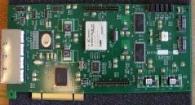
How can we get there?
4D
Decision Computation Service
Generating table entries
D
Routing Table
Access Control Table
NAT Table
Tunnel Table
Dissemination Service
D
Install table entries
Discovery
D
Data Plane
Modeled as a set of tables
D

Slide 26
Discuss Implementations Possibilities
Decision Plane
Centralized, or
Distributed
Dissemination Plane
In-band, or
Out-of-band
Data Plane
Flow table entries
Piece of code run at every router
Piece of code in each packet
Notes:
Choice based on reliability requirements
Data plane evolution should be driven by needs of decision and dissemination planes

Slide 27
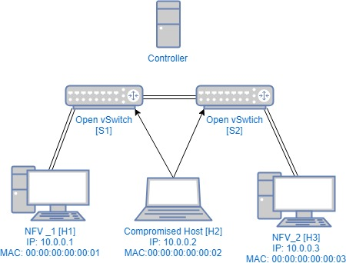
Topology Discovery
Report the received LLDP
Broadcast the LLDP messages

Slide 28
LLDP Man-in-the-Middle Attack (2/5)
Compromised host tries to attack the network
Sniff LLDP messages from S1
Modify and the LLDP and send it back

Slide 29
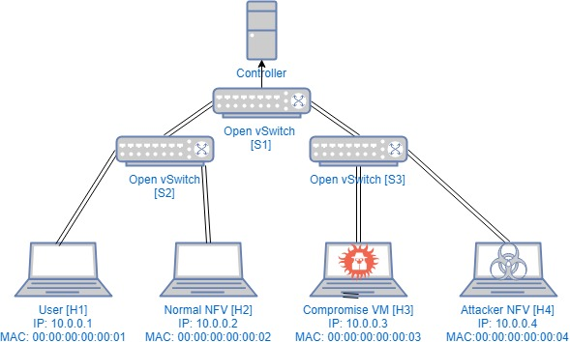
Host Tracking Service Attack (1/5)
Host location information
Switch tells controller the host location when the host sends any data packet
Data Packets

Slide 30

Host Tracking
Host location information
Data Packets

