Slide 1
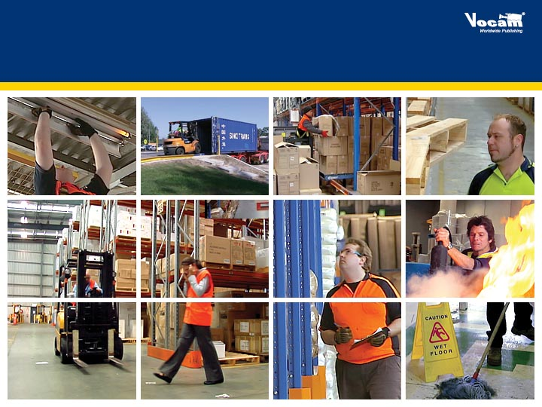
Warehousing & Storage Safety
Essentials

Slide 2
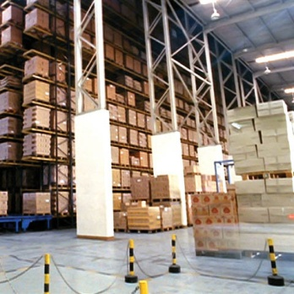
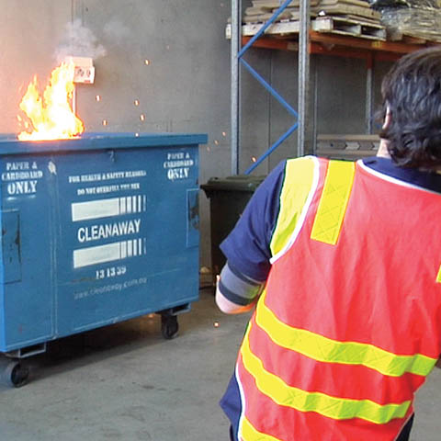
01/ Training Overview
Warehousing & Storage Safety Essentials
Working in the warehousing and storage industry presents
a variety of hazards.
Collisions between vehicles and pedestrians, musculoskeletal injuries, and slips and trips are amongst the most common causes of time off work and lost productivity.

Slide 3

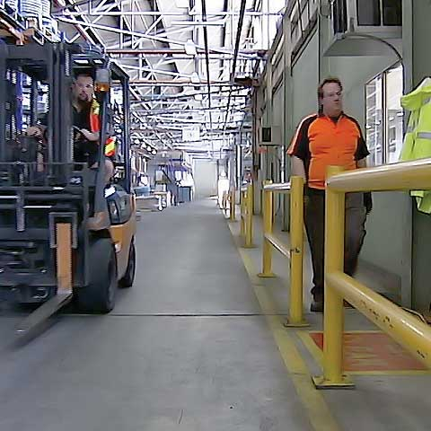
02/ Workplace safety 101
Warehousing & Storage Safety Essentials
Everyone at work is responsible for maintaining a safe workplace.
Health and safety legislation requires:
Ongoing identification of hazards at work
Assessment of risks
Implementation of control measures to eliminate or reduce risk
Review of control measures
Risk assessments must be updated when conditions in the
workplace change.
Be pro-active about safety.
If you see a hazard:
First attempt to eliminate or reduce the risk, if it is safe to do so
If you cannot, or if it is not safe, protect others from harm, and
then notify a supervisor

Slide 4
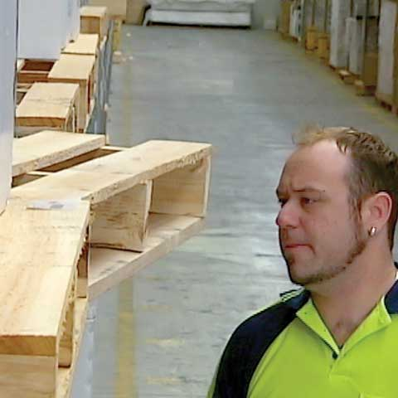
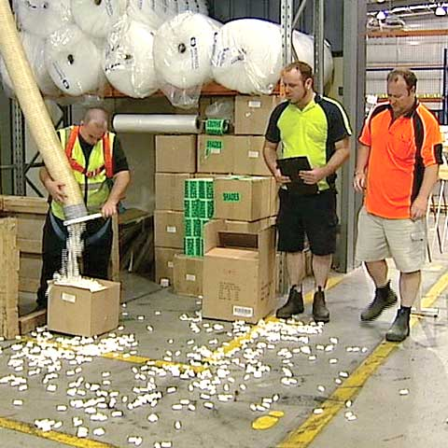
02/ Workplace safety 101 cont…
Warehousing & Storage Safety Essentials
Communicate any safety issues or newly implemented risk control measures to your co-workers during shift changeovers.
Ensure you adhere to established safe work practices.
Slip and trip accidents can happen for a number of reasons,
however, all too often we attribute them to regular human
error and fail to investigate the actual causes.
Never perform tasks requiring a competency that you have
not been trained in.
Read safety signs and follow their instructions.
Know what personal protective equipment, or PPE, is required
in different sections of the workplace.

Slide 5
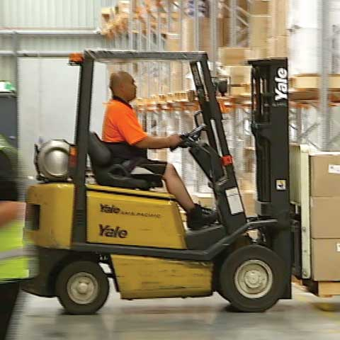
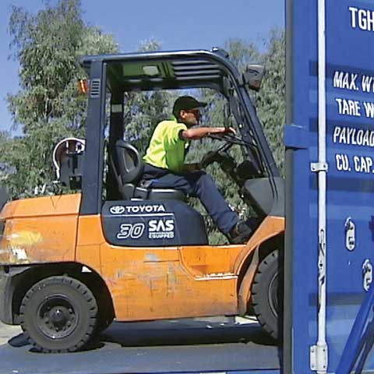
03/ Forklifts
Warehousing & Storage Safety Essentials
Forklifts may only be operated by trained, competent personnel.
All other personnel should avoid going near a forklift in operation, and should not approach until the driver indicates that it is safe to
When assisting a driver, allow an adequate safety zone between yourself and the forklift.
Never walk under a raised load.
Forklifts steer from the rear.
Avoid standing in doorways and thoroughfares that are used by forklifts.
do so.

Slide 6
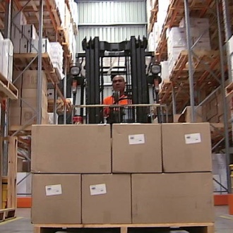
03/ Forklifts cont…
Warehousing & Storage Safety Essentials
Never allow passengers to travel on a forklift or on the forks.
Only approved attachments can be used to elevate persons
using a forklift.
Before driving forklifts in and out of trailers:
Ensure the trailer wheels are chocked
Support the trailer nose with a stand
Check the integrity of the trailer floor
Ensure the dock plate is secure, undamaged, and adequate
for the weight of the forklift and load
Take precautions to reduce the risk of harm from exhaust fumes
or toxic loads.

Slide 7
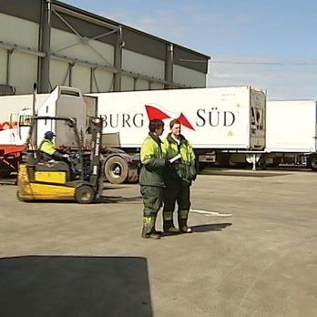
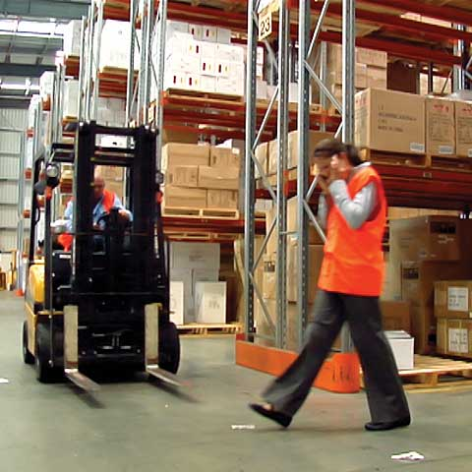
04/ Traffic & pedestrians
Warehousing & Storage Safety Essentials
On-site traffic needs to be carefully managed to reduce
the risk of accidents.
Visiting drivers should be given any information they need,
in advance, to ensure their own safety and that of others.
Visiting drivers may need to complete a site induction.
Traffic routes should be properly designed and clearly marked.
Traffic routes should:
• Be appropriate for the vehicles using them
• Minimise the need for reversing
• Avoid sharp bends and blind corners
• Be properly maintained
• Be appropriately signed

Slide 8
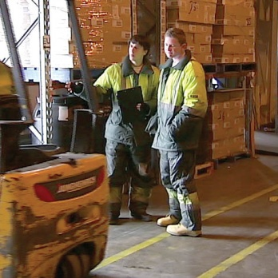
04/ Traffic & pedestrians cont…
Warehousing & Storage Safety Essentials
Pedestrian and vehicular traffic routes should be kept completely
separate, where possible.
Where pedestrians and vehicles use the same traffic route, there
should be adequate separation.
When entering shared traffic areas, pedestrians should wear hi
visibility clothing or PPE.
Stick to designated walkways and follow all signs and instruction.
Use mirrors, where available, to observe traffic around blind corners.
Stay alert, and always look and listen for horns, warning lights and
back-up alarms.

Slide 9
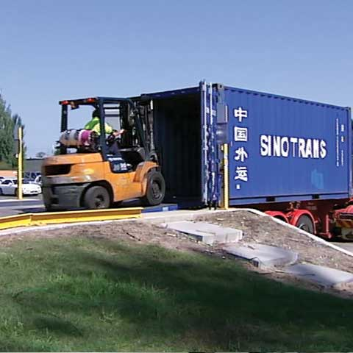
05/ Loading docks
Warehousing & Storage Safety Essentials
Injuries occur at loading docks due to:
• The manual labour of unloading goods
• The risk of slips, trips and falls
• Congestion of people and forklifts
• The high volume of activity
Ensure that drivers follow proper procedures for the coupling
and uncoupling of trailers.
Have a safe system of work in place so that drivers never move
their vehicles until the load is secure and it is safe to depart.
Communicate clearly with drivers by using:
• Hand signals
• Lighting systems
• Signs
• Other methods

Slide 10
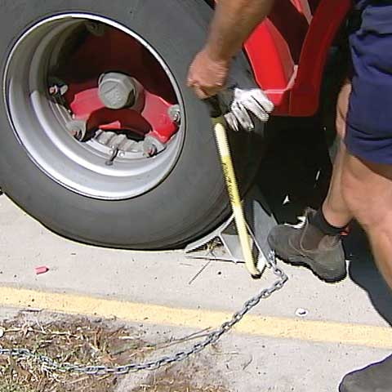
05/ Loading docks cont…
Warehousing & Storage Safety Essentials
Loads often shift in transit so always take care when opening trailer doors to avoid being injured by falling boxes or product.
Avoid working or operating equipment near open or exposed dock doors as they present a fall hazard.
Do not jump from trucks or docks. The risk of injury is extremely high. It can happen in an instant, or develop over a long period of time.

Slide 11

06/ Fire safety
Warehousing & Storage Safety Essentials
Fires cause significant financial losses, serious injury and sometimes death, so you must be diligent in controlling the risks.
Good housekeeping can help prevent fires and reduce the risk
of harm should one occur.
Take care when placing flammable substances or combustible objects such as:
• Paper
• Cardboard
• Rags
Keep them well away from:
• Sources of heat
• High voltage power supplies
• Sources of ignition

Slide 12

06/ Fire safety cont…
Warehousing & Storage Safety Essentials
Do not stack goods closer than 45cm, or 18 inches, from
a sprinkler head.
  You must ensure that all fire exits, fire-fighting equipment
  and electrical panels are clear of obstructions.
  Where flammable materials are stored, ensure that proper storage, labelling and handling procedures are followed.
  Mechanical and electrical equipment should be maintained properly to prevent overheating.
  All electrical cables and equipment must be regularly tested
  and tagged.
  Never place cables in:
• Wet areas
• Near sharp edges
• Near heat sources
• In places wear they can be damaged or worn

Slide 13

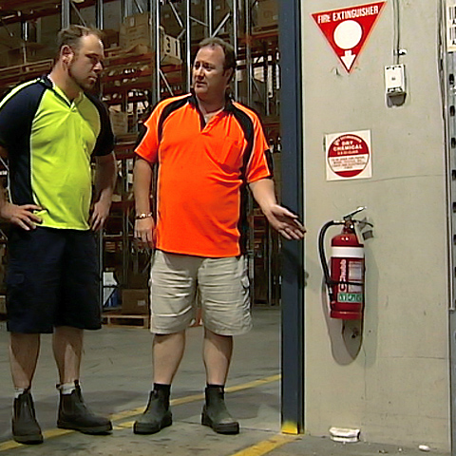
06/ Fire safety cont…
Warehousing & Storage Safety Essentials
If you are confronted by a fire:
• Don’t panic
• Close off the affected area if possible
• Go to the nearest alarm and activate it
• Report the fire
Only properly trained persons may operate:
• Fire extinguishers
• Fire hoses
Using the incorrect type of fire extinguisher will increase
the risk of injury or death.

Slide 14


06/ Fire safety cont…
Warehousing & Storage Safety Essentials
If the fire is spreading rapidly and getting out of control, you
need to be prepared to evacuate.
All personnel must be familiar with their workplace’s evacuation procedure.
When an alarm sounds:
  Turn off all equipment, if safe to do so
  Calmly move to your designated safe assembly area
  Do not use the lift, exit via the stairs
  Keep talk to a minimum
  Go directly to your safe assembly area
  Do not re-enter the building until the fire brigade has
  confirmed that it is safe to do so

Slide 15
07/ Slips & Trips
Warehousing & Storage Safety Essentials
Slips usually occur when the floor is wet or contaminated.
Examples of floor contamination include:
• Water
• Oil
• Cleaning products
• Dry powders
• Foodstuffs
• Stretch wrapping
• Label backing
• Plastic bags

Slide 16
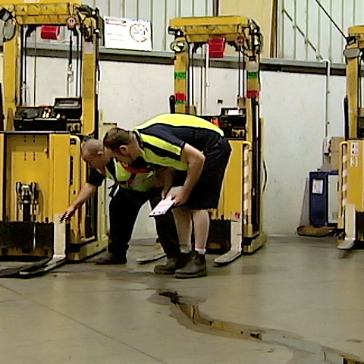
07/ Slips & Trips cont…
Warehousing & Storage Safety Essentials
When contamination does happen, you need to deal with it immediately.
Cleaning creates its own slip hazards. So ensure areas being cleaned are properly signed and barricaded.
Stop contaminants getting onto the floor by:
• Fixing leaks
• Keeping equipment well maintained
• Practicing good housekeeping

Slide 17
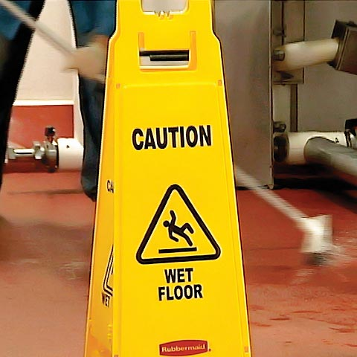
07/ Slips & Trips cont…
Warehousing & Storage Safety Essentials
Trips are caused by:
• Objects on the floor
• Uneven surfaces
• Ill-fitting or inappropriate footwear
Make sure that goods, equipment and waste do not cause obstructions or project into places where people may walk.
Check that floor surfaces are even and fill in any holes.
Floor penetrations or changes in level may require:
• Barriers
• Stable covers
• Signage
Ensure that lighting is adequate.
Hoses and electrical cables are common causes of trip accidents. Ensure they are placed safely.

Slide 18
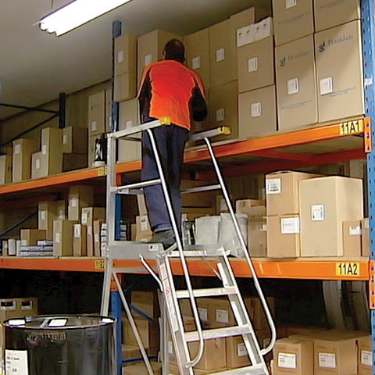
08/ Working at Height
Warehousing & Storage Safety Essentials
Working at height includes any work where there is a risk of a fall liable to cause personal injury, even if it is at or below ground level.
Any work at height must be:
• Properly planned
• Appropriately supervised
• Carried out in a safe way by certified competent personnel
Risk Control:
1. Take all reasonable steps to avoid work at height.
2. If you cannot, make sure the risk of a fall is prevented.
3. Where this is not practicable, minimise the consequences of a fall.

Slide 19
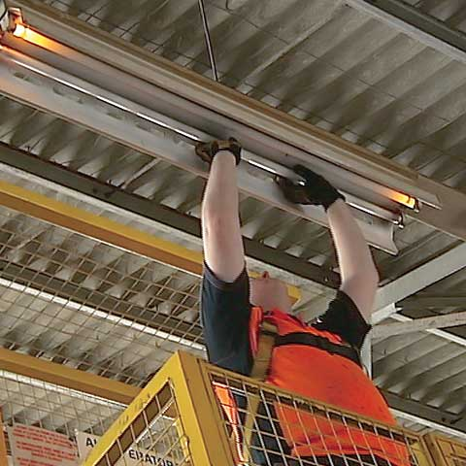
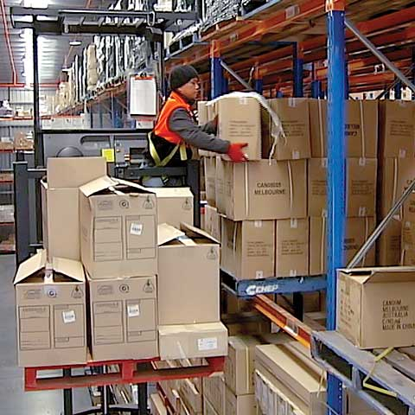
08/ Working at Height cont…
Warehousing & Storage Safety Essentials
Some access equipment requires specialist training, and that the user be competent in its use.
Always inspect equipment for work at height before use and after
any incident that may affect the equipment’s safety.
Before using a ladder at work, you must be able to show that it was not reasonable to select safer equipment and that the task is:
• Low risk
• Light duty
• Short duration
Ladder safety tips:
• Do not work off the top steps
• Avoid side-on
• Always maintain 3 points of contact while climbing and working

Slide 20
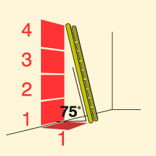
08/ Working at Height cont…
Warehousing & Storage Safety Essentials
Leaning ladder safety:
• Ensure it is at an angle of 75 degrees to the ground
Or
• Apply the 1 in 4 rule: One metre out for every four metres up.
Working at height may create a risk of injury from falling objects
Sign and barricade the affected area.
Where this is not possible, you should inform co-workers so that
they can take precautions.
Never climb on racking unless it is specifically designed for use
as access equipment.

Slide 21

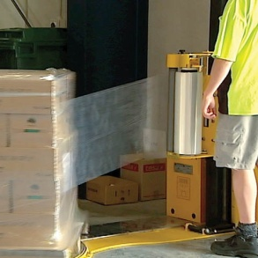
09/ Safe Storage
Warehousing & Storage Safety Essentials
All storage systems are rated for the maximum load that they can bare safely.
This is known as the “Safe Working Load” or SWL.
To avoid structural failure, never exceed weight restrictions and
have storage systems inspected by a competent person at regular intervals.
Any impact with racking should be reported to a supervisor immediately.

Slide 22

09/ Safe Storage cont…
Warehousing & Storage Safety Essentials
Inspect pallets before loading them. Damaged pallets must be
taken out of service until repaired.
Follow proper procedures and only use the correct type of pallet
for the task.
Stabilise loads by:
• Interlocking the stacked material
• Stretching plastic wrap around the items
• Using straps to tie the load down
Ensure that the weight of the load is balanced, and evenly distributed on the pallet.
Make sure product is stacked within the confines of the pallet and
not sticking out.

Slide 23
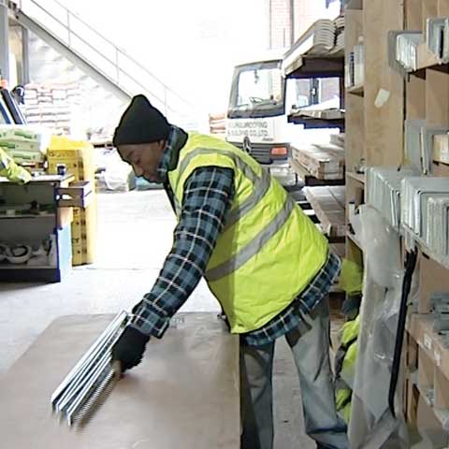
10/ Manual tasks & ergonomics
Warehousing & Storage Safety Essentials
Manual tasks are the most common cause of injury in
the storage and warehousing industry.
Musculoskeletal disorders (MSDs):
• May occur as a result of a single event
• May develop over a prolonged period from the accumulation of many minor tissue injuries
The risks may increase when working in hot or cold environments.
Risk Control:
• If there is a risk of injury from a manual handling task, the task should be avoided
• Where the task cannot be avoided, you need to
minimise the risk

Slide 24
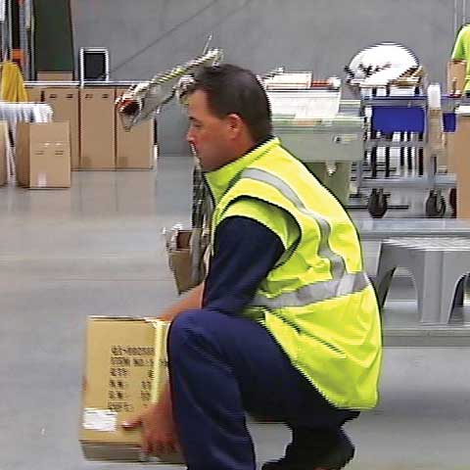
10/ Manual tasks & ergonomics cont…
Warehousing & Storage Safety Essentials
Mechanical aids are designed to reduce the force and physical
effort required to handle materials, and/or the need to bend, reach
or stoop, making the task easier and safer.
When required to handle materials manually, ensure you:
• Plan the lift
• Plan the route
• Clear the destination
• Adopt safe lifting techniques
Safe Lifting Techniques:
• Push, don’t pull
• Bend the knees, not the back
• Don’t jerk a load, lift smoothly
• Keep the load close
• Turn with the feet instead of twisting

Slide 25
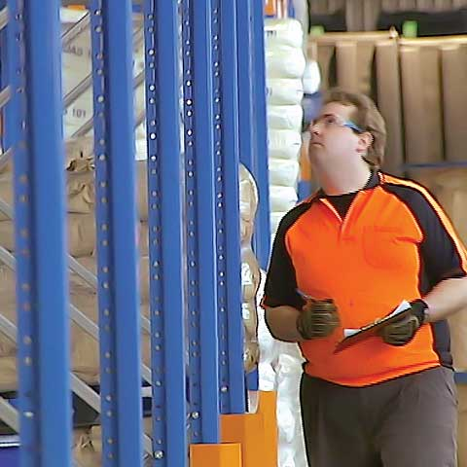
10/ Manual tasks & ergonomics cont…
Warehousing & Storage Safety Essentials
Workstations and tasks should be designed and set up to minimise the risk of musculoskeletal injuries.
Light duty tasks can cause serious injury when they involve:
• Awkward postures
• Long durations
• High frequency
To minimise ergonomic risks:
• Vary your posture and position whenever possible
• Take regular short breaks
• Perform stretches and exercises
If you experience back or neck pain, or soreness and stiffness in joints, see your doctor as soon as possible.

Slide 26
This PowerPoint® has been made only as a guide and may not conform with current and local standards, statutes, regulations, requirements and procedures. The training package may or may not be relevant to your particular standards and needs. Trainers should make their own enquires and seek the assistance of local authorities, experts and consultants. This training package is merely an aid to learning and understanding and is not a substitute for practice, experience, drills and hands-on instruction and tuition which is essential.
VOCAM PTY LTD. and other parties involved in this production shall not be liable for any expenses, claims, damages, suits, actions, judgements and costs whatsoever arising out of or in any way connected with or howsoever caused by this production and whether arising from contract, tort, negligence, strict liability statute or howsoever otherwise.
DISCLAIMER - All rights reserved. No part of this PowerPoint® may be reproduced by any means without written permission from the author, except for the inclusion of brief quotations in a review.
© Copyright 2010 - Vocam Pty Ltd.
This PowerPoint® is not to be used or shared on - Intranets, Local Area Networks, Via Internet or Any other Networks.
Warehousing & Storage Safety Essentials

