Slide 1
FINAL PROJECT PRESENTATION
RENTAL MANAGEMENT SYSTEM
Phase 3 — Final Project Presentation
PROPERTY
TENANTS
PAYMENTS
NAHABWE DERRICK ERIC
Certificate in Software Development with AI (CSDA)
Instructor: AJWADH JALAL
SAI PALI INSTITUTE OF TECHNOLOGY AND MANAGEMENT
2 November 2026
Python · Tkinter
MySQL
NAHABWE DERRICK ERIC | Rental Management System
01
Notes:
Target speaking time: 40 seconds
Introduce yourself and the project. Explain that this is the same local desktop project approved in Phase 1 and designed in Phase 2. The presentation describes what the current code provides and the remaining gaps. Do not describe it as a fully production-ready system.

Slide 2
FINAL PROJECT PRESENTATION
Project background
One workspace for a landlord or property manager.
PROPERTY
TENANTS
PAYMENTS
Keep rental locations
and unit counts together.
Connect resident details
to a property and unit.
Record rent and balances;
prepare a receipt.
Local desktop use · One office or property portfolio
NAHABWE DERRICK ERIC | Rental Management System
02
Notes:
Target speaking time: 45 seconds
Explain the context from the Phase 1 introduction. Rental information is often spread across paper receipts, notebooks, and spreadsheets. The intended users are landlords and property managers overseeing a local portfolio. Linking property, tenant, and payment information reduces repeated lookup work. These are intended benefits; no measured time-saving study was performed.

Slide 3
FINAL PROJECT PRESENTATION
Problem statement and objectives
Scattered records make rent, leases, and vacant units difficult to track.
Property control
Add / view / delete present; editing missing
Tenant registry
Registration present; profile editing missing
Payments and leases
Payment entry present; lease lifecycle incomplete
MySQL and reliability
Storage code present; live integration pending
Reporting and validation
Dashboard and selected checks; full scope incomplete
NAHABWE DERRICK ERIC | Rental Management System
03
Notes:
Target speaking time: 60 seconds
State the original problem: manual record keeping can cause misplaced agreements, duplicate entries, financial mistakes, and slow reporting. The five groups shown combine the six approved objectives: MySQL security and storage is grouped with reliability, and reporting is grouped with validation. All six objectives remain partly achieved. Give credit to working entry and viewing features while explaining that editing, full leases, exports, and reports are still missing.

Slide 4
FINAL PROJECT PRESENTATION
Scope and key requirements
APPROVED IN SCOPE
APPROVED OUT OF SCOPE
Property and tenant records
Payments and lease tracking
Search, reports, and exports
Tkinter interface + MySQL
Validation and admin access
Web and mobile applications
Cloud synchronisation
Multiple-company management
Online payment gateways
Biometrics and price forecasting
In scope does not mean complete. Current delivery is evaluated against all 22 approved requirements.
NAHABWE DERRICK ERIC | Rental Management System
04
Notes:
Target speaking time: 50 seconds
Use the approved Phase 1 scope. Emphasise that missing in-scope features have not been reclassified as excluded features. The current scope remains one local desktop system. Payment-method choices such as Mobile Money or Card record how rent was received; they do not connect to payment gateways. The report contains the full mapping of the 22 requirements.

Slide 5
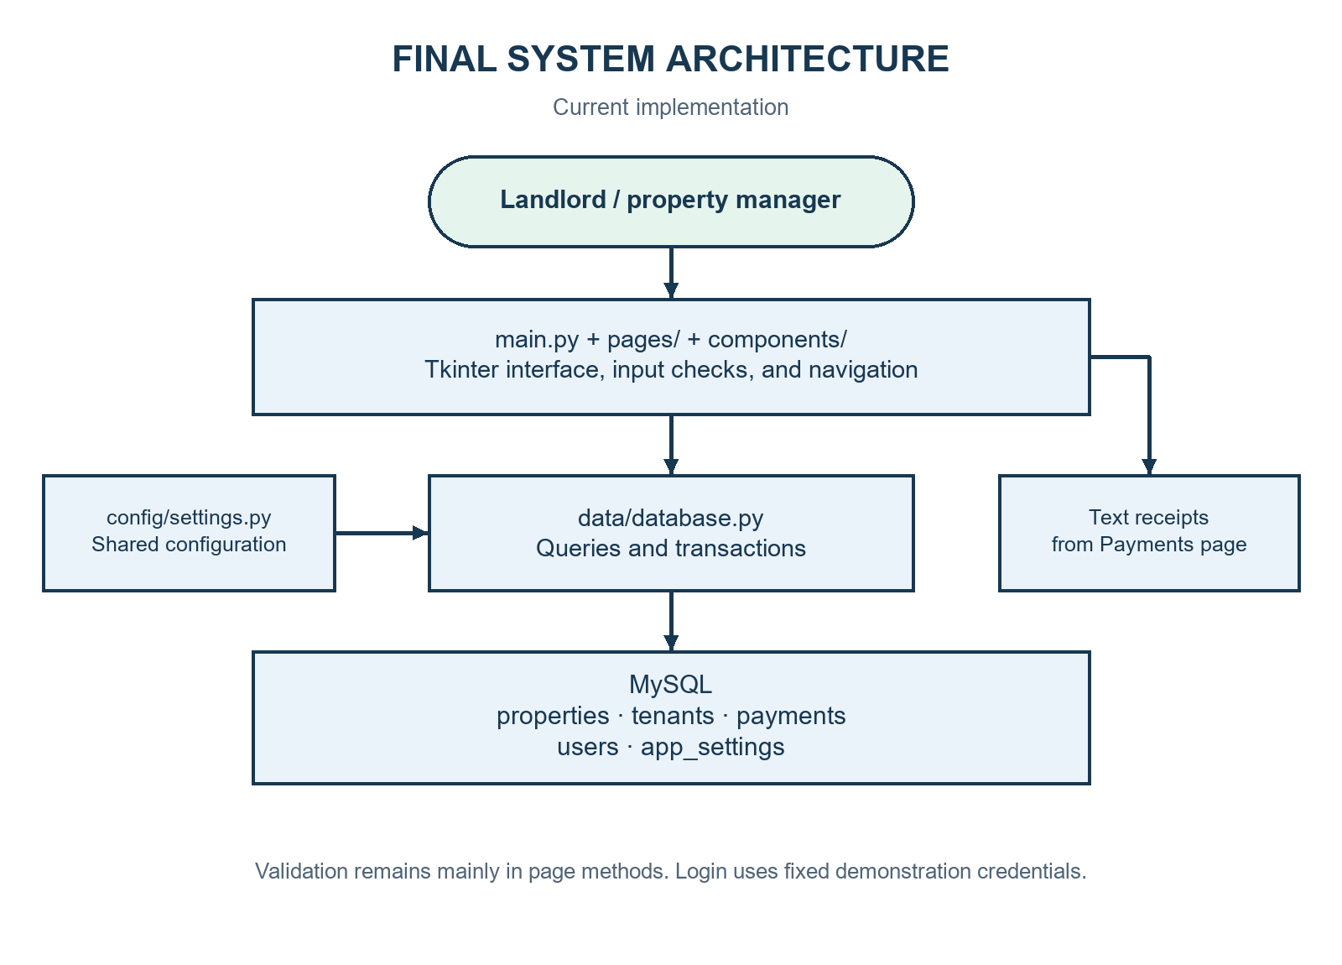
FINAL PROJECT PRESENTATION
System design and architecture
main.py
Startup, navigation, logout
pages/ + components/
Forms and shared controls
data/database.py
Queries and transactions
Since Phase 2:
Validation stays in pages;
editing and search remain planned.
NAHABWE DERRICK ERIC | Rental Management System
05
Notes:
Target speaking time: 60 seconds
Trace one save operation: the user enters details in a page, the page validates supported inputs, and a function in data/database.py saves the record using parameterised SQL. The interface then reloads the table. Compared with the refined Phase 2 plan, common validation has not been extracted into its own module, and planned edit/search workflows are incomplete. Logout now destroys the old interface and creates a fresh login screen.

Slide 6
FINAL PROJECT PRESENTATION
Tools and technologies
PYTHON 3.13.5
TKINTER + ttk
Application logic
and standard modules
Desktop windows, forms,
dropdowns, and tables
MYSQL + CONNECTOR
WINDOWS + VS CODE
Related persistent records
mysql-connector-python 26.7.0
Windows: inspected environment
VS Code: proposed Phase 1 editor
MySQL server version and the editor version were not independently verified.
NAHABWE DERRICK ERIC | Rental Management System
06
Notes:
Target speaking time: 45 seconds
Explain why the stack suits a local desktop application: Python organises the logic, Tkinter provides built-in GUI tools, and MySQL holds linked records. The connector sends SQL requests. Python and connector versions were observed in this environment; the MySQL server version was not checked. VS Code is specified in the proposal, but actual editor use and version were not independently verified. Windows supports the current print request.

Slide 7
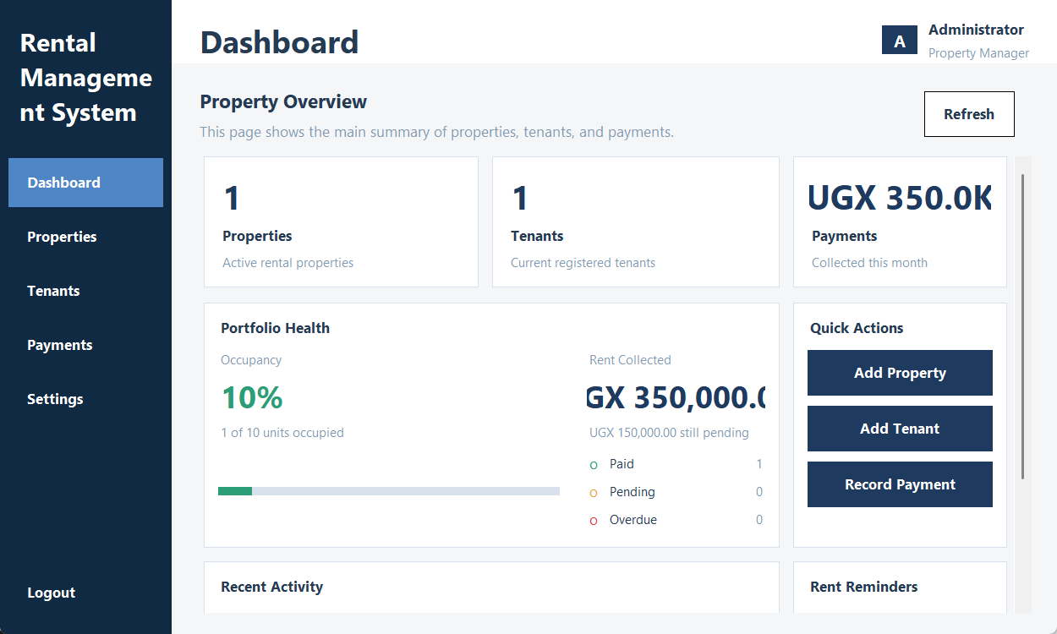
FINAL PROJECT PRESENTATION
Implemented features
Available in code
Add / view properties
Register / view tenants
Record payment + balance
Create text receipts
Settings and dashboard
Logout and sign in again
Partial / missing
Secure login, editing, search, leases,
exports, and detailed reports.
Current application widgets with controlled sample data; no live database save is implied.
NAHABWE DERRICK ERIC | Rental Management System
07
Notes:
Target speaking time: 60 seconds
Point out the actual sidebar and the Logout button at its bottom. This screenshot uses the current application widgets with controlled sample values and no MySQL writes. Distinguish source-code availability from live acceptance: the report has not verified every database workflow. Logout itself has three real-widget checks. Mention that deletion currently removes linked payments, so it must not be demonstrated with real tenant records.

Slide 8
FINAL PROJECT PRESENTATION
Application workflow / live demonstration
01
02
03
04
05
LOGIN
ADD PROPERTY
REGISTER TENANT
RECORD PAYMENT
LOGOUT
DEMO INPUT
SHOW ONE INVALID INPUT
Main amount: UGX 500,000
Balance: UGX 150,000
Expected paid amount: UGX 350,000
Balance above main amount → warning
Then correct and save in test database.
Reopen records to check persistence.
Live demonstration follows the talk. Prepare a test database and sample records first.
NAHABWE DERRICK ERIC | Rental Management System
08
Notes:
Target speaking time: 50 seconds
Walk through the journey briefly here; perform the live demonstration after Slide 12. Use an existing prepared test database, a sample property, and a sample tenant. Demonstrate at least property or tenant viewing, payment recording with one invalid balance, and logout followed by re-login. Confirm persistence through an actual save-and-reopen check during the demonstration. If the database is unavailable, say so and use labelled screenshots as backup only. Do not claim this has already been verified.

Slide 9
FINAL PROJECT PRESENTATION
Testing and results
13
13
0
CHECKS EXECUTED
PASSED
FAILED
FEATURE
EXPECTED
ACTUAL
Partial payment
500,000 − 150,000
350,000 passed to save
Invalid balance
Negative / above main amount
Warning; save blocked
Logout + re-login
Close old UI, enter password again
Fresh login and pages confirmed
10 isolated/source checks + 3 real-widget logout checks. Live database and printer scenarios remain pending.
NAHABWE DERRICK ERIC | Rental Management System
09
Notes:
Target speaking time: 60 seconds
The current run passed ten source/isolated-function checks and three Tkinter logout integration checks. The logout checks use real widgets but replace database availability and record-page content, so they do not prove MySQL integration. The three cases cover closing forms and clearing pages, repeated sign-in cycles, and rejecting a wrong password after logout. Existing checks cover syntax, money parsing, login, balance computation, and invalid balances/dates. Eight live integration scenarios remain pending in the report.

Slide 10
FINAL PROJECT PRESENTATION
Challenges and solutions
Connected records
Properties, tenants, and payments depend on each other.
Use linked queries and ordered transactional deletes.
Code present; live rollback check pending.
Incorrect payment entries
An invalid balance can produce a wrong paid amount.
Check number, date, and balance before saving.
Selected validation and calculation checks pass.
Logout and stale screens
Old pages or forms must not remain available after sign-out.
Destroy old widgets and reset the layout before login.
Three logout / re-login checks pass.
NAHABWE DERRICK ERIC | Rental Management System
10
Notes:
Target speaking time: 55 seconds
Describe these as concrete implementation issues visible in the code and checks, rather than inventing a development story. Related records require careful deletion order and rollback. Payment entry needs checks before the amount is calculated. Logout needs more than displaying a login frame: the old records and popups must be destroyed, navigation state cleared, and layout reset. History retention and live database verification still remain limitations.

Slide 11
FINAL PROJECT PRESENTATION
Final outcome and next improvements
CURRENT RESULT
KNOWN LIMITATIONS
A local desktop prototype for linked
property, tenant, and payment records.
Receipts, dashboard, settings, and logout.
Fixed demonstration credentials
Incomplete leases, editing, search, exports
Deletion removes payment history
Next priorities
1 Secure login + verified database setup and live tests
2 Editing + filtered search + complete lease / vacancy workflow
3 Preserve history + provide the approved reports and exports
NAHABWE DERRICK ERIC | Rental Management System
11
Notes:
Target speaking time: 65 seconds
Evaluate the result honestly against the approved proposal. All six objectives are partly achieved. The system provides a useful base but is not fully complete or production-ready. Prioritise security and repeatable installation, the missing record/lease operations, and reporting plus history preservation. Existing exclusions such as mobile apps, cloud services, online gateways, biometrics, and pricing forecasts should remain outside this delivery.

Slide 12
FINAL PROJECT PRESENTATION
Thank you. Questions?
One place for rental records.
A clear foundation to improve.
Python · Tkinter · MySQL
Next: live demonstration
and assessor questions
Backup screenshot uses controlled sample data.
NAHABWE DERRICK ERIC | Rental Management System
12
Notes:
Target speaking time: 35 seconds
Close by explaining the value: connected rental records and easier day-to-day lookup in one desktop interface. Acknowledge that the current prototype still needs the approved missing features and live integration tests. Thank the assessor and move into the prepared demonstration, then questions. Be ready to explain the data relationships, balance calculation, logout cleanup, and the limits of the tests.

