Slide 1
Lecture 4
E-commerce Marketing Concepts
Marketing Concepts
Slide 6-<number>

Slide 2
ELECTRONIC MARKETS AND NETWORKS
Electronic market (e-marketplace)
An online marketplace where buyers and sellers meet to exchange goods, services, money, or information
Intranet
An internal corporate or government network that uses Internet tools, such as Web browsers, and Internet protocols
Extranet
A network that uses the Internet to link multiple intranets

Slide 3
AN EC FRAMEWORK
EC applications are supported by infrastructure and by the following five support areas:
1. People
2. Public policy
3. Marketing and advertising
4. Support services
5. Business partnerships

Slide 4
The 3Rs of E-Business Strategy
Reach
Range
Richness
A-<number>

Slide 5
Reach
The degree to which an organization can manage its value chain activities to connect its customers to an accessible product/service offering.
Reach is characterized by two bipolar extremes: physical infrastructure versus digital infrastructure
  On one extreme; products, services, and processes are strictly manual and offline, thus limiting the reach dimension
  On the other extreme; a digital infrastructure is purely virtual, increasingly including attributes inherent to IT with a digital product/service being offered online
A-<number>

Slide 6
Richness
The degree to which an organization can facilitate the exchange of information to deliver products/services that match customers’ exact wants/needs
Richness is characterized by two bipolar extremes: limited and standardized content for all customers versus extensive and variable content customized for each customer
  Lower extreme offers little accompanying product/service information and low use of customer-specific information, resulting in little organization-customer interaction
  Higher extreme represents an organization with customizable product/service information and high use of rich customer-specific information; producing a higher degree of customer interaction
A-<number>

Slide 7
Range
The degree to which an organization can offer its customers a breadth of products/services.
Range is characterized by two bipolar extremes: narrow versus broad product/service offering
  An organization on the lower extreme offers a homogenous product/service offering that is singular in its focus
  An organization on the other extreme offers a wide range a products/services that crosses traditional industry boundaries.
A-<number>

Slide 8
Consumer Behavior Models
Study of consumer behavior
  Social science that attempts to predict/explain what consumers purchase and where, when, how much and why they buy.
Consumer behavior models
  Predict wide range of consumer decisions
  Based on background demographic factors and other intervening, more immediate variables
Marketing Concepts
Slide 6-<number>

Slide 9
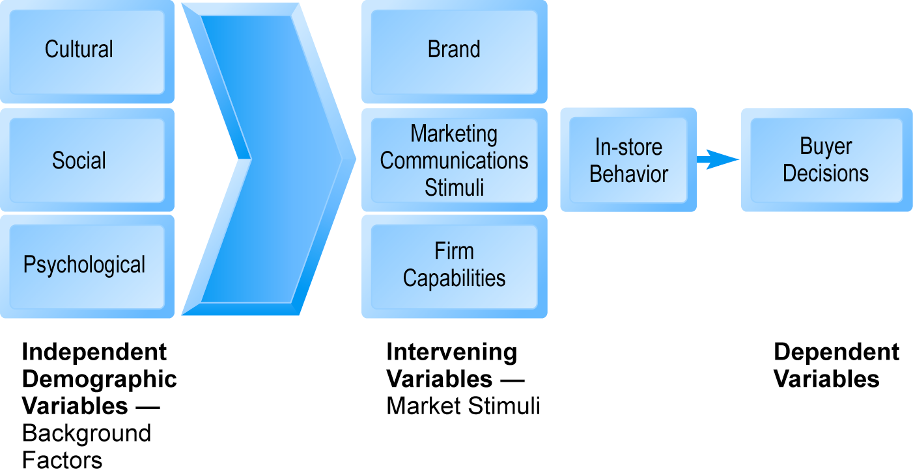
A General Model of Consumer Behavior
Figure 6.1, Page 348
SOURCE: Adapted from Kotler and Armstrong, 2009.
Marketing Concepts
Slide 6-<number>

Slide 10
Background Demographic Factors
Cultural: Broadest impact
  Subculture (ethnicity, age, lifestyle, geography)
Social
  Reference groups
    Direct reference groups
    Indirect reference groups
    Opinion leaders (viral influencers)
    Lifestyle groups
Psychological
  Psychological profiles
Marketing Concepts
Slide 6-<number>

Slide 11
The Online Purchasing Decision
Psychographic research
  Combines demographic and psychological data
  Divides market into groups based on social class, lifestyle, and/or personality characteristics
Five stages in the consumer decision process:
  Awareness of need
  Search for more information
  Evaluation of alternatives
  Actual purchase decision
  Post-purchase contact with firm
Marketing Concepts
Slide 6-<number>

Slide 12
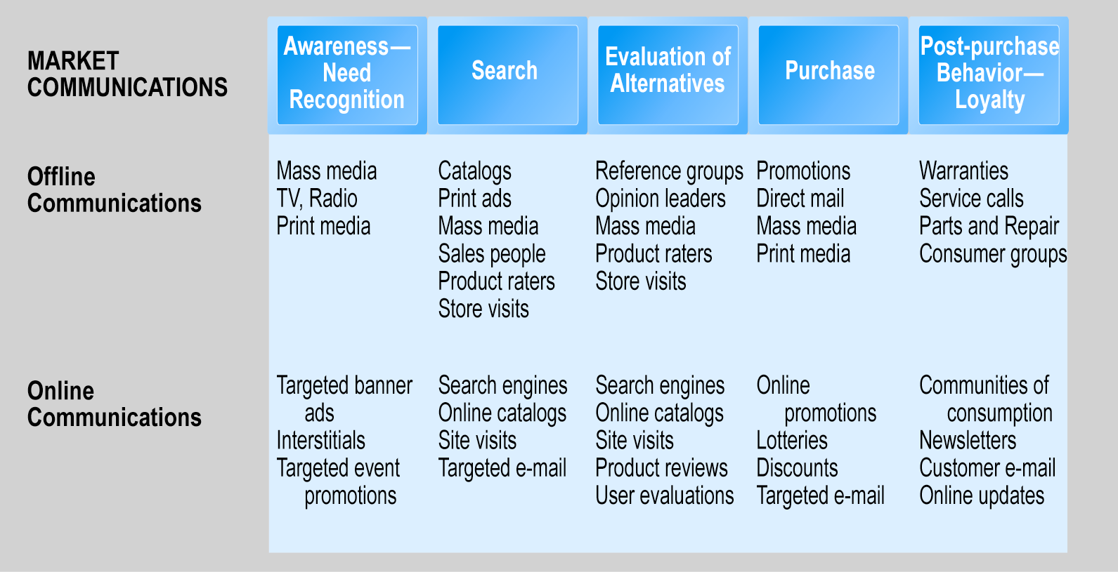
The Consumer Decision Process and Supporting Communications
Figure 6.3, Page 352
Marketing Concepts
Slide 6-<number>

Slide 13
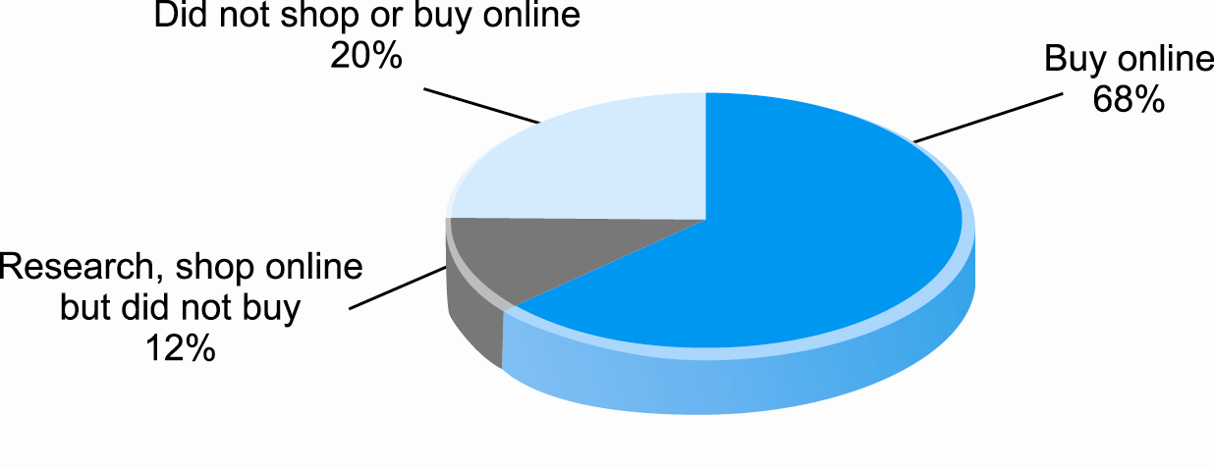
Online Shoppers and Buyers
Figure 6.5, Page 355
SOURCE: Based on data from eMarketer, Inc., 2008a; authors’ estimates.
Marketing Concepts
Slide 6-<number>

Slide 14
What Consumers Shop for and Buy Online
Two groups roughly divide online sales:
  Big ticket items:
    $500 plus
    Travel, computer hardware, consumer electronics
    Expanding
  Small ticket items:
    On average, $100 or less
    Apparel, books, office supplies, software, etc.
    Sold by first movers
      Physically small
      High margin items
      Broad selection of products available
Marketing Concepts
Slide 6-<number>

Slide 15
Why More People Don’t Shop Online
44% uneasy about online credit card use
42% have concerns about privacy of data
37% dislike shipping charges
33% feel no need to purchase online
32% prefer to touch/feel product before purchase
27% find returning a product too difficult
21% have not seen anything online interested in buying
Marketing Concepts
Slide 6-<number>

Slide 16
Trust, Utility, and Opportunism in Online Markets
Two most important factors shaping decision to purchase online:
  Utility:
    Consumers looking for better prices, convenience, speed
  Trust:
    Consumers also need to trust merchants before they are willing to purchase
    Asymmetry of information can lead to opportunistic behavior by sellers
    Sellers can develop trust by building strong reputations for honesty, fairness, delivery
Marketing Concepts
Slide 6-<number>

Slide 17
Basic Marketing Concepts
Marketing:
  Strategies and actions firms take to establish relationship with consumer and encourage purchases of products and services
Internet marketing
  Using Web, as well as traditional channels, to develop positive, long-term relationship with customers, thereby creating competitive advantage for firm by allowing it to charge higher prices for products or services than competitors can charge
Marketing Concepts
Slide 6-<number>

Slide 18
Basic Marketing Concepts (cont’d)
Marketing addresses competitive situation of industries, firms
  Threat of substitute products or services
  Threat of new entrants
  Power of customers and suppliers to influence pricing
  Nature of industry competition
Marketing seeks to create unique, highly differentiated products or services that are produced or supplied by one trusted firm (“little monopolies”)
Marketing Concepts
Slide 6-<number>

Slide 19
Basic Marketing Concepts (cont’d)
Feature set
  Bundle of capabilities offered by product or service
Commodity
  Good or service for which there are many dealers and all products essentially identical, e.g. wheat, steel
Marketing goals:
  Avoid pure price competition, products becoming commodities
  Limit competition, product substitution
  Increase product differentiation
  Emphasize nonmarket qualities of product
Marketing Concepts
Slide 6-<number>

Slide 20
Feature Sets
Three levels
  Core product
    Core benefit of product
    e.g. cell phone
  Actual product
    Characteristics that deliver core benefits
    e.g. cell phone, music player with wide screen that connects through wireless networks to Internet
  Augmented product
    Includes additional benefits beyond core benefits
    e.g. product warranty, after-sale support
    Basis for building the product’s brand
Marketing Concepts
Slide 6-<number>

Slide 21
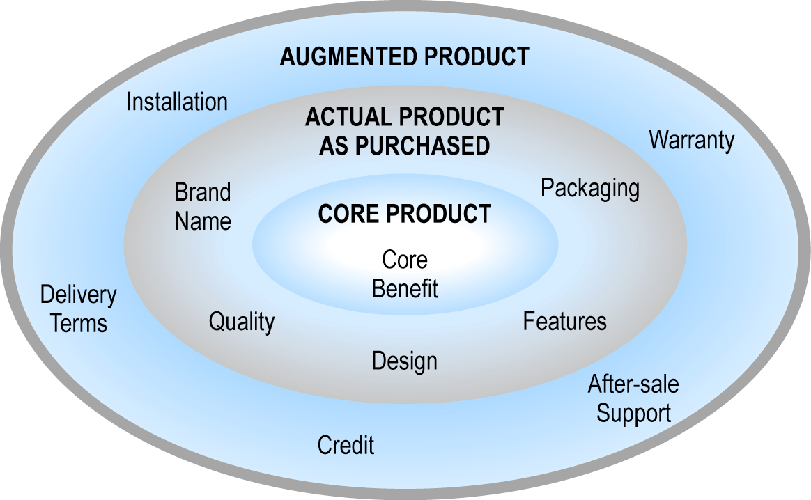
Feature Set
Figure 6.7, Page 361
Marketing Concepts
Slide 6-<number>

Slide 22
Products, Brands and the Branding Process
Brand:
  Expectations consumers have when consuming, or thinking about consuming, a specific product
  Most important expectations: Quality, reliability, consistency, trust, affection, loyalty, reputation
Branding:
  Process of brand creation
Closed loop marketing:
  Marketers directly influencing design of core product based on market research and feedback
  E-commerce enables unique opportunities for this
Marketing Concepts
Slide 6-<number>

Slide 23
Products, Brands and the Branding Process (cont’d)
Brand strategy:
  Set of plans for differentiating product from its competitors, and communicating these differences to marketplace
Brand equity:
  Estimated value of premium customers are willing to pay for branded product versus unbranded competitor
Marketing Concepts
Slide 6-<number>

Slide 24
Segmenting, Targeting, and Positioning
Major ways used to segment, target customers
  Behavioral
  Demographic
  Psychographic
  Technical
  Contextual
  Search
Within segment , product is positioned and branded as a unique, high-value product, especially suited to needs of segment customers
Marketing Concepts
Slide 6-<number>

Slide 25
Are Brands Rational?
For consumers, a qualified yes:
  Brands introduce market efficiency by reducing search and decision-making costs
For business firms, a definite yes:
  Brands a major source of revenue
  Lower customer acquisition cost
  Increased customer retention
  Successful brand constitutes a long-lasting (though not necessarily permanent) unfair competitive advantage
Marketing Concepts
Slide 6-<number>

Slide 26
Can Brands Survive the Internet? Brands and Price Dispersion
Early postulations: Web would result in “Law of One Price,” “frictionless commerce”
Instead:
  Consumers still pay premium prices for products and services they view as differentiated
  E-commerce firms rely heavily on brands to attract customers and charge premium prices
  Substantial price dispersion
  Increase in relative dispersion and large differences in price sensitivity for same product
  “Library effect”: Increased gains where product variety is high
Marketing Concepts
Slide 6-<number>

Slide 27
The Revolution in Internet Marketing Technologies
Three broad impacts:
  Scope of marketing communications broadened
  Richness of marketing communications increased
  Information intensity of marketplace expanded
Internet marketing technologies:
  Web transaction logs
  Cookies and Web bugs
  Databases, data warehouses, data mining
  Advertising networks
  Customer relationship management systems
Marketing Concepts
Slide 6-<number>

Slide 28
Customer Relationship Management (CRM) Systems
Repository of customer information that records all contacts that customer has with firm and generates customer profile available to everyone in firm with need to “know the customer”
Customer profiles can contain:
  Map of the customer’s relationship with the firm
  Product and usage summary data
  Demographic and psychographic data
  Profitability measures
  Contact history
  Marketing and sales information
Marketing Concepts
Slide 6-<number>

Slide 29
Establishing the Customer Relationship
Advertising Networks
  Present users with banner advertisements based on a database of user behavioral data
  DoubleClick: Best-known example
  Ad server selects appropriate banner ad based on cookies, Web bugs, backend user profile databases
Marketing Concepts
Slide 6-<number>

Slide 30
Establishing the Customer Relationship (cont’d)
Permission marketing
  Obtain permission before sending consumer information or promotional messages
  e.g. opt-in e-mail
Affiliate marketing
  Relies on referrals
  Web site agrees to pay another Web site commission for new business opportunities it refers to site
Marketing Concepts
Slide 6-<number>

Slide 31
Establishing the Customer Relationship (cont’d)
Viral marketing
  Getting customers to pass along company’s marketing message to friends, family, and colleagues
Blog marketing
  Using blogs to market goods through commentary and advertising
Social network marketing and social shopping
  Similar to viral marketing
Brand leveraging
  Using power of existing brand to acquire new customers for new product or service
Marketing Concepts
Slide 6-<number>

Slide 32
Customer Retention: Strengthening the Customer Relationship
Mass marketing
Direct marketing
Micromarketing
Personalized, one-to-one marketing
  Segmenting market on precise and timely understanding of individual’s needs
  Targeting specific marketing messages to these individuals
  Positioning product vis-à-vis competitors to be truly unique
Personalization
  Can increase consumers sense of control, freedom
  Can also result in unwanted offers or reduced anonymity
Marketing Concepts
Slide 6-<number>

Slide 33
Other Customer Retention Marketing Techniques
Customization: Changing product according to user preferences
Customer co-production: Customer interactively participates in creation of the product
Transactive content: Combine traditional content with dynamic information tailored to each user’s profile
Customer service tools
  Frequently asked questions (FAQs)
  Real-time customer service chat systems (intelligent agent technology or bots)
  Automated response systems
Marketing Concepts
Slide 6-<number>

Slide 34
Net Pricing Strategies
Pricing
  Putting a value on goods and services
  Integral part of marketing strategy
Traditionally, prices based on:
  Fixed cost
  Variable costs
  Market’s demand curve
Price discrimination
  Selling products to different people and groups based on willingness to pay
Marketing Concepts
Slide 6-<number>

Slide 35
Net Pricing Strategies (cont’d)
Free products/services
  Can be used to build market awareness
Versioning
  Creating multiple versions of product and selling essentially same product to different market segments at different prices
Bundling
  Offers consumers two or more goods for one price
Dynamic pricing:
  Auctions
  Yield management
Marketing Concepts
Slide 6-<number>

Slide 36
Channel Management Strategies
Channels:
  Different methods by which goods can be distributed and sold
Channel conflict:
  When new venue for selling products or services threatens or destroys existing sales venues
Example
  Online airline/travel services and traditional offline travel agencies
Some manufacturers are using partnership model to avoid channel conflict
Marketing Concepts
Slide 6-<number>

Slide 37
Questions???
What should businesses do to retain their customers?
What are the strategies that businesses can use to ensure they remain in business no matter the competition and other market forces?
Marketing Concepts
Slide 6-<number>

