Slide 1
ARTIFICIAL INTELLIGENCE
<number>

Slide 2
What is Intelligence?
Intelligence:
“the capacity to learn and solve problems” (Websters dictionary)
in particular,
the ability to solve novel problems
the ability to act rationally
the ability to act like humans
Artificial Intelligence
build and understand intelligent entities or agents
2 main approaches: “engineering” versus “cognitive modeling”
<number>

Slide 3
What is AI?
The exciting new effort to make computers thinks … machine with minds, in the full and literal sense”
(Haugeland 1985)
“The study of mental faculties through the use of computational models”
(Charniak et al. 1985)
“The art of creating machines that perform functions that require intelligence when performed by people” (Kurzweil, 1990)
A field of study that seeks to explain and emulate intelligent behavior in terms of computational processes” (Schalkol, 1990)
Systems that think like humans
Systems that think rationally
Systems that act like humans
Systems that act rationally
<number>

Slide 4
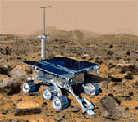

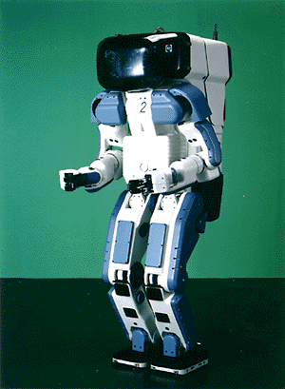

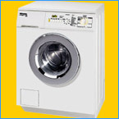
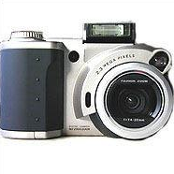

Why study AI?
Search engines
Science
Medicine/
Diagnosis
Labor
Appliances
<number>
What else?

Slide 5
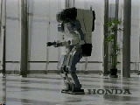
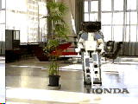
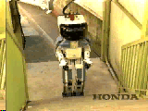
Honda Humanoid Robot
Walk
Turn
<number>
http://world.honda.com/robot/
Stairs

Slide 6
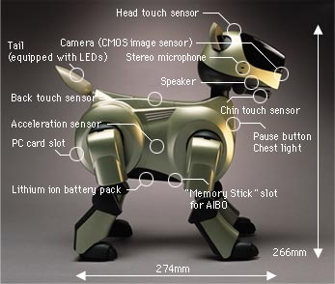
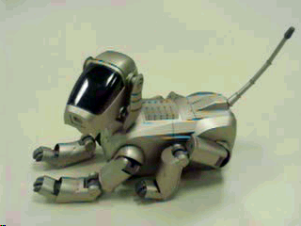
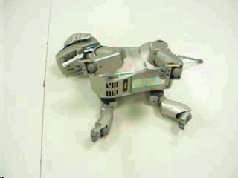
Sony AIBO
<number>
http://www.aibo.com

Slide 7
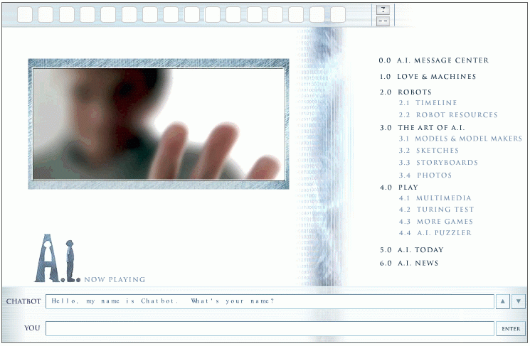
Natural Language Question Answering
<number>
http://aimovie.warnerbros.com
http://www.ai.mit.edu/projects/infolab/

Slide 8
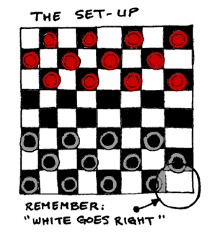


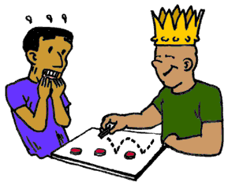
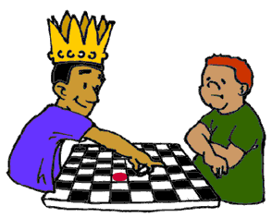
Playing games:Draughts
<number>
Is a computer more intelligent
if it beats you in a game of draughts?

Slide 9
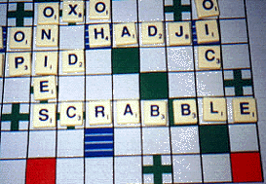
Playing games:Scrabble
Is a computer more intelligent
if it beats you in a game of scrabble?
<number>

Slide 10
What tasks require AI?
“AI is the science and engineering of making intelligent machines which can perform tasks that require intelligence when performed by humans …”
What tasks require AI?
<number>

Slide 11
What tasks require AI?
Tasks that require AI:
Solving a differential equation
Brain surgery
Inventing stuff
Playing Jeopardy
Playing Wheel of Fortune
What about walking?
What about grabbing stuff?
What about pulling your hand away from fire?
What about watching TV?
What about day dreaming?
<number>

Slide 12
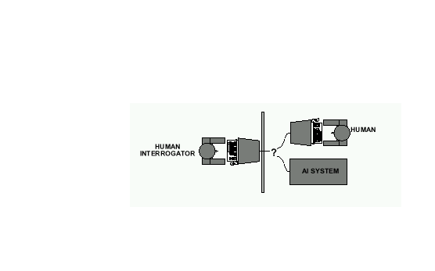
Acting Humanly: The Full Turing Test
Alan Turing's 1950 article Computing Machinery and Intelligence discussed conditions for considering a machine to be intelligent
“Can machines think?” ←→ “Can machines behave intelligently?”
The Turing test (The Imitation Game): Operational definition of intelligence.
Computer needs to posses:Natural language processing, Knowledge representation, Automated reasoning, and Machine learning
Problem: 1) Turing test is not reproducible, constructive, and amenable to mathematic analysis. 2) What about physical interaction with interrogator and environment?
Total Turing Test: Requires physical interaction and needs perception and actuation.
<number>

Slide 13
Acting Humanly: The Full Turing Test
Problem:
1) Turing test is not reproducible, constructive, and amenable to mathematic analysis.
2) What about physical interaction with interrogator and environment?
<number>

Slide 14
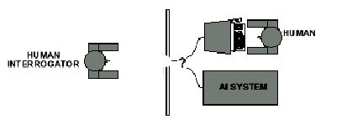
Acting Humanly: The Full Turing Test
Problem:
1) Turing test is not reproducible, constructive, and amenable to mathematic analysis.
2) What about physical interaction with interrogator and environment?
Trap door
<number>

Slide 15
What would a computer need to pass the Turing test?
Natural language processing: to communicate with examiner.
Knowledge representation: to store and retrieve information provided before or during interrogation.
Automated reasoning: to use the stored information to answer questions and to draw new conclusions.
Machine learning: to adapt to new circumstances and to detect and extrapolate patterns.
<number>

Slide 16
What would a computer need to pass the Turing test?
Vision (for Total Turing test): to recognize the examiner’s actions and various objects presented by the examiner.
Motor control (total test): to act upon objects as requested.
Other senses (total test): such as audition, smell, touch, etc.
<number>

Slide 17
Thinking humanly
Cognitive Science approach
Try to get “inside” our minds
E.g., conduct experiments with people to try to “reverse-engineer” how we reason, learning, remember, predict
Problems
Humans don’t behave rationally
e.g., insurance
The reverse engineering is very hard to do
The brain’s hardware is very different to a computer program
<number>

Slide 18
Thinking rationally
Represent facts about the world via logic
Use logical inference as a basis for reasoning about these facts
Can be a very useful approach to AI
E.g., theorem-provers
Limitations
Does not account for an agent’s uncertainty about the world
E.g., difficult to couple to vision or speech systems
Has no way to represent goals, costs, etc (important aspects of real-world environments)
<number>

Slide 19
Acting rationally
Decision theory/Economics
Set of future states of the world
Set of possible actions an agent can take
Utility = gain to an agent for each action/state pair
An agent acts rationally if it selects the action that maximizes its “utility”
Or expected utility if there is uncertainty
Emphasis is on autonomous agents that behave rationally (make the best predictions, take the best actions)
on average over time
within computational limitations (“bounded rationality”)
<number>

Slide 20
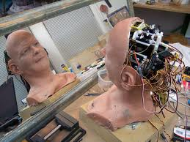
Can we build hardware as complex as the brain?
How complicated is our brain?
a neuron, or nerve cell, is the basic information processing unit
estimated to be on the order of 10 ¹² neurons in a human brain
many more synapses (10 ¹⁴) connecting these neurons
cycle time: 10 ⁻³ seconds (1 millisecond)
How complex can we make computers?
10⁸ or more transistors per CPU
supercomputer: hundreds of CPUs, 10¹² bits of RAM
cycle times: order of 10 ⁻ ⁹ seconds
Conclusion
YES: in the near future we can have computers with as many basic processing elements as our brain, but with
far fewer interconnections (wires or synapses) than the brain
much faster updates than the brain
but building hardware is very different from making a computer behave like a brain!
<number>

Slide 21
Can Computers beat Humans at Chess?
Chess Playing is a classic AI problem
well-defined problem
very complex: difficult for humans to play well
Conclusion:
YES: today’s computers can beat even the best human
Deep Blue
Human World Champion
Deep Thought
Points Ratings
<number>

Slide 22
Can Computers Talk?
This is known as “speech synthesis”
translate text to phonetic form
e.g., “fictitious” -> fik-tish-es
use pronunciation rules to map phonemes to actual sound
e.g., “tish” -> sequence of basic audio sounds
Difficulties
sounds made by this “lookup” approach sound unnatural
sounds are not independent
e.g., “act” and “action”
modern systems (e.g., at AT&T) can handle this pretty well
a harder problem is emphasis, emotion, etc
humans understand what they are saying
machines don’t: so they sound unnatural
Conclusion:
NO, for complete sentences
YES, for individual words
<number>

Slide 23
Can Computers Recognize Speech?
Speech Recognition:
mapping sounds from a microphone into a list of words
classic problem in AI, very difficult
“Lets talk about how to wreck a nice beach”
(I really said “________________________”)
Recognizing single words from a small vocabulary
systems can do this with high accuracy (order of 99%)
e.g., directory inquiries
limited vocabulary (area codes, city names)
computer tries to recognize you first, if unsuccessful hands you over to a human operator
saves millions of dollars a year for the phone companies
<number>

Slide 24
Recognizing human speech…
Recognizing normal speech is much more difficult
speech is continuous: where are the boundaries between words?
e.g., “John’s car has a flat tire”
large vocabularies
can be many thousands of possible words
we can use context to help figure out what someone said
e.g., hypothesize and test
try telling a waiter in a restaurant: “I would like some dream and sugar in my coffee”
<number>

Slide 25
Recognizing human speech…
background noise, other speakers, accents, colds, etc
on normal speech, modern systems are only about 60-70% accurate
Conclusion:
NO, normal speech is too complex to accurately recognize
YES, for restricted problems (small vocabulary, single speaker)
<number>

Slide 26
Can Computers Understand speech?
Understanding is different to recognition:
“Time flies like an arrow”
assume the computer can recognize all the words
how many different interpretations are there?
<number>

Slide 27
Can Computers Understand speech?
Understanding is different to recognition:
“Time flies like an arrow”
assume the computer can recognize all the words
how many different interpretations are there?
1. time passes quickly like an arrow?
2. command: time the flies the way an arrow times the flies
3. command: only time those flies which are like an arrow
4. “time-flies” are fond of arrows
<number>

Slide 28
Can Computers Understand speech?
Understanding is different to recognition:
“Time flies like an arrow”
assume the computer can recognize all the words
how many different interpretations are there?
1. time passes quickly like an arrow?
2. command: time the flies the way an arrow times the flies
3. command: only time those flies which are like an arrow
4. “time-flies” are fond of arrows
only 1. makes any sense,
but how could a computer figure this out?
clearly humans use a lot of implicit commonsense knowledge in communication
“Mary made her duck”
Conclusion: NO, much of what we say is beyond the capabilities of a computer to understand at present
<number>

Slide 29
Can Computers Learn and Adapt ?
Learning and Adaptation
consider a computer learning to drive on the freeway
we could teach it lots of rules about what to do
or we could let it drive and steer it back on course when it heads for the embankment
systems like this are under development (e.g., Daimler Benz)
e.g., RALPH at CMU
in mid 90’s it drove 98% of the way from Pittsburgh to San Diego without any human assistance
machine learning allows computers to learn to do things without explicit programming
many successful applications:
requires some “set-up”: does not mean your PC can learn to forecast the stock market or become a brain surgeon
Conclusion: YES, computers can learn and adapt, when presented with information in the appropriate way
<number>

Slide 30
Can Computers “see”?
Recognition v. Understanding (like Speech)
Recognition and Understanding of Objects in a scene
look around this room
you can effortlessly recognize objects
human brain can map 2d visual image to 3d “map”
Why is visual recognition a hard problem?
Conclusion:
mostly NO: computers can only “see” certain types of objects under limited circumstances
YES for certain constrained problems (e.g., face recognition)
<number>

Slide 31
Can computers plan and make optimal decisions?
Intelligence
involves solving problems and making decisions and plans
e.g., you want to take a holiday in Brazil
you need to decide on dates, flights
you need to get to the airport, etc
involves a sequence of decisions, plans, and actions
What makes planning hard?
the world is not predictable:
your flight is canceled or there’s a backup on the 405
there are a potentially huge number of details
do you consider all flights? all dates?
no: commonsense constrains your solutions
AI systems are only successful in constrained planning problems
Conclusion:
NO, real-world planning and decision-making is still beyond the capabilities of modern computers
exception: very well-defined, constrained problems
<number>

Slide 32
How to achieve AI?
How is AI research done?
AI research has both theoretical and experimental sides. The experimental side has both basic and applied aspects.
There are two main lines of research:
One is biological, based on the idea that since humans are intelligent, AI should study humans and imitate their psychology or physiology.
The other is phenomenal, based on studying and formalizing common sense facts about the world and the problems that the world presents to the achievement of goals.
The two approaches interact to some extent, and both should eventually succeed. It is a race, but both racers seem to be walking. [John McCarthy]
<number>

Slide 33
Different Types of Artificial Intelligence
Modeling exactly how humans actually think
Modeling exactly how humans actually act
Modeling how ideal agents “should think”
Modeling how ideal agents “should act”
Modern AI focuses on the last definition
we will also focus on this “engineering” approach
success is judged by how well the agent performs
<number>

Slide 34
Branches of AI
Logical AI
Search
Natural language processing
pattern recognition
Knowledge representation
Inference From some facts, others can be inferred.
Automated reasoning
Learning from experience
Planning To generate a strategy for achieving some goal
Epistemology Study of the kinds of knowledge that are required for solving problems in the world.
Ontology Study of the kinds of things that exist. In AI, the programs and sentences deal with various kinds of objects, and we study what these kinds are and what their basic properties are.
Genetic programming
Emotions???
…
<number>

Slide 35
AI State of the art
Have the following been achieved by AI?
World-class chess playing
Playing table tennis
Cross-country driving
Solving mathematical problems
Discover and prove mathematical theories
Engage in a meaningful conversation
Understand spoken language
Observe and understand human emotions
Express emotions
…
<number>

Slide 36
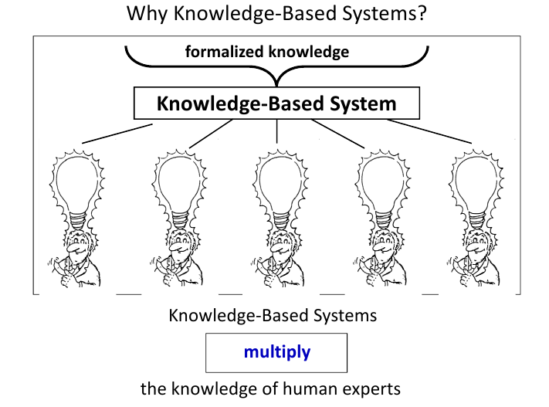
Course Overview
Brief introduction to AI
Intelligent Agents.
Intelligent agents and artificial intelligence
Fundamentals and types of KBS.
KBS is a software system capable of supporting the explicit representation of knowledge in some specific competence domain and of exploiting it through appropriate reasoning mechanisms in order to provide high-level problem-solving performance.
<number>

Slide 37
Course Overview…
Knowledge-based systems
Medical Diagnosis - MYCIN
1971, A program that could diagnose blood infections. It had 450 rules
Mineral Prospecting - PROSPECTOR
1979, A program that with geological data. It recommended exploratory drilling sites that proved to have substantial molybdenum deposits.
<number>

Slide 38
Course Overview…
Knowledge engineering
Knowledge Engineering is the process of developing knowledge based systems in any field, whether it be in the public or private sector, in commerce or industry”
Activities - Knowledge Acquisition, Knowledge Representation, Design of an Inference strategy, Design of an Explanation facility, System Validation
Reasoning
The process of drawing inferences or conclusions; moving from what is known (fact) to what is unknown (inference).
Inferencing - The process of accessing the knowledge stored in the knowledge base in order to make conclusions.
Proposition and predicate logic.
<number>

Slide 39
Course Overview…
Inference in logic, belief networks and decision theory
Dealing with uncertainty
Uncertainty and incompleteness representation and management
Fuzzy logic and evolutionary techniques.
Fuzzy Systems
Bayesian and statistical approaches
Strategies for space search such as data and goal driven, and heuristics.
Search - The sequence of applying rules of inference to the knowledge base is important when processing knowledge. The inference engine must know how to search the state space or the structure of the knowledge base.
<number>

Slide 40
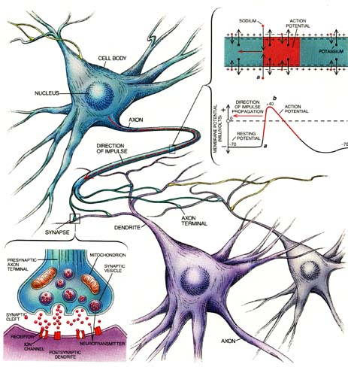
Course Overview…
Learning.
Learning from observation and examples
Decision trees and ID3 algorithm
Neural Networks.
Introduction to perceptrons. What can neural networks achieve?
<number>

Slide 41


Course Overview…
Expert systems.
Introduction to JESS. Overview of modern rule-based expert systems.
Natural Language Processing.
Planning
<number>

Slide 42
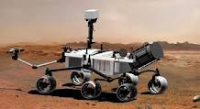
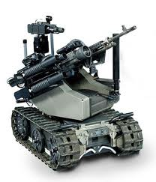
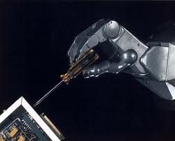
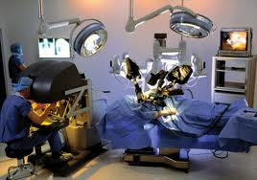
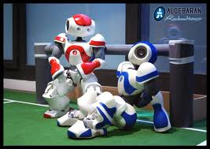
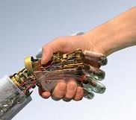
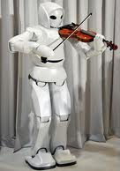
Course Overview…
Robotics. A robot is a mechanical or virtual intelligent agent that can perform tasks automatically or with guidance, typically by remote control (autonomous, semi-autonomous or remotely controlled)
<number>

Slide 43
Major issues
How to represent knowledge about the world?
How to react to new perceived events?
How to integrate new percepts to past experience?
How to understand the user?
How to optimize balance between user goals & environment constraints?
How to use reasoning to decide on the best course of action?
How to communicate back with the user?
How to plan ahead?
How to learn from experience?
<number>

Slide 44
AI, a Multi-disciplinary domain
Engineering:
robotics, vision, control-expert systems, biometrics,
Computer Science:
AI-languages , knowledge representation, algorithms, …
Pure Sciences:
statistics approaches, neural nets, fuzzy logic, …
Linguistics:
computational linguistics, phonetics and speech, …
Psychology:
cognitive models, knowledge-extraction from experts, …
Medicine:
human neural models, neuro-science,...
<number>

Slide 45
Outlook
AI is a very exciting area right now.
This course will teach you the foundations.
<number>

