Slide 1



Slide 2

Learning Objectives
Understand the elements that make good project scope management important.
Explain the scope planning process and describe the contents of a scope management plan.
Describe the process for developing a project scope statement using the project charter and preliminary scope statement.
Discuss the scope definition process and work involved in constructing a work breakdown structure using the analogy, top-down, bottom-up, and mind-mapping approaches.
Information Technology Project Management

Slide 3
Learning Objectives
Explain the importance of scope verification and how it relates to scope definition and control.
Understand the importance of scope control and approaches for preventing scope-related problems on information technology projects.
Describe how software can assist in project scope management.
Information Technology Project Management

Slide 4
What is Project Scope Management?
Scope refers to all the work involved in creating the products of the project and the processes used to create them.
A deliverable is a product produced as part of a project, such as hardware or software, planning documents, or meeting minutes.
Project scope management includes the processes involved in defining and controlling what is or is not included in a project.
Information Technology Project Management

Slide 5
Project Scope Management Processes
Scope planning: Deciding how the scope will be defined, verified, and controlled.
Scope definition: Reviewing the project charter and preliminary scope statement and adding more information as requirements are developed and change requests are approved.
Creating the WBS: Subdividing the major project deliverables into smaller, more manageable components.
Scope verification: Formalizing acceptance of the project scope.
Scope control: Controlling changes to project scope.
Information Technology Project Management

Slide 6
Scope Planning and the Scope Management Plan
The scope management plan is a document that includes descriptions of how the team will prepare the project scope statement, create the WBS, verify completion of the project deliverables, and control requests for changes to the project scope.
Key inputs include the project charter, preliminary scope statement, and project management plan.
Information Technology Project Management

Slide 7
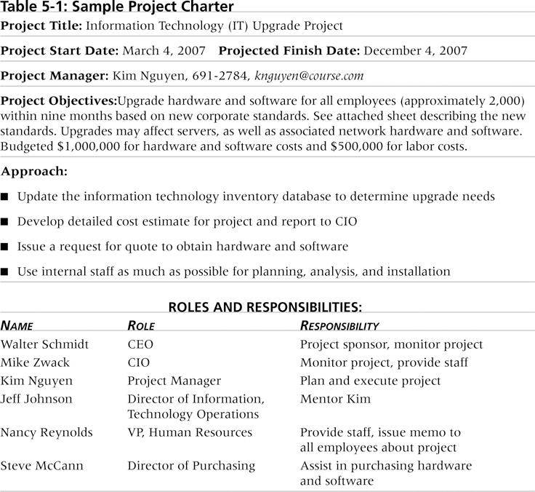
Information Technology Project Management

Slide 8

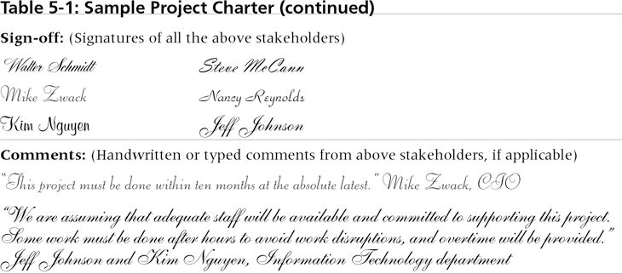
Information Technology Project Management

Slide 9
Scope Definition and the
Project Scope Statement
The importance of project scope statement
  Improve the accuracy of time, cost, and resource estimate
  Define a baseline for performance measurement and project control
  Aids in communicating clear work responsibilities
Main tools and techniques
  Analyzing products
  Identifying alternative approached to doing the work
  Understanding and analyzing stakeholder needs
  Using expert judgment
Information Technology Project Management

Slide 10
Scope Definition and the
Project Scope Statement
The preliminary scope statement, project charter, organizational process assets, and approved change requests provide a basis for creating the project scope statement.
As time progresses, the scope of a project should become clearer and more specific.
Information Technology Project Management

Slide 11
Scope Definition and the
Project Scope Statement
Project scope statements should include
  A description of the project
  Overall objectives and justification
  Detailed description of all project deliverables
  The characteristics and requirements of products and services
Information Technology Project Management

Slide 12
Scope Definition and the
Project Scope Statement
Project scope statement is helpful to document
  Project success criteria
  Project boundaries
  Product acceptance criteria
  Project constraints and assumptions
  Project organization
  Defined risks, schedule milestones
  Cost estimation
  Approve requirement
  Configuration management requirement
Information Technology Project Management

Slide 13

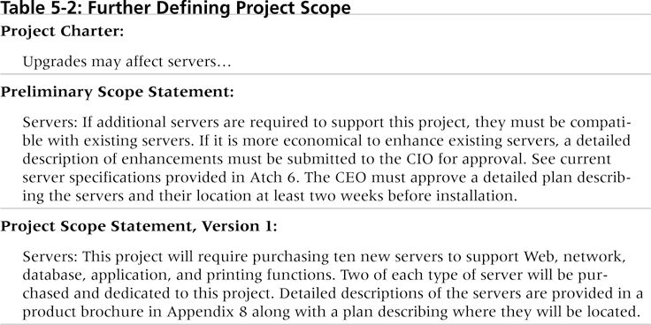
Information Technology Project Management

Slide 14
Creating the Work Breakdown Structure (WBS)
A WBS is a deliverable-oriented grouping of the work involved in a project that defines the total scope of the project.
A WBS is a foundation document that provides the basis for planning and managing project schedules, costs, resources, and changes.
Decomposition is subdividing project deliverables into smaller pieces.
Work package is a task at the lowest level of the WBS that the project manager is using to monitor and control the project
Information Technology Project Management

Slide 15

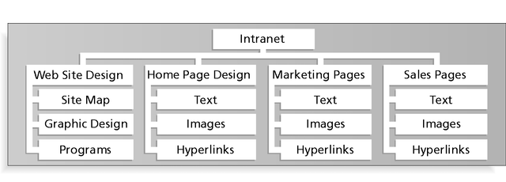
Information Technology Project Management

Slide 16

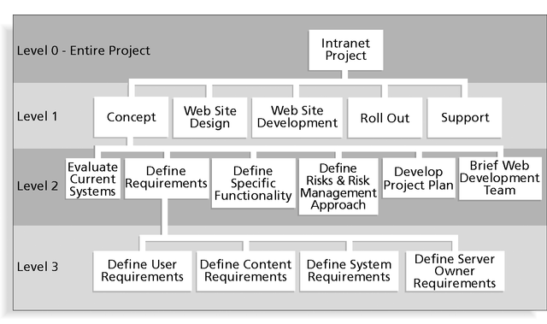
Work package
Information Technology Project Management

Slide 17

1.0 Concept
1.1 Evaluate current systems
1.2 Define requirements
1.2.1 Define user requirements
1.2.2 Define content requirements
1.2.3 Define system requirements
1.2.4 Define server owner requirements
1.3 Define specific functionality
1.4 Define risks and risk management approach
1.5 Develop project plan
1.6 Brief Web development team
2.0 Web Site Design
3.0 Web Site Development
4.0 Roll Out
5.0 Support
Information Technology Project Management
<number>br

Slide 18

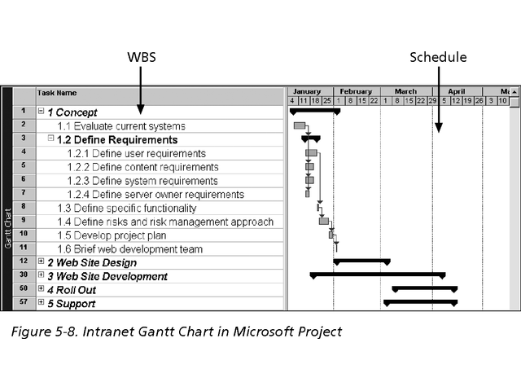
Information Technology Project Management

Slide 19

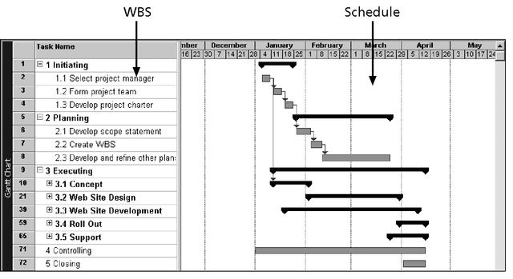
Information Technology Project Management

Slide 20

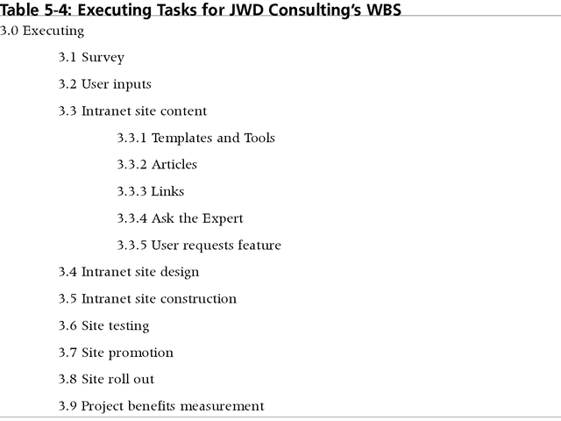
Information Technology Project Management

Slide 21
Approaches to Developing WBSs
Guidelines: Some organizations, such as the DOD, provide guidelines for preparing WBSs.
Analogy approach: Review WBSs of similar projects and tailor to your project.
Top-down approach: Start with the largest items of the project and break them down.
Bottom-up approach: Start with the specific tasks and roll them up.
Mind-mapping approach: Write tasks in a non-linear, branching format and then create the WBS structure.
Information Technology Project Management

Slide 22
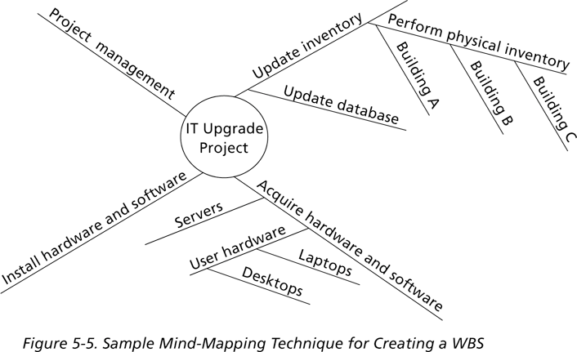
Information Technology Project Management

Slide 23
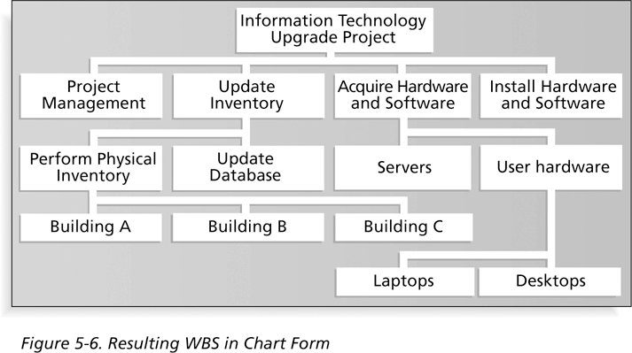
Information Technology Project Management

Slide 24
The WBS Dictionary and Scope Baseline
Many WBS tasks are vague and must be explained in more detail so that people know what to do and can estimate how long the work will take and what it will cost.
A WBS dictionary is a document that describes detailed information about each WBS item.
The approved project scope statement and its WBS and WBS dictionary form the scope baseline, which is used to measure performance in meeting project scope goals.
Information Technology Project Management

Slide 25
Advice for Creating a WBS and WBS Dictionary*
A unit of work should appear in only one place in the WBS.
The work content of a WBS item is the sum of the WBS items below it.
A WBS item is the responsibility of only one individual, even though many people may be working on it.
The WBS must be consistent with the way in which work is actually going to be performed; it should serve the project team first, and other purposes only if practical.
*Cleland, David I., Project Management: Strategic Design and Implementation, 2nd edition (New York: McGraw-Hill 1994).
Information Technology Project Management

Slide 26
Advice for Creating a WBS and WBS Dictionary (cont’d)*
Project team members should be involved in developing the WBS to ensure consistency and buy-in.
Each WBS item must be documented in a WBS dictionary to ensure accurate understanding of the scope of work that is included and not included in that item.
The WBS must be a flexible tool to accommodate inevitable changes while properly maintaining control of the work content in the project according to the scope statement.
*Cleland, David I., Project Management: Strategic Design and Implementation, 2nd edition (New York: McGraw-Hill 1994).
Information Technology Project Management

Slide 27
Scope Verification
Scope verification involves formal acceptance of the completed project scope by the stakeholder
Careful procedures must be developed to ensure the customer is getting what they want and the project team has enough time and money to produce the desired products and services
Scope creep is scope keep getting bigger and bigger
Information Technology Project Management

Slide 28
Scope Control
Scope control involves controlling changes to the project scope.
Goals of scope control are to:
  Influence the factors that cause scope changes.
  Ensure changes are processed according to procedures developed as part of integrated change control.
  Manage changes when they occur.
Variance is the difference between planned and actual performance.
Information Technology Project Management

Slide 29
Suggestions for Improving User Input
Develop a good project selection process and insist that sponsors are from the user organization.
Place users on the project team in important roles.
Hold regular meetings with defined agendas, and have users sign off on key deliverables presented at meetings.
Deliver something to users and sponsors on a regular basis.
Don’t promise to deliver when you know you can’t.
Co-locate users with developers.
Information Technology Project Management

Slide 30
Suggestions for Reducing Incomplete and Changing Requirements
Develop and follow a requirements management process.
Use techniques such as prototyping, use case modeling, and JAD to get more user involvement.
Put requirements in writing and keep them current.
Create a requirements management database for documenting and controlling requirements.
Information Technology Project Management

Slide 31
Suggestions for Reducing Incomplete and Changing Requirements (cont’d)
Conduct adequate testing throughout the project life cycle.
Review changes from a systems perspective.
Emphasize completion dates to help focus on what’s most important.
Allocate resources specifically for handling change requests and enhancements (as NWA did with ResNet).
Information Technology Project Management

Slide 32
Using Software to Assist in Project Scope Management
Word-processing software helps create scope-related documents.
Spreadsheets help perform financial calculations and weighed scoring models, and help develop charts and graphs.
Communication software, such as e-mail and the Web, helps clarify and communicate scope information.
Project management software helps create a WBS, the basis for tasks on a Gantt chart.
Specialized software is available to assist in project scope management.
Information Technology Project Management
<number>fin

