Slide 1


IT Project Management

Slide 2

Learning Objectives
Understand the importance of good project cost management
Explain basic project cost management principles, concepts, and terms
Describe how resource planning relates directly to project cost management
Explain cost estimating using definitive, budgetary, and rough order of magnitude (ROM) estimates
IT Project Management

Slide 3
Learning Objectives
Understand the processes involved in cost budgeting and preparing a cost estimate for an information technology project
Understand the benefits of earned value management and project portfolio management to assist in cost control
Describe how software can assist in project cost management
IT Project Management

Slide 4
The Importance of Project Cost Management
IT projects have a poor track record for meeting cost goals
Average cost overrun from 1995 CHAOS study was 189% of the original estimates; improved to 145% in the 2001 study
In 1995, cancelled IT projects cost the U.S. over $81 billion
IT Project Management

Slide 5

According to the San Francisco Chronicle front-page story, "Computer Bumbling Costs the State $1 Billion," the state of California had a series of expensive IT project failures in the late 1990s, costing taxpayers nearly $1 billion…ironic that the state which leads in creation of computers is the state most behind in using computer technology to improve state services.
…The Internal Revenue Service (IRS) managed a series of project failures that cost taxpayers over $50 billion a year—roughly as much money as the annual net profit of the entire computer industry.
…Connecticut General Life Insurance Co. sued PeopleSoft over an aborted installation of a finance system.
IT Project Management

Slide 6
What is Cost and Project Cost Management?
Cost is a resource sacrificed or foregone to achieve a specific objective or something given up in exchange
Costs are usually measured in monetary units like dollars
Project cost management includes the processes required to ensure that the project is completed within an approved budget
IT Project Management

Slide 7
Project Cost Management Processes
Resource planning: determining what resources and quantities of them should be used
Cost estimating: developing an estimate of the costs and resources needed to complete a project
Cost budgeting: allocating the overall cost estimate to individual work items to establish a baseline for measuring performance
Cost control: controlling changes to the project budget
IT Project Management

Slide 8
Basic Principles of Cost Management
Most CEOs and boards know a lot more about finance than IT, so IT project managers must speak their language
  Profits are revenues minus expenses
  Life cycle costing is estimating the cost of a project plus the maintenance costs of the products it produces
  Cash flow analysis is determining the estimated annual costs and benefits for a project
  Benefits and costs can be tangible or intangible, direct or indirect
  Sunk cost should not be a criteria in project selection
IT Project Management

Slide 9
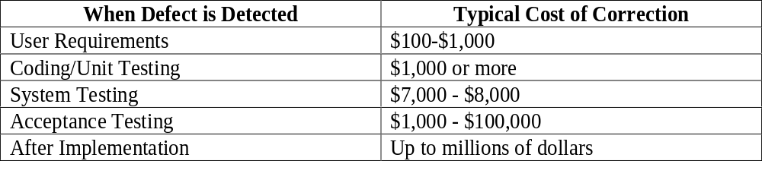
It is important to spend money up-front on IT projects to avoid spending a lot more later.
IT Project Management

Slide 10
Resource Planning
The nature of the project and the organization will affect resource planning
Some questions to consider:
  How difficult will it be to do specific tasks on the project?
  Is there anything unique in this project’s scope statement that will affect resources?
  What is the organization’s history in doing similar tasks?
  Does the organization have or can they acquire the people, equipment, and materials that are capable and available for performing the work?
IT Project Management

Slide 11

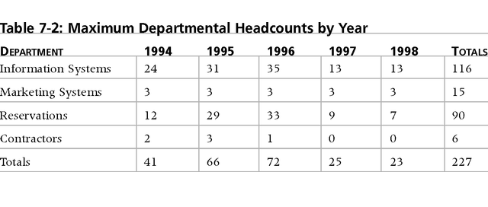
A large percentage of the costs of many IT projects are
human resource costs.
IT Project Management

Slide 12
Cost Estimating
An important output of project cost management is a cost estimate
There are several types of cost estimates and tools and techniques to help create them
It is also important to develop a cost management plan that describes how cost variances will be managed on the project
IT Project Management

Slide 13

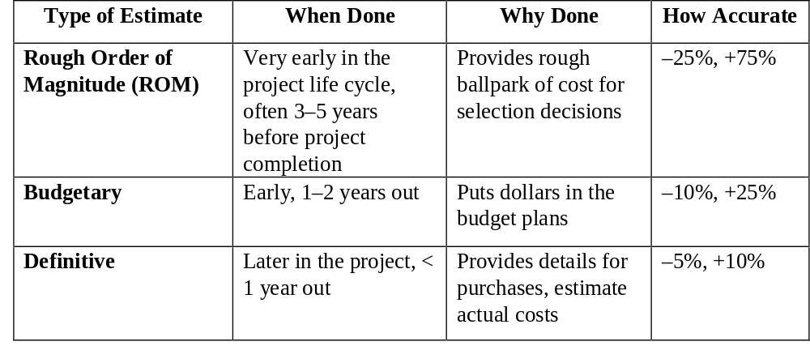
IT Project Management

Slide 14
Cost Estimation Tools and Techniques
3 basic tools and techniques for cost estimates:
  analogous or top-down: use the actual cost of a previous, similar project as the basis for the new estimate
  bottom-up: estimate individual work items and sum them to get a total estimate
  parametric: use project characteristics in a mathematical model to estimate costs
IT Project Management

Slide 15
Constructive Cost Model (COCOMO)
Barry Boehm helped develop the COCOMO models for estimating software development costs
Parameters include source lines of code or function points
COCOMO II is a computerized model available on the Web
Boehm suggests that only parametric models do not suffer from the limits of human decision-making
IT Project Management

Slide 16
Typical Problems with IT Cost Estimates
Developing an estimate for a large software project is a complex task requiring a significant amount of effort. Remember that estimates are done at various stages of the project
Many people doing estimates have little experience doing them. Try to provide training and mentoring
People have a bias toward underestimation. Review estimates and ask important questions to make sure estimates are not biased
Management wants a number for a bid, not a real estimate. Project managers must negotiate with project sponsors to create realistic cost estimates
IT Project Management

Slide 17
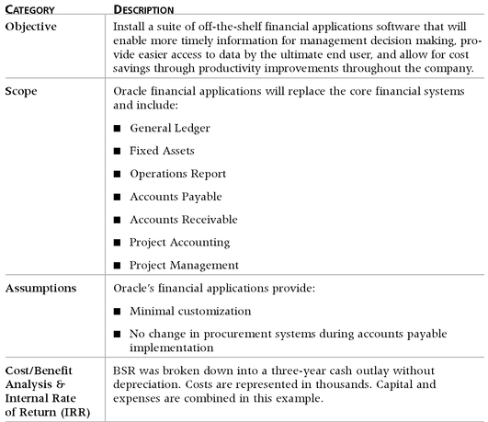
Table 7-4. Business Systems Replacement Project Cost Estimate Overview
IT Project Management

Slide 18

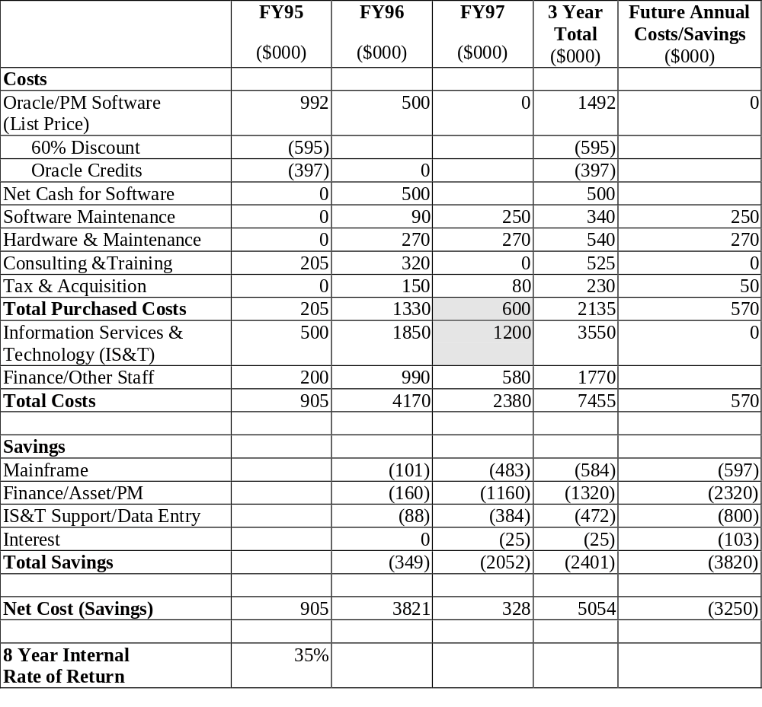
IT Project Management

Slide 19
Cost Budgeting
Cost budgeting involves allocating the project cost estimate to individual work items and providing a cost baseline
For example, in the Business Systems Replacement project, there was a total purchased cost estimate for FY97 of $600,000 and another $1.2 million for Information Services and Technology
These amounts were allocated to appropriate budgets as shown in Table 7-6
IT Project Management

Slide 20

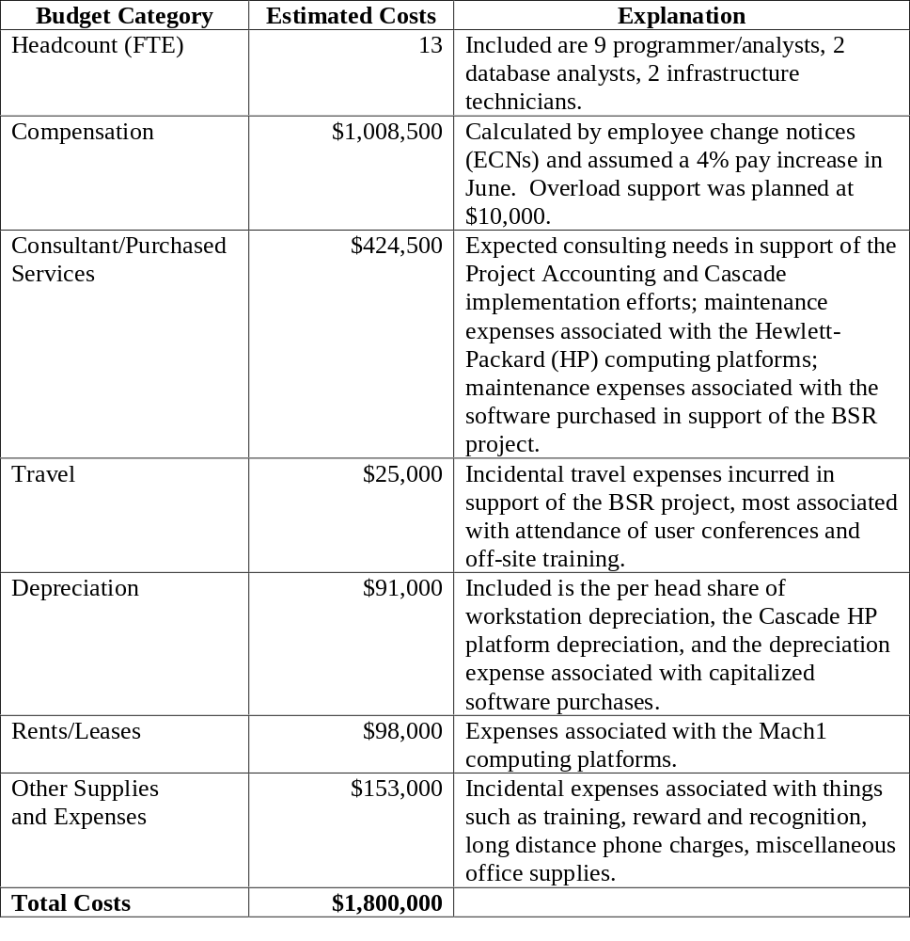
IT Project Management

Slide 21
Cost Control
Project cost control includes
  monitoring cost performance
  ensuring that only appropriate project changes are included in a revised cost baseline
  informing project stakeholders of authorized changes to the project that will affect costs
Earned value management is an important tool for cost control
IT Project Management

Slide 22
Earned Value Management (EVM)
EVM is a project performance measurement technique that integrates scope, time, and cost data
Given a baseline (original plan plus approved changes), you can determine how well the project is meeting its goals
You must enter actual information periodically to use EVM. Figure 7-1 shows a sample form for collecting information
IT Project Management

Slide 23

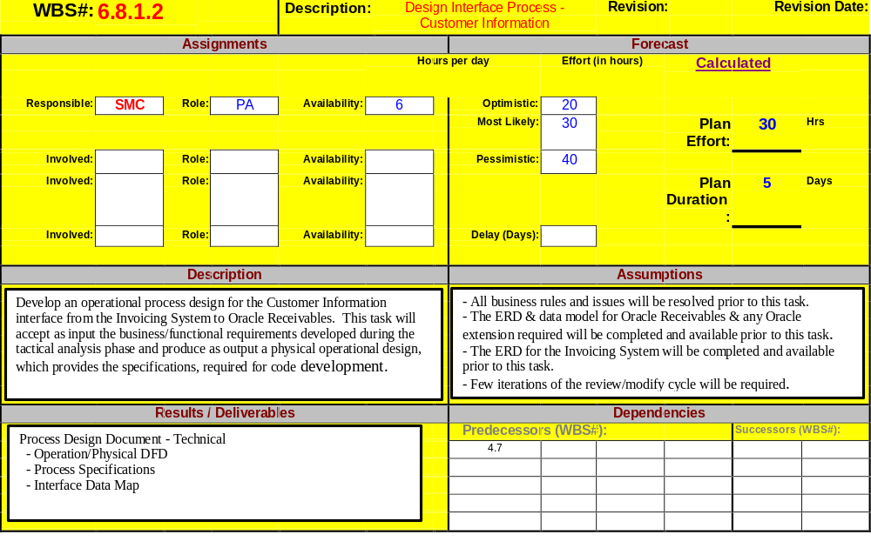
IT Project Management

Slide 24
Earned Value Management Terms
The planned value (PV), formerly called the budgeted cost of work scheduled (BCWS), also called the budget, is that portion of the approved total cost estimate planned to be spent on an activity during a given period
Actual cost (AC), formerly called actual cost of work performed (ACWP), is the total of direct and indirect costs incurred in accomplishing work on an activity during a given period
The earned value (EV), formerly called the budgeted cost of work performed (BCWP), is an estimate of the value of the physical work actually completed
IT Project Management

Slide 25

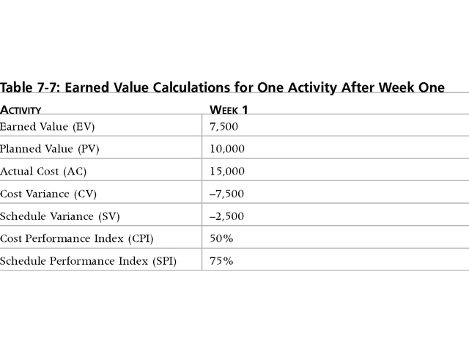
IT Project Management

Slide 26
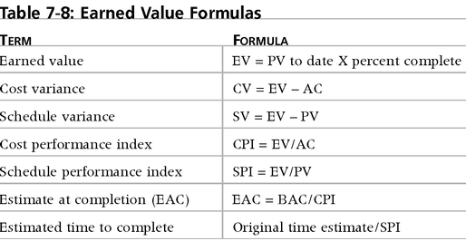
Earned Value Formulas
IT Project Management

Slide 27
Rules of Thumb for Earned Value Numbers
Negative numbers for cost and schedule variance indicate problems in those areas. The project is costing more than planned or taking longer than planned
CPI and SPI less than 100% indicate problems
IT Project Management

Slide 28

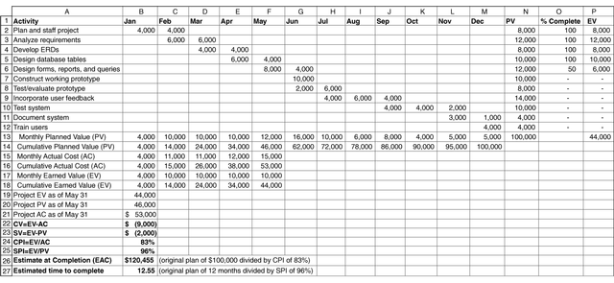
IT Project Management

Slide 29
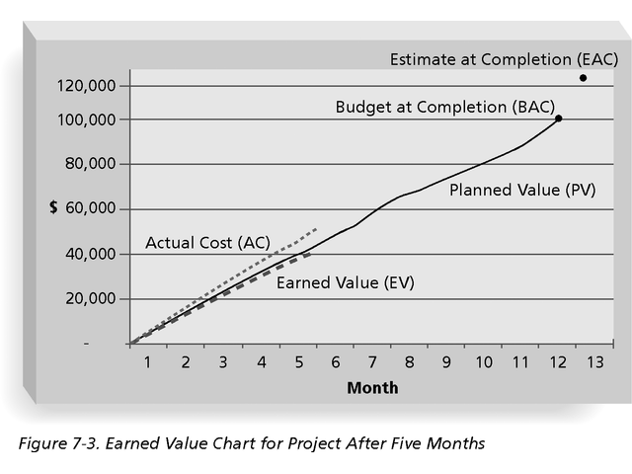
IT Project Management

Slide 30
Project Portfolio Management
Many organizations collect and control an entire suite of projects or investments as one set of interrelated activities in a portfolio
Five levels for project portfolio management
  Put all your projects in one database
  Prioritize the projects in your database
  Divide your projects into two or three budgets based on type of investment
  Automate the repository
  Apply modern portfolio theory, including risk-return tools that map project risk on a curve
IT Project Management

Slide 31
Using Software to Assist in Cost Management
Spreadsheets are a common tool for resource planning, cost estimating, cost budgeting, and cost control
Many companies use more sophisticated and centralized financial applications software for cost information
Project management software has many cost-related features
IT Project Management

Slide 32

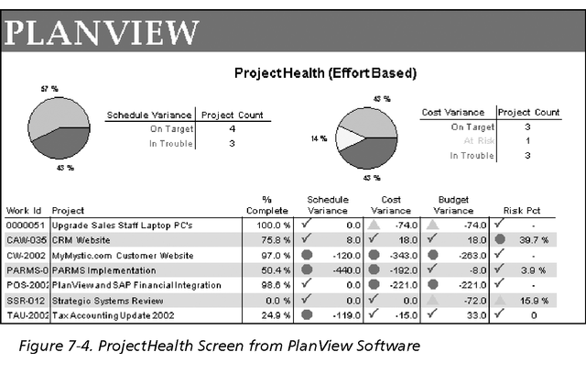
IT Project Management

