Slide 1

Information Technology Project Management.

Slide 2
Learning Objectives
Understand what risk is and the importance of good project risk management
Discuss the elements involved in risk management planning and the contents of a risk management plan
List common sources of risks in information technology projects
Information Technology Project Management

Slide 3
Learning Objectives (continued)
Describe the risk identification process, tools and techniques to help identify project risks, and the main output of risk identification: a risk register
Discuss the qualitative risk analysis process and explain how to calculate risk factors, create probability/impact matrixes, and apply the Top Ten Risk Item Tracking technique to rank risks
Information Technology Project Management

Slide 4
Learning Objectives (continued)
Explain the quantitative risk analysis process and how to apply decision trees, simulation, and sensitivity analysis to quantify risks
Provide examples of using different risk response planning strategies to address both negative and positive risks
Discuss what is involved in risk monitoring and control
Describe how software can assist in project risk management
Information Technology Project Management

Slide 5
The Importance of Project Risk Management
Project risk management is the art and science of identifying, analyzing, and responding to risk throughout the life of a project and in the best interests of meeting project objectives
Risk management is often overlooked in projects, but it can help improve project success by helping select good projects, determining project scope, and developing realistic estimates
Information Technology Project Management

Slide 6
Research Shows Need to Improve Project Risk Management
Study by Ibbs and Kwak shows risk has the lowest maturity rating of all knowledge areas
A similar survey was completed with software development companies in Mauritius, South Africa in 2003, and risk management also had the lowest maturity
KLCI study shows the benefits of following good software risk management practices
Information Technology Project Management

Slide 7

KEY: 1 = LOWEST MATURITY RATING 5 = HIGHEST MATURITY RATING
Knowledge Area | Engineering/ Construction | Telecommunications | Information Systems | Hi-Tech Manufacturing
Scope | 3.52 | 3.45 | 3.25 | 3.37
Time | 3.55 | 3.41 | 3.03 | 3.50
Cost | 3.74 | 3.22 | 3.20 | 3.97
Quality | 2.91 | 3.22 | 2.88 | 3.26
Human Resources | 3.18 | 3.20 | 2.93 | 3.18
Communications | 3.53 | 3.53 | 3.21 | 3.48
Risk | 2.93 | 2.87 | 2.75 | 2.76
Procurement | 3.33 | 3.01 | 2.91 | 3.33
*Ibbs, C. William and Young Hoon Kwak. “Assessing Project Management Maturity,”
Project Management Journal (March 2000).
Information Technology Project Management

Slide 8
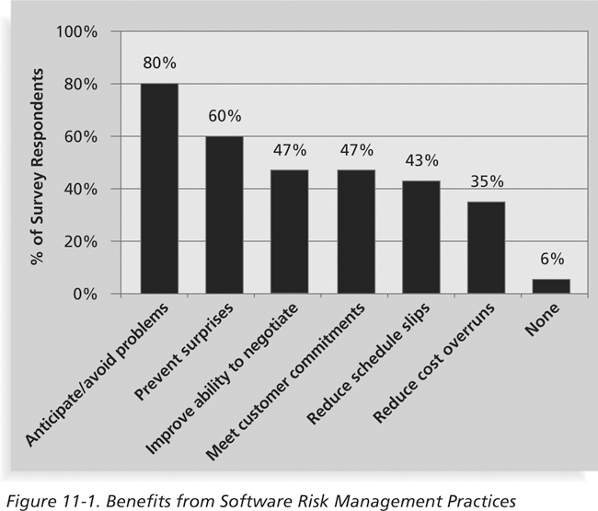
Figure 11-1: Benefits from Software Risk Management Practices*
*Kulik, Peter and Catherine Weber, “Software Risk Management Practices – 2001,” KLCI Research Group (August 2001).
Information Technology Project Management

Slide 9
Negative Risk
A dictionary definition of risk is “the possibility of loss or injury”
Negative risk involves understanding potential problems that might occur in the project and how they might impede project success
Negative risk management is like a form of insurance; it is an investment
Information Technology Project Management

Slide 10
Risk Can Be Positive
Positive risks are risks that result in good things happening; sometimes called opportunities
A general definition of project risk is an uncertainty that can have a negative or positive effect on meeting project objectives
The goal of project risk management is to minimize potential negative risks while maximizing potential positive risks
Information Technology Project Management

Slide 11
Best Practice
Some organizations make the mistake of only addressing tactical and negative risks when performing project risk management
David Hillson (www.risk-doctor.com) suggests overcoming this problem by widening the scope of risk management to encompass both strategic risks and upside opportunities, which he refers to as integrated risk management
Information Technology Project Management

Slide 12
Risk Utility
Risk utility or risk tolerance is the amount of satisfaction or pleasure received from a potential payoff
  Utility rises at a decreasing rate for people who are risk-averse
  Those who are risk-seeking have a higher tolerance for risk and their satisfaction increases when more payoff is at stake
  The risk-neutral approach achieves a balance between risk and payoff
Information Technology Project Management

Slide 13

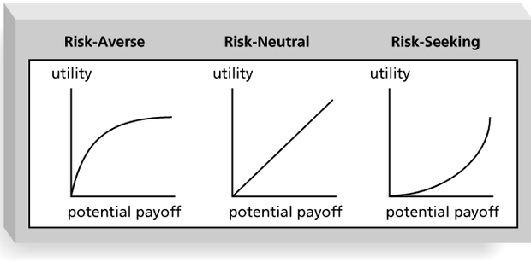
Information Technology Project Management

Slide 14
Project Risk Management Processes
Risk management planning: deciding how to approach and plan the risk management activities for the project
Risk identification: determining which risks are likely to affect a project and documenting the characteristics of each
Qualitative risk analysis: prioritizing risks based on their probability and impact of occurrence
Information Technology Project Management

Slide 15
Project Risk Management Processes (continued)
Quantitative risk analysis: numerically estimating the effects of risks on project objectives
Risk response planning: taking steps to enhance opportunities and reduce threats to meeting project objectives
Risk monitoring and control: monitoring identified and residual risks, identifying new risks, carrying out risk response plans, and evaluating the effectiveness of risk strategies throughout the life of the project
Information Technology Project Management

Slide 16
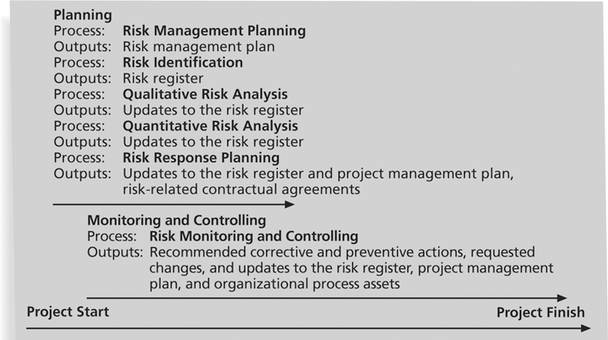
Figure 11-3: Project Risk Management Summary
Information Technology Project Management

Slide 17
Risk Management Planning
The main output of risk management planning is a risk management plan—a plan that documents the procedures for managing risk throughout a project
The project team should review project documents and understand the organization’s and the sponsor’s approaches to risk
The level of detail will vary with the needs of the project
Information Technology Project Management

Slide 18
Table 11-2: Topics Addressed in a Risk Management Plan
Methodology
Roles and responsibilities
Budget and schedule
Risk categories
Risk probability and impact
Risk documentation
Information Technology Project Management

Slide 19
Contingency and Fallback Plans, Contingency Reserves
Contingency plans are predefined actions that the project team will take if an identified risk event occurs
Fallback plans are developed for risks that have a high impact on meeting project objectives, and are put into effect if attempts to reduce the risk are not effective
Contingency reserves or allowances are provisions held by the project sponsor or organization to reduce the risk of cost or schedule overruns to an acceptable level
Information Technology Project Management

Slide 20
Common Sources of Risk in Information Technology Projects
Several studies show that IT projects share some common sources of risk
The Standish Group developed an IT success potential scoring sheet based on potential risks
Other broad categories of risk help identify potential risks
Information Technology Project Management

Slide 21

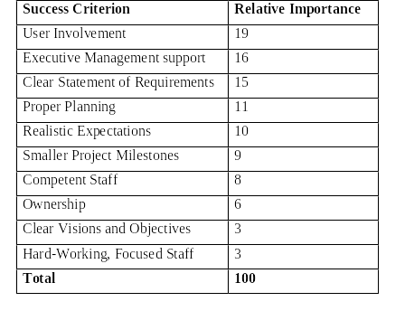
Information Technology Project Management

Slide 22
Broad Categories of Risk
Market risk
Financial risk
Technology risk
People risk
Structure/process risk
Information Technology Project Management

Slide 23
What Went Wrong?
KPMG, a large consulting firm, published a study in 1995 that found that 55 percent of runaway projects—projects that have significant cost or schedule overruns—did no risk management at all; 38 percent did some (but half did not use their risk findings after the project was underway); and 7 percent did not know whether they did risk management or not
The timing of risk management is also an important consideration
Information Technology Project Management

Slide 24
Risk Breakdown Structure
A risk breakdown structure is a hierarchy of potential risk categories for a project
Similar to a work breakdown structure but used to identify and categorize risks
Information Technology Project Management

Slide 25
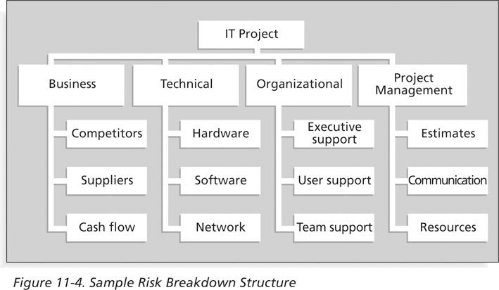
Figure 11-4: Sample Risk Breakdown Structure
Information Technology Project Management

Slide 26

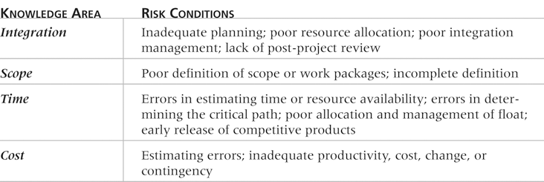
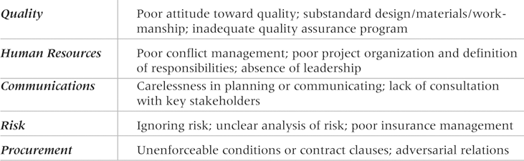
Information Technology Project Management

Slide 27
Risk Identification
Risk identification is the process of understanding what potential events might hurt or enhance a particular project
Risk identification tools and techniques include:
  Brainstorming
  The Delphi Technique
  Interviewing
  SWOT analysis
Information Technology Project Management

Slide 28
Brainstorming
Brainstorming is a technique by which a group attempts to generate ideas or find a solution for a specific problem by amassing ideas spontaneously and without judgment
An experienced facilitator should run the brainstorming session
Be careful not to overuse or misuse brainstorming
  Psychology literature shows that individuals produce a greater number of ideas working alone than they do through brainstorming in small, face-to-face groups
  Group effects often inhibit idea generation
Information Technology Project Management

Slide 29
Delphi Technique
The Delphi Technique is used to derive a consensus among a panel of experts who make predictions about future developments
Provides independent and anonymous input regarding future events
Uses repeated rounds of questioning and written responses and avoids the biasing effects possible in oral methods, such as brainstorming
Information Technology Project Management

Slide 30
Interviewing
Interviewing is a fact-finding technique for collecting information in face-to-face, phone, e-mail, or instant-messaging discussions
Interviewing people with similar project experience is an important tool for identifying potential risks
Information Technology Project Management

Slide 31
SWOT Analysis
SWOT analysis (strengths, weaknesses, opportunities, and threats) can also be used during risk identification
Helps identify the broad negative and positive risks that apply to a project
Information Technology Project Management

Slide 32
Risk Register
The main output of the risk identification process is a list of identified risks and other information needed to begin creating a risk register
A risk register is:
  A document that contains the results of various risk management processes and that is often displayed in a table or spreadsheet format
  A tool for documenting potential risk events and related information
Risk events refer to specific, uncertain events that may occur to the detriment or enhancement of the project
Information Technology Project Management

Slide 33
Risk Register Contents
An identification number for each risk event
A rank for each risk event
The name of each risk event
A description of each risk event
The category under which each risk event falls
The root cause of each risk
Information Technology Project Management

Slide 34
Risk Register Contents (continued)
Triggers for each risk; triggers are indicators or symptoms of actual risk events
Potential responses to each risk
The risk owner or person who will own or take responsibility for each risk
The probability and impact of each risk occurring
The status of each risk
Information Technology Project Management

Slide 35
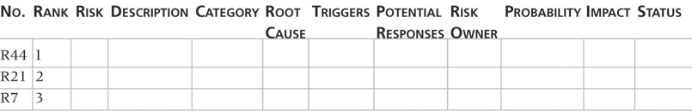
Table 11-5: Sample Risk Register
Information Technology Project Management

Slide 36
Qualitative Risk Analysis
Assess the likelihood and impact of identified risks to determine their magnitude and priority
Risk quantification tools and techniques include:
  Probability/impact matrixes
  The Top Ten Risk Item Tracking
  Expert judgment
Information Technology Project Management

Slide 37
Probability/Impact Matrix
A probability/impact matrix or chart lists the relative probability of a risk occurring on one side of a matrix or axis on a chart and the relative impact of the risk occurring on the other
List the risks and then label each one as high, medium, or low in terms of its probability of occurrence and its impact if it did occur
Can also calculate risk factors
  Numbers that represent the overall risk of specific events based on their probability of occurring and the consequences to the project if they do occur
Information Technology Project Management

Slide 38

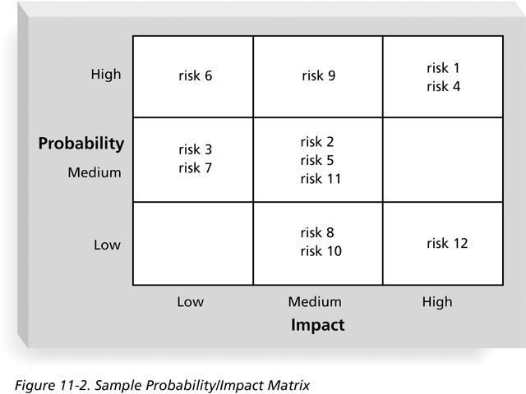
Information Technology Project Management

Slide 39
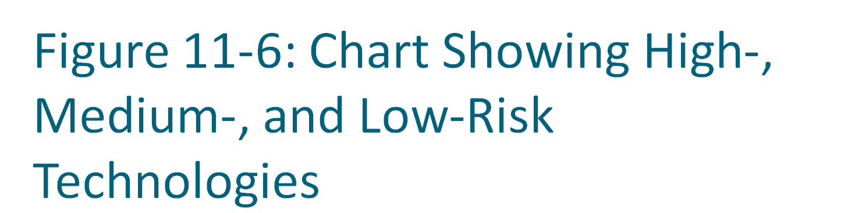
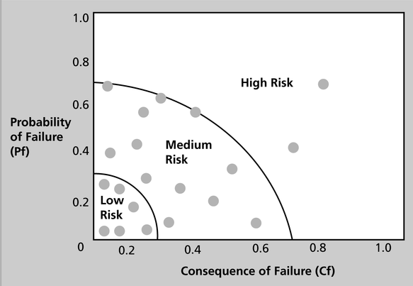
Information Technology Project Management

Slide 40
Top Ten Risk Item Tracking
Top Ten Risk Item Tracking is a qualitative risk analysis tool that helps to identify risks and maintain an awareness of risks throughout the life of a project
Establish a periodic review of the top ten project risk items
List the current ranking, previous ranking, number of times the risk appears on the list over a period of time, and a summary of progress made in resolving the risk item
Information Technology Project Management

Slide 41
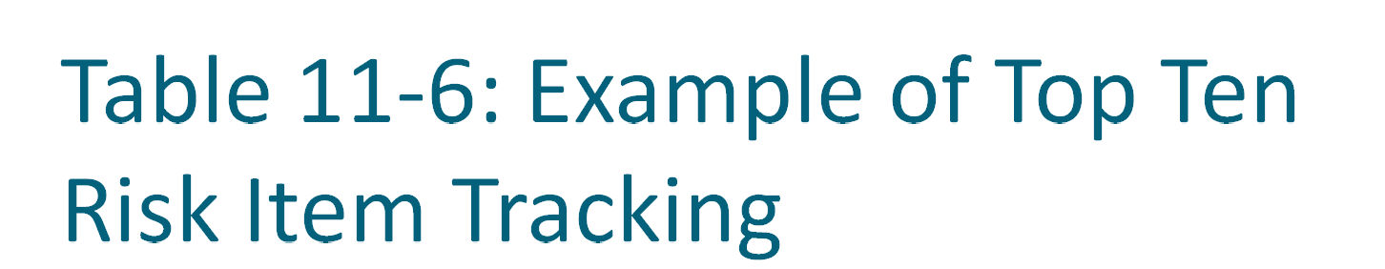
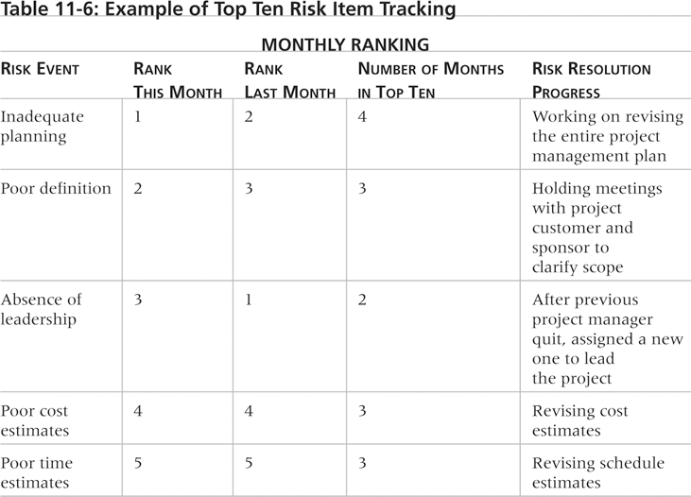
Information Technology Project Management

Slide 42
Watch List
A watch list is a list of risks that are low priority, but are still identified as potential risks
Qualitative analysis can also identify risks that should be evaluated on a quantitative basis
Information Technology Project Management

Slide 43
Quantitative Risk Analysis
Often follows qualitative risk analysis, but both can be done together
Large, complex projects involving leading edge technologies often require extensive quantitative risk analysis
Main techniques include:
  Decision tree analysis
  Simulation
  Sensitivity analysis
Information Technology Project Management

Slide 44
Decision Trees and Expected Monetary Value (EMV)
A decision tree is a diagramming analysis technique used to help select the best course of action in situations in which future outcomes are uncertain
Estimated monetary value (EMV) is the product of a risk event probability and the risk event’s monetary value
You can draw a decision tree to help find the EMV
Information Technology Project Management

Slide 45

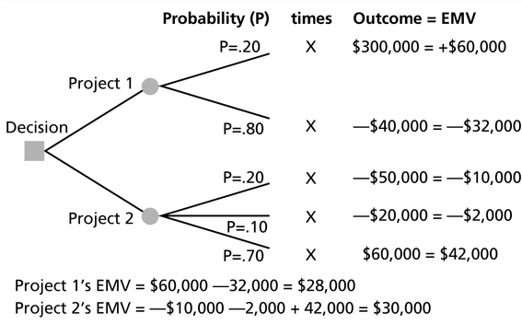
Information Technology Project Management

Slide 46
Simulation
Simulation uses a representation or model of a system to analyze the expected behavior or performance of the system
Monte Carlo analysis simulates a model’s outcome many times to provide a statistical distribution of the calculated results
To use a Monte Carlo simulation, you must have three estimates (most likely, pessimistic, and optimistic) plus an estimate of the likelihood of the estimate being between the most likely and optimistic values
Information Technology Project Management

Slide 47
Steps of a Monte Carlo Analysis
Assess the range for the variables being considered
Determine the probability distribution of each variable
For each variable, select a random value based on the probability distribution
Run a deterministic analysis or one pass through the model
Repeat steps 3 and 4 many times to obtain the probability distribution of the model’s results
Information Technology Project Management

Slide 48

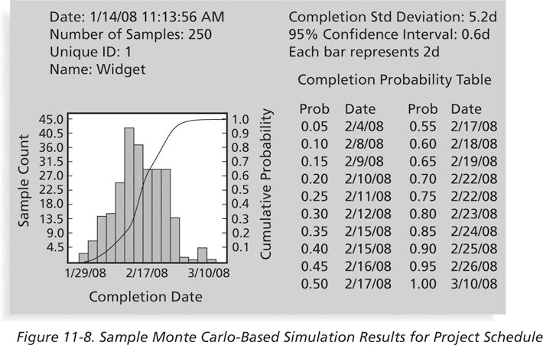
Information Technology Project Management

Slide 49
What Went Right?
A large aerospace company used Monte Carlo simulation to help quantify risks on several advanced-design engineering projects, such as the National Aerospace Plan (NASP)
The results of the simulation were used to determine how the company would invest its internal research and development funds
Although the NASP project was terminated, the resulting research has helped develop more advanced materials and propulsion systems used on many modern aircraft
Information Technology Project Management

Slide 50
Sensitivity Analysis
Sensitivity analysis is a technique used to show the effects of changing one or more variables on an outcome
For example, many people use it to determine what the monthly payments for a loan will be given different interest rates or periods of the loan, or for determining break-even points based on different assumptions
Spreadsheet software, such as Excel, is a common tool for performing sensitivity analysis
Information Technology Project Management

Slide 51
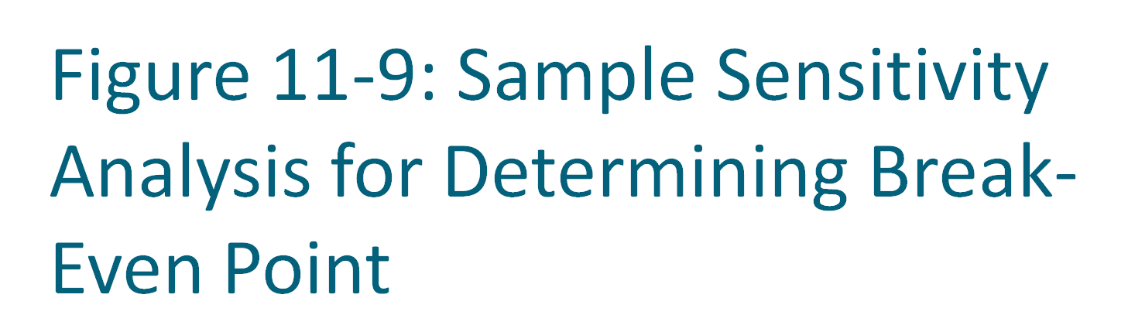
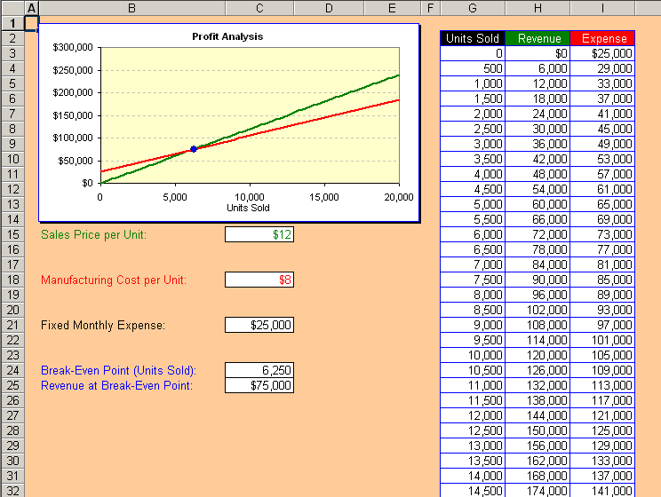
Information Technology Project Management

Slide 52
Risk Response Planning
After identifying and quantifying risks, you must decide how to respond to them
Four main response strategies for negative risks:
  Risk avoidance
  Risk acceptance
  Risk transference
  Risk mitigation
Information Technology Project Management

Slide 53
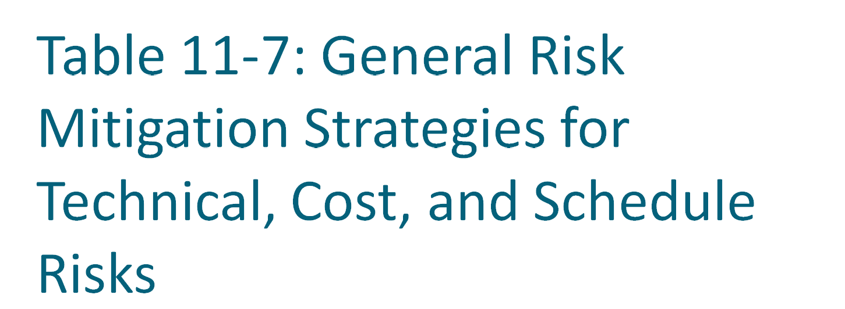
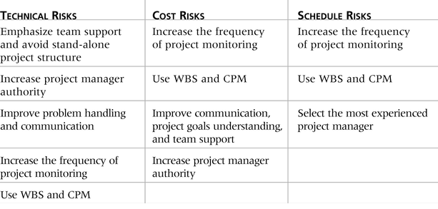
Information Technology Project Management

Slide 54
Response Strategies for Positive Risks
Risk exploitation
Risk sharing
Risk enhancement
Risk acceptance
Information Technology Project Management

Slide 55
Residual and Secondary Risks
It’s also important to identify residual and secondary risks
Residual risks are risks that remain after all of the response strategies have been implemented
Secondary risks are a direct result of implementing a risk response
Information Technology Project Management

Slide 56
Media Snapshot
A highly publicized example of a risk response to corporate financial scandals, such as those affecting Enron, Arthur Andersen, and WorldCom, was legal action
The Sarbanes-Oxley Act is considered the most significant change to federal securities laws in the United States since the New Deal
This Act has caused many organizations to initiate projects and other actions to avoid litigation
Information Technology Project Management

Slide 57
Risk Monitoring and Control
Involves executing the risk management process to respond to risk events
Workarounds are unplanned responses to risk events that must be done when there are no contingency plans
Main outputs of risk monitoring and control are:
  Requested changes
  Recommended corrective and preventive actions
  Updates to the risk register, project management plan, and organizational process assets
Information Technology Project Management

Slide 58
Using Software to Assist in Project Risk Management
Risk registers can be created in a simple Word or Excel file or as part of a database
More sophisticated risk management software, such as Monte Carlo simulation tools, help in analyzing project risks
The PMI Risk Specific Interest Group’s Web site at www.risksig.com has a detailed list of software products to assist in risk management
Information Technology Project Management

Slide 59
Results of Good Project Risk Management
Unlike crisis management, good project risk management often goes unnoticed
Well-run projects appear to be almost effortless, but a lot of work goes into running a project well
Project managers should strive to make their jobs look easy to reflect the results of well-run projects
Information Technology Project Management

Slide 60
Summary
Project risk management is the art and science of identifying, analyzing, and responding to risk throughout the life of a project and in the best interests of meeting project objectives
Main processes include:
  Risk management planning
  Risk identification
  Qualitative risk analysis
  Quantitative risk analysis
  Risk response planning
  Risk monitoring and control
Information Technology Project Management

