Slide 1


Heart Attack Risk Indicators
Eric Dickey
DSC 530

Slide 2
Research Questions
Is heart rate a good indicator of a heart attack?
Is high cholesterol a good predictor for a heart attack?

Slide 3
Dataset
Variables
14 total variables, 303 instances
Analysis done on the following variables:
age – Age in years
trtbps – Resting blood pressure in mm Hg on hospital admission
chol – Serum cholesterol in mg/dl
thalachh – Maximum heart rate
sex – Gender of patient
output– Heart attack Y(1) N (0)
Source
University of California, Irvine Machine Learning Repository
"Cleveland" dataset here

Slide 4
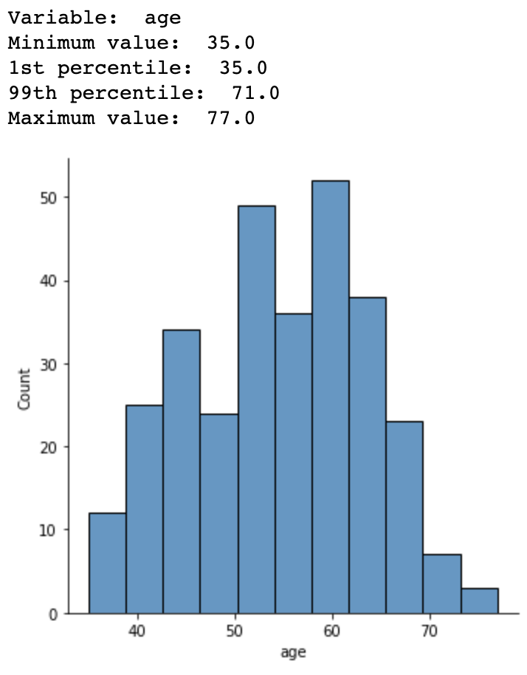
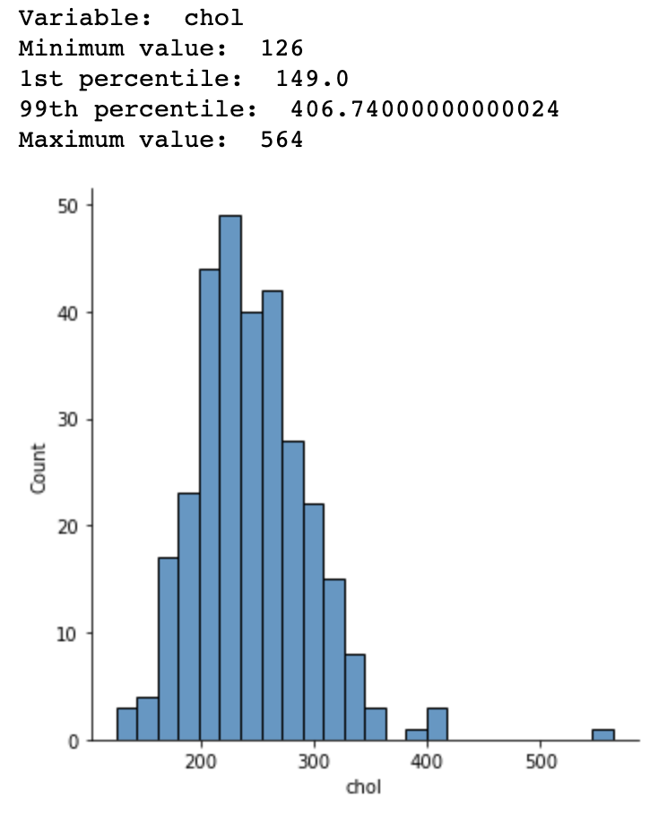
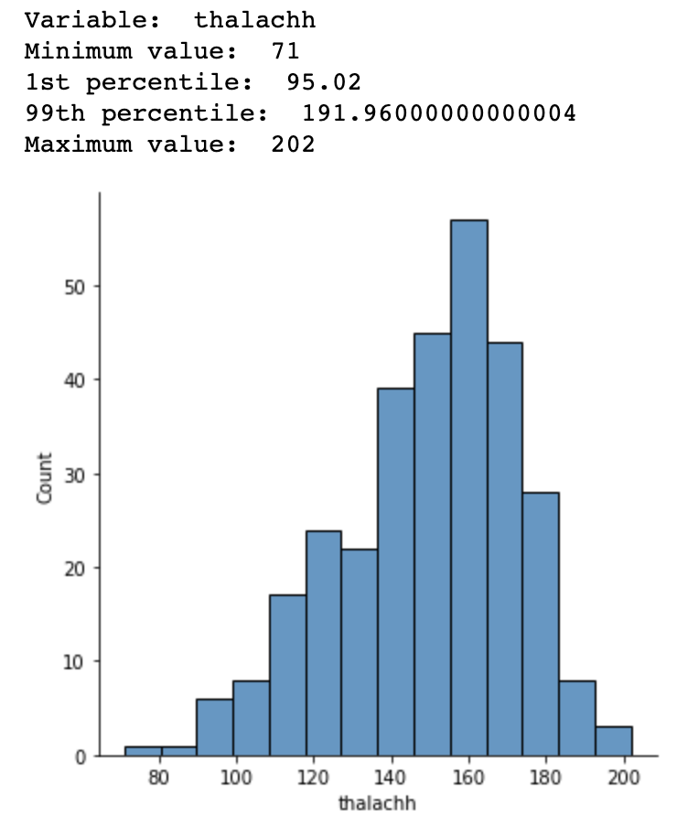
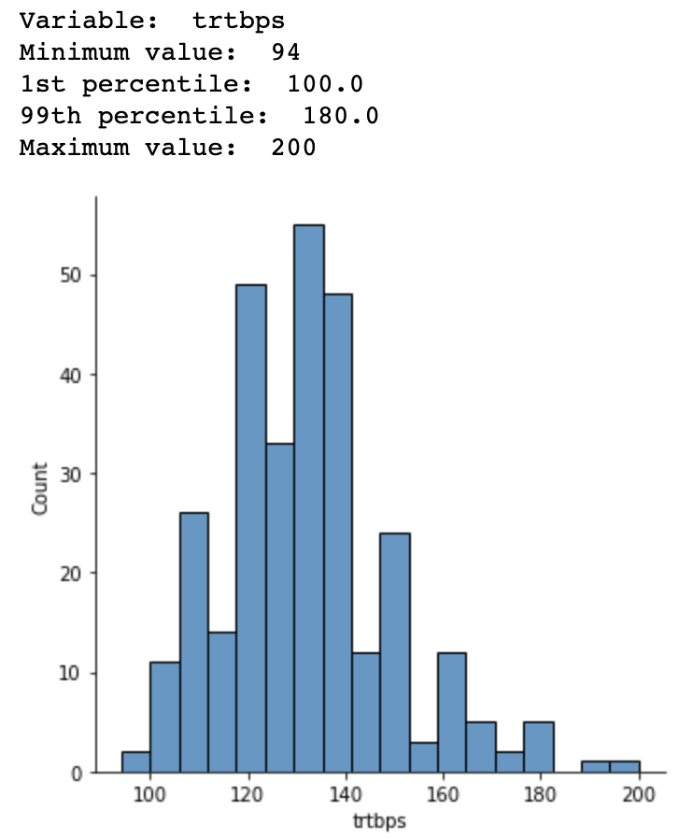
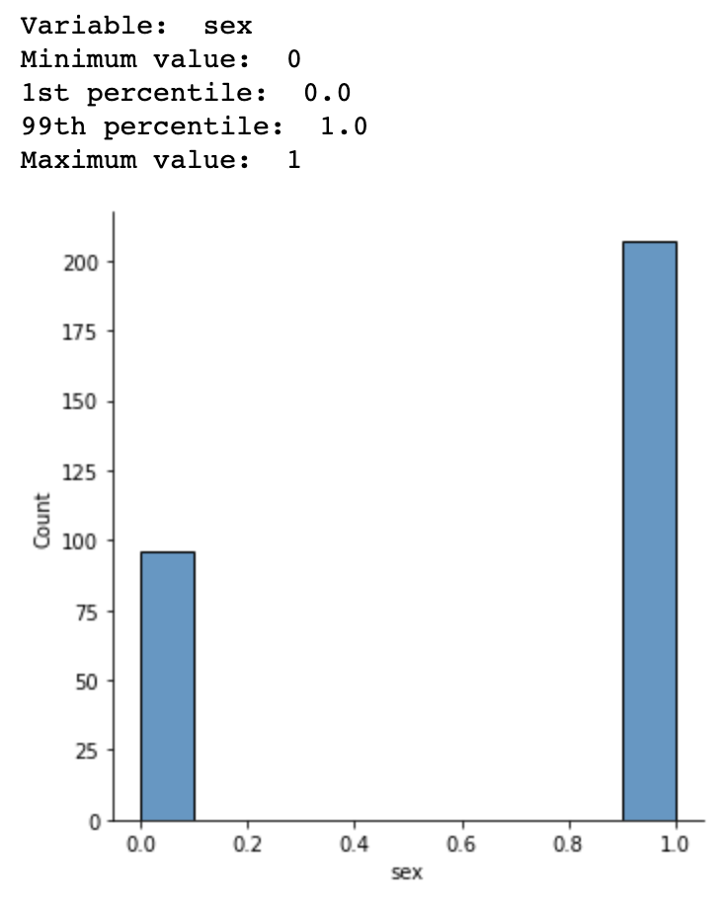
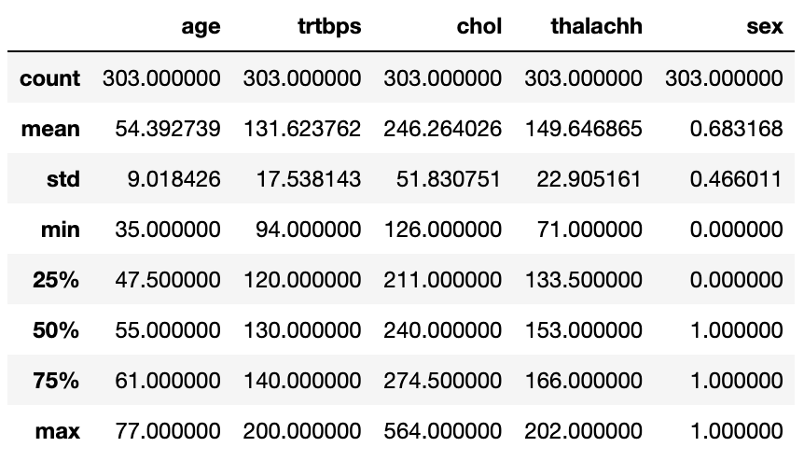
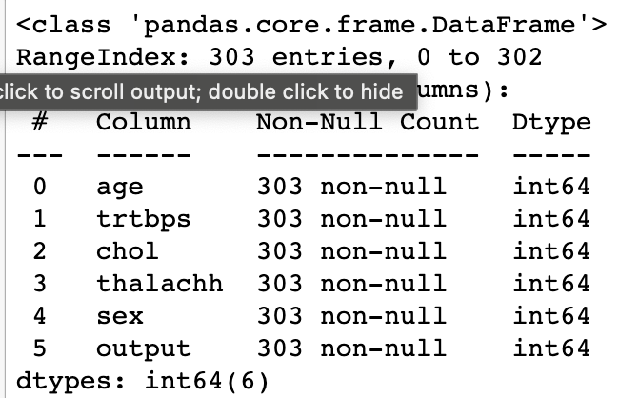
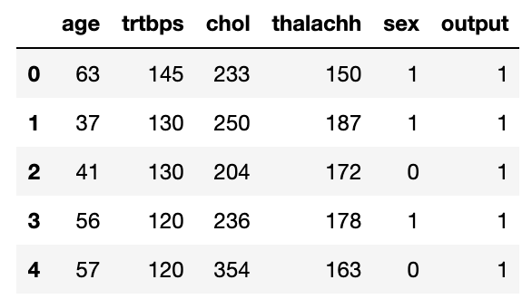
Dataset
Understanding the variables

Slide 5
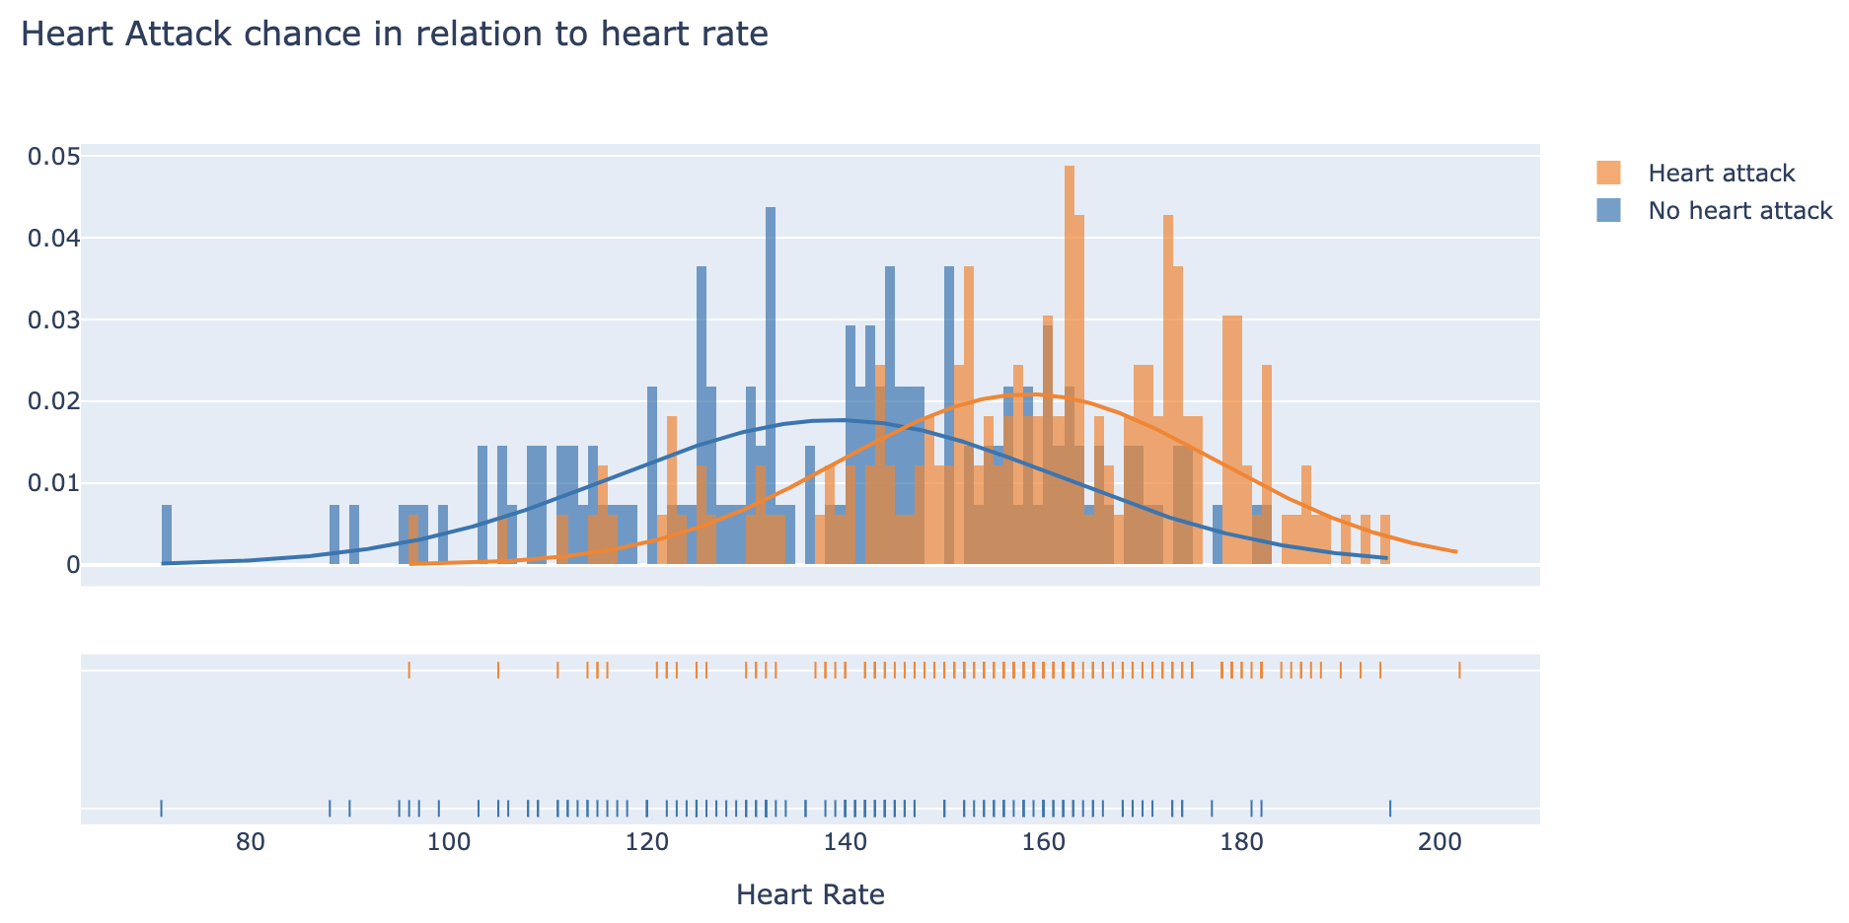
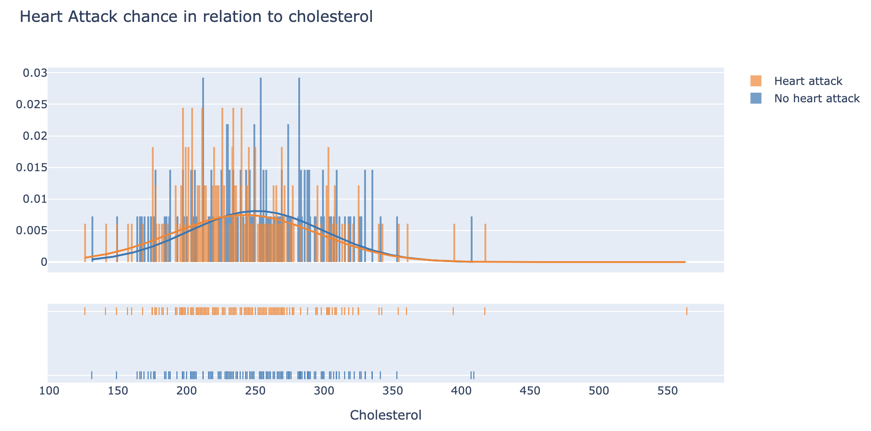
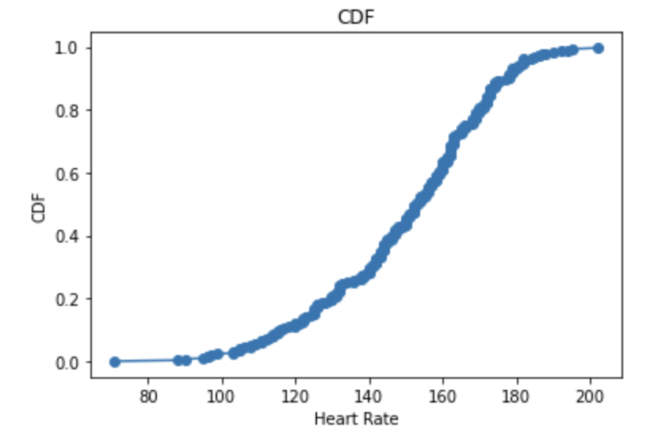
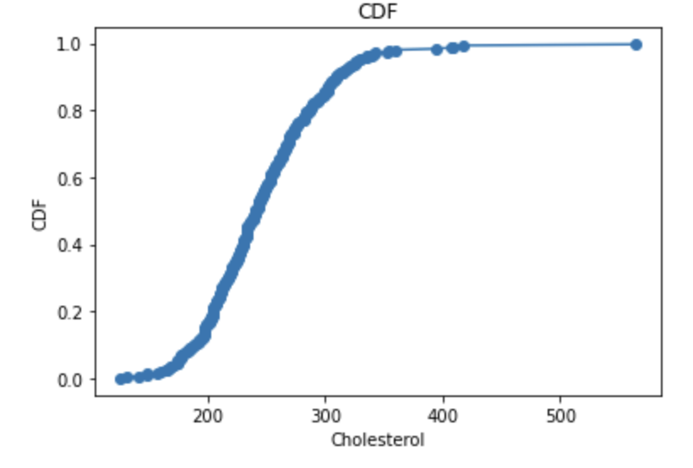
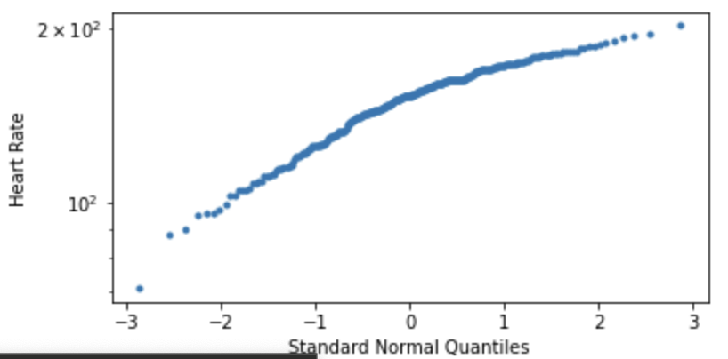
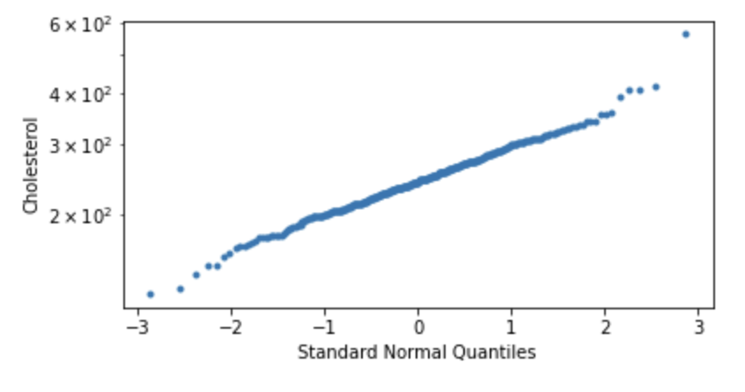
PMF AND CDF

Slide 6
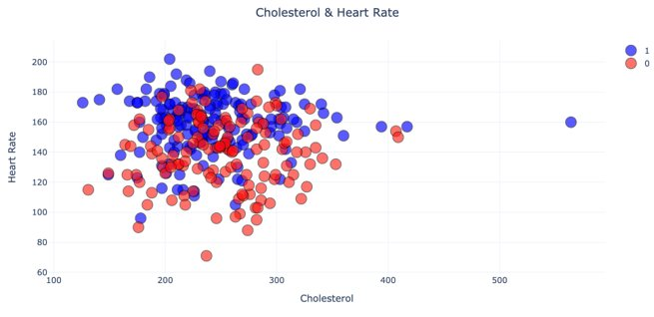
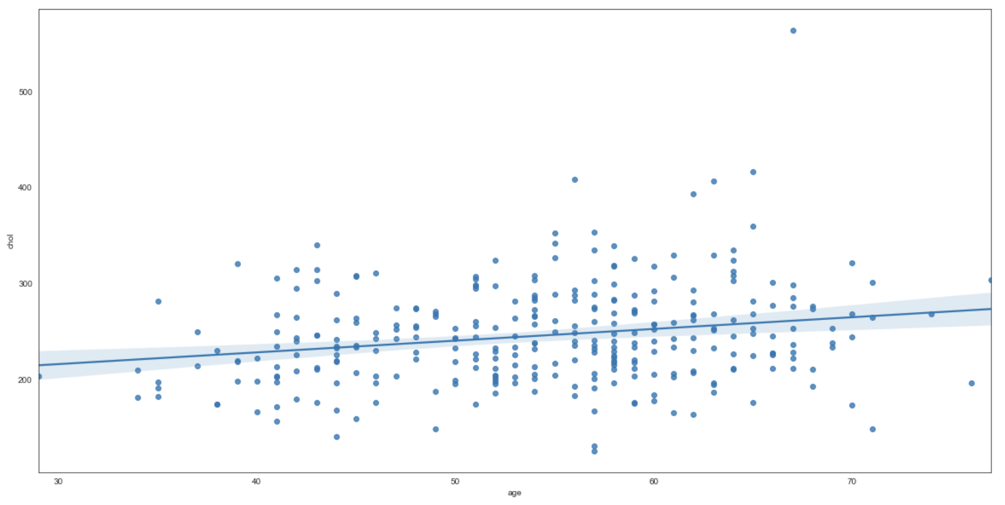
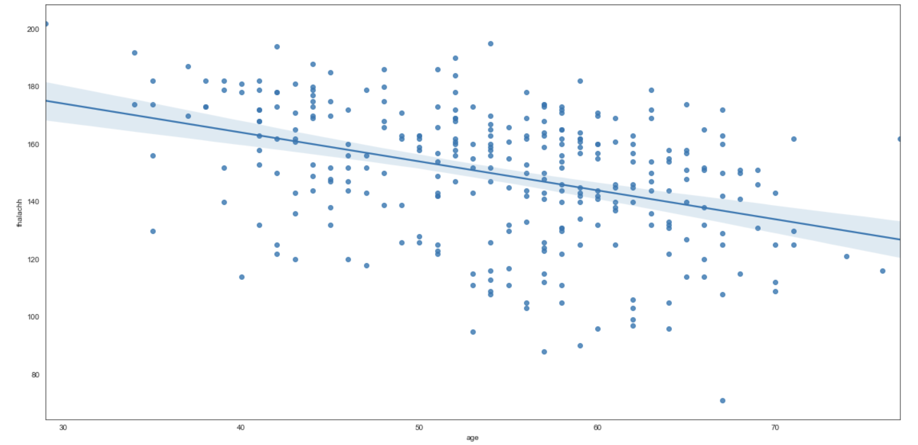
Scatterplots

Slide 7
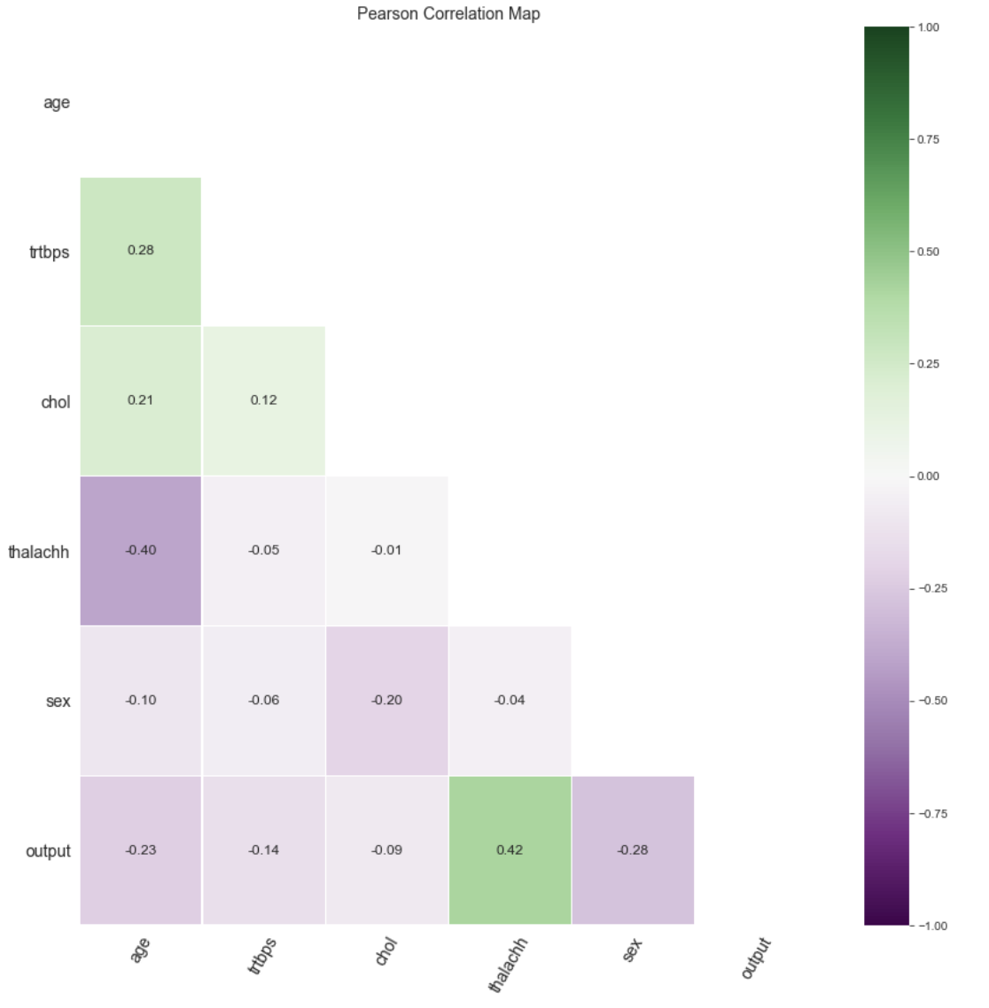
Correlation and Permutation Test
Heart rate + heart attack pvalue: 0.0
Cholesterol + heart attack pvalue: 0.0

Slide 8

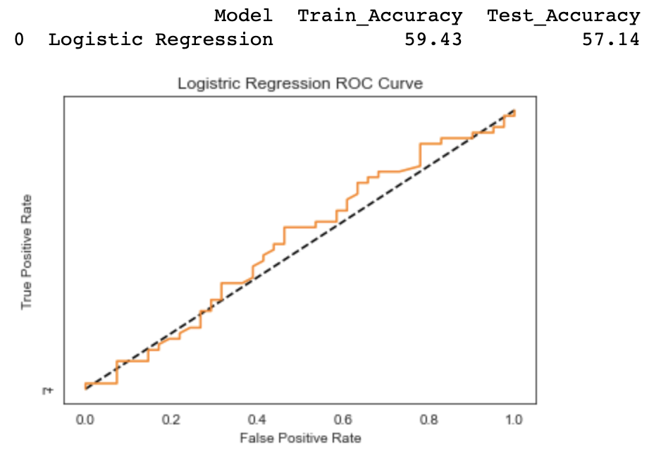
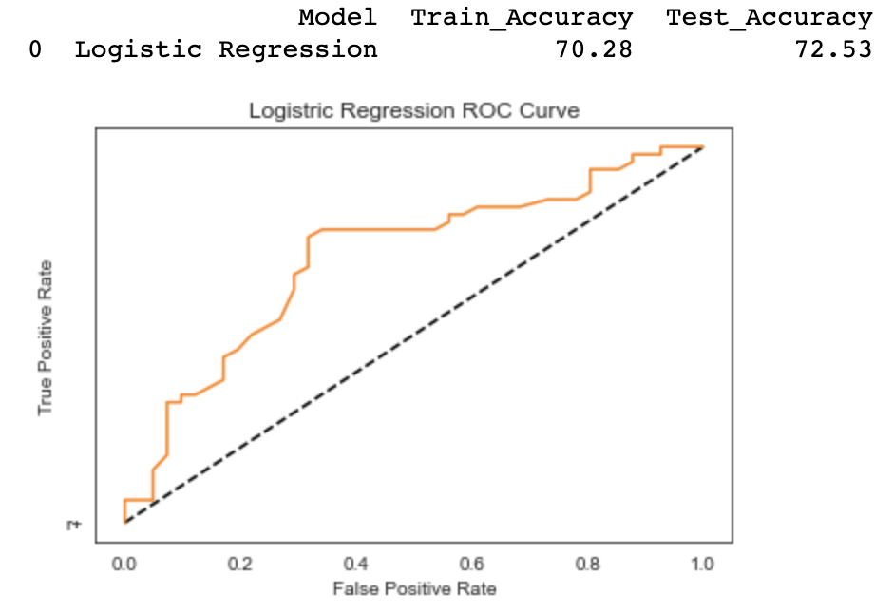
Logistic Regression Model
Cholesterol only
Heart Rate only

