Slide 1

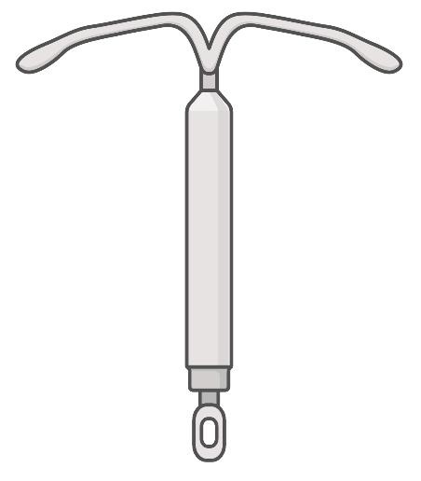

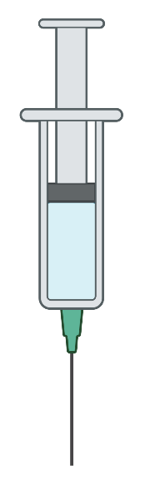
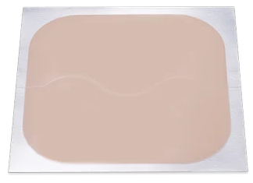
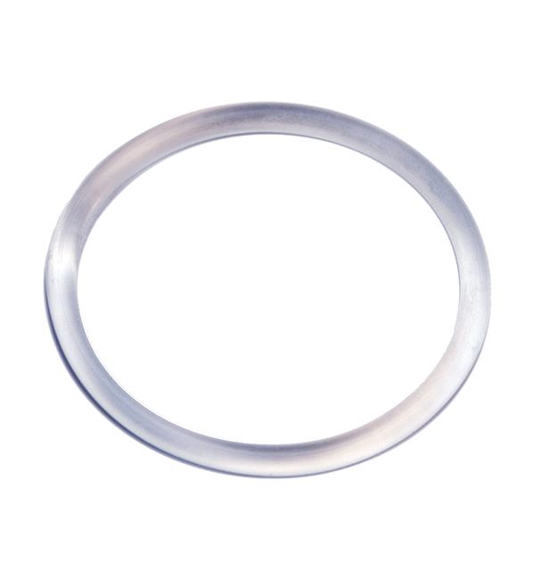
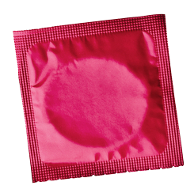


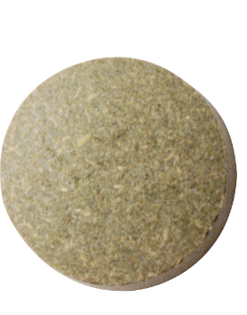

PATH Questions
Contraception Counseling
Methods
Contraindications
IUD
Implant
Depo-Provera
Patch
Emergency Use
Cases
Contraception App
Pill
Ring
Condom
Bonus Resources

Slide 2
PATH Questions
What phrasing do you use to discuss contraception options with your patients?
Methods
Conversation opener
Conversation opener
Method Selection
Contraindications
Method Selection
Emergency Use
Pregnancy
Attitudes?
Pregnancy
Attitudes?
“Do you think you might like to have (more) children at some point?”
“What’s the most important thing you’d like your birth control to do for you?”
Cases
Timing?
“When do you think that might be?”
“What have you tried in the past?”
Timing?
How important is prevention?
How important is prevention?
“How important is it to you to prevent pregnancy (until then)?”
“What worked well and what did not?”
Bonus Resources
Notes:
Possible script: “There are many ways to introduce the topic of contraception in an office visit. One approach that has been suggested is using the "PATH" questions, which address pregnancy attitudes and timing in a patient-centered way that acknowledges that many women will not have a well-defined plan. How might we assess the patient’s attitude towards…pregnancy attitudes? Timing of pregnancy? Lastly we can gauge their interest in contraception by asking how important it is to prevent pregnancy until then.
These questions are more inclusive in addressing family planning beyond cis couples. Consider that the perspective of pregnancy as a “planned” behavior may be inappropriate and/or triggering as some people are not able to achieve the self-determination and other conditions that dominant society considers prerequisites to starting a family due to existing racism and other forms of oppression. If the patient initiates the conversation about birth control, you may want to start by asking if they have reasons beyond pregnancy prevention. In general, ask open-ended questions about the patient’s reproductive goals and avoid assumptions about their beliefs or attitudes towards pregnancy.”
Source:
Callegari LS, Aiken AR, Dehlendorf C, et al. Addressing potential pitfalls of reproductive life planning with patient-centered counseling. Am J Obstet Gynecol 2017; 216:129. Tool available from the Reproductive Health National Training Center at https://rhntc.org/resources/client-centered-reproductive-goals-counseling-flow-chart

Slide 3
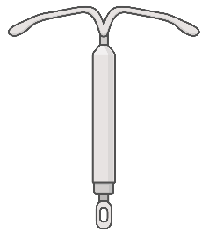


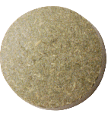



PATH Questions
Methods of Contraception
Methods
OCP selection
Contraindications
IUD
Implant
Depo-
Provera
Patch
Pill
Emergency Use
Copper
LNG
Cases
Hormone-Free
Efficacy
How many people will get pregnant? (per 100 users/y)
<1
<1
Low Maintenance
Q3-10 years
Q3 years
Q3 month
Q week
Q day
Impact on Bleeding
↑
↓
↓
↓
↓
↓
Regular menses
Can have regular menses
Can have regular menses
Bonus Resources
Notes:
The best method of birth control is the one that matches patient needs. Our job as the provider is to help patients choose the method that best accomplishes their goals and minimizes risks of adverse effects. Also be aware that there is a history of reproductive coercion in this country. Therefore, it is important to avoid presenting efficacy-first schematics and engage your patient in shared decision-making according to what’s important to them. Let’s start off by matching the benefits listed on the left side to the appropriate method.
Specific efficacy per UpToDate: 99.98+% with LNG IUD, 99.92+% with copper IUD (women under 25 experience slightly higher failure rate due to increased fertility but comparable to surgical sterilization). With perfect use, efficacy of depo-provera is 99.3% but typical use has an unintended pregnancy rate of 6%. Pregnancy rates for the patch are 1.07-8.6%. Typical use failure rate for OCP is approx. 7% (with perfect use 0.3%), 5% for POP (unclear data on perfect use failure rate).
Here is a tool to start with: https://www.bedsider.org/methods
The following app developed by Dr. Joshua Steinberg contains all the information you’ll need on prescribing contraception including effectiveness, medical eligibility criteria, prerequisites to starting, quick start algorithms, OCP formulations and help selecting one, etc.
Source:
https://iwhc.org/2020/12/addressing-the-legacy-of-us-sponsored-reproductive-coercion/

Slide 4
PATH Questions
Choosing an OCP
Methods
Estrogen
Estrogen
Progestin
Mechanism
Progestin
OCP selection
Suppresses ovulation
Stabilizes the endometrium
Thickens cervical mucus to inhibit sperm migration
Endometrium less suitable for implantation
Contraindications
Emergency Use
Ethinyl estradiol
(usually)
Generation
Cases
1
Norethindrone
Ethynodiol
10
Medications
low
20
2
Levonorgestrel
Norgestrel
Breakthrough bleeding
Risk of thrombosis
Anti-androgenic
Risk of thrombosis
25
when used with estrogens
3
Desogestrel
Norgestimate
30
medium
35
4
Drospirenone
mcg
Ethinyl estradiol (20 mcg) + progestin
Bonus Resources
Combination OCP dosing
Notes:
Two expert reviewers suggested offering a 3rd or 4thgeneration progestin formulation because of the potential for minimizing androgenic side effects, and to consider switching to a 3rd or 4th generation formulation if my patient is concerned/complaining of androgenic side effects to their current COC. If, however, the patient is happy with their method and it happens to be a 1st or 2nd generation formulation, you may want to just continue the current method.

Slide 5

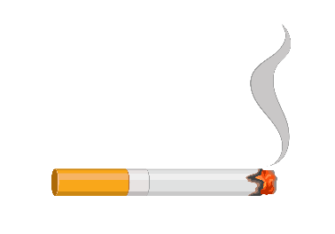
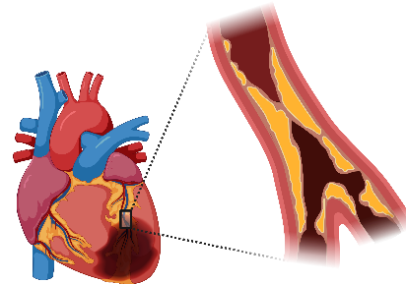
PATH Questions
Which methods are contraindicated with the following conditions?
Methods
Use the Contraception App: Medical Eligibility tab
Contraindications
Smoking
Age >35
Migraines with Aura
Personal history of VTE/ CVD/ CVA
Emergency Use
Cases
Avoid Combined Hormone Contraception (Pill, patch or ring)
Avoid Combined Hormone Contraception (Pill, patch or ring)
Avoid Combined Hormone Contraception (Pill, patch or ring)
History of Breast Cancer
Cervical or uterine cancer or
anatomic abnormalities or active PID
Bonus Resources
Avoid ANY hormone-based therapies
Avoid IUDs
Notes:
First ask the audience what might be some contraindications to estrogen use?
In addition to documenting medical problems, all medications/vitamins/supplements/herbals, and reviewing allergies, be sure to ask about the following to assess the safety of estrogen-containing methods. You want to narrow down possible options by excluding what the patient cannot have.
Smoking status
History of cardiovascular conditions (hypertension, CAD, CVA)
Migraine with aura (ask what the aura is)
Personal/family history of clotting disorders/VTE
Personal or family history of breast cancer and other hormone-responsive cancers (endometrial)
Patient’s BMI as BMI >30 is a relative contraindication for the hormonal patch as well as plan B due to decreased efficacy
Side note: Cervical cancer and known uterine anatomic abnormalities (ie. Known bicornate uterus) is a contraindication for IUD placement.
This history taking section is a great opportunity to offer STI screening and counseling!
For more information on contraindications for specific conditions, see the CDC’s Classifications for Combined Hormonal Contraceptives: https://www.cdc.gov/reproductivehealth/contraception/mmwr/mec/appendixd.html
Centers for Disease Control and Prevention (CDC. (2011). Update to CDC's US Medical Eligibility Criteria for Contraceptive Use, 2010: revised recommendations for the use of contraceptive methods during the postpartum period. MMWR. Morbidity and mortality weekly report, 60(26), 878-883.
Dehlendorf, C. Contraception: Counseling and Selection. In: Shreiber, C., Eckler, K, ed. UpToDate. UpToDate, 2020. Accessed July 31, 2021. www.uptodate.com
Samuelson Bannow, B., Grant, K., Watto, M, Williams, P., O’Glasser, A. Heavy Menstrual Bleeding, Anticoagulation & Coagulopathy in Menstruating Patients. The Curbsiders. 2021. Available at: https://thecurbsiders.com/podcast/280. Accessed June 21, 2021.

Slide 6

PATH Questions
Emergency Use Contraceptives
Methods
Levonorgestrel
(Plan B)
Ulipristal
(Ella)
Copper
IUD
Combo
OCPs
Levonorgestrel
(Plan B)
Ulipristal
(Ella)
Copper
IUD
Combo
OCPs
Contraindications
↑ nausea/ vomiting, headache, next menses irregular
50% if <120h
$ 4-5 pills of generic OCP pack
PO q12h x2 doses <120h of intercourse
Safety
Tolerability
Efficacy
Price
Simplicity
Headache, nausea, next menses irregular
52-100% if <72h. Less effective if 72-120h or BMI >25
$$ $35-50 each use
PO within 120h of intercourse
Pump and discard if breastfeeding
Headache, nausea, next menses irregular
62-85% if <120h. Less effective when on progestin methods
$$ $50-60 each use
PO within 120h of intercourse
Risk of perforation, infection, and ectopic
Initial spotting, then heavier menses
99.9% effective if <5 days
$$$$ $500-1,000
Intrauterine insertion q10 years
Emergency Use
Cases
Contraception App
Adapted from Contraception app developed by Dr. Joshua Steinberg
Bonus Resources
Notes:
Since a urine pregnancy test can take up to 14 days after fertilization occurs to become positive (it can take up to 10 days for a serum hCG test as well), if someone has had unprotected sex after their LMP and is outside of the 5-day window for emergency contraception, may wish to practice caution despite a negative UPT and consider an alternative form of contraception for 2 weeks to confirm negative pregnancy prior to placing an IUD.
Sources:
Sanders JN, Howell L, Saltzman HM, Schwarz EB, Thompson IS, Turok DK. Unprotected intercourse in the 2 weeks prior to requesting emergency intrauterine contraception. Am J Obstet Gynecol. 2016 Nov;215(5):592.e1-592.e5. doi: 10.1016/j.ajog.2016.06.028. Epub 2016 Jun 24. PMID: 27349294. Available at https://pubmed.ncbi.nlm.nih.gov/27349294/
Also discussed here:
https://providers.bedsider.org/articles/clinical-minute-placing-an-iud-after-unprotected-sex

Slide 7
PATH Questions
Case 1
Case 2
Methods
Ella is a 23 year-old F with history of acne who comes to clinic to establish care. She is interested in starting a combined oral contraceptive pill (COCP) to prevent pregnancy.
Vitals and physical exam are normal. BMI is 35.
Miranda is a 35 year-old F with well-controlled hypertension, bipolar depression on lamotrigine, and menorrhagia who is interested in switching her COCP to another contraception method for pregnancy prevention.
Contraindications
What category risk are COCPs for this patient?
What category risk is associated with lamotrigine and combined hormonal methods?
Emergency Use
Category 2 due to BMI > 30 (advantages generally outweigh theoretical or proven risks)
1 | Use without restriction
2 | Advantages > Risks
3 | Usually not recommended
4 | DO NOT USE
Category 3 – not recommended unless no other options. Estrogen ↑ lamotrigine clearance.
1 | Use without restriction
2 | Advantages > Risks
3 | Usually not recommended
4 | DO NOT USE
Cases
1-2
How will you counsel her on benefits/risks?
What options would be discreet?
3-4
Assess contraindications to estrogen (tobacco use, migraine with aura, history of VTE). Counsel on possible reduced efficacy due to BMI and don’t protect against STIs.
IUD, Depo-Provera, or Nexplanon (implant)
How can you counsel her on choosing between levonorgestrel IUDs?
What dose of estrogen /generation(s) of progestin would be most suitable?
Duration (3, 5, 6, or 7 years) and period preferences (interest in having lighter vs no period)
Low to medium dose estrogen. For her acne, it may be beneficial to use 3rd or 4th G progestins.
How can you counsel her on benefits, risks, and side effects?
How can she skip her period if she plans to travel?
Skip placebo pills and continue the next pack.
Benefits: efficacy, lighter/no period
Risks: procedural complications, STIs
Side effects: irregular bleeding 3-6 mos
Bonus Resources

Slide 8
PATH Questions
Case 3
Case 4
Methods
David is a 21 year-old transgender man with obesity and type I diabetes who presents for “the shot”. He is sexually active with one male partner.
His last HbA1C was 9% and he was found to have microalbuminuria and mild retinopathy during a prior visit.
Kylee is a 35 year-old woman who presents for contraceptive counseling. What options for combined hormonal contraceptives are recommended if she had the following comorbidities?
Contraindications
Compensated cirrhosis from hepatitis B
Emergency Use
All methods would be low risk
What categories of risk are associated with his condition?
Cases
He has DM with complications. Combined hormonal methods and Depo-Provera are category 3. All others (except for copper IUD) are category 2.
Decompensated cirrhosis from alcohol
COCPs would be contraindicated. All other methods except copper IUD are category 3.
1-2
What methods of contraception may worsen gender dysphoria in a female-to-male transgender patient?
Smoking
3-4
Avoid methods that would worsen menstrual bleeding (e.g., copper IUD). Consider methods that eradicate or lighten menstrual bleeding (e.g. LNG IUD).
For combined hormonal methods:
< 35 yo – category 2
> 35 yo, smoking <15 cigarettes/day – category 3
> 35 yo, smoking > 15 cigarettes/day – category 4.
All other methods are safe.
In addition to helping him select an alternative method, what additional counseling will you provide?
…You prescribe the patch. She breaks her leg in a skiing accident and requires ORIF.
Counsel on condom use for STI prevention.
Use the PATH questions to assess future pregnancy goals.
How will you manage her contraception after surgery?
Consider switching to a progestin only method. Combined hormonal methods are category 4 after major surgery with anticipated immobilization.
Bonus Resources

Slide 9
PATH Questions
Resources for Clinicians and Patients
Methods
bedsider.org: A free website developed by the National Campaign to Prevent Teen and Unplanned Pregnancy, a private nonprofit group
The Family Planning National Training Center: The website for federally funded contraceptive resources developed with the support of the Office of Population Affairs
Center for Young Women's Health: A free website run by Boston Children's Hospital that addresses reproductive health needs of teens and young adults
Beyond the Pill: A free website run by the University of California San Francisco
ReproductiveAccess.org
SexualityandU.ca: An educational site run by the Society of Obstetricians and Gynaecologists of Canada that includes descriptions of various methods and a tool to help with selection of birth control
Planned Parenthood: A nonprofit organization dedicated to reproductive health with resources for patients and clinicians
ACOG Contraceptive FAQs: American College of Obstetricians and Gynecologists addresses frequently asked questions (FAQs) about contraception
ACOG LARC Program: American College of Obstetricians and Gynecologists Long-Acting Reversible Contraception Program
United States Medical Eligibility Criteria for Contraceptive Use
United States Selected Practice Recommendations for Contraceptive Use
World Health Organization Medical Eligibility Criteria for Contraceptive Use
Contraindications
Emergency Use
CASES
Bonus Resources

Slide 10
2024 Practice Update — CDC US MEC & US SPR (added in optimization)
CDC released updated US MEC 2024 and US SPR 2024 (MMWR, Aug 2024) — this deck’s framework still holds; key additions below.
• US MEC 2024: new recommendations for chronic kidney disease; revised guidance across DVT/PE ± anticoagulation, thrombophilia, SLE, cirrhosis/liver tumor, sickle cell, solid-organ transplant, obesity, surgery, and ARV drug interactions; new formulations added (COCs, patch, ring, POPs, LNG-IUDs, vaginal pH modulator).
• NEW transgender guidance (directly relevant to Case 4/David): testosterone does NOT reliably prevent pregnancy — up to ~36% of users ovulate. Offer contraceptive counseling to testosterone users with a uterus who do not desire pregnancy.
• US SPR 2024: lidocaine (paracervical block or topical) recommended to reduce pain at IUD placement; new support for self-administration of subcutaneous DMPA (DMPA-SC 104 mg).
• OTC access: Opill (norgestrel 0.075 mg, progestin-only) — first FDA-approved nonprescription daily oral contraceptive (FDA Jul 2023; on shelves 2024, ~$20/mo). No estrogen; same POP cautions (e.g., current breast cancer).
• Newer non-hormonal method: vaginal pH modulator gel (Phexxi; lactic/citric acid + potassium bitartrate; FDA 2020) — typical-use efficacy ~86% (per-cycle), used immediately before intercourse.
Sources: CDC US MEC 2024 (MMWR RR-73/4); CDC US SPR 2024 (MMWR RR-73/3); FDA Opill approval 2023; Phexxi label/AMPOWER (Obstet Gynecol 2020). Educational use — clinician-reviewed.

Slide 11
Take-Home Points
• Lead with the patient: use open-ended PATH questions to gauge pregnancy attitudes/timing; avoid efficacy-first or assumption-laden counseling.
• Match the method to what matters to the patient — hormone-free vs hormonal, efficacy, maintenance burden, and effect on bleeding all drive the choice.
• Take a focused history for estrogen contraindications: smoking at age >35, migraine with aura, VTE/CVD/CVA, breast cancer. When unsure, use the US MEC categories (1–4) in the Contraception app.
• A reasonable COC default is ethinyl estradiol ~20 mcg + a progestin; reserve 3rd/4th-gen progestins for anti-androgenic benefit given higher VTE risk. Have 2–3 go-to pills.
• Emergency contraception: copper IUD is most effective; ulipristal (Ella) and levonorgestrel (Plan B) balance efficacy and tolerability; combined OCPs (Yuzpe) are the widely-available backup.
• Know the 2024 updates: testosterone is NOT contraception; lidocaine for IUD-placement pain; self-administered DMPA-SC; and OTC Opill expand access.

Slide 12
Attribution & Optimization Notes
• Original: “Contraception” — TeachIM.org, published April 2022.
• Authors: deQuillfeldt, Saxon, Guinn, Ramaswami, Haynes, Cleeves, Soiseth, Fainstad, Do; Section Eds. Brett, McClintock; Exec. Ed. Zhang.
• Source URL: https://teachim.org/teaching_material/contraception/
• License: CC BY-NC 4.0 — attribution required, non-commercial use only. Optimized June 2026.
Corrections made to this deck (surgical, animations preserved):
• Slide 7 MEC legend: “Usual not recommended” → “Usually not recommended” (×2).
• Slide 8 Case 3: “In additional to” → “In addition to”.
Added: 2024 CDC US MEC/US SPR practice-update slide; take-home slide. No clinical thresholds changed from memory — all updates source-cited.
Companion files (copied into lesson folder): Facilitator Guide, Learner Handout, Contraception Cases (learner + facilitator/answer key), PATH Questions handout.

