Slide 1

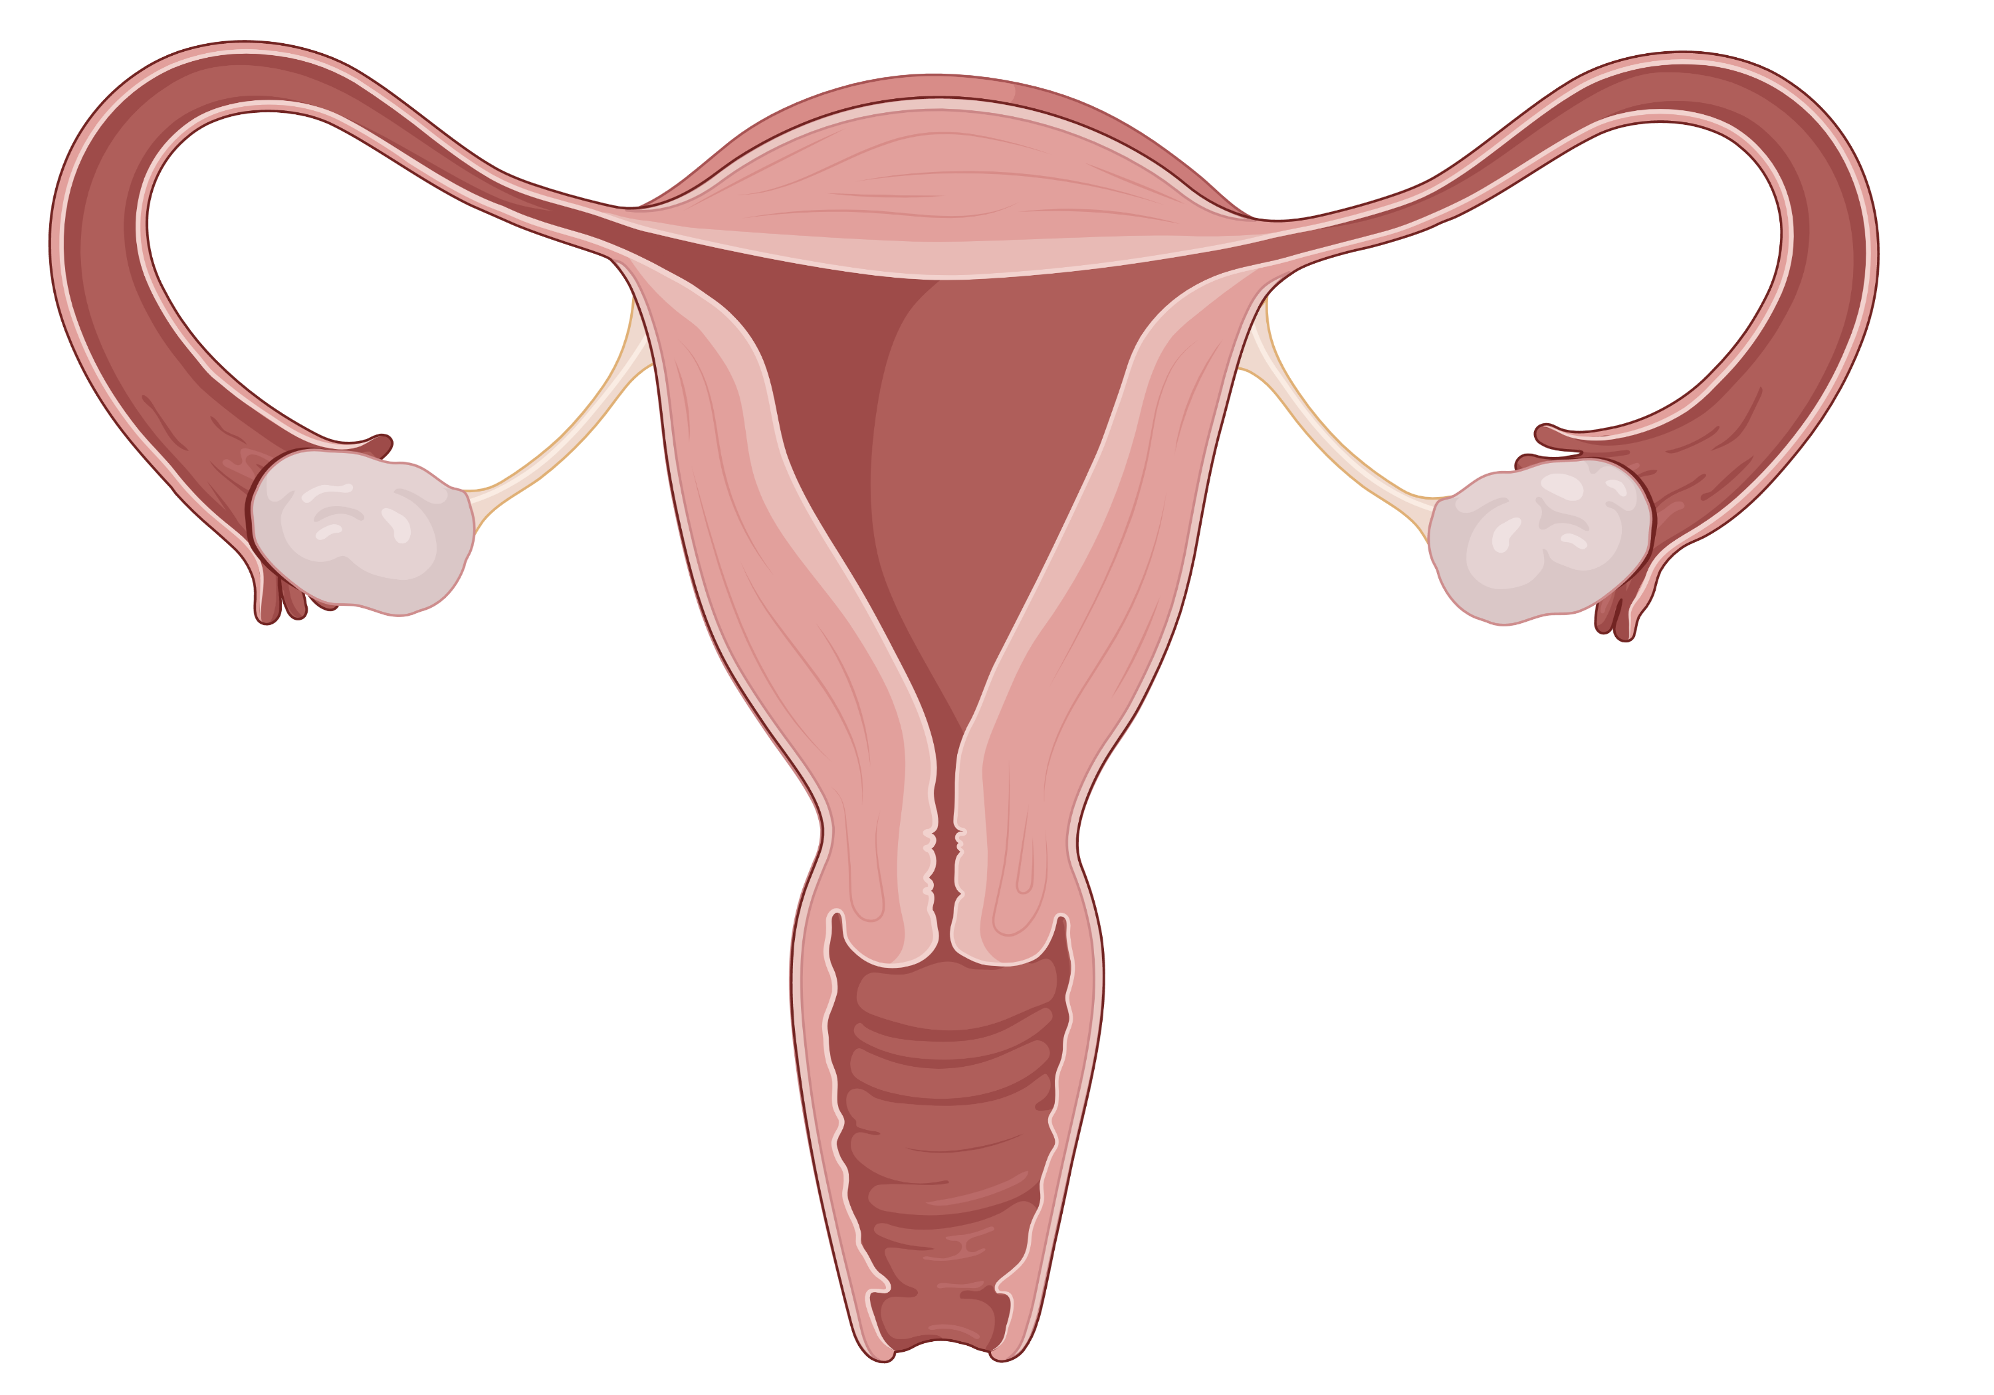
Definitions & Diagnoses
Perimenopause
&
Menopause
Hormone Therapy (MHT)
Cases

Slide 2
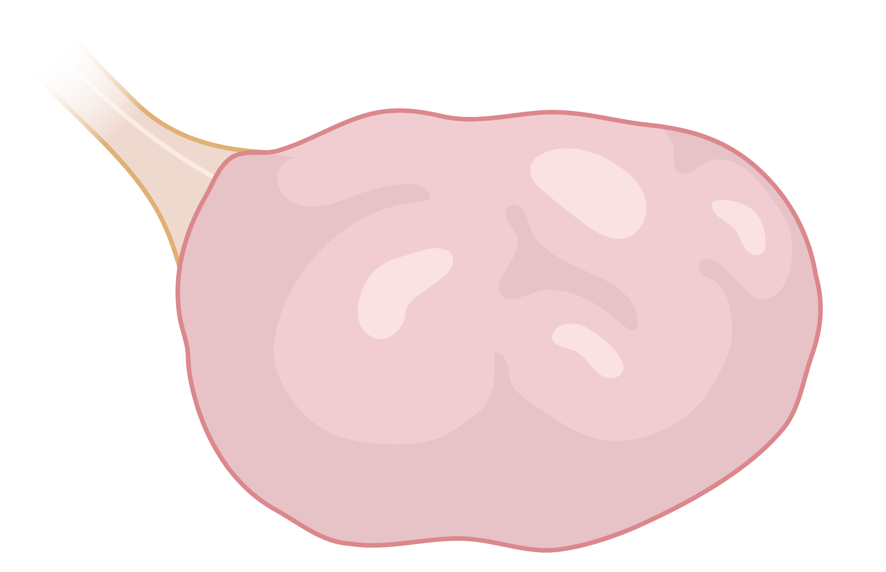
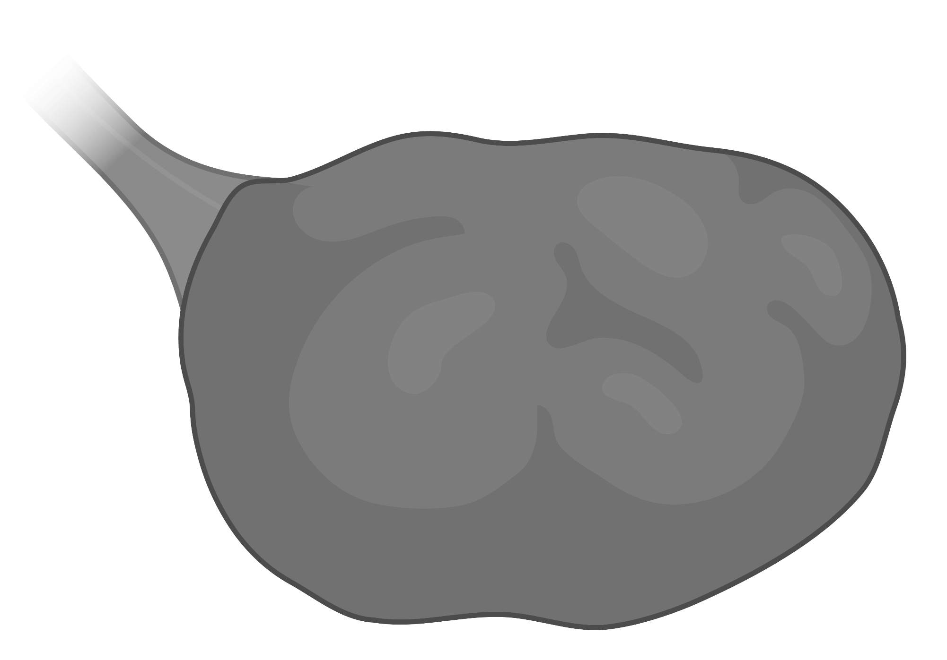
Definitions & Diagnoses
Clinical Features of Perimenopause and Menopause
Peri-menopause
Menopause
Hormone Therapy (MHT)
<40 y
40-45 y
~45-50 y
~50 y
Menopausal
Transition
Reproductive period
Menopausal
Transition
Menopause
Menopause
Cases
“Perimenopause”
Irregular menses
Hormonal symptoms
*hot flashes*
*mood changes*
Amenorrhea
>12 months
(following menstrual irregularity)
When is Testing Indicated?

Slide 3
Definitions & Diagnoses
Clinical Features of Perimenopause and Menopause
Peri-menopause
Menopause
Hormone Therapy (MHT)
<40 y
40-45 y
~45-50 y
~50 y
Primary ovarian insufficiency
Reproductive period
Primary ovarian insufficiency
Early Menopause
Menopausal
Transition
Early Menopause
Menopause
Cases
“Perimenopause”
Irregular menses
Hormonal symptoms
*hot flashes*
*mood changes*
Amenorrhea
>12 months
(following menstrual irregularity)
Complete work-up for Amenorrhea
Serum hCG
Prolactin
TSH
Clinical Diagnosis
When is Testing Indicated?
FSH not necessary
(SWAN study. Sowers, 2000)

Slide 4
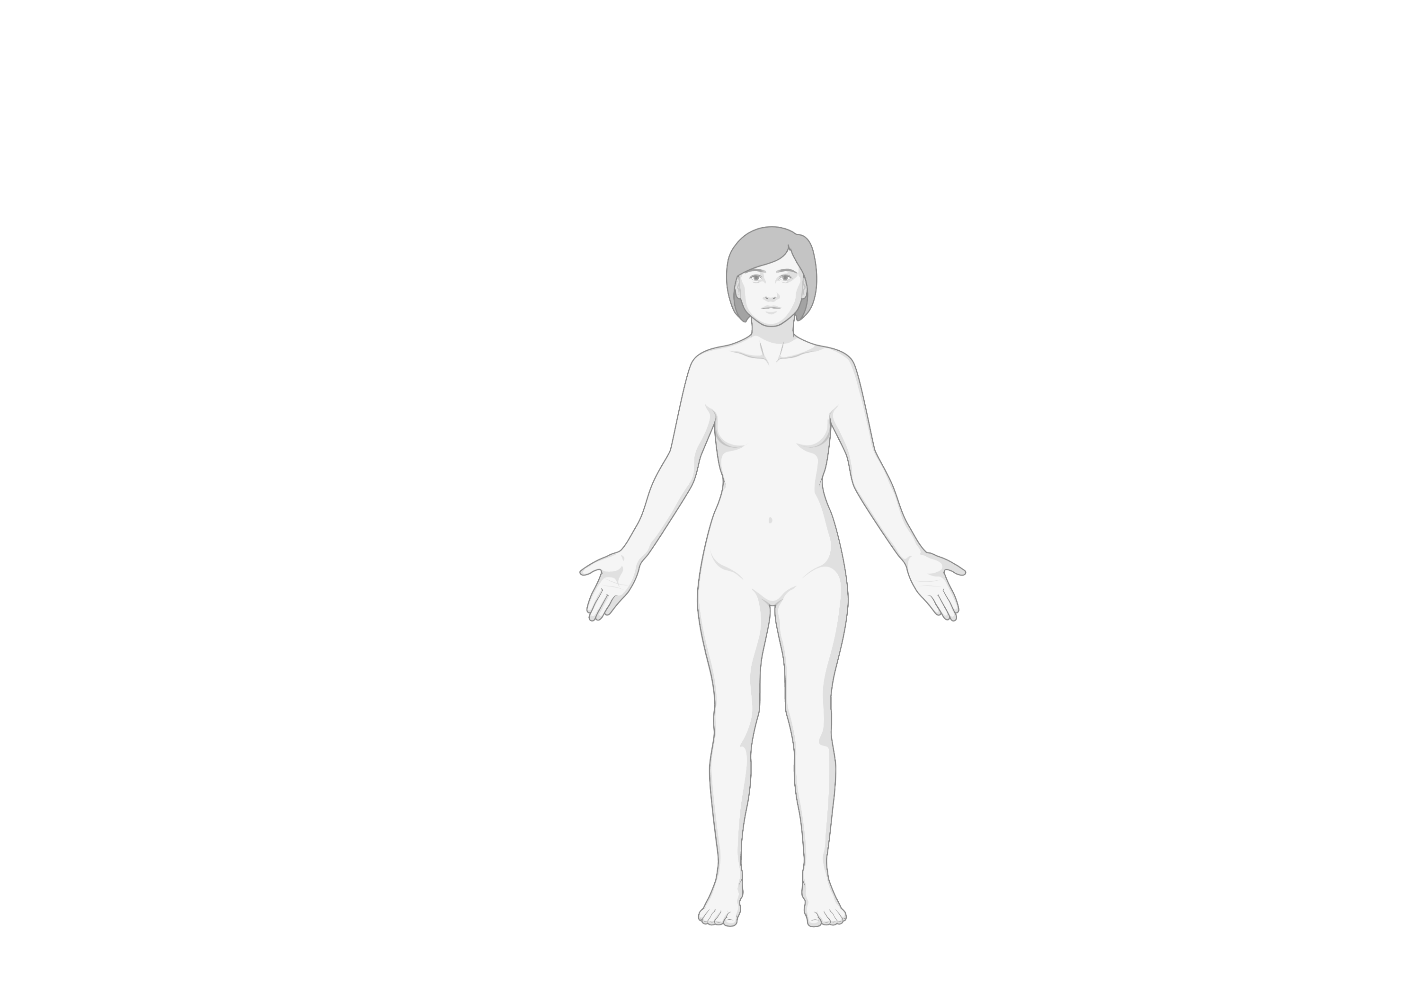
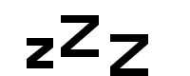
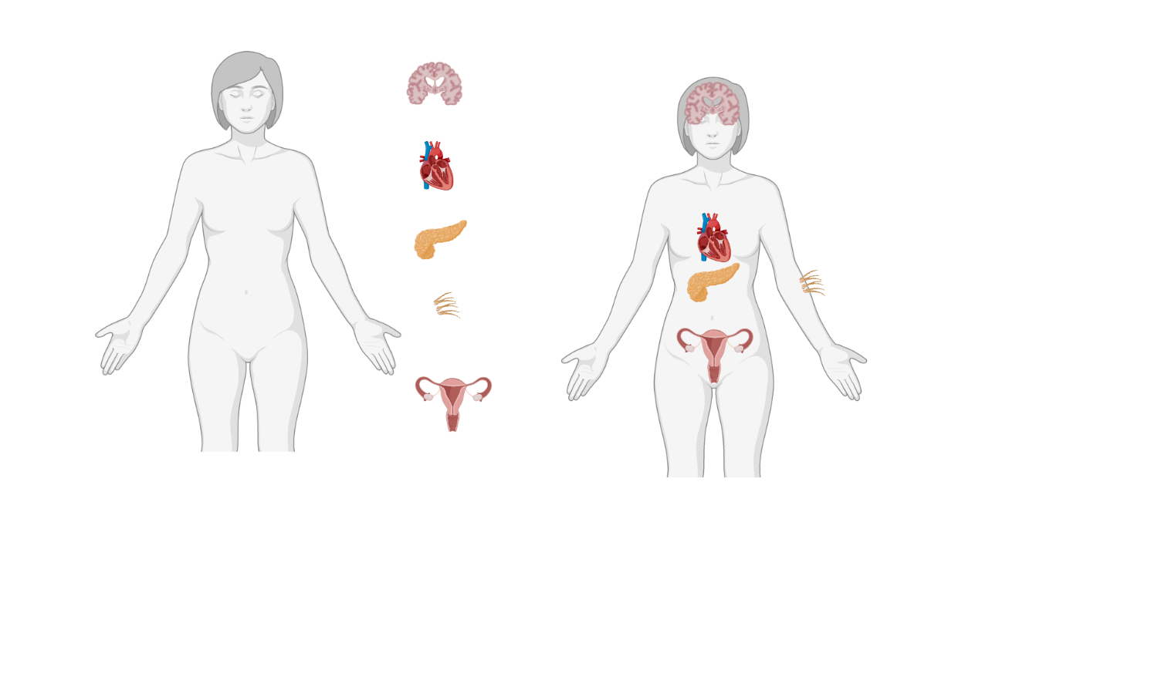

Definitions & Diagnoses
Menopausal Transition (Perimenopause)
47 yo woman with hypothyroidism and asthma presents with hot flashes and difficulty sleeping. Her menses previously occurred every month. Now they occur every 2-4 months with heavy flow.
What additional work-up is indicated?
Peri-menopause
What additional work-up is indicated?
Rule out malignancy in patients with heavy bleeding!
Otherwise, no work-up to confirm diagnosis
Menopause
Hormone Therapy (MHT)
How would you manage her symptoms of perimenopause?
How would you manage her symptoms of perimenopause?
Mood Changes & Sleep Disturbance
Hot Flashes
Cases
Mood Changes & Sleep Disturbance
Hot Flashes
1. Lifestyle measures
Avoid hot rooms, hot drinks, EtOH, caffeine and cigarettes.
Carry a fan & wear layers.
Weight loss & exercise.
Menstrual Irregularity
Menstrual Irregularity
Menopausal hormone therapy
(IUD or combined oral contraceptives)
2. SSRI or SNRI, gabapentin
3. Menopausal hormone therapy (MHT) for hot flashes

Slide 5
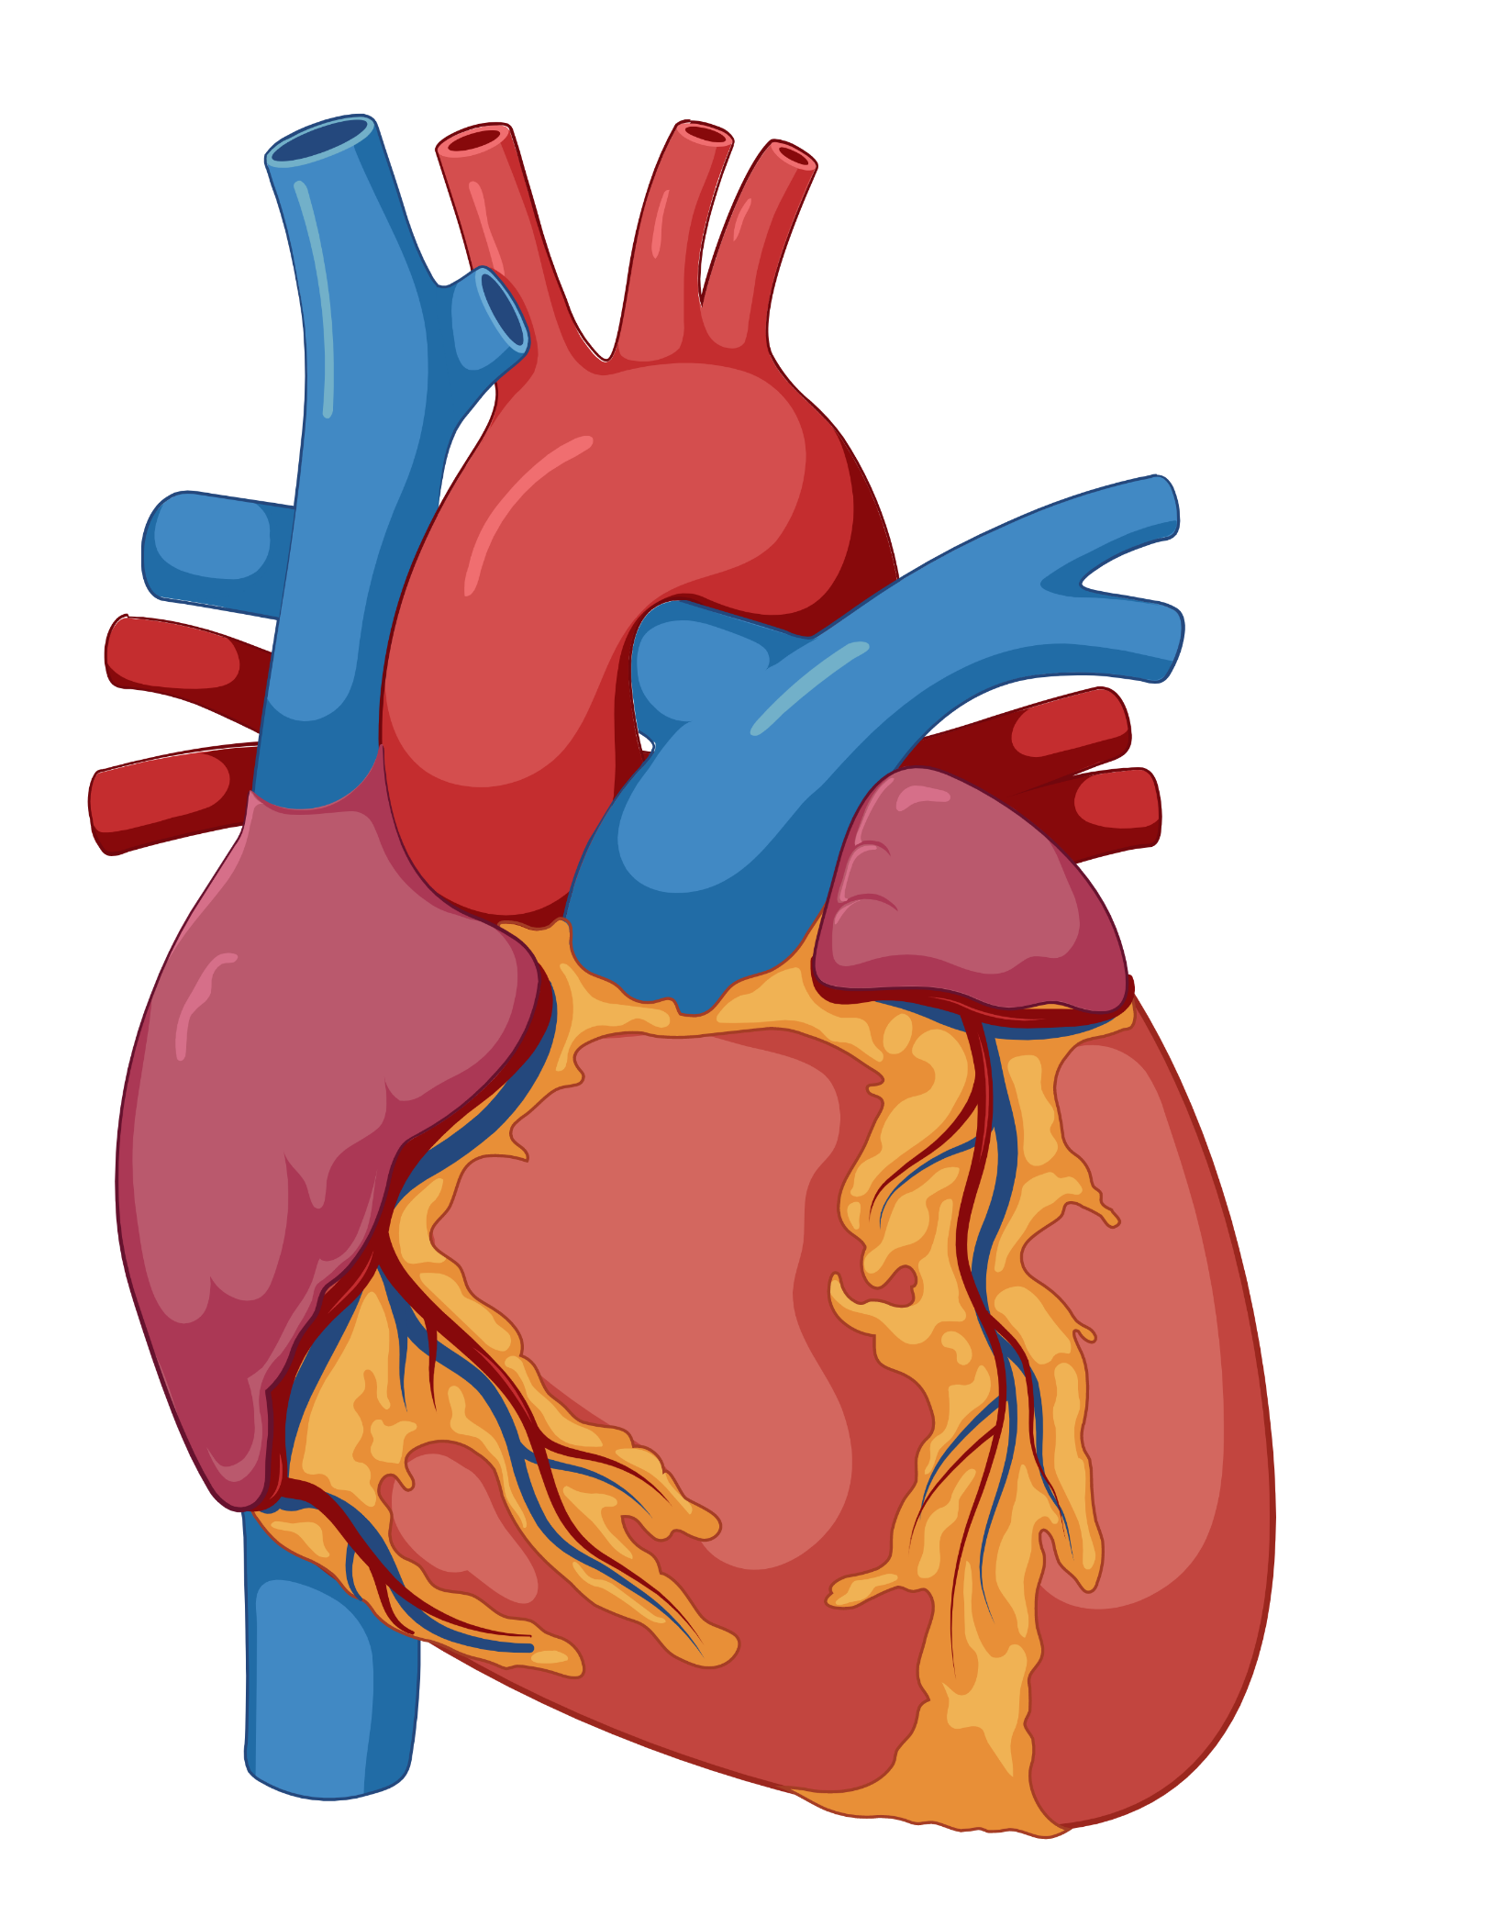
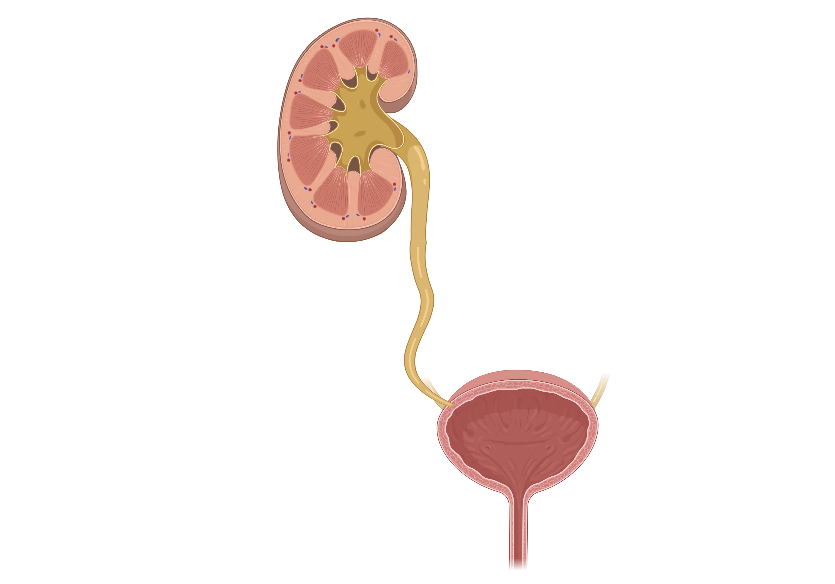
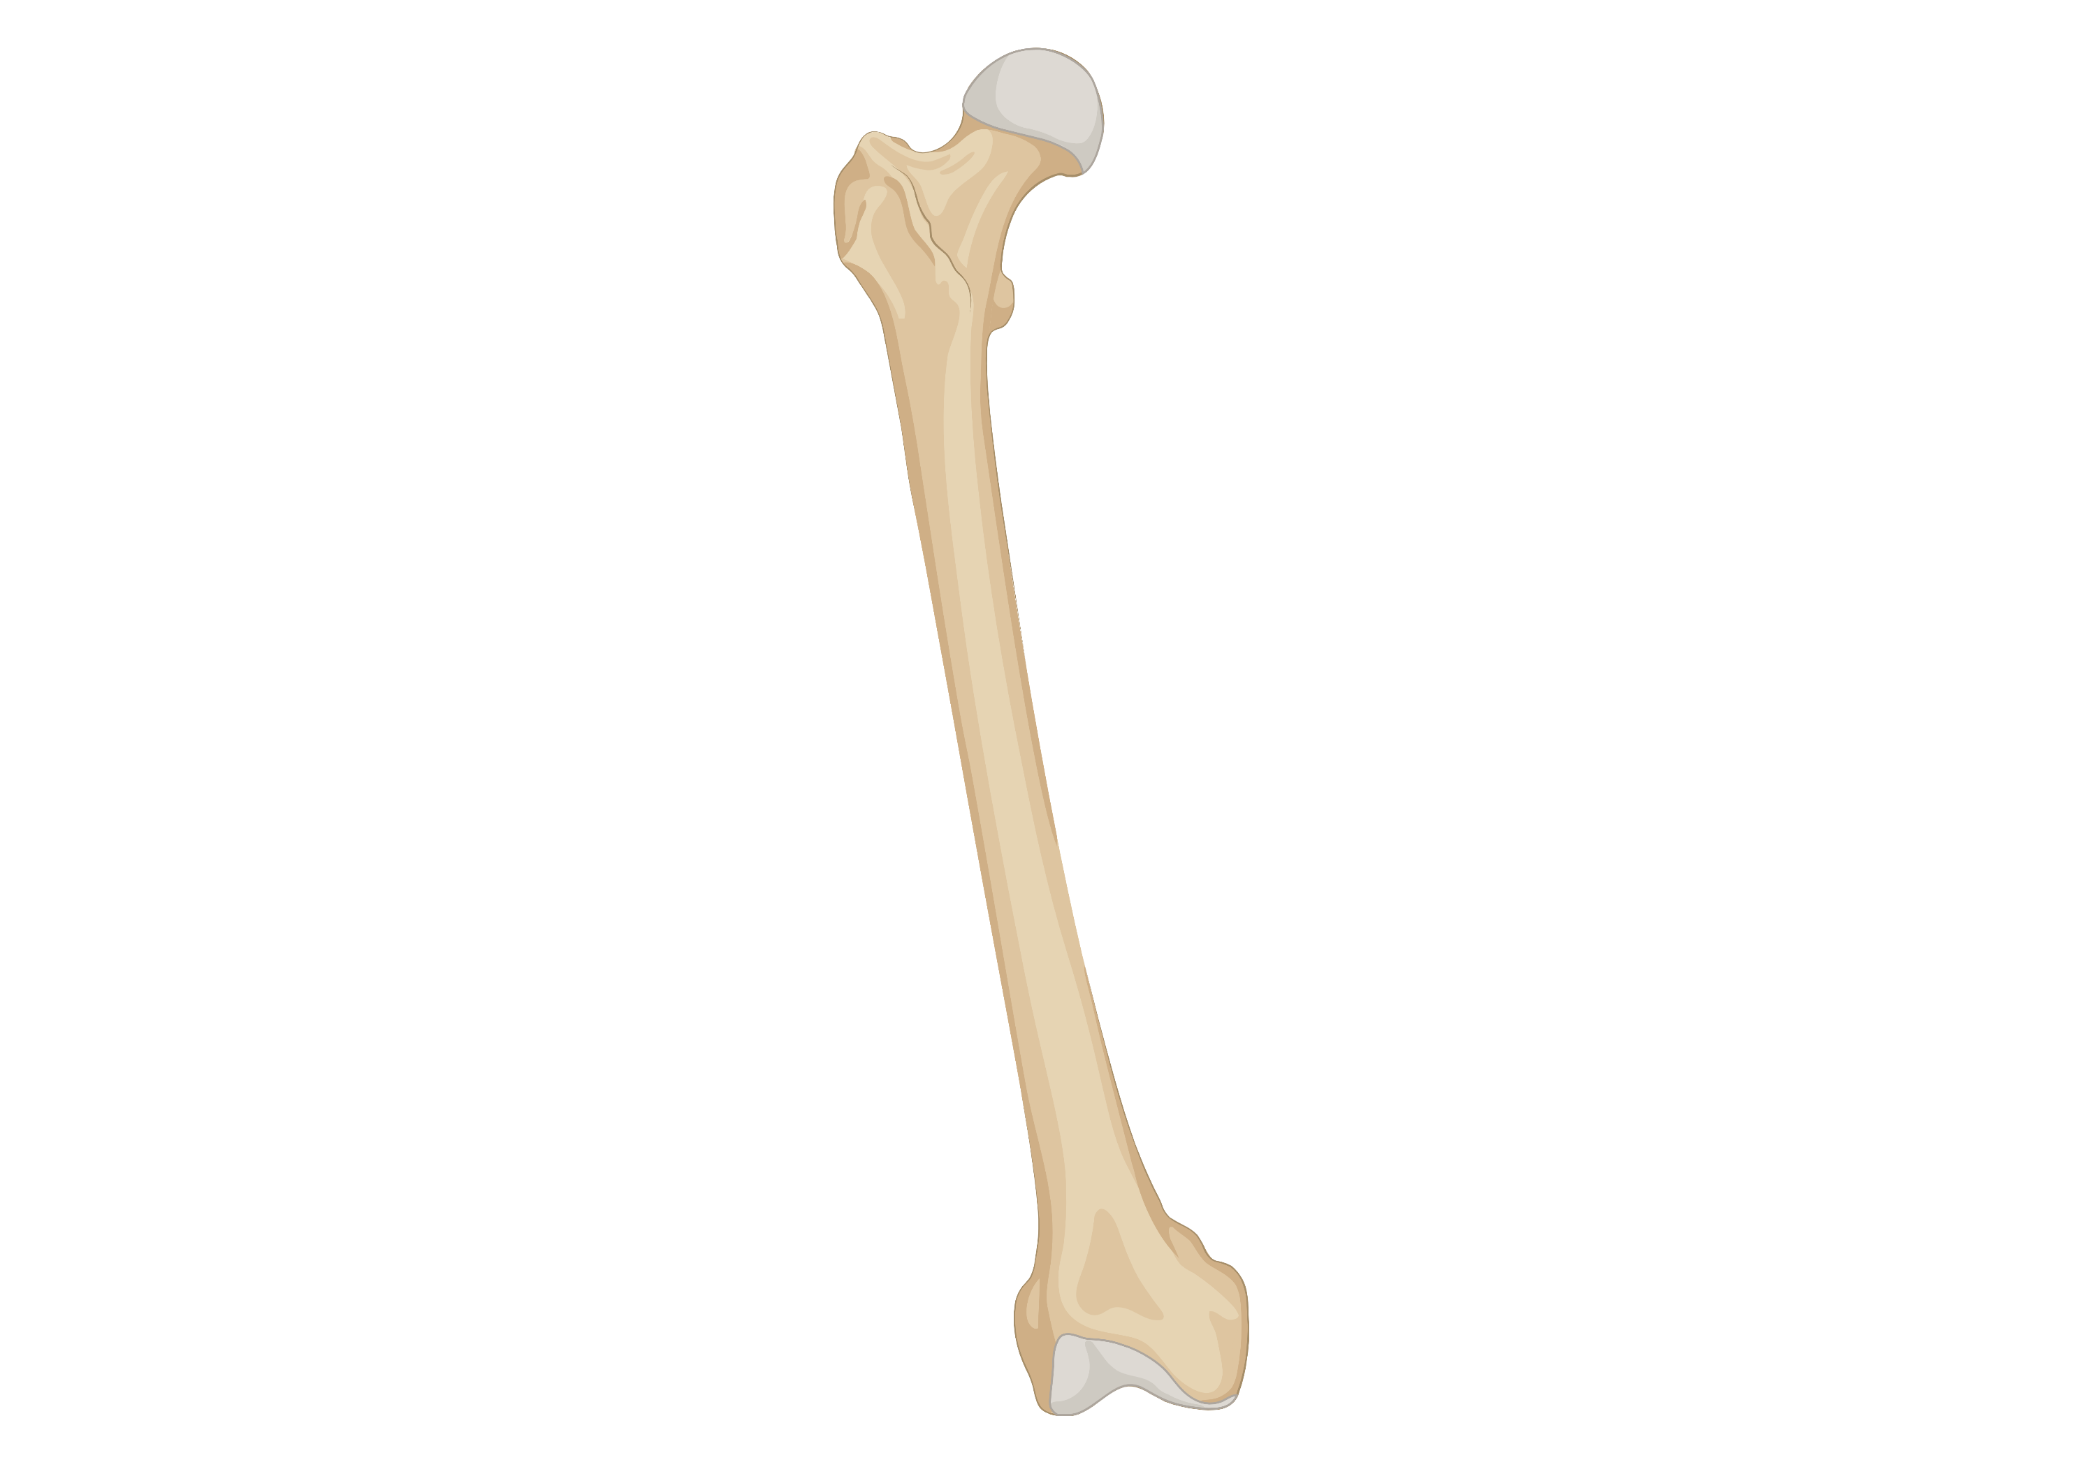
Definitions & Diagnoses
Menopause
51yo woman presents with hot flashes and a depressed mood. Her last menses was 14 months ago and was preceded with two years of irregular menses.
What additional work-up is indicated?
What additional work-up is indicated?
Peri-menopause
None!
Menopause
What complications is she at risk for? How would you manage them?
What complications is she at risk for? How would you manage them?
How would you manage her symptoms?
How would you manage her symptoms?
Hormone Therapy (MHT)
Mood Changes, Sleep Disturbance,
&
Hot Flashes (early)
Mood Changes, Sleep Disturbance,
&
Hot Flashes (early)
Atherosclerosis
Atherosclerosis
Cases
Primary prevention with:
Lifestyle modifications
± statin by ASCVD risk
Lifestyle changes
MHT (for hot flashes)
SSRI or SNRI
Vaginal dryness/ Dyspareunia
UTIs & LUTS
Vaginal dryness/ Dyspareunia
UTIs & LUTS
Osteoporosis
Osteoporosis
Primary prevention with:
Calcium, vitamin D, exercise
Smoking cessation
↓ EtOH
From vaginal atrophy
Vaginal moisturizers, lubricants, topical estrogen

Slide 6



Definitions & Diagnoses
Menopausal Hormone Therapy (MHT)
Who is a candidate?
Who is a candidate?
Duration of therapy?
Duration of therapy?
Hormone Therapy (MHT)
Moderate to severe hot flashes
Within 10 y of menopause OR < 60 y of age
5-10 y
Re-evaluate risk/benefit yearly
Risk/Benefit
What is used for MHT?
Estrogen
±
Estrogen
Progesterone
Progesterone
Cases
Oral
Oral
Transdermal
Transdermal
Vaginal
Vaginal
For all patients with an intact uterus
Fem-ring
Low-dose
VTE/thrombophilia
±
High ASCVD
Known CHD/ CVA
Mod ASCVD
±
Preferred
±
Breast cancer
Endometrial cancer
= contraindicated
Migraines
±
Preferred
±
±
= discuss risks/benefits
Active liver Disease
= safe
Vulvovaginal atrophy
Preferred
Notes:
Endocrine Society's 2015 Clinical Practice Guideline, which suggests calculating cardiovascular and breast cancer risks before initiating MHT
Treatment of Symptoms of the Menopause: An Endocrine Society Clinical Practice Guideline. Stuenkel CA, Davis SR, Gompel A, Lumsden MA, Murad MH, Pinkerton JV, Santen RJ. J Clin Endocrinol Metab. 2015;100(11):3975. ’
Transdermal preferred for mod ASCVD, migraines, VTE (just in general) if not cost prohibitive
Decmpensated cirrhosis – should not use estrogen

Slide 7








Definitions & Diagnoses
Menopause Hormonal Therapy (MHT)
For 50-59 yo
Hormone Therapy (MHT)
Estrogen only
Estrogen + Progesterone
-5.5
fewer cases
Coronary Heart Disease
+2.5
additional cases
Coronary Heart Disease
Risk/Benefit
-2.5
fewer cases
Breast Cancer
+3
additional cases
Breast Cancer
Cases
-0.5
fewer cases
CVA
+2.5
additional cases
CVA
+1.5
additional cases
PE
+3
additional cases
PE
0
additional cases
Endometrial Cancer
0
additional cases
Endometrial Cancer
-4.9
fewer cases
Hip fractures
-5.9
fewer cases
Osteoporotic fractures
-5.5
fewer cases
All cause mortality
-5.5
fewer cases
All cause mortality
# affected per 1000 women
(per 5 y of MHT)
Base incidence of each condition varies and is not represented
Notes:
Endocrine Society's 2015 Clinical Practice Guideline, which suggests calculating cardiovascular and breast cancer risks before initiating MHT
Treatment of Symptoms of the Menopause: An Endocrine Society Clinical Practice Guideline. Stuenkel CA, Davis SR, Gompel A, Lumsden MA, Murad MH, Pinkerton JV, Santen RJ. J Clin Endocrinol Metab. 2015;100(11):3975.
People

Slide 8
Definitions & Diagnoses
Case 1
Case 2
Case 3
45 yo woman with no PMH presents to clinic with 3 months of amenorrhea, fatigue, and hot flashes.
50 yo woman presents with heavy bleeding. Her periods used to last 3-4 days every month, recently they have been lasting 10-18 days and she has needed to change her sanitary pad every 1-2 hours.
49 yo woman with a history of DM, HTN, PAD, tobacco use disorder presents with menopause and asks about hormonal therapy to manage hot flashes.
Hormone Therapy (MHT)
What are your first steps in evaluation?
What lifestyle interventions will you discuss to improve hot flashes?
Cases
How will you evaluate her menorrhagia?
Pregnancy test – women in their 40s are among the highest “at risk group” (second most at risk group) for unplanned pregnancies
Consider TSH and prolactin (see AUB talk)
1-3
Pelvic exam, transvaginal US ± endometrial bx to rule out endometrial cancer.
Consider FSH, prolactin, TSH to evaluate for perimenopause and thyroid disease.
Avoid hot rooms, hot drinks, EtOH, caffeine and cigarettes.
Carry a fan & wear layers.
Weight loss & exercise.
4-6
Workup for other causes are negative, how will you manage her menorrhagia?
Would you recommend MHT?
You suspect perimenopause. What medications are most effective for hot flashes?
No, MHT is contraindicated in PAD.
HTN, DM, and tobacco are all moderate risk when assessed individually, but are high risk in combination.
Progesterone IUD or OCPs to manage her peri-menopausal menorrhagia
MHT with estrogen and progesterone (if intact uterus).
How will you counsel on the risks of MHT?
She is interested in using combined OCPs. What are contraindications to use in perimenopause?
What other medications may be helpful for her hot flashes?
Risk of breast cancer, VTE, ACS, stroke.
Plan to stop 5 to 10 years later.
SNRI/SSRI. Venlafaxine and escitalopram are the most studied.
Gabapentin, pregabalin > clonidine are other options.
She is sexually active with men. How else will you counsel her?
Risk factors for CVD (e.g. smoking, obesity, HTN, DM)
History of VTE
Migraines w/ aura
Breast cancer.
If she desires to avoid pregnancy, discuss contraception options with patient. (IUD OK to age 55, OCPs to age 51)

Slide 9
Definitions & Diagnoses
Case 4
Case 5
Case 6
48 yo woman with a history of migraine with aura presents with severe hot flashes.
50 yo woman with a history of TAH (hysterectomy) who presents with hot flashes not responsive to conservative measures. Her ASCVD risk if 7.5%.
52 yo woman with a history of breast cancer and frequent UTIs, dyspareunia not responsive to non-hormonal therapies.
Hormone Therapy (MHT)
What formulation of MHT would you recommend, if any?
What formulation of MHT would you recommend, if any?
What formulation of MHT would you recommend, if any?
Cases
Transdermal estrogen (given migraine with aura) + progesterone.
Given her history of breast cancer, systemic hormonal therapies are contraindicated. Discuss low dose vaginal estrogen with her oncologist.
1-3
Transdermal estrogen (given moderate ASCVD risk). Progesterone is not needed given history of hysterectomy.
What risks and benefits are associated with this regimen?
4-6
What risks and benefits are associated with this regimen?
What risks and benefits are associated with this regimen?
Slight ↑ risk of breast cancer.
Slight ↓ risk of fracture, all cause mortality.
No significant risks.
Slight ↓ risk of CAD, CVA, breast cancer, fracture, and mortality.
Risk of small amount of systemic absorption. Limited data does not show ↑ risk of cancer recurrence, but this should still be discussed with oncology prior to initiation.
May interfere with aromatase inhibitor efficacy.

Slide 10
Newer Context (2022–2025)
2022 Menopause Society (NAMS) HT Position Statement — reaffirms the deck's rule
Benefits of hormone therapy outweigh risks for most healthy symptomatic women <60 yr OR <10 yr post-menopause; HT remains most effective for VMS and genitourinary syndrome of menopause (GSM), and prevents bone loss/fracture. (NAMS rebranded “The Menopause Society,” 2023.)
New nonhormonal NK-receptor antagonists for moderate–severe hot flashes
Fezolinetant (Veozah), NK3 antagonist — FDA May 2023 (SKYLIGHT trials). FDA later warned of rare serious liver injury → check LFTs at baseline & periodically.
Elinzanetant (Lynkuet), dual NK1/NK3 antagonist — FDA Oct 2025 (OASIS trials); ~73% VMS reduction, also improves sleep.
2023 Menopause Society Nonhormone Therapy Position Statement
Endorses SSRIs/SNRIs, gabapentin, fezolinetant, CBT, and clinical hypnosis; oxybutynin an option. Vaginal estrogen remains preferred for isolated GSM (minimal systemic absorption).
Sources: NAMS HT Position Statement, Menopause 2022;29(7):767; FDA May 2023 (fezolinetant) & Oct 2025 (elinzanetant); NAMS Nonhormone Statement, Menopause 2023;30(6):573. Standing framework unchanged.

Slide 11
Take-Home Points
Menopause is primarily a CLINICAL diagnosis based on age and symptoms; lab testing (hCG, TSH, prolactin ± FSH) is for women <45, or atypical features. FSH is a poor single marker.
Clinical features: menstrual irregularity, vasomotor symptoms (hot flashes), mood/sleep changes, and genitourinary symptoms (dryness, dyspareunia, recurrent UTIs).
Menopausal hormone therapy is the MOST effective treatment for moderate–severe hot flashes; risks are low with good selection (<60 yr or <10 yr post-menopause). Add progesterone whenever the uterus is intact.
Transdermal estrogen has lower VTE/stroke risk than oral (preferred for moderate ASCVD risk, migraine). Vaginal estrogen is preferred for isolated GSM.
Nonhormonal options: SSRI/SNRI (venlafaxine, escitalopram, paroxetine), gabapentin, and now NK-antagonists (fezolinetant, elinzanetant).

Slide 12
Attribution & Changelog
Adapted from TeachIM.org — “Menopause” (Molly Brett MD; sec. ed. Adelaide McClintock MD; exec. ed. Yilin Zhang MD; published Feb 2022).
https://teachim.org/teaching_material/menopause/ · Licensed CC BY-NC 4.0 (non-commercial, attribution required).
Optimized 2026-06-11. No projected-text errors found in the 9-slide board → append-only edit. All click-to-reveal animations & graphics preserved.
Added a newer-context slide (2022 NAMS HT statement; fezolinetant 2023; elinzanetant 2025; 2023 nonhormone statement) — standing teaching unchanged.
Companion files: Menopause-Guide-final.docx (teaching guide); Handout-learner-menopause.pdf. Educational use only — clinician-review before teaching.

