Slide 1
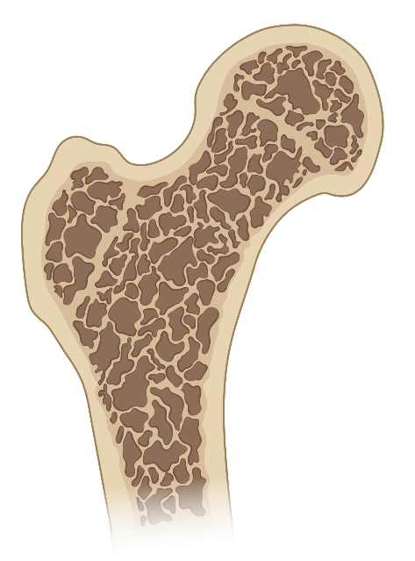

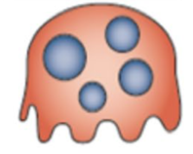
Romosozumab
Example | Romosozumab/ Evenity (SQ inj monthly)
Best candidate | 3rd line T < -3.0 or T< -2.5 with vertebral fracture
Side effects | Hypocalcemia Arthralgias Do not use in CVD
Bisphosphonate
Example | Alendronate (PO weekly) Ibandronate (PO monthly) Zoledronic acid (IV yearly)
Best candidate | 1st line for most people, GFR >35
Side effects | Hypocalcemia Esophagitis Atypical femur fracture (AFF) Osteonecrosis of jaw (ONJ)
Monitoring | Consider drug holiday after 3-5 years
Teriparatide
Example | Teriparatide/Forteo (SQ inj daily)
Best candidate | 3rd line T< -3.0 or T < -2.5 with vertebral fracture
Side effects | Hypercalcemia Arthralgias Nausea
Osteoclast
Resorbs Bone
RANK
Osteoblast
Builds bone
SERMs
Example | Raloxifene/Evista (PO daily)
Best candidate | Rarely used; Consider in post-menopausal women, can’t take bisphosphonate or denosumab, high risk for breast cancer
Side effects | Risk of DVT
Denosumab
Example | Denosumab/Prolia (SQ inj every 6 months)
Best candidate | 2nd line; can’t tolerate or fracture on bisphosphonate; use if GRF <35
Side effects | Rapid bone loss and increased risk of vertebral fractures after discontinuation

