Slide 1

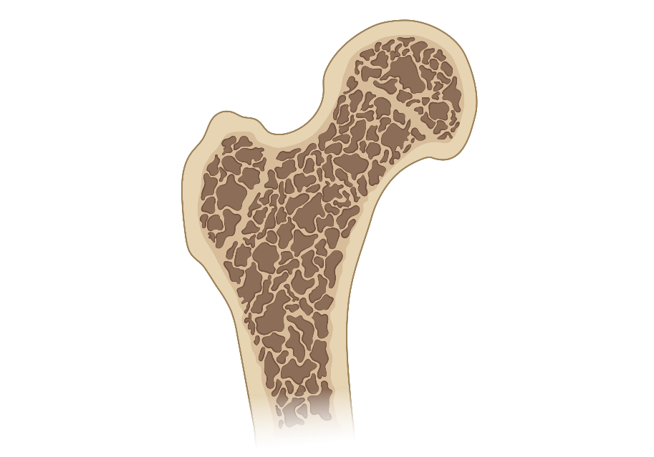

Burden of disease
Screening
Osteoporosis
Diagnostic Criteria
Treatment
Cases
What is osteoporosis?
Low bone mass + Microarchitectural destruction
Skeletal fragility
Notes:
Osteoporosis

Slide 2
Prevalence
Burden of disease
What percent of people over the age of 50y have osteoporosis?
Screening
What percent of people over the age of 50y have osteoporosis?
Diagnostic Criteria
Treatment
~20% of women
~5% of men
Cases
Complications
Prevention
Hip Fracture:
1-year mortality and likelihood of returning to independent living?
RRR and NNT to prevent osteoporotic fracture with bisphosphonates
Hip Fracture:
1-year mortality and likelihood of returning to independent living?
RRR and NNT to prevent osteoporotic fracture with bisphosphonates
1 year mortality ~25%
Return to independence ~50%
RRR: ~ 40% for spin or hip fx
NNT: ~100 for hip & ~ 15 spine
Barrionuevo, 2019; Wells, 2008
Notes:
RRR data
Patricia Barrionuevo, Ekta Kapoor, Noor Asi, Fares Alahdab, Khaled Mohammed, Khalid Benkhadra, Jehad Almasri, Wigdan Farah, Maria Sarigianni, Kalpana Muthusamy, Alaa Al Nofal, Qusay Haydour, Zhen Wang, Mohammad Hassan Murad, Efficacy of Pharmacological Therapies for the Prevention of Fractures in Postmenopausal Women: A Network Meta-Analysis, The Journal of Clinical Endocrinology & Metabolism, Volume 104, Issue 5, May 2019, Pages 1623–1630, https://doi.org/10.1210/jc.2019-00192
NNT data
wells GA, Cranney A, Peterson J, et al. Alendronate for the primary and secondary prevention of osteoporotic fractures in postmenopausal women. The Cochrane database of systematic reviews. 2008;(1):CD001155. doi:10.1002/14651858.CD001155.pub2
https://www.eurospinepatientline.org/en/osteoporosis---introduction.htm
1 rib fracture →10% mortality
3-4 rib fracture → 20% mortality
6 rib fracture → 33% mortality

Slide 3
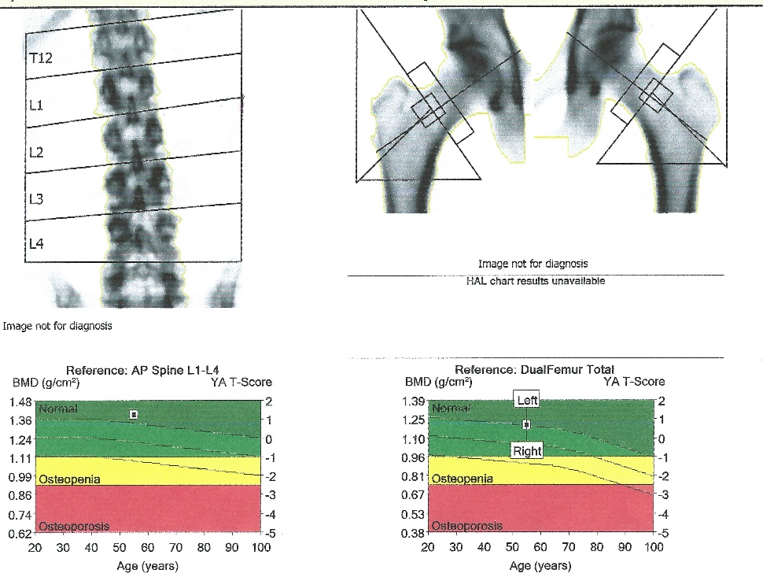
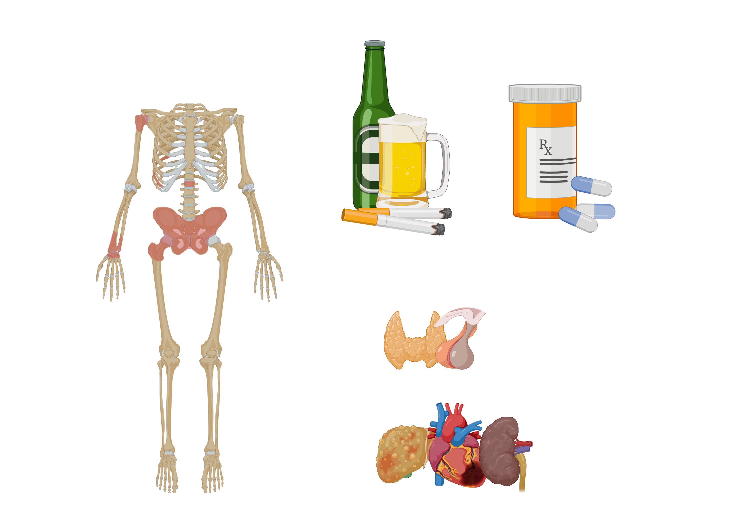
Who should be screened?
Burden of disease
Who should be screened?
DXA
Screening
Women ≥ 65 years old.
Postmenopausal women <65 with at least 1 risk factor (consider using FRAX calculator)
Consider for men with major risk factors.
Diagnostic Criteria
Treatment
Cases
Major risk factors
Major risk factors
hint: included in FRAX calculator
Substances
Endocrinopathies
Chronic disease/ Malignancy
Substances
Active tobacco use
Alcohol use (>2 drinks/d)
Endocrinopathies
Premature menopause
Hypogonadism
Hyperparathyroidism, T1DM, Cushing’s
Chronic disease/ Malignancy
Malabsorption, celiac disease, IBD
Rheumatoid arthritis
Chronic liver disease
CKD
HIV
Multiple myeloma
Medications
Other
Medications
Corticosteroids (>20mg x 3mo)
Aromatase inhibitors
Androgen deprivation
Anti-epileptics
Other
Low BMI/ Anorexia
Family hx hip fracture
Previous fracture

Slide 4
Burden of disease
What are the 3 ways to diagnose osteoporosis?
What are the 3 ways to diagnose osteoporosis?
What are the 3 ways to diagnose osteoporosis?
Screening
Diagnostic Criteria
1
T-score
Secondary eval
Treatment
Cases
Fragility Fracture
2
3
FRAX score

Slide 5
Burden of disease
What are the 3 ways to diagnose osteoporosis?
Screening
Classification | T-score on DXA
Normal | > -1.0
Osteopenia (LBM) | -1.0 to -2.5
Osteoporosis | < -2.5
Diagnostic Criteria
1
T-score
Secondary eval
Treatment
Cases
Fragility Fracture
2
3
FRAX score
Notes:
Why do we use T-score and not Z-score (Age-matched)

Slide 6
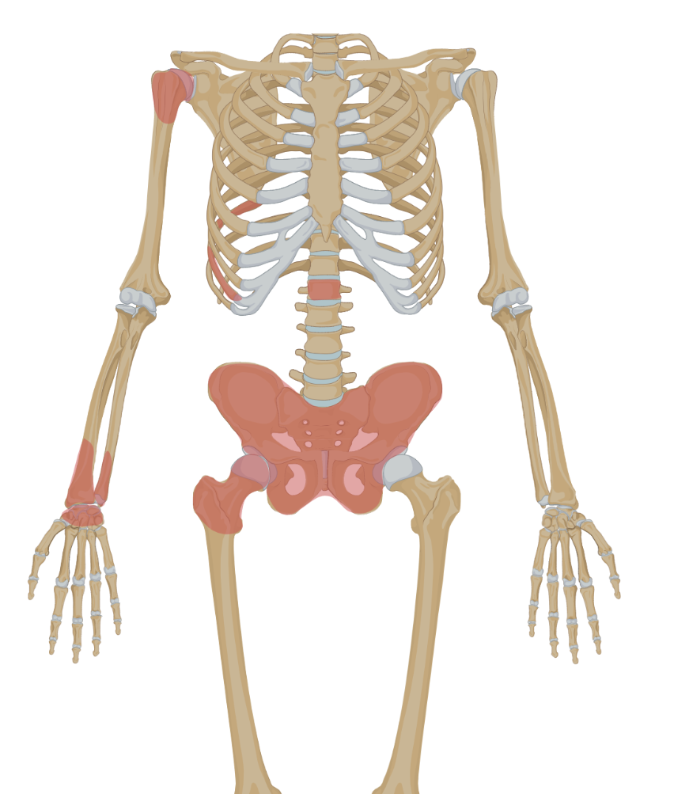
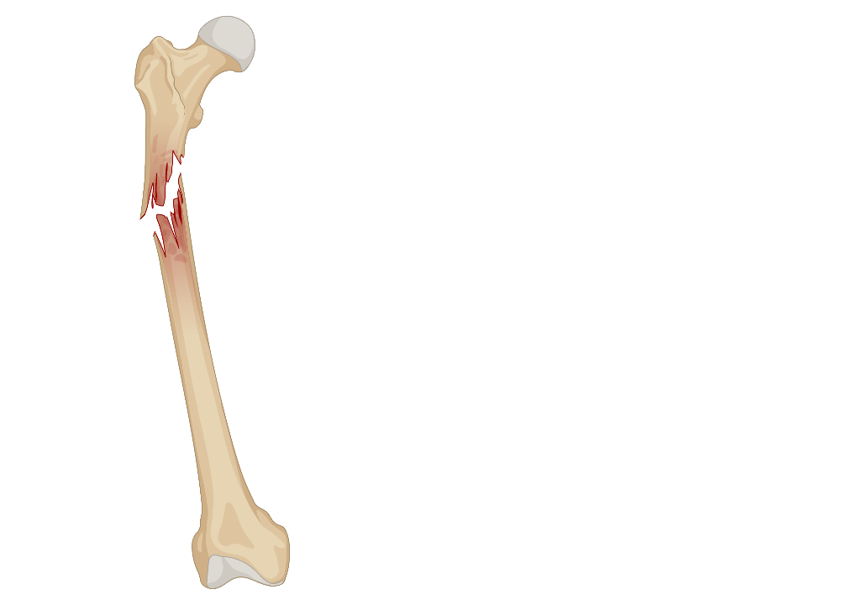
Burden of disease
What are the 3 ways to diagnose osteoporosis?
Screening
Diagnostic Criteria
A fracture that occurs spontaneously or with minor trauma (e.g., GLF)
1
T-score
Secondary eval
Treatment
humerus
Cases
Fragility Fracture
2
ribs
spine
pelvis
wrist
3
FRAX score
hip

Slide 7
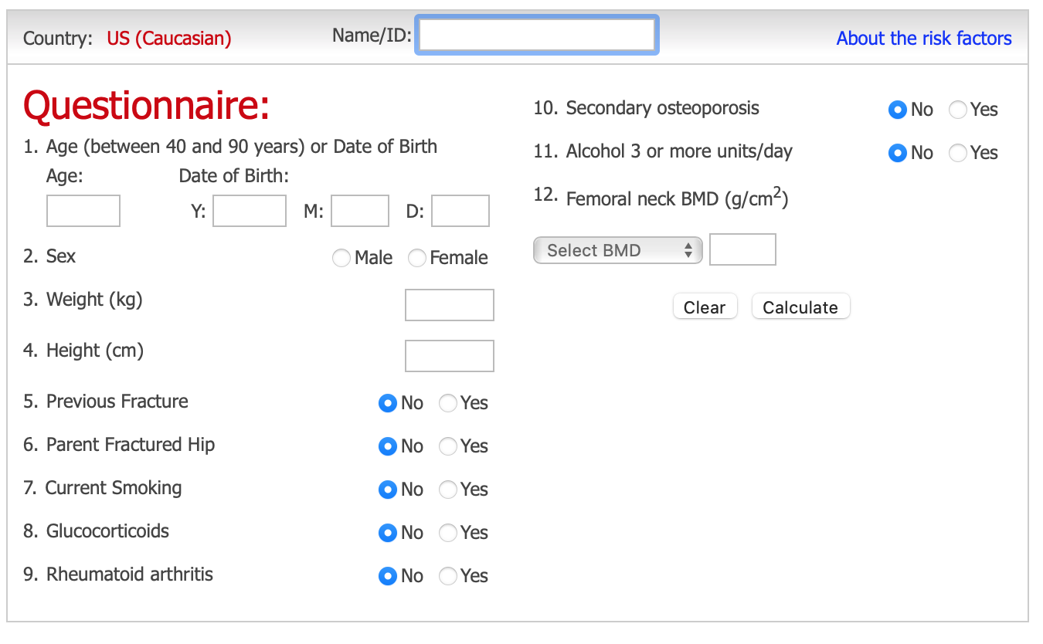
Burden of disease
What are the 3 ways to diagnose osteoporosis?
Screening
Diagnostic Criteria
1
T-score
Secondary eval
Treatment
Cases
Fragility Fracture
2
3
FRAX score
>20% risk of any fracture
OR
>3% risk hip fracture over 10 years

Slide 8
Burden of disease
Of those diagnosed, who needs a secondary work-up?
Women?
Men?
Screening
Women
Men
Diagnostic Criteria
Pre-menopausal
All men.
Especially if unexplained by comorbidities or <50 years
Secondary eval
Treatment
Initial evaluation?
Initial evaluation
Cases
CBC, CMP, Mg, Phos
Vitamin D-25OH
Testosterone (men)
Subsequent testing?
Subsequent testing
Dictated by initial labs and/or clinical evaluation
FSH/LH
Estradiol
women)
TSH
Intact PTH
Cushing’s screen
Prolactin
Celiac panel
ESR, Ferritin
SPEP/UPEP

Slide 9
Burden of disease
Primary Interventions
Targeted Therapies
Screening
Diagnostic Criteria
Treatment
Algorithm
Cases

Slide 10
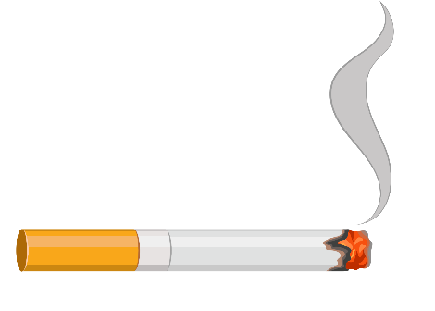
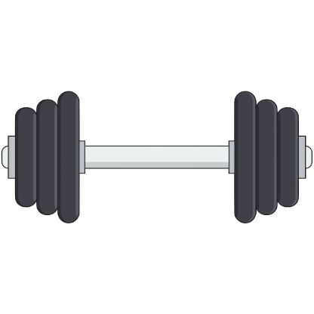
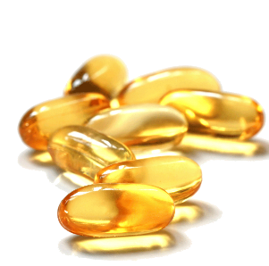
Burden of disease
Primary Interventions
Targeted Therapies
Screening
Diagnostic Criteria
Treatment
Ca²⁺
Algorithm
Cases
Vitamin D
800 IU daily
(50,000 IU qWeek if Vit D <40)
Calcium
1200 mg daily
(ideally from diet)
Smoking Cessation
Weight-bearing exercise

Slide 11

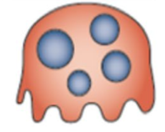
Burden of disease
Primary Interventions
Targeted Therapies
Screening
Bisphosphonate
Diagnostic Criteria
Osteoclast
Resorbs Bone
Treatment
Algorithm
Anabolics
Cases
RANK
Osteoblast
Builds bone
Denosumab
SERMs

Slide 12
Burden of disease
Primary Interventions
Targeted Therapies
Screening
Bisphosphonate
Diagnostic Criteria
Osteoclast
Resorbs Bone
Treatment
Alendronate (PO weekly) Zoledronic acid (IV yearly)
1st line for most, GFR >35
Adverse effects: Esophagitis (PO) Hypocalcemia Atypical femur fracture Osteonecrosis of jaw
Consider drug holiday after 5 years (PO) or 3 years (IV)
Algorithm
Anabolics
Cases
RANK
Osteoblast
Builds bone
Denosumab
SERMs

Slide 13
Burden of disease
Primary Interventions
Targeted Therapies
Screening
Bisphosphonate
Diagnostic Criteria
Osteoclast
Resorbs Bone
Treatment
Algorithm
RANK-L
Anabolics
Cases
Denosumab
RANK
Osteoblast
Builds bone
Denosumab/Prolia (SQ Q6 months)
2nd line, lifetime therapy Intolerant or refractory to bisphosphonate GFR <35
Rapid bone loss and increased risk of vertebral fractures after discontinuation
Denosumab
SERMs

Slide 14
Burden of disease
Primary Interventions
Targeted Therapies
Screening
Bisphosphonate
Romosozumab (SQ monthly) Teriparatide (SQ daily)
3rd line; severe osteoporosis (T < -3) or T < -2.5 + fragility fracture
Diagnostic Criteria
Osteoclast
Resorbs Bone
Treatment
Algorithm
Anabolics
Cases
RANK
Osteoblast
Builds bone
Denosumab
SERMs

Slide 15
Burden of disease
Primary Interventions
Targeted Therapies
Screening
Bisphosphonate
Diagnostic Criteria
Osteoclast
Resorbs Bone
Treatment
Algorithm
Anabolics
Cases
RANK
Osteoblast
Builds bone
Denosumab
SERMs
Raloxifene/Evista (PO daily)
Rarely used, typically 5 year duration Selective estrogen receptor modifier Consider in post-menopausal women who can’t take bisphosphonate/ denosumab and/or high risk for breast cancer
Adverse effects: ↑ risk of DVT, hot flashes

Slide 16
Burden of disease
1. Obtain screening DXA
2. Determine FRAX score
Screening
T score
- 1.5
- 2.0
- 2.5
- 3.0
Diagnostic Criteria
Low risk
Low-Mod risk
Moderate risk
High risk (Osteoporosis)
Fragility fracture
FRAX 10y risk of major >10% or hip >3%
Low risk
Low-Mod risk
Moderate risk
High risk (Osteoporosis)
Severe osteoporosis
Severe osteoporosis
Treatment
Algorithm
Repeat DXA in 15y
Repeat DXA in 5y
If RFs persists, repeat DXA in 1y
Bisphosphonate
Cases
Bisphosphonate
contraindicated
Re-assess BMD
5 years (PO) or 3 years (IV)
Re-assess BMD
5 years (PO) or 3 years (IV)
Consult Endo
to consider Denosumab or
Anabolic
Stable/improved
Worse
Stable/improved
Worse
Drug Holiday
Repeat DXA in 2-4y
Consider continuing for 10 years
Notes:
Fix animations

Slide 17

Burden of disease
For the following clinical situations, when would you consider repeating a DXA scan?
Screening
Diagnostic Criteria
65 year-old with normal DXA (low risk)
Treatment
15 years
Cases
60 year-old with osteopenia T = -2.2 (moderate risk)
DXA
1-2 years.
1-2
Osteoporosis on bisphosphonate (IV)
3-4
3 years
Osteoporosis on bisphosphonate (PO)
5 years
During bisphosphonate holiday
2-4 years

Slide 18
Burden of disease
Case 1
Case 2
Screening
A 72 year-old man is evaluated for a 2-week history of low back pain. He has a history of alcohol and tobacco use disorder (50 pack years) and stage 3 chronic kidney disease.
Weight 70kg, 160cm tall. A lumbar XR shows a compression fracture of L4. A DXA scan shows a T-score of −2.2 in the lumbosacral spine and −1.7 in the left hip.
A 64 year-old woman with a history of hypertension, rheumatoid arthritis, and type II DM is admitted to the hospital after slipping on ice and sustaining a left femoral neck fracture.
Diagnostic Criteria
Treatment
What diagnostic workup should be done?
Cases
What is his FRAX score?
Check vitamin D, BMP, calcium, DXA
10-year risk of: major fracture = 15%; hip fracture = 6.5%
DXA
T-score at femoral neck is -2.7.
What treatment should you start?
What is the diagnosis?
1-2
Calcium, vitamin D, weight bearing exercise, and oral bisphosphonate
Osteoporosis, based on fragility fracture and FRAX score.
(Note DXA T-score of -1.7 is only osteopenic range)
3-4
What are some side effects of bisphosphonates?
Is a secondary work-up indicated?
Esophagitis - take with full glass of water and stand upright >30min to reduce risk.
Osteonecrosis of jaw and atypical fractures are very rare
No. Osteoporosis likely explained by age and identified risk factors (tobacco use, alcohol use).
What is the next step in management?
Encourage smoking cessation, ↓ alcohol intake and ↑ weight-bearing physical activity
Begin vitamin D and calcium supplementation.
Offer oral bisphosphonate
How long do you continue bisphosphonate therapy?
Re-assess BMD in 5 years with DXA scan. If stable, can consider a drug holiday.

Slide 19
Burden of disease
Case 3
Case 4
Screening
A 65 year-old-man with presents to clinic with acute atraumatic lower back pain and fatigue. He has no known chronic medical conditions and has never smoked. Lumbar XR shows a L1 compression fracture.
A 74year-old woman with severe COPD and osteoporosis who presents to clinic following an ED visit for an atraumatic vertebral compression fracture following a coughing spell. Her T-score was -2.8 at femoral neck 5 years ago and she has been on alendronate since. Her repeat DXA reveals T-score of -3.1 at the femoral neck.
Diagnostic Criteria
Treatment
What additional workup is warranted?
He has osteoporosis based on a fragility fracture. Initial work-up should include CBC, CMP, Vit D, Mg, Phos, testosterone (in men) and a DXA scan. TSH and PTH are often checked early.
Cases
What is the next step in management?
DXA
Anabolic agents should be considered when T-score is < -3.0 OR T-score is <-2.5 with a vertebral fracture.
Options include: teriparatide or romosozumab
…His results show the following:
WBC 6.3, Hgb 13.1
Cr 2.4, Ca 10, albumin 2.7, total protein 10.8, ALP 200
TSH: 1.08 | PTH: 27 (15-63) | Vit D: 41
Testosterone: 438 (230-800)
T score at femoral neck = -2.7
1-2
Cr 2.4, Ca 10
3-4
When would you repeat a DXA?
What additional work-up would you order?
2 years
Initial evaluation is unrevealing. Based on his age, hypercalcemia and renal insufficiency, this is likely multiple myeloma (MM). SPEP/UPEP would be next step.
…Her repeat DXA 2 years later is stable with a T-score of -3.0.
He is diagnosed with MM and is started on treatment. What additional therapy is indicated?
What is the next step in management?
Resume bisphosphonate or denosumab
Vitamin D and bisphosphonate are first line therapy.
Likely would avoid calcium with active MM.

Slide 20
Practice Update — ACP 2023 & ASBMR/BHOF 2024
• The deck’s framework is current and reinforced by the 2023 ACP living guideline (Ann Intern Med). Key points to surface:
• Bisphosphonates remain FIRST-LINE: strong recommendation in postmenopausal women, conditional in men with primary osteoporosis.
• Denosumab is SECOND-LINE — for bisphosphonate intolerance/contraindication (e.g., eGFR <35).
• VERY-HIGH-RISK women (e.g., T ≤ −3.5, or T ≤ −2.5 + fragility fracture, recent/imminent fracture): use an anabolic FIRST (romosozumab or teriparatide) THEN follow with a bisphosphonate. Sequence matters — anabolic-first then antiresorptive gives the greater BMD/fracture benefit.
• Never stop denosumab without transitioning to a bisphosphonate — abrupt cessation causes rebound vertebral fractures. Do NOT follow denosumab with a PTH analog.
• Avoid romosozumab if recent MI/stroke (CV signal). Treat-to-target / goal-directed therapy is the emerging frame (ASBMR/BHOF 2024).
Sources: ACP, Ann Intern Med 2023 (M22-1034); ASBMR/BHOF goal-directed position statement, JBMR 2024.

Slide 21
Take-Home Points
• Screen all women ≥65 (and postmenopausal women <65 or men with major risk factors) with DXA. Diagnose osteoporosis by T-score ≤ −2.5, a fragility fracture, or a high FRAX score.
• Counsel everyone on calcium, vitamin D, weight-bearing exercise, and tobacco/alcohol reduction. Most fractures occur in people with T-scores better than −2.5 — use clinical risk, not BMD alone.
• Bisphosphonates are first-line for most (eGFR ≥35). Counsel on rare harms: esophagitis, osteonecrosis of the jaw, atypical femur fracture. Denosumab second-line; anabolics for very-high-risk.
• Consider a drug holiday after 5 yr oral / 3 yr IV bisphosphonate; re-screen during the holiday every 2–4 yr.

Slide 22
Attribution & Optimization Notes
• Adapted from TeachIM.org "Management of Osteoporosis" (Saxon, deQuillfeldt, Jankousky, Guinn, Wagoner; eds. Brett, Fainstad, Zhang). Published Feb 2022, last reviewed Mar 2023.
• teachim.org/teaching_material/management-of-osteoporosis/ — Licensed CC BY-NC 4.0 (attribution, non-commercial). Educational use only; clinician-reviewed.
• Surgical correction to original deck: "Anabolic steroids" → "Anabolic agents" (Case 3, slide 19) — teriparatide/romosozumab are anabolic agents, not anabolic steroids.
• Added (source-cited): ACP 2023 living-guideline update slide (first-/second-line sequencing, anabolic-first for very-high-risk, denosumab transition rule).
• Human review: slide 16 algorithm lists FRAX "major >10%" for the high-risk/treatment node, while the diagnostic slide (7) and take-home use ">20% major or >3% hip". Left unchanged pending clinician confirmation of intended threshold.
• Companion files in package: Facilitator Guide 2023 (DOCX), Learner Handout — Treatment Options (PPTX), Learner Handout — Treatment Pathway (PDF). Optimization run 2026-06-10.

