Slide 1

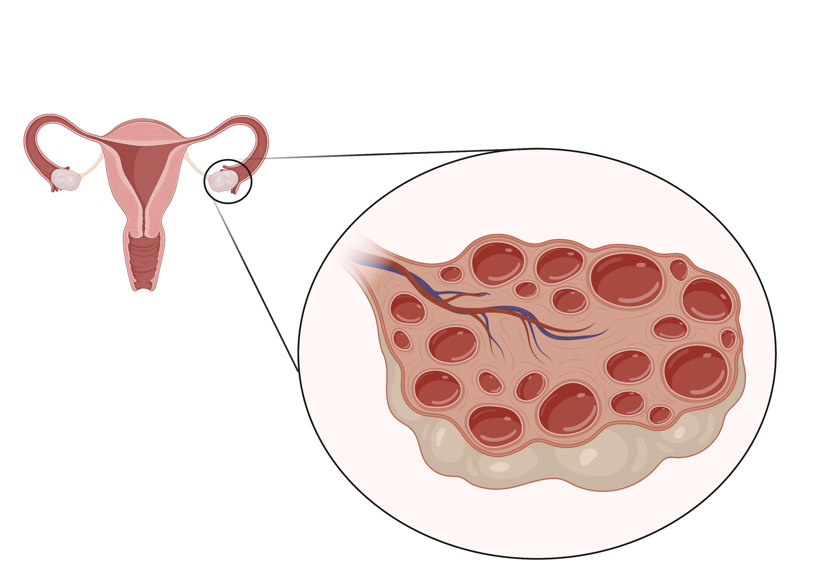

Diagnosis
Polycystic Ovarian Syndrome (PCOS)
DDx and Eval
Associated Co-Morbidities
Cases
Image created with biorender.com

Slide 2
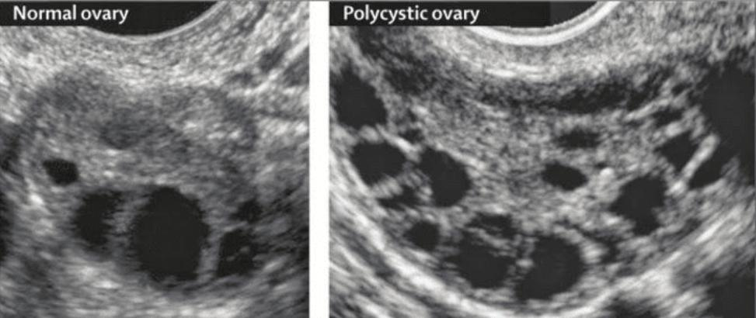
Diagnosis
How do we diagnose PCOS?
DDx and Eval
Rotterdam Criteria
Rotterdam Criteria
We use the to diagnose PCOS.
Associated Co-Morbidities
2
of the 3 criteria are needed for diagnosis
Cases
Clinical OR Biochemical
Clinical: acne, hair loss, hirsutism
Biochemical: ↑ circulating androgen levels
1
1
Hyperandrogenism
Hyperandrogenism
Menstrual irregularities
Chronic anovulation
Oligomenorrhea (cycle >35d)
Amenorrhea (no menses x 3 mos)
2
Menstrual irregularities
2
>12 follicles and/or volume > 10 cc
(seen on pelvic ultrasound)
3
3
Polycystic Ovaries
Polycystic Ovaries
Normal ovary
Polycystic ovary
Notes:
Kiconco S. The Need to Reassess Diagnosis of Polycystic Ovary Syndrome (PCOS): A Review of Diagnostic Recommendations from the International Evidence-Based Guideline for the Assessment and Management of PCOS. Semin Reprod Med. 2021; 31:71-77.
Picture from: Norman RJ, Dewailly D, Legro RS, Hickey TE. Polycystic ovary syndrome. Lancet. 2007 Aug 25;370(9588):685-97. doi: 10.1016/S0140-6736(07)61345-2. PMID: 17720020.

Slide 3
Diagnosis
PCOS is a diagnosis of exclusion!
DDx and Eval
Many conditions mimic signs and symptoms of PCOS.
What other conditions are on your differential?
Associated Co-Morbidities
Total testosterone
Congenital adrenal hyperplasia
Acromegaly
Androgen secreting tumors
Cushing’s syndrome
± 17-OH progesterone
1
1
Hyperandrogenism
Evaluation?
Hyperandrogenism
Cases
± SHBG, DHEAS
Midnight salivary cortisol
Thyroid disorders
Hyperprolactinemia
Endometrial causes (polyp, adenomyosis, leiomyoma, malignancy/hyperplasia)
Perimenopause/ ovarian failure
Pregnancy
Hypothalamic hypogonadism
TSH, fT4
Prolactin
Menstrual irregularities
2
Menstrual irregularities
Evaluation?
2
±Pelvic ultrasound
± LH/FSH
β-HCG
3
Normal cycle
Exogenous testosterone use
3
Polycystic Ovaries
Polycystic Ovaries
Notes:
Kyritsi EM, t al. PCOS remains a diagnosis of exclusion: a concise review of key endocrinopathies to exclude. Clinical Endocrinology. 2017. 86: 1-6

Slide 4
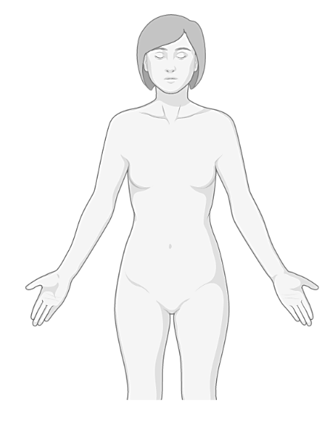

Diagnosis
What comorbidities are associated with PCOS?
DDx and Eval
Mood disorders
↑ risk of anxiety, depression, ED
Associated Co-Morbidities
Screen/treat for MDD and GAD
Management?
PCOS is associated with wide array of non-gynecologic and gynecologic comorbidities.
Non-Gyn
Hyperandrogenism (1º feature)
↑ androgens → ↑ facial hair, acne
Gyn
OCPs ± spironolactone ↓ androgens.
Cosmetic procedures (hair removal)
What non-gynecologic comorbidities are associated with PCOS?
Management?
All patients with PCOS should receive fasting BG, HgbA1C, fasting lipid panel.
Cases
Cardiovascular risk
↑ lipids, ↑ CV events
Screen with fasting lipid panel. Treat CV risk factors.
Management?
Insulin resistance
Common regardless of weight, ↑ DM risk
Screen with A1c, fasting BG.
Lifestyle, low threshold for metformin
Management?
Image created with biorender.com

Slide 5






Diagnosis
What comorbidities are associated with PCOS?
DDx and Eval
Menstrual irregularities
↑ irregular/disruptive bleeding
Menstrual irregularities
Associated Co-Morbidities
PCOS is associated with a wide array of gynecologic comorbidities.
OCPs regulate menses
(3rd/4th G progestins are less androgenic)
Management?
Non-Gyn
What gynecologic comorbidities are associated with PCOS?
Infertility
Most common cause of
anovulatory infertility in the US
Gyn
Infertility
Cases
Discuss fertility goals
Early referral to OB/Gyn or REI
Management?
Endometrial hyperplasia
3x ↑ risk of endometrial
cancer due to chronic anovulation
Endometrial hyperplasia
Pregnancy complications
Early pregnancy loss, GDM,
pre-eclampsia, and pre-term labor
Pregnancy complications
Promote endometrial turnover with OCPs, progestin IUDs, or cyclic progesterone
Close monitoring and treat if condition develops
Management?
Management?
Image created with biorender.com

Slide 6
Diagnosis
Case 1a
Case 1b
Olga is a 24 yo woman who presents with irregular periods since menarche. Her periods occur every 45 to 60 days.
Family history is notable for type II DM.
Olga returns for a follow-up visit to review her labs and imaging results.
Labs: TSH and prolactin are normal. Total testosterone is elevated.
Transvaginal ultrasound 15-20 small follicles in both ovaries. Otherwise, normal.
DDx and Eval
Associated Co-Morbidities
What additional history or exam findings can help build your differential?
What is her diagnosis?
PCOS. She meets all 3 Rotterdam criteria: oligomenorrhea, biochemical hyperandrogenism, and polycystic ovaries. Other causes of oligomenorrhea ruled out. Remember, PCOS is a diagnosis of exclusion!
Cases
She has oligomenorrhea (a form of abnormal uterine bleeding). Causes and associated signs/symptoms include:
What additional non-gynecologic comorbidities should you screen for?
Hirsutism | PCOS, hyperandrogenism
Breast discharge | Prolactinoma
Hot flashes | Premature ovarian failure
Weight gain | Cushing’s, hypothyroidism
Weight loss | Stress, malnutrition, hyperthyroidism
Sexually active | Pregnancy, STIs
Abnormal pelvic exam | Structural cause (e.g., polyp, fibroid)
Psych → MDD, GAD screen
Insulin resistance → HbA1c, fasting BG
CV risk → fasting lipids
What gynecologic comorbidities is she at risk for?
Infertility
Pregnancy complications
Endometrial hyperplasia and higher risk of endometrial cancer
…She has acne and some hair growth on her chin. She reports slow weight gain. Otherwise, she is not sexually active.
What are your next steps in evaluation?
What options does she have for endometrial protection?
Beta-HCG (rule out pregnancy in all reproductive age women)
Transvaginal US (rule out structural causes)
TSH, prolactin, FSH
Total testosterone (signs of hyperandrogenism, ± 17-OH progesterone, ± SHBG, ±DHEAS)
Combined oral contraceptives, progestin-containing IUDs, and cyclic progesterone all can be used to decrease risk of endometrial hyperplasia.

Slide 7
Polycystic Ovarian Syndrome (PCOS)
To diagnose PCOS we use the Rotterdam Criteria:
1.
2.
3.
You need ___ of 3 criteria to diagnose PCOS!
PCOS is a diagnosis of exclusion. What are some other conditions to consider before making this diagnosis?
Differential | Evaluation
Other conditions associated with PCOS:
Non-Gynecologic: Gynecologic:
Notes:
Learner Guide

Slide 8
2023 Guideline Update — Rotterdam framework unchanged
• The 2023 International Evidence-Based Guideline for PCOS (Teede et al.) updates the 2018 version the deck builds on. Rotterdam (2 of 3) and "diagnosis of exclusion" are unchanged.
• NEW diagnostic option: anti-Müllerian hormone (AMH) may substitute for pelvic ultrasound to establish polycystic ovarian morphology in ADULTS (not adolescents). For irregular cycles + hyperandrogenism (~70% of cases), neither US nor AMH is needed — those two criteria already make the diagnosis.
• Adolescents: require BOTH hyperandrogenism AND ovulatory dysfunction; ultrasound and AMH are NOT recommended (<8 yr post-menarche) due to poor specificity.
• Strengthened recognition of the metabolic/CV burden, obstructive sleep apnea, and the very high prevalence of psychological features (screen for depression, anxiety, and disordered/binge eating).
• Therapy: lifestyle first; metformin for metabolic/weight/cycle benefit; combined OCPs ± anti-androgen for hyperandrogenism/cycle control. Anti-obesity pharmacotherapy incl. GLP-1 receptor agonists may be CONSIDERED for weight in adults (evidence still limited — high-priority research area).
– Sources: Teede HJ et al., 2023 International Evidence-Based Guideline for PCOS (Hum Reprod / JCEM / Fertil Steril 2023); Goldberg, Obes Rev 2024 (anti-obesity agents).

Slide 9
Take-Home Points
• PCOS is defined by the Rotterdam criteria — hyperandrogenism (clinical or biochemical), menstrual irregularity/ovulatory dysfunction, and polycystic ovaries on ultrasound (or, in adults, AMH per 2023 guideline). Two of three are required.
• It is a DIAGNOSIS OF EXCLUSION — rule out other causes first: total testosterone (± 17-OHP, SHBG, DHEAS), TSH/free T4, prolactin, β-hCG; consider midnight salivary cortisol or LH/FSH per clinical picture.
• Screen for the comorbidities, not just the diagnosis: insulin resistance/T2DM (A1c, fasting glucose or 2-h OGTT, q1–2y), cardiovascular risk (BP, fasting lipids), mood/eating disorders (PHQ-9, GAD-7), OSA, and NAFLD.
• Protect the endometrium: chronic anovulation → 3× endometrial cancer risk. Ensure a withdrawal bleed at least every 90 days (OCPs, progestin IUD, or cyclic progesterone). Routine US screening for endometrial cancer is not recommended.
• PCOS is the most common cause of anovulatory infertility — discuss fertility goals early; 5–10% weight loss improves ovulation; refer to OB/Gyn or REI; clomiphene/letrozole for ovulation induction.

Slide 10
Attribution & Changelog
• Original: "Polycystic Ovary Syndrome," TeachIM.org, published May 2022 — Nikki Zarling MD, Natalie deQuillfeldt MD, Molly Brett MD; Section Ed. Adelaide McClintock MD; Exec. Ed. Yilin Zhang MD.
– https://teachim.org/teaching_material/pcos/ — CC BY-NC 4.0 (attribution required, non-commercial). Optimized June 2026. Deck: Teach-IM-PCOS-yz-6.2-1.pptx (page embed URL).
• Correction to this copy (all click-to-reveal animations & BioRender graphics preserved):
– Slide 3 (menstrual-irregularity evaluation): "± LH/FH" → "± LH/FSH" (the page text and standard workup are LH and FSH).
• Appended: this changelog + 2023 Guideline Update + Take-Home slides. No original content removed; 7 original slides (1 hidden learner worksheet) → 10.
• Companions copied & linked (reviewed, unchanged): PCOS-Teach-IM-Guide-yz-6.2-1.docx (facilitator guide), PCOS-Learner-Handout.pdf. Package: HTML, OnePager PDF, Anki TSV.
• Educational use only — not medical advice; clinician-review before teaching.

