Slide 1

Engineering Center of Excellence
We are students of our craft

Slide 2
Infrastructure as code and AWS CDK
Introduction

Slide 3

Infrastructure as code benefits
Cost reduction.
Increase in speed of deployments.
Reduce errors.
Improve infrastructure consistency.
Eliminate configuration drift.
Repeatable

Slide 4

Cloud Formation
ELB*
CDK*
CLI
*other CLIs might be available.

Slide 5

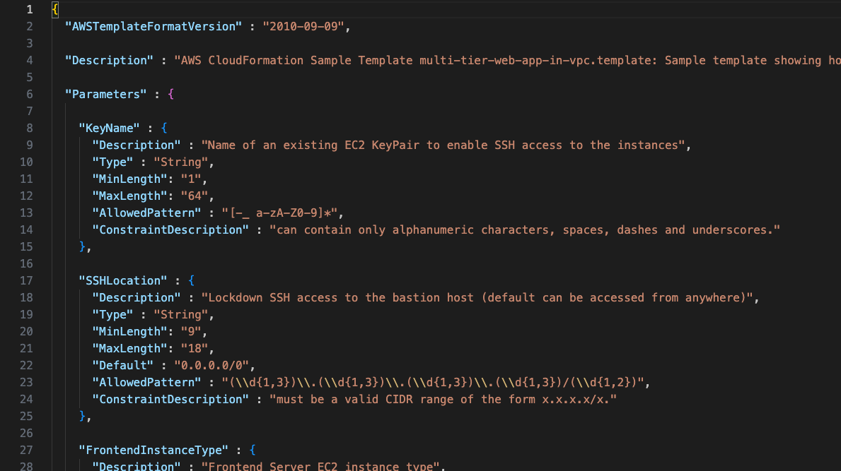
AWS CloudFormation
CONFIG (not code)

Slide 6

https://aws.amazon.com/cdk/

Slide 7
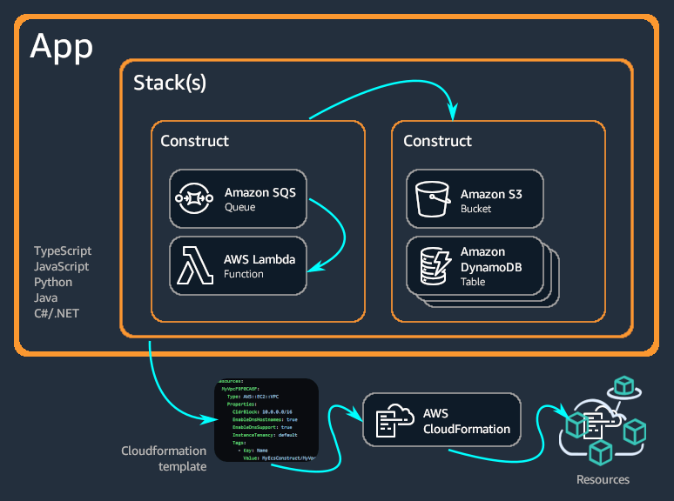
AWS CDK

Slide 8
Notes
Stacks are the unit of deployment: everything in a stack is deployed together
A nested stack is a what to group constructs logically. A nested stack is deployed as part of it’s parent stack
Constructs is how everything is abstracted
A level 1 construct has 1 to 1 relationship with an AWS Resource, i.e a S3 bucket or a RDS database
You can create your own constructs that wrap level 1 constructs
The number of community constructs is HUGE
Configure with properties and methods, not environment variables
You can unit test your infrastructure

Slide 9
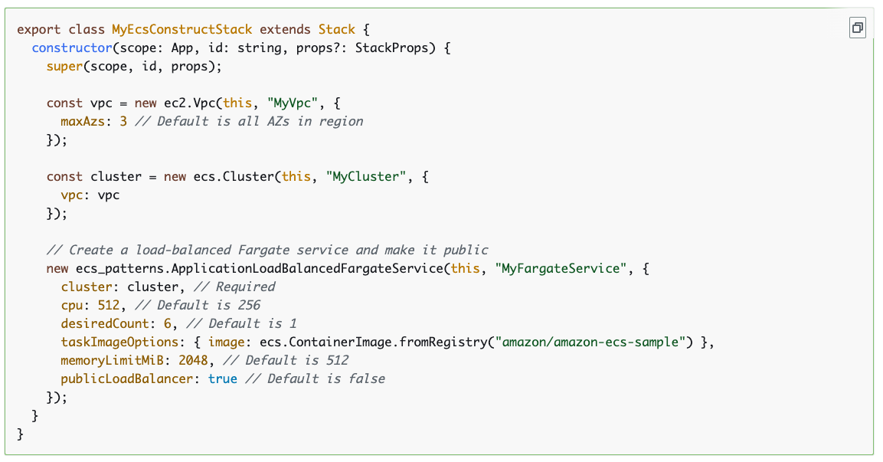
Example
This creates a CloudFormation template of more than 500 lines!!

Slide 10
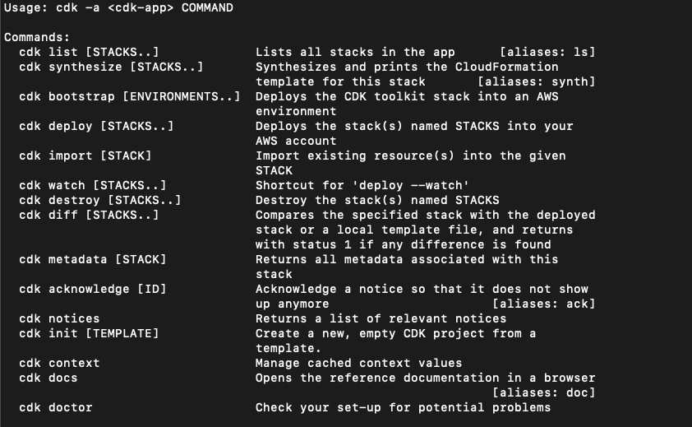
Workflow
See: https://github.com/aws/aws-cdk/b lob/main/packages/aws-cdk/README.md

Slide 11
Local configuration pattern
~/.cdk.json
/app/cdk.json
/app/cdk.context.json - created by CDK cli and is a cache

