Slide 1

An oversimplification of distributed processing

Slide 2
This is not intended to be a recommendation. Just introducing another way to process a large amount of data.

Slide 3
How else do you process that much data?
Apache spark is the most popular big data distributed processing framework. In terms of data size, Spark has been shown to work well up to petabytes. It has been used to sort 100 TB of data 3X faster than Hadoop MapReduce on 1/10th of the machines, winning the 2014 Daytona GraySort Benchmark, as well as to sort 1 PB.

Slide 4
How is it so fast?
Parallelization,
Functional programming and MapReduce.

Slide 5
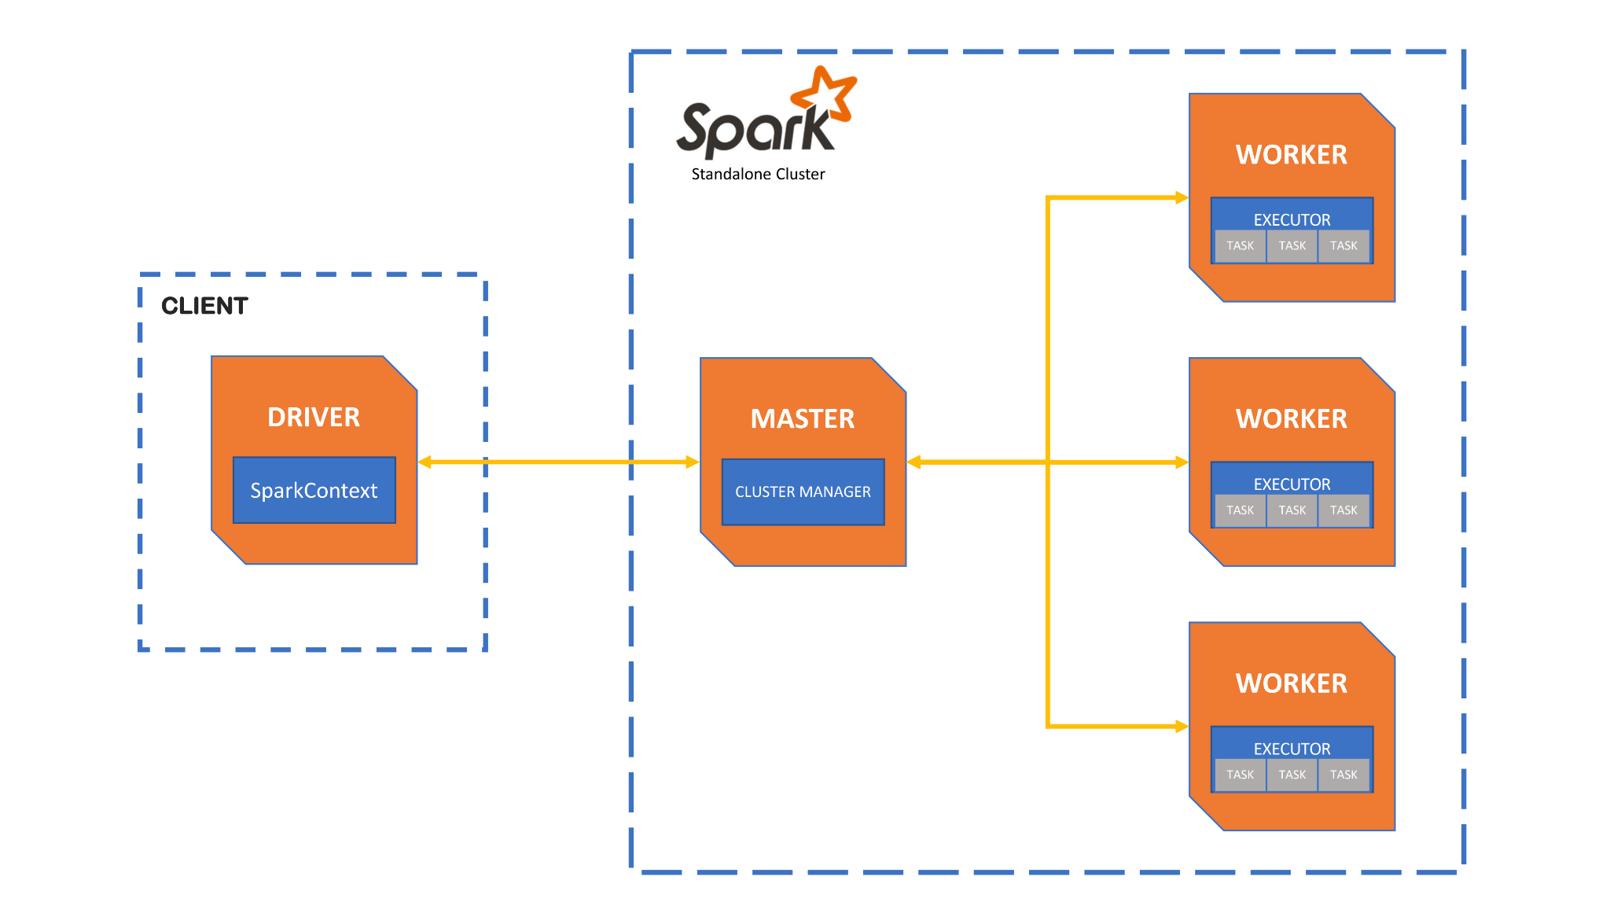
Parallelization
Spark has the ability to parallels the processing of data at huge levels. The largest number of nodes in a cluster I was able to find was 8k.

Slide 6
Apache Spark Task
In order to achieve the work necessary, Spark has to send at least two things to each worker:
A slice of data
The code needed to transform the data (task)
In Spark, a Task is the smallest individual unit of execution.

Slide 7
Apache Spark Task (continued)
A task is essentially a function. It can be:
An anonymous function
A reference to a class function (or a UDF)
A native function
In all of the above cases, spark must serialize the function in order to send it to each worker. This means it must included any additional class references or dependencies.

Slide 8
Apache Spark Task (continued 2)
A task is can be most effective when they follow functional programing techniques or they are pure functions.
Most functional programming functions/methods are pure functions.

Slide 9
Pure functions
A pure function is a function that has the following properties:
The function always returns the same value for the same inputs.
Evaluation of the function has no side effects. Side effects refer to changing other attributes of the program not contained within the function, such as changing global variable values or using I/O streams.
Things that make a function impure:
$this->{anything};
Echo, print, var_dump
Passed by reference parameters
file_puts, file_gets, flush, ect.
Calls an API
Connects to a socket
Any injected dependency that violates pure function requirements

Slide 10
Functional Programing
Functional Programming focuses on:
Immutability
Pure functions
This reduces the writes to disc and the need for tracking pointers, etc.

Slide 11
MapReduce
Map and reduce methods follow functional programing paradigms.

Slide 12
Flip the mindset
Think of MapReduce as a mindset flip. Instead of sending the data, item by item to the function, you are sending the function to the data.
This is why a “task” must be serializable.

Slide 13
Map
Mapping is the concept of applying a unit of work (or a task) to each item in a collection. Because functional programming focuses on immutability, map functions return a new collection rather than updating the existing collection. The advantage of a new collection is to reduce the pointer and memory management.
The datatype of each item can change.
A collection is something that implements the Traversable and Countable interfaces

Slide 14
Reduce
Reduce actually refers to multiple functions or concepts. All reduce the size of the collection in different ways. Usually, the result is one “item” instead of a collection.
Examples are:
Reduce, reduce left, etc.
Fold, fold left, etc.
Scan, scan left, etc.

Slide 15
Filtering and sorting
It is worth noting that filtering can be applied with the same mindset. The function that determines what is filtered or what compares two items for sorting can be much more complex and address different data types. For example. How do you sort a collection of Objects.

Slide 16
PHP examples
<?php
$a = [1, 2, 3, 4, 5];
$b = array_map(function($value): int { return $value * 2;}, $a); //$a = [2, 4, 6, 8, 10];
$b1 = array_reduce($a, function($x, $y) { return $x + $y;}); //$b1 = 15;
$b2 = array_filter($a, function($item) {return $item < 3;}); //$b2 = [1, 2];
usort($a, function ($a, $b){ if ($a == $b) { return 0; } return ($a < $b) ? 1 : -1; }); //$a = [5, 4, 3, 2, 1]; - reverse;
//NOTICE That usort is not follow the “immutable” paradigm. The array is passed by reference

Slide 17
PHP examples (continued)
In the previous PHP examples, I am using an anonymous function. You can pass anything that is “callable”. This could be a function reference etc.
In Spark, in these callable items must also be serializable so that spark can send it to the workers, unpack it and apply the methods to each data element.
$x = function ($message) use ($returnChar) { return $message . $returnChar; };

Slide 18
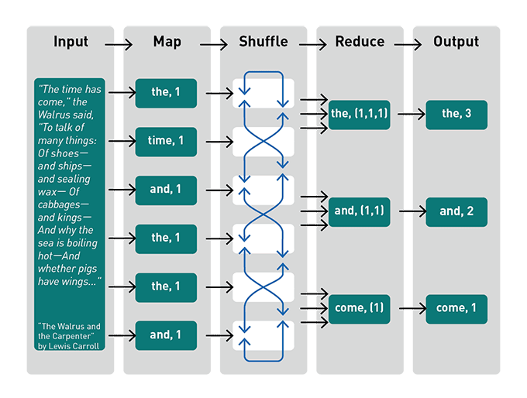
Term frequency index example

Slide 19
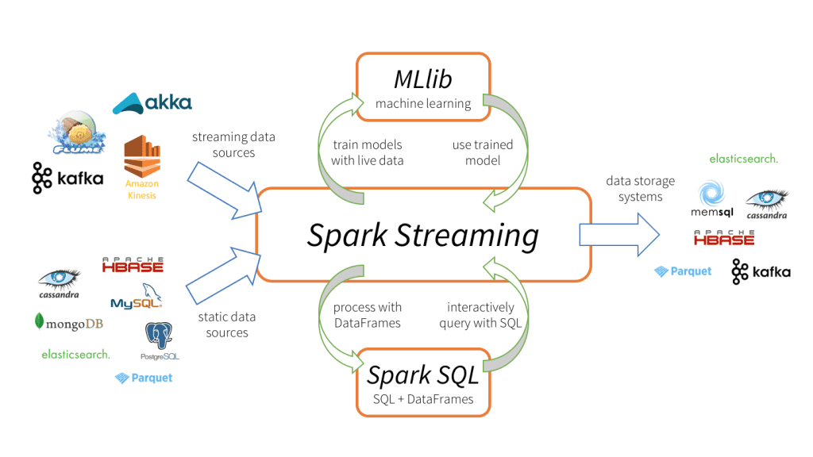
Spark can do a lot.

Slide 20
Writing data to RDBMS
You’ll notice in the previous picture, that no RDBMS is listed in the output of Spark. This is because big data follows a different paradigm that a RDBMS is not suited for.
However, it is still possible to do. Writes are parallelized as a necessity of the architecture of distributed systems.
Spark facilitates sending the connection information, not an instantiated database adapter, to each worker. Each worker creates its own DB connection and writes in batches. This is done by native libraries for most RDBMSs.

Slide 21
Columnar datastores
CSV and RDBMS are row-based datastores
Parquet, Hadoop, ORC are column based stores
Column-oriented data stores facilitate parallel reads much more efficiently.

Slide 22
Distributed processing downsides
Much bigger learning curve.
Resource heavy
Inefficient on small datasets
On AWS:
Provisioning resources can take a long time (15 minutes)
No observability into the process

Slide 23


STREAMING!!!!!!!!!
I have not implemented streaming and spark. But I really wanted to.

Slide 24
Streaming (continued)
Cluster needs to be up all to the time during streaming.
Additional technology need to do the streaming

Slide 25
Spark workflow
Spark
Data transformation
CSV
Postgres

Slide 26
Final Brainstorm
CSV
Transforming Queue
Transformer
Writer Queue
Writer
Postgres

