Slide 1
Project Management and Process Improvement (PDCA)
Leadership Training

Slide 2
What is PDCA?

Slide 3
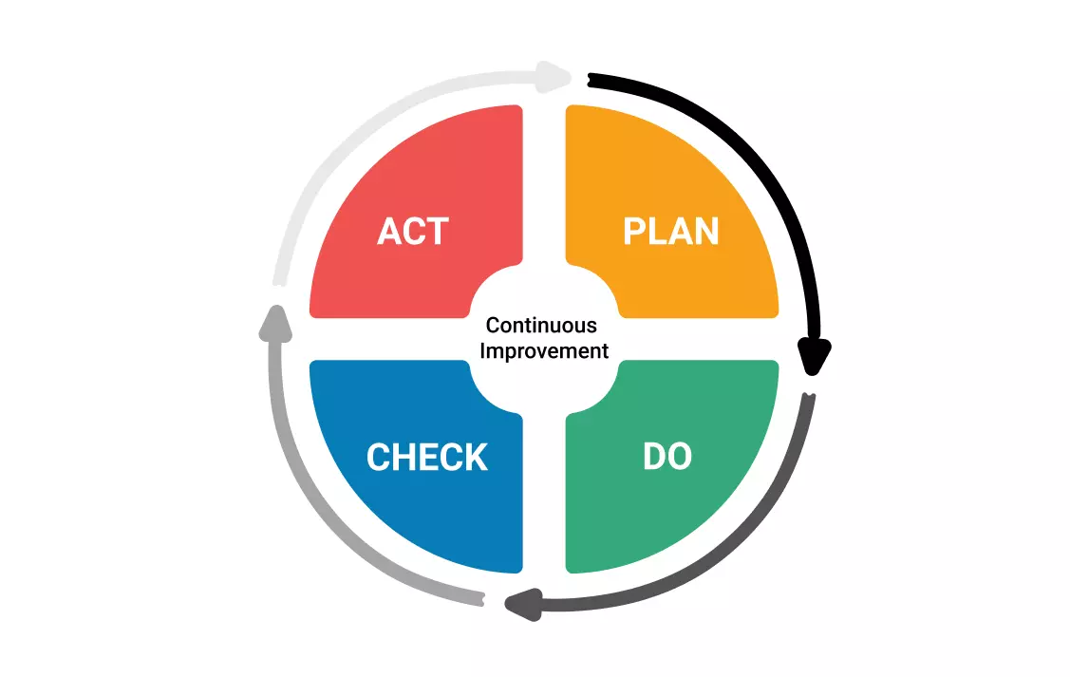
Overview of PDCA
PDCA is an interactive process for continually improving and has become an integral part of Lean Management
Includes solutions testing, analyzing results, and improving the process
https://asq.org/quality-resources/pdca-cycle
https://en.wikipedia.org/wiki/PDCA

Slide 4
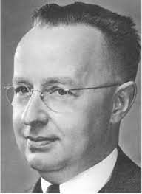
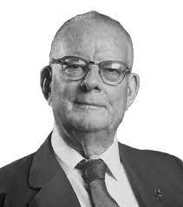
How it started
PDCA was introduced by Walter Shewhartin 1929 and then promoted by W. Edwards Deming in the 1950’s as a flow graph as a learning and improvement cycle.
Walter Shewhart was an american physicist, engineer and statistician who is known as the father of statistical quality control.
W. Edwards Deming was a engineer, statistician, and management consultant who developed methods that helped hasten the recovery of Japan’s recovery after WWII and beyond.
https://asq.org/quality-resources/pdca-cycle
https://en.wikipedia.org/wiki/PDCA

Slide 5
Not Project Management
Good for
Not good for
New Processes
Process improvement
Quality improvement
Change management
Iterating to achieve well defined outcomes
Project management
Implementing a top down plan

Slide 6
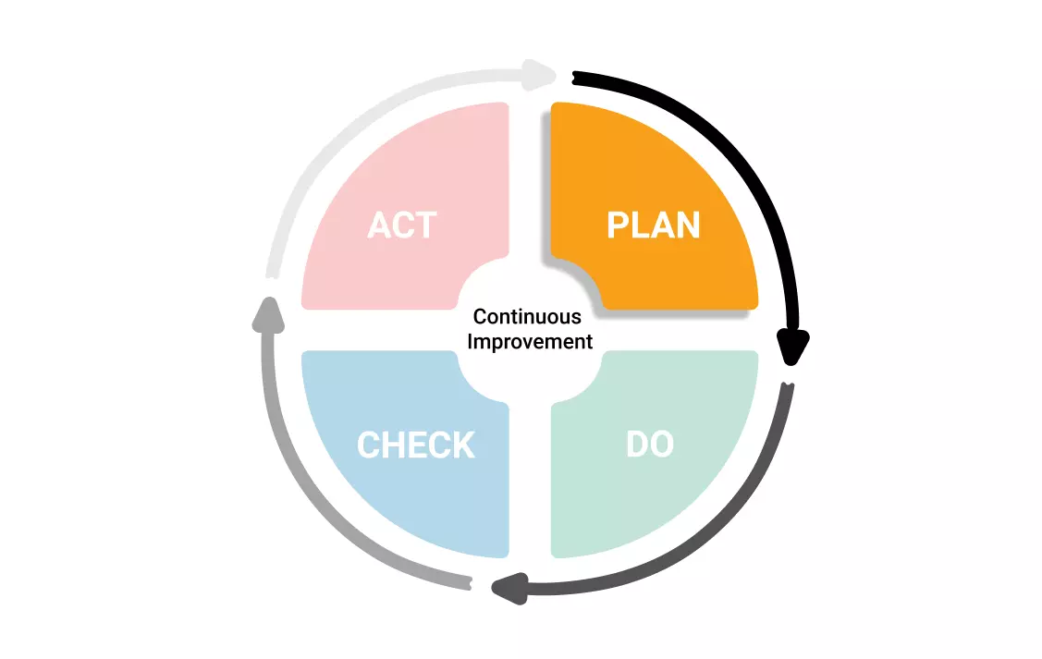
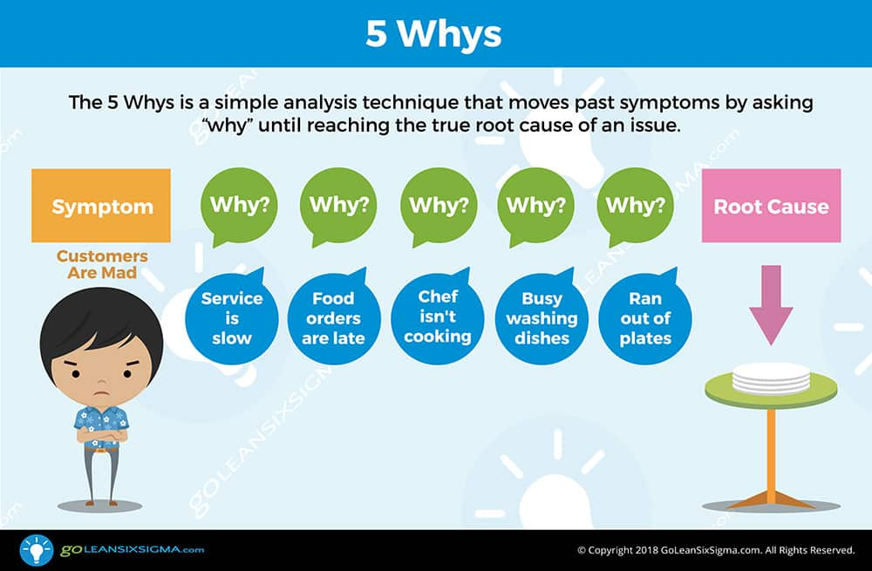
Plan phase
Identify the problem
Problem statements are hard. Focus on what you want to improve not just the side effects. This should be the focused on the Root Cause. Use the 5 Whys to identify. Avoid groupthink.

Slide 7
Plan phase
Identify the outcomes
Sometimes problem statements and outcomes can be combined.
Define metrics for success
How do you know you’ve achieved your desired outcome

Slide 8
Plan phase
Gather data and identify the metrics (Plan the Check phase)
How do you know you’ve succeeded? When do you know to stop? This should prepare you for the check phase. Metrics don’t have to be tracked programmatically. It could be surveys or other forms of measuring success.
You may have to implement the metrics as the first phase of the Do phase.

Slide 9
Plan phase
Propose changes
This is your action plan. It could be a project plan with dependencies and a critical path or just a list of changes to put into place.
Do you need a pilot or beta program?
Do you have the needed resources?
What are the dependencies?

Slide 10
Plan phase
Do you need to complete a risk analysis?
What could go wrong? Ask the seven “so whats”
If yes, Create a risk response plan.

Slide 11
Plan phase
Schedule the DO and the Check
Decide when to start. Do you need a soft rollout?
The Check should not be at the end of your objective time frame.
If you don’t schedule it, it may never happen!

Slide 12
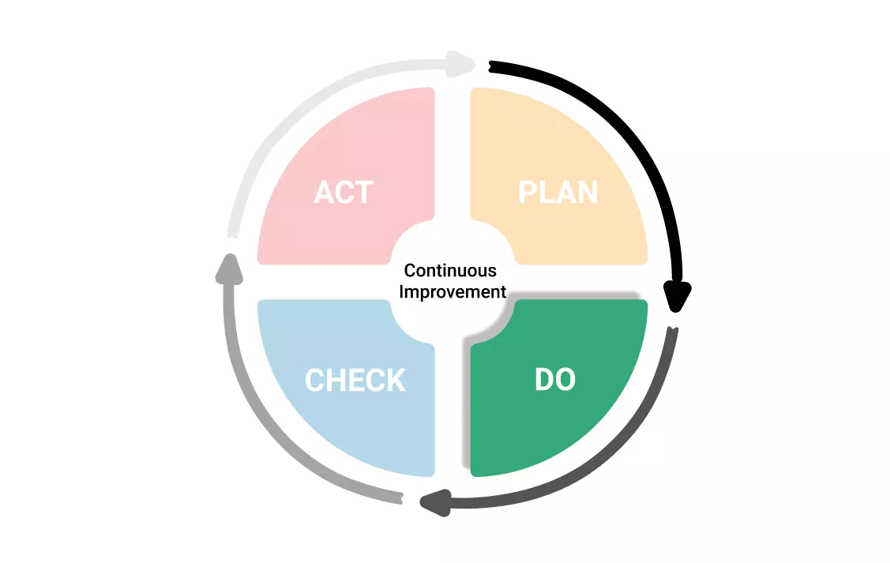
Do phase
Execute!
Don’t forget to track the changes and metrics
Track risks and implement any mitigating plans
Remove roadblocks

Slide 13
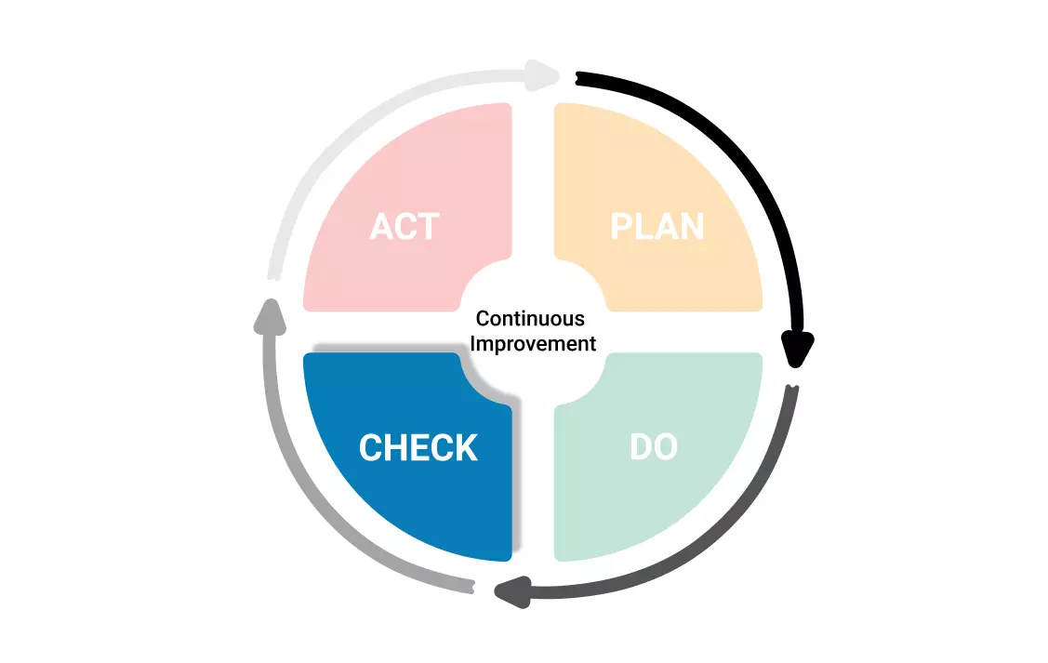
Check phase
This is the most important stage of PDCA and crucial to have continuous improvement.
Are you on track to achieve your desired outcome?
What is the state of anticipated risks?
Was the plan executed as designed?

Slide 14
Check phase
Plan adjustments
Mostly, this is a rework of the planning phase but should take less time.
What worked?
What didn’t?
What should be adjusted, abandoned?
Were the metrics useful and accurate? Should you measure something else?

Slide 15
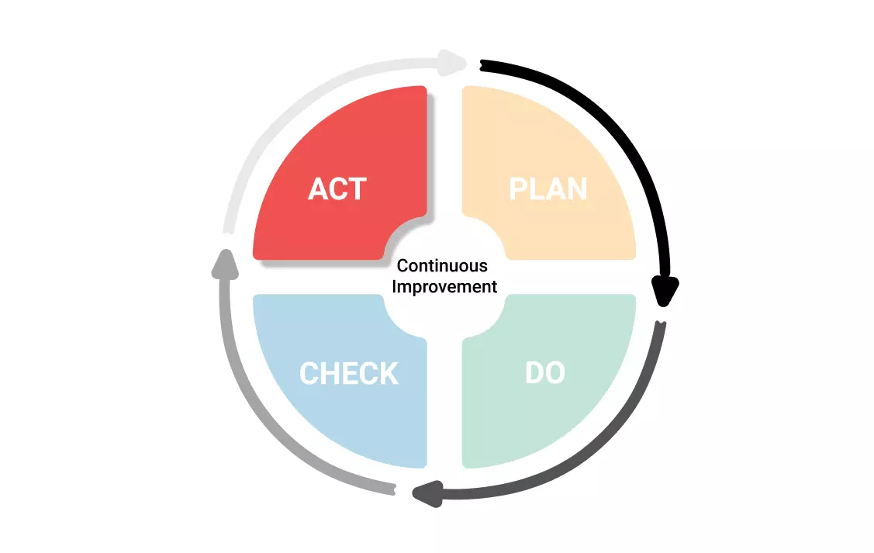
Act Phase
Do phase 2.0
This PDCA cycle will now become the baseline
Remember to continue to track or implement new metrics

Slide 16
Pitfalls
Plan-Do, Plan-Do ad nauseum
PDCA without Try and Test
PDCA without a specific improvement goal
PDCA to implement a plan
PDCA without Outcomes, Outputs and data analysis
https://www.passionned.com/the-5-biggest-pdca-pitfalls/

Slide 17
Pitfalls
The pattern of Plan-Do, Plan-Do keeps repeating itself. Check and Act are left behind. There’s always a new plan you can implement. The mistake here is not applying PDCA consistently. If you want to achieve the desired change, you have to complete the cycle, as quickly and as often as possible. You won’t make the most of PDCA by applying it once a year.
Plan-Do, Plan-Do ad nauseum
PDCA without Try and Test
PDCA without a specific improvement goal
PDCA to implement a plan
PDCA without Outcomes, Outputs and data analysis
https://www.passionned.com/the-5-biggest-pdca-pitfalls/

Slide 18
Pitfalls
This pitfall should be familiar to managers who like to stay in control (control freaks, if you will). They primarily see PDCA as a tool to plan and check the work. That leaves you with an approach that impedes progress, rather than one that solves problems. Those managers don’t want you to experiment, because it’s seen as being too risky. But Try and Test are essential to the Do and Check steps. Also, experimenting is essential to creating a sense of ownership of solutions to the bottlenecks that pop up daily in the workplace. And that sense of ownership is crucial to making progress together.
Plan-Do, Plan-Do ad nauseum
PDCA without Try and Test
PDCA without a specific improvement goal
PDCA to implement a plan
PDCA without Outcomes, Outputs and data analysis
https://www.passionned.com/the-5-biggest-pdca-pitfalls/

Slide 19
Pitfalls
Too often, we still see organizations applying PDCA to help execute the regular process. This is the third pitfall. They may be looking for the missing link in the process. Then they add that missing link, so that the process functions as intended once again. Very useful, but it doesn’t contribute to the continuous improvement of processes. Without a specific goal for improvement in mind, PDCA doesn’t reach its full potential. But keep in mind that continuous improvement should be a standard part of the function.
Plan-Do, Plan-Do ad nauseum
PDCA without Try and Test
PDCA without a specific improvement goal
PDCA to implement a plan
PDCA without Outcomes, Outputs and data analysis
https://www.passionned.com/the-5-biggest-pdca-pitfalls/

Slide 20
Pitfalls
This pitfall starts with a plan that came from the upper management echelons without any rhyme or reason. But the plan has already been defined from start to finish. Management will pull out all the stops to execute this plan no matter the cost, even if it turns out that the plan is based on erroneous assumptions. This also misses the point of PDCA. The workplace ends up having to contort itself into all kinds of awkward shapes to be able to implement the plan, or at least make it look like the plan’s been implemented. At the same time, they try to keep doing whatever’s actually useful. It’s exhausting and irritating, and it negatively affects morale and your bottom line.
Plan-Do, Plan-Do ad nauseum
PDCA without Try and Test
PDCA without a specific improvement goal
PDCA to implement a plan
PDCA without Outcomes, Outputs and data analysis
https://www.passionned.com/the-5-biggest-pdca-pitfalls/

Slide 21
Pitfalls
Maybe the most important pitfall: trying to kickstart PDCA without genuine KPIs (or outcomes for Entrata). You’ll notice that the continuous improvement process rests on quicksand. You’ll keep sinking further down. Without KPIs, you can’t make good plans and set goals and targets. And you’re lacking the data to monitor and analyze the execution. The check conversation then misses the point completely, because you don’t even have the data to know if you’re right or wrong. You won’t get past generalizations. If you want PDCA to work as a precision instrument, you have to think carefully about your KPIs. They connect the steps to each other. And that’s the only way to complete the cycle.
Plan-Do, Plan-Do ad nauseum
PDCA without Try and Test
PDCA without a specific improvement goal
PDCA to implement a plan
PDCA without Outcomes, Outputs and data analysis
https://www.passionned.com/the-5-biggest-pdca-pitfalls/

Slide 22
“An hour of planning can save you 10 hours of doing”
-Dale Carnegie

Slide 23
PDCA Template

