Slide 1
Unit testing
Theory of Value Based Testing

Slide 2
Developer: There is no I in TEAM
Tester: We cannot spell BUGS without U
Manual Regression Testing
End to End
Slower feedback
More like production
API and Integration tests
Quicker feedback
Less like production
Quality Gate to main branch
Unit Testing

Slide 3
SMOke Tests
Smoke Testing is a software testing process that determines whether the deployed software build is stable or not.
Site loads
Site correctly communicates with others services
DB, SQS, etc.

Slide 4
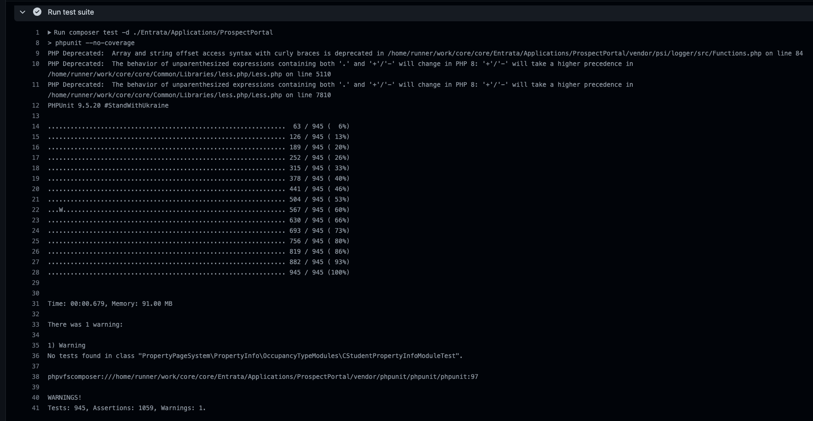
Every tester has the heart of a developer … in a jar on their desk
Example of output
E = Error
W = Warning
S = Skipped
I = Incomplete
R = Risky

Slide 5
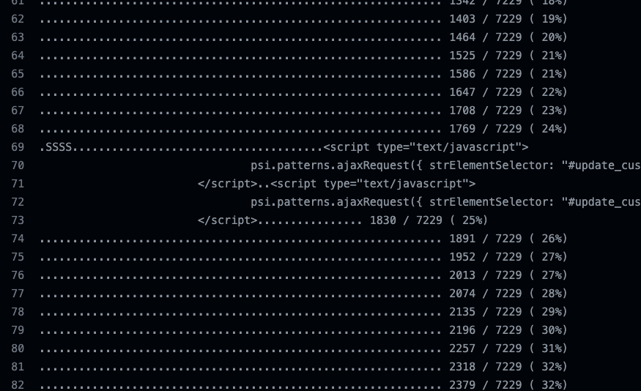
It’s Automation, Not Automagic!
Tests should not write to standard out or log warnings and notices.
This is sometimes the product code and not test code. But we should still watch out for it and handle it by suppressing output or capturing it in the test.

Slide 6
Even though it doesn’t work, how does it feel?
FUN!
MOre unit tests, more coverage, more
Cleanup output
Cleanup warnings and notices
Re-introduce skipped and incomplete tests (fix them first)
Monitor the team’s code coverage
Reject code reviews if the developer has not written sufficient unit tests
EVENTUALLY, right now TBD
No better time to to start then right now!

Slide 7
Maximizing the value of a test

Slide 8
All code does one of the following (simplified):
Reads data (inputs)
Transforms data
Writes data (outputs)
Coordinates the above
Decision making
Flows
Read
Transform
Write
Coordinate

Slide 9
Types of reading
Request parameters
Buffers
Database
Files
API
Services (cache)
Library or Dependency output
Memory
(more)

Slide 10
Types of transformations
Combining multiple sources
Altering
Algorithmic operations
Reducing
Filtering
(more)

Slide 11
Types of writing
HTTP Response object
Buffers
Database
Files
API
Services (cache)
Input into Libraries or Dependencies
Memory
(more)

Slide 12
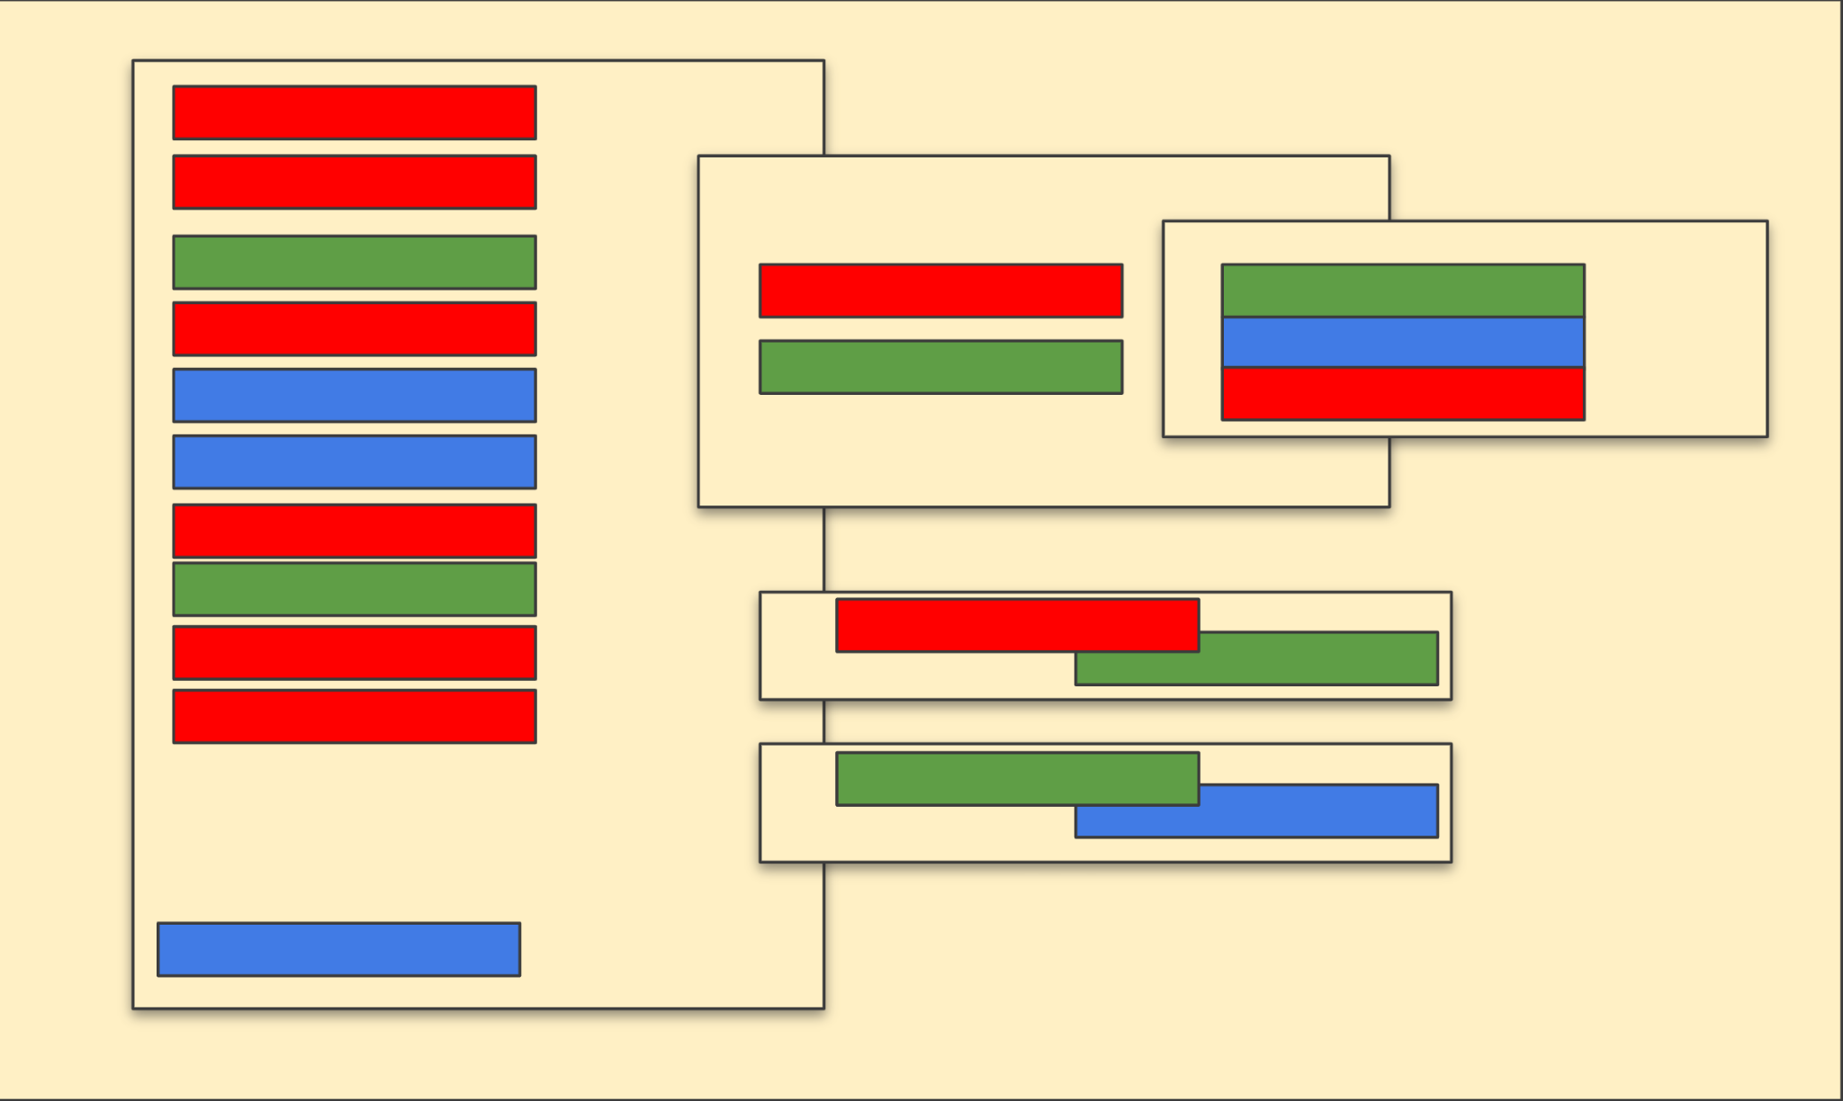
Then, we mix it all up!

Slide 13
High value vs low value
Unit tests achieve the highest value when they focus on data transformation and coordination. But achieve very little value when testing reading and writing operations.
Integration tests achieve the highest value when they focus on validating reading, writing and the coordination between resources, etc.
Integration tests
Read
Transform
Unit Tests
Integration tests
Write
Unit Tests
Coordinate

Slide 14
Maximize value
Method 1**
Method call
Read
By organizing your code to separate the different types of functionality (concerns), you maximize the ability to test data transformations and work flow coordination
Method 2
Method call
Transform
Method call
Method 3
Transformation verification
Coordination verification
Transform
Method call
Coordinate
Method 4**
**Reading and writing are typically handled by dependencies. That’s why we mock them!
Display

Slide 15
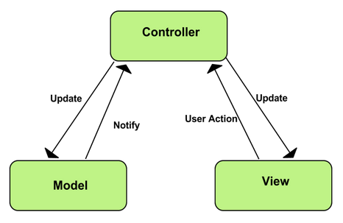
Look familiar?
Model 1
MVC design patterns leverage similar methodologies.
Model call
Read
Model 2
Model call
Transform
Model call
Model 2
Model call
Transform
Controller
View
Write

Slide 16
Balance approach
This doesn’t mean we can mix read, writes, transformations and work flows. If a method makes sense as a unit of work, then you’ve probably achieved a good balance.

Slide 17
Q & A

