Slide 1
User Stories and Acceptance Criteria
Writing, estimating and velocity

Slide 2
What is a user story?
In Agile, a user story is a short, informal, plain language description of what a user wants to do within a software product to gain something they find valuable.
Template:
As a <user persona>, in <context>, I want to <an action> so that <benefit/value>

Slide 3
User Personas
A User Persona represents a target audience for your product or service that you have researched or observed.
Examples
Client
Affiliate
Agent
Admin

Slide 4
Non-persona’s
The system
Developers/engineers
Product owners (unless the application is built for them)
Wombats

Slide 5
Why user stories?
Helps you think of the problem from the correctly user’s perspective
Gives a unit of work a placeholder to estimate the amount of work to be done.
Gives a unit of work a starting place for discussion between the engineering team and stakeholders
They are part of the Definition of Ready (DOR)
When completed, they contribute to the Definition of Done (DOD)

Slide 6
Tips for writing user stories
Focus on the user’s experience
Focus on outcomes rather than output
Don’t use stories as specifications, rather as a collaboration tool
If you can’t fit your story into the template, it’s probably too big and should be broken up into additional stories
Start with epics and refine them into multiple stories

Slide 7
When to use something else
If the user you identify is not one of the companies supported personas, you don’t need to write a user story. Track it a different way, or create a story but don’t follow the user story template.
If you are struggling to fit the template, maybe what you’re should be writing is a feature, epic or just tasks of things to get done.

Slide 8
Acceptance Criteria

Slide 9
Acceptance Criteria Template
Given <The starting state of the scenario>, when <The action that a user takes>, then: The result of the action.

Slide 10
Acceptance Criteria Tips
Don’t include the technical details for implementation
Choose acceptance criteria that can be tested
Don’t be too broad, or too narrow
Take a step back and ask if the acceptance criteria sufficiently represents the successful delivery of the desired outcome.
As with User Stories, the Acceptance Criteria templates urges you to think about success from the user persona’s perspective.
Like user stories, if something that needs to be checked wont fit into this pattern, it’s reasonable to break the template and include it anyways. Better to have something to check then miss an expectation.

Slide 11
Why acceptance criteria?
Provides clear guidelines to all how an item should be tested
Help ensure all parties agree on what should be built
Help define the Definition of Done
Prevents unmet expectations

Slide 12

Sizing (Story Points)

Slide 13
Complexity vs Time
You cannot get away from a story point being relevant to time. This is because velocity is a measure of points per developer per sprint and a sprint is always time bound.
Complexity and uncertainty is why we use the Fibonacci Sequence. Although we want to be as accurate as possible, story sizing will alway need some flexibility

Slide 14
1, 2, 3, 5, 8, 13…
Modified Fibonacci Sequence

Slide 15
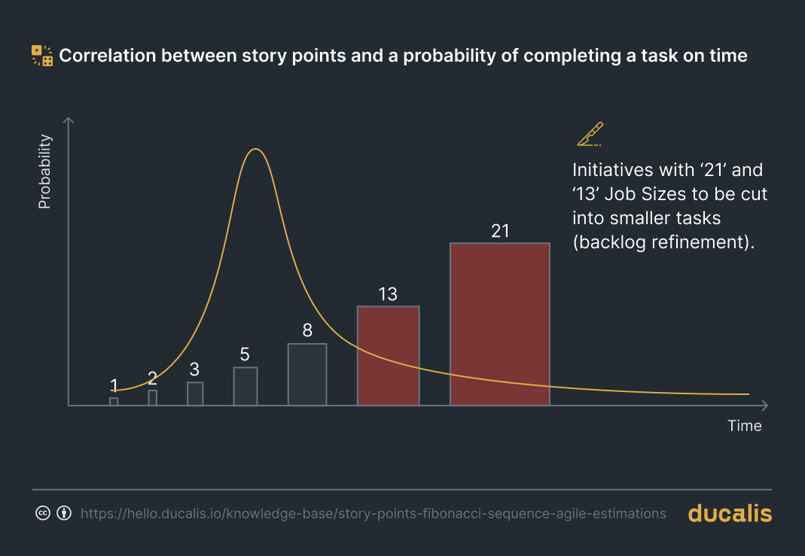


Why use a modified Fibonacci Sequence for sizing?
Forces the splitting of large stories into small stories (split at 5 or 8)
The antidote to ambiguity is agility

Slide 16
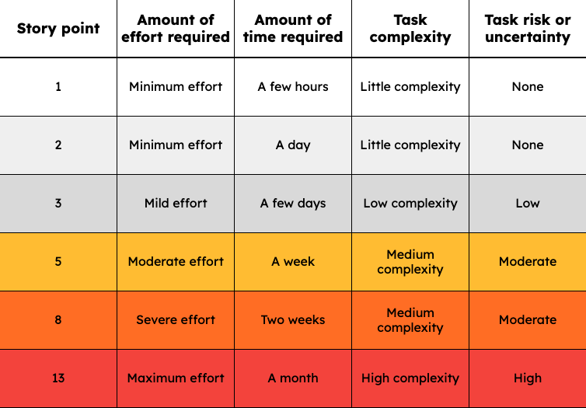
Story Point Rubric

Slide 17
Sizing tips
Make sure to use relative sizing. One of the strengths of story points is knowing how different stories compare to each other.
Remember that story points take into account not only the time spent on a project, but also the related complexity and risk.
Don’t take skill level into account when assigning story points

Slide 18
Velocity
Points per developer per sprint

Slide 19
Velocity is not a measure of performance. It is a tool to predict the amount of work that can be completed in a sprint. It’s important, it should be measured, visible and used by the team for insight into their work. It should not be used to evaluate an engineer’s performance, pay, bonuses or rewards.

Slide 20
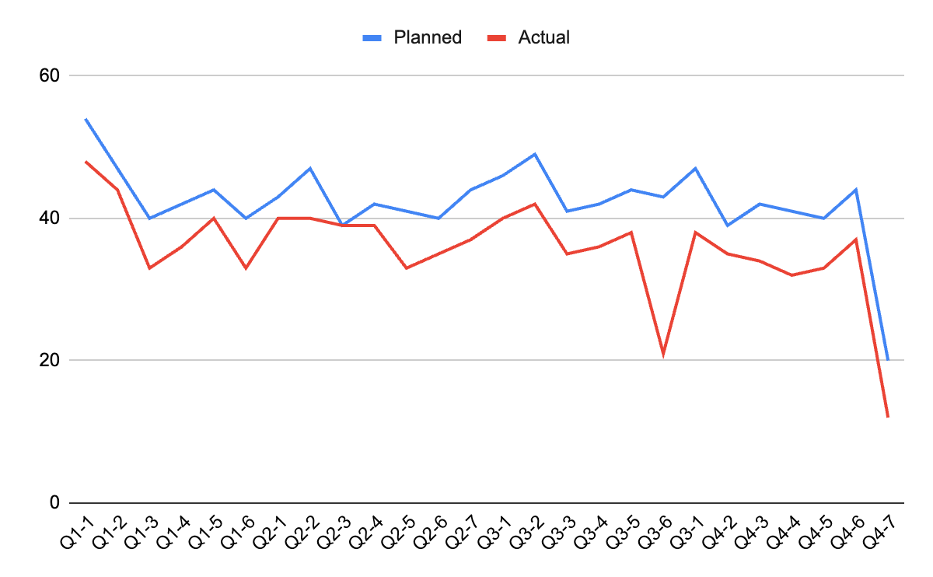
Interesting to view over time.
There always danger in incentivising velocity metrics.
The true metric of success is how each feature we deliver add value to the company.
This is difficult to measure.

Slide 21
Capacity Planning

Slide 22
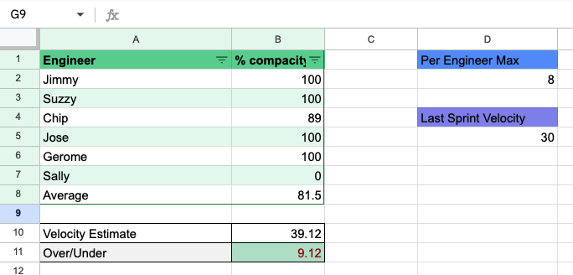
Capacity Planning - one way to do it

Slide 23
Thanks!

