Slide 1

SOJOURN KOREA Immigration, Housing, Tenancy Management - Busan, Changwon, Ulsan
메인타이틀 main title: Korea Relocation Specialists
참고SITE: www.proway.com
www.cartus.com
www.santaferelo.com
main menus:
SERVICES
ABOUT SOJOURN KOREA
WORK WITH US
KOREA VISA
LIVING IN BUSAN
visa & immigration
work visa
overview
home-search
non-working visa
attractions
settling-in
Visa-waiver
housing
tenancy management
schools
schools search
orientation

Slide 2
SOJOURN KOREA Immigration, Housing, Tenancy Management - Busan, Changwon, Ulsan
페이지 디자인 요청
모든 디자인은 둥글고 간결하게. 색상은 원색위주로
메인타이틀 밑에 큰 사진으로 표현… 들어갈 문구는 제가 만들어 드릴께요
기본 메뉴는 Bar형식으로 위쪽에 배치 (apple.com) 기본세팅은 www.sataferelo.com 참고
서브페이지 내용 은 모두 영어로 들어갈 예정입니다. Font 및 내용은 기획 후 보내드릴께요
저희 회사 주요 업무 성격은 대인, 법인 응대 서비스 및 컨설팅입니다.
주요 이미지 제안: 한국인 상담사 이미지, 집, 생활 이미지: 각페이지 이미지는 내용에 맞게 정함
메인 사진은 플래쉬이미지로 보다 JPG 또는 GIF로 간결히 바뀌는 형식으로 바뀌는 것을 선호합니다.
(www.apple.com 참조)

Slide 3
SOJOURN KOREA Immigration, Housing, Tenancy Management - Busan, Changwon, Ulsan
SERVICES
visa & immigration

Slide 4
SOJOURN KOREA Immigration, Housing, Tenancy Management - Busan, Changwon, Ulsan
SERVICES
home-search

Slide 5
SOJOURN KOREA Immigration, Housing, Tenancy Management - Busan, Changwon, Ulsan
SERVICES
settling-in

Slide 6
SOJOURN KOREA Immigration, Housing, Tenancy Management - Busan, Changwon, Ulsan
SERVICES
schools search

Slide 7
SOJOURN KOREA Immigration, Housing, Tenancy Management - Busan, Changwon, Ulsan
SERVICES
orientation

Slide 8
SOJOURN KOREA Immigration, Housing, Tenancy Management - Busan, Changwon, Ulsan
ABOUT SOJOURN

Slide 9
SOJOURN KOREA Immigration, Housing, Tenancy Management - Busan, Changwon, Ulsan
WORK WITH US

Slide 10
SOJOURN KOREA Immigration, Housing, Tenancy Management - Busan, Changwon, Ulsan
KOREA VISA
work visa

Slide 11
SOJOURN KOREA Immigration, Housing, Tenancy Management - Busan, Changwon, Ulsan
KOREA VISA
non-working visa

Slide 12
SOJOURN KOREA Immigration, Housing, Tenancy Management - Busan, Changwon, Ulsan
KOREA VISA
Visa-waiver

Slide 13
SOJOURN KOREA Immigration, Housing, Tenancy Management - Busan, Changwon, Ulsan
LIVING IN BUSAN
overview
attractions
housing
schools

Slide 14
SOJOURN KOREA Immigration, Housing, Tenancy Management - Busan, Changwon, Ulsan
<회사간략 소개 PPT>

Slide 15
SOJOURN KOREA Immigration, Housing, Tenancy Management - Busan, Changwon, Ulsan
KOREA RELOCATION SPECIALISTS
SEOUL
BUSAN
CHANGWON
ULSAN

Slide 16
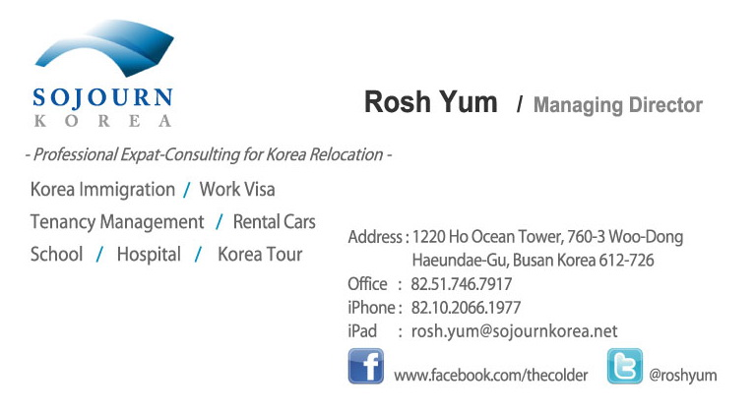
SOJOURN KOREA Immigration, Housing, Tenancy Management - Busan, Changwon, Ulsan

Slide 17
SOJOURN KOREA Immigration, Housing, Tenancy Management - Busan, Changwon, Ulsan
Service Categories:
Immigration
Home-Search
Tenancy
Management
Orientation
& Settling-In

Slide 18
SOJOURN KOREA Immigration, Housing, Tenancy Management - Busan, Changwon, Ulsan
1. IMMIGRATION – Documenting Services
Work Visa application and Korean Alien Cards : All types of work visa types
Immigration Reports: Address change, employment status and etc
Korean Driving License Application
Establishment of Foreign-Direct Invested Enterprises: establishment process
Visa Extension Application
Visas for Domestic House-hold Assistants

Slide 19
SOJOURN KOREA Immigration, Housing, Tenancy Management - Busan, Changwon, Ulsan
2. HOME-SERCH SERVICES
Securing for exclusive property listings in preferred area
School Search
Temporary Housing arrangement
Lease contract process: English and Korean
House-inspection Services
Lease Extension follow-up

Slide 20
SOJOURN KOREA Immigration, Housing, Tenancy Management - Busan, Changwon, Ulsan
3. TENANCY MANAGEMENT SERVICES
Cleaning arrangement
Repairs arrangement for appliances, furniture
Neighborhood orientation: Shopping assistance
Security Management while absence
House-inspection Services: Move-in inspection, move-out inspection
Negotiation process with landlords

Slide 21
SOJOURN KOREA Immigration, Housing, Tenancy Management - Busan, Changwon, Ulsan
4. ORIENTATION and SETTLING-IN
Visits to Shopping area, public transportation, parks and other amenities
Neighborhood orientation: Shopping assistance
Local Bank account set-up assistance
Setting up assistances for Internet, phone, cell phones,
Hospital Visits, arrangments, medical tour arrangement
Korea tour arrangements

