Slide 1



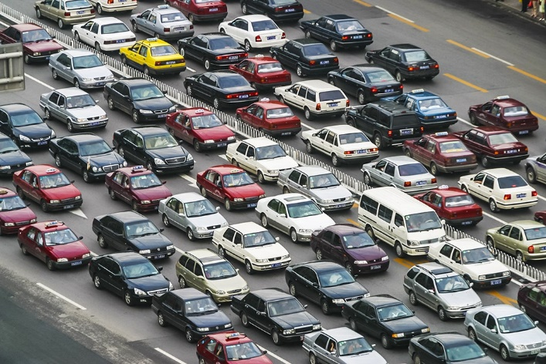
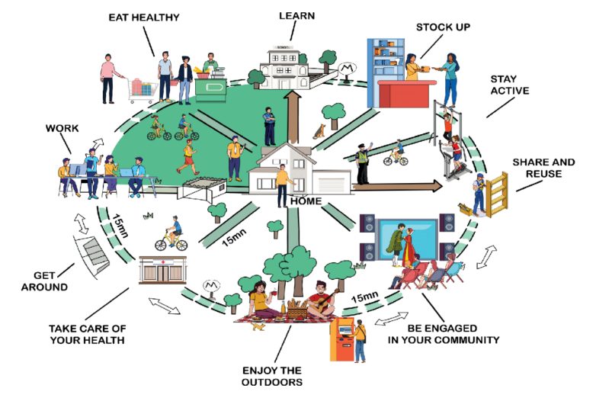

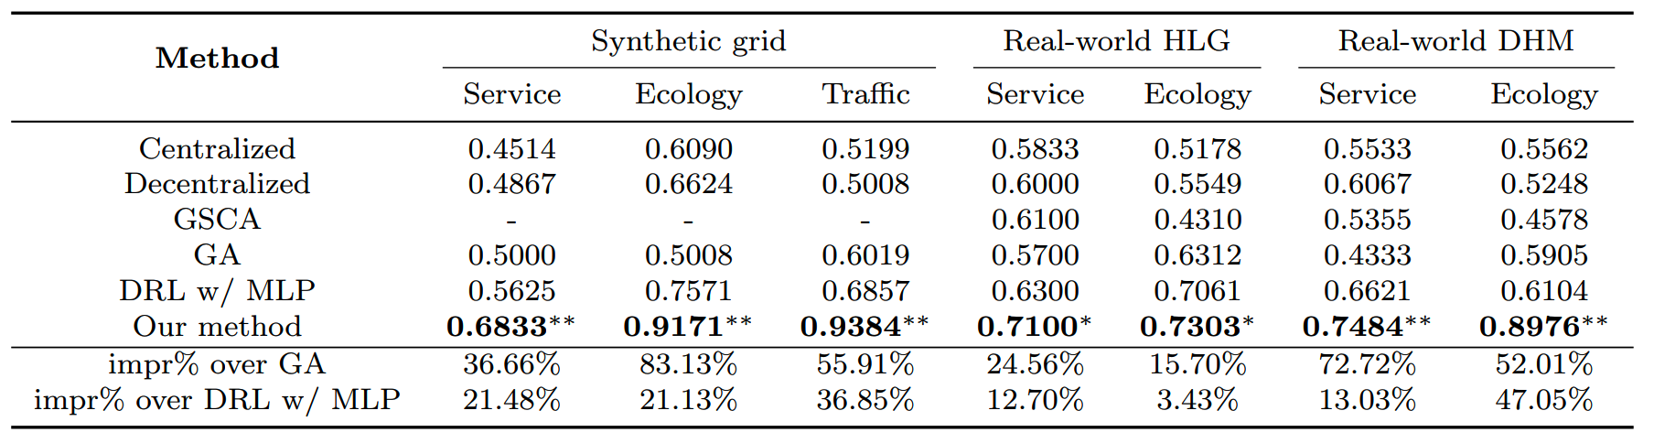
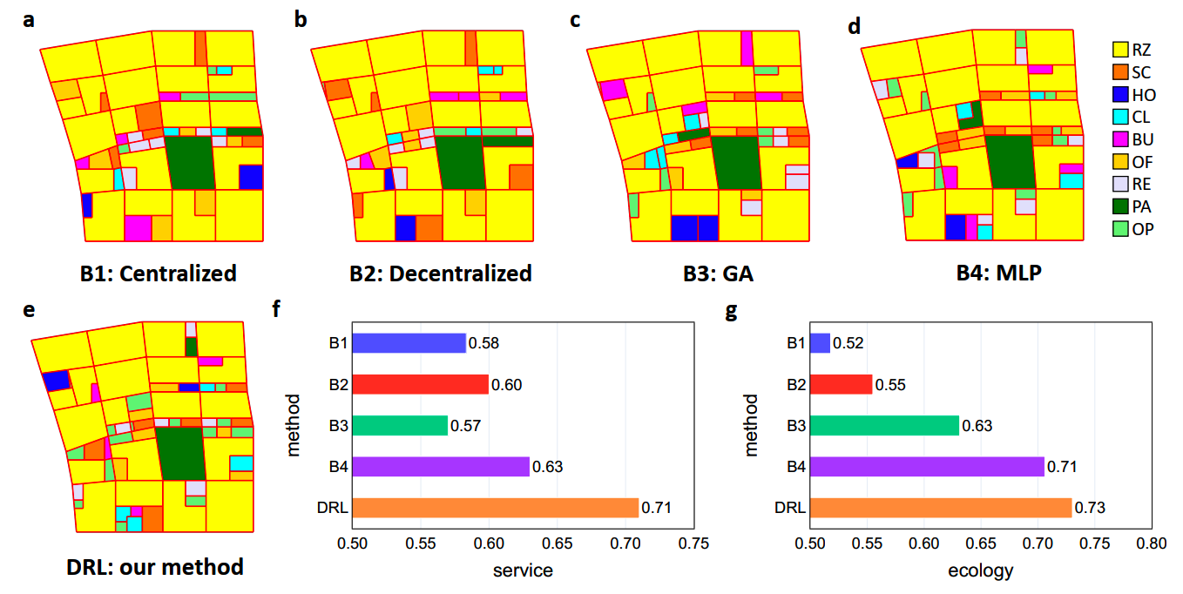
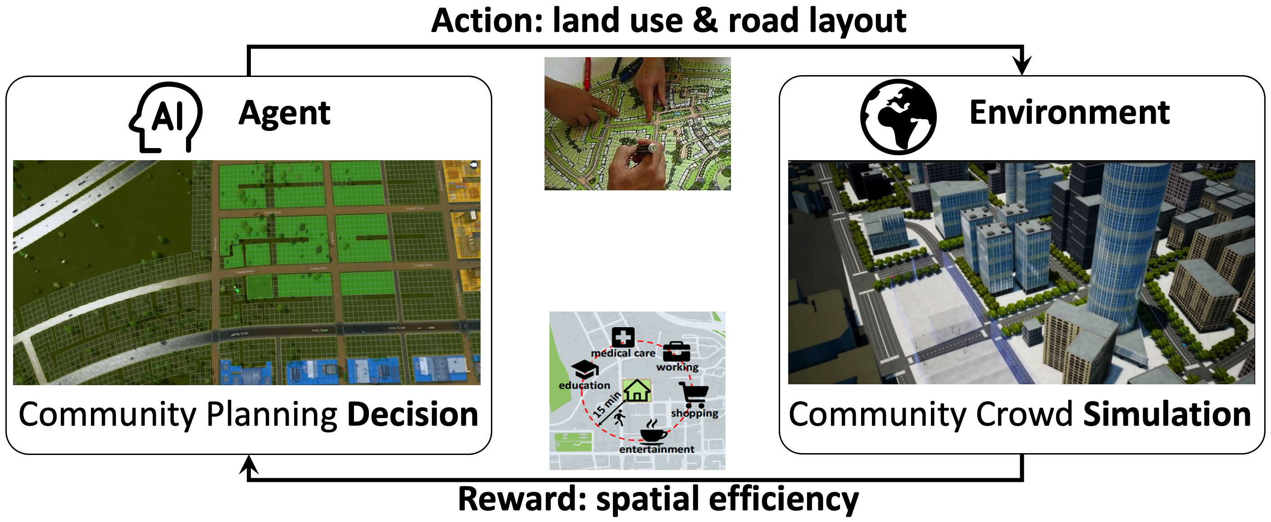
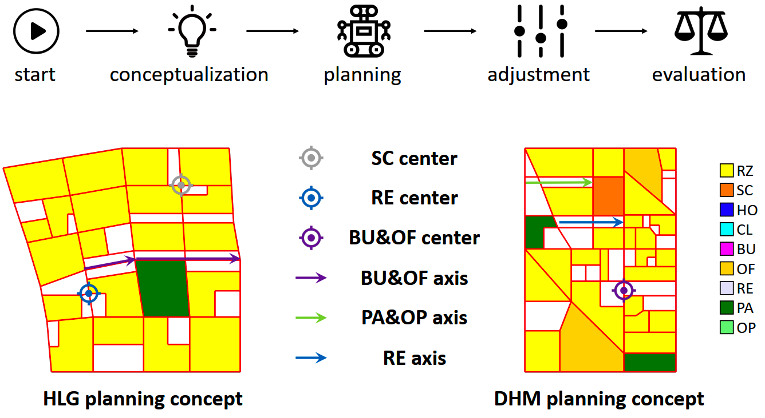

[Title]
Author 1, Author 2, Author 3, …, Author N
Institute XX
Introduction
[Section C]
Current issues of centralized urban planning
traffic congestion
climate change (CO2, NO2 emissions)
inequality
health risk
A Deep Reinforcement Learning Model with Graph Neural Networks
A new trend of urban planning: 15-minute city
high spatial efficiency
more accessible to basic urban services
more sustainable and inclusive
Why AI for urban planning
accuracy in complex and multi-objective tasks
efficiency and flexibility in generating adaptive plans
success in similar planning tasks: Go, chip design
[Section A]
[Section D]
Comparison with existing approaches
Stage I: Land Use Planning
place one facility at each step
reward: accessibility (15-min city)
Stage II: Road Planning
place one road segment at each step
reward: traffic (density, connectivity)
[Section B]
Collaboration with human designers
Stage I: Land Use Planning
edge selection on the graph
topology changes after selection
Stage II: Road Planning
node selection on the graph
attribute changes after selection
[References]
Spatial Planning of Urban Communities via Deep Reinforcement Learning, Y. Zheng, Y. Lin, L. Zhao, T. Wu, D. Jin, Yong Li, in Nature Computational Science.
GitHub: https://github.com/tsinghua-fib-lab/DRL-urban-planning
The 2nd Research Summit of Urban Science and Human Dynamics

