Slide 1
Evolutionary Dynamics Simulations Examining the Effect of Genotype-specific Fitness on Population-level Allele Frequencies
Eric Gong

Slide 2
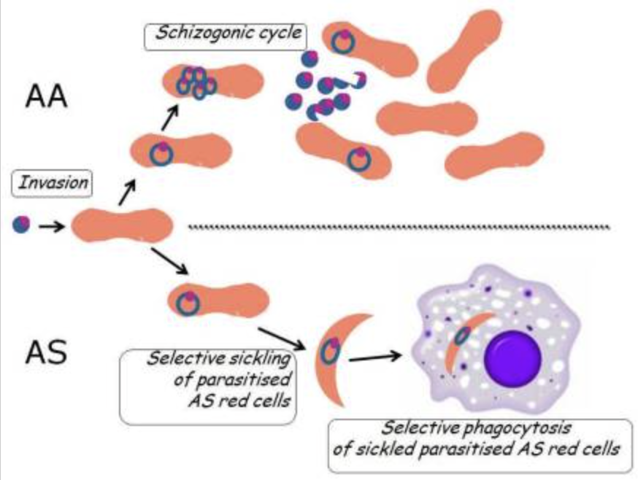
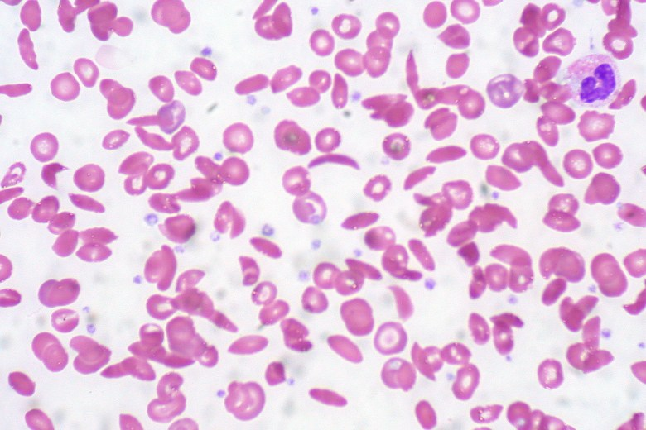
The Heterozygote Advantage
Lethal Autosomal Recessive Diseases:
Homozygous inheritance is fatal, carrier is asymptomatic
Tay-Sachs Disease: 1 in 100,000 born homozygotes, 1 in 250 individuals are carriers
Sickle Cell Anemia: In certain regions: 2.6% born homozygotes, 29% of individuals are carriers
Sickle Cell Anemia Carriers gain Malaria resistance!

Slide 3

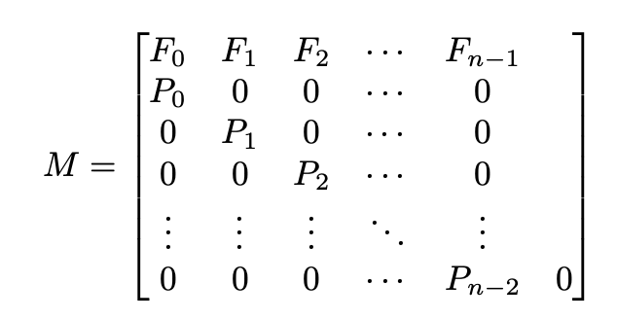
Evolutionary Dynamics Simulations: The Leslie Model
We can predict how populations change over time
Divide into age groups
Find age-specific survival rates
Update the newborn group based on reproductive capacity

Slide 4
Evolutionary Dynamics Simulations: The Leslie Model
Different life expectancies for different genotypes requires different population vectors
Mendelian
Inheritance
Generation
n
Carriers
Generation
n + 1
Carriers
Generation
n + 1
Non-carriers
Generation
n
Non-carriers

Slide 5
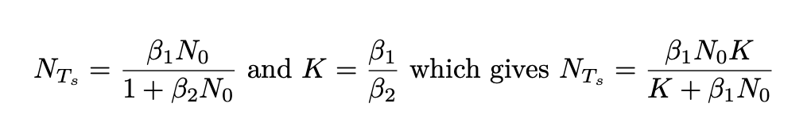
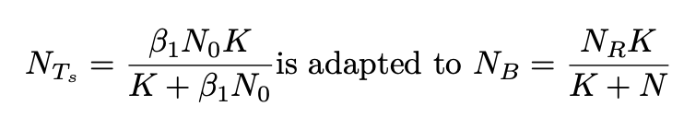
Stabilizing Population Size: Beverton-Holt Model
Population sizes stay relatively constant relative to the carrying capacity

Slide 6
Simulation Setup and Assumptions
We want to simulate under circumstances similar to the pre-1800s, where the selective pressures would have occurred
The life expectancy should be constant!
The average life expectancy in the African Continent was around 26 before the 19th century
We need data where there is no medical intervention (pre 1960-1970s)
Sickle Cell Anemia homozygous inheritance assumed to be fatal
Everyone gets Malaria in high transmission regions
Malaria primarily affects those under the age of 5, causing 10% of deaths in high transmission regions (without medical intervention)
Carriers of Sickle Cell are conferred a 90% decrease in Malarial fatalities
We run each simulation for 2000 steps (each step is 5 years)
We typically see convergence of the proportion of carriers between 200 and 500 steps (1000 to 2500 years)
Malaria has been documented since 2700 BCE

Slide 7
Select Results on Simulating High Malarial Transmission

Slide 8
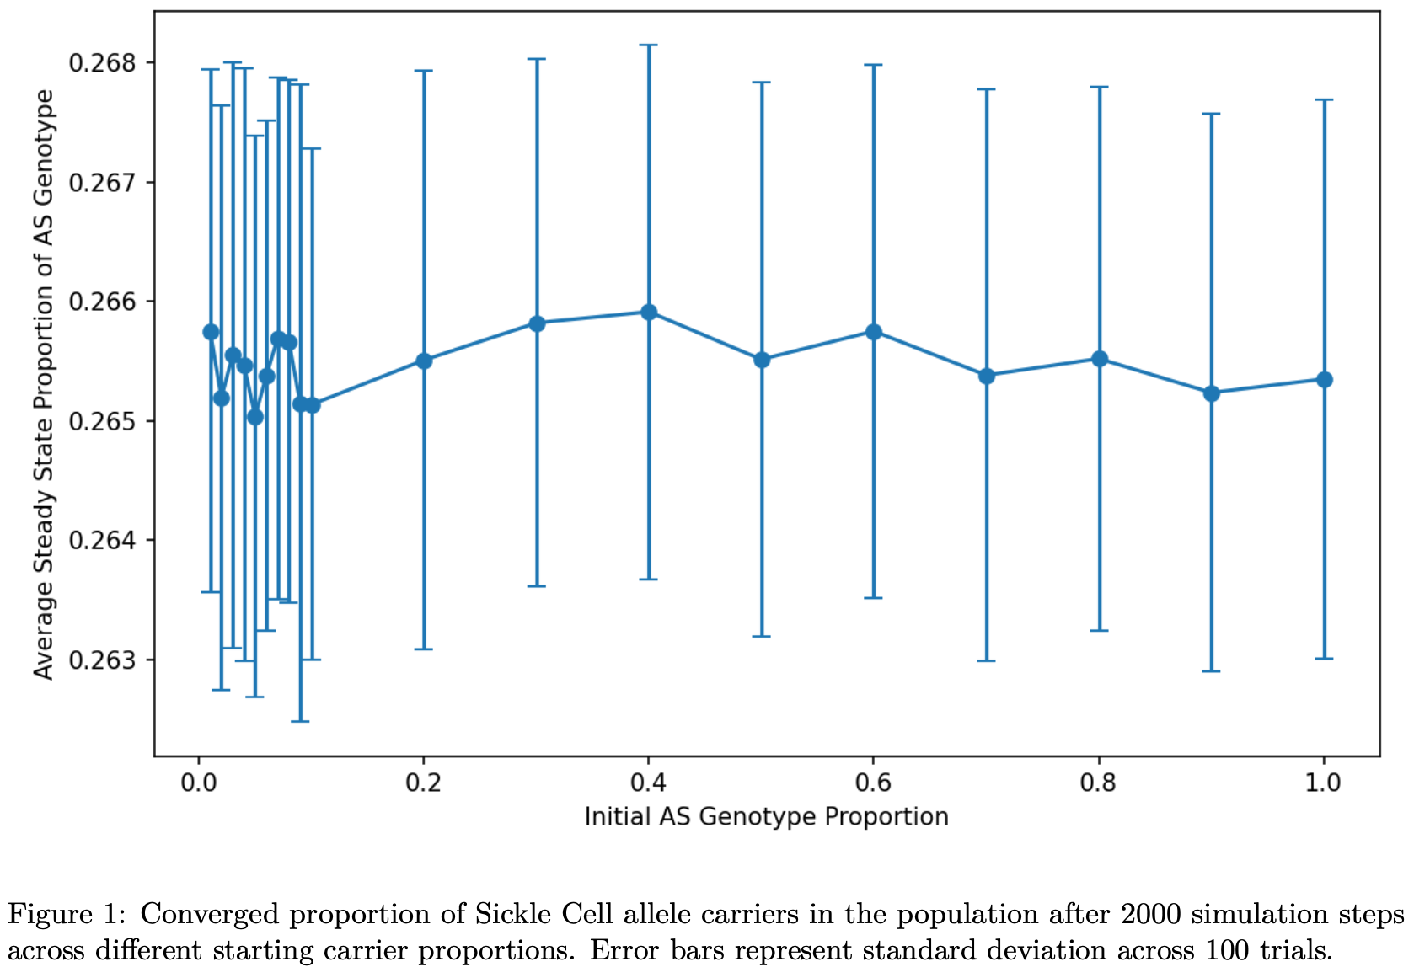
Effect of Ablating the Initial Proportion of the Carrier Genotype

Slide 9
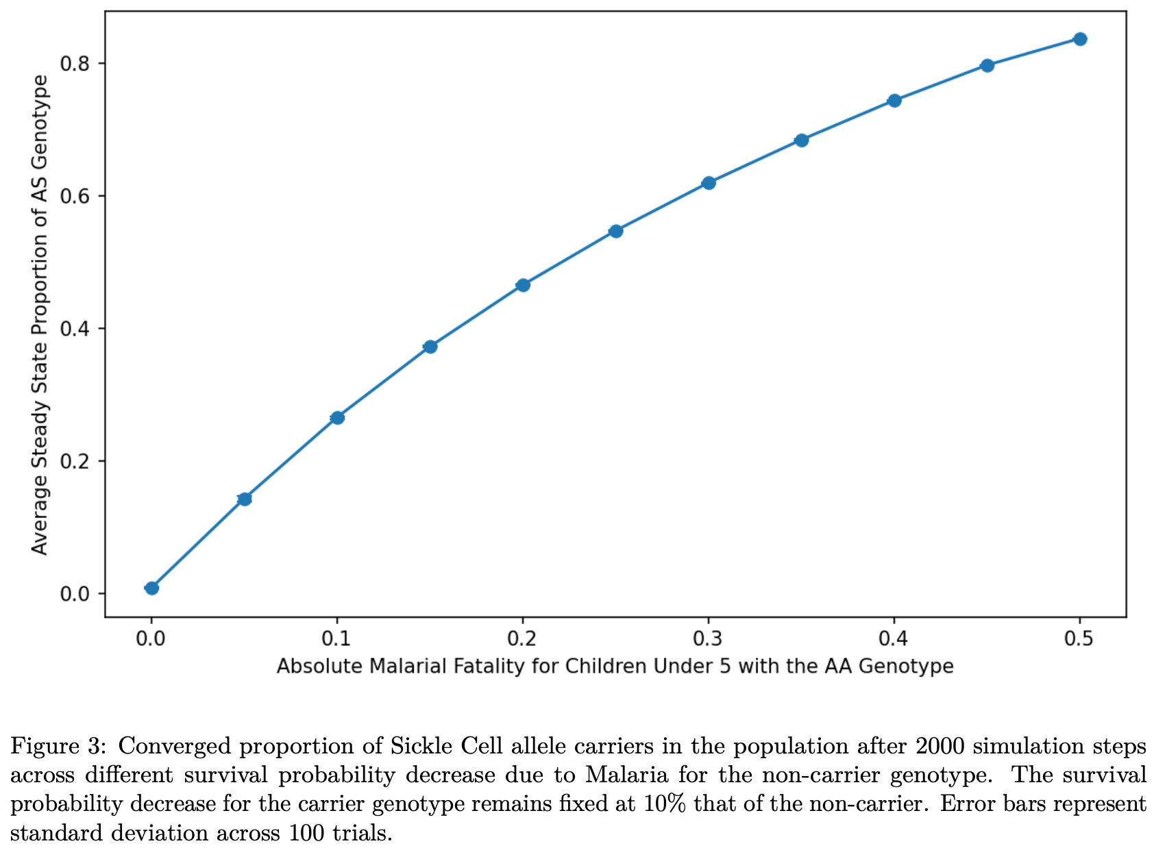
Effect of Ablating the Survival Probability

Slide 10
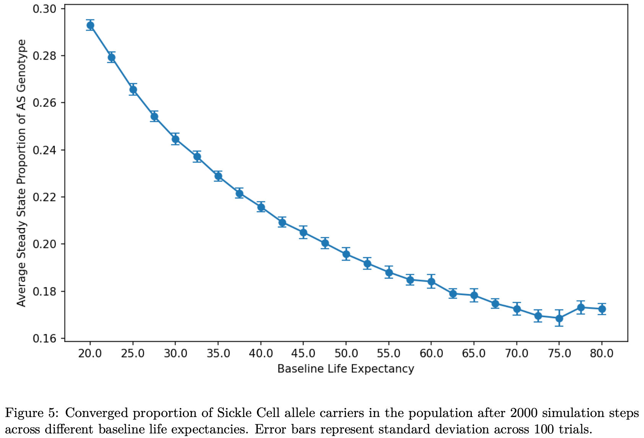
Effect of Ablating the Baseline Life Expectancy

Slide 11
Select Results on Simulating No Malarial Transmission

Slide 12
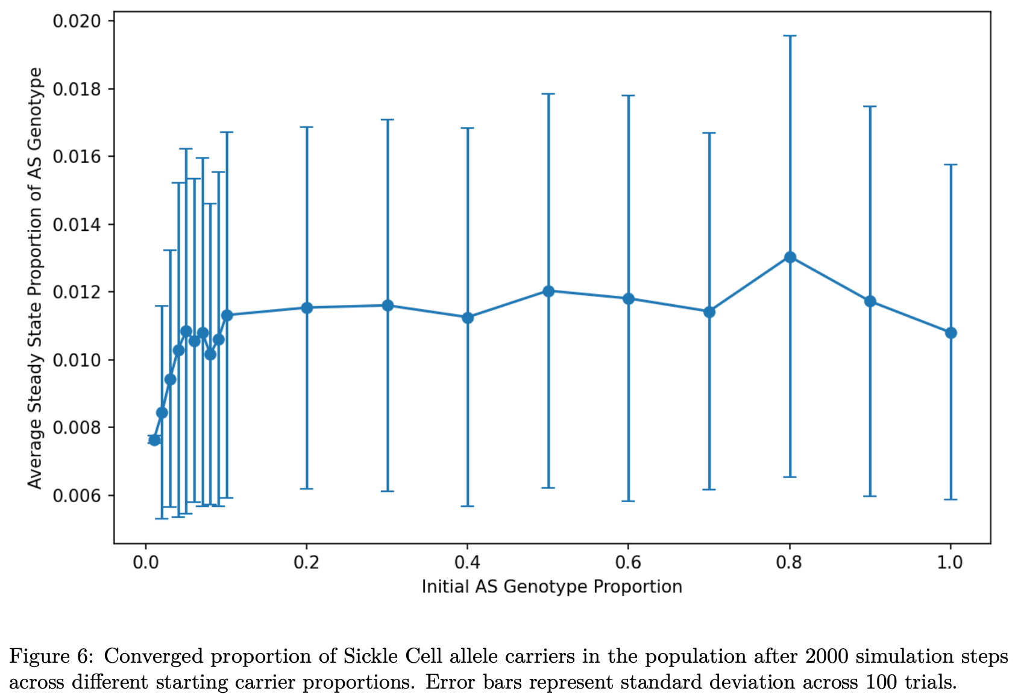
Effect of Ablating the Initial Proportion of the Carrier Genotype

Slide 13
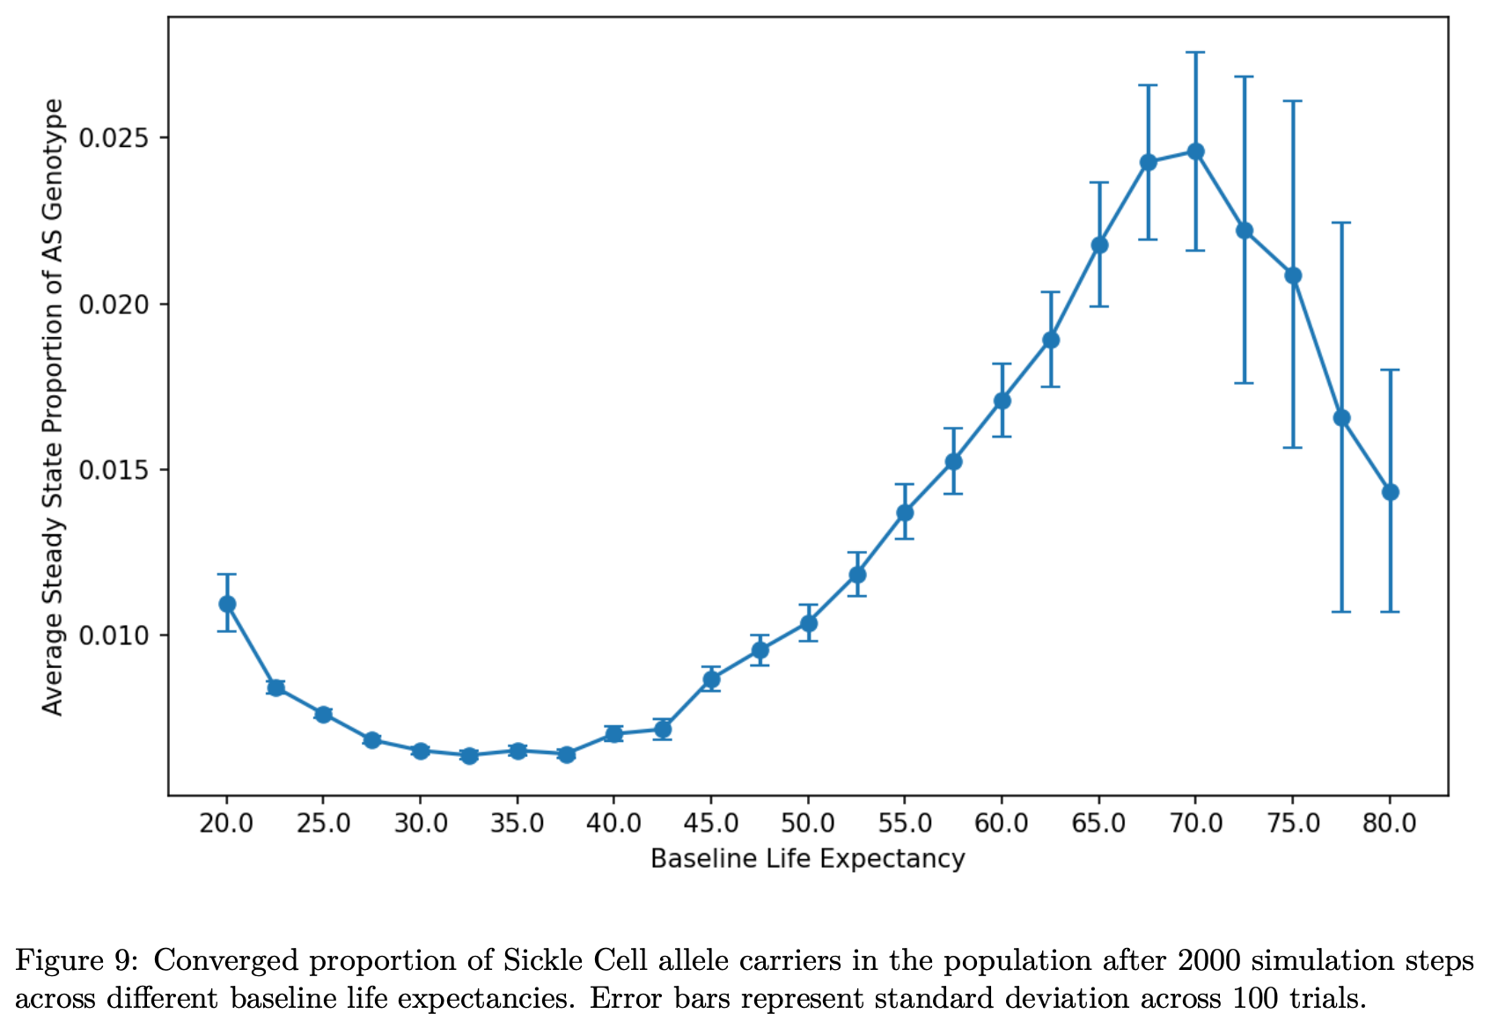
Effect of Ablating the Baseline Life Expectancy

Slide 14
In Conclusion:
The Leslie Model can be adapted to accurately model selective pressures on allele frequencies over long periods of time
There are numerous applications in retrospectively examining and explaining historic evolutionary trends
There are potential applications to predicting future evolutionary trends
This may be more useful for species with quick turnover

