Slide 1
Evaluating Lossless LLM Weight Compression Algorithms on Representative Synthetic Data Across Quantization Formats
Eric Gong

Slide 2
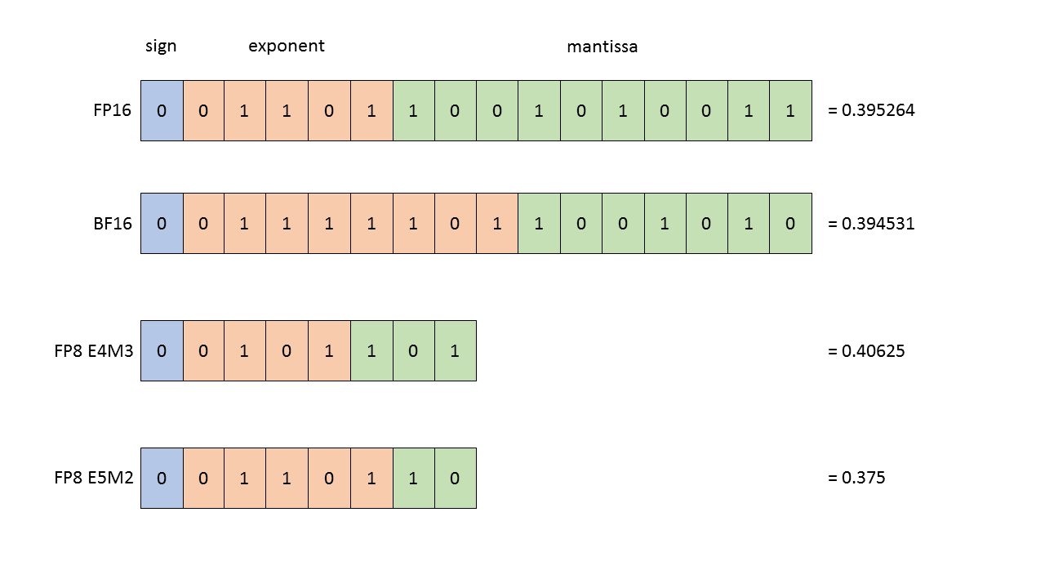
Background
There are more and more LLM models by the day
3.27 PB of storage dedicated to LLMs in 2025
3.24 PB dedicated to fine-tuned variants of models (99.22% by storage)
How do we improve storage efficiency?
Repeated components (Tokenizer, Architecture, etc.)
Weights: Quantization vs. Compression

Slide 3
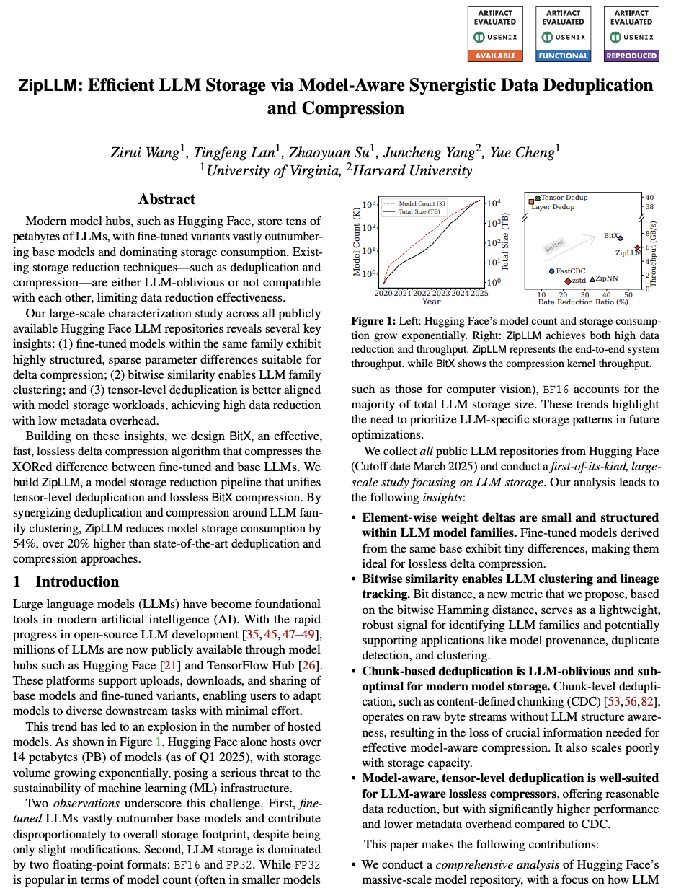
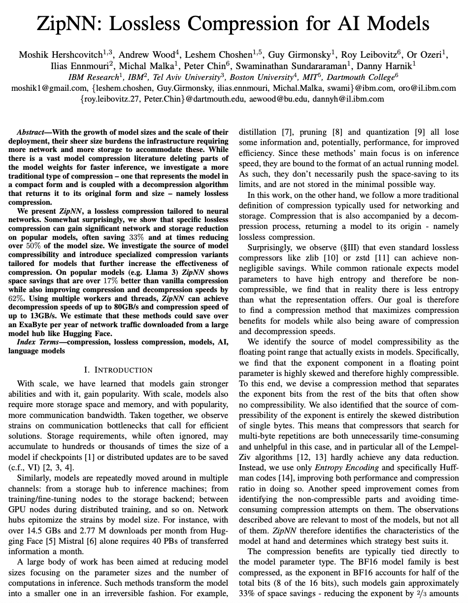
Current Works

Slide 4
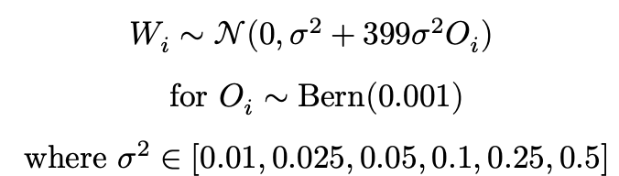
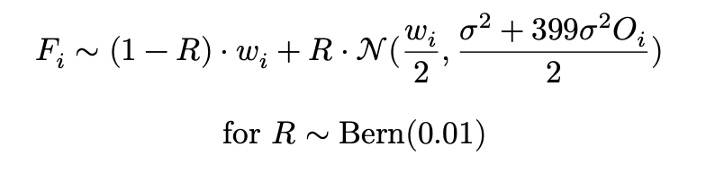
Synthetic Model Weight Generation
Empirical Observations on Model Weights
Model weights are normally distributed and centered at 0
There are a small number of outliers by magnitude (20x, with frequency <0.1%)
Light fine-tuning changes very few weights (<0.01%)

Slide 5
Compression Algorithms
Base model weight pre-processing
Baseline
Split weights by byte
Split weights by semantics
Split weights by bit
Gorilla
Underlying Compressor
Huffman Encoding
Zstandard (LZ77 + Huffman)
Fine-tuned model weight pre-processing
Weight-pair XOR
Weight-pair XOR with Gorilla

Slide 6
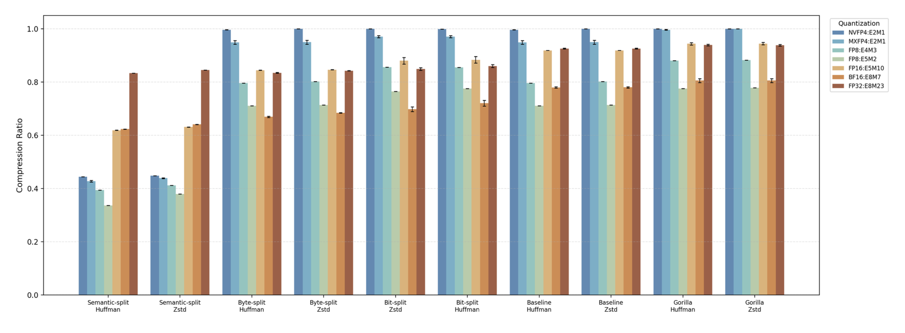
Base Model: Pre-processing over compressor

Slide 7
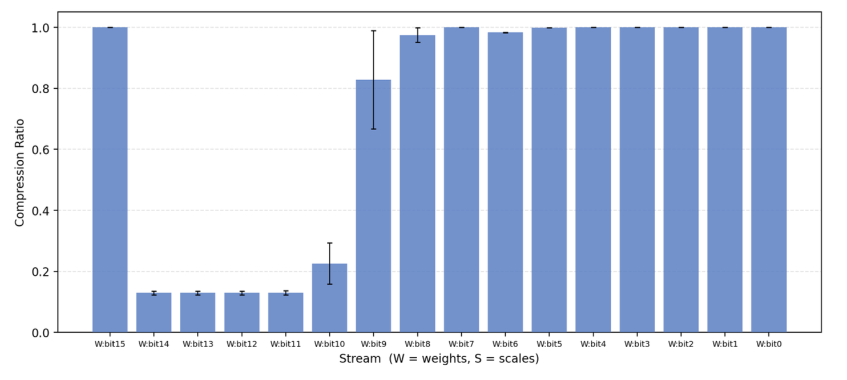
Exponential bits compress well
S1
E8
M7

Slide 8
Exponential to Mantissa Bit Ratio

Slide 9
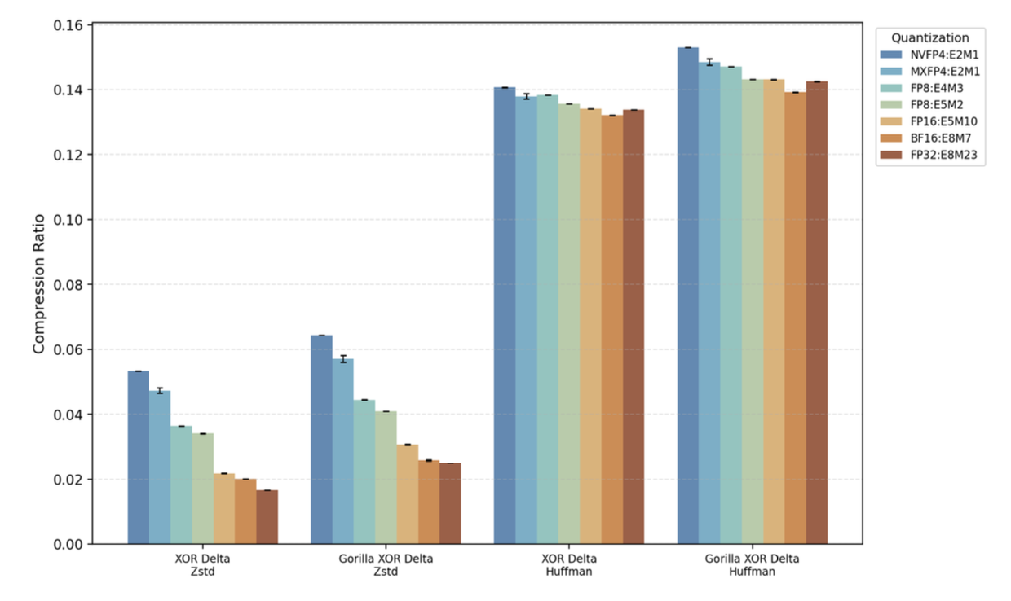
Fine-tuned model: XOR Delta is strong Compressor is key for improvements

Slide 10
Conclusions
Compression offers promise orthogonal to quantization
Insights for Future Development
Pre-processing is critical for full model weight compression
Sparsity optimization is critical for fine-tuned model deltas
Limitations of Synthetic Data
Application to model checkpoints?
Pareto distribution for weights by layer?
General analysis on a representative set of model weights across families

Slide 11
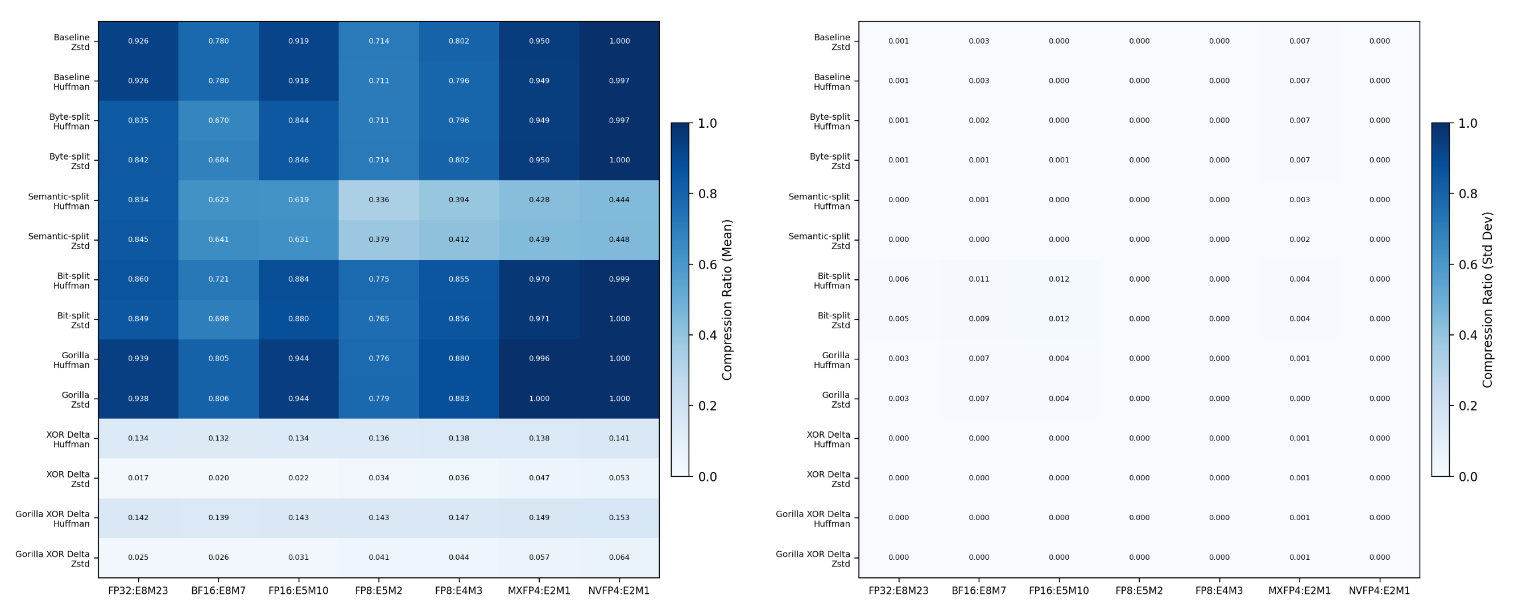
Robustness against Variance Ablations

Slide 12
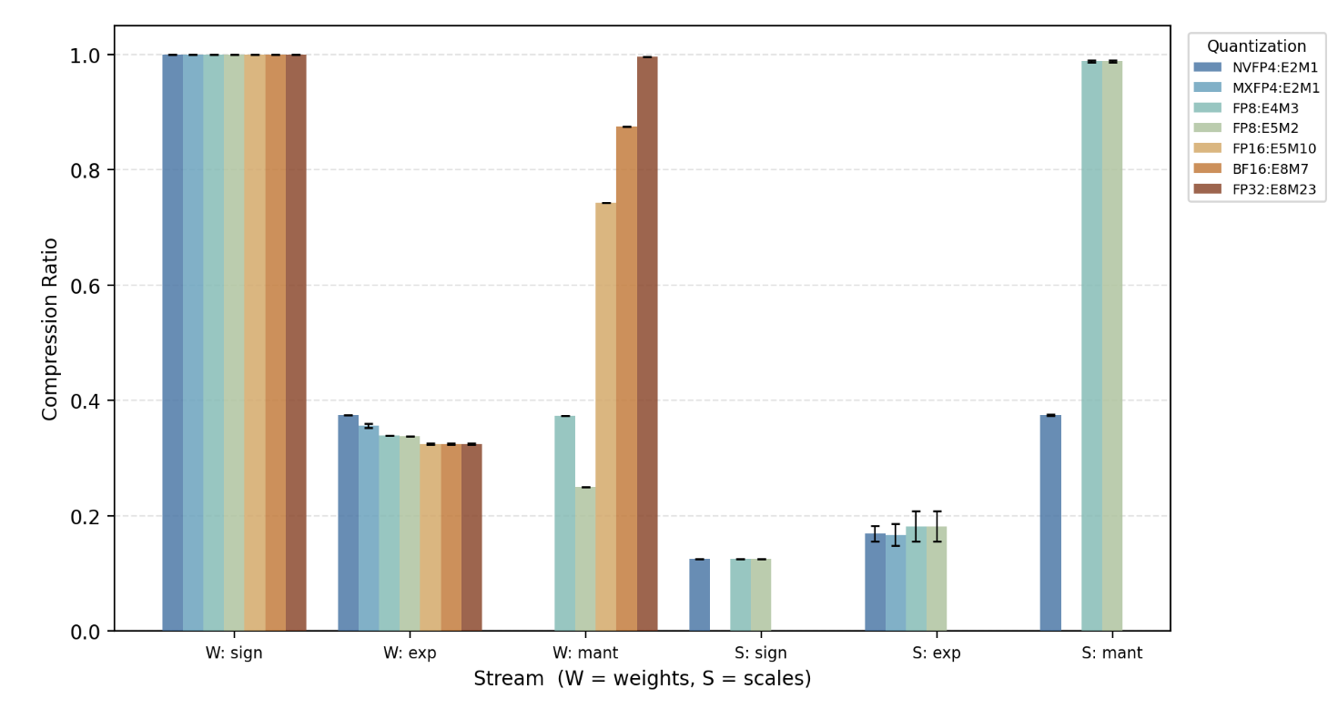
Mantissa bits compress under semantic split

Slide 13
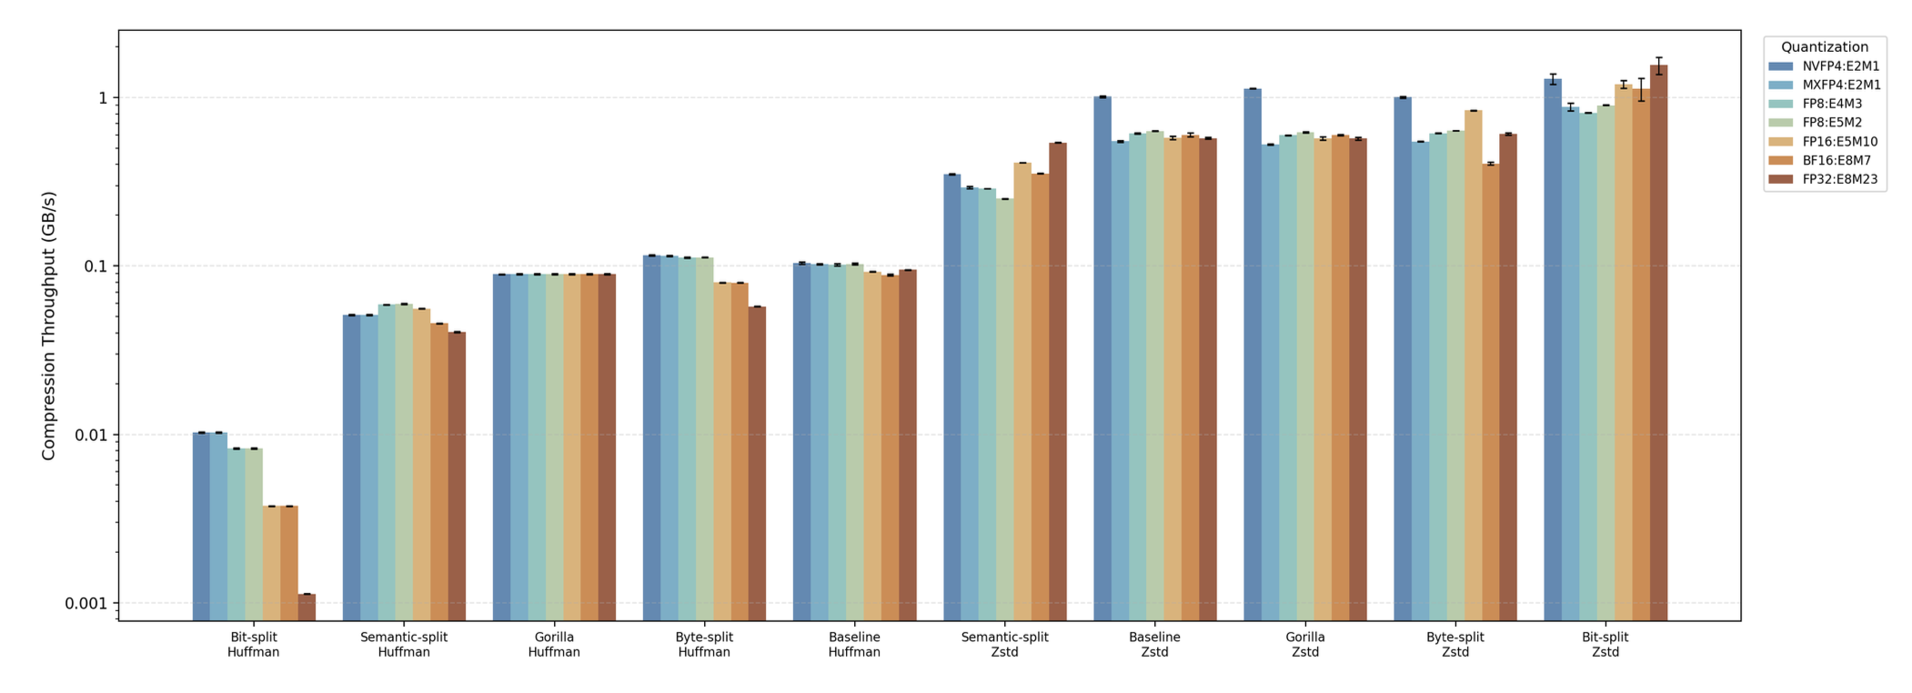
Compression Throughput (Base Model)

Slide 14
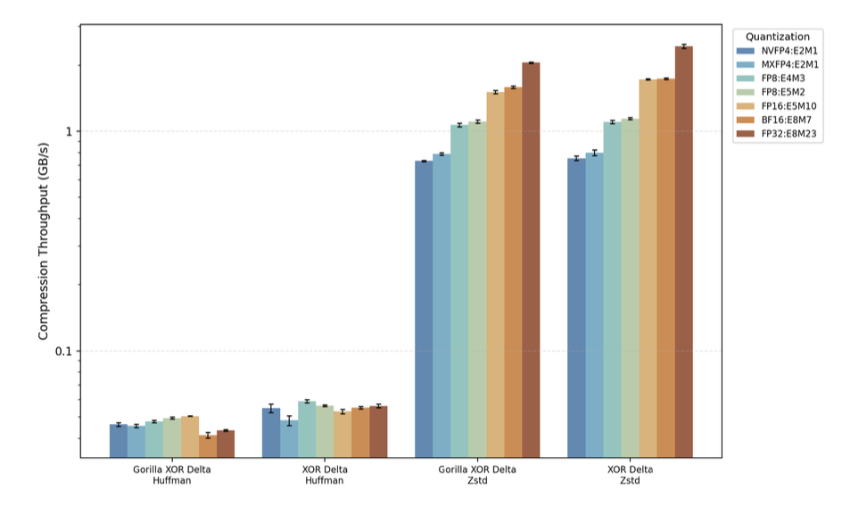
Compression Throughput (Fine-tuned Model)

