Slide 1
Problem Statement
Microservices Security

Slide 2
1: What are the Microservices aggravating security complexities
Microservices architecture, is an architectural style that divides the traditional monolithic model into independent, distributed services that can be scaled and deployed separately.
But the complicates service to service communication, running on different ports etc. increases the attack surfaces. For example many microservices communicate by defined API and the APIs easily become vulnerable to security threats.
Since there are many security challenges need to be addressed in the microservices. The fundamental security requirements that must be addressed during design phase.
It is vital for applications security architects to understand and properly use existing architecture patterns to implement authentication and authorization in microservices-based systems.

Slide 3
2: The strategies which can applied to secure a Microservices.
We can apply below strategies for Microservices security:
Defense in Depth: Defense in depth is a security strategy that calls for placing multiple levels of security controls throughout an organization’s software systems.
DevSecOps: Like all components in the DevOps pipeline, microservices security requires DevSecOps tools and practices. These include shifting security left by integrating application security testing tools into the entire DevSecOps pipeline, from design all the way up to production.
Isolation: A microservice needs to be able to be deployed, maintained, modified, scaled and retired without affecting any of the other microservices around it.
In the actual design, we can consider below approaches to implement the authentication and authorization in microservices-based systems:
Edge-level authorization: In simple scenario, authorization can happen only at the edge level (API gateway). The API gateway can be leveraged to centralize enforcement of authorization for all downstream microservices. But this approach is only for simple microcervices system and have many limits, like pushing all authorization decisions to API gateway can quickly become hard to manage in complex ecosystems with many roles and access control rules, API gateway may become a single-point-of-decision that may violate “defense in depth” principle etc.
Service-level authorization: Service-level authorization gives each microservice more control to enforce access control policies in service level.
Service-level authorization has below 4 function components:
Policy Administration Point (PAP) provides a user interface for creating, managing, testing, and debugging access control rules;
Policy Decision Point (PDP) computes access decisions by evaluating the applicable access control policy;
Policy Enforcement Point (PEP) enforces policy decisions in response to a request from a subject requesting access to a protected object;
Policy Information Point (PIP) serves as the retrieval source of attributes, or the data required for policy evaluation to provide the information needed by the PDP to make the decisions.

Slide 4
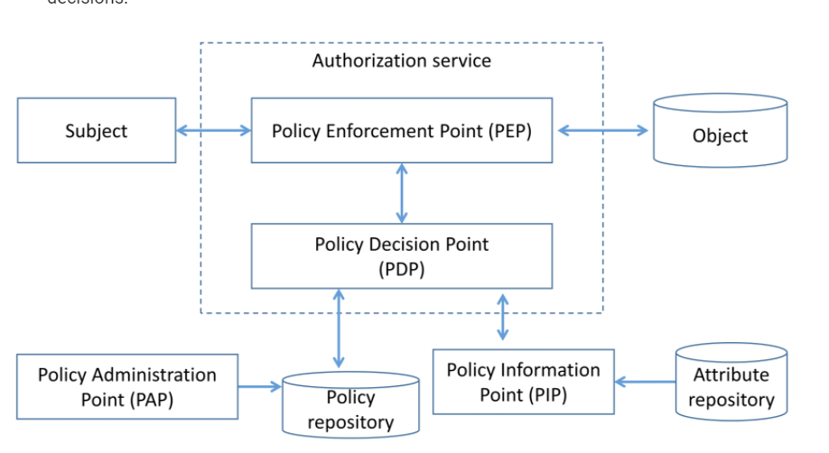
2: The strategies which can applied to secure a Microservices. continues

Slide 5
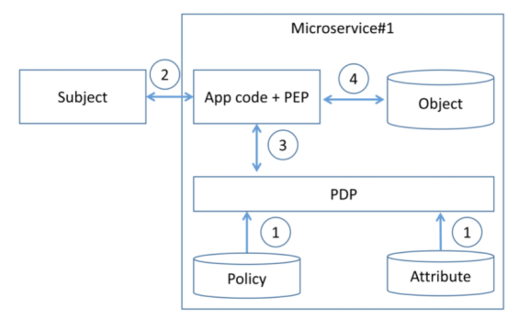
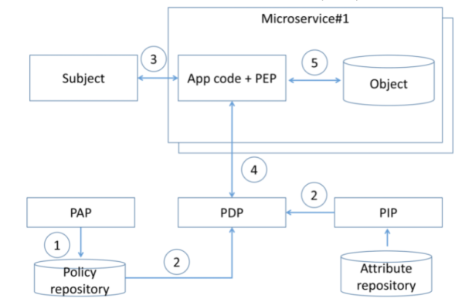
2: The strategies which can applied to secure a Microservices. continues
Service-level authorization has below patterns:
Decentralized pattern:
Centralized pattern with single policy decision point:

Slide 6
3: How can we secure communications between Microservice.
Since most microservices commnucate between Web API, we can implement the Token base security between services. In .Net technology, we can use below technologies:
Implement the JWT token with .Net built in Authentication
Implement by using .Net building Authentication and Authorization library.
Can implement the Authentication and Authorization with custom authentication handers
Can implement the Authorization by Role base or by Policy base.
If the micorservices commnucate each other via Internet, we can use Transport Layer Security (TLS) or Mutual Transport Layer Security (mTLS, or Mutual TLS) technology to secure the data transfer via internet.
Implement audit logging in microservices-based systems for security operations.
Also we may adapt existing service, like AWS X-Ray to help log the operations for the Microservices system.
X-Ray helps to perform end-to-end tracing of requests, record a representative sample of the traces, see a map of the services and the trace data, and to analyze performance issues and errors. It will helps developer to understand how application and its underlying services are performing so you can identify and address the root cause of issues.

Slide 7
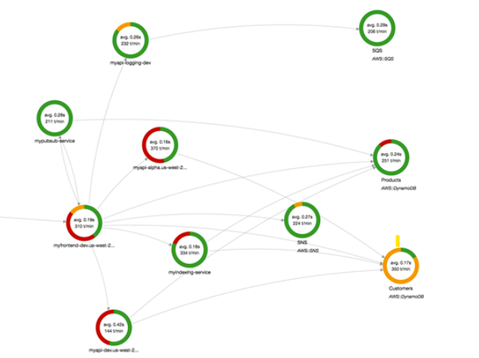
X-Ray demo

